Slide 1



ProjectorKit
Easing Rapid Prototyping of Interactive Applications for Mobile Projectors
Martin Weigel, Sebastian Boring, Jürgen Steimle,
Nicolai Marquardt, Saul Greenberg and Anthony Tang
Notes:
Welcome, Name
Projectorkit a toolkit to ease rapid prototyping of interactive applications for mobile projectors
This research was part of my internship
University of Calgary
Sebastian Boring, Jürgen Steimle, Nicolai Marquardt, Saul Greenberg and Anthony Tang.

Slide 2
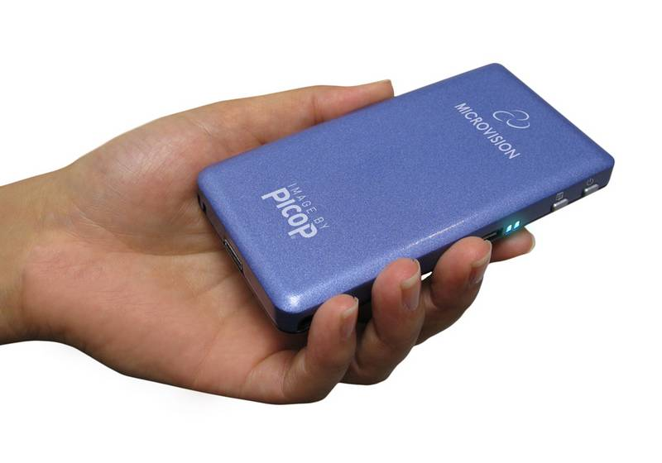
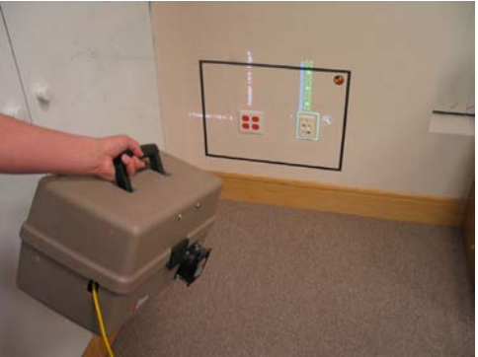
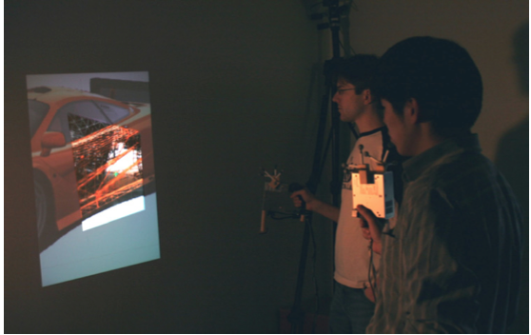
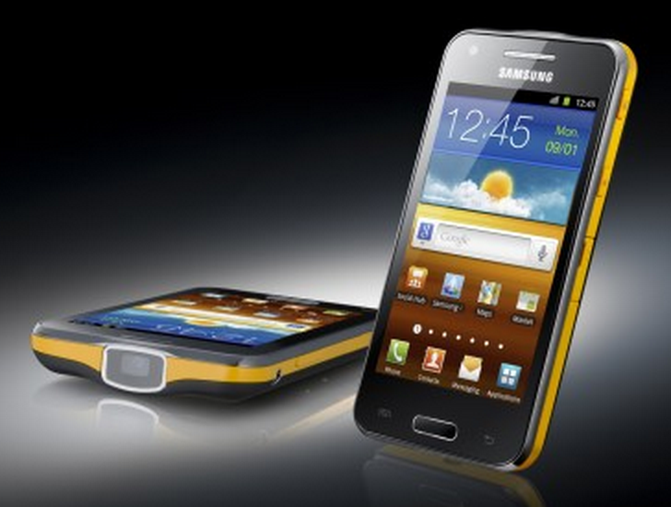
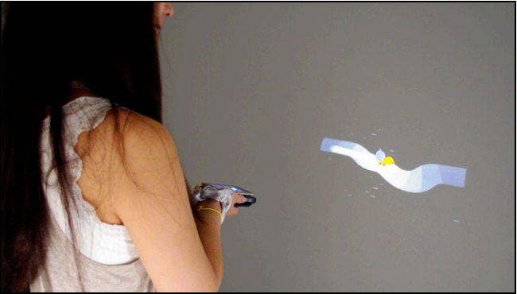
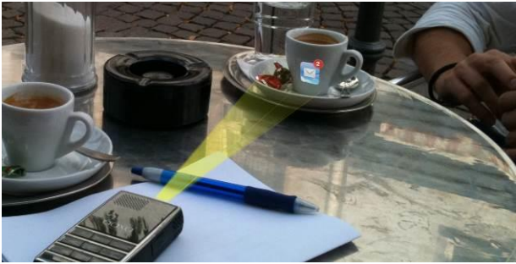
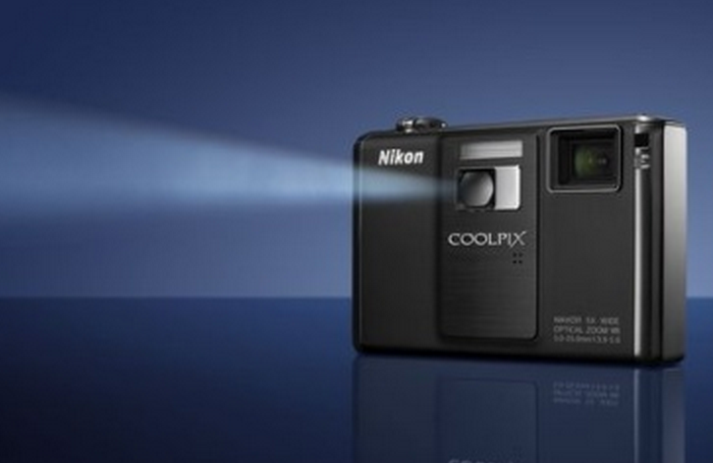
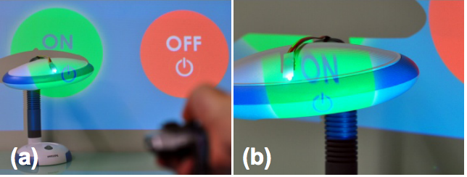
Mobile Projectors
MicroVision ShowWX+
[Raskar, SIGGRAPH’03]
[Cao, UIST’06]
Samsung Galaxy Beam
[Willis, CHI’11]
[Huber, MUM’12]
…
Nikon Coolpix
[Schmidt, UIST’12]
Notes:
Recently many devices embedded mobile projectors
Bring digital information into the real-world
Directly share them with other people
A lot of research was done.
Huge undiscovered space interaction techniques
Still, most programming environments are
still based on 2D interactions
Lack support of mobile projectors
Programmed from scratch -> time-consuming and complex task
It takes a long time to get from an initial idea to a first working prototype.

Slide 3
ProjectorKit
A rapid prototyping toolkit for mobile projectors
Architecture
Based on Proximity Toolkit [Marquardt, UIST’11]
Client-server architecture
Event-driven programming
Notes:
To solve this problem we contribute an open-source toolkit that eases rapid prototyping of interaction techniques with mobile projectors. We call this toolkit “ProjectorKit”.
Based upon Proximity Toolkit
Tracks spatial relationships between physical objects
Uses client-server structure
multiple mobile projectors connect to the same application.
fast development-testing cycle
easy debugging
Similar to 2D GUI: Event driven programming
developer binds events
automatically notified

Slide 4
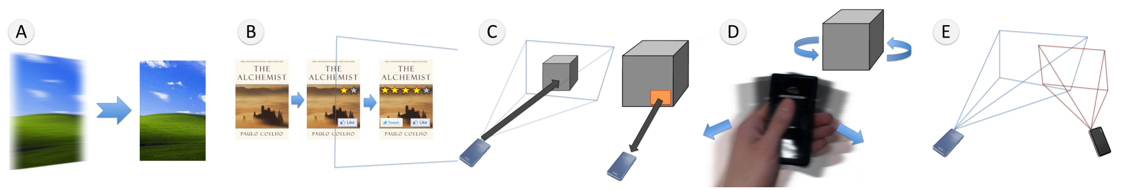
Requirements
Guided the development of ProjectorKit
Project
Augment
Select
Command
Share
Early Feedback
Two prototyping workshops
Two long-term student projects
Notes:
Analyzed prior work
Identified 5 requirements
Guided the toolkit
Furthermore we had two prototyping workshops and two long-term student projects.
Let us have a look at the identified requirements.

Slide 5
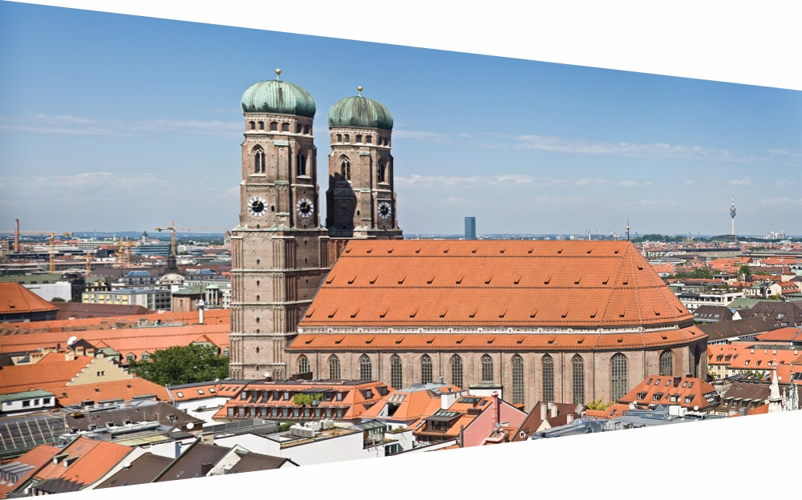
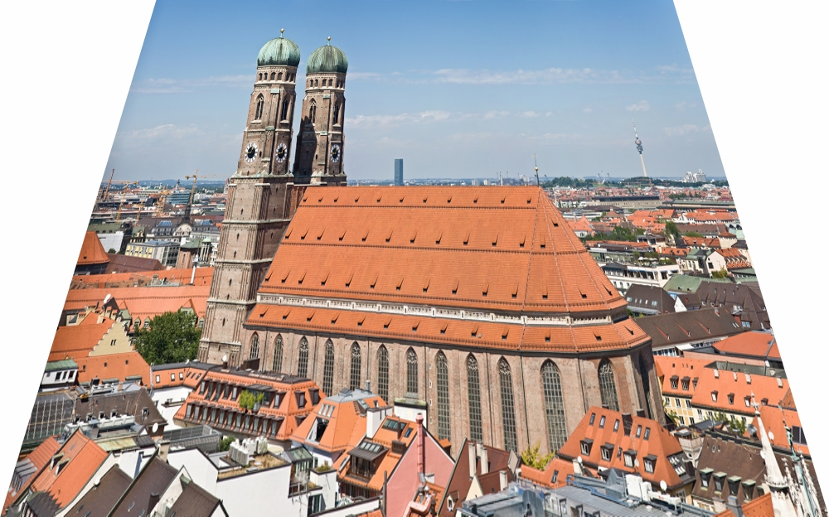
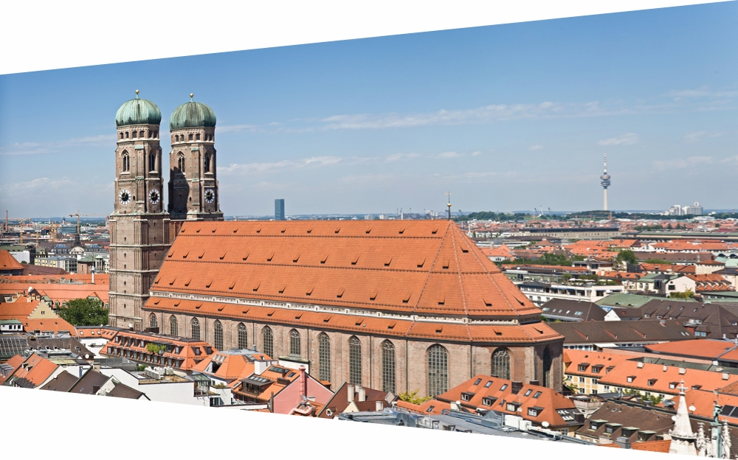
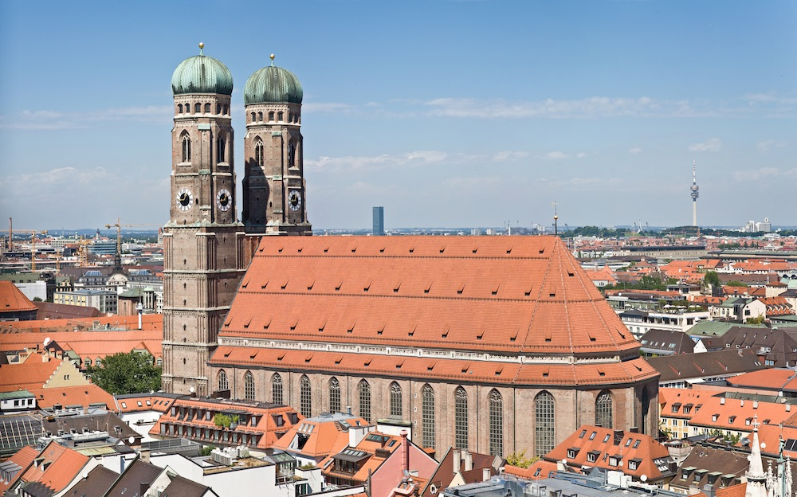
Requirement
Project
Projected Keystone Effects
Code Example
var projector = env.World.Get(“projector”);
var image = new
ImageElement(@”frauenkirche.jpg");
env.World.ProjectElement(
image, projector, x, y, width, height);
Corrected Projection
Notes:
1st thing you might be interested: project a picture from the Frauenkirche here in Munich
Handheld devices have no fixed location or orientation
This might introduce keystone effects
The picture is not rectangular anymore
FIX: fit rectangular picture into the projection
Cumbersome and redundant task
Let us do this in three lines:
First we get the tracked projector
Second we load the frauenkirche
Third we project it. Done!
Let us move on to the next requirement.

Slide 6
Requirement
Augment
Code Example
var outlet = env.World.Get(“outlet”);
// Load image with size 250x100mm
var image = new ImageElement(
250, 100, @”outlet_information.jpg");
image.PositionOn(outlet, -250, 0);
env.World.Add(image);
[Raskar, SIGGRAPH’03]
Notes:
Next let us create an augmented reality application.
This binds digital information onto physical objects
Here Raskar augmented the power outlets with digital information.
Todays projectors are a bit smaller, but let us rebuild the example.
First we load the outlet, than we load the outlet information picture
Afterwards we position it on the outlet, so that the information is displayed on its left side.
Finally we add it to the scene.
Projected automatically if any projector shines fully or partially on the outlet.
See, four lines of code and were done.
Btw.: Toolkit supports 2D positioning for novice and lazy users and 3D positioning for advanced users.

Slide 7
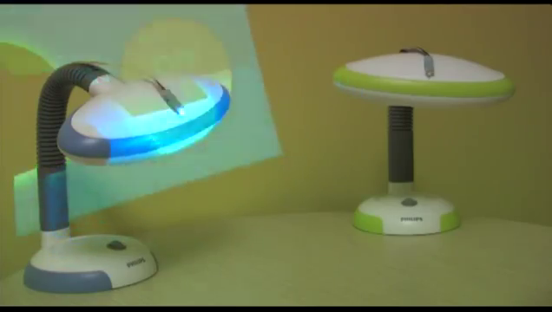
Requirement
Select
Code Example
var selection = new Selection(
projector, on-circle, lamp);
selection.Changed += SelectionEvent;
void SelectionEvent(object sender, SelectionEventArgs e)
{
/* Turn lamp on */
}
[Schmidt, UIST’12]
Notes:
Highlights a point of interest of the user.
PICOntrol: Selecting lamp with projected on/off turns lamp on or off
Let us rebuild it:
Create a Selection-object with projector, the on-circle and specify the lamp as the selected-object
Bind a callback to the changed-event
Implement the callback which is automatically triggered
Again we used only 3 lines of code.

Slide 8
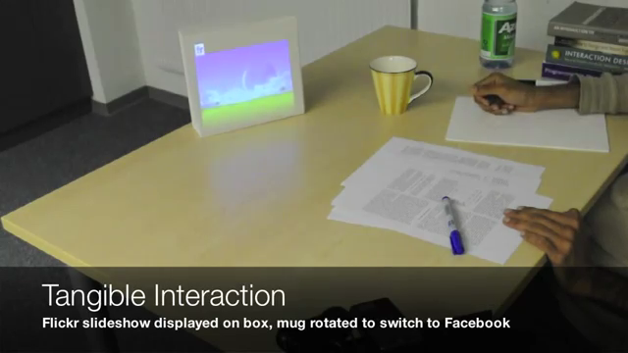
Requirement
Command
Code Example
var rotating =
new RotatingGesture(mug, 10);
rotating.RotationChanged += RotatingEvent;
void RotatingEvent (object sender, RotatingEventArgs e)
{
/* Change Applications */
}
[Huber, MUM’12]
Notes:
Besides selection, more interaction is required
App is changed by rotating a mug
Let us do the same with Projectorkit
Create rotation gesture for the mug that fires after 10 degrees
Bind a callback method
Change the applications in it
Again three lines of code.

Slide 9
Requirement
Sharing
Code Example
var overlap = new OverlappingDisplays(projector, p2);
overlap.OverlappingChanged += OverlappingEvent;
void OverlappingEvent(object s, OverlappingEventArgs e)
{
if (e.Display1.Distance <= e.Display2.Distance)
/* Create a magic lens */
}
[Cao, UIST’06]
Notes:
Projections can overlap and share the same display space
Here: The closer user creates a magic lens on the projected car
Let us build it:
Create OverlappingDisplays Event between two projectors
Bind a method to the callback
Check which projector is closer using the event arguments
Available for all callbacks
Interesting parameters of the event, e.g. pixel density, overlapping percentage, overlapping regions, and so on.
4. Create the magic lens
Again, done.
Does not only work with projectors
Here a video of one example application.

Slide 10

Notes:
Combined smartboard and projector to F+C display

Slide 11
Notes:
Combined smartboard and projector to F+C display

Slide 12

Notes:
Combined smartboard and projector to F+C display

Slide 13
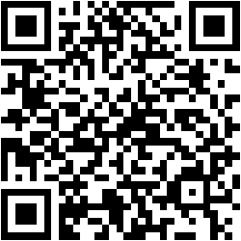
Summary
ProjectorKit supports rapid-prototyping to speed up and ease further research on mobile projectors
Download
http://grouplab.cpsc.ucalgary.ca/cookbook/index.php/Toolkits/ProjectorKit
Martin Weigel
mweigel@mpi-inf.mpg.de
http://embodied.mpi-inf.mpg.de
Notes:
In summary, I presented projectorkit, a toolkit that allows for rapid-prototyping of interaction techniques that use mobile projectors.
It is available open-source.
Follow QR code or the link or have a look into the paper
Thank you for listening!

