Slide 1
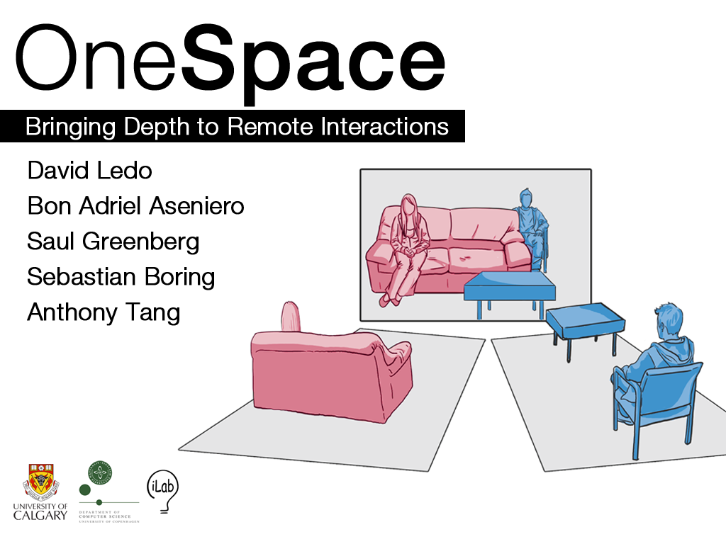

Slide 2
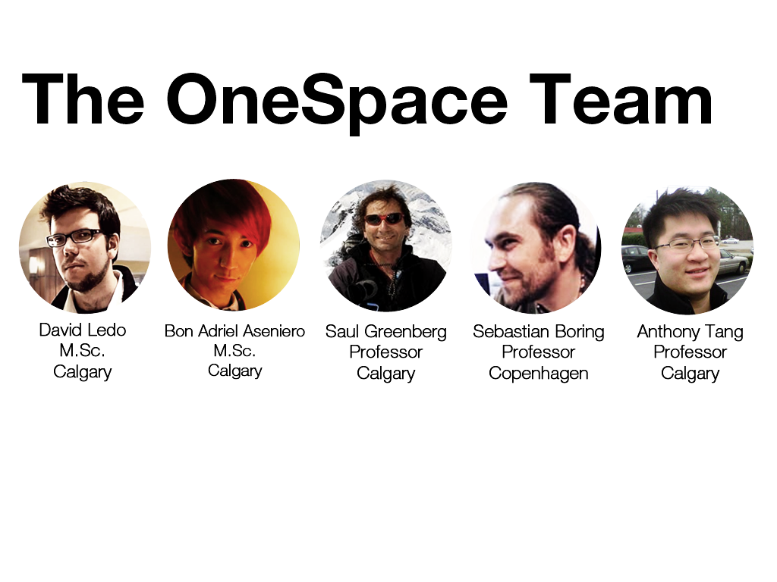

Slide 3
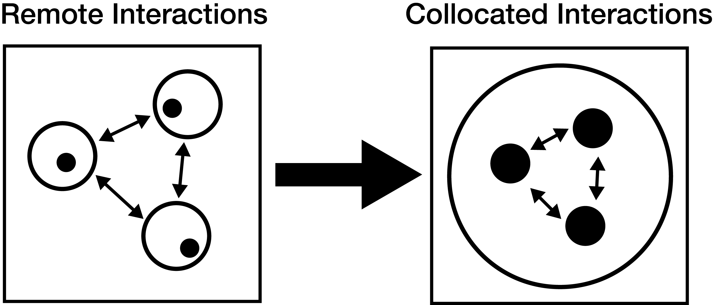
Communication

Slide 4
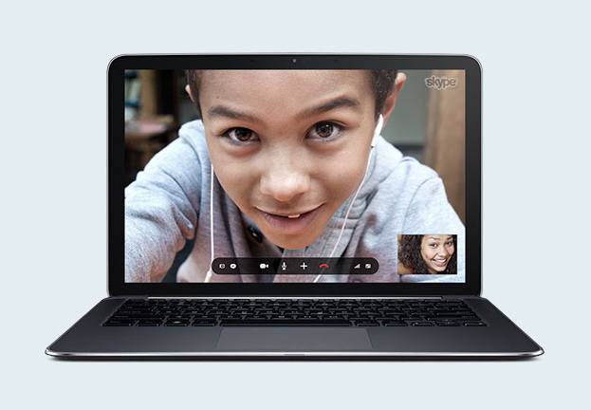

Slide 5
How can we create engaging remote interactions among users that go beyond talking heads?

Slide 6
Current Remote Communications
Portals (e.g. Skype)
Shared Workspaces (e.g. ClearBoard)
Shared Stages (e.g. HyperMirror)

Slide 7
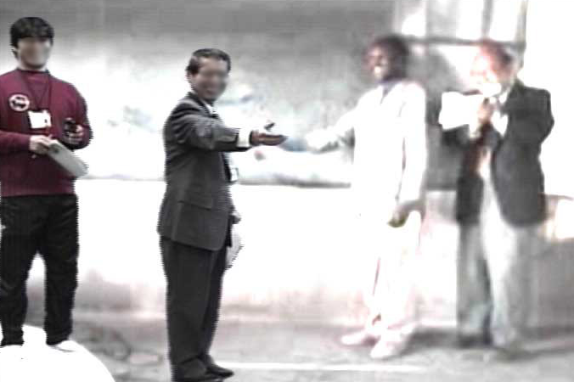
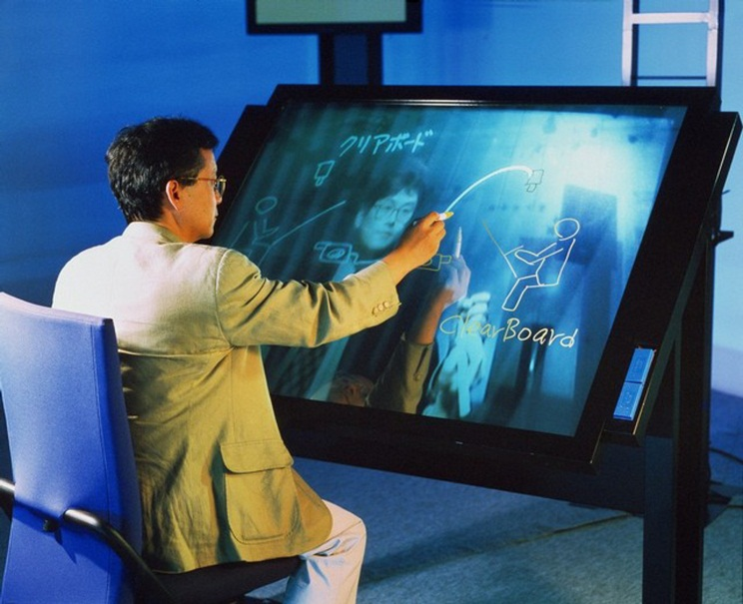
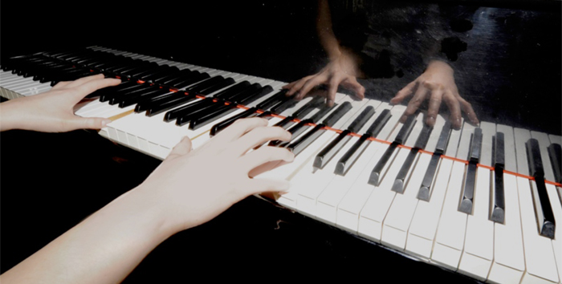
HyperMirror (Morikawa et. al)
ClearBoard (Ishii et. al)
MirrorFugue (Xiao et. al)

Slide 8
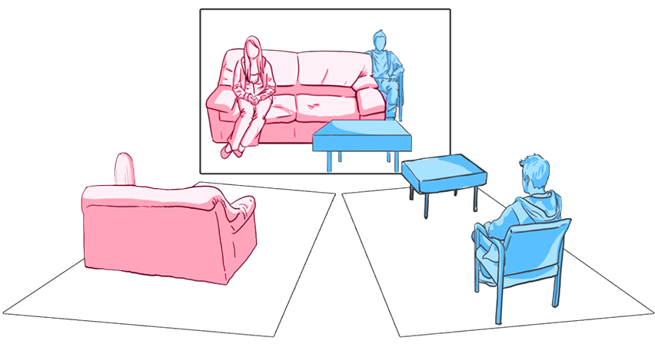
OneSpace

Slide 9
OneSpace
1. exploration of virtual space
2. preservation of spatial relations between people

Slide 10
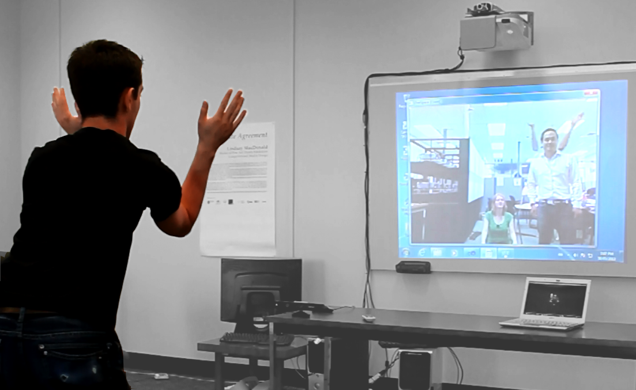

Slide 11
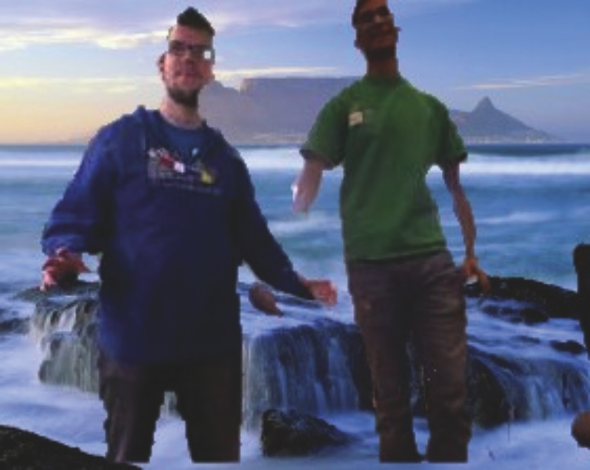
Environment Effects

Slide 12
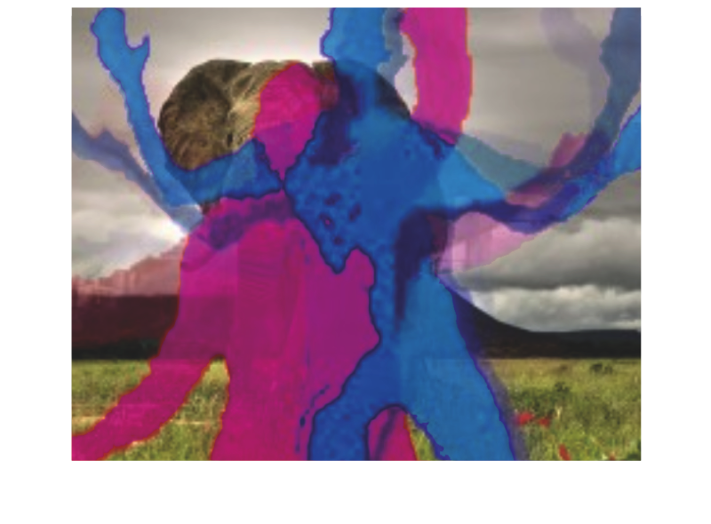
Silhouettes and Traces

Slide 13
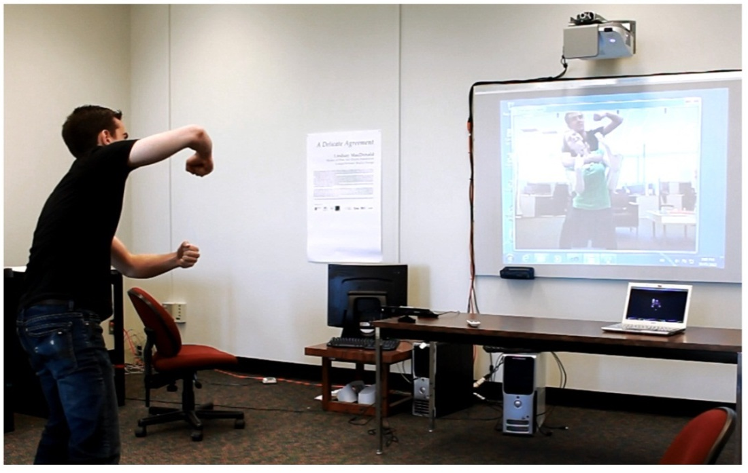

Preliminary Observations

Slide 14


Slide 15
Future Directions

Slide 16
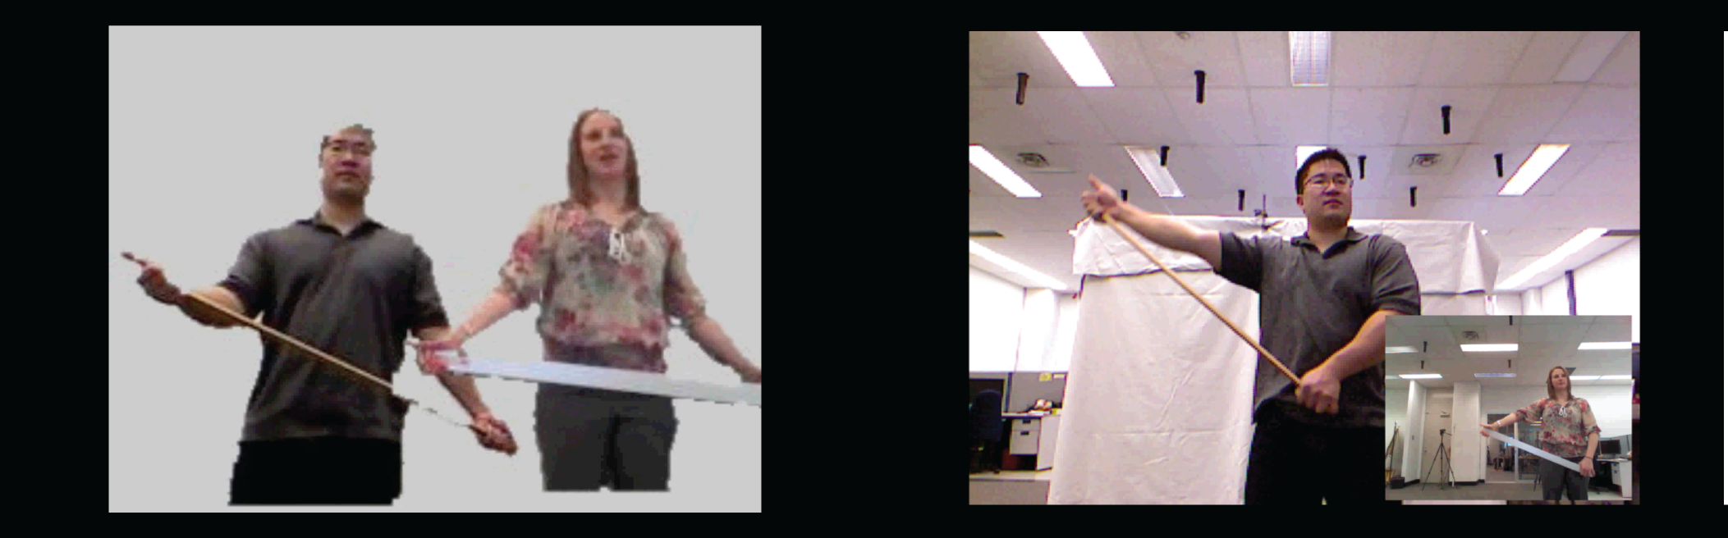
Physiotherapy
Dillman, K., Tang, A.

Slide 17
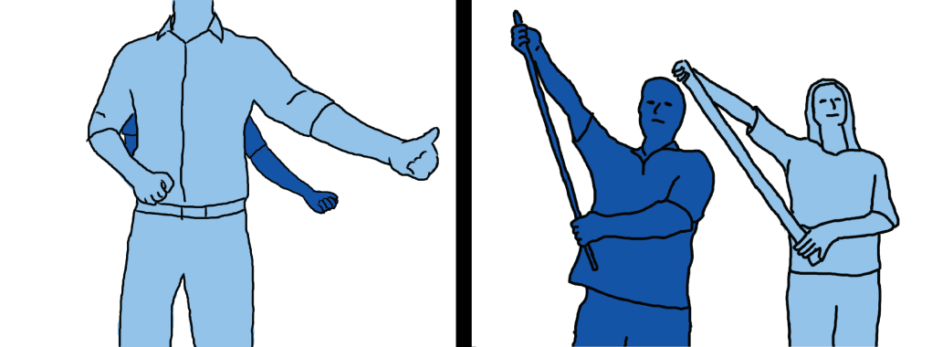
Physiotherapy
Dillman, K., Tang, A.

Slide 18
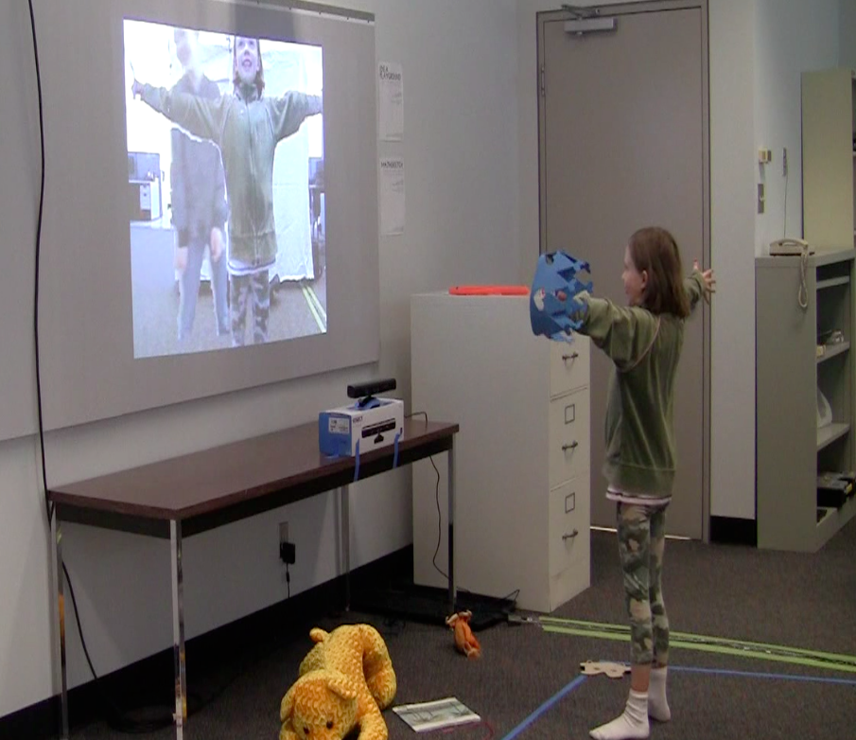
Free Play for Children
Dillman, K., MacLeod, H., Tang, A.

Slide 19



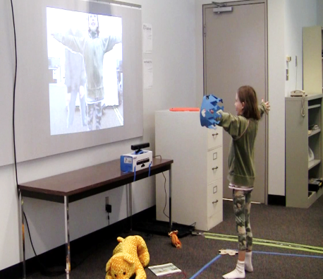
Wrap-up

