Slide 1
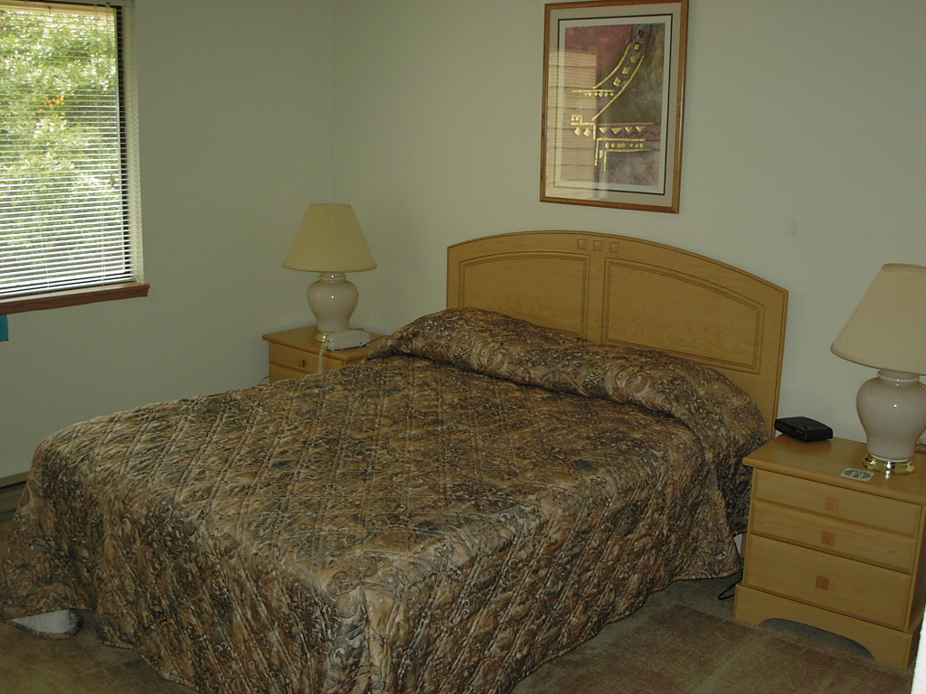
intimacy in long distance relationships over video chat
carman neustaedter
simon fraser university
saul greenberg
university of calgary

Slide 2
Note: this deck includes extra slides not shown at the actual presentation due to time constraints.
These extra slides are included but marked as hidden.

Slide 3
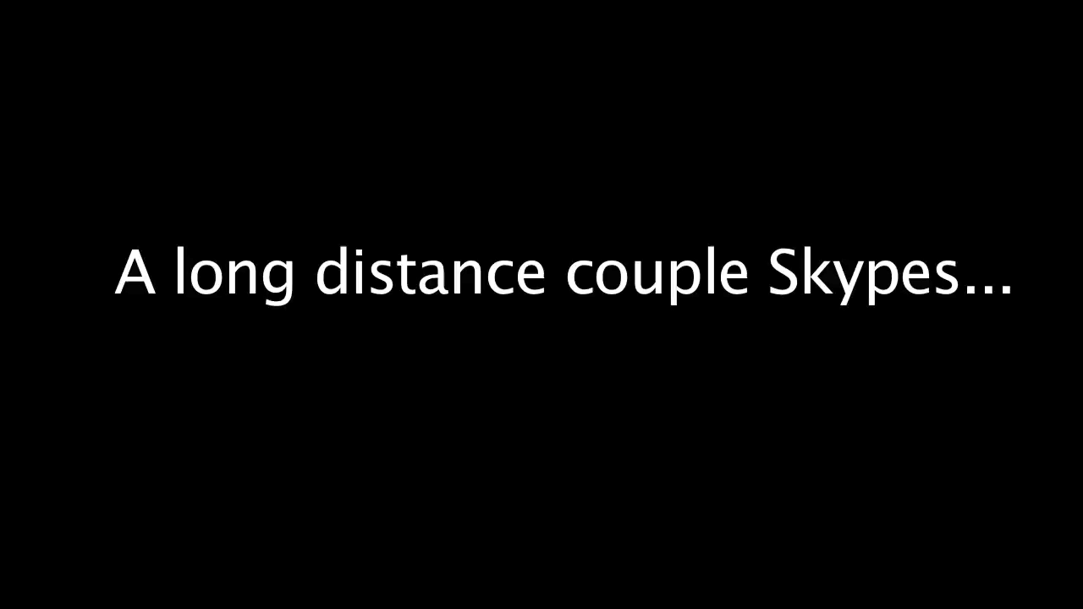
The Big Bang Theory, Season 5, Episode 2
Click to play video

Slide 4
the message
video chat affords shared living, which in turn provides intimacy

Slide 5
before I move on…

Slide 6
before I move on… i am not a couples’ therapist
but there is lots of other research
e.g., Laura Stafford and others

Slide 7
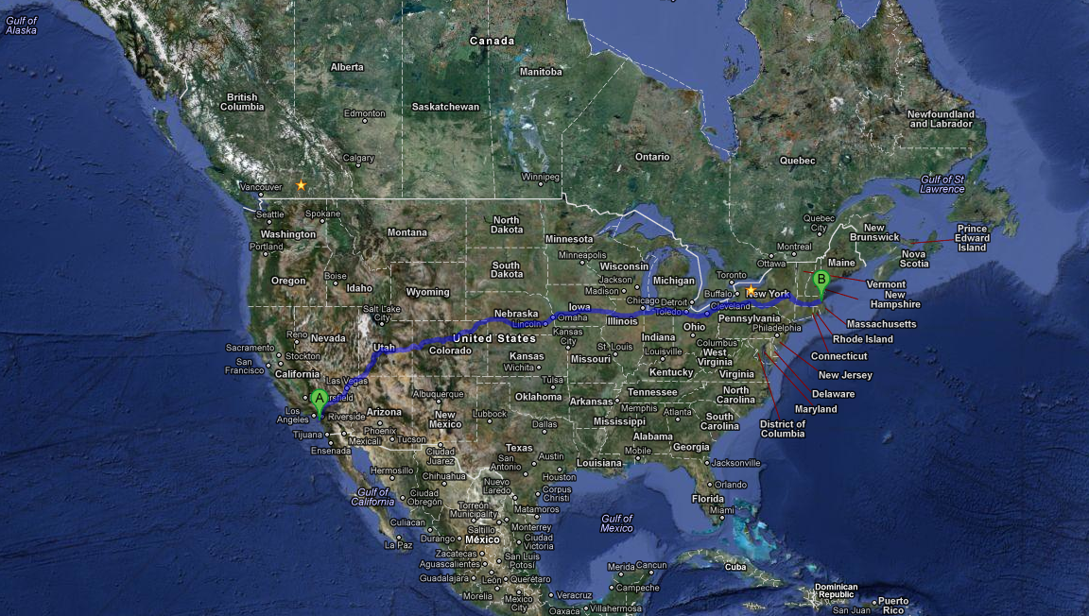
long distance relationships

Slide 8
long distance relationships
college students
‘two-body’ problems
dual careers
professional athletes
offshore oil workers
military

Slide 9

relationships
positivity, openness
providing assurances
physical expressions of love
managing conflicts
sharing tasks and chores
stafford et al
Justglamgirls.org

Slide 10
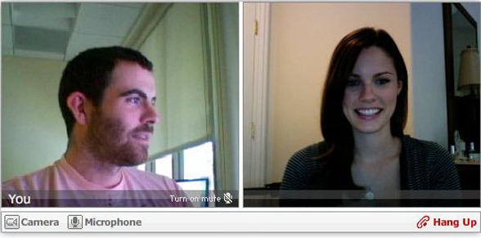
how do couples maintain their relationship?
venturebeat.com

Slide 11
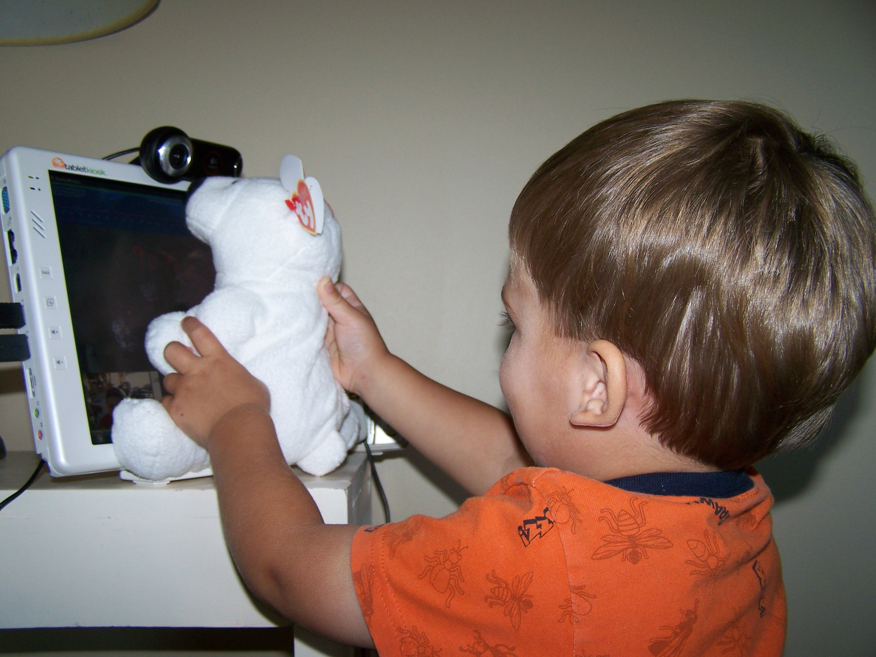
existing research
Judge and Neustaedter, 2010
Kirk et al., 2010
Ames et al., 2010
Judge et al., 2010, 2011
Raffle et al., 2010, 2011
Yarosh et al., 2009
Notes:
Briefly say: there has been a bunch of work studying skype and new video systems over the last few years, but nobody has studied long distance couples and video chat

Slide 12
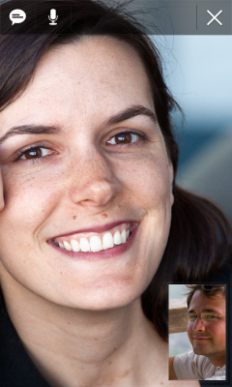
interview study
googleblog.com
14 people; aged 19 to 35 years
across north america
serious relationships
open, axial, and selecting coding

Slide 13
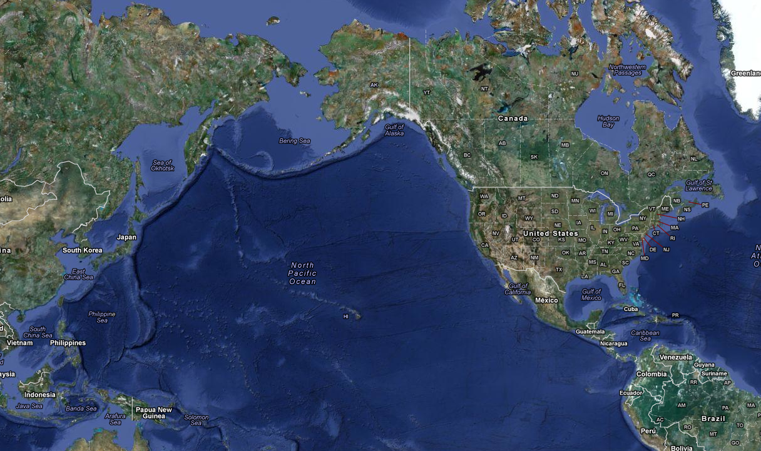
short distance
Notes:
GO FAST THROUGH THIS PART

Slide 14
short distance
across continent

Slide 15
short distance
across continent
across the world

Slide 16
outline
why video chat?
aspects of shared living
discussion

Slide 17
reasons for other technology usage
Notes:
i'm going to briefly mention… by way of contrast, these are other technologies used for very different things

Slide 18

reasons for other technology usage
greetings
terms of endearment
coordination
Notes:
i'm going to briefly mention… by way of contrast, these are other technologies used for very different things

Slide 19
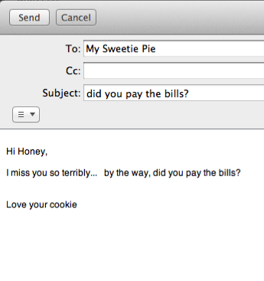
reasons for other technology usage
greetings
terms of endearment
coordination
stories
funny
tasks
Notes:
i'm going to briefly mention… by way of contrast, these are other technologies used for very different things

Slide 20

reasons for other technology usage
greetings
terms of endearment
coordination
stories
funny
tasks
deep conversations
Notes:
i'm going to briefly mention… by way of contrast, these are other technologies used for very different things

Slide 21
seeing for emotional closeness
googleblog.com
"…she can see that I’m smiling, she can see that I’m being supportive, she can see that I’m not frowning or being angry at her…"

Slide 22
seeing for emotional closeness
googleblog.com
“I could not stand not seeing my husband, I mean, I needed him, I needed to see him, and actually everyday we also talk by our cell phone but it’s not enough for us. I need to see his face.”

Slide 23
seeing for emotional closeness
googleblog.com
“its just that if you see someone you feel its real … you see their reaction instantly. With audio, it’s harder to get the same information of how someone feels.”
Notes:
say, it’s not just talking heads

Slide 24
day-to-day shared living
Notes:
the most important thing we saw that created intimacy was this idea of day-to-day sharing and it happened in a variety of ways that I am going to go through now
in each, I will also point out some challenges, but there are more in the paper

Slide 25
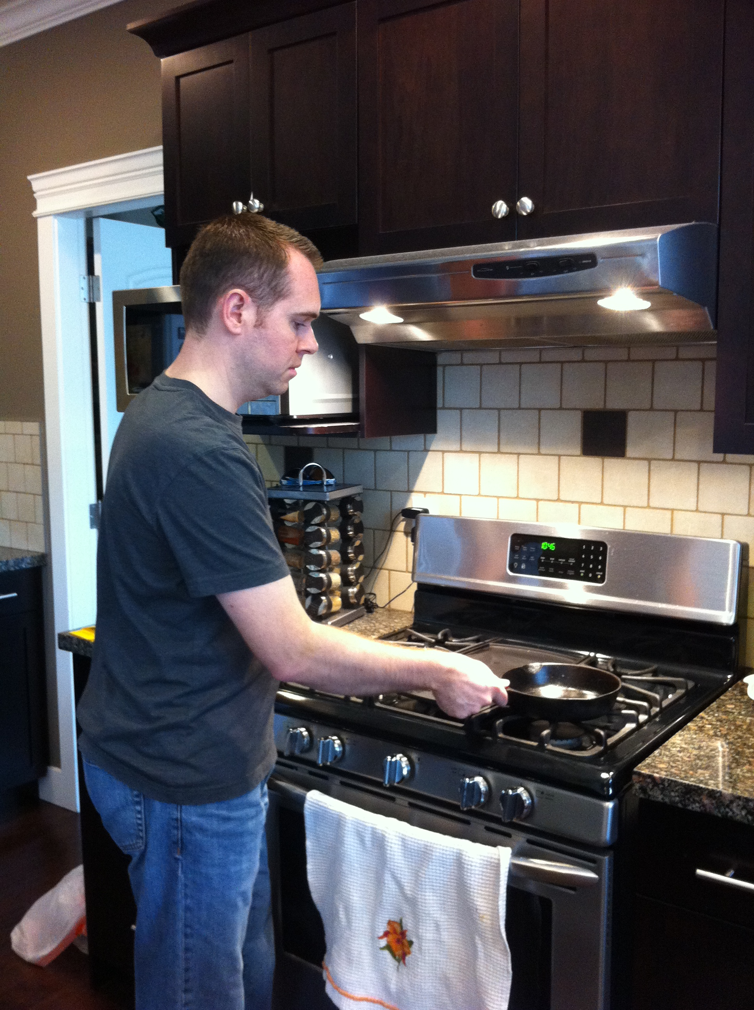
parallel activities
“We use video as a method to simulate shared living. Even if we aren’t talking, the video channel is open. In fact, even when open it is on mute most of the time … We do things we would normally do if we were together and can see one another doing it.”

Slide 26
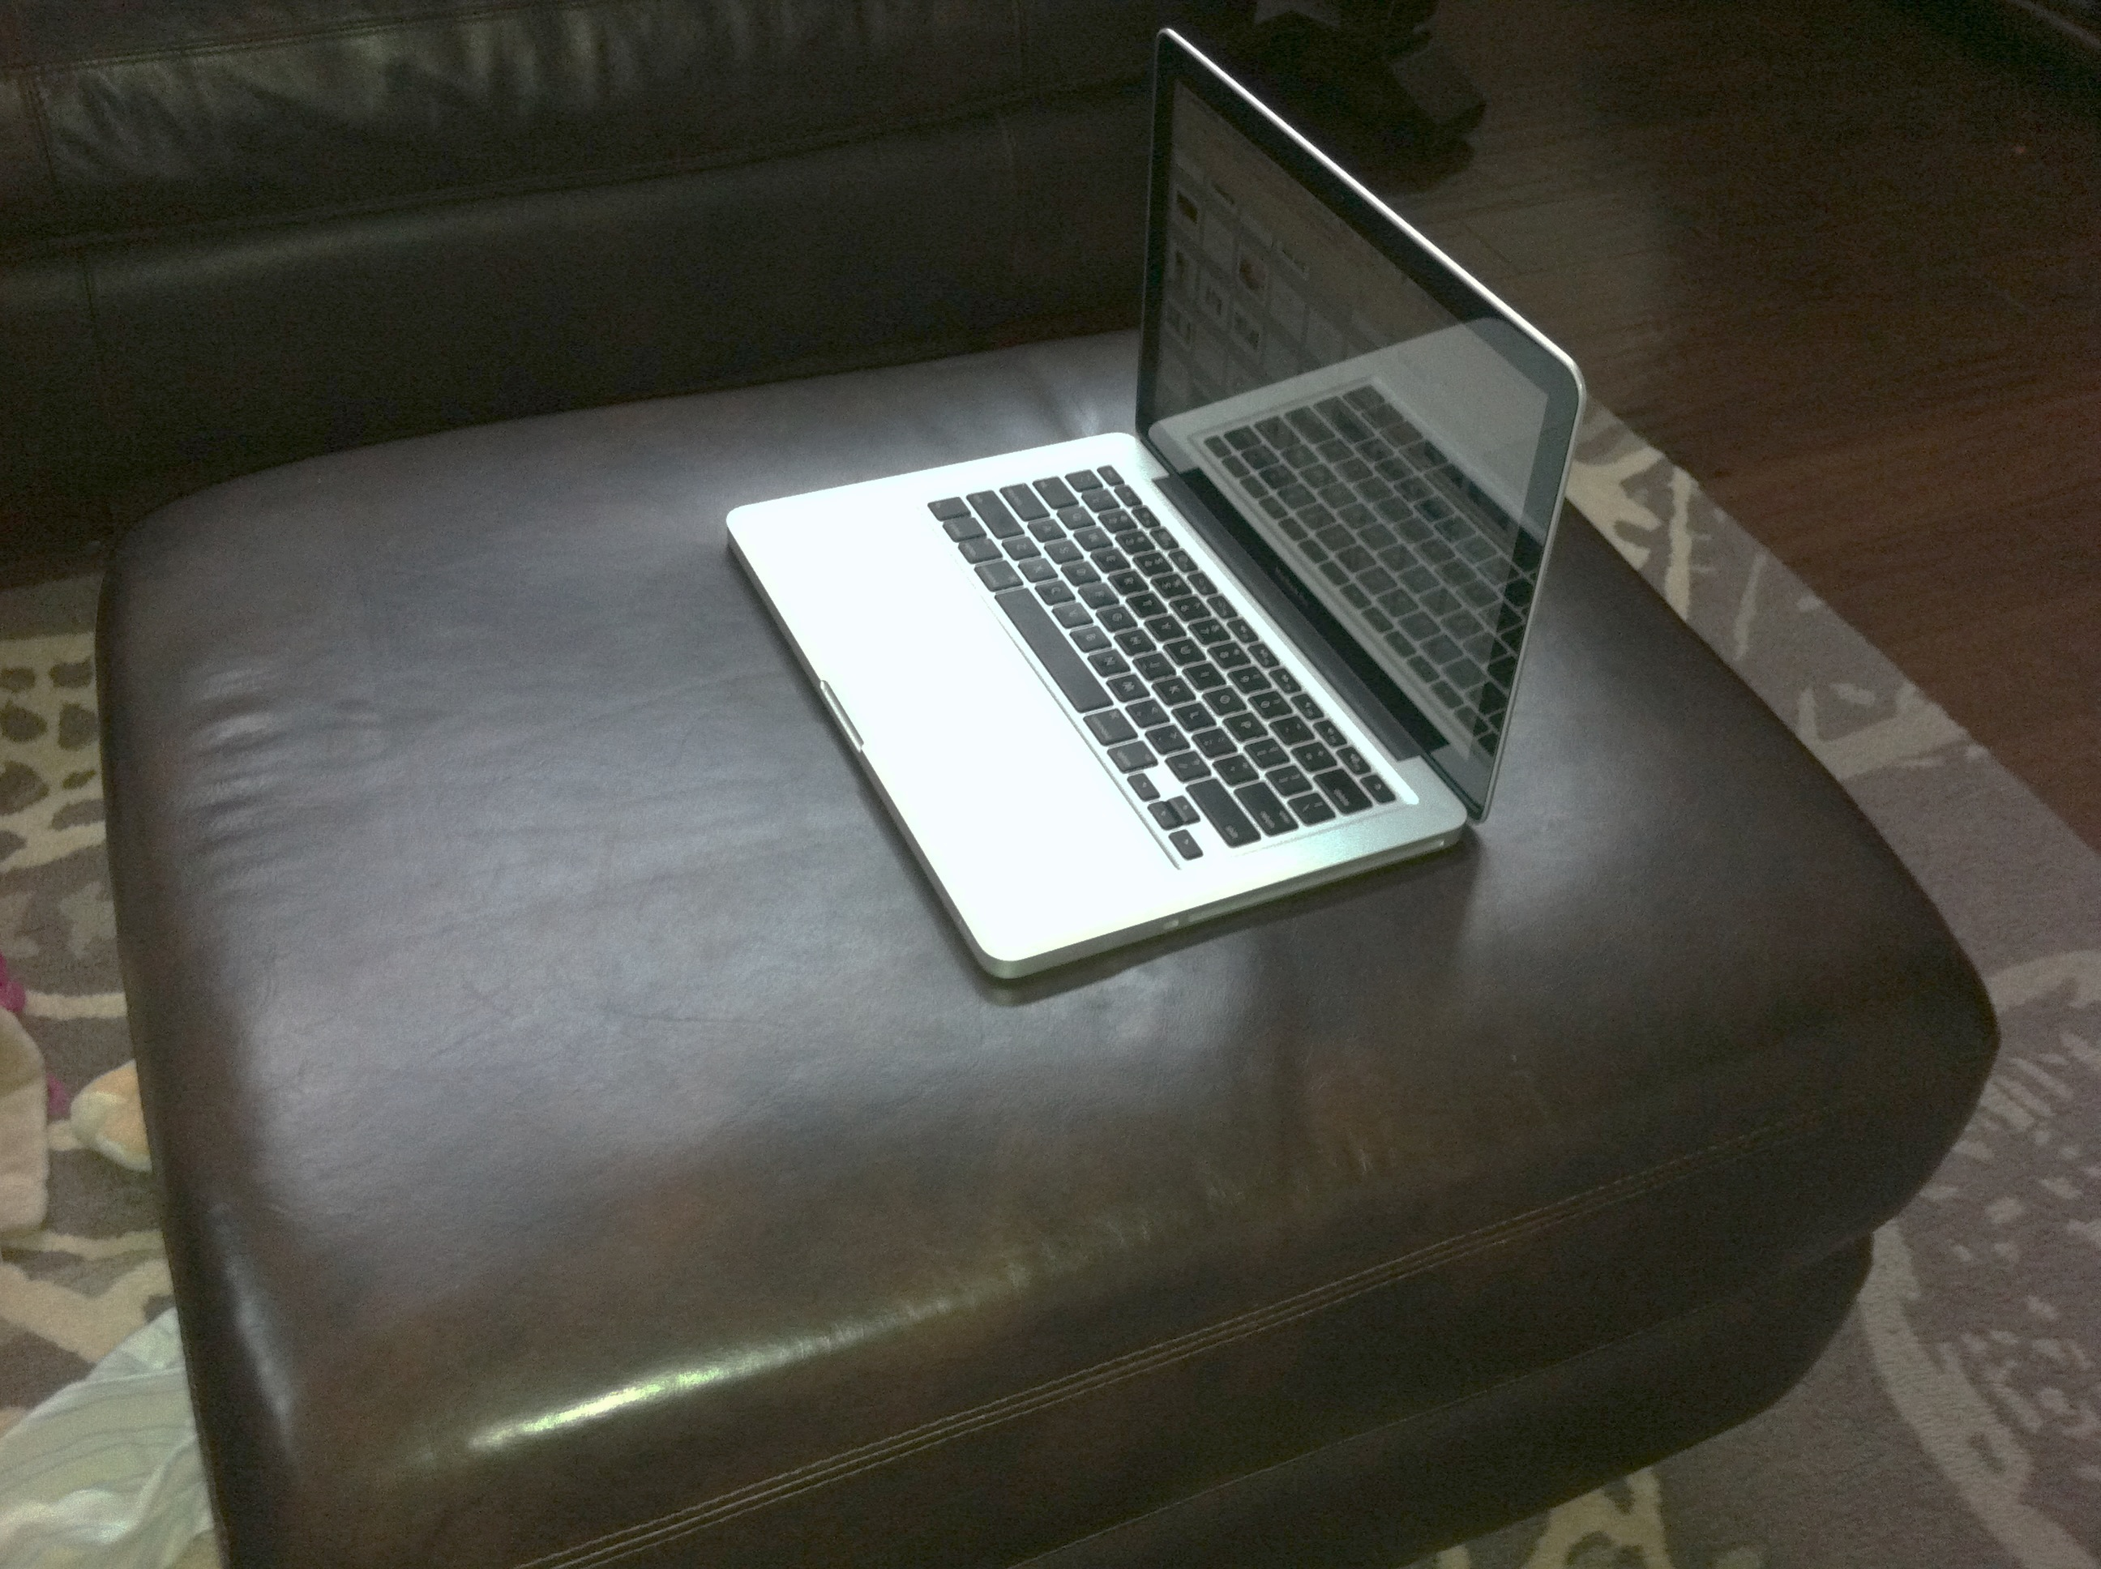

Slide 27
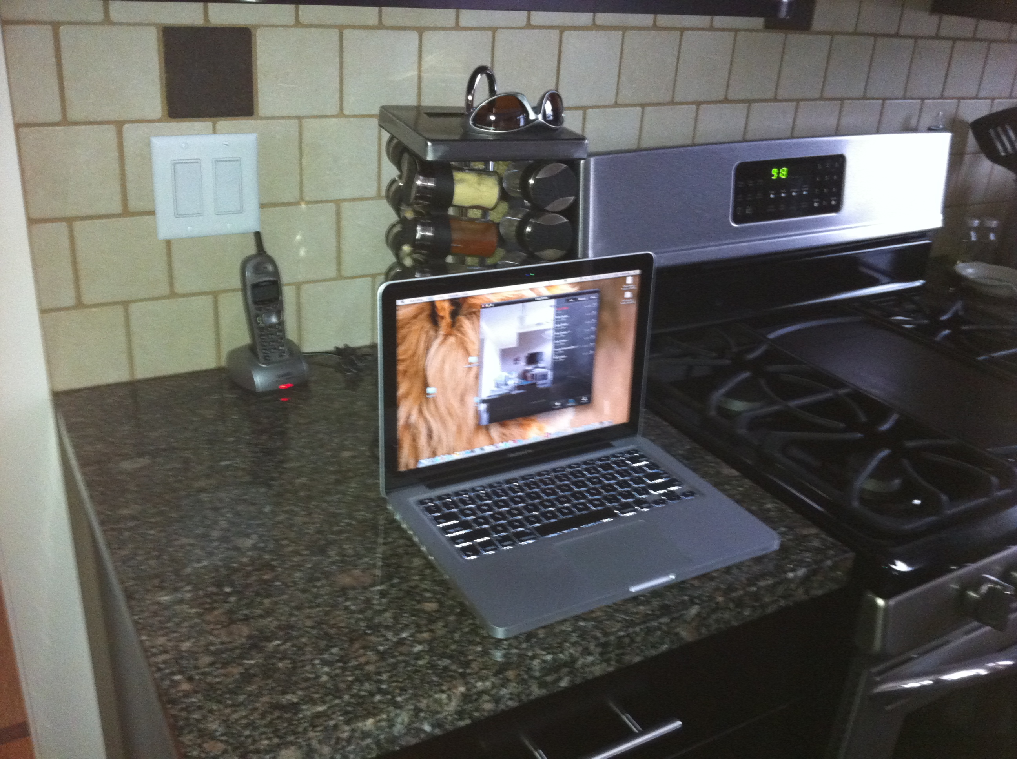

Slide 28
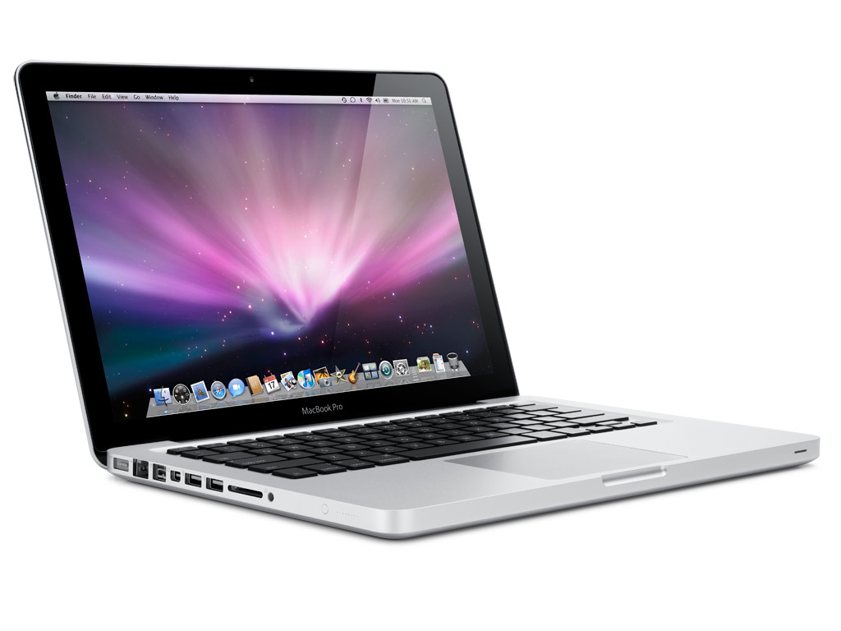
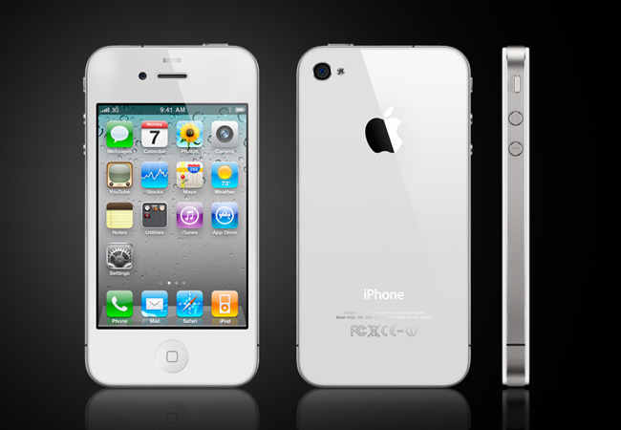
the ideal

Slide 29
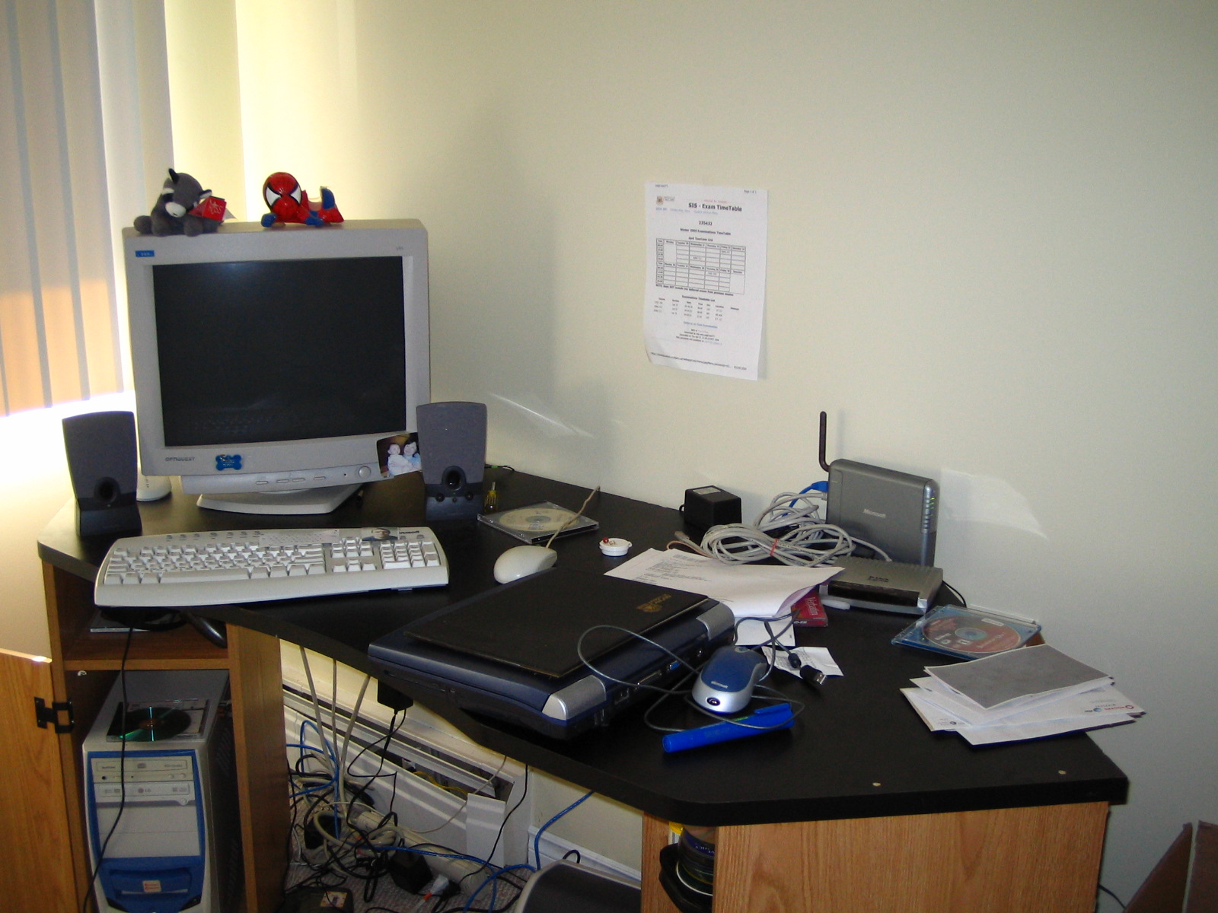
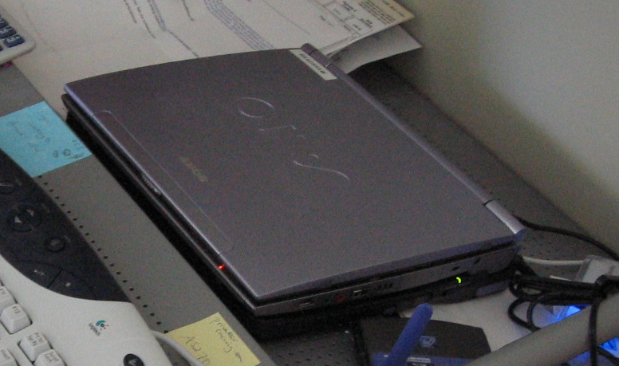
the reality: mobility and location issues
Notes:
e.g., have a photo with a desktop computer with lots of cords, a really old laptop, new mac laptop, iPhone - put a box around the old stuff saying this is the reality
wires are everywhere, they are tethered

Slide 30
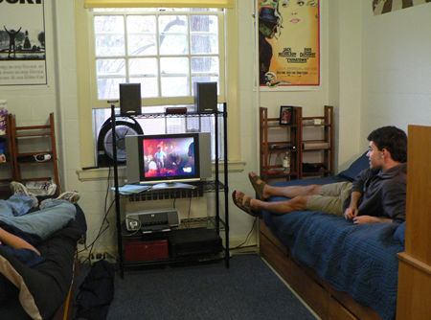
parallel activities
“At home, a lot of times at night, he likes to put on his pjs and turn out all the lights and sit there with a snack and, you know, watch TV. So sometimes it’s hard to see him but other than that, as long as you can see the form of somebody that’s a nice thing. I think it’s just the comfort of knowing that they’re there.”

Slide 31
periodic conversation
“I would sometimes be reading or something while we’d be on video … we’d just have [Skype] open, and sometimes we’d not really say anything for like 15 minutes, 20 minutes you know but I’d be able to talk to her. So it was kinda like being in the same room as her but not necessarily interacting actively.”

Slide 32
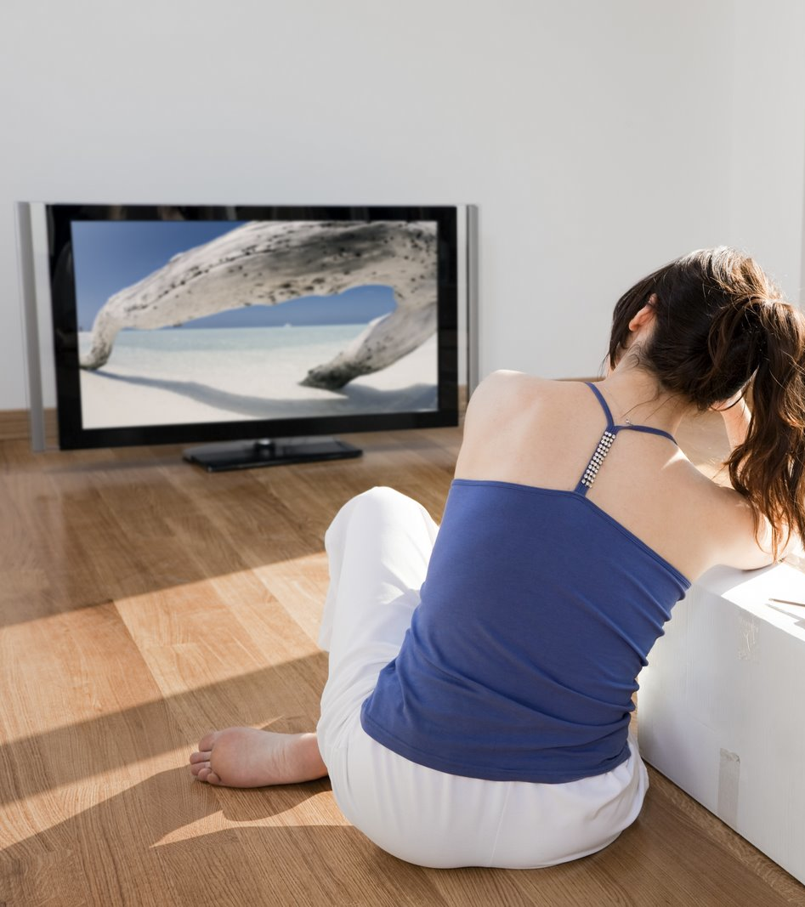
shared activities
antheaanka.com
virginia.edu

Slide 33
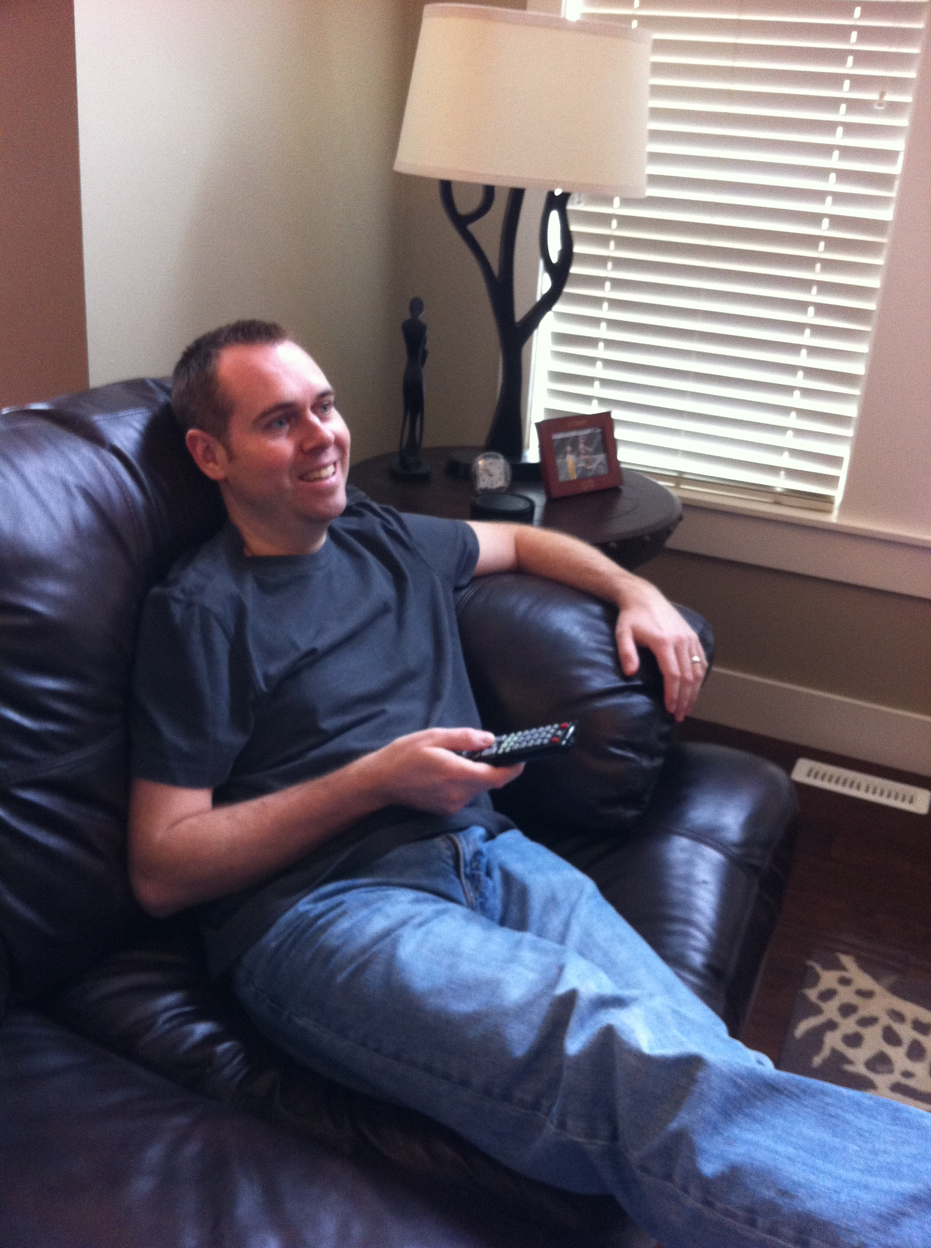
shared activities
“We video Skyped while we both had this movie and we watched it at the same time … we could see each other’s reaction … it was nice … I could see him laugh at the funny parts or I could see his reaction to something ridiculous.”

Slide 34
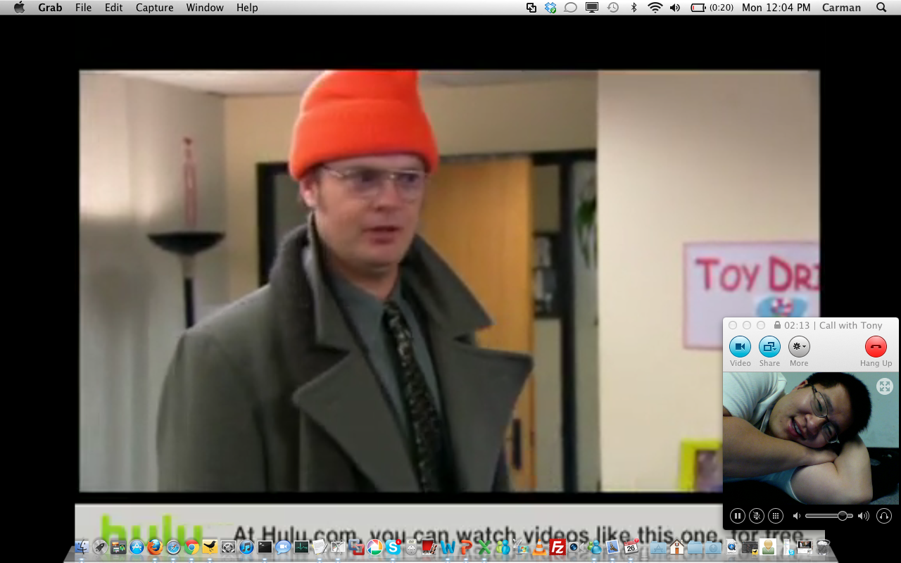
video challenges

Slide 35
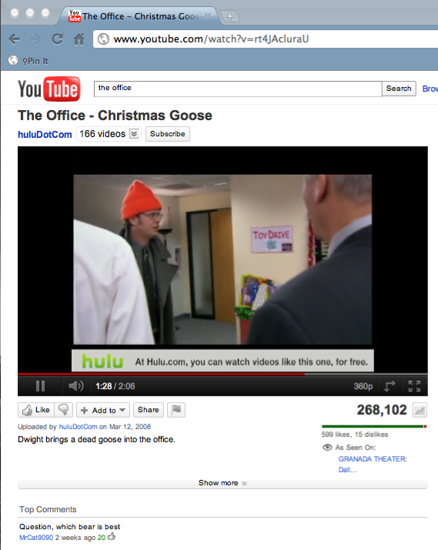
audio challenges

Slide 36
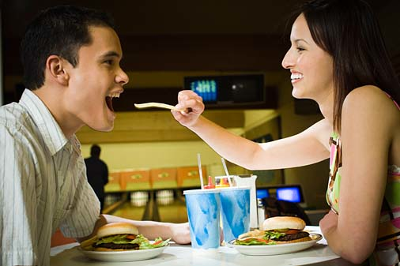
shared activities
collegecandy.com

Slide 37
shared meals
“This year we started video chatting and having dinner, which has been nice … it’ll be a sushi night and we’ll get sushi … as much as we can sort of normalize this ridiculous long distance relationship, we try … in a way we both know it’s not a date, it’s just we’re having dinner together in front of Skype.”

Slide 38
a matter of routine

Slide 39
short distance: evenings after work
short distance
8am
noon
midnight

Slide 40
evenings after work
short distance
Partner A
Partner B
8am
noon
midnight

Slide 41
evenings after work
short distance
Partner A
Partner B
8am
noon
midnight

Slide 42
evenings after work, limited time
across continent
8am
noon
midnight

Slide 43
evenings after work, limited time
across continent
Partner A
8am
noon
midnight

Slide 44
evenings after work, limited time
across continent
Partner B
8am
noon
Partner A
8am
noon
midnight

Slide 45
evenings after work
across continent
Partner B
8am
noon
Partner A
8am
noon
midnight

Slide 46
evening to morning
across the world
Partner A
8am
noon
midnight

Slide 47
evening to morning
across the world
Partner B
midnight
8am
noon
Partner A
8am
noon
midnight

Slide 48
evening to morning
across the world
Partner B
midnight
8am
noon
Partner A
8am
noon
midnight

Slide 49
people went out of their way
modify work hours
change sleep times
move meal times
avoid friends/family
…

Slide 50
conversation and conflict

Slide 51
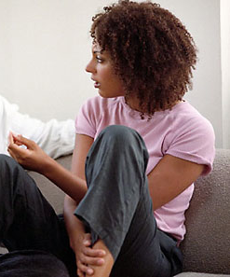
conversation (and conflict)
clutchmagonline.com

Slide 52
conversation (and conflict)
“Even when we fight we prefer to fight online and see each because we can see the facial expressions of the other person … I think in some cases it can make it worse. In some cases, it can soften it, depending on our reactions. If say I get so upset I’m bursting into tears, he calms down.”
clutchmagonline.com

Slide 53
conversation (and conflict)
“I would never have an argument on Skype. I’d much rather have an argument over the telephone… when you’re on Skype, you are expected to look straight into the camera. A lot of my argument style involves not looking at the other person.”
clutchmagonline.com

Slide 54
intimate and sexual acts

Slide 55
kissing and hugging
Notes:
showing affection is important. some thought it was silly, but for others it expressed their feelings despite being awkward

Slide 56
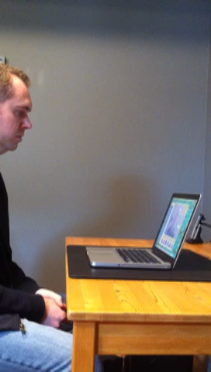
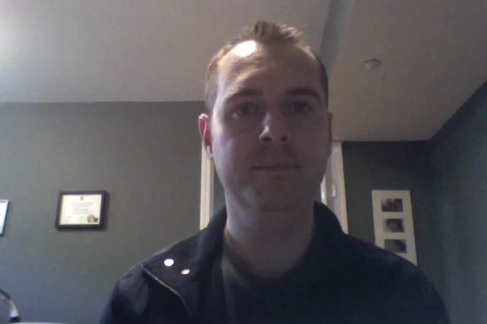
kissing and hugging
Click on each to play video

Slide 57
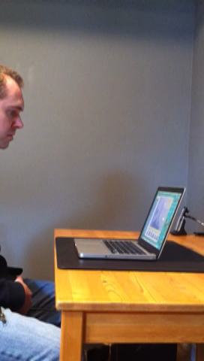
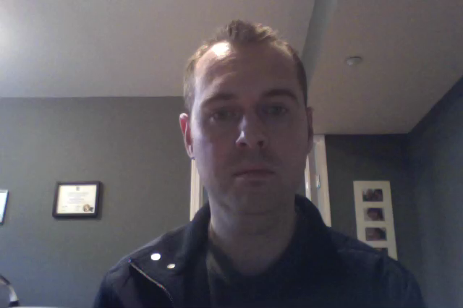
kissing and hugging
Click on each to play video

Slide 58
position mismatch
“Every now and then like every night we’ll typically sign off by giving each other kisses, which is actually like kissing the webcam so it actually looks like you’re kissing. If you kiss the screen, you get the other person’s forehead.”

Slide 59
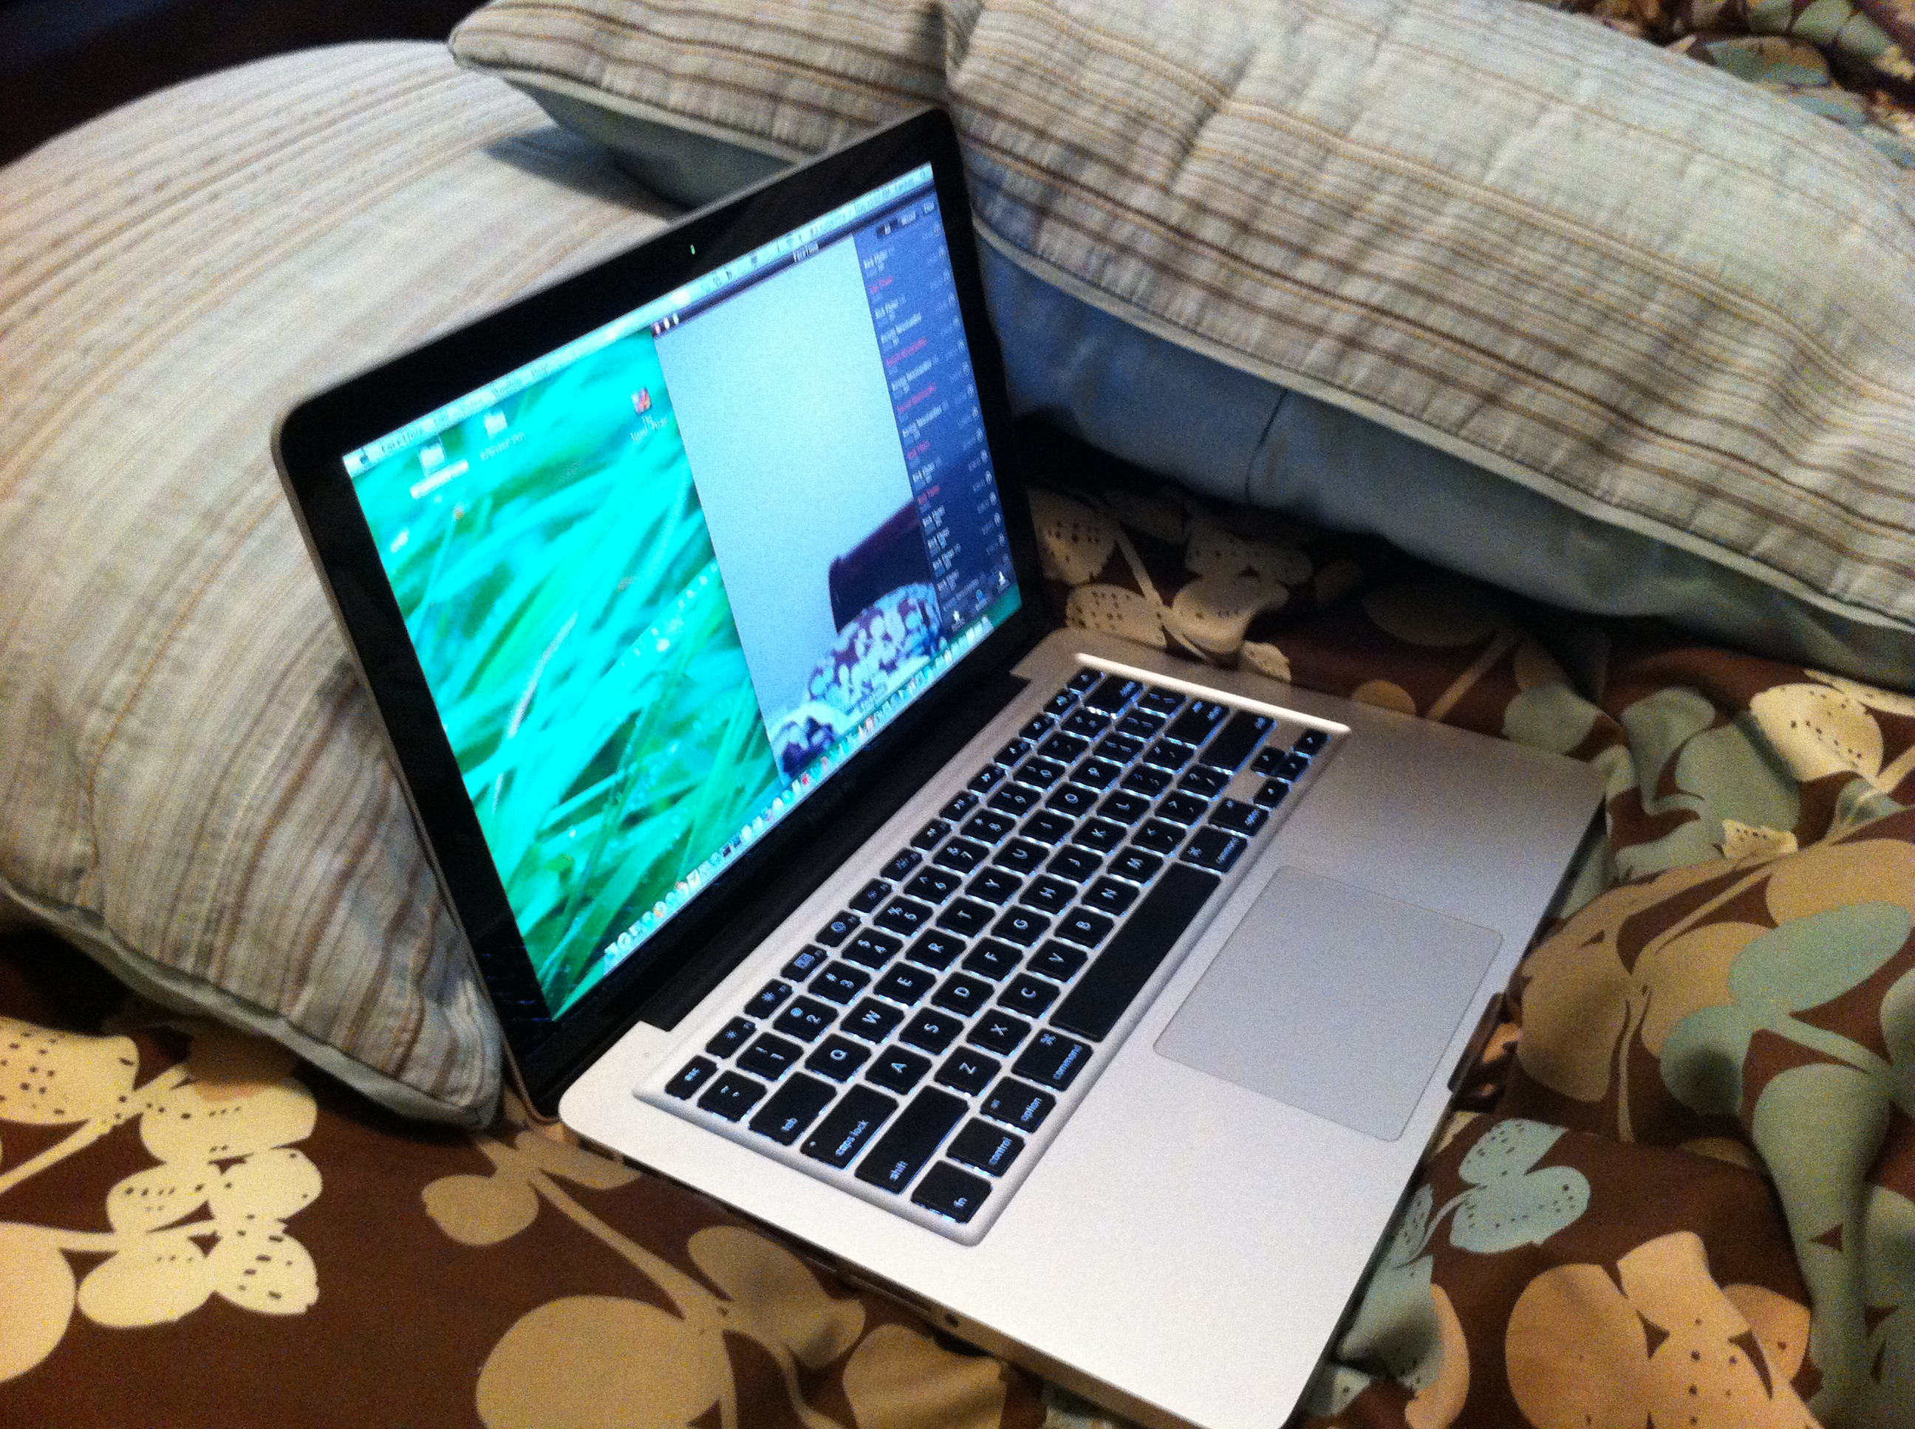
going to bed
“I will move [the laptop] to my bedroom, the light is on normally because if I don’t turn it on he can’t see me … and he normally cuts his voice off so I don’t wake up from his phone calls or him talking to people. And at some point in time the computer goes to sleep so it cuts it off … it’s on the bedside table and I normally position it towards my face.”

Slide 60
heat and positioning issues

Slide 61
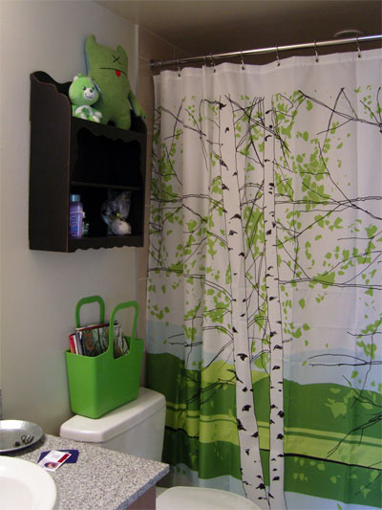
nudity
crookedbrains.net

Slide 62
non-sexual
“There were a few times where if I was changing or whatever if I was putting my pajamas on I’d just pull off my clothes and not bother to turn the camera off. It wasn’t in a sexual context … and she does the same thing.”

Slide 63

cybersex
“I feel it goes back to that culture thing, the shyness… you feel like it’s not right. Maybe he feels more distant when he’s on the video.”

Slide 64
cybersex
“But I did like to just strip tease and have this fun with the video and just showing parts of clothing or parts of skin. Like playing with the frame… I’d step away and just show my bra…or showing my back so not really showing everything but still teasing.”
Notes:
we had two that engaged in full cyber sex. concerns about privacy, awkwardness…
intimate acts: in our small sample, we didn't see much but we know it exists, but it's not about that, it's about how people felt about expressing their intimate feelings - kissing, hugging, etc. - the technology got in the way
while awkward, it is important
what people really want to do is express intimacy
make it all about intimacy
make kiss more real
don't be goofy

Slide 65
cybersex
“Maybe it’s like I’m being watched or something. A lot of times when people ask do you have intimate stuff going on online I always think to myself that they are talking about a porn movie. I don’t want to be in a porn movie for my boyfriend … there’s no real intimacy after that.”

Slide 66
discomfort
“You feel like it’s not right. Maybe he feels more distant when he’s on video.”
“I didn’t feel very comfortable or in the mood.”

Slide 67
being watched
“Maybe it’s like I’m being watched or something. A lot of times when people ask do you have intimate stuff going on online I always think to myself that they are talking about a porn movie. I don’t want to be in a porn movie for my boyfriend … there’s no real intimacy after that.”
Notes:
for cybersex, I overemphasize the negative of it. we had two that engaged in full cyber sex. put some bullets up, concerns about privacy, awkwardness…

Slide 68
the message
video chat affords shared living, which in turn provides intimacy
Notes:
emphasize shared living, you can't get that over the other channels
richness comes in the small nuances, don't leave that out when simplifying for the presentation
here's how you get the intimacy
here's how you get the shared living
intimacy comes from many things: seeing each other, shared activities, parallel activities, etc.
you can't do these over the other channels
put those key things under the message

Slide 69
the message
video chat affords shared living, which in turn provides intimacy
not a phone call
not talking heads
day-to-day companionship
Notes:
emphasize shared living, you can't get that over the other channels
richness comes in the small nuances, don't leave that out when simplifying for the presentation
here's how you get the intimacy
here's how you get the shared living
intimacy comes from many things: seeing each other, shared activities, parallel activities, etc.
you can't do these over the other channels
put those key things under the message

Slide 70
shared living is about:
seeing each other
shared activities
parallel activities
physical and sexual acts
Notes:
emphasize shared living, you can't get that over the other channels
richness comes in the small nuances, don't leave that out when simplifying for the presentation
here's how you get the intimacy
here's how you get the shared living
intimacy comes from many things: seeing each other, shared activities, parallel activities, etc.
you can't do these over the other channels
put those key things under the message

Slide 71
shared living is about:
seeing each other
shared activities
parallel activities
physical and sexual acts
Notes:
emphasize shared living, you can't get that over the other channels
richness comes in the small nuances, don't leave that out when simplifying for the presentation
here's how you get the intimacy
here's how you get the shared living
intimacy comes from many things: seeing each other, shared activities, parallel activities, etc.
you can't do these over the other channels
put those key things under the message

Slide 72
challenges
mobility in the home
location complexities
video and audio
time zones
physicality for sexual acts

Slide 73
More Information:
clab.iat.sfu.ca
grouplab.cpsc.ucalgary.ca
GROUP 2012 Workshop
Moving Beyond Talking Heads to Shared Experiences
Watch for it!

