Slide 1
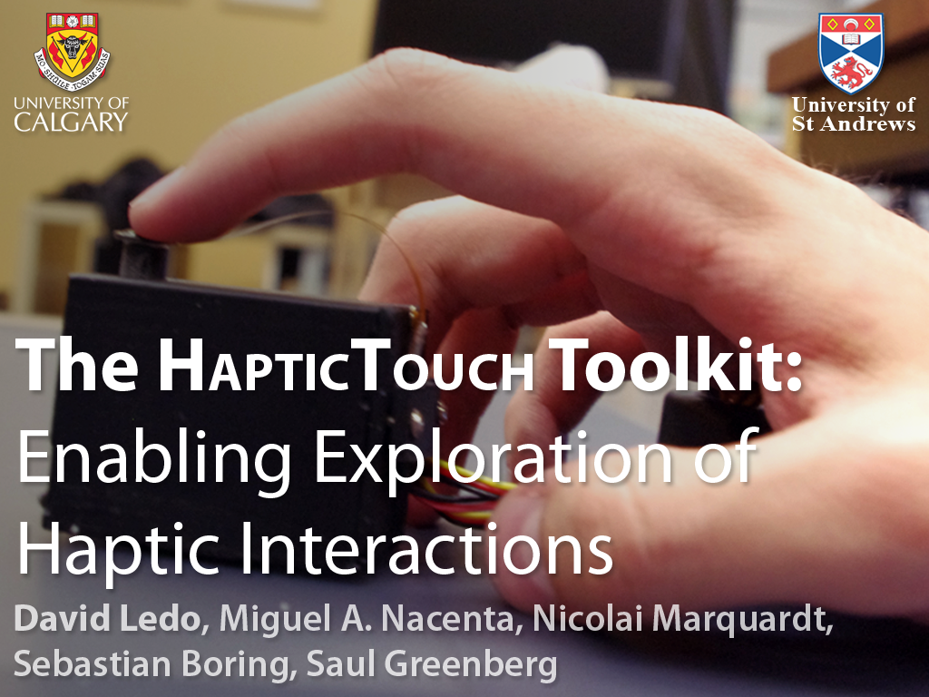

Slide 2
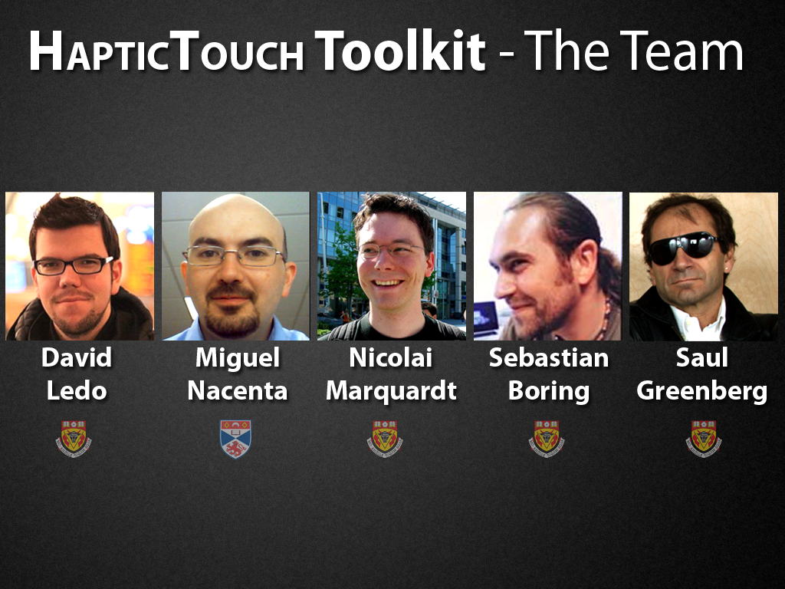

Slide 3
The HapticTouch Toolkit provides a way to rapidly prototype rich haptic applications without the need to know the underlying hardware details

Slide 4
Notes:
We’re talking about haptics, and the truth is that we touch things, we feel things.
Haptics represent a major sensorial channel in interaction with every day physical objects.

Slide 5
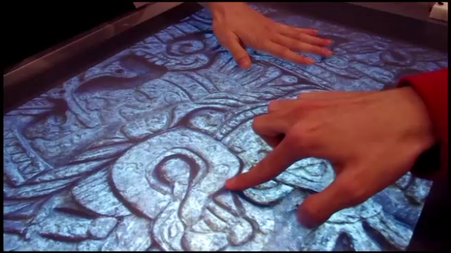
C

Slide 6
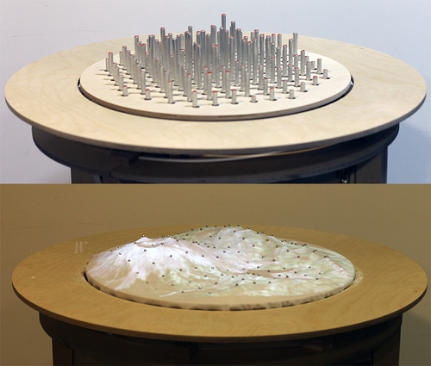
Relief
Leithinger et al. (TEI ’10)
Notes:
There is work that has been done before trying to look at haptic feedback for two dimensional surfaces

Slide 7
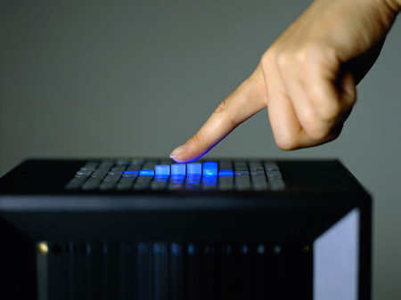
Lumen
Poupyrev et al. (SIGGRAPH ‘04)
Notes:
There is work that has been done before trying to look at haptic feedback for two dimensional surfaces

Slide 8
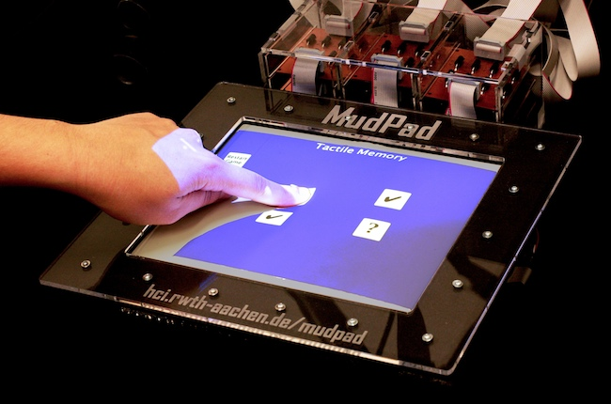
MudPad
Jansen et al. (ITS ’10)
Notes:
There is work that has been done before trying to look at haptic feedback for two dimensional surfaces

Slide 9
Haptic Tabletop Puck
Marquardt et al. (ITS ’09)
Notes:
But the Haptic Tabletop Puck, developed in our lab and presented at ITS 2009 is a
Cheap do it yourself alternative.

Slide 10
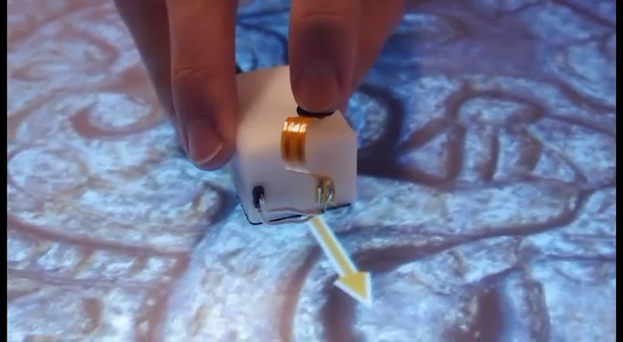
Click to play video
Notes:
The idea is that we have a physical device that provides tactile feedback on a two dimensional surface.
But how does it work?

Slide 11
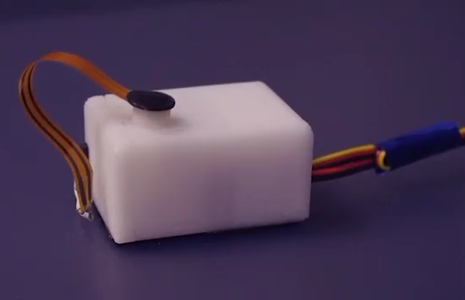
Haptic Tabletop Puck (HTP)
Click to play video
Vertical Rod
Pressure Sensor

Slide 12
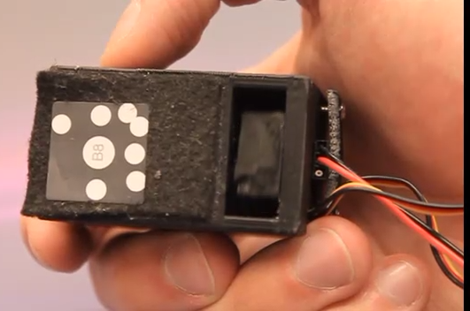
Haptic Tabletop Puck (HTP)
Click to play video
Byte Tag
Rubber Surface

Slide 13
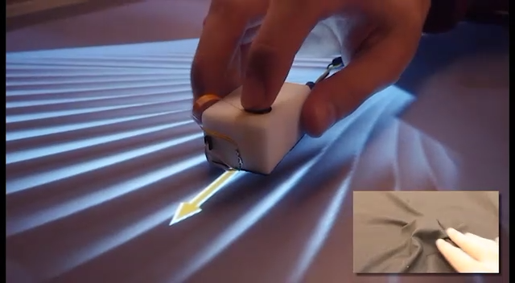
Click to play video

Slide 14
HapticTouch Toolkit
Notes:
However, the HTP is difficult to program
One has to understand and put together the different hardware components.

Slide 15
GUI Model
Notes:
Programs are familiar with it
It fits the two dimensional constraints of an interactive surface

Slide 16
3-Layer Architecture
Notes:
We want a simple haptics interface for development
We want people to have flexibility from physical control to interaction paradigms

Slide 17
Graphical Haptics Layer
Behavior
Lab
Behavior Layer
Raw Layer
Low Level Details

Slide 18
Graphical Haptics Layer
Behavior
Lab
Behavior Layer
Raw Layer
Low Level Details

Slide 19
Graphical Haptics Layer
Behavior
Lab
Behavior Layer
Raw Layer
Low Level Details

Slide 20
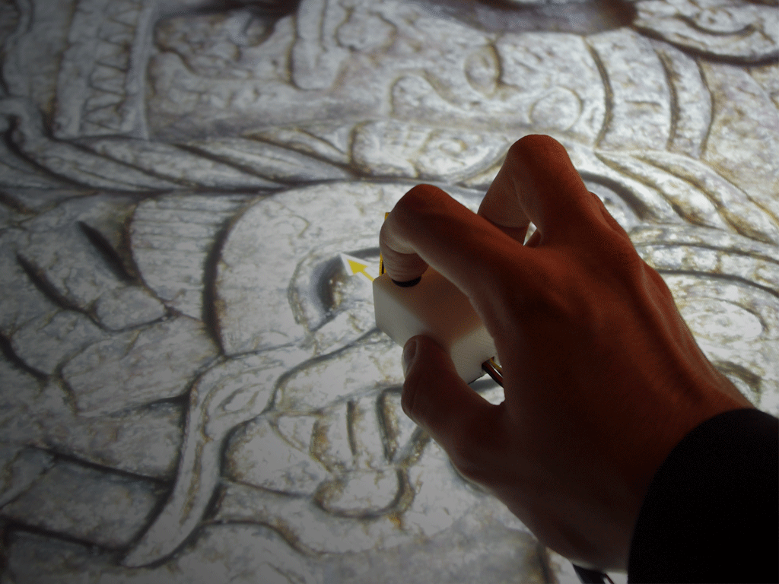
Raw Layer
ID
Height
Friction
Pressure
Location
Orientation

Slide 21
Graphical Haptics Layer
Behavior
Lab
Behavior Layer
Raw Layer
Low Level Details

Slide 22
Haptic Behaviors
Haptic Behavior

Slide 23
Haptic Behaviors
Height
Haptic Behavior

Slide 24
Haptic Behaviors
Height
Haptic Behavior
Pressure

Slide 25
Haptic Behaviors
Height
Haptic Behavior
Pressure
Friction

Slide 26
Haptic Behaviors
Height
Haptic Behavior
Pressure
Friction

Slide 27
Haptic Behaviors
Height
Haptic Behavior
Pressure
Friction
External Factors
(time, location, etc)

Slide 28
Haptic Behaviors
Height
Haptic Behavior
Height
Pressure
Friction
External Factors
(time, location, etc)

Slide 29
Haptic Behaviors
Height
Haptic Behavior
Height
Pressure
Friction
Friction
External Factors
(time, location, etc)

Slide 30
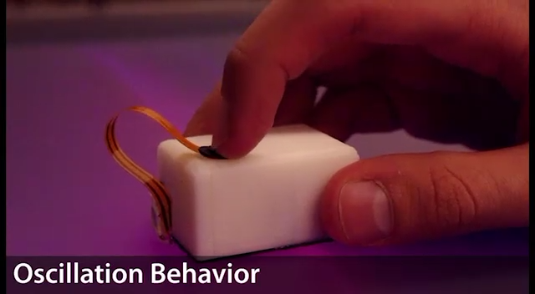
Click to play video

Slide 31
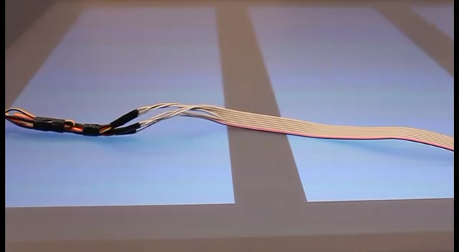
Click to play video

Slide 32
Haptic Behaviors
Softness
Breakiness
Oscillation
Static

Slide 33
Haptic Behaviors
Softness
Breakiness
Oscillation
Static
Hard
Soft

Slide 34
Haptic Behaviors
Softness
Breakiness
Oscillation
Static
Hard
Soft
Single Breakpoint
Many Breakpoints

Slide 35
Haptic Behaviors
Softness
Breakiness
Oscillation
Static
Hard
Soft
Single Breakpoint
Many Breakpoints
Low Frequency
High Frequency

Slide 36
Haptic Behaviors
Softness
Breakiness
Oscillation
Static
Hard
Soft
Single Breakpoint
Many Breakpoints
Low Frequency
High Frequency
Minimum
Maximum

Slide 37
Haptic Behaviors
Oscillation Behavior
Softness Behavior

Slide 38
Haptic Behaviors
Oscillation Behavior
Weight = 1
Softness Behavior

Slide 39
Haptic Behaviors
Oscillation Behavior
Weight = 1
Softness Behavior
Weight = 1

Slide 40
Haptic Behaviors
Oscillation Behavior
Weight = 2
Weight = 1
Softness Behavior

Slide 41
Graphical Haptics Layer
Behavior
Lab
Behavior Layer
Raw Layer
Low Level Details

Slide 42
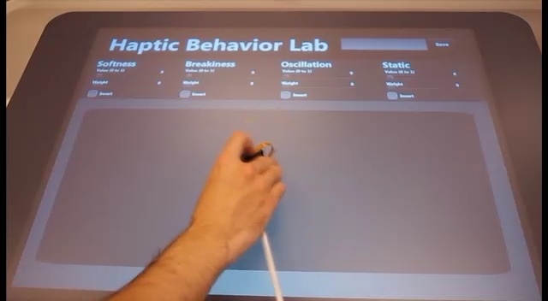
Click to play video

Slide 43
Graphical Haptics Layer
Behavior
Lab
Behavior Layer
Raw Layer
Low Level Details

Slide 44
1.
Haptic Shapes

Slide 45
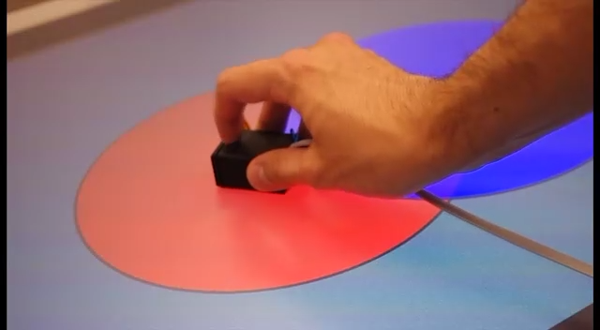
Click to play video

Slide 46
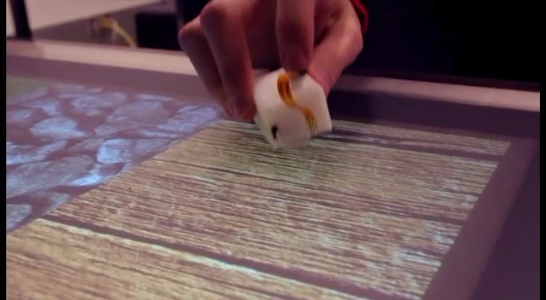
Click to play video

Slide 47
2.
Haptic Images

Slide 48
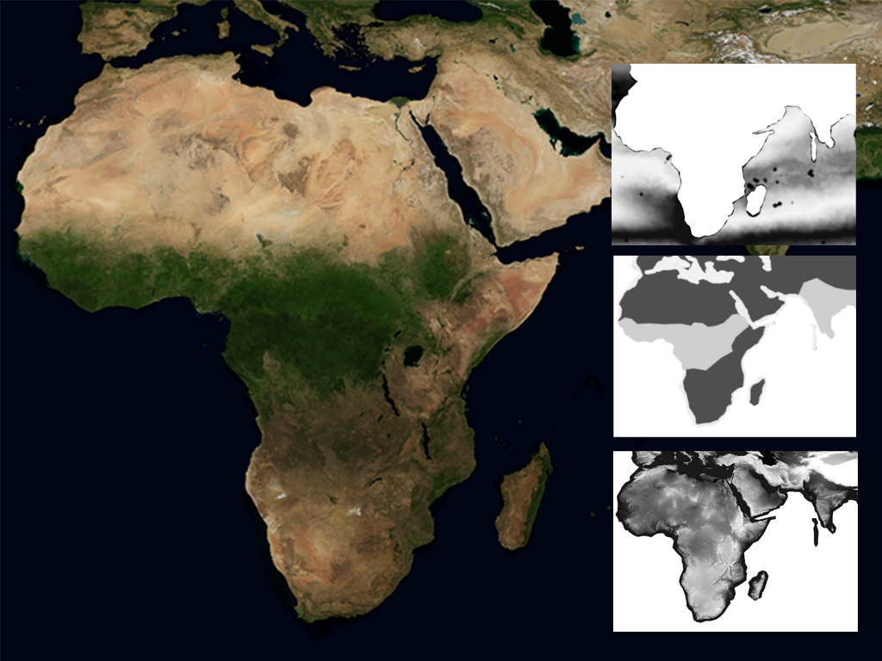
Notes:
Visible image to the user
Images for the programmer map the different behavior parameters (black is 0, white is 1).

Slide 49
Oscillation
Softness
Static
Notes:
Visible image to the user
Images for the programmer map the different behavior parameters (black is 0, white is 1).

Slide 50
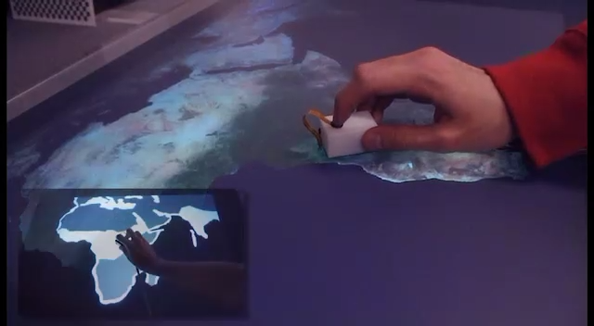
Click to play video

Slide 51
3.
Haptic
Widgets

Slide 52
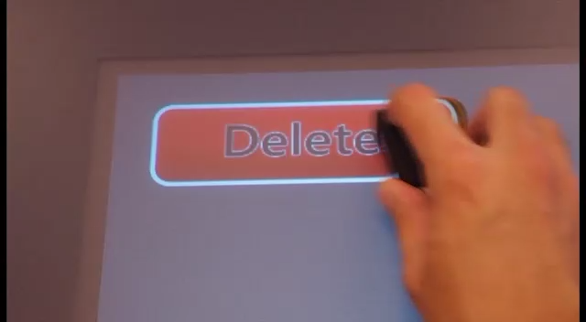
Click to play video

Slide 53
Graphical Haptics Layer
Behavior
Lab
Behavior Layer
Raw Layer
Low Level Details

Slide 54
Sample Applications
Notes:
We gave our toolkit to 3 people, as a primary exploration
Little training, access to our documentation
Cool stuff in 3 hours.

Slide 55
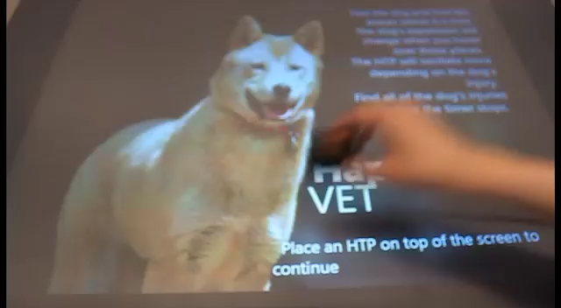
Click to play video

Slide 56
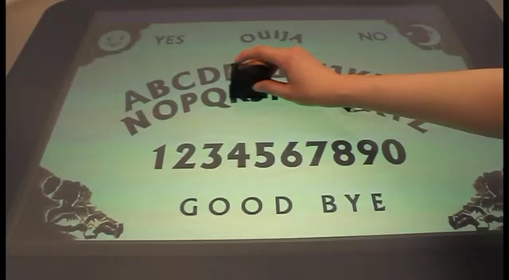
Click to play video

Slide 57
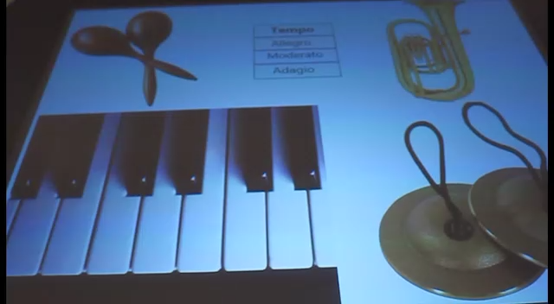
Click to play video

Slide 58
Notes:
We gave our toolkit to 3 people
Little training, access to our documentation
Cool stuff in 3 hours.

Slide 59
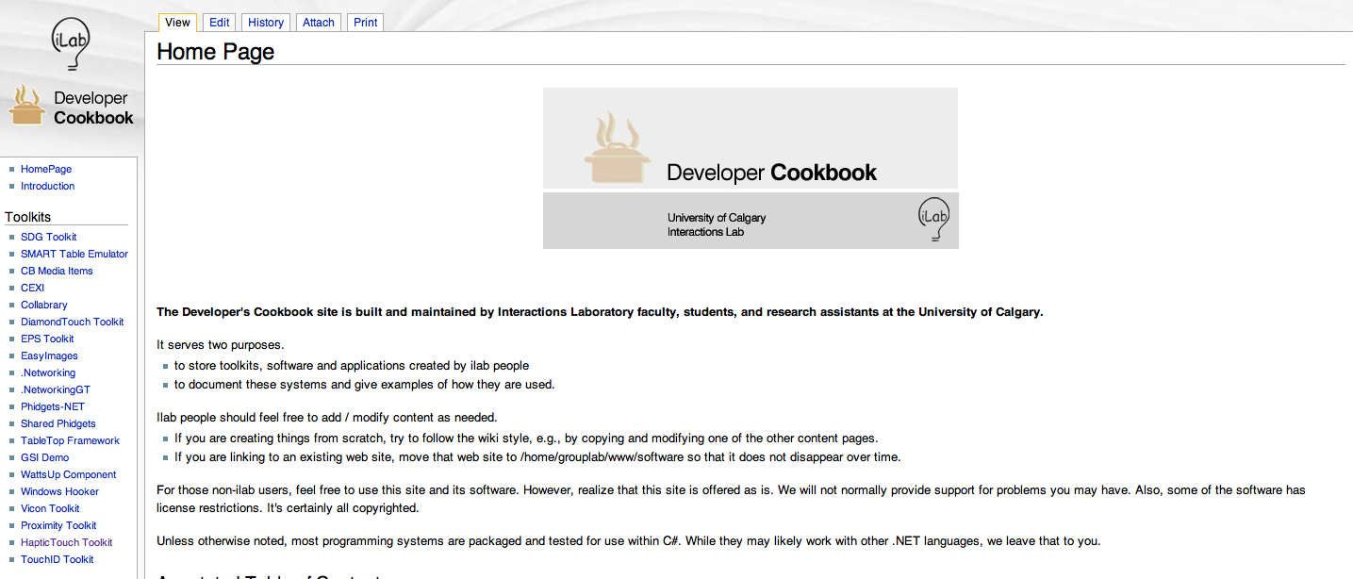
Search: “iLab Cookbook”

Slide 60
The HapticTouch Toolkit provides a way to rapidly prototype rich haptic applications without the need to know the underlying hardware details

