Slide 1
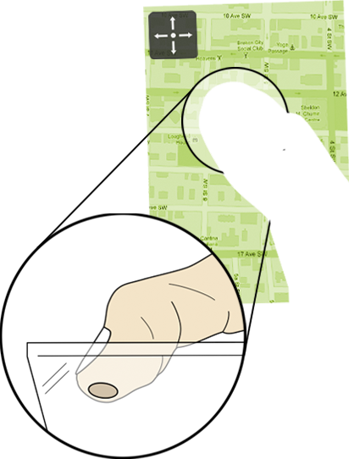
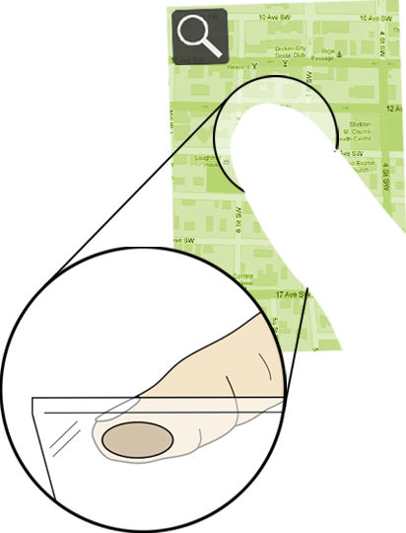

The Fat Thumb
Using the Thumb’s Contact Size For Single-Handed Mobile Interaction
Sebastian Boring, David Ledo, Xiang ‘Anthony’ Chen,
Nicolai Marquardt, Anthony Tang, Saul Greenberg
Interactions Lab, University of Calgary, Canada

Slide 2
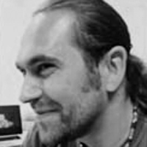
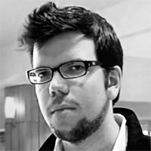
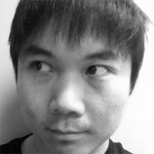

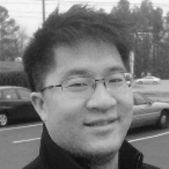
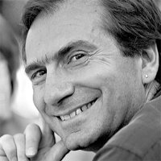
authors
Sebastian Boring
University of Calgary
David Ledo
University of Calgary
Xiang ‘Anthony’ Chen
University of Calgary (now: Carnegie Mellon University)
Nicolai Marquardt
University of Calgary
Anthony Tang
University of Calgary
Saul Greenberg
University of Calgary

Slide 3
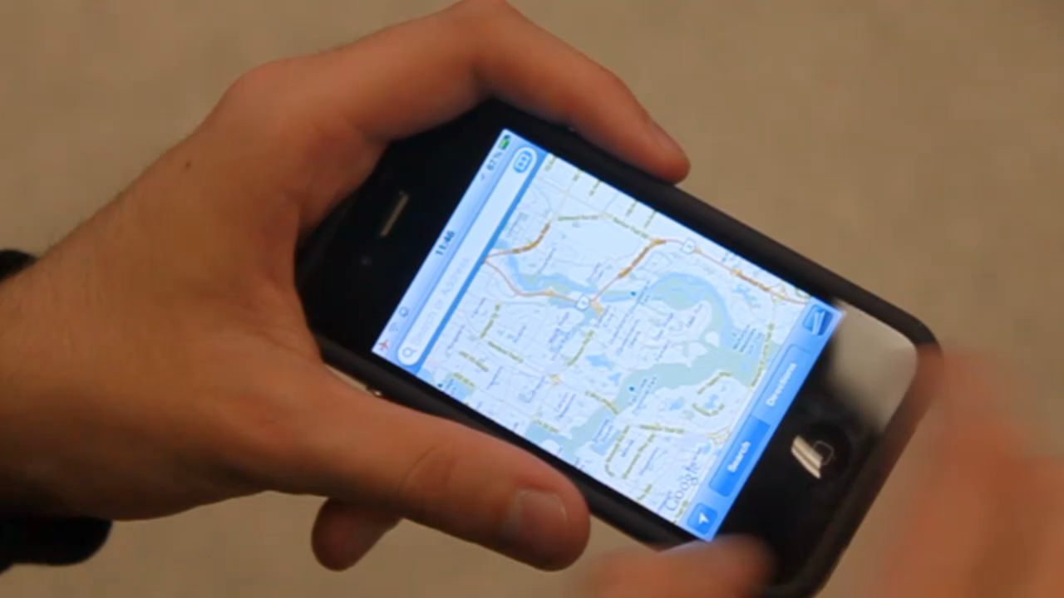
Click to play video

Slide 4
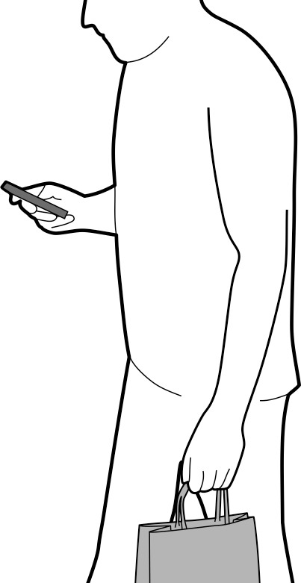
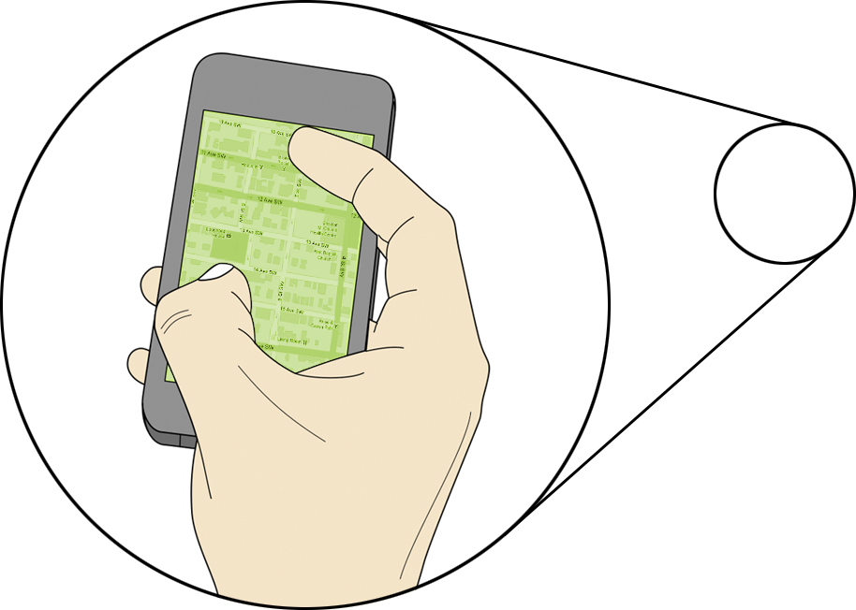
one-handed interaction
how to switch between modes?

Slide 5
contact size as mode switch
while the touch is in motion

Slide 6
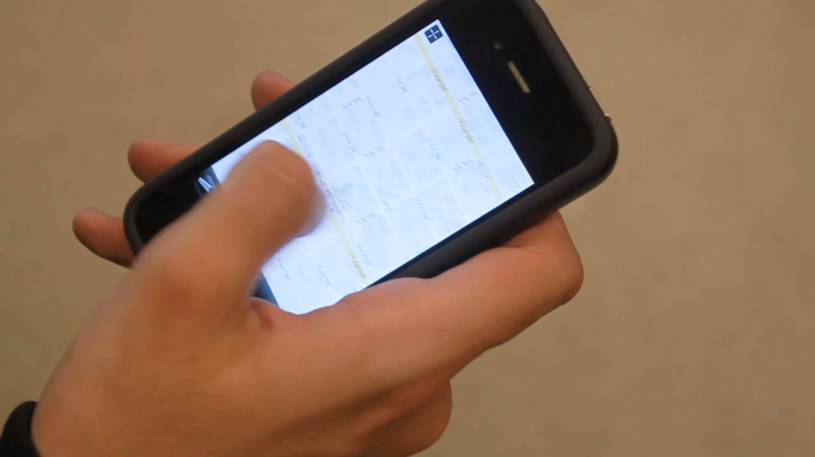
Click to play video

Slide 7
background
thumb-based mobile touch input

Slide 8
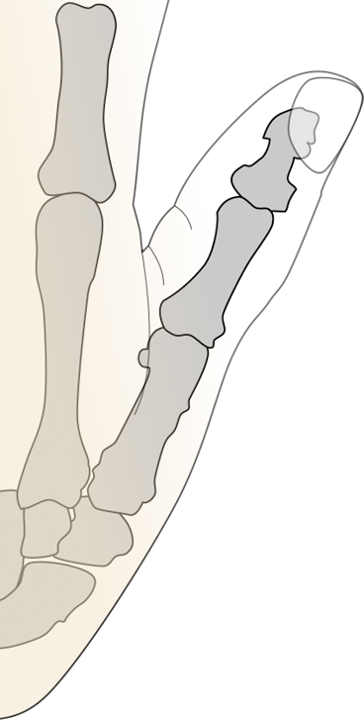
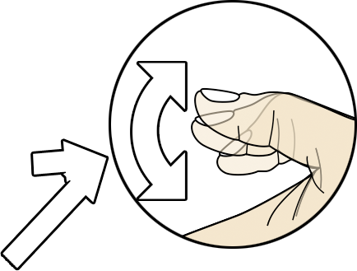
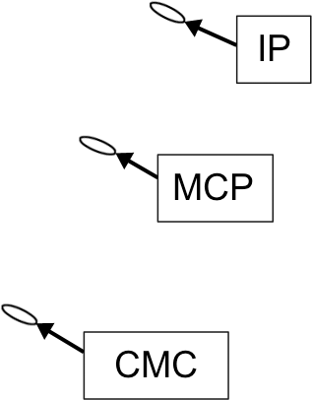
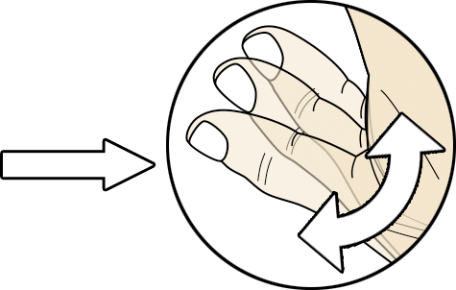

Slide 9
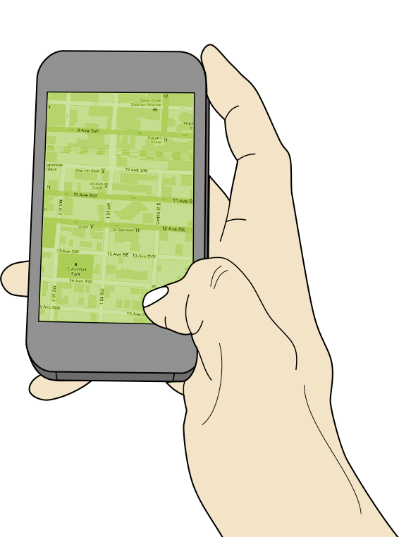
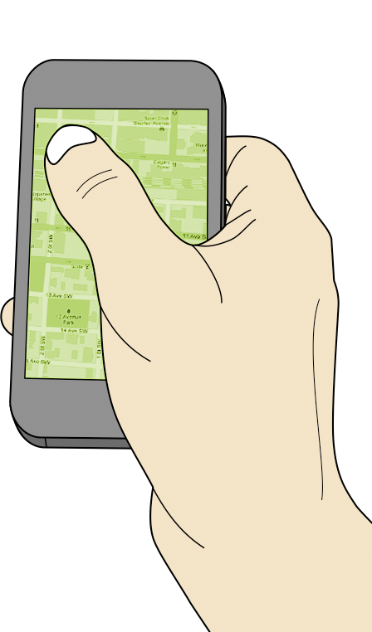
corners are hard to reach

Slide 10
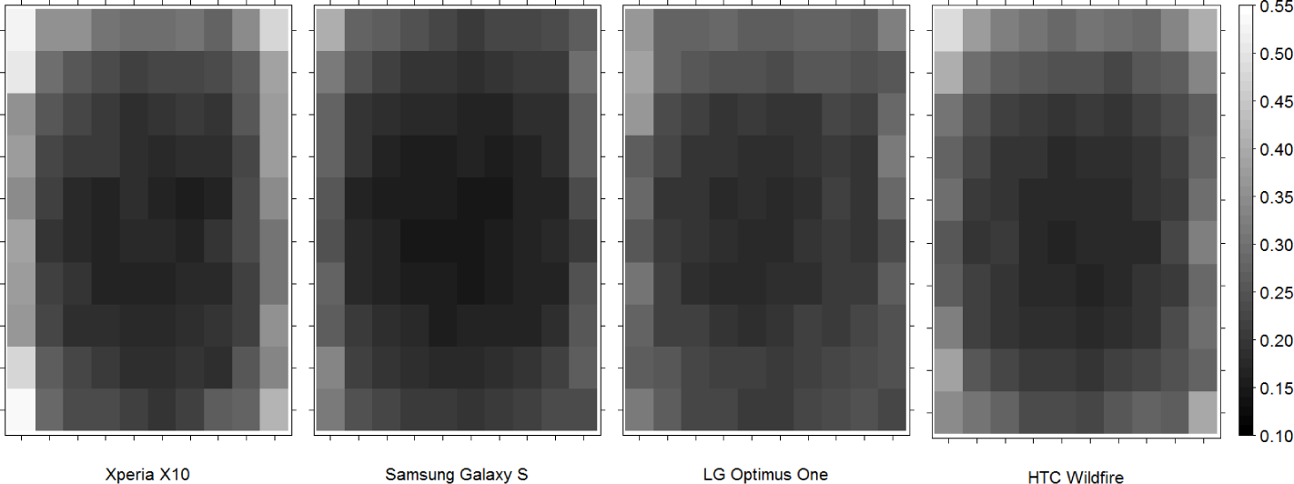
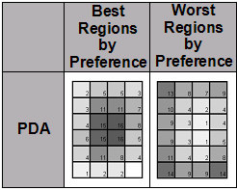
100,000,000 Taps [Henze et al., MobileHCI 2011]
center is the sweet spot
Mobile Phone Studies
[Karlson et al., TR Maryland 2006]

Slide 11
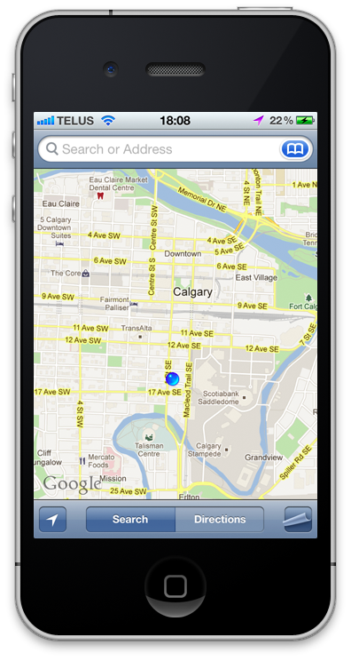

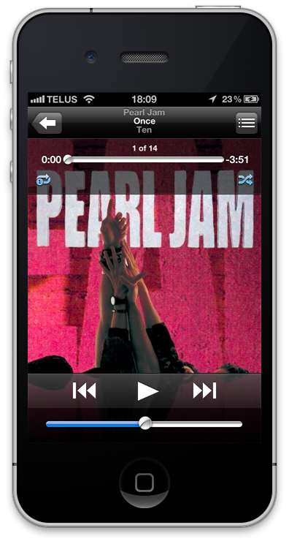
controls are located on borders

Slide 12
or directly in corners

Slide 13
related work
performance, expressivity, pressure & shape

Slide 14
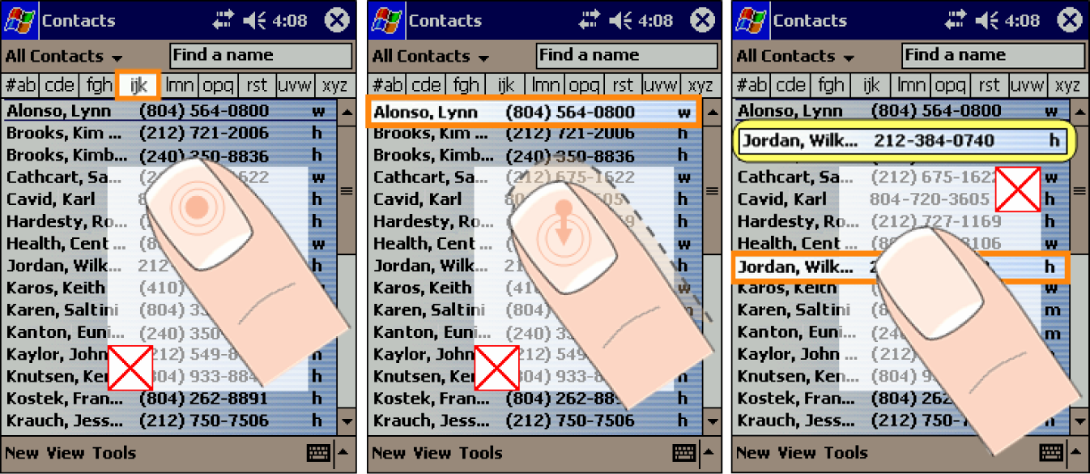
1
the thumb’s reachability
ThumbSpace [Karlson et al., Interact 2007]

Slide 15
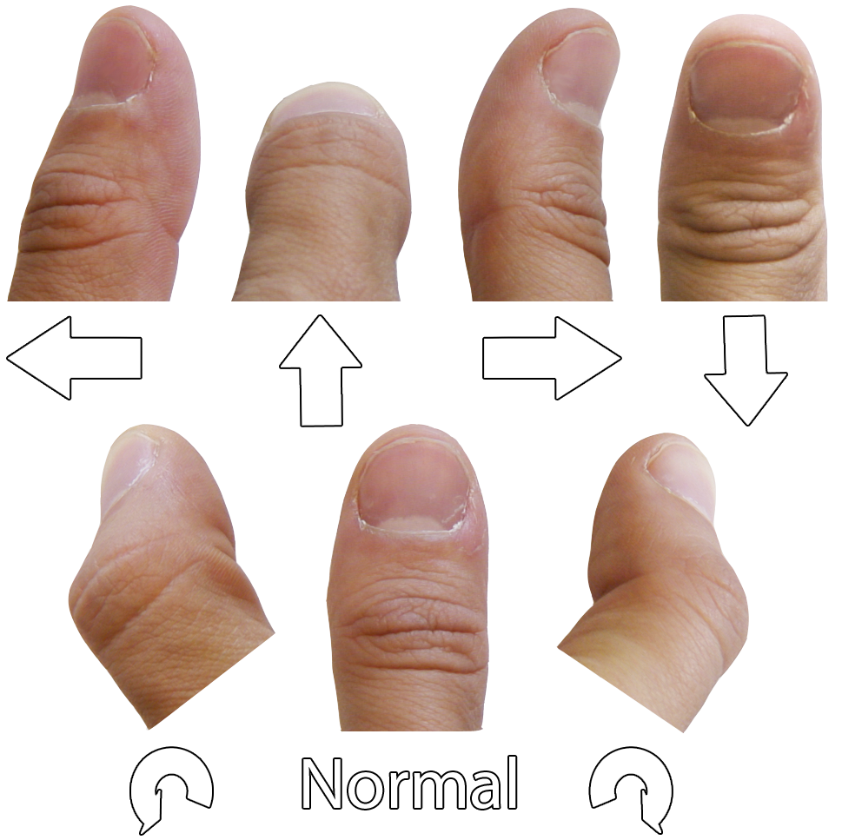
2
expressivity of touch
MicroRolls [Roudaut et al., CHI 2009]

Slide 16
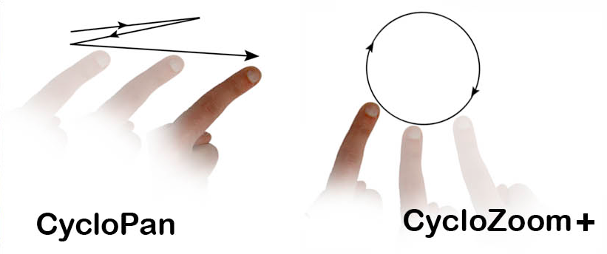
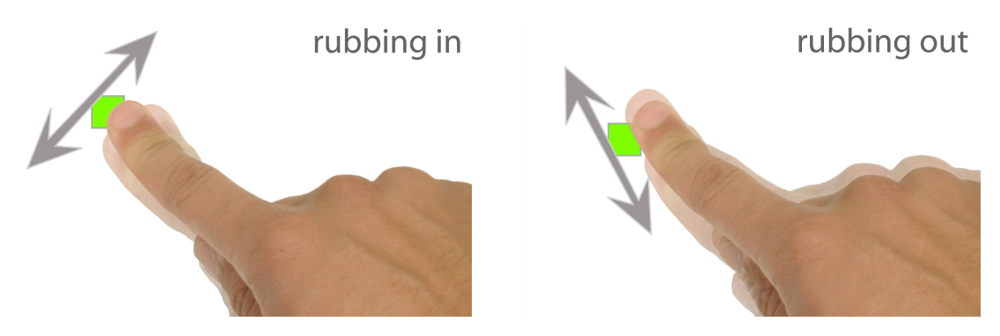
2
expressivity of touch
CycloPan & CycloStar [Malacria et al., CHI 2010]
Rubbing & Tapping [Olwal et al., CHI 2008]

Slide 17
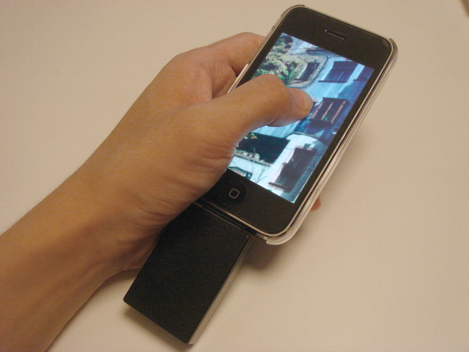
3
pressure & shape
GraspZoom [Miyaki et al., MobileHCI 2009]

Slide 18
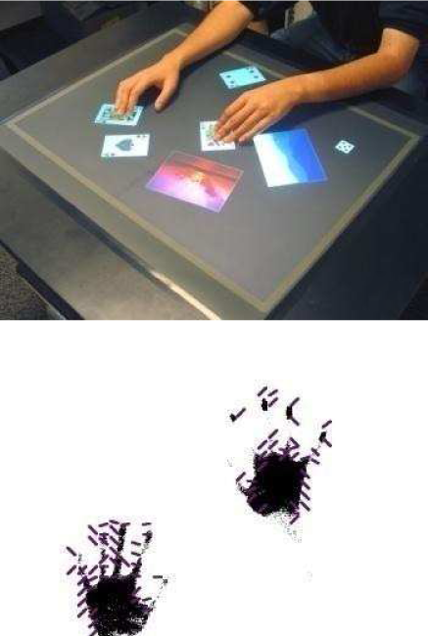
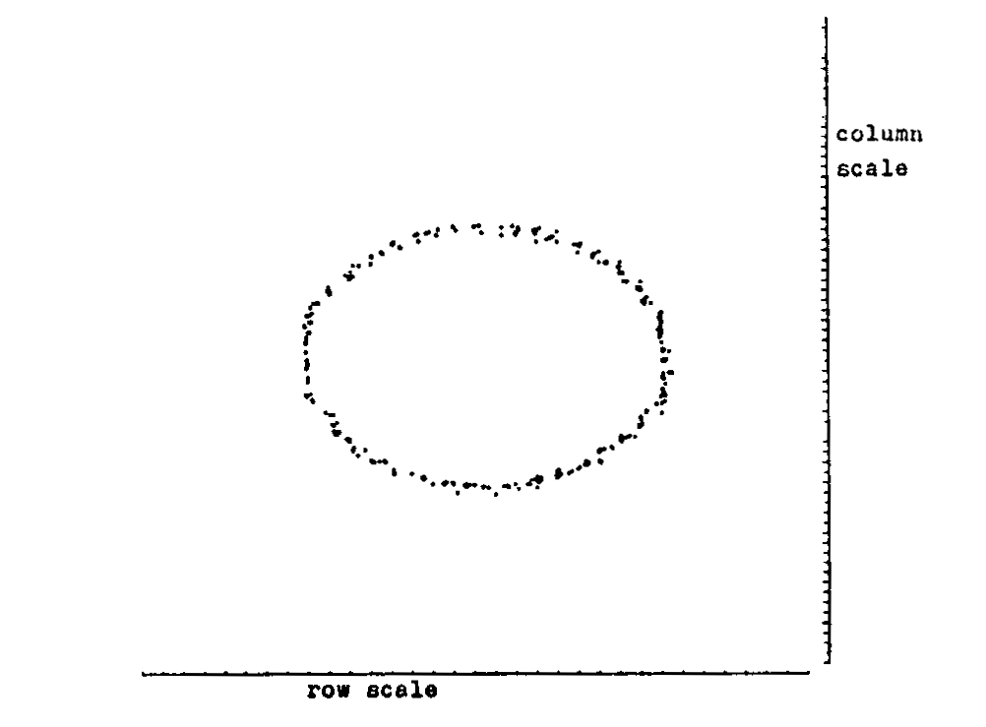
3
pressure & shape
Shape Detection [Lee et al., CHI 1985]
ShapeTouch [Cao et al., Tabletop 2008]

Slide 19
the thumb’s motion
applying different input modes

Slide 20
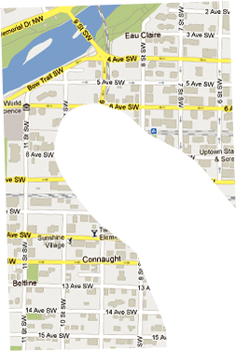
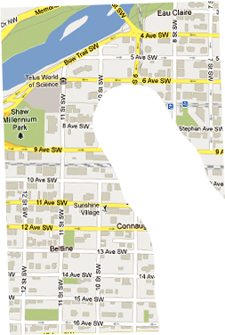
1
moving the thumb
panning the map
pan

Slide 21
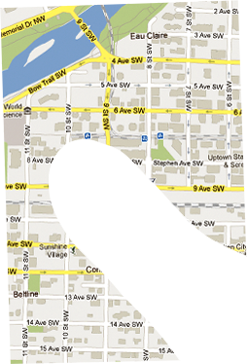
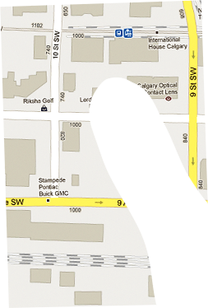
2
moving the thumb
zooming the map
zoom

Slide 22
ambiguity of motion
how to switch between operations?
?

Slide 23
pressure vs. pitch
changing the meaning of touch motion

Slide 24
1
pressure-based input
normal touch
press
w
≈w
w
≈w

Slide 25
2
changing the pitch
normal touch
pitch
w
≫ w
w
≫ w

Slide 26
pressure induces friction
when the thumb is in motion
press
pitch

Slide 27
implementation
making use of the contact size

Slide 28
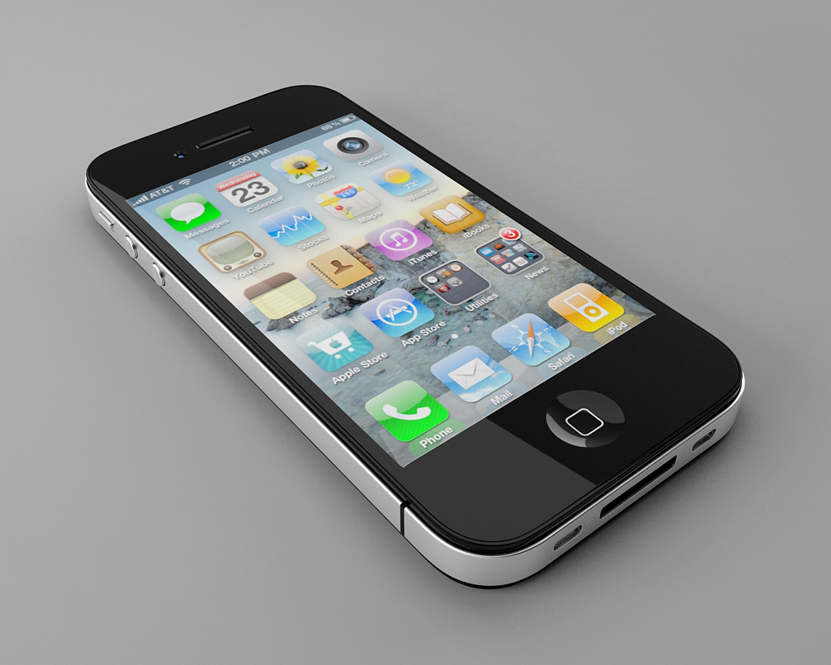
1
getting the contact size
on today’s hardware
NSValue *value = [touch valueForKey:@”_pathMajorRadius”];
float size = [value floatValue]; // size in pixels

Slide 29
2
estimate the orientation
and correcting for input

Slide 30
2
estimate the orientation
and correcting for input
Sensed
Location
Corrected
Location
Rotation
Center

Slide 31
3
calibration
people have different contact sizes
alternate
Min. Size
Max. Size
0.0
1.0

Slide 32
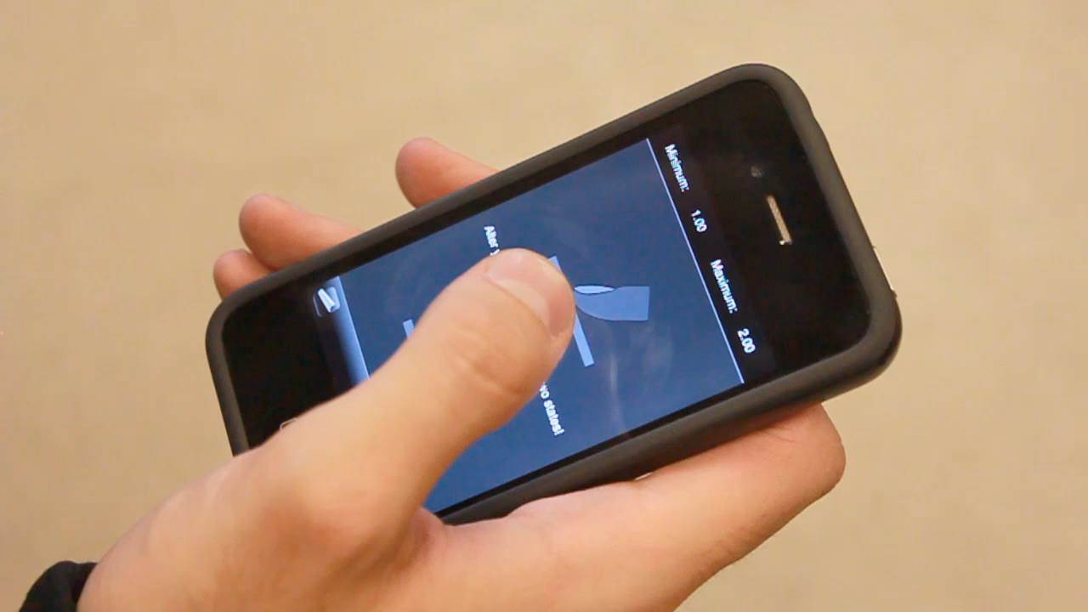
Click to play video

Slide 33
example application
using pan or zoom based on contact size

Slide 34
1
pan or zoom?
switch based on the contact size
Pan
Zoom
Min. Size
Max. Size
0.0
1.0

Slide 35
2
panning
use x,y position directly
Δv

Slide 36
2
zooming
use angular change
Δα

Slide 37
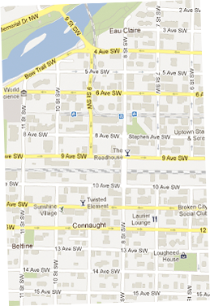
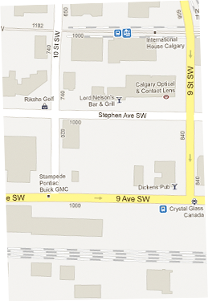
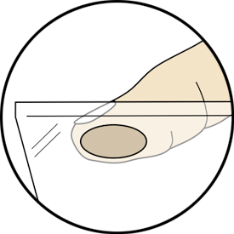
3
adjusting zoom factor
less contact size means smaller change

Slide 38
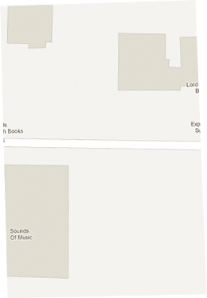

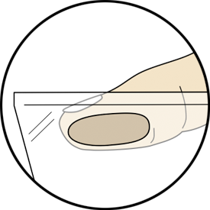
3
adjust zoom factor
more contact size means higher change

Slide 39
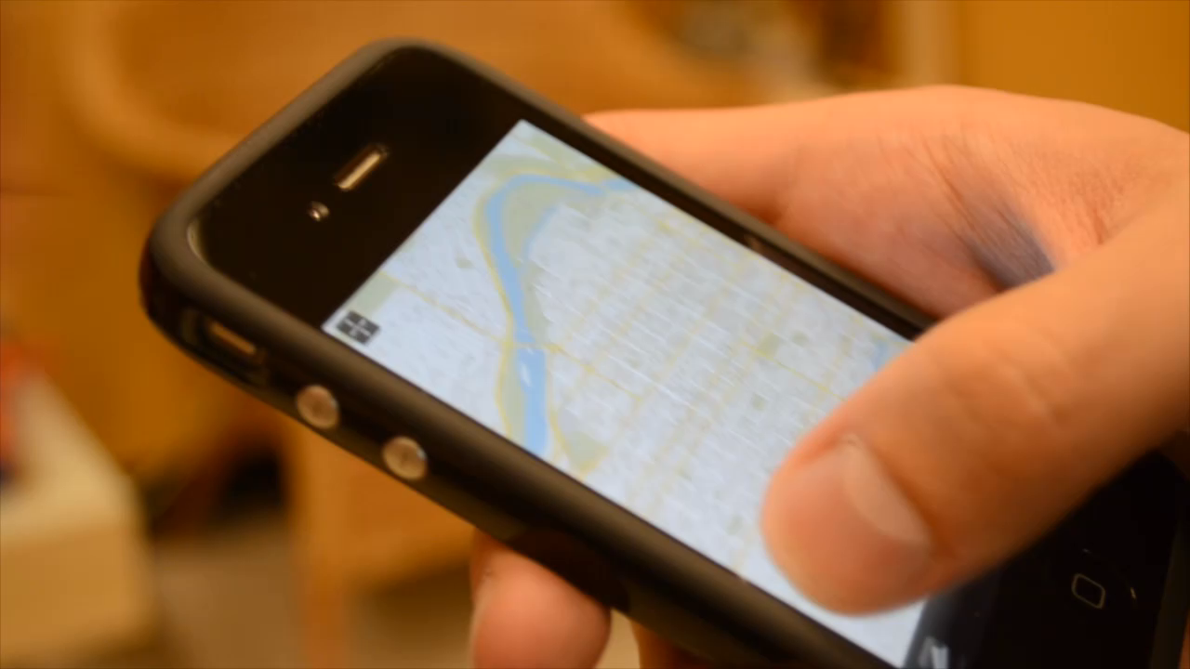
Click to play video

Slide 40
user study
aligning rectangles with the display

Slide 41
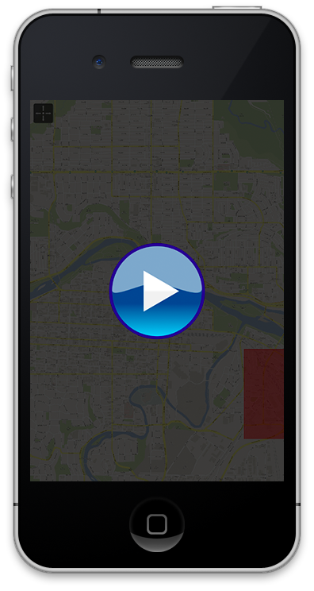
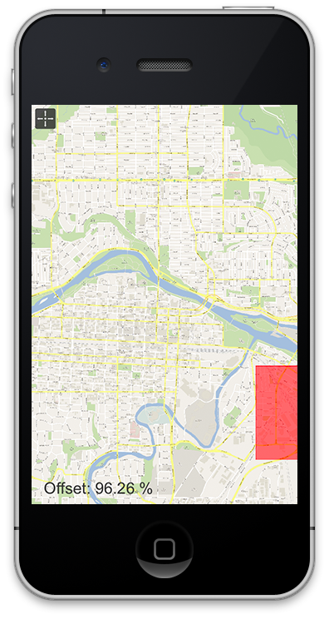
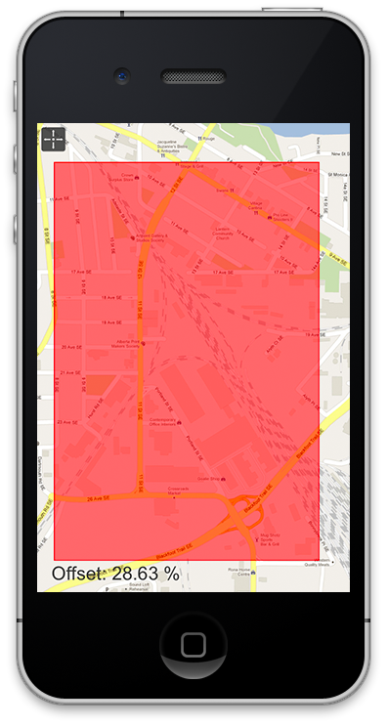
1
task

Slide 42
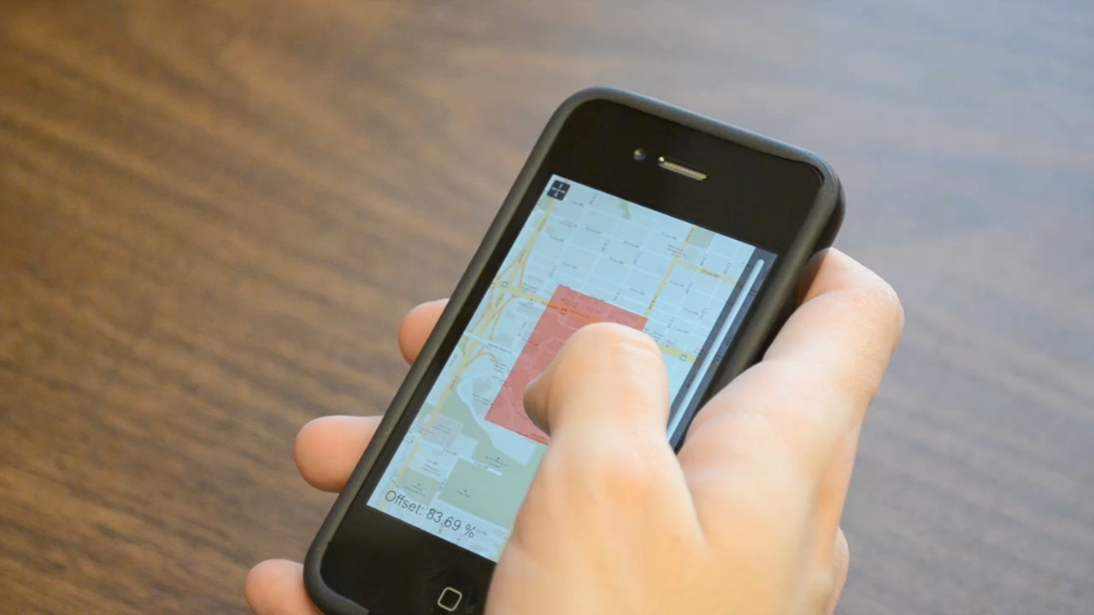
2
interfaces: slider
Click to play video

Slide 43
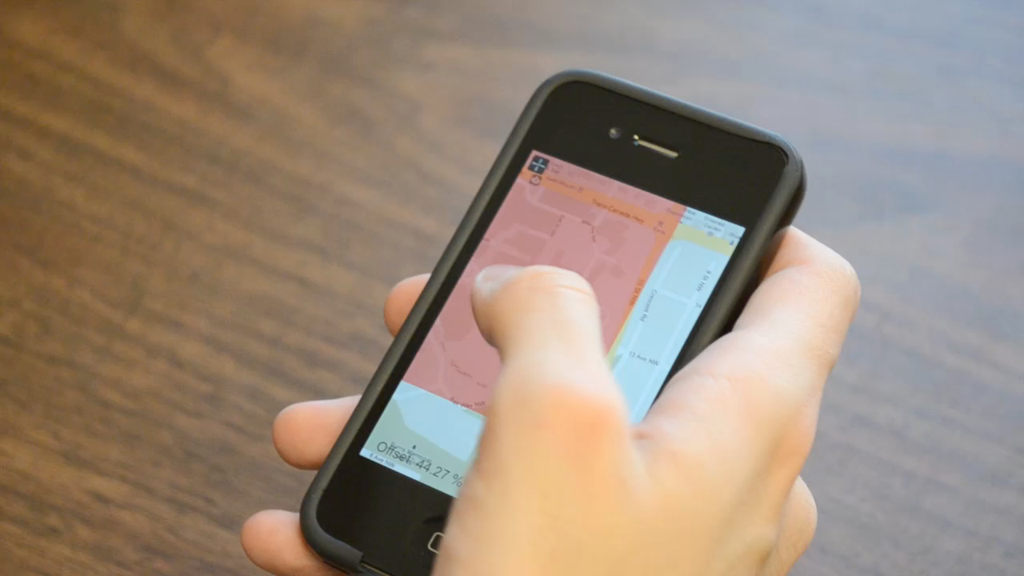
2
Click to play video
interfaces: cyclostar
CycloPan & CycloStar [Malacria et al., CHI 2010]

Slide 44
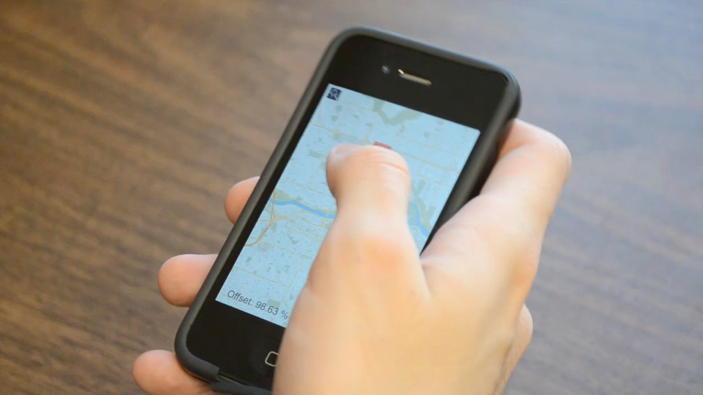
2
Click to play video
interfaces: tilt-to-zoom
Tilt-to-Zoom (Sensor Synaesthesia) [Hinckley et al., CHI 2011]

Slide 45
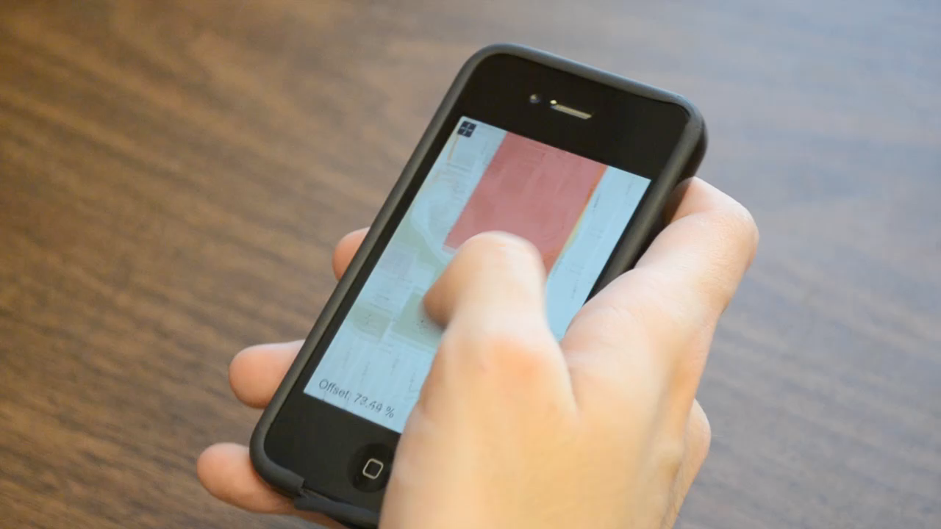
2
Click to play video
interfaces: fat thumb

Slide 46

3
target sizes
width = 1.8 cm
height = 2.7 cm
width = 1.2 cm
height = 1.8 cm
width = 0.6 cm
height = 0.9 cm

Slide 47
4
target locations
2 cm
2.25 cm
2.25 cm
2 cm

Slide 48
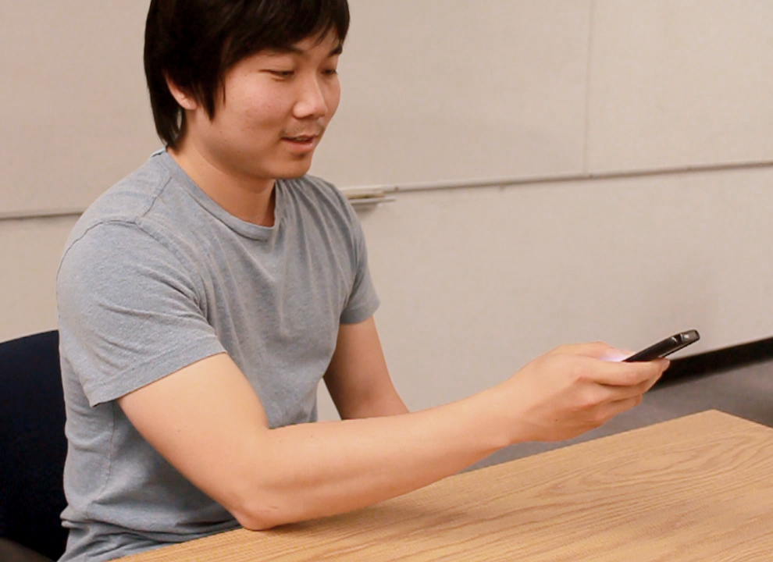
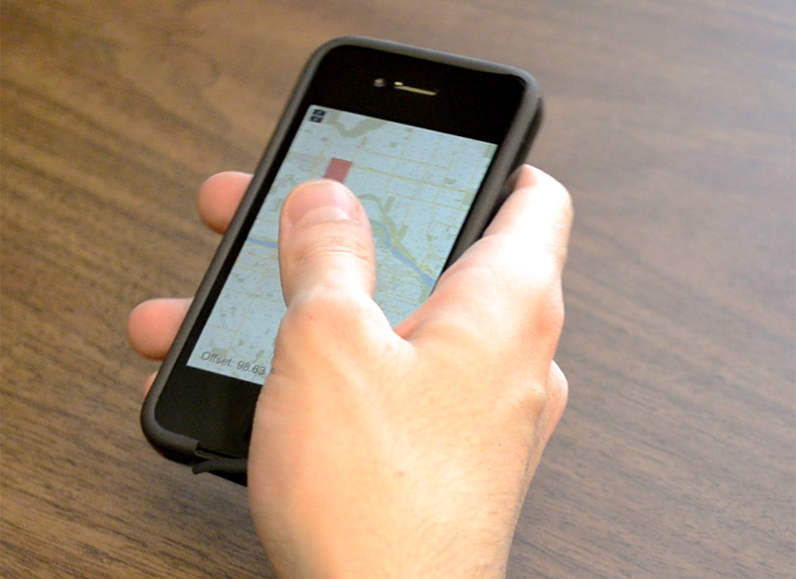
experimental design
[4 Interfaces × 3 Target Sizes × 4 Target Locations]
3 repetitions for each cell (excluding training)
16 participants (10 female)

Slide 49
hypotheses
1
Fat Thumb more accurate for small targets
2
Fat Thumb faster for small targets
3
Fat Thumb & Tilt-to-Zoom require less strokes
4
Fat Thumb is most preferred technique

Slide 50
results
offset, strokes, task time

Slide 51
offset
40%
CycloStar
Slider
Tilt-to-Zoom
Fat Thumb
30%
20%
10%
0%
Small
Medium
Large

Slide 52
offset
40%
CycloStar
Slider
Tilt-to-Zoom
Fat Thumb
30%
20%
10%
0%
Small
Medium
Large

Slide 53
number of strokes
25
CycloStar
Slider
Tilt-to-Zoom
Fat Thumb
20
15
10
5
0
Small
Medium
Large

Slide 54
number of strokes
25
CycloStar
Slider
Tilt-to-Zoom
Fat Thumb
20
15
10
5
0
Small
Medium
Large

Slide 55
number of strokes
25
CycloStar
Slider
Tilt-to-Zoom
Fat Thumb
20
15
10
5
0
Small
Medium
Large

Slide 56
task time
25s
CycloStar
Slider
Tilt-to-Zoom
Fat Thumb
20s
15s
10s
5s
task times extremely high
0s
Small
Medium
Large

Slide 57
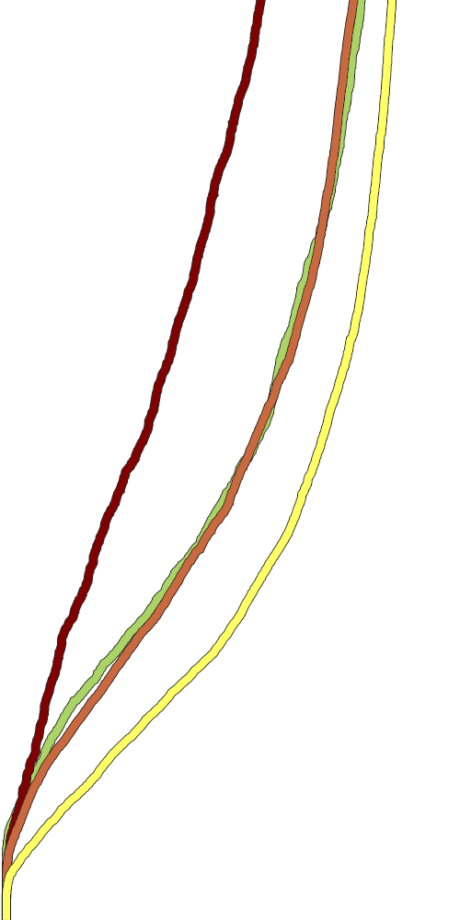


offset over time
CycloStar
Slider
Tilt-to-Zoom
Fat Thumb
5s
5s
5s
4s
4s
4s
3s
3s
3s
2s
2s
2s
1s
1s
1s
100%
80%
60%
40%
20%
100%
80%
60%
40%
20%
100%
80%
60%
40%
20%
Small
Medium
Large

Slide 58
subjective preferences
5
CycloStar
Slider
12
Tilt-to-Zoom
Fat Thumb
11
4.5
4
9
4
4
4
3
6
3
3
3
3
2
3
4
2
2
2
1.5
1
0
0
1
Finger
Fatigue
Wrist
Fatigue
General
Comfort
Preferred
Technique

Slide 59
subjective preferences
5
CycloStar
Slider
12
Tilt-to-Zoom
Fat Thumb
11
4.5
4
9
4
4
4
3
6
3
3
3
3
2
3
4
2
2
2
1.5
1
0
0
1
Finger
Fatigue
Wrist
Fatigue
General
Comfort
Preferred
Technique

Slide 60
subjective preferences
5
CycloStar
Slider
12
Tilt-to-Zoom
Fat Thumb
11
4.5
4
9
4
4
4
3
6
3
3
3
3
2
3
4
2
2
2
1.5
1
0
0
1
Finger
Fatigue
Wrist
Fatigue
General
Comfort
Preferred
Technique

Slide 61


heatmaps
where did people touch?
Slider
CycloStar
circular
motions
hard to
reach

Slide 62


heatmaps
where did people touch?
Tilt-to-Zoom
Fat Thumb
easy to
reach

Slide 63
results
1
Fat Thumb more accurate for small targets
2
Fat Thumb faster for small targets
3
Fat Thumb & Tilt-to-Zoom require less strokes
4
Fat Thumb is most preferred technique

Slide 64
next?
other applications & devices

Slide 65



1
applications
contact-size dependent speed
Tilt-to-Zoom
Fat Thumb

Slide 66
1
applications
contact-size dependent speed
Tilt-to-Zoom
Fat Thumb

Slide 67

2
tablet PCs?
the fat index finger
Tilt-to-Zoom
Fat Thumb

Slide 68
Q?
Sebastian Boring, David Ledo, Xiang ‘Anthony’ Chen,
Nicolai Marquardt, Anthony Tang, Saul Greenberg
University of Calgary, Calgary, Alberta, Canada
Email: sebastian.boring@gmail.com
URL: http://www.sebastianboring.com

