Slide 1

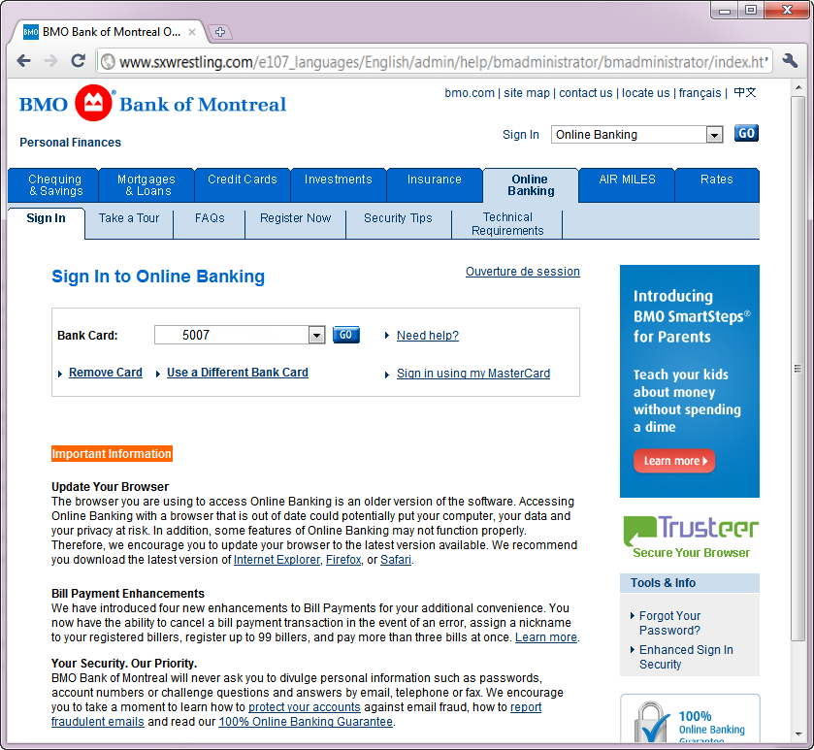
Does Domain Highlighting Help People Identify Phishing Sites?
Eric Lin, Saul Greenberg
Eileah Trotter, David Ma & John Aycock
University of Calgary
Notes:
I’m Saul Greenberg from the University of Calgary. My co-authors are…
For the next few minutes, I’m here to ask and answer a simple question:
<TITLE>

Slide 2

Phishers
Fraudsters who steal user’s credentials
Login: Saul
Password HCIisReallyCool
Bank Bank of Antarctica
Account # 3444 555 6677
Notes:
But first, for those of you who aren’t familiar with Phishing and domain highlighting, let me define some terms and show you the problem.
Phishers are fraudsters, who exploit digital means to steal your credentials.
Information includes your login names, passwords, bank account information, credit cards.
What we are talking about is identity theft, and is potentially very serious.

Slide 3
Phishing Sites
Fraudulent web sites used to steal user’s credentials
Notes:
Phishing sites are one way for fraudsters to do this.
Essentially, they create fraudulent web sites, where these sites fool you into logging into them and supplying critical information. The sites, of course, capture this critical information.

Slide 4
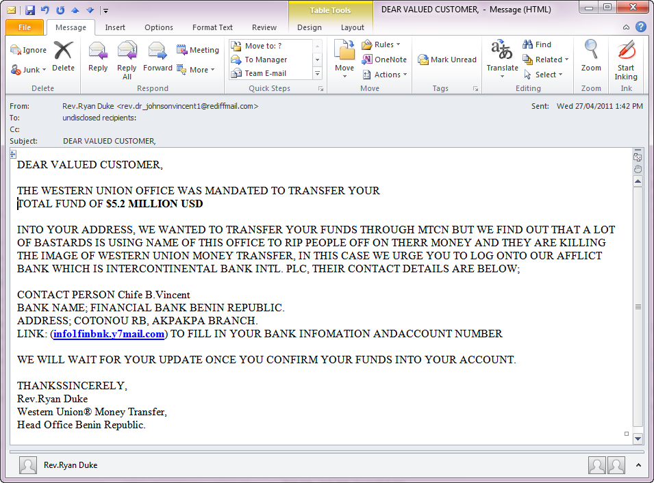
You’ve got mail
Notes:
A common way that phishers get you to their web site is via email spamming, where the message tries to get you to visit some link.
I am sure that virtually everyone in this room sees attacks like these almost daily when they read email.

Slide 5
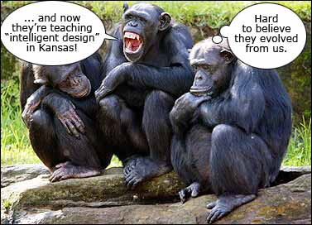
I’m way too smart for that!!!
Hah
Image modified from: http://www.briancuban.com/the-science-of-intelligent-design/
Notes:
Of course, you’re way to smart to be fooled by these kinds of emails, The all caps, the millions of dollars offered to you…

Slide 6
Delete
Notes:
So you immediately hit the delete button

Slide 7
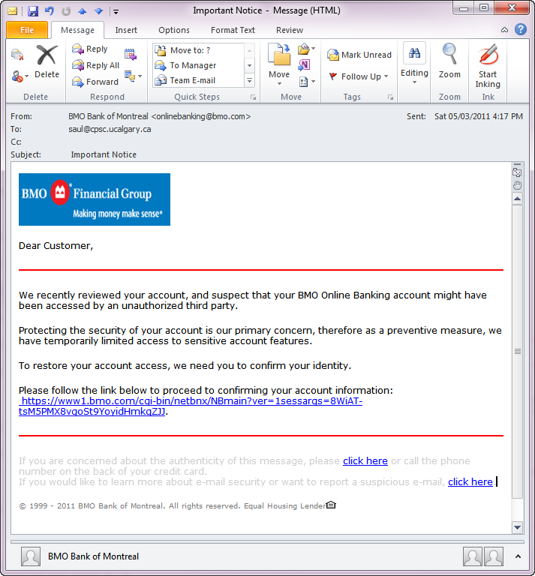
You’ve got mail
Notes:
But… phishers are getting better and better at crafting their messages. You are now probably getting emails that look more like this… good language, look and feels that match the brand, reasonable arguments…where its increasingly hard to tell what is legitimate or not.

Slide 8
Let me check
Notes:
So you, or maybe your mother, sister, friends, or children, decide to follow the link.

Slide 9
Notes:
And this is what you see. Looks good, doesn’t it?

Slide 10
Phishing site?
Notes:
But the real question, is this a phishing site or isn’t it?
Take a look at it… we’ll come back to this question shortly.

Slide 11
Notes:
I’m going to show you several sites for a few seconds each. I want you to examine it. If you are pretty certain it’s a phishing site, put up your hand.
But first lets practice.

Slide 12
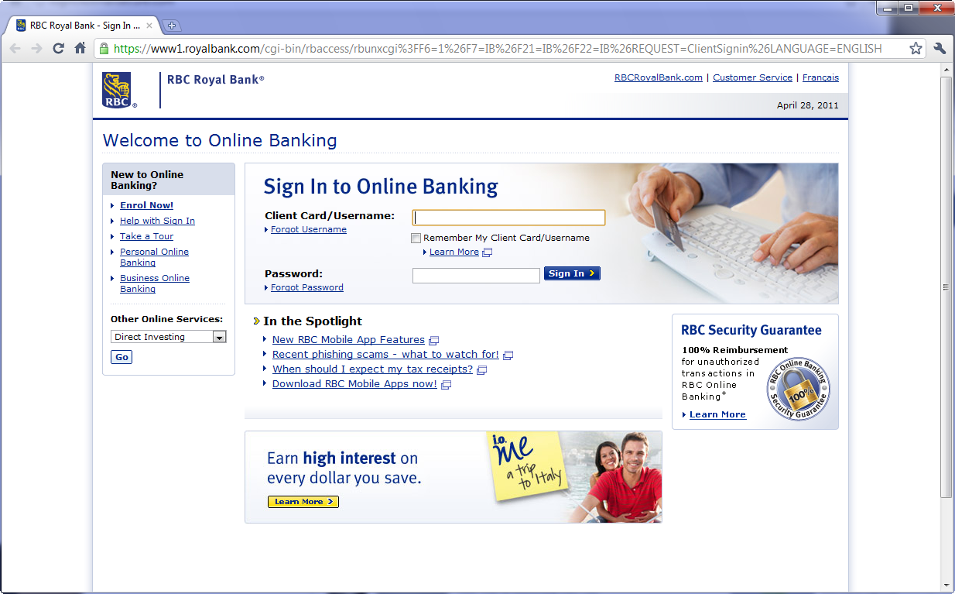
Notes:
This one claims to be the Royal Bank of Canada sign in page for online banking.
Legitimate or fraudulent? How many of you would judge this site as unsafe to enter?

Slide 13
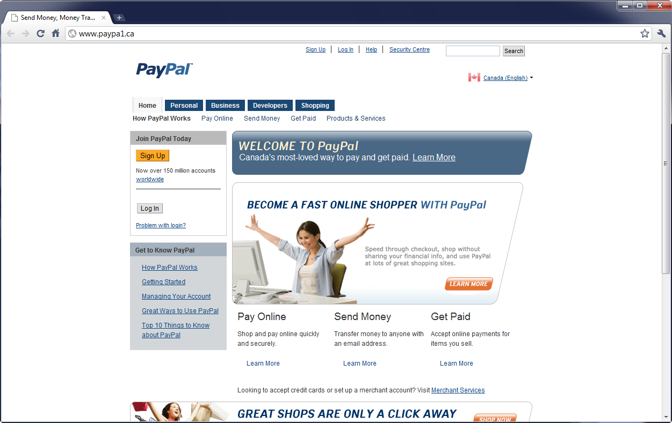
Notes:
This one claims to be Pay Pal, where you can sign up to get an account.
Fraudulent?

Slide 14
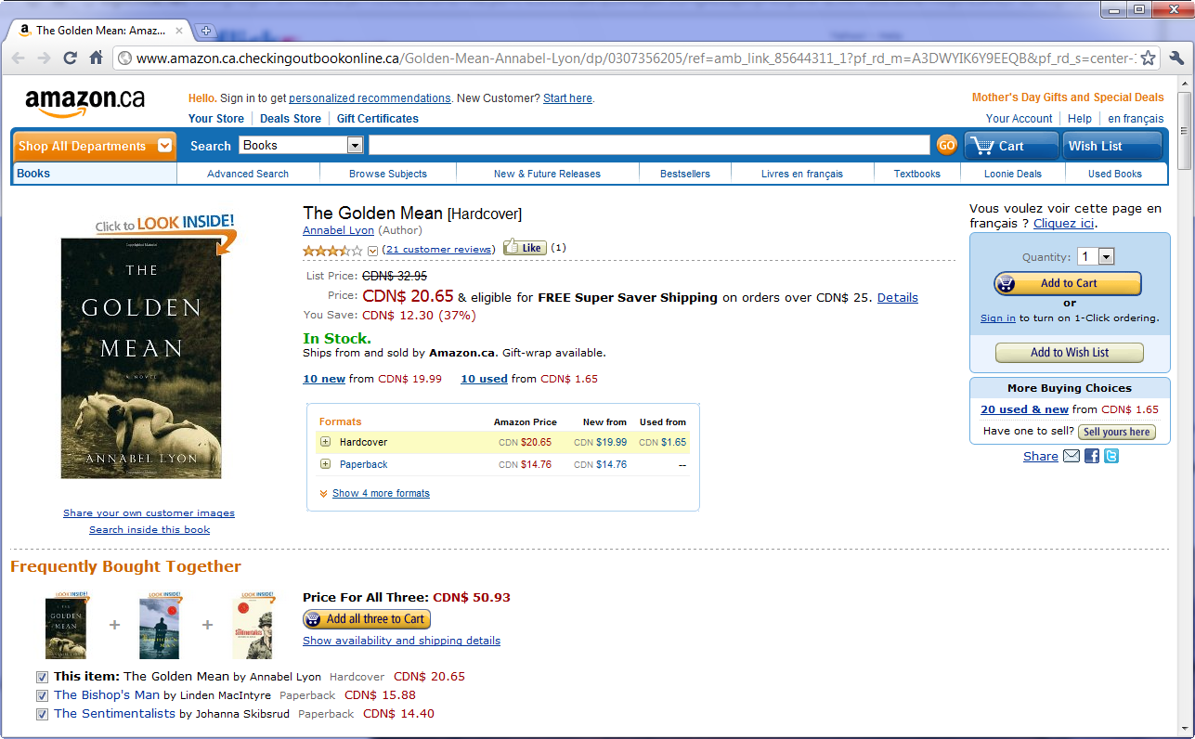
Notes:
And this one is Amazon, where you can shop and pay for books

Slide 15
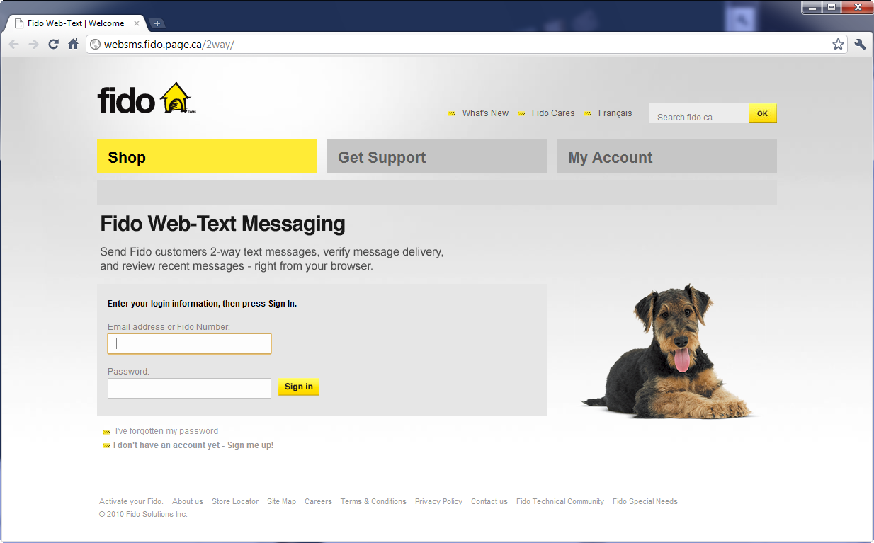
Notes:
Finally, we have the Fido login page that lets you send text messages.

Slide 16
Notes:
So… which were real, and which were fraudulent?
The answer is that its very difficult to tell, simply because Phishers are now crafting fraudulent web pages are visually identical to legitimate web page.
In fact, there is only a single difference that would hint at the answer: The domain name.

Slide 17
www1.royalbank.com
Legitimate
Notes:
Look at the address bar. If you are familiar with this bank, you would know that www1.royalbank.com was correct

Slide 18
www.paypa1.ca
Fraudulent
Notes:
Paypal is fraudulent. Here, the phisher created their own domain name which differs from the paypal name by a single letter, where they substituted a 1 for the l in pal.

Slide 19
www.amazon.ca.checkingoutbookonline.ca
Fraudulent
Notes:
But amazon looks ok… or is it? While you see the familiar www.amazon.ca in the URL, the domain name is actually checkingoutbookonline.ca which was created by the phisher.

Slide 20
Websms.fido.page.ca
Legitimate
Notes:
But even if you are phishing-savvy, its hard to tell. For example, the domain name here is ‘page’, which may make you suspicious. But its actually the correct domain name held by the PageMail service used by Fido.

Slide 21
Common URL Obfuscations
Similar name amazon.checkingoutbooksonline.ca
Letter substitution www.paypa1.com
IP addresses 192.168.111.112/login
Complex URLs www.login.xyz.flikr.net/config/login/
src-flickr.domain=secure.access
324a568x-pictauthor=frodo…
Notes:
Here are a few common ways that phishers try to fool people – even those who are aware of phishing attacks – into thinking the domain name and URL are legitimate.

Slide 22
Phishing site?
Notes:
So lets go back to our bank site… Hands up for those who think its fraudulent.

Slide 23
www.sxwrestling.com/e107_lang...
Notes:
The answer should now be obvious, as this phisher didn’t even try to use a good domain name spoofing method.

Slide 24
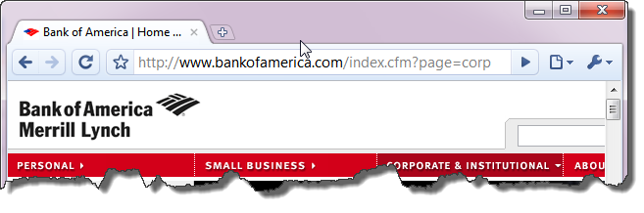
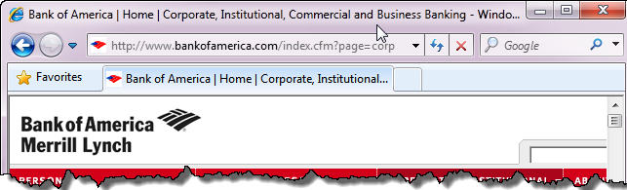
Domain name highlighting
Notes:
Vendors of Web browsers know all about phishing. One of the methods they use is called Domain name highlighting, where the browser highlights the domain name to make it easier for the user to see and visually inspect it.
At the top, we see how Google Chrome does it: everything after the http: up to the end of the domain name is in black, with the rest of the URL in faded gray.
At the bottom is Internet explorer: the only different is that Explorer also mutes the www prefix.

Slide 25
Does it work?
Notes:
The question is,

Slide 26

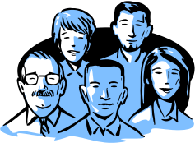
Method
16 legitimate & fraudulent real web pages
4 different obfuscation methods used
22 participants
Phase 1. Rate safety of these web pages
Phase 2: Look at address bar for additional cues
Redo safety ratings.
Notes:
Answering this question is what our study was all about.

Slide 27
‘Best case’ for domain highlighting
Participants
heavy internet users, university educated
heightened sense of security
rating security, not browsing, was primary task
directed to look at address bar (phase 2)
BUT
not instructed about domain names
Notes:
One thing to stress is that our methodology will produce the ‘best case’, or upper bound, of people’s ability to judge web page safety.
Unlike most real life browsing situations, participants were…
Whatever our results, we would expect real world performance to do worse than what we find.

Slide 28
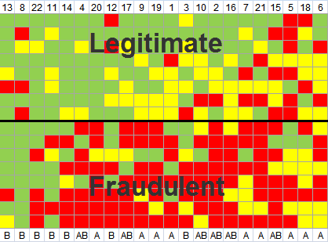
Phase 1
most
correct
least
correct
participants
Notes:
This graphic highlights our results for Phase 1, where participants were just told to visually inspect the web page.
Because I will use this graphic quite a bit, let me explain it to you.
The top part contains their ratings of legitimate pages, while the bottom is their ratings of fraudulent pages.
Green boxes are correct ratings, yellow is when they weren’t sure, and red is when they were wrong.
Each column is a user, where users are sorted by the most correct on the left to the least correct on the right.

Slide 29
Phase 1
Legitimate pages
  54% correct
  31% unsure
  15% incorrect
Notes:
So what does this tell us? If we look at legitimate pages, we see lots of green, a good amount of yellow, and only a modest mount of red. The actual numbers are on the left.
We also see that some people are much better than others: the ‘bad’ decision makers on the far right mis-rated the majority of legitimate pages as fraudulent.

Slide 30
Phase 1
Legitimate pages
  54% correct
  31% unsure
  15% incorrect
Consequence
doesn’t enter legitimate site
Notes:
But what is the consequence of being wrong? If you think this legitimate page was fraudulent, or even if you were unsure, you may not enter this site. This is usually an inconvenience but it doesn’t lead to identity theft.

Slide 31
Phase 1
Legitimate pages
  54% correct
  31% unsure
  15% incorrect
Fraudulent pages
  25% correct
  18% unsure
  57% incorrect
Notes:
Now let’s look at the fraudulent pages.
In this case, we see way more red, where fully 57% incorrectly rated a fraudulent web page as legitimate. If you then add in the yellow – how many people were unsure – then only 25% of these pages were correctly identified as fraudulent.

Slide 32
Phase 1
Legitimate pages
  54% correct
  31% unsure
  15% incorrect
Fraudulent pages
  25% correct
  18% unsure
  57% incorrect
Consequence
enters site,
vulnerable to identity theft
Notes:
This is pretty serious, as the consequence of thinking a phishing page is legitimate means the user is likely to enter the site, which makes them extremely vulnerable to identity theft.

Slide 33
Don’t be a fool,
look at the address bar!!!
Notes:
But maybe the problem is that users didn’t know to look at the address bar. They only looked at the web page content.
So in phase 2 we asked them to look at the address bar and redo their ratings.

Slide 34
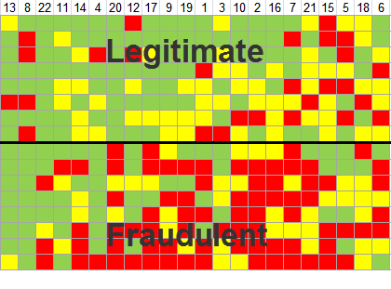
Phase 2
Notes:
Here are our results for phase 2.

Slide 35

Phase 1
Notes:
We can flip it back and forth with the phase 1 results to highlight the differences.
But a better way is to just show you the differences

Slide 36
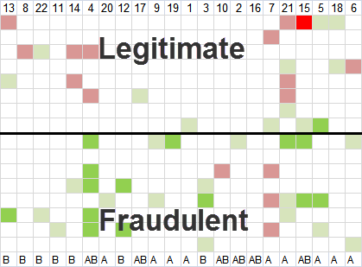
Phase 2 changes
Changes
  more correct
  unchanged
  more wrong
Notes:
This graphic compares how and where people changed their decision between Phase 1 and Phase 2.
White cells are those where people did not change their decision.
The greener the color, the more they changed their incorrect rating to a correct one.
The redder the color, the more they changed their correct rating to an incorrect one, that is, they added to their errors.
Overall, you should get the sense that looking at the address bar didn’t really change the story very much.

Slide 37
Phase 2 changes
Legitimate pages
  no significant
  differences in
  overall ratings
Notes:
Lets dive into a bit more detail.
For legitimate pages, there was no significant difference in overall ratings. That is, while they did change some of their ratings, the overall frequencies stayed the same.

Slide 38
Phase 2 changes
Legitimate pages
  no significant
  differences in
  overall ratings
Fraudulent pages
  25→34 % correct
  18→23% unsure
  57→44 % incorrect
Notes:
For fraudulent pages, people were making better guesses. But this improvement is marginal, as only 1/3 of the pages were correctly identified as fraudulent. Remember, this is likely the upper bound, or the best case, of how people will do!

Slide 39
Phase 2
Legitimate pages
  no significant
  differences in
  overall ratings
Fraudulent pages
  25→34 % correct
  18→23% unsure
  57→44 % incorrect
Consequence
Somewhat better, but still vulnerable to identity theft

Slide 40
How do people judge legitimacy?
Institutional brand
    some brands considered more ‘trustworthy’
The page
    content including professional layout
    reviews suggesting others had visited it
    security / privacy information
Information requested
    sensitivity, quantity…
Address bar
    URLs
    security indicators
Notes:
If people didn’t look at domain names to determine safety, what did they look at? During exit interviews, we asked participants this question and coded the results via qualitative means.
Primarily, four factors came into play.
Brand and Brand familiarity e.g., banks are ‘more secure’, familiar brands are more trustworthy
Page content: all the stuff displayed in the browser.
Security / privacy – any visual that suggested it was ‘safe’ or that the site was somehow protecting you. E.g., a ‘verified by visa’ icon.
Information requested. Whether the particular information and quantity of information requested was somehow out of line with norms.

Slide 41
Typology of Users
Type A
    content and brand
Type B
    address bar, security indicators, information requested
Type AB
    mostly like Type A
    occasionally like Type B
Notes:
Importantly, people roughly fell into 3 categories of how they used this information to judge safety.
Type A made their judgements almost entirely on ..d
Type B made judgements mostly on….

Slide 42
Type B
B
B
B
B
B
B
B
AB
AB
AB
AB
AB
AB
A
A
A
A
A
A
A
A
A
Type A
most
correct
least
correct
participants
Notes:
We also found that our user types are roughly correlated with their abilities.
Lets revisit our phase 1 graph. Remember that the columns ordered participants from most correct on the left to least correct on the right. Now look at the bottom. We see moreT ype Bs on the left – i.e., those who scrutinized the address bar and other security indicators. Type As tend to be more on the right, with AB scattered around these.
But even so, we have to stress that even some of our type Bs had a large number of wrong ratings.

Slide 43
Summary
Good news for phishers!
  phishing web sites work
  domain name highlighting only works somewhat
    best case: only ¼ - ⅓ of phishing pages detected
Phishers can target specific user groups
  Type A & A/B
    very high risk for perfectly copied pages
  Type B
    you can still fool them
    domain name obfuscation works even better

Slide 44
Summary
Good news for anti-phishing researchers!
    lots to do: the phishing problem isn’t solved
Strategies?
    education
    UI redesign
      to get people to attend domain name
      to highlight common spoofing methods within the domain name
      …

Slide 45
Does Domain Highlighting Help People Identify Phishing Sites?
Somewhat, but not enough

