Slide 1
Communication, Collaboration, and Bugs:
The Social Nature of Issue Tracking in Small, Collocated Teams
Notes:
Hi, my name is Dane Bertram, and today I’ll be presenting a paper I wrote along with Amy Voida, Saul Greenberg, and Robert Walker while we were all at the University of Calgary, however, Amy is now at the University of California Irvine, and I am now working for Fog Creek Software in New York. Our paper is entitled:
Communication, Collaboration, and Bugs: The Social Nature of Issue Tracking in Small, Collocated Teams.

Slide 2
What makes this interesting?
Small, collocated teams use issue trackers to support communication and collaboration both inside and outside their immediate teams despite these tools not being explicitly designed to do so.
Notes:
So what makes the social dynamics surrounding issue tracking within small, collocated teams interesting from a CSCW perspective? Well, it’s interesting because…
[click]
Small, collocated teams use issue trackers to support communication and collaboration both inside and outside their immediate teams despite these tools not being explicitly designed to do so.
To help illustrate this, we’ll start with an example…

Slide 3
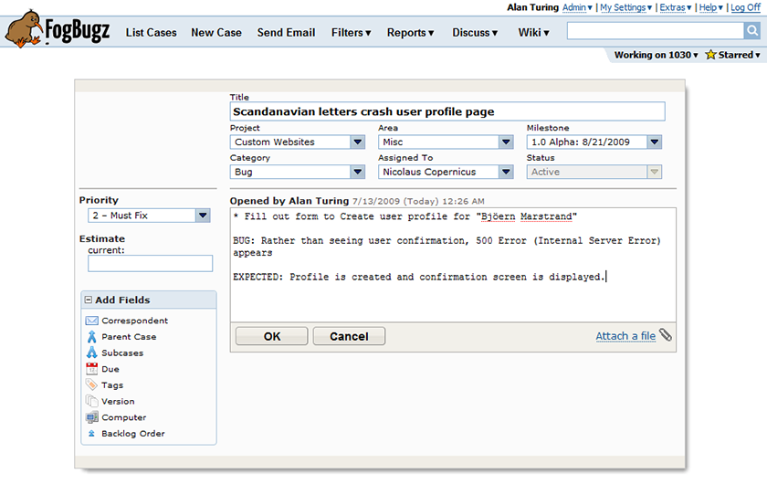
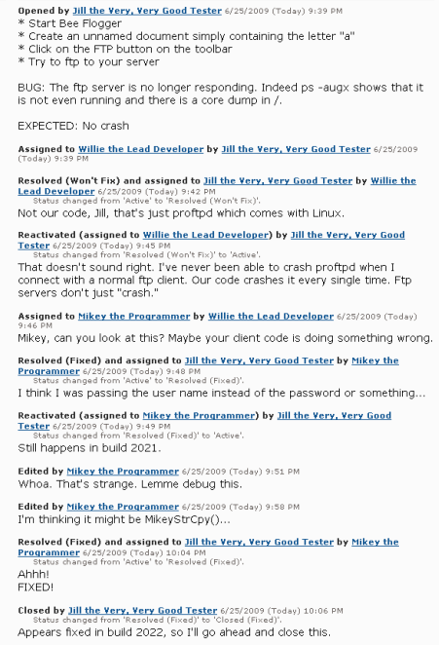
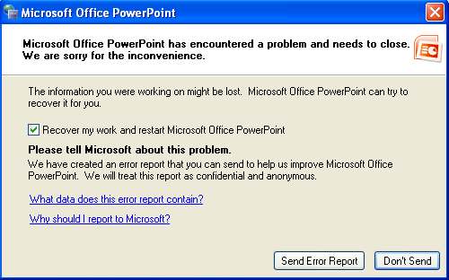
What is issue tracking?
Notes:
So issue tracking, on the surface, is primarily about keeping track of bugs.
[click] …so things like this, for example.
But once you click on that “Submit error report” button or someone explicitly goes to file a bug against a piece of software, they (and the development teams that work on these cases) are quickly met with interfaces that look like this.
[click]
And as you can see, these types of input entry forms illustrate just how largely issue trackers have been traditionally viewed as relatively simple databases. There are a bunch of fields of various types associated with every case that gets filed, and these all get stored in some big database for people to query against in various ways.
And that’s all fine and good, but the problem with this relatively simplistic view of issue tracking systems is that it glosses over an important (if not fundamental) aspect of their functionality; which is to serve as a communication and coordination tool that facilitates the process of developing software systems with other people.
As we can see, even in this relatively short example, the comment or description field of the cases that live in these systems very quickly becomes overloaded. There’s lots of back-and-forth of ownership, changes in priority, discussion of possible workarounds, etc. And what this helps illustrate, is our need to re-focus our examination of these systems in order to take into account the social dynamics that surround them.
Now what does the process of software development look like from the perspective of the issue tracker? …

Slide 4
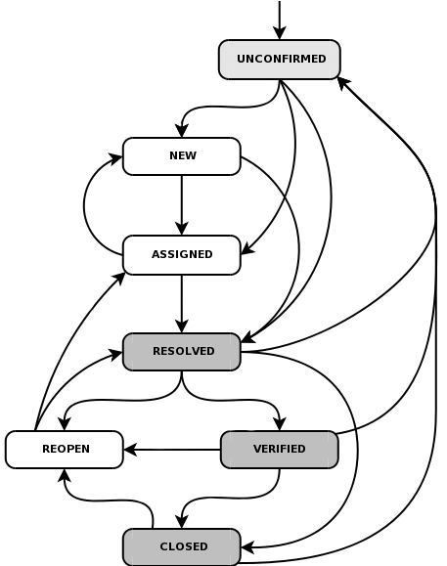

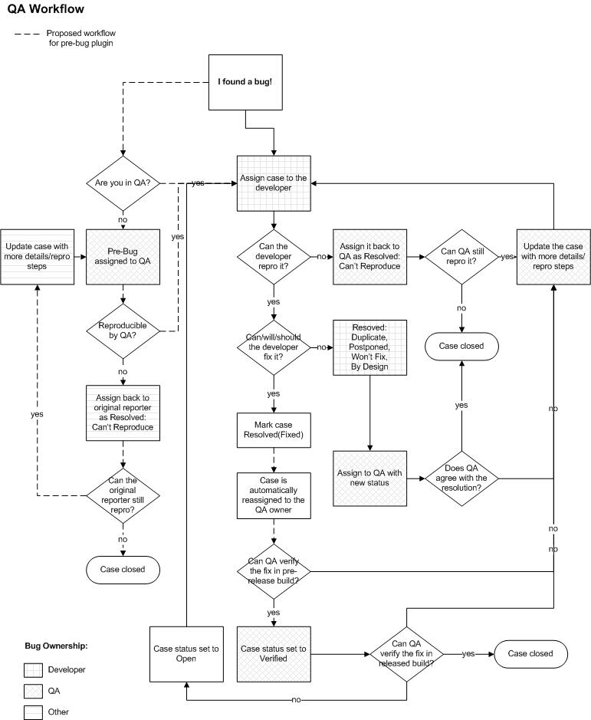
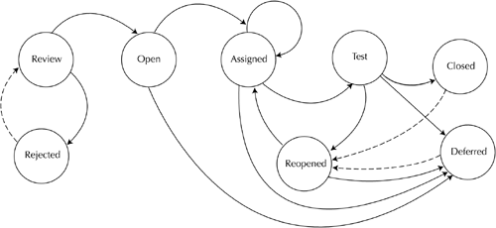
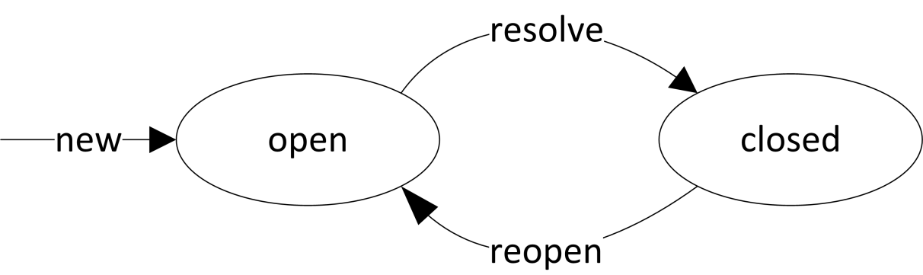
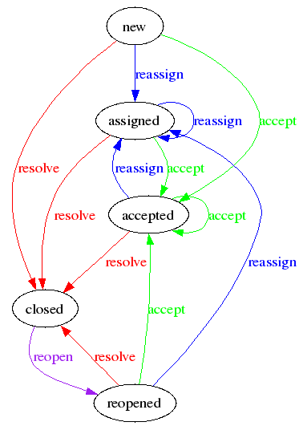
What is issue tracking? (cont.)
What if the issue is a duplicate?
What if I can’t reproduce the problem?
What if that’s how it’s supposed to work?
When/how does this bug get checked by QA?
…
Notes:
Well, in an ideal world, it might look something like this state diagram. Once an issue has been created it enters an “open” state and then at some point it ideally follows the “resolve” transition to end up in a “closed” state. If it turns out the bug was not actually fixed, it can then follow the “reopen” transition to end up back in the “open” state.
…but in practice, the realities of software development quickly begin to rear their ugly heads.
[click]
How do we handle things like…duplicate cases or bugs we can't reproduce? And how do we make sure that the bugs we “fix” actually get tested by the QA team before we ship the next version of our software?
[click]
All of these things lead to issue tracking systems having much more flexible, but also much more complex workflows. So this is more like what’s going on in the real world, and even that isn’t what’s actually going on.

Slide 5
What’s already been done?
Social aspects of software development & dev tools:
  Perry et al. ‘94, Kraut & Streeter ‘95, Ye ‘06,
  LaToza et al. ‘06, Grinter ‘95, Fitzpatrick et al. ‘06, etc.
Studying issue tracking systems specifically:
  Sandusky & Gasser ‘05, Bettenburg et al. ‘08,
  Anvik et al. ‘06, Fenton & Neil ‘99, Carstensen et al. ‘95
Notes:
Now, when we look at the related work, we see essentially two large categories or research. One that has explored the social aspects of software development in broader strokes, and another that has examined issue tracking systems specifically. The gap that our work helps to fill however, lies in the in-depth investigation of the communication and coordination dynamics surrounding issue tracking systems, and in our case, specifically within small, collocated teams.

Slide 6
What’s already been done? (cont.)
If we want to understand and improve coordination dynamics we need our bug histories to include the social, political, and otherwise tacit information that is also part of the bread and butter of software development. This is often subtle, not always apparent, and it must be read between the lines of the evidence collected.
— Aranda & Venolia ‘09
Notes:
Other more recent work that has brought attention to this niche is that of Aranda & Venolia, who say that…
[click]
If we want to understand and improve coordination dynamics we need our bug histories to include the social, political, and otherwise tacit information that is also part of the bread and butter of software development. This is often subtle, not always apparent, and it must be read between the lines of the evidence collected.
And it was precisely these coordination dynamics we looked to explore, albeit with the added focus of specifically examining small, collocated teams. To better understand the coordination dynamics within these teams, we conducted a qualitative study…

Slide 7
Qualitative Study Design
Small, collocated, industrial development teams
3 roles within the immediate development team
  Developer/Dev Lead
  Quality Assurance/Tester
  Project/Product Manager
Variety of tools used for issue tracking purposes
Notes:
When designing our study, we decided to focus on small, collocated, *industrial* development teams. We targeted industrial teams because these teams exhibit professional cultures whose processes and practices had been developed and refined over time. And “industrial” as we’re using it here, means teams that work directly on the production, or customization and maintenance of, a software product that is used by clients in a professional or commercial setting.
So, for example, this would include “IT staff” programmers at a university, but excludes laboratory settings such as researchers or students making prototype software as part of their research.
We also decided to target 3 specific roles within the immediate development team due to their frequent, intimate interaction with the issue tracker: developers/dev leads, quality assurance personnel or testers, and project or product managers.
Finally, we also wanted to sample at least some of the variety of tools being used in industrial settings for issue tracking purposes.

Slide 8
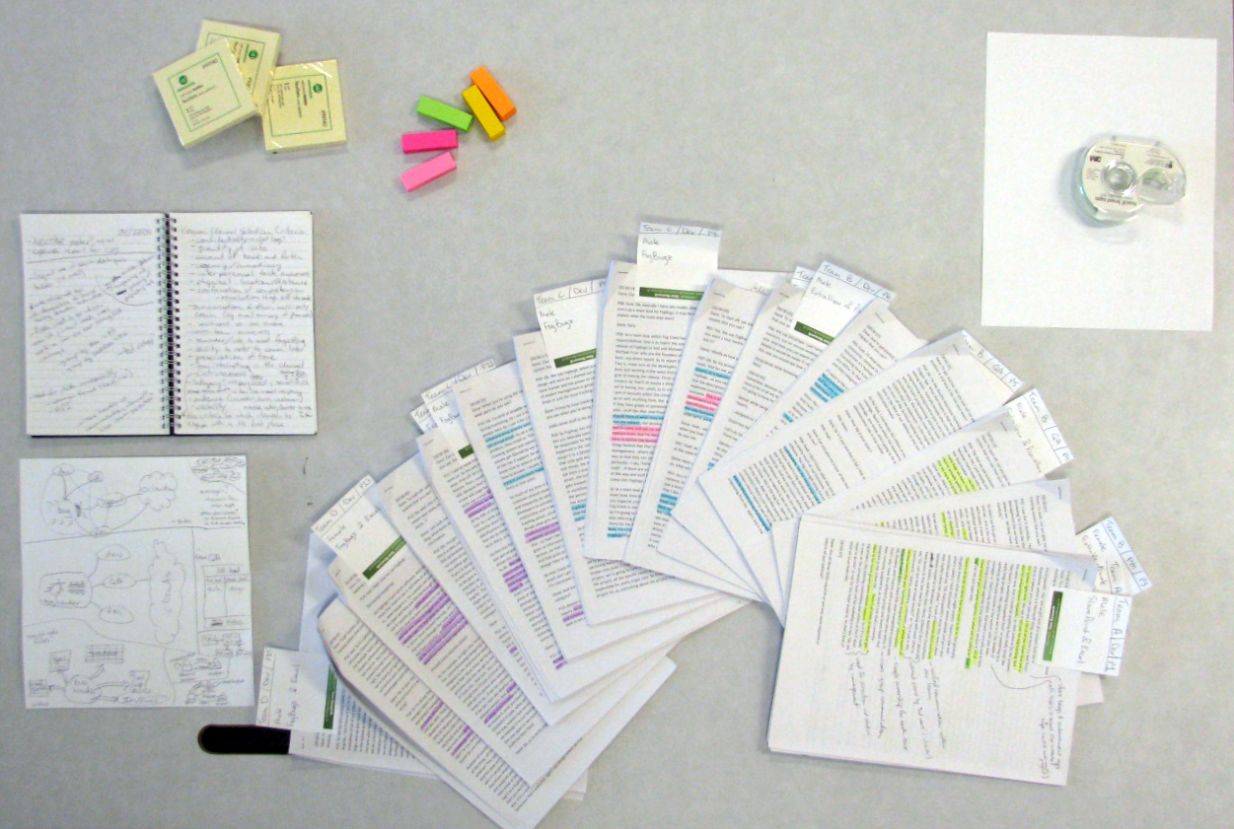
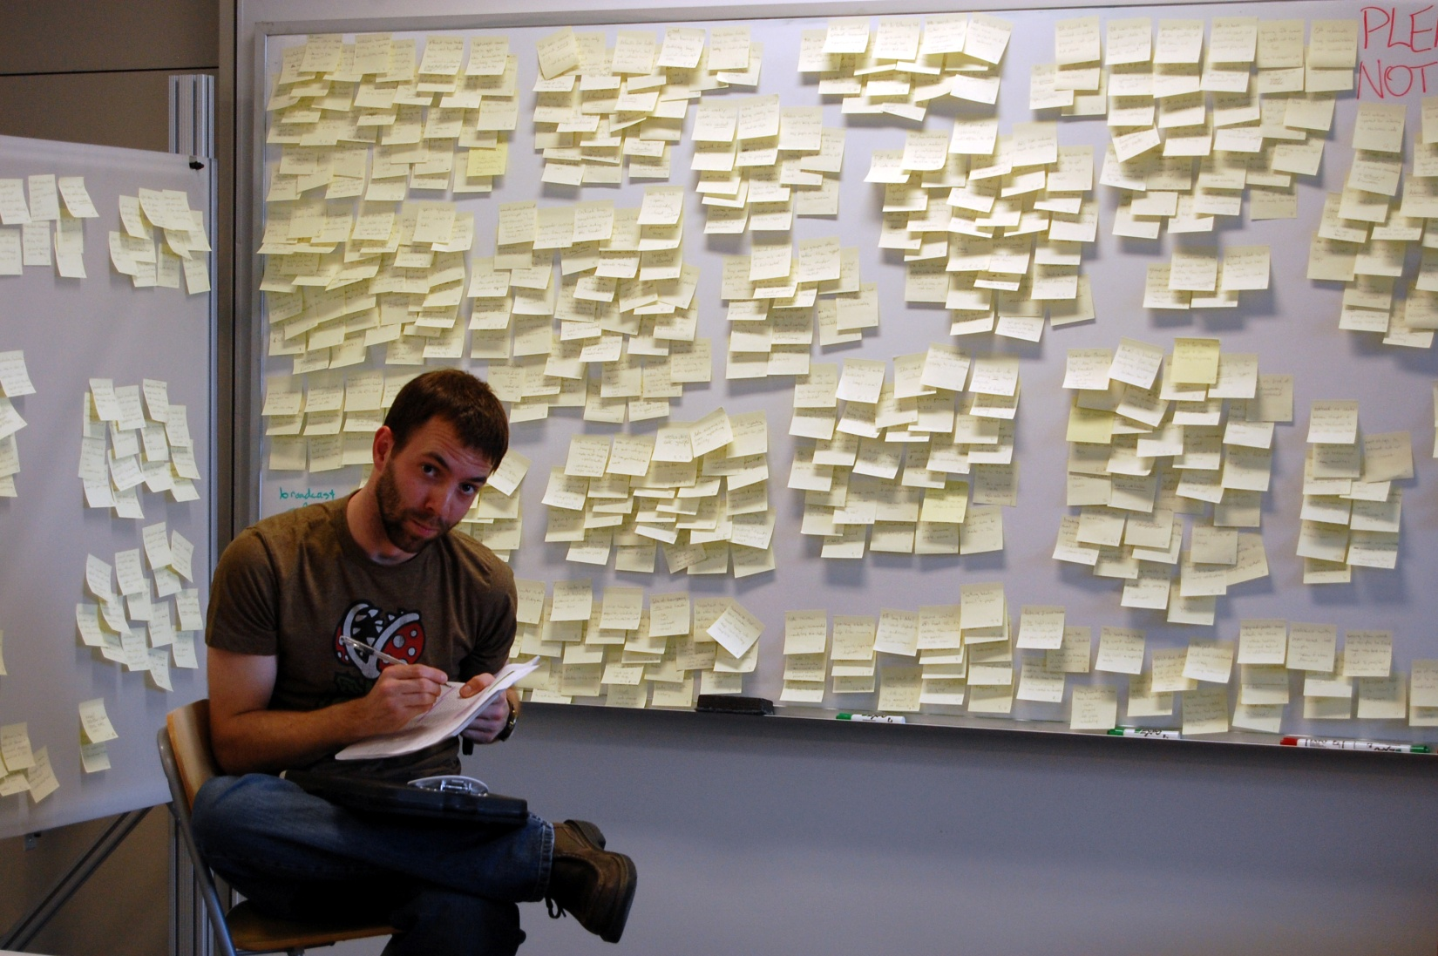
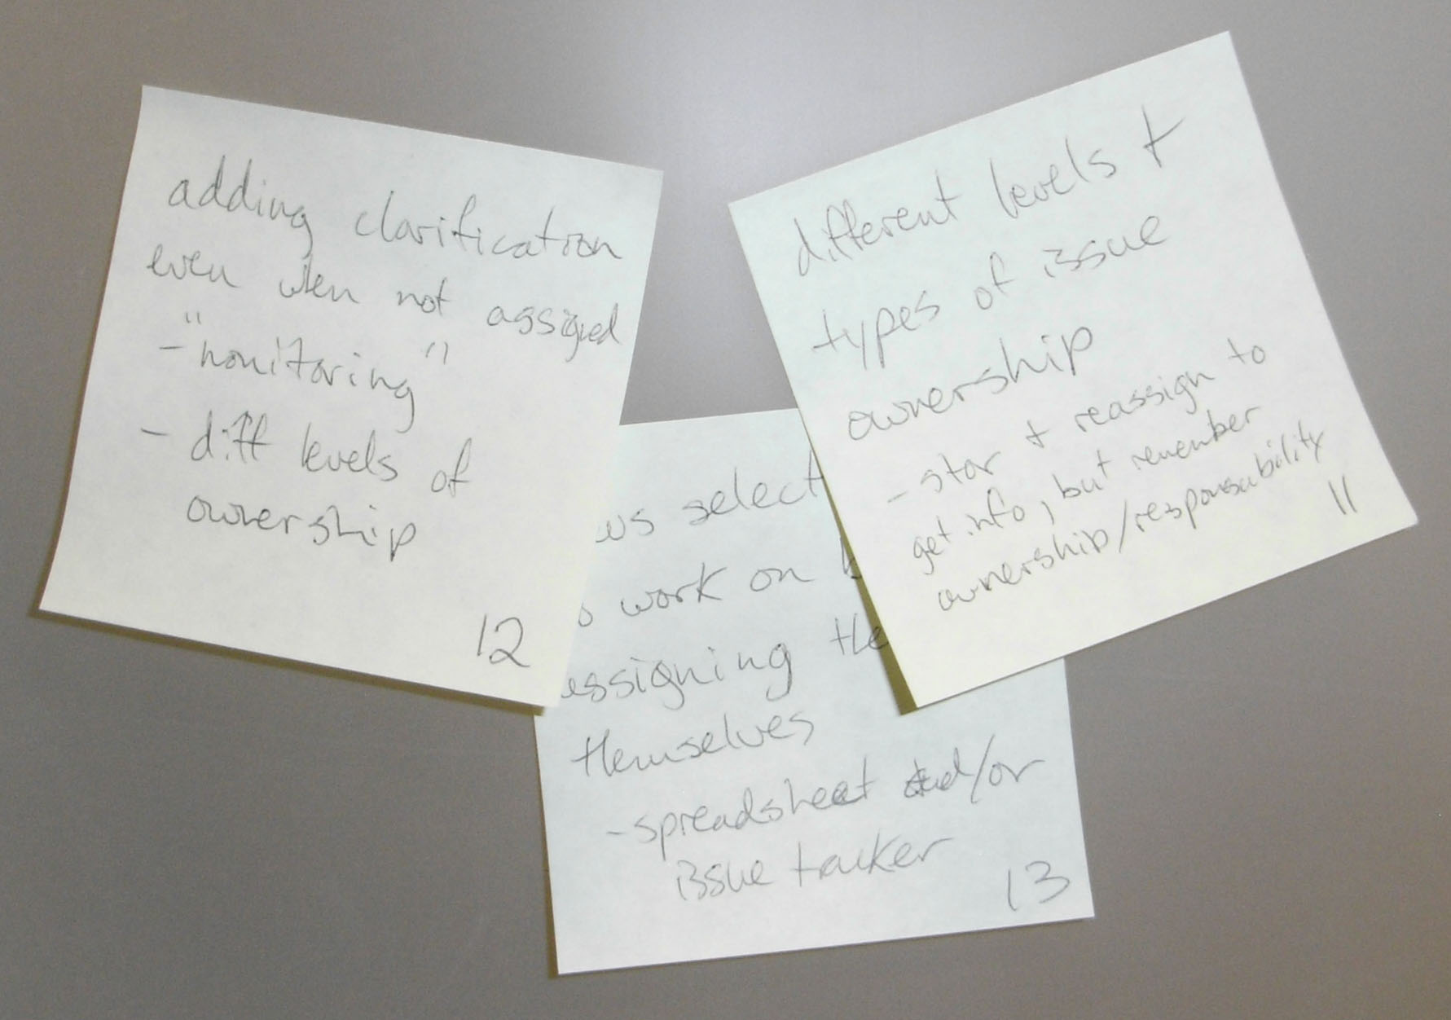
Data Collection & Analysis
Collection
4
15
21
~130
334
100s
Different issue tracking tools
Participants spread across 4 organizations
Hours of audio (semi-structured interviews)
Hours spent transcribing (probably more)
Pages of transcripts (1” margins, single-spaced)
Sticky notes used for affinity diagramming
Shades of Ownership: Yours, Mine, or Ours?
Analysis
Notes:
When we conducted our study, we ended up sampling 4 different tools (Microsoft Sharepoint, Microsoft Excel, ExtraView, and FogBugz).
We interviewed 15 participants spread across 4 different organizations: a team within a university’s IT department, a product team within a gaming company, a commercial issue tracking system vendor, as well as a team writing the software that supported a hardware large display product. In total, we recorded over 21 hours of semi-structured interviews.
[click]
Our analysis phase began by creating detailed…painstakingly detailed…transcripts of this interview data. I’m sure those of you that have done these know just what an incredible amount of work is involved here.
[click]
Once this was completed, we used an open coding technique where we generated concepts inductively from the data.
[click]
We then used affinity diagramming to group these terms as they bubbled up from the data.
[click]
And here you can see a close-up of one of the forming clusters that we later used to pull out representative quotes from the data and became one of the sub-sections of our paper…
[click]
Shades of Ownership: Yours, Mine, or Ours?

Slide 9
Overview of Results
Through our study and analysis we…
  Articulated 4 roles issue trackers played within our participant development teams
  Described 6 areas related to issue tracking where team member perspectives differed
  Identified 7 considerations for the design of issue tracking and software development coordination tools
Notes:
Through our study and analysis we…
[click] Articulated 4 roles issue trackers played within our participant development teams
[click] Described 6 areas related to issue tracking where team member perspectives differed
[click] Identified 7 considerations for the design of issue tracking and software development coordination tools.
Due to time constraints though, I will be deferring to the paper for the details of the design considerations.

Slide 10
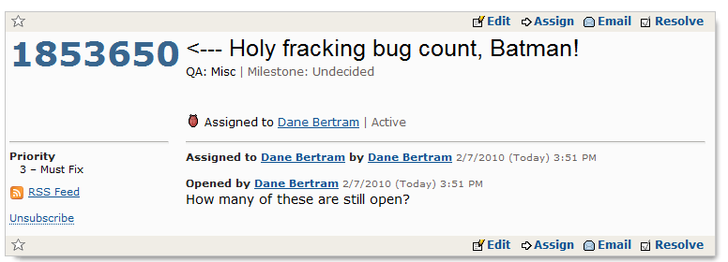
Roles of the Issue Tracker
Issue Tracker as…
Knowledge Repository
We’ve had this thing for 8 years, starting from case 1, and now we’re at 1,354,487 cases. All these little bits… little bits of insight and little bits of things are in there and you can search them. … It has been really valuable for us, and in the future it’s just going to grow and grow and be more valuable.
—P08, Dev Lead
Notes:
One of the first roles we identified was that of a knowledge repository. Issue trackers are first and foremost a bug database [click], but they are seen as being much more than that by those who use them on a day-to-day basis.
[click]
As participant 8, a dev lead said…
We’ve had this thing for 8 years, starting from case 1, and now we’re at 1,354,487 cases. All these little bits… little bits of insight and little bits of things are in there and you can search them. … It has been really valuable for us, and in the future it’s just going to grow and grow and be more valuable.

Slide 11

Roles of the Issue Tracker
Issue Tracker as…
Stakeholders’ Boundary Objects
Organization/customer boundary
Dev Team
Customers
Notes:
Issue trackers and the issue contained within them also often became boundary objects among the various stakeholders involved in the software development process; that is, as described by Star & Griesemer, “they have different meanings in different social worlds but their structure is common enough to more than one world to make them recognizable, a means of translation.”
One example of this is how the issue tracker often straddled the organization/customer boundary. Customers generally viewed the issue tracker as a means for monitoring the status of any bugs they had filed with the company using the tracker, while the development team saw the issue tracker as an almost living embodiment of the progress their product was making toward the next upcoming release.

Slide 12
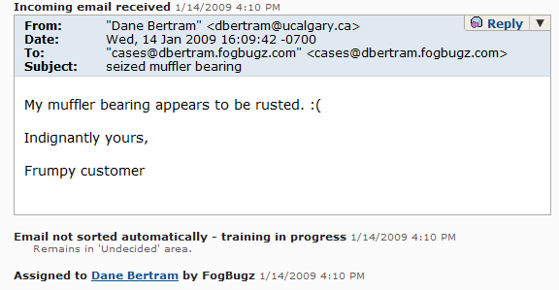
Roles of the Issue Tracker
Issue Tracker as…
Communication & Coordination Hub
You’re not going to be able to do it in your head or in files or in multiple emails that are being sent to all these different people…they’re not connected. … If it’s in this one central place that other people can see, maybe there’s a chance for it to get fixed twice. Not just fixed once for the customer we fixed it for, but fixed for all the customers.
—P08, Dev Lead
Notes:
Another role the issue tracker played for the teams we interviewed, was one of being a communication and coordination hub.
[click]
The ability of issue trackers to integrate with email and otherwise tie together many different communication channels was greatly valued by their users.
[click]
As one of the dev leads we interviewed said…
You’re not going to be able to do it in your head or in files or in multiple emails that are being sent to all these different people…they’re not connected. … If it’s in this one central place that other people can see, maybe there’s a chance for it to get fixed twice. Not just fixed once for the customer we fixed it for, but fixed for all the customers.

Slide 13
Roles of the Issue Tracker
Issue Tracker as…
Communication Channel
Ok, so in that specific case I would use [the issue tracker] for sure because then there’s a record of the communication with the bug, which is where I want it anyway. Like, if I ask someone separately in a different way than I am just going to write it in the bug anyway.
—P07, Quality Assurance
Notes:
Finally, the issue tracker also served as a communication channel in and of itself.
[click]
Examples such as this one show how something as simple as a text area [click] and a list that just appends new messages onto the end can transform a simple state machine into a type of asynchronous (and often times multicast) communication channel.
[click]
As participant 7, one of our quality assurance participants, said…
Ok, so in that specific case I would use [the issue tracker] for sure because then there’s a record of the communication with the bug, which is where I want it anyway. Like, if I ask someone separately in a different way than I am just going to write it in the bug anyway.

Slide 14
Differing Perspectives
A bug list, a task list, a to-do list, or a…?
Full-fledged bugs and almost bugs
A “flurry of fields” vs. ease of entry
Different perceptions of priority
Shades of ownership: yours, mine, or ours?
Privacy, transparency, and the ‘in’ crowd
Notes:
Now that we’ve seen the various roles the issue tracker played within the teams we interviewed, above and beyond a simple bug database, let’s move on to some of the areas where the perspectives of the issue tracker’s primary stakeholders varied.

Slide 15
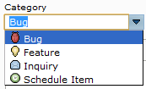
Differing Perspectives ( 1 of 6 )
A bug list, a task list, or a to-do list?
[The issue tracker is there] to track problems. Not tasks, problems. Totally different. You can track tasks with Excel if you have to. It can be done. You don’t want to track problems with Excel. Because a problem is not perception, it’s reality, right? That’s the difference.
—P04, Quality Assurance
What I’ve found now is that we need something more than just bug tracking. We actually need a way to match that to the schedule as well and have some sort of time tracking built-in.
—P15, Dev Lead
Notes:
Some members of the development team held strong opinions about what should, and shouldn’t be stored within the issue tracker.
[click] As participant 4, one of our quality assurance team members, said…
[The issue tracker is there] to track problems. Not tasks, problems. Totally different. You can track tasks with Excel if you have to. It can be done. You don’t want to track problems with Excel. Because a problem is not perception, it’s reality, right? That’s the difference.
Other team members were more open to the types of data that should be stored in the issue tracker and acknowledged the need for these items connect with artifacts outside the issue tracking system.
[click] For example, one of our dev leads, participant 15, said…
What I’ve found now is that we need something more than just bug tracking. We actually need a way to match that to the schedule as well and have some sort of time tracking built-in.
What this tells us, is that although issue trackers manage simple lists of bugs on the surface, underneath, the view of their contents is as varied as the list of people that use these systems.

Slide 16
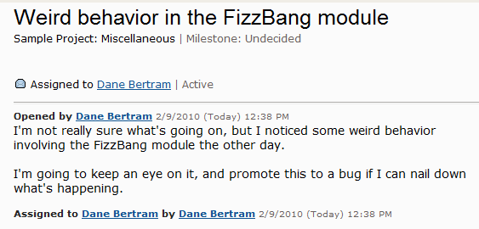
Differing Perspectives ( 2 of 6 )
Full-fledged bugs and almost bugs
In this case I knew that we were monitoring it, so I didn’t create the issue for it right at that point. … As soon as I’d figured out what it was I logged the issue because I knew which program was causing the problem.
—P02, Quality Assurance
Often bugs that are that critical don’t even get filed because by the time that you would go to file it, the bug is already resolved.
—P05, Quality Assurance
Notes:
Ideally, our participants felt that every bug found in a system should find its way into the issue tracking system to serve as a record of its existence and eventual resolution. In reality however, the pragmatics of day-to-day development sometimes resulted in a less-than-complete record. The distinction between a bug and non-bug sometimes depended on the accuracy of its reproduction steps or the level of detail known about its underlying cause.
[click] As participant two, another of our quality assurance participants, said…
In this case I knew that we were monitoring it, so I didn’t create the issue for it right at that point. … As soon as I’d figured out what it was I logged the issue because I knew which program was causing the problem.
Similarly, it was not unheard of for even important bugs to end up unaccounted for in the issue tracker because, as participant 5 said, …
[click]
Often bugs that are that critical don’t even get filed because by the time that you would go to file it, the bug is already resolved.
So, clearly the starting point of a bug is not always well defined, but undue or premature exposure of partially-completed bugs to others on the team may dampen a bug filers’ motivation for keeping as accurate a bug history as possible.
Another potential barrier to readily entering bugs, is the number and quality of details required by the bug filer when creating a new record in the issue tracker.

Slide 17
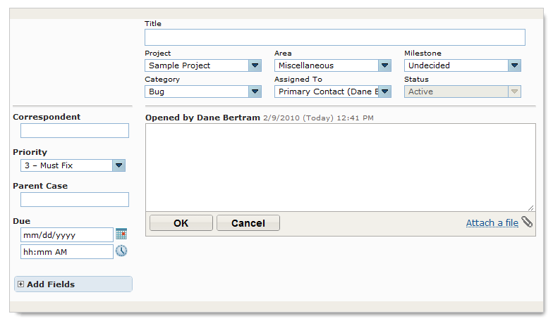
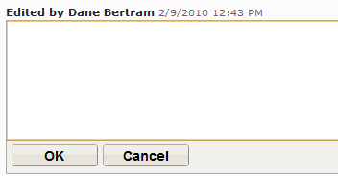
Differing Perspectives ( 3 of 6 )
A “flurry of fields” vs. ease of entry
Generally, everyone does feel that there’s too many [laughs]. … So, it does get frustrating. And we’ve tried at different times to pare it down, but then it always explodes back out because someone feels they need to indicate something different about the issue and there’s no other appropriate way to track that property.
—P01, Dev Lead
Because you kind of have to be an expert with the bug tracking system to file good bugs with this system, we wrote a very simple interface to encourage non-experts to file bugs. … We found that when we put this in, people in other departments who have never filed a bug before ever, were filing bugs.
—P05, Quality Assurance
vs.
Notes:
Certain members of the development team with frequent data mining tasks, such as QA, team leads, and management, found value in having a large collection of small, well-compartmentalized fields. Those who file bugs, however, often become frustrated when faced with entering a vast array of fields for each and every bug…especially when a number of those fields are required fields. This tension turned out to be the number one complaint from our participants who used issue trackers with customizable fields.
[click] Our first participant, a dev lead, explains…
Generally, everyone does feel that there’s too many [laughs]. … So, it does get frustrating. And we’ve tried at different times to pare it down, but then it always explodes back out because someone feels they need to indicate something different about the issue and there’s no other appropriate way to track that property.
To help ease this pain, one of our teams when so far as to build their own, homegrown abstraction on top of their issue tracker, as one of their quality assurance team members we interviewed described…
[click]
Because you kind of have to be an expert with the bug tracking system to file good bugs with this system, we wrote a very simple interface to encourage non-experts to file bugs. … We found that when we put this in, people in other departments who have never filed a bug before ever, were filing bugs.
Clearly there is a challenge in keeping the bug creation interface simple and streamlined while at the same time supporting the robust data mining needs of other stakeholders using the issue tracker.

Slide 18
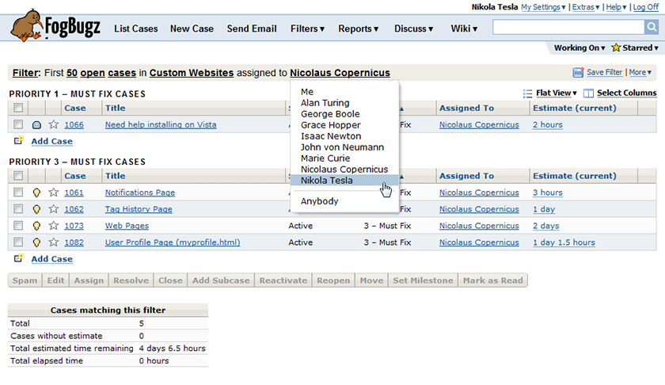
Differing Perspectives ( 4 of 6 )
Different perceptions of priority
It’s up to them to decide, you know, “Hey, we’ve got 2 projects of seemingly equal priority, what do you want us to do?” And they’ll prioritize “OK, that one’s higher” or “That’ll solve more of our problems.”
—P01, Dev Lead
We have a pretty simple priority system in [our issue tracker]. There’s low, medium, high, or blocker, but when you have 3 high bugs “Uh, which one’s the first one?”
—P06, Developer
Notes:
One of the most fundamental services provided by the issue tracker, as described by our participants, was its ability to prioritize and order their team’s outstanding work. We found that the priority assigned to an issue, though, could come from a number of different sources depending on the development team’s workflow and authority structure.
The university IT staff team we interviewed worked directly in support of another department on campus and, as such, that department’s manager had a well-defined influence over the prioritization of projects for their team.
[click] As the dev lead on that team said…
It’s up to them to decide, you know, “Hey, we’ve got 2 projects of seemingly equal priority, what do you want us to do?” And they’ll prioritize “OK, that one’s higher” or “That’ll solve more of our problems.”
Even once the high-level priority on an issue had been set, our participants still expressed the need for finer level granularity when prioritizing their day-to-day work.
[click] For example, participant 6 commented on their team’s priority structure…
We have a pretty simple priority system in [our issue tracker]. There’s low, medium, high, or blocker, but when you have 3 high bugs “Uh, which one’s the first one?”
So we can see that the idea of an issue’s “priority” is not always as simple as it might initially appear. Actors outside of the immediate development team may have an impact here, and the pragmatics of day-to-day development sometimes require a higher resolution of specificity than a simplistic priority field can provide.

Slide 19
Differing Perspectives ( 5 of 6 )
Shades of ownership: yours, mine, or ours?
[Issues are] always assigned to an individual—someone’s always responsible for them. None of this diffusion of responsibility stuff. So at any point your boss can come and say “You’re responsible for this. What’s going on?”
—P08, Dev Lead
In this case, [the bug would] still be active and it wasn’t assigned to me, but I was monitoring it because it was a showstopper…like it was a really big deal.
—P12, Quality Assurance
Notes:
During our study, issue ownership was also repeatedly reported as being an essential component of the software development process. Having the ability to assign an issue to a single person via the issue tracker—and having a record of that assignment—provided the accountability needed by the team in order to complete their work effectively.
[click] The dev lead at the issue tracking vendor put it this way…
[Issues are] always assigned to an individual—someone’s always responsible for them. None of this diffusion of responsibility stuff. So at any point your boss can come and say “You’re responsible for this. What’s going on?”
Issue ownership was not always a clear case of “mine vs. yours” however, and the restriction of having only a single active owner at any point in time sometimes resulted in participants monitoring bugs even though they were no longer assigned to them personally.
[click] For example, participant 12 talked abt their monitoring habits by saying…
In this case, [the bug would] still be active and it wasn’t assigned to me, but I was monitoring it because it was a showstopper…like it was a really big deal.
So, while it is apparent that accountability demands there be a single overall owner for any individual case at any specific point in time, there are still clearly a number of other varieties of “ownership” they may need to be expressible within the issue tracker.

Slide 20
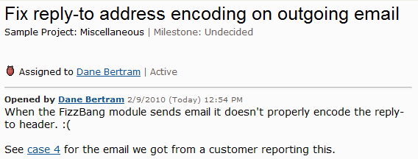
Differing Perspectives ( 6 of 6 )
Privacy, transparency, and the ‘in’ crowd
A lot of that stuff is not accessible in [our issue tracker] and would take a lot of work to make it accessible without exposing private information.
—P09, Developer
The benefit of [our issue tracker] is that it’s really rich and you can see the entire issue history and a whole bunch of other stuff. But the downside is that it’s a fairly closed system in terms of there’s a clear sense of who’s in and who’s out, and customers are sort of out. Even though we can collect information from them, they can’t interact with the system directly.
—P10, Project Manager
Notes:
One final area where perspectives differed, involved walking the fine line between exposing appropriate information to customers who filed bug reports while protecting proprietary or vulnerability-related details.
[click] Participant 9, a developer, describes part of the challenge as follows…
A lot of that stuff is not accessible in [our issue tracker] and would take a lot of work to make it accessible without exposing private information.
This dichotomy between “insider” and “outsider” views of the issue tracker was a palpable source of frustration for those on the development team who frequently interacted with customers.
[click] Such as participant 10, a project manager, who said…
The benefit of [our issue tracker] is that it’s really rich and you can see the entire issue history and a whole bunch of other stuff. But the downside is that it’s a fairly closed system in terms of there’s a clear sense of who’s in and who’s out, and customers are sort of out. Even though we can collect information from them, they can’t interact with the system directly.
Exposing the necessary aspects of cases stored within the issue tracker to its stakeholders outside of the organization is a tricky, and potentially dangerous, line to walk. It may be necessary to graduate the distinction between the fully-public and fully-private portions of an issue, but care must be given to ensure that such exposure is overt and deliberate.

Slide 21
Design Considerations
Design Consideration #5:
Multiple levels of issue ownership exist throughout the software development team. By supporting this pattern of “interested” vs. “owned by” in the issue tracker itself, stakeholders may eliminate their need to manually monitor issues they still partially own.
Notes:
So now we’ve seen 6 areas where the stakeholders who interact with the issue tracker have somewhat different perspectives. These differing opinions lead us to 7 different design considerations, and although I unfortunately don’t have time to go over all of them, I’d like to share Design Consideration #5 with you, which was inspired by the “Shades of Ownership: Yours, Mine, or Ours?” perspective.
[click]
Multiple levels of issue ownership exist throughout the software development team. By supporting this pattern of “interested” vs. “owned by” in the issue tracker itself, stakeholders may eliminate their need to manually monitor issues they still partially own.
The rest of our design considerations are detailed in the paper, but the important thing to take away from them is that although each individual design suggestion may be relatively simple to implement, actually creating better tools is more challenging than it may initially appear. Different teams have different needs, and as a result, there are trade-offs to be made when designing these development tools. We can’t simply implement all of the design suggestions together and magically obtain the perfect issue tracker.

Slide 22
Summary
Developing software is a fundamentally social process
  Even within small, collocated teams
The issue tracker is more than just a simple bug database
Notes:
So in summary, we’ve seen that…
[click]
Developing software is a fundamentally social process…
[click]
Even within small, collocated teams.
[click]
And that the issue tracker is much more than just a simple bug database to these teams.

Slide 23
Summary (cont.)
4 roles issue trackers play within development teams
  Knowledge repository
  Stakeholder boundary object
  Communication & coordination hub
  Communication channel
6 areas where stakeholder perspectives differ
  A bug list, a task list, a to-do list, or a…?
  Full-fledged bugs and almost bugs
  A “flurry of fields” vs. ease of entry
  Different perceptions of priority
  Shades of ownership: yours, mine, or ours?
  Privacy, transparency, and the ‘in’ crowd
7 design considerations for future tools (see paper)
Notes:
And we’ve identified…
[click]
4 roles issue trackers play within development teams
[click]
6 areas where stakeholder perspectives differ
[click]
And 7 considerations for the design of future issue tracking and software development coordination tools.

Slide 24









Small, collocated teams use issue trackers to support communication and collaboration both inside and outside their immediate teams despite these tools not being explicitly designed to do so.
FogBugz screenshots taken, with permission, from http://www.fogbugz.com
Notes:
So, in closing…
Small, collocated teams use issue trackers to support communication and collaboration both inside and outside their immediate teams despite these tools not being explicitly designed to do so.
So if people can accomplish all of the things they’re clearly accomplishing with tools that aren’t explicitly deigned to support their communication and collaboration, just imagine what they could accomplish if they were using tools that did support them.
[pause]
It’s not difficult to see how many of the roles and perspectives identified through our study might apply outside of the world of issue tracking. How do people coordinate over these types of tasks? Clearly this space is nuanced, and there are tensions in the communication patterns not being served by the toolsets that are currently being used to mitigate them.
This clearly points toward a large body of potential future work to be explored, but also perhaps suggest that there might be an underlying theory to be uncovered that applies to group coordination over these types of tasks more generally.
Thank you!

Slide 25
Design Considerations
Tracker means different things to different people
Starting point for a bug not always well-defined
Integrating lightweight tagging to fight field bloat
Priority isn’t a single, compartmentalized attribute
Support >1 level of ownership to avoid monitoring
Distinct facets contained within a single entity
Graduation between fully-private & fully-public data
Notes:
The issue tracker represents different things to different people. These small but significant distinctions should be acknowledged and exposed in the issue tracker through features catering to each of the stakeholder’s individual needs. Customizable, role-oriented interfaces that emphasize certain aspects of the tracker’s data while abstracting away others may provide a better fit for the multitude of stakeholders that make up the issue tracking system’s audience.
The starting point for a bug was not always a well-defined point in time and an issue’s visibility to others on the team could place an onus of completeness on the filer that may prevent them from filing an issue as soon as possible. Providing functionality for stakeholders to enter semi-private, lightweight “pre-bugs” may increase the number of bugs that eventually end up being recorded.
Providing lightweight tagging capabilities to issue tracking would likely help ease some of the tensions between wanting detailed fields associated with issues, and maintaining a simplified, hassle-free interface for creating cases. It would be important for these tags to leverage the issue tracker’s existing robust infrastructure for searching, sorting, and filtering issues.
Acknowledging the multitude of factors that compose an issue’s priority is important to serving the needs of its stakeholders. It may prove useful to present users of the issue tracker with a personal, persistent, and easily re-orderable list that is separated from those strictly ordered based on issue fields such as priority. Giving users the means to articulate their personal ordering of issues without explicitly affecting its priority may help them to better organize their day-to-day work.
Multiple levels of issue ownership exist throughout the software development team. By supporting this pattern in the issue tracker itself, stakeholders can eliminate their need to manually monitor issues that they still partially own.
Allowing for distinct facets of an issue (e.g., customer communication and its technical discussion) to be contained within a single entity while remaining easily distinguishable may also prove useful in acknowledging the multiple identities of certain issues.
Careful consideration of the multiple potential audiences for an issue and its attributes is necessary when developing external-facing interfaces and views. Graduation between fully-private and fully-public data may be needed and a clear distinction among these levels of privacy should be maintained in order to gain transparency without risking undue exposure of sensitive information.

