Slide 1



the Individual and the Group in Console Gaming
Amy Voida
UC Irvine
Sheelagh Carpendale
Univ. of Calgary
Saul Greenberg
Univ. of Calgary
1
Notes:
Thanks...
This is research I carried out with Sheelagh Carpendale and Saul Greenberg while I was at the University of Calgary.

Slide 2
Computer-Supported Cooperative Work
2
Notes:
It is a pretty common reality in CSCW that not all “cooperative” systems are

Slide 3
Computer-Supported Cooperative Work
3
Notes:
...actually used in cooperative contexts [13]. Some CSCW systems are used in

Slide 4
Computer-Supported Cooperative Work
Contentious
4
Notes:
contentious contexts or even

Slide 5
Computer-Supported Cooperative Work
Competitive
5
Notes:
... competitive contexts. And, not unsurprisingly, this reality may never be more blatantly borne out than in the context of gaming.

Slide 6
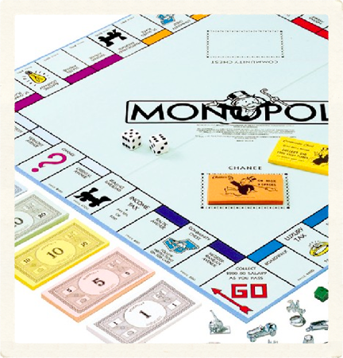

Image from hasbro.com & wimbledon.org
6
Notes:
Whether analog gaming...

Slide 7
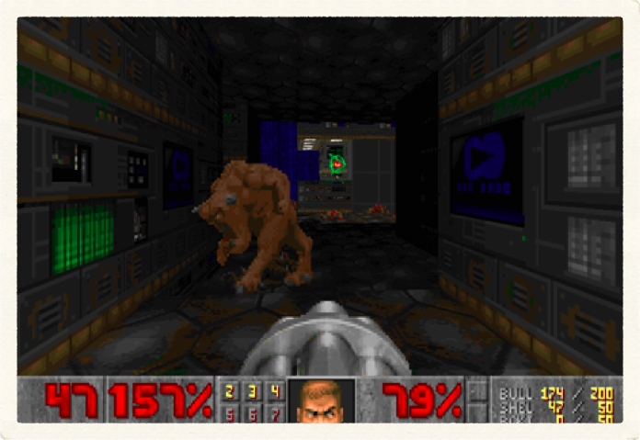
Image from brainygamer.com
7
Notes:
Or digital gaming... Most games have been, after all, fundamentally competitive in nature.

Slide 8
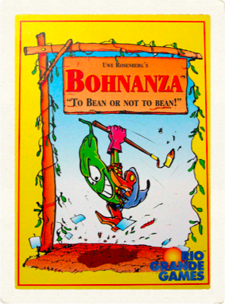
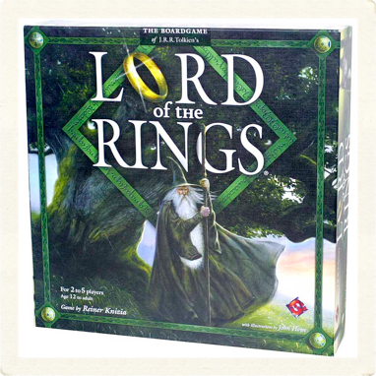

Images from connecticon.org, areyougame.com, www.game-town.nl
8
Notes:
This has been changing, though, with a surge of interest in both boardgames and videogames featuring more cooperative modes of gameplay [28].

Slide 9

Competitive
Games
Cooperative
Games
[Adapted from Zagal et. al 2006, in Simulation & Gaming]
9
Notes:
Game studies researchers have traditionally classified games into one of two categories: competitive or cooperative.

Slide 10

Competitive
Games
Cooperative
Games
[Adapted from Zagal et. al 2006, in Simulation & Gaming]
10
Notes:
Competitive games such as tennis, Monopoly, or Doom “require players to form strategies that directly oppose the other players in the game” [28]. So gamers have to look out for their own self-interests in order to be successful.

Slide 11

Competitive
Games
Cooperative
Games
[Adapted from Zagal et. al 2006, in Simulation & Gaming]
11
Notes:
In a cooperative game, players’ goals are not necessarily in direct opposition; but their goals aren’t completely aligned, either [28]. In cooperative games, such as the card game Bohnanza or the massively multiplayer game World of Warcraft, some real value can be had from gamers working together; but because ultimately their goals may be different, not all players are guaranteed to benefit from whatever cooperation.

Slide 12

Competitive
Games
Cooperative
Games
[Adapted from Zagal et. al 2006, in Simulation & Gaming]
12
Notes:
More recently, a third category of gameplay has also been recognized as distinct from the other two...

Slide 13

Competitive
Games
Cooperative
Games
Collaborative
Games
[Adapted from Zagal et. al 2006, in Simulation & Gaming]
13
Notes:
...collaborative gameplay [28]. In collaborative games, such as the board game Lord of the Rings or certain modes of Rock Band, players share common goals and common outcomes. Gamers all win together or they all lose together. So in this case, looking out for shared, group interests instead of individual interests provides the greatest benefit to all players.

Slide 14


Game Mechanics
Competitive
Games
Cooperative
Games
Collaborative
Games
?
?
Group Dynamics
14
Notes:
While an understanding of how individual or group interests can help to distinguish classes of game mechanics or modes of gameplay, it may not necessarily follow that group dynamics follow suit... that competitive games mechanics rewarding individual interest breed very individual-focused interactions among gamers or that collaborative game mechanics rewarding group interest foster group-focused dynamics...

Slide 15
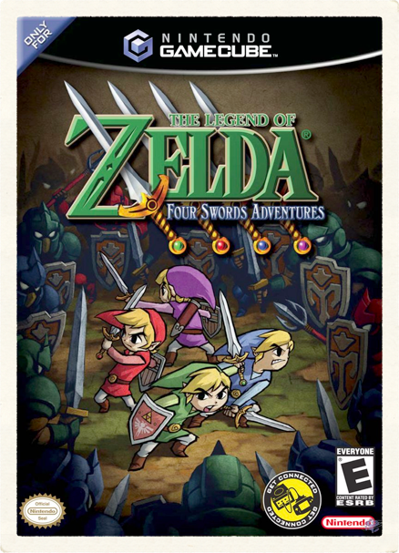
Although it’s a game that four players have to cooperate to solve puzzles, when you play it… you actually end up competing a lot more in that game than you do cooperating.- Shigeru Miyamoto
Image from nintendoworldreport.com
15
Notes:
Miyamoto, the producer of the Zelda games has said about his cooperative game Four Swords Adventures, that [quote]
And our own prior research has also found that competitive games sometimes have a less competitive tenor when playing in groups with diverse expertise levels [25].
As group gaming becomes more common, it will be increasingly important for game designers to consider how their design decisions will affect—and be affected by—the sociality of the groups who get together to play group games. A naïve approach would be to assume that shifting the focus to developing cooperative or collaborative modes of gameplay would foster group-oriented dynamics. But as we’re going to find out, the relationship between game mechanics and group dynamics appears much less straightforward...

Slide 16

Exploring Sociality in Gaming
Massively Multiplayer Online Games
  Ducheneaut et al. [CHI 2006, JCSCW 2007...]
  Nardi et al. [CSCW 2006...]
Console and/or Physical Games
  Voida & Greenberg [CHI 2009]
  Sall & Grinter [JCSCW 2007]
Handheld Games
  Szentgyorgyi [CHI 2008]
16
Notes:
We can tease through related work in the area and see glimpses of both group- and individual- oriented practices, emergent conga lines in Bonnie Nardi’s studies of World of Warcraft or trash talk in studies of Nintendo DS gaming clubs, but for the most part, the emphasis of this body of work has been in exploring, more broadly, the nature of sociality in digital games and the features of games that foster it. We want to build on this body of work, recognizing that social interactions can be a great asset for group building, helping to foster a sense of cohesiveness and interdependence among group members. But social interactions could also contribute to the deterioration of groups, if individual group members only look out for their own self-interests. As we examined group gaming practices, then, we aimed to understand what gaming practices emphasized groups, what gaming practices emphasized individuals and, where possible, what design decisions — game mechanics, interaction design, or even special effects design — correlated with which types of gaming practices.

Slide 17
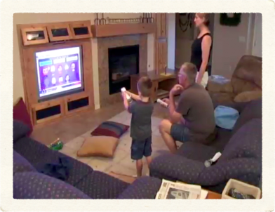
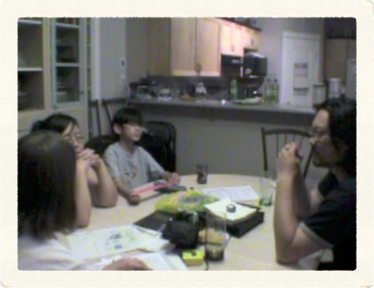
Methods
Group Gameplay
Focus group
17
Notes:
In this study, participants gathered in groups of friends or family members who regularly got together to play games. These established groups of gamers played whatever game or games they typically played for 75 minutes, on average. We observed, videotaped the gameplay, and kept fieldnotes.
When groups were finished playing games together, they participated in a semi-structured focus group with other members of their gaming group and we discussed some of the practices observed during gameplay as well as some of the motivations behind the gaming activity.
In looking at game mechanics and group dynamics, we turned primarily to the observational group gameplay data, where our inductive, grounded theoretical analysis foregrounded practices that were more group-focused and practices that were more individual-focused. We were able to triangulate this data with some focus group data where we asked participants to explain some of the gaming practices that we observed.

Slide 18
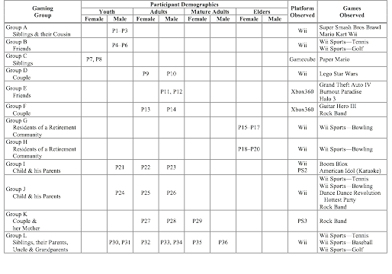
18
Notes:
We recruited 12 groups of participants, including 36 individuals, who gathered regularly to play console video games. We recruited all but two groups of participants via snowball sampling starting on our university campus. Participants included both inter–generational and intra– generational gaming groups:

Slide 19
19
Notes:
...three groups of all youth participants... one group of girls and two groups of boys. They played Wii sports games, Mario games, and a fighting game called Brawl.

Slide 20
20
Notes:
There were three groups of all adult participants, two mixed-gendered couples and a pair of male friends. They played games like Lego Star Wars, Grand Theft Auto, Halo, and Rock Band...

Slide 21
21
Notes:
There were two groups of all elder participants,These were all women and all residents of retirement communities. These were the gaming groups that we specifically recruited, outside of our snowball sampling. And they all played Wii Bowling...

Slide 22
22
Notes:
And finally, there were four groups whose participants spanned multiple generations; these were families... adult parents and their youth-aged children, mature adult parents and their adult children, or grandparents, parents and their children.
While we entered into this research understanding that there was a significant diversity among these gaming groups, the big surprise for us in this study was the amount of diversity within those gaming groups, as well.

Slide 23
Emphasizing the Individual
Talking Trash
Falling Prey to the Computer’s Holding Power
Emphasizing the Group
Constructing Shared Awareness
Reinforcing Shared HistorySharing in Success and Failure
Engaging in Interdependence and Self-Sacrifice
Pivot Points
Negotiating Individual Contributions to the Group
Reviewing Scores
23
Notes:
In the remainder of this talk, I’ll present the results of our analysis and talk about the various practices that emphasized the group as well as those that emphasized the individual. I’ll also discuss two “pivot points.” These were particular points in gameplay where these group- and individual-oriented practices most commonly intersected

Slide 24
Emphasizing the Individual
Talking Trash
Falling Prey to the Computer’s Holding Power
Emphasizing the Group
Constructing Shared Awareness
Reinforcing Shared HistorySharing in Success and Failure
Engaging in Interdependence and Self-Sacrifice
Pivot Points
Negotiating Individual Contributions to the Group
Reviewing Scores
24
Notes:
We observed a number of practices that emphasized the individual gamer. As one might expect, we did observe individual-oriented practices during competitive and cooperative modes of gameplay. But we also observed very individual-oriented practices during collaborative modes of gameplay, as well.

Slide 25
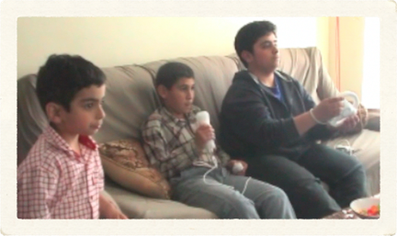
Emphasizing the Individual
Talking Trash
P2: I’m in first!
P3: Not for long!
P2 & P3
(Youth males, cousins)
25
Notes:
While some CSCW research has noted that gamers frequently think trash talk is just in good fun, the sociological literature finds it firmly rooted in a class of insult talk that emphasizes and fosters power relationships and hierarchical distinctions between individuals [11]. In gaming groups, we observed interactions in which individuals were vying to establish their place in the hierarchy of a competitive game [quote]
Mind you, this was one of the milder examples of trash talk in our data, but we’ll stick with this out of respect for the parents who allowed me to observe their children...

Slide 26
Emphasizing the Individual
Talking Trash
P2: I’m in first!P3: Not for long!P2 & P3
(Youth males, cousins)
26
Notes:
Before I get too much farther, I should also mention here that many of the images I’ll be using in this talk are stills I’ve grabbed from our video data. And as it turns out, the lighting that is conducive for gaming is not really the same kind of lighting that is conducive for shooting video. So I apologize in advance for the quality of some of the images...

Slide 27
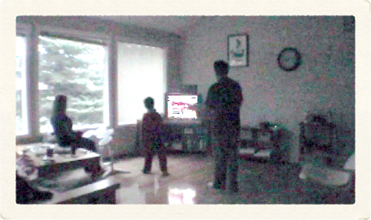
Emphasizing the Individual
Talking Trash
P26 [Dad]: How about I do drums?
P24 [Son]: Fine, then I’ll do guitar.
P25 [Mom]: No, I’m doing guitar.
P24 [Son]: I’m gonna do guitar.
P25 [Mom]: No way, I’m doing guitar.
P24 [Son]: First one to touch it…
P24–P26
(An adult couple and their youth son)
27
Notes:
Trash talk is also used as a way for individuals to stake claim to their own turf [11]. We observed a number of instances in which gamers attempted to stake claim over a particular input device, planting themselves firmly on top of the Dance, Dance Revolution floormat, for example, so as not to relinquish their turn. We also observed trash talking turf wars as gamers tried to stake claim to more or less desirable input devices in the collaborative game of Rock Band: [quote]
It was difficult to identify correlations between trash talk and specific features or mechanics of games — trash talking occurred during both competitive and collaborative games. But we did observe a correlation between these trash talking turf wars and the presence of physical input devices in the gaming environment. This correlation was particularly prominent in situations where the group perceived different degrees of desirability for different input devices. No one ever wanted to do the vocals in Rock Band...

Slide 28
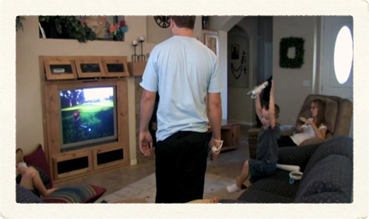
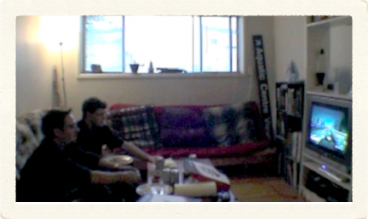
Emphasizing the Individual
Falling Prey to the Computer’s Holding Power
28
Notes:
Sherry Turkle talks of the computer’s “holding power,” which she refers to as a sort of “seduction” between the human and the machine. And Mimi Ito, in her study of childrens’ gaming at a computer clubhouse, identified instances of this holding power that correlated with special effects in games. She found special effects to be quite antisocial... sucking people in to the machine at the expense of others in the gaming group.
In our study, we observed a number of similar instances in which gamers seemed to fall prey to the computer’s holding power. Each of these instances correlated with some form of special effects or “Easter eggs” within the game... whether it was a child entranced by an Easter Egg in Wii Sports that disrupted the flow of the game for the rest of the group. Or whether it was two adults who took turns crashing cars in burnout paradise, totally enthralled by the slow motion crash sequences.

Slide 29
Emphasizing the Individual
Talking Trash
Falling Prey to the Computer’s Holding Power
Emphasizing the Group
Constructing Shared Awareness
Reinforcing Shared HistorySharing in Success and Failure
Engaging in Interdependence and Self-Sacrifice
Pivot Points
Negotiating Individual Contributions to the Group
Reviewing Scores
29
Notes:
We observed a number of practices that emphasized the gaming group as a whole. As you might expect, we did observe group-oriented practices during cooperative and collaborative modes of gameplay. But we also observed group-oriented practices during competitive modes of gameplay, as well.

Slide 30
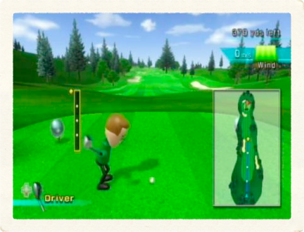
Emphasizing the Group
Constructing Shared Awareness
P4 Wind... wind!
P5 And consider the downhill, though, so it’s probably pretty straight…
P4 The wind is going this way… so you want to go that way....
P5 That’s good.
P4 , P5 & P6
(Youth males, friends)
Image from frequencycast.co.uk
30
Notes:
Participants used conversation during gameplay to construct a shared, group awareness of game state.During competitive gameplay in Wii Sports: Golf, for example, the active golfer had to account for the direction of the hole, the slope of the green, the direction and force of the wind, as well as the power of the golf stroke. We observed group members helping each other keep track of these different factors and using that information to make suggestions about the force and direction that other players should hit the golf ball... [quote]

Slide 31
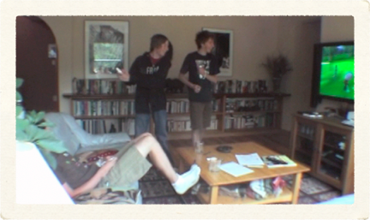
Emphasizing the Group
Reinforcing Shared History
P5: Remember that time that you, like, just got mad and gave up trying…
P4: (Laughing) Shot it back and forth for like half an hour?
P6: Yeah, that sucked!
P4 , P5 & P6
(Youth males, friends)
31
Notes:
Participants also emphasized the group by reflecting on their own shared history. In the competitive game of Wii golf, three gamers reminisced about previous times that they had played the game together. It was common for more than one player to contribute to these stories, reinforcing the shared history of the gaming group: <quote>
Most interactions where groups reinforced a shared history corresponded to moments of arrival at a particular location within the game and the longer stories occurred during cut scenes in the game, whether that game was competitive or collaborative. Because these parts of the game didn’t require input from gamers, there seemed to be time for the group to reflect on... tell stories about their previous experiences together. And because these game elements frequently provided an overview of a new location, they also seemed to provide enough context to trigger memories among gamers.

Slide 32
Emphasizing the Group
Sharing in Success and Failure
P24 [Son]: We’re going down!
P25 [Mom]: Who is?
P24 [Son]: We are...
P25 [Mom]: Going where?
P24 [Son]: …as a band.
P25 [Mom]: Oh dear!
P24–P25
(Youth male & adult female, his mother)
32
Notes:
Gaming groups also shared in both successes and failures, celebrating together and commiserating together: [quote]

Slide 33
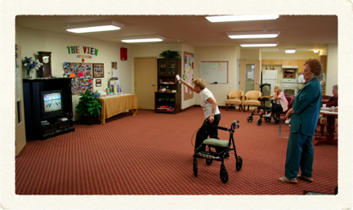
Emphasizing the Group
Sharing in Success and Failure
Oh boy, we’re rusty, aren’t we? We haven’t played in a while
P17
(Elder adult female, played with
other gamers in her retirement community)
33
Notes:
We also observed a number of instances in which gaming groups worked to create a shared environment in which it was more socially acceptable to fail. In a competitive game of Wii bowling, for example, the winning gamer constructed shared excuses for poor scores: <quote>
We didn’t observe a correlation between any particular elements of game design and practices related to shared success and failure, but we did notice that these practices seemed to be more prevalent in groups of elder gamers and in intergenerational gaming groups.

Slide 34
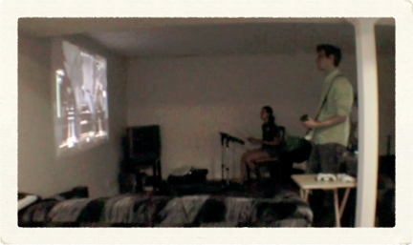
Emphasizing the Group
Engaging in Interdependence and Self-Sacrifice
P13: If you get enough star power, you can bring them back.
P14: You have to kind of plan ahead. If you know it's going to be a hard song… and you know that maybe one of your friends is not going to make it, you're actually probably not going to use it.
P13: Store it.
P14: You're going to store it for, to save them, rather than to try to… boost your own life gauge.
P13 & P14
(Adult female & adult male, couple)
34
Notes:
Some of the most striking group-oriented interactions we observed involved instances where individual gamers sacrificed their own interests for the sake of the group. Part of what made these interactions striking was the lack of conversation surrounding them during the gameplay. If an act of self-sacrifice was requested or seemed to be needed during a game, that action was carried out without comment. Because there was so little discussion about these practices during gameplay, we asked participants to explain what was going on afterward during the focus group... Here, two gamers describe acts of self sacrifice and how to save players who have failed out in the game of Rock Band [quote]
The game mechanics of Rock Band made interdependence a central facet of gameplay and the game provided explicit incentives for players to look out for the interests of the group instead of themselves.

Slide 35
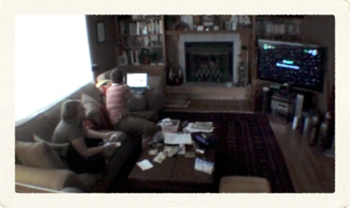
Emphasizing the Group
Engaging in Interdependence and Self-Sacrifice
P10: There are certain points where you do something and if the other person is way far behind…
P9: And, like, the things that we’re doing were timed too.
P10: Yes. So you have to go quickly.P9: …but if you can’t find the guy... can’t jump high enough or can’t fly—
P10: Drop out!
P9 & P10
(Adult female & adult male, couple)
35
Notes:
Other games, such as Lego Star Wars, also allowed players to sacrifice themselves for their team: [quote]
In Lego Star Wars, though, these interdependent behaviors weren’t explicitly rewarded by the game so some gamers were confused about whether what they were doing reflected great teamwork or whether what they were doing would actually be considered cheating!

Slide 36
Emphasizing the Individual
Talking Trash
Falling Prey to the Computer’s Holding Power
Emphasizing the Group
Constructing Shared Awareness
Reinforcing Shared HistorySharing in Success and Failure
Engaging in Interdependence and Self-Sacrifice
Pivot Points
Negotiating Individual Contributions to the Group
Reviewing Scores
36
Notes:
Some phases in console gaming seemed to bring the distinction between group- and individual-oriented practices into much sharper relief. We observed a number of what we call “pivot points,” points in the game in which there was a striking shift between an emphasis on the group and an emphasis on the individual or the other way round...

Slide 37

Pivot Points
Negotiating Individual Contributions to the Group
P27: Bogus, we didn’t get our first star…
P29: You should play the guitar.
P27: You know, a bass part is what you need.
P29: Should I switch it?
P27: Nah, you’re good.
P29: No I’m not!
P27 & P29
(Adult female & mature adult female, her mother)
37
Notes:
There were a number of points during gameplay when group members discussed the contributions of individuals to the larger group. These discussions were most prominent during the configuration and setup of each new game, when gamers assigned or reassigned group roles to individual players. <quote>
Groups continually assessed and reassessed individuals’ contributions to the group and adjusted individual roles as gameplay unfolded. Individual team members’ strengths and, more often, their weaknesses were taken into consideration in an attempt to create a more successful team for the next game.

Slide 38
Pivot Points
Reviewing Scores
P24 [Son]: Yeah! Woohoo!
P25 [Mom]: We did it!
[scores displayed]
P26 [Dad]: I sucked.
P25 [Mom]: Maybe you shouldn’t quit your job, dear.
P26 [Dad]: I only got fifty-two.
P24–P26
(Youth male playing with his adult parents)
38
Notes:
We observed another striking shift in conversation at the point in games when scores were displayed. In most cases, there was a very explicit shift between singular and plural tenses in the language used... participants used a plural tense immediately following gameplay and focused their discussion on group performance. Once the scores for the game were posted, though, participants frequently shifted to a singular tense, refocusing the discussion on an individual: <quote>
In most of the games we observed, even in collaborative modes of gameplay in which an entire group would win or lose together, the screen displaying scores still presented scores for individual gamers; sometimes these individual scores were given actually more visual prominence than was the shared group score.

Slide 39
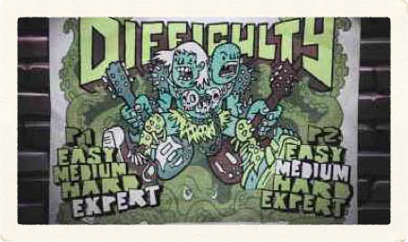
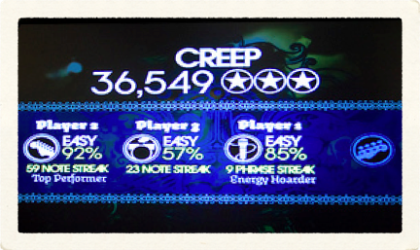
Pivot Points
Negotiating Individual Contributions to the Group • Reviewing Scores
Images from the XBox 360 Guitar Hero manual & dreamyouralive’s Flickr photostream
39
Notes:
These pivot points suggest two key places in game design where designers might carefully consider the ways in which their decisions influence group dynamics during gameplay. I think it is particularly interesting... these two pivot points served as the bookends around what one might generally consider the classic gameplay experience. Negotiations about individual contributions to the group most typically occurred during game setup and configuration while displays of scores typically occurred after the game had ended.

Slide 40
Emphasizing the Individual
Talking Trash
Falling Prey to the Computer’s Holding Power
Emphasizing the Group
Constructing Shared Awareness
Reinforcing Shared HistorySharing in Success and Failure
Engaging in Interdependence and Self-Sacrifice
Pivot Points
Negotiating Individual Contributions to the Group
Reviewing Scores
40
Notes:
To wrap up then, I have presented results from a study of collocated group console gaming where we endeavored to disentangle the discussion of gameplay practices from the traditional classifications of game mechanics in order to better understand the range of individual- and group- oriented gaming practices. We identified two classes of practices that emphasized the individual gamer, four practices that emphasized the gaming group as a whole, and two pivot points where an individual orientation intersected with a group orientation.

Slide 41
Both group- and individual-oriented gaming practices were present in competitive, cooperative, and collaborative games, transcending the classic modes of gameplay with which they would most likely be associated.
41
Notes:
We found that both group- and individual-oriented gaming practices were present in competitive, cooperative, and collaborative games, transcending the classic modes of gameplay with which they would most likely be associated.
In fact, some of the most group-oriented practices we observed occurred in a group that was playing a competitive game. And some of the most individual-oriented practices we observed occurred in a group that was playing a collaborative game.

Slide 42
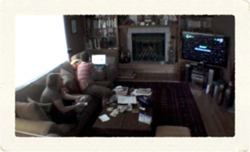
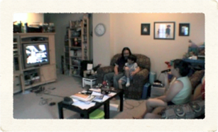
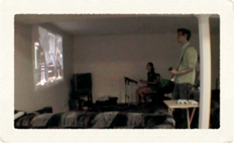

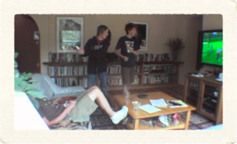
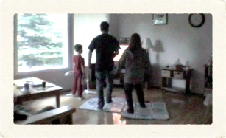
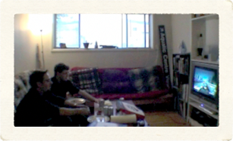
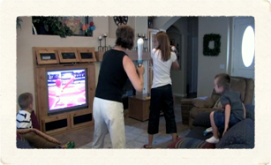
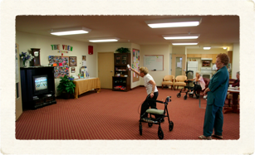
42
Notes:
Overall, this research points to the rich dynamics within gaming groups and contributes initial insights about relationships between console game design and group interactions—that competitive games do not always equate to individual-oriented practices, that collaborative games do not always equate to group-oriented practices, and that the dynamics within groups are not merely influenced by the mechanics of the gameplay but by the design of the setup and scoring, as well.

Slide 43
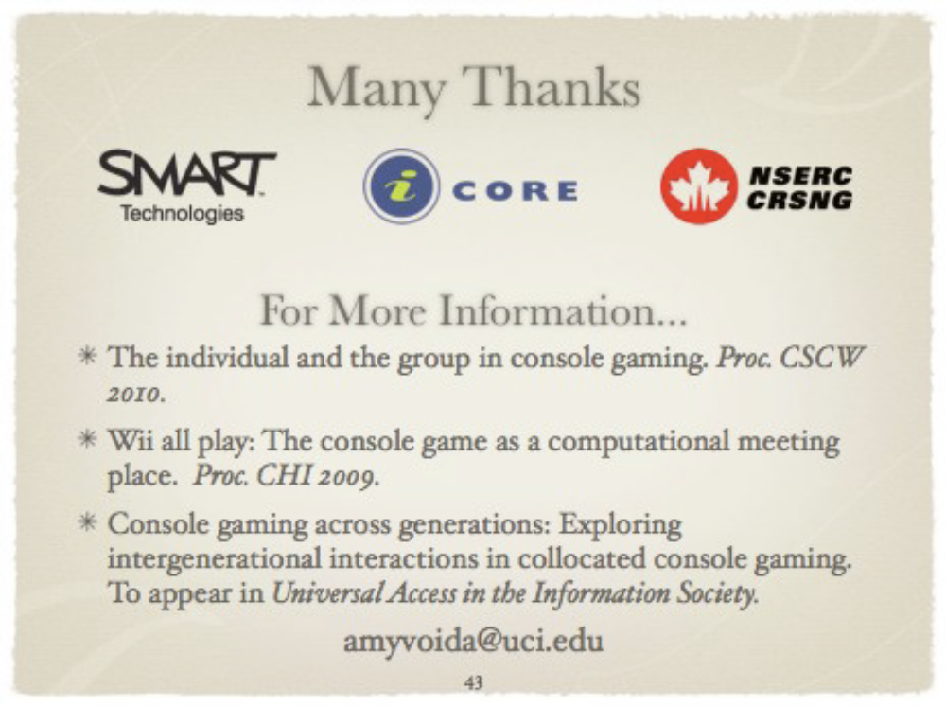
Notes:
Thank you very much.

