Slide 1
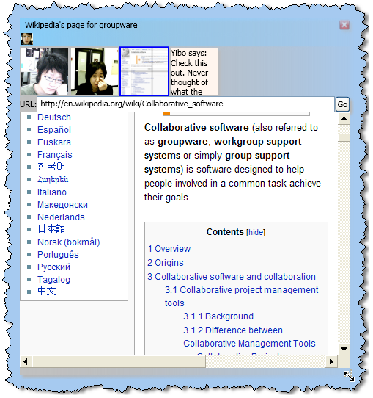
The Design of Come Together Places for light-weight group meetings
Yibo Sun and Saul Greenberg
University of Calgary
Notes:
Good afternoon. I’m going to present some work by Yibo Sun as part of his MSc research, and Saul Greenberg his supervisor, both from the University of Calgary.
Mr. Sun, who was going to present this work, had visa issues entering the US, while Dr. Greenberg had a commitment in Europe.
I will be presenting the design of Come Together, a new groupware system that creates places for light-weight group meetings.

Slide 2
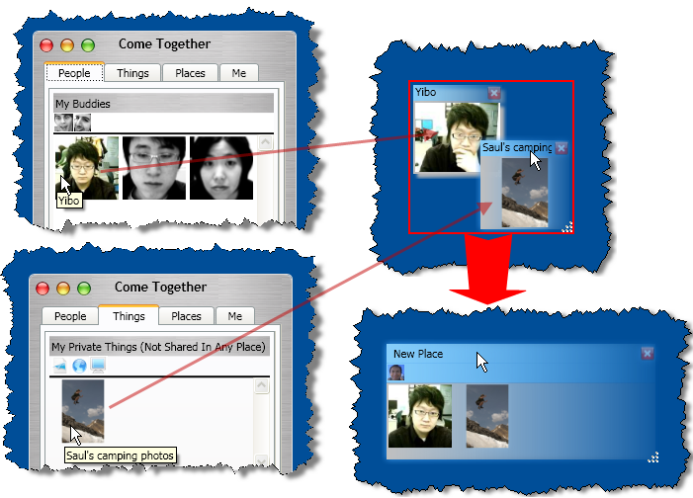
The message
People must be able to quickly bring together other people and their things to form a place for light-weight meetings
Notes:
The main message of this presentation is our believe that, through groupware, people must be able to quickly bring together other people and their things to form a place for light-weight meetings.
To deliver this message,
I’ll explain what I mean by lightweight meetings
I’ll talk about some of the strengths and weaknesses in other groupware systems.
I’ll illustrate our design of the working ComeTogether system, mostly via videos,
I’ll present some highlights from a user-based design critique, which isn’t reported in the paper.

Slide 3
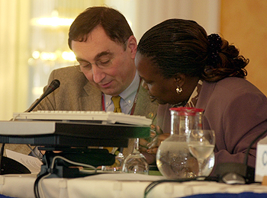
Light-weight meetings
Informal, casual, opportunistic and somewhat ad-hoc
  awareness of people
  easy engagement with little cost
  involves artefacts and tools
  persistence of meeting places
  proximity and social context
  centre/peripheral involvement
http://www.iisd.ca/climate/sb22/wed2505.html
Notes:
Lightweight meetings sit somewhere between brief casual interactions and formal meetings.
Every day, people constantly meet in small social groups. While some gatherings happen via scheduling formal meetings,
the vast majority are informal, casual, opportunistic, somewhat ad hoc, and have some degree of continuity, or persistence, over time.
For such meetings to work, several things must happen.
1. People need to know about presence, activity and availability of each other to trigger meeting opportunities.
2. People need to easily engage, leave and re-enter into such meetings with very low cost.
3. Its not just about talk. People should be able to share artefacts and tools.
4. It usually occurs in a social place, where the proximity of people and artifacts in a social place make all the above happen within a context infused with social meanings.
5. That place - including the artefacts and people involved – can persist over a series of meetings, where the meeting context can be restored when needed.
6. Finally, people can have varying degrees of involvement within that place

Slide 4
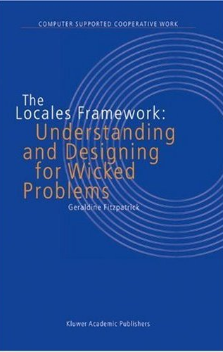
Light-weight meetings
Locales Framework (Fitzpatrick)
  locales: social worlds, sites & means
  center/periphery principle
  mutuality and awareness
  individual views
  interaction trajectories
  Civic structure
Notes:
Although I won’t discuss it any further, all these attributes are reflected in Geralidine Fitzpatrick’s Locales Framework, which (as explained in the paper) became the theoretical foundation behind our system design. For brevity, I’ll use every-day terms to explain our design rather than the constructs described by the Locales Framework.

Slide 5
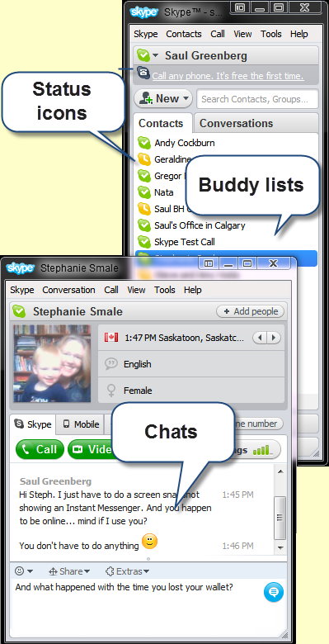
Instant Messengers
People-focused awareness
  awareness of people
  easy engagement with little cost
  involves artefacts and tools
  proximity and social context
  persistence of meeting places
  centre/peripheral involvement
Notes:
The question is how we can use groupware systems to support these elements for light-weight meetings between distance separated people. The problem is that most existing systems only support some of them.
Instant messengers are a good example of light-weight meeting system.
They provide rudimentary awareness of others via a status indicator for people on the buddy list.
Engaging into a conversation is just a quick double click away.
However, other aspects of Instant Messengers are more rudimentary.
They usually have only simple mechanisms for artefact sharing, such as file transfers or access to out of band groupware tools.
Social context is totally individual centered around one’s buddy list; others outside the conversation have no awareness of it.
The meeting context does not persist beyond a conversation except as a chat script.
Participants are either involved or not in a conversation; there is no middle ground.

Slide 6
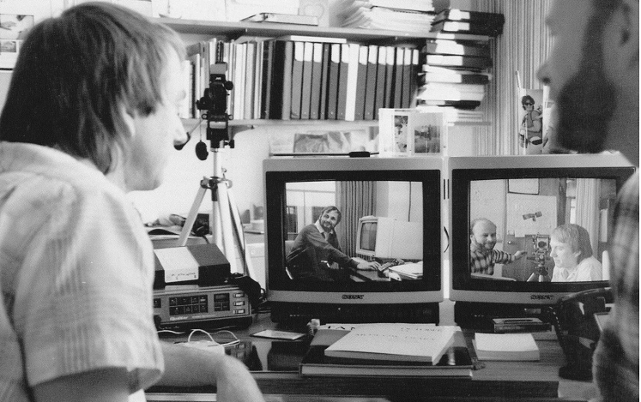
Media Spaces
People-focused awareness
  awareness of people
  easy engagement with little cost
  involves artefacts and tools
  proximity and social context
  persistence of meeting places
  centre/peripheral involvement
Notes:
Media spaces are another good example of light-weight meeting system.
Through the video link, they too provide awareness of others and rapid engagement simply by talking.
However, most do not integrate artefact sharing
Also, because they are so heavily tied to the physical space viewed in the video channel, the other three aspects are limited to only what is happening between those spaces. For example, one’s involvement can only happen if one is actually present in the physical space.

Slide 7
Community Bar McEwan, 2006
Sidebar metaphor
Notes:
Our own research is primarily inspired the Community Bar, which is a groupware sidebar located at the periphery of the screen.

Slide 8
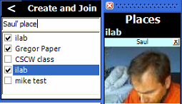
Community Bar McEwan, 2006
Place
“CSCW class”
Groupware places
Place
“G-place”
Place
“ilab”
Place
“mike test”
Notes:
The sidebar organizes people and artefacts into multiple meeting places, - a site and means for people to do their interactions - and we see 4 places here. Any person can create a place using a pop-up dialog box. Once a place is created, people can be invited in. Afterward, the person has to accept the invitation to join. People can then populate that place with things.

Slide 9
Community Bar McEwan, 2006
Places collect people & things
Notes:
The small tiles within a place are media items representing people (live video), things (e.g., pictures, web pages, shared screens), and conversations (e.g., text chat).

Slide 10
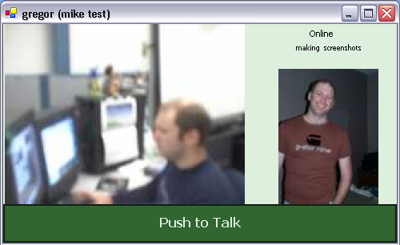
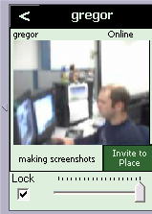
Community Bar McEwan, 2006
Drill down awareness
tooltip
grande
full view
sidebar
Notes:
A person can drill down into a media item by raising a transeint tooltip grande or a larger full view window, each providing more awareness, detail and interaction possibilities of a person, artefact or conversation.
While Community Bar was designed for lightweight meetings and succeeded in many ways, a field deployment and study also revealed where it failed.
In particular, people using the system ended up in only one single place. They rarely create new places, mostly because place creation and the invitation process was heavy-weight.
Another issues is that artefacts could only be created within the scope of a place. This meant that things created previously could not be added in easily, that they could not be shared across places, and that – if a place was destroyed – it could not persist afterwards.
We then set a new research goal: to use the best features of Community Bar and Instant Messengers, while improving over those that failed. The result was Come Together.

Slide 11
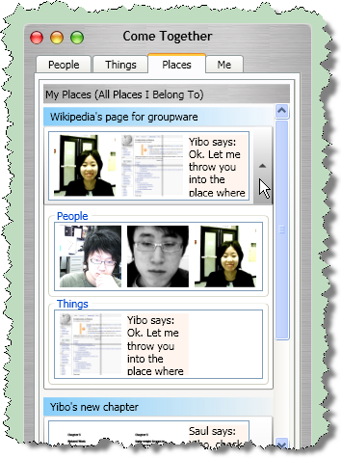
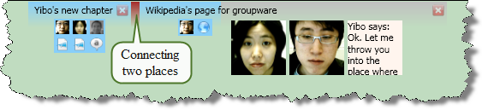
Come Together
media items
Place strip
console / buddy list
Place window
Notes:
Come Together is designed specifically to support light-weight meeting places, concentrating on meetings and group membership that are somewhat impromptu and ad hoc, and where the level of people’s involvement and likelihood of continuing a meeting in the future are highly variable. It has several primary constructs: media items as in Community bar, a console that collects independent media items and places, a place window that creates a place containing media items, and a place strip that lets people set a place at the periphery of their attention.
I’ll use several video scences to illustrate the primary features of Come Together. In all scenes, I use a deliberately trivial example of a meeting, as I want to illustrate the method rather than the meeting itself.

Slide 12
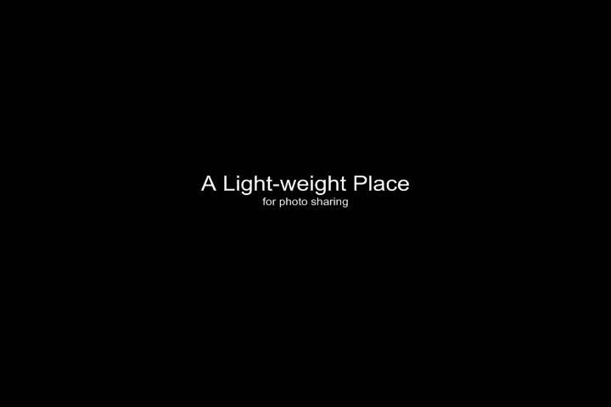
Creating a Light-weight Meeting
Notes:
In this first scene, you will see three important things
How a console window collects people and things, similar to a buddy list in Instant Messnger
how a meeting place is created simply by bringing people and existing artefacts together
how one can drill down to get details about people and things
<SHOW VIDEO>

Slide 13
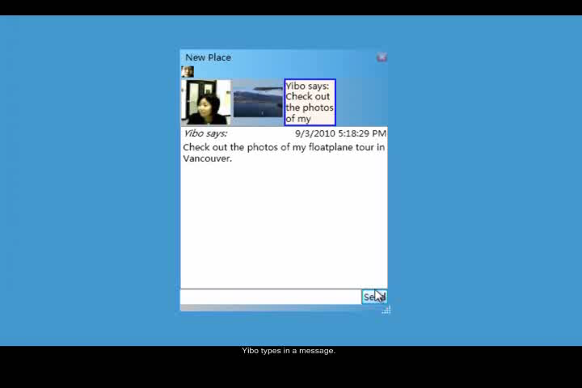
What the other person sees
Click to play video
Notes:
At the same time, the other participant sees this meeting place in a very similar way.
What you will see in this scene is:
The easy way people know that they have been added to a place, and how they can immediately enter and manipulate things within it
<Show Video>
While that scene didn’t show it, I should mention that the picture viewer is groupware, where helen and yibo could have linked it (by a checkbox) so that the slides changed simultaneously on both sides.

Slide 14
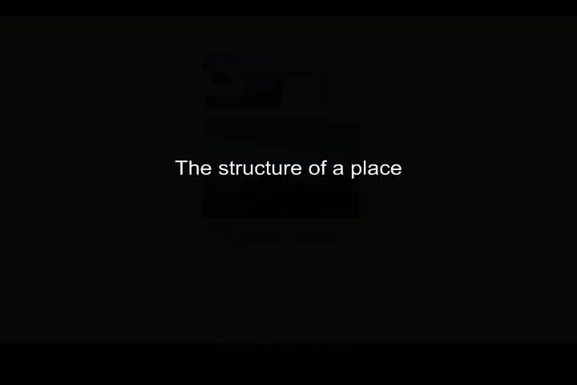
Structure of a meeting place
Click to play video
Notes:
Our third scene reveals a bit more about the structure of a place. You will see how:
people, things and communication channels are collected in media items
people can adjust the presentation– and thus their interest - in these media items
Although all can see the same thing, each individual can customize their own views of items.

Slide 15
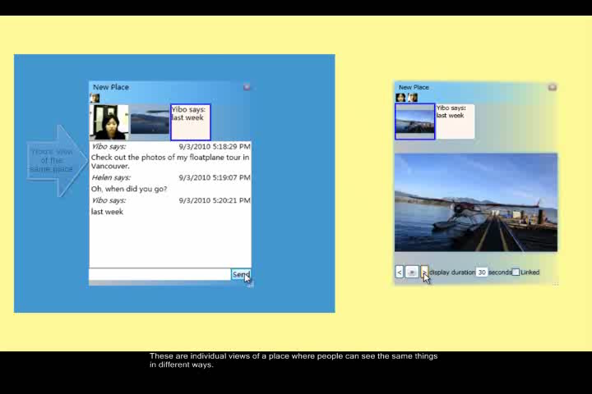
Another Light-weight Place
Click to play video
Notes:
This scene shows you other aspects of places. You’ll see :
another way to create a place simply by dragging files atop of people
How places can also support asynchonous interaction and persistence
Another media item, in this case a groupware document viewer
How awareness of a place can be adjusted by moving it to the screen’s periphery as a border strip.

Slide 16
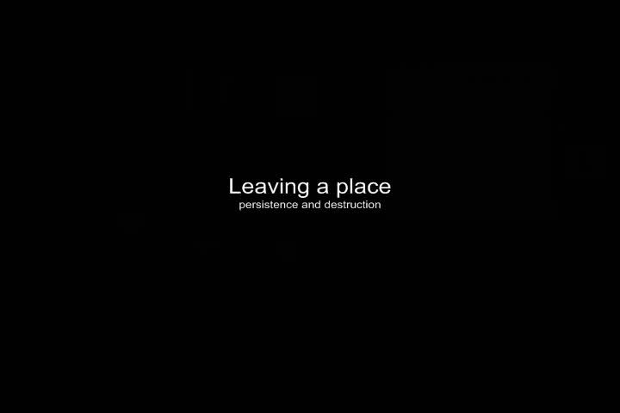
Leaving a Place
Click to play video
Notes:
This next scene shows the many ways that one can leave a place. We will see how
* people can adjust how the place, their things in that place, and their involvement persists over time.

Slide 17
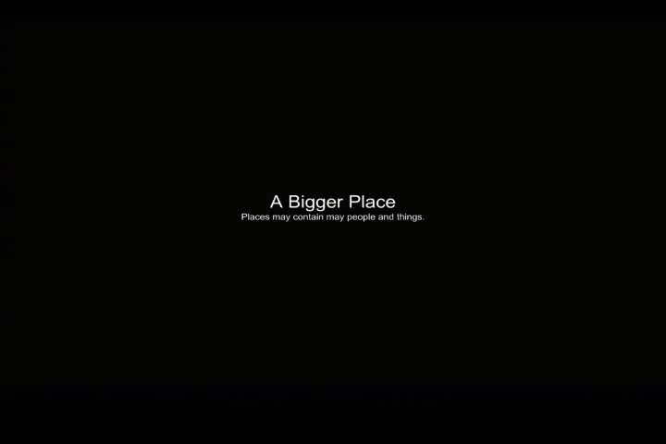
A Bigger Place
Click to play video
Notes:
The next scene shows a more complex place. You will see that:
-People and things can exist outside of a place as individual entities in a console window
A place can contain many people and things, where they can be added (and removed) dynamically
That there are many types of media items
<SHOW VIDEO>
I should emphasise the last point. Come Together is not just a system, but a toolkit, where programmers can create and populate this extensible system with their own media items.

Slide 18
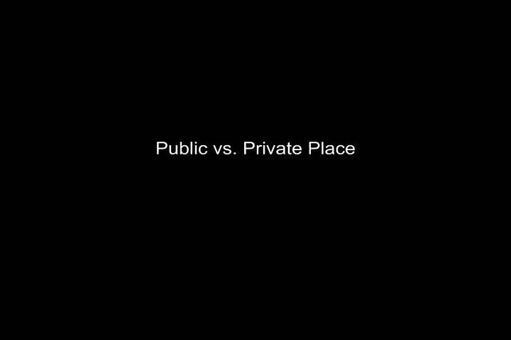
From Public to Private Places
Click to play video
Notes:
The final scene shows how people can adjust how public or private a place is. You will see that they can set:
The level of visibility of things in a place to outsiders
The visibility of the place itself
In closing, what these video segments have illustrated is that Come Together merges the merits of both instant messengers and the Community Bar.
- Through the console window, it extends the buddy list idea to capture the people, things and places a person is interested in
Place creation is literally a single click or drag and drop away
It keeps the tiered drill-down design of media items to support different levels of engagement

Slide 19
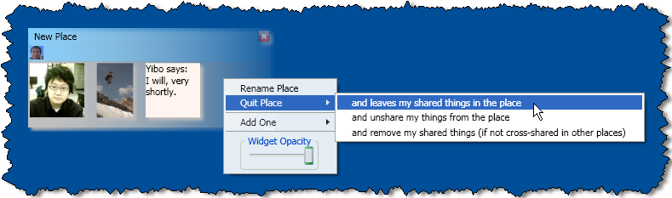
Preliminary Evaluation
12 individual participants
  scenario walkthrough: think-aloud
  interview
Results
  generally positive
  could improve
    withdrawal process too heavy-weight
    public nature of a place only works with certain communities
Notes:
While the paper doesn’t cover it, we conducted a preliminary evaluation of Come Together.
We recruited 12 HCI expert, where each individual saw and experienced the system’s main features using a combination of think-aloud, discussion, and usage scenarios.
Overall, we gathered quite positive reactions that the actual design of CB meets our main goal: light-weight formation of persistent meeting places and easy customization of adjustable awareness and involvement in a meeting place.
However, there were several areas that could be improved
First, while entering a place was easy, leaving it was too heavy-weight, where one had to decide how the place should be configured on departure (see image)
Second, we set the a place to be open and public by default, as our design philosophy is not to impose any heavy-weight and unnecessary restrictions, controls, or formal procedures between intimate collaborators in a small community. Many found this questionable, as it would depend on the actual community. They suggested that these setting should be site-specific.

Slide 20
Summary
People must be able to quickly bring together other people and their things to form a place for light-weight meetings
Notes:
To close, I would like to return to my main message:
People must be able to quickly bring together other people and their things to form a place for light-weight meeting
Come together illustrates one way that this can be done.

Slide 21
Console
Notes:
The primary design elements in Come Together that makes this happen are:
<animate>
A console that acts as a buddy list containing people, places and things
<animate>

Slide 22
Rapid Place Creation
Notes:
Rapid construction of places by simply dragging people and things together
<animate>
Control of awareness and involvement by adjusting how and where places appear

Slide 23
Center / Periphery Awareness
Notes:
Rapid construction of places by simply dragging people and things together
<animate>
Control of ones involvement and awareness at the center or periphery by adjusting how and where places appear, and how media items appear within it

Slide 24
Come Together
People- and artefact focused awareness
  awareness of people, things and places
  easy engagement with little cost
  involves artefacts and tools
  proximity and social context
  persistence of meeting places
  centre/peripheral involvement
Notes:
Collectively, these features support the key needs that make light-weight meetings work, and I hope the video scenarios illustarated that

