Slide 1
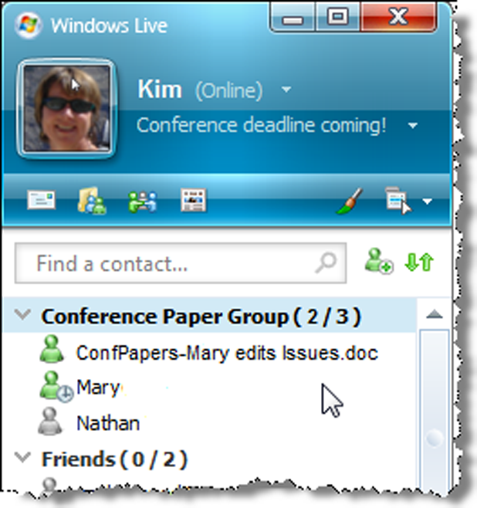
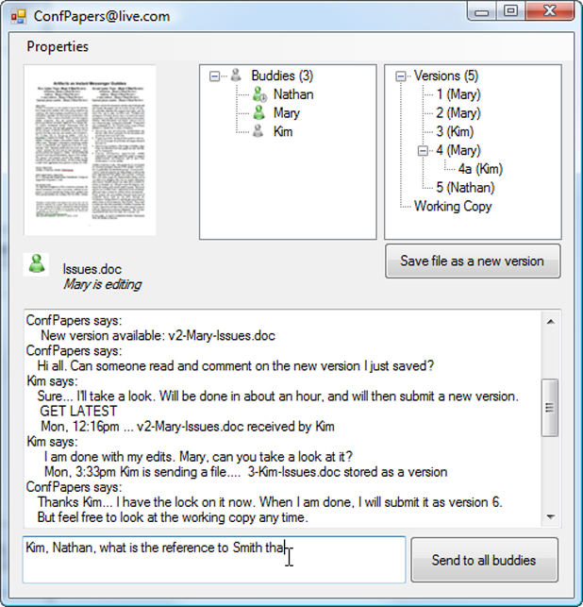
Artifacts as Instant Messaging Buddies
Saul Greenberg
Stephen Voida
Nathan Stehr
Kimberly Tee
University of Calgary

Slide 2


Slide 3
The Message
What if artifacts – documents - could be 1st class “buddies” in instant messaging?
Artifact Buddy: leverages IM where
  documents equivalent to people
  awareness of both people & document status
  people & documents can converse

Slide 4
Groupware
Notes:
Groupware – small groups of 2 - ~ 10
intimate collaborators - people with common goals and needs to work together

Slide 5
Communication, Work & Play

Slide 6


















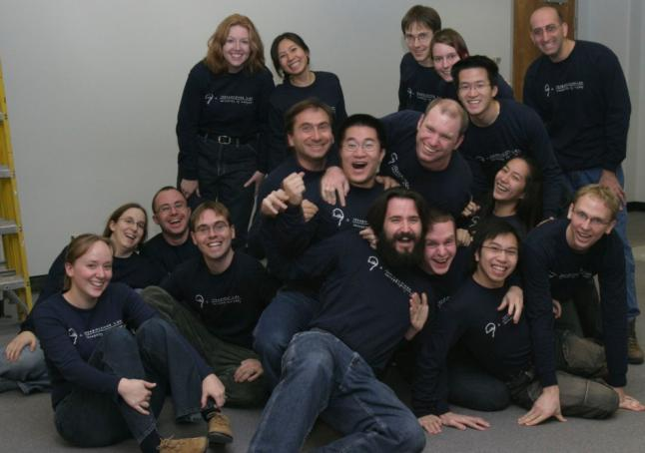






Interpersonal Awareness
up to the moment knowledge of group members
Notes:
-the glue behind casual interactions [Whittaker, Kraut]
-creates opportunities, helps continuity

Slide 7


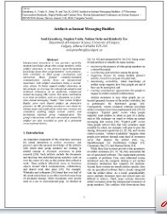

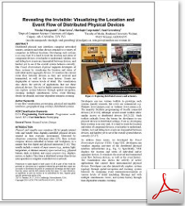


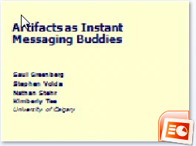

Artifact Awareness
up to the moment knowledge of group artifacts
Notes:
Groupware for sharing artifacts - Screen sharing, document editor
-coordinating joint activities
-monitoring progress
-determining availability
-creating opportunities
-Triggering mutual interests,

Slide 8
Artifact Awareness
  >½ of all casual interactions involves
  document sharing [Whittaker et. al.]
  Artifact awareness: Why? [Tee et. al]
  coordinating joint activities
  monitoring progress
  determining availability
  creating opportunities
  triggering interests

Slide 9
Can we do both?
Notes:
Groupware for doing both, i.e., having people communicate over shared artifacts

Slide 10
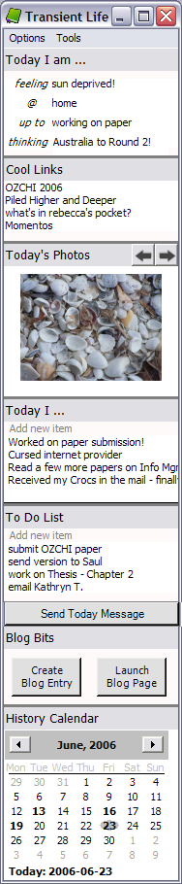
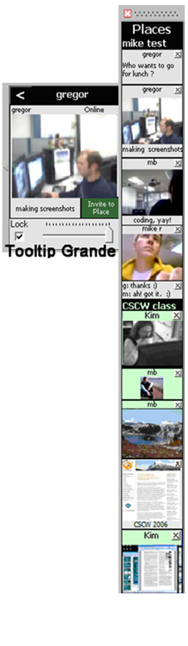
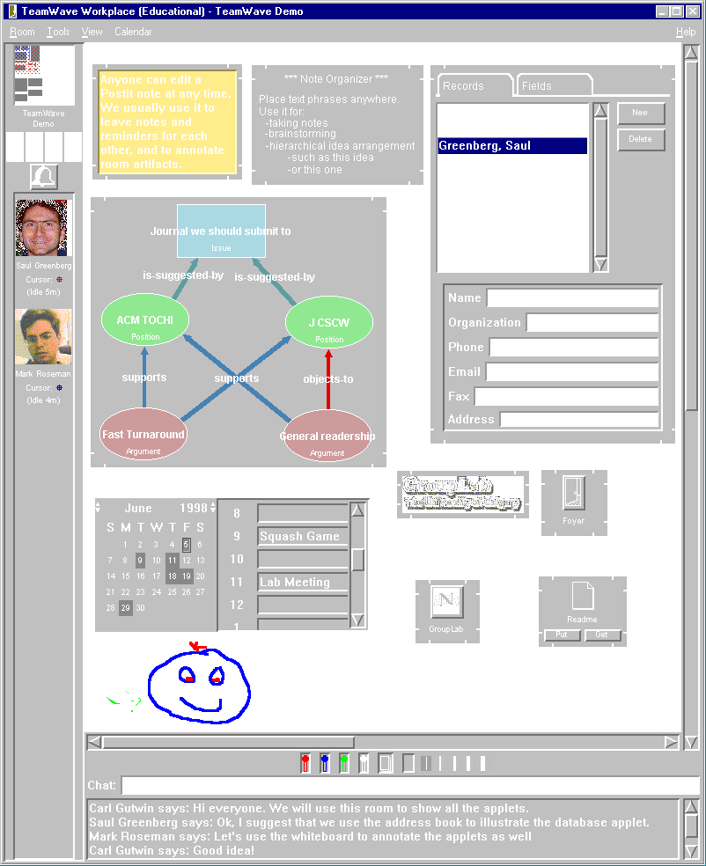
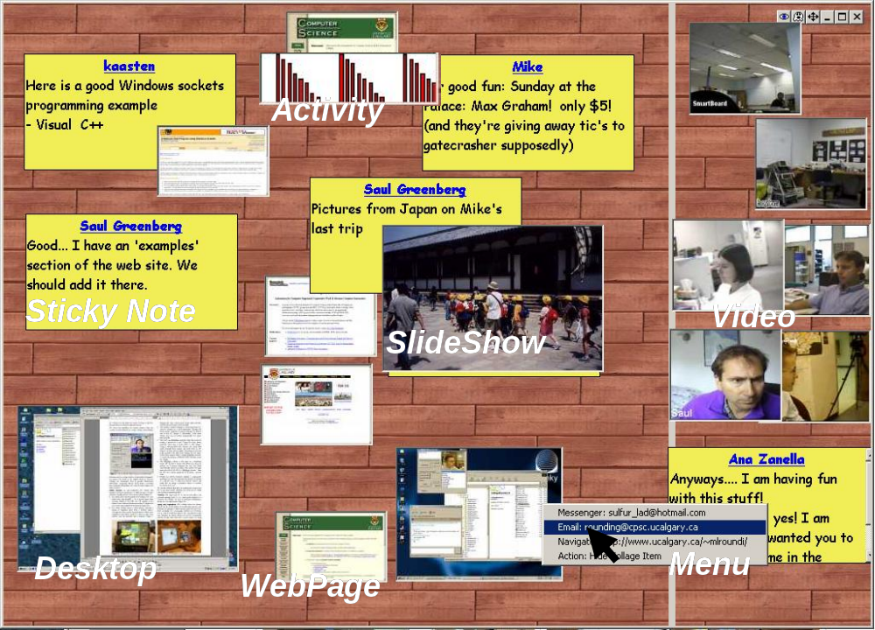
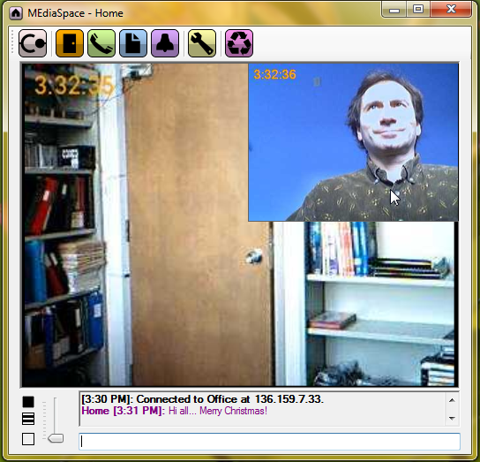
Transient
Transient
Life
Community
Life
Bar
TeamRooms
Notification
Collage
ME-dia
space
Notes:
History of work.
Primary idea with many variations: create a local or place where people and artifacts interconnect and persist
Perspective: real time system that provide for semi- or asynch interaction via persistence

Slide 11
New ideas

Slide 12
lightly used

Slide 13
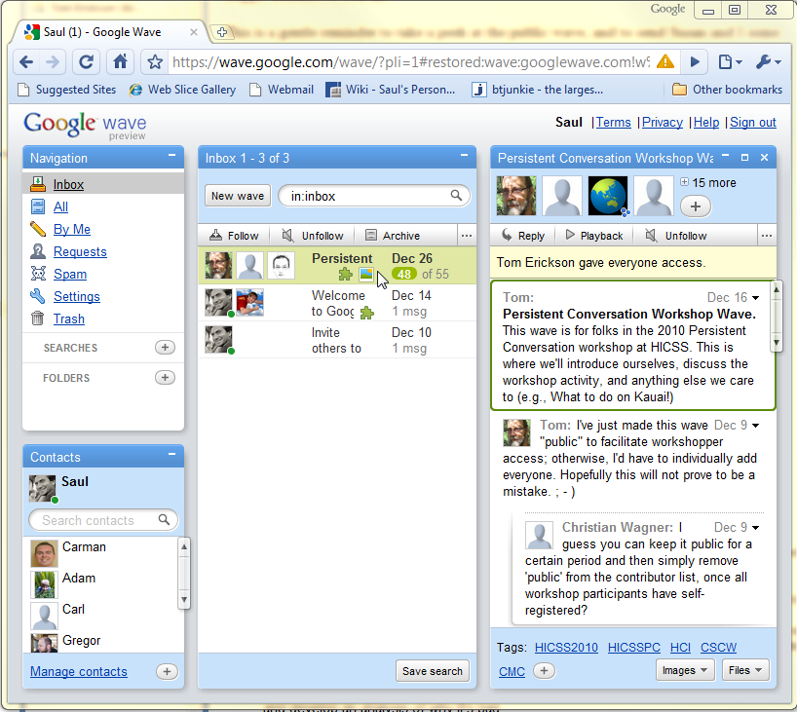
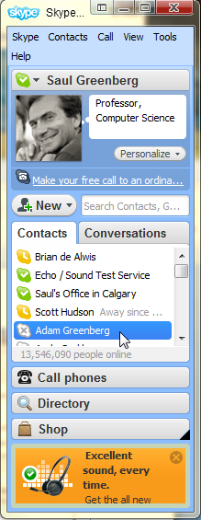
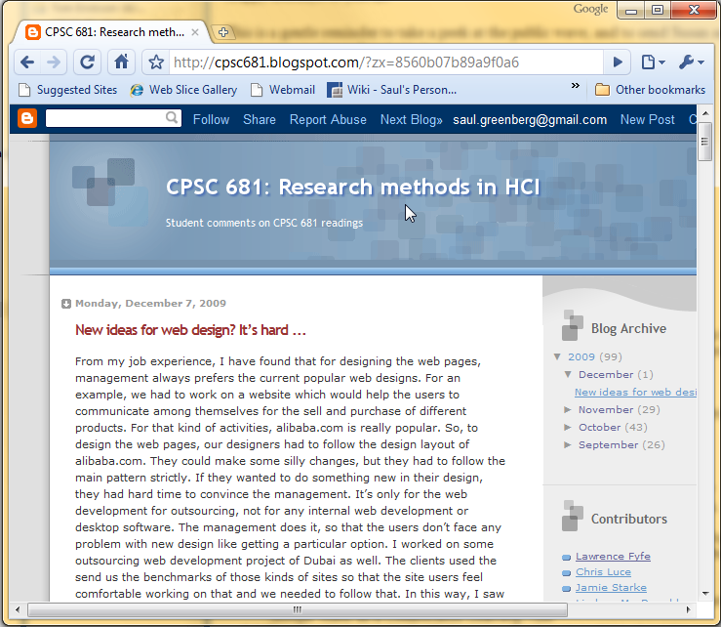
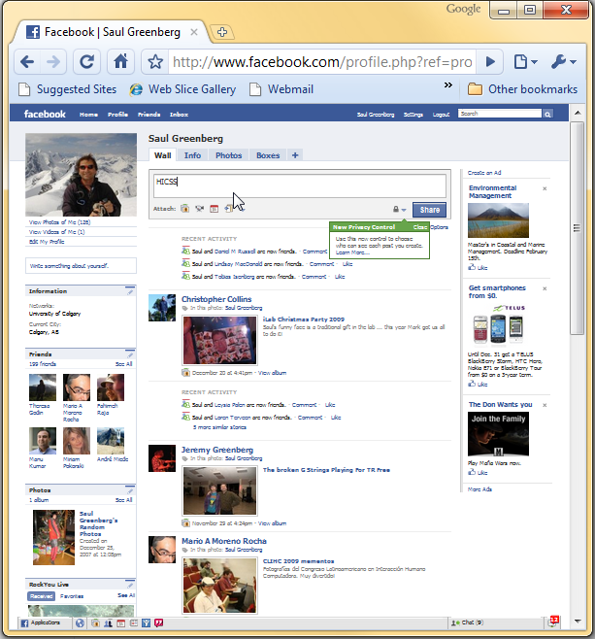
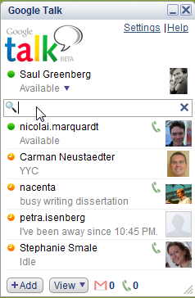
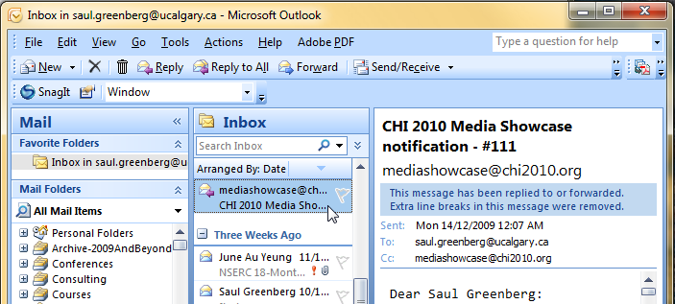

Slide 14
Established ideas

Slide 15
heavily used

Slide 16
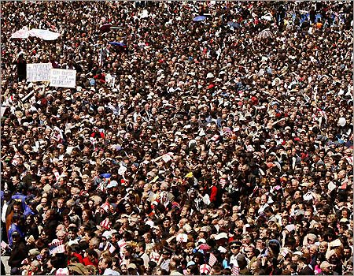
How do we get critical mass?

Slide 17
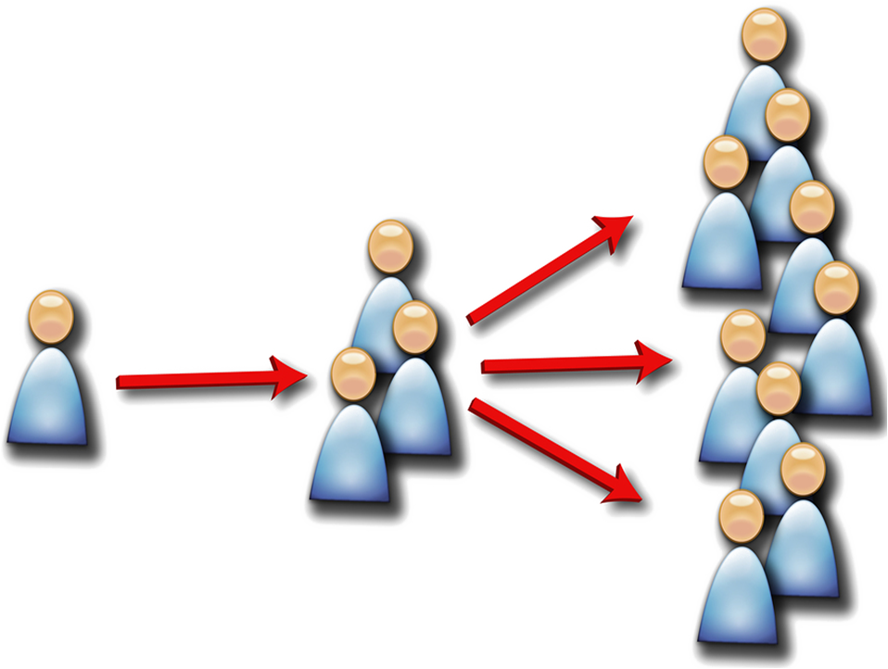
1. Hope our systems go viral

Slide 18
2. Appropriate existing systems
  good for interpersonal awareness
  add artifact awareness

Slide 19
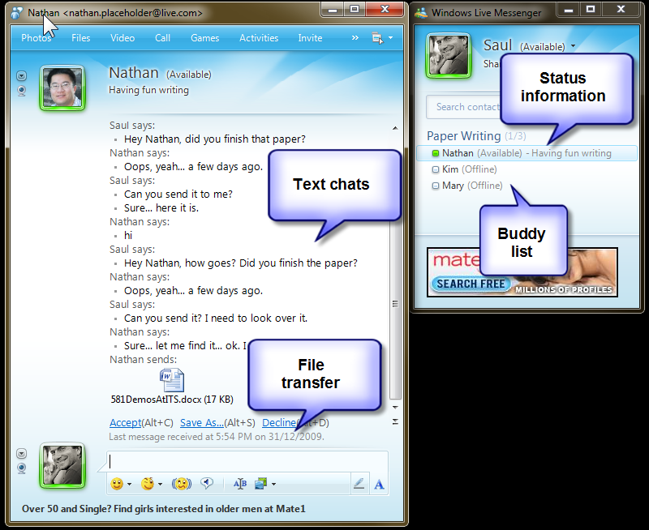

Slide 20
Artifact Buddy
Adds artifacts to IM as buddies
MS Word document

Slide 21
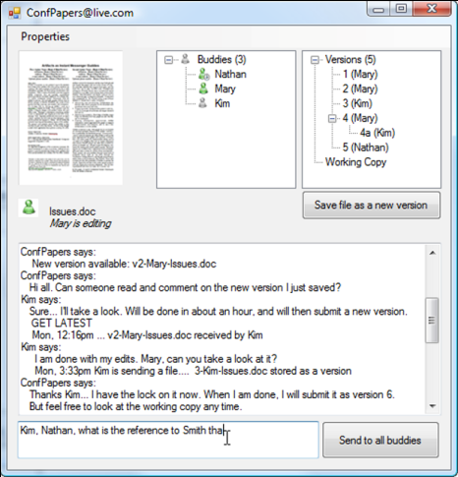



Artifact Buddy
  a single ‘helper app’ wraps MS Live Messenger API
Kim’s machine
Saul’s
machine
Helper app
Saul (online)
Nathan’s machine
IM Hub

Slide 22


Scenario

Slide 23
Setting Up Artifact Buddy
Create a Live Messenger account for the document
Enter IM account credentials into Artifact Buddy
Drag & Drop document into Artifact Buddy
Add collaborators as ‘buddies’ to Artifact Buddy

Slide 24
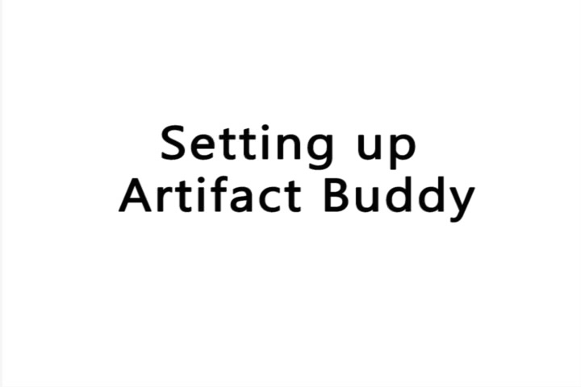
Click to play video

Slide 25
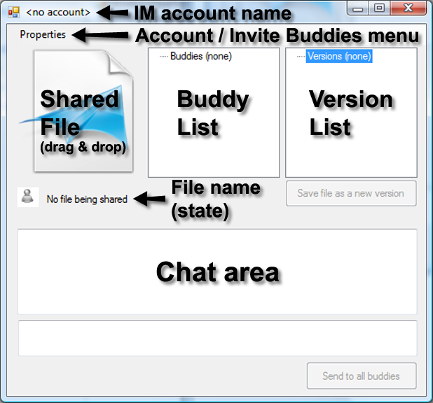
Basic Artifact Awareness
As Nathan edits the document
  Artifact Buddy monitors document activities
  updates document display name and status to reflect this
  others see this as they use IM as normal
update
monitor

Slide 26
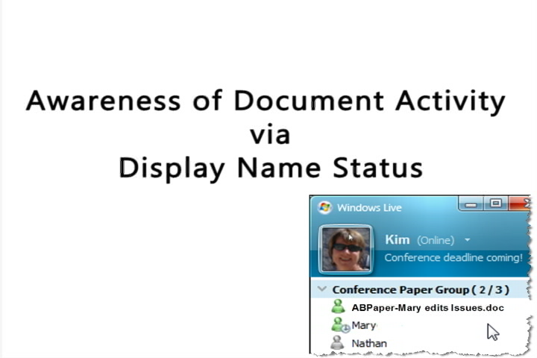
Click to play video

Slide 27
Version Control
As the document is revised, Artifact Buddy:
  stores multiple versions
  notifies others that a new version is available
  lets others retrieve particular versions through IM chat
  Get Latest
  - Artifact buddy sends latest version via IM file transfer

Slide 28

Click to play video

Slide 29
Conversing with Artifacts via Chat
Versions
  list of available document versions
Get <version #> or <original> or <latest>
  get a particular version, sent via file transfer
Free form text
  relayed to team members
  saved as a persistent transcript
Get transcript
  gets a transcript of all activity / discussion around the document
File tranfer to document
  stores it as a sub-version

Slide 30
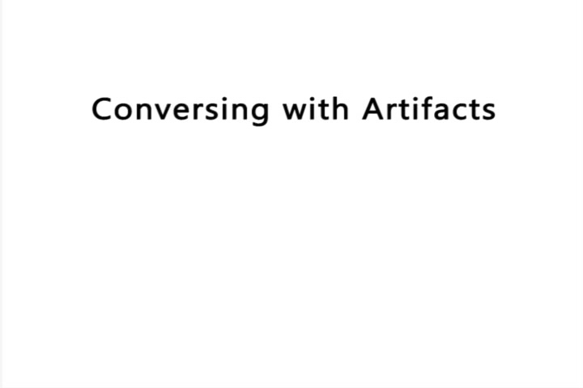
Click to play video

Slide 31
Click to play video

Slide 32
Migrating Control of Artifacts
Request control via chat to migrate system & versions
Blah
  Blah
Kim’s machine
Saul’s
machine
Helper app
Saul (online)
Nathan’s machine
IM Hub

Slide 33
Migrating Control of Artifacts
Request control via chat to migrate system & versions
Blah
  Blah
Kim’s machine
Saul’s
machine
Nathan’s machine
Saul (online)
IM Hub

Slide 34
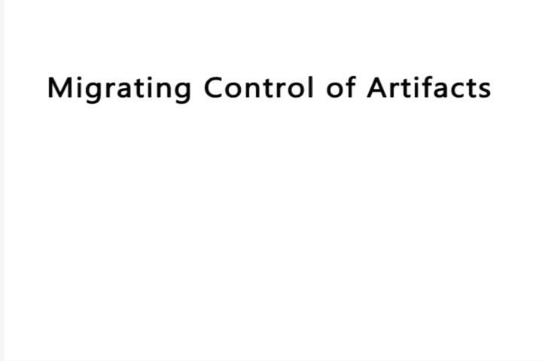
Click to play video

Slide 35
Advantages
Adds artifact awareness functionality to IM
Exploits
  critical mass of commercial IM use
  previously learnt mechanisms
  robust account maintenance and security
  robust IM communications hub and infrastructure
Only one person needs to set it up
  primary document author gets the benefit
  others only have to do modest work

Slide 36
Disadvantages
Restricted to IM capabilities
  requires open API
  some things require workarounds
  some things not possible

Slide 37
The Message
What if artifacts – documents - could be 1st class “buddies” in instant messaging?
Artifact Buddy: leverages IM where
  documents equivalent to people
  awareness of both people & document status
  people & documents can converse

Slide 38
Its more than IM ...
Artifact as your Facebook friend?

Slide 39
Sharing Control of Artifacts
Announce Editing / Editing Done
Blah
  Blah
Kim’s machine
Saul’s
machine
Helper app
Saul (online)
Nathan’s machine
IM Hub

Slide 40
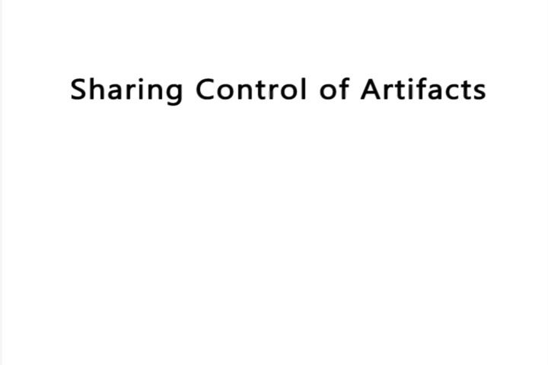
Click to play video

Slide 41
Migrating Control of Artifacts
People can take control by
  requesting control via chat
  Artifact Buddy migrates itself and its documents to that person’s machine

