Slide 1
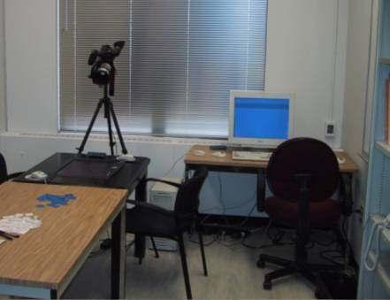
Usability Evaluation Considered Harmful
Some of the time
Saul Greenberg
University of Calgary
Bill Buxton
Microsoft Research
Notes:
This presentation was given at the ACM CHI Conference, April 2008, in Florence, Italy. It was immediately followed by a panel that discussed it (Moderator: Beth Mynatt. Panelists: Tom Rodden, Bonnie John, and Dan Olson).
Detailed speaking notes are included in the slide deck.

Slide 2
Warning: Opinions Ahead
Notes:
First, a warning. This is an opinion paper and may be controversial. We do expect arguments.

Slide 3
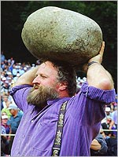
Warning: Opinions Ahead
Source: stadtherr.com/Rock_Throwing.jpg /
Notes:
Some people may want to throw rock at us,

Slide 4
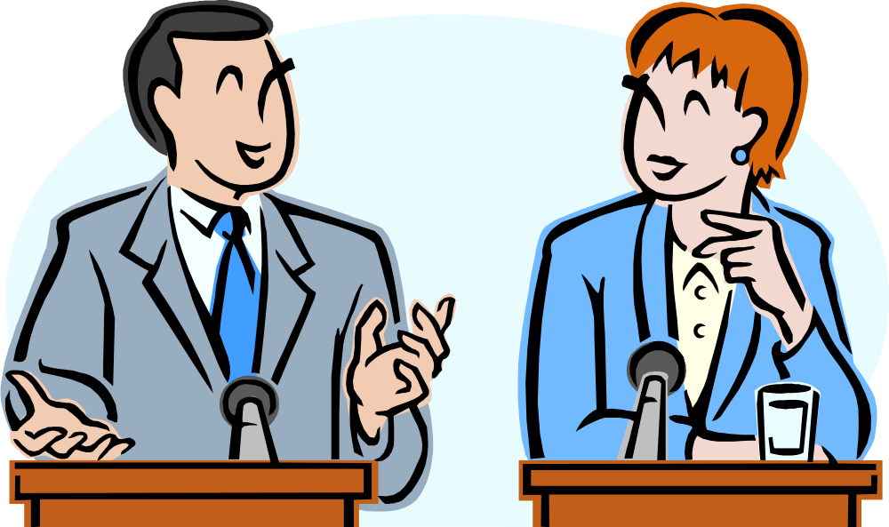
Warning: Opinions Ahead
Notes:
But we would prefer well-informed debate.

Slide 5
An anti usability rant?
Bill
Saul
Tohidi, M., Buxton, W., Baecker, R. & Sellen, A. (2006). Getting the Right Design and the Design Right: Testing Many Is Better Than One. Proceedings of the 2006 ACM Conference on Human Factors in Computing Systems, CHI'06, 1243-1252.
Owen, R., Kurtenbach, G., Fitzmaurice, G., Baudel, T. & Buxton, W. (2005). When it Gets More Difficult, Use BothHhands - Exploring Bimanual Curve Manipulation. Proceedings of Graphics Interface, GI'05, 17-24.. Buxton, W., Fitzmaurice, G. Balakrishnan, R. & Kurtenbach, G. (2000). Large Displays in Automotive Design. IEEE Computer Graphics and Applications, 20(4), 68-75.
Fitzmaurice, G. & Buxton, W. (1997). An empirical evaluation of graspable user interfaces: Towards specialized space-multiplexed input. Proceedings of the 1997 ACM Conference on Human Factors in Computing Systems, CHI '97, 43-50.
Leganchuk, A., Zhai, S.& Buxton, W. (1998).Manual and Cognitive Benefits of Two-Handed Input: An Experimental Study. Transactions on Human-Computer Interaction, 5(4), 326-359.
Kurtenbach, G., Fitzmaurice, G., Baudel, T. & Buxton, W. (1997). The design and evaluation of a GUI paradigm based on tabets, two-hands, and transparency. Proceedings of the 1997 ACM Conference on Human Factors in Computing Systems, CHI '97, 35-42.
MacKenzie, I.S. & Buxton, W. (1994). Prediction of pointing and dragging times in graphical user interfaces Interacting With Computers, 6(4), 213-227.
Kurtenbach, G., Sellen, A. & Buxton, W. (1993). An empirical evaluation of some articulatory and cognitive aspects of "marking menus." Human Computer Interaction, 8(1),. 1-23.
MacKenzie, I.S., Sellen, A. & Buxton, W. (1991). A comparison of input devices in elemental pointing and dragging tasks. Proceedings of CHI '91, ACM Conference on Human Factors in Software, 161-166
Buxton, W. & Sniderman, R. (1980). Iteration in the Design of the Human-Computer Interface. Proceedings of the 13th Annual Meeting, Human Factors Association of Canada, 72-81.
…
Tse, E., Hancock, M. and Greenberg, S. (2007) Speech-Filtered Bubble Ray: Improving Target Acquisition on Display Walls. Proc 9th Int'l Conf. Multimodal Interfaces (ACM ICMI'07), (Nov. 12-15, Nagoya, Japan). ACM Press.
Neustaedter, C., Greenberg, S. and Boyle, M. (2006). Blur Filtration Fails to Preserve Privacy for Home-Based Video Conferencing. ACM Transactions on Computer Human Interactions (TOCHI), 13, 1, March, p1-36.
Smale, S. and Greenberg, S. (2005) Broadcasting Information via Display Names in Instant Messaging. Proceedings of the ACM Group 2005 Conference, (Nov 6-9, Sanibel Island, Florida), ACM Press.
Kruger, R., Carpendale, M.S.T., Scott, S.D., and Greenberg, S. (2004) Roles of Orientation in Tabletop Collaboration: Comprehension, Coordination and Communication. J Computer Supported Cooperative Work, 13(5-6), Kluwer Press.
Tse, E., Histon, J., Scott, S. and Greenberg, S. (2004). Avoiding Interference: How People Use Spatial Separation and Partitioning in SDG Workspaces. Proceedings of the ACM CSCW'04 Conference on Computer Supported Cooperative Work, (Nov 6-10, Chicago, Illinois), ACM Press.
Baker, K., Greenberg, S. and Gutwin, C. (2002) Empirical development of a heuristic evaluation methodology for shared workspace groupware. Proceedings of the ACM Conference on Computer Supported Cooperative Work, 96-105, ACM Press.
Kaasten, S. and Greenberg, S. and Edwards, C. (2002) How People Recognize Previously Seen WWW Pages from Titles, URLs and Thumbnails. In X. Faulkner, J. Finlay, F. Detienne (Eds) People and Computers XVI (Proceedings of Human Computer Interaction 2002), BCS Conference Series, 247-265, Springer Verlag.
Steves, M.P., Morse, E., Gutwin, C. and Greenberg, S. (2001). A Comparison of Usage Evaluation and Inspection Methods for Assessing Groupware Usability. Proceedings of ACM Group'01 Conference on Supporting Group Work, 125-134, ACM Press.
Zanella, A. and Greenberg, S. (2001) Reducing Interference in Single Display Groupware through Transparency. Proceedings of the Sixth European Conf Computer Supported Cooperative Work (ECSCW 2001), September 16-20, Kluwer.
…
Notes:
If you’ve come here expecting an anti-usability rant, you may be disappointed.
<CLICK>
Both Bill and I strongly believe that usability evaluation has a significant role to play in HCI, and indeed many of our own publications over the years relies on usability evaluation as a critical method in our research.

Slide 6
Usability evaluation if wrongfully applied
In early design
  stifle innovation by quashing (valuable) ideas
  promote (poor) ideas for the wrong reason
In science
  lead to weak science
In cultural appropriation
  ignore how a design would be used in everyday practice
Notes:
So, what is the problem?
We believe that usability evaluation, if wrongfully applied, can lead to problems in various stages of technology development.
<read slides>
…

Slide 7
The Solution - Methodology 101
  the choice of evaluation methodology - if any – must arise and be appropriate for the actual problem, research question or product under consideration
Notes:
The good news is that solving this problem is easy.
Indeed, its something that you should have been taught in an introductory methodology class…
<read slides>
The challenge is that we as a community have forgotten this most basic lesson.

Slide 8
Changing how you think
Usability evaluation
CHI trends
Theory
Early design
Science
Cultural appropriation
Notes:
To meet this challenge, Bill and I (and maybe the panel) will try to change how you think. We will do this by first
-Defining usability evaluation
Looking at trends in usability evaluation in CHI over the years
Using a theory of science innovation over time as a framework to talk about the role of usability evaluation in early design, science, and cultural appropriation
We are going to leave much out that is discussed in the paper – please read it!

Slide 9
Part 1. Usability Evaluation
Notes:
Let’s begin by quickly reviewing what usability evaluation is for and typical methods we employ to do it.

Slide 10
Usability Evaluation
assess our designs and
test our systems to ensure that they actually behave as we expect and
meet the requirements of the use
Dix, Finlay, Abowd, and Beale 1993
Notes:
There are many definitions, and this one is as good as any <READ> …

Slide 11
Usability Evaluation Methods
Most common (research):
controlled user studies
laboratory-based user observations
Less common
inspection
contextual interviews
field studies / ethnographic
data mining
analytic/theory
…
Notes:
In CHI research, here is the methods we choose
<READ>
The order is different in HCI practice, where observational and some form of inspection-based studies dominate.

Slide 12
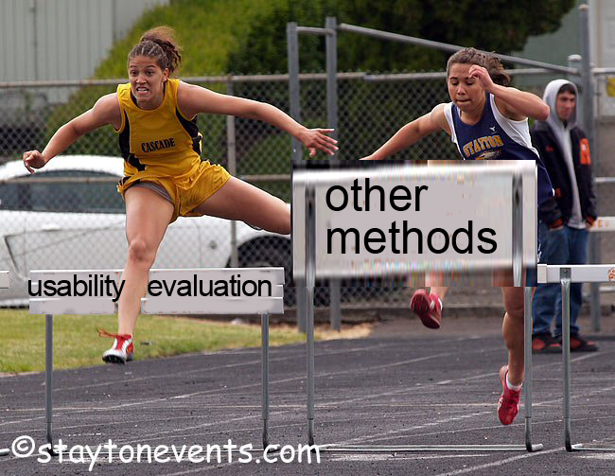
Notes:
There are, of course, many other methods available. The issue is not whether these other methods are known or used by our community, for they are. However, there is a much higher barrier getting papers using those other methods published in CHI, or in incorporating those methods in Education and Industrial Practice.

Slide 13
Part 2. CHI Trends
Notes:
To understand why usability evaluation can be a problem, we have to look at how it fits within the current context of CHI research, HCI Education, and HCI practice. We’ll start with CHI Research.

Slide 14
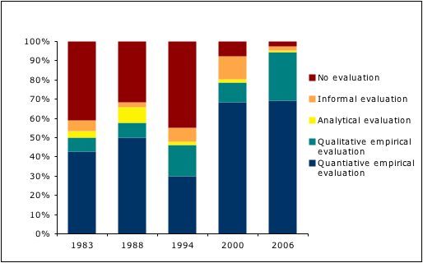
CHI Trends (Barkhuus/Rode, Alt.CHI 2007)
none
analytic
informal
qualitative
quantitative
2007
Notes:
In Alt.CHI 2007, Barkhuus and Rodes presented an analysis of 24 years of evaluation reported in CHI proceedings.
They counted the percentage of papers that included
-quantitive evaluation (blue, bottom)
-qualitative evaluation (peacock green)
-informal and analytic evaluation (yellow & orange)
-no evaluation (red)
From 1983 – 94, we see that about half the papers included a usability evaluation component, mostly quantitative.
<CLICK>In 2000, the amount of papers including usability evaluation increased sharply,
<CLICK> rising to 95% of all papers by 2006, where fully 70% of all papers had some kind of quantitative study.
<CLICK>We just checked the 2007 CHI proceedings, and this ratio also hold.

Slide 15
CHI Trends (Barkhuus/Rode, Alt.CHI 2007)
usability evaluation
in industry
2007
Notes:
One possible reason for this trend could be CHI’s success in the mid-90s in promoting usability evaluation in day to day industrial practice, which in turn influenced its incorporation in research.

Slide 16
CHI Trends
User evaluation is now
a pre-requisite for
CHI acceptance
Qualitative 25%
Quantitative 70%
2007
Notes:
Regardless of the reason, somewhere along the way, we started insisting that usability evaluation should be part of all of our research.
I think few would dispute the believe that <READ>

Slide 17
CHI Trends (Call for papers 2008)
Authors
“you will probably want to demonstrate ‘evaluation’ validity, by subjecting your design to tests that demonstrate its effectiveness ”
Reviewers
“reviewers often cite problems with validity, rather than with the contribution per se, as the reason to reject a paper”
Qualitative 25%
Quantitative 70%
Notes:
This believe is re-enforced in how we interpret our call for papers.
The instructions to authors state… <READ>
Reviewers have also bought into the need for usability evaluation. As the call for papers states…<READ>

Slide 18
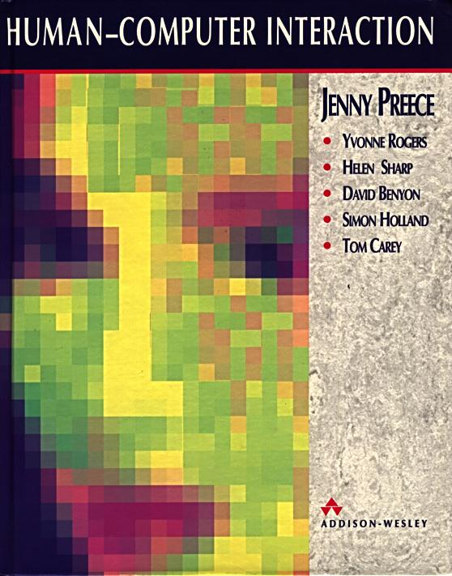
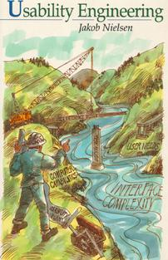
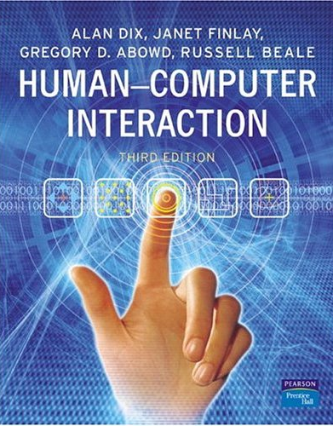
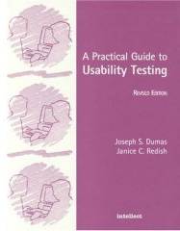
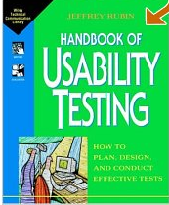
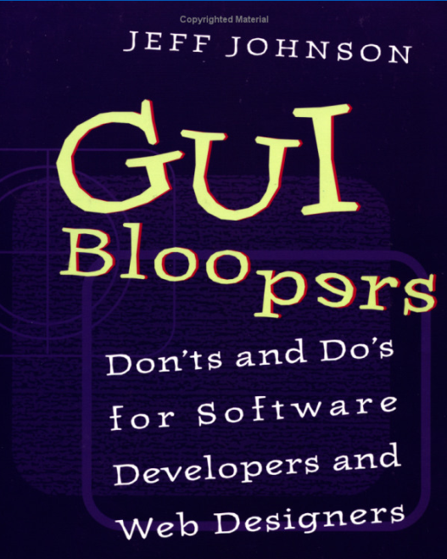
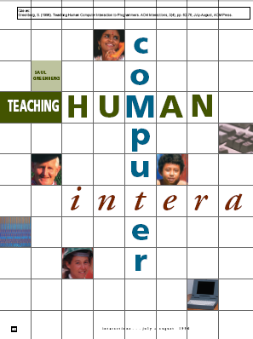
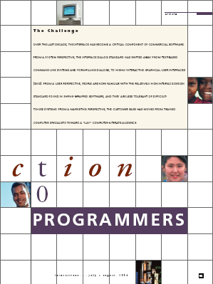
HCI Education
Notes:
HCI education also promotes usability evaluation, with heavy weight placed on it in general HCI texts and whole books on the topic.
We typically teach usability observation in undergraduate courses, and quantitative controlled methods in graduate courses.
This often comes at the expense of other methods, such as field studies, contextual interviews, design reflection, likely because those are much harder to teach and test.

Slide 19
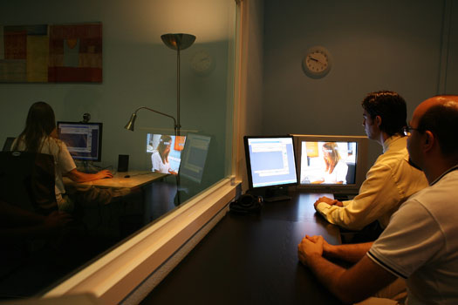
HCI Practice
Source: http://www.xperienceconsulting.com/eng/servicios.asp?ap=25
Notes:
HCI practice in industry also maintains a strong focus on usability testing. While current HCI practice in the best places is now somewhat broader with its focus on user experiences, usability testing still dominates many (but not all) companies. We fully understand there is way more to today’s usability practice than the usability lab. However, that best is not well reflected in the literature, in education, and in our conferences.

Slide 20
Notes:
So, why is the promotion of usability evaluation a problem instead of a good thing?

Slide 21
Dogma
Usability evaluation = validation = CHI = HCI
Notes:
Usability evaluation is now dogma. We do it because everyone does it and everyone expects it.
Usability evaluation is now considered the primary tool for validating almost everything we do, which means it in turn is defining CHI research and heavily influencing HCI education and practice.
Usability evaluation = validation = CHI = HCI
Dogma, to remind you, is a doctrine or code of beliefs accepted as authoritative. We challenge this.

Slide 22
Part 3. Some Theory
Notes:
To frame the rest of our arguments, let me introduce you to some theory.

Slide 23
Discovery vs Invention (Scott Hudson UIST ‘07)
Discovery
uncover facts
detailed evaluation
Understand what is
Notes:
First, lets talk about the differences between discovery vs. invention.
At a UIST 2007 panel, Scott Hudson described discovery as akin to science. It is the process where we uncover facts. Detailed evaluation has a significant role to play here, for small differences and detail matter, especially in helping us compare competing theories. Its primary purpose is to understand what is.

Slide 24
Discovery vs Invention (Scott Hudson UIST ‘07)
Discovery
Invention
uncover facts
detailed evaluation
Understand what is
create new things
refine invention
Influence what will be
Notes:
Invention is akin to art and engineering, where it creates new things. The idea is to refine the invention over time, usually by looking at big effect to ensure that the invention fits in our real world context. Its primary purpose is to influence what will be.

Slide 25

Notes:
I would argue that HCI is about both discovery and invention,
<CLICK>
But I am not sure this is reflected in how we do things.

Slide 26
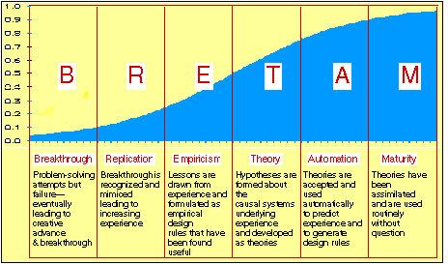
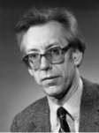
Time
Learning
Breakthrough
Replication
Empiricism
Theory
Automation
Maturity
Brian Gaines
Notes:
Now lets consider how discovery and invention happens over time
Quite a while ago, Brian Gaines, a computer scientist, developed a theory of the evolution of science technology. The X axis is time, while the Y axis, and the blue area of the graph, show our increased understanding of the technology.
In general, technology goes through the following cycles, where we progressively learn over time.
B – major creative advances // Rep - ideas mimicked and altered; gain increasing experience // Emp & Theory – where the lessons learnt are formulated as empirical design rules & underlying causal systems proposed // A&M – accepted and used routinely

Slide 27
Time
Learning
Breakthrough
Replication
Empiricism
Theory
Automation
Maturity
early design
& invention
science
cultural
appropriation
Notes:
Another way of looking at this is to consider technology and how it fits into various categories of development.
Breakthrough and replication is a consequence of inventions & early designs
Science happens when we learn from our experiences with these technologies, that is, it is about discovery.
Cultural appropriation occurs when the technologies move outside the domain of designers and scientists, where the culture invents new meanings of use around the technology.

Slide 28
Time
Learning
Breakthrough
Replication
Empiricism
Theory
Automation
Maturity
early design
& invention
science
cultural
appropriation
Notes:
Of course, this is not strictly linear, for any stage can influence any prior stage.
For example, our understandings discovered in science can provide insight to promoting new designs and inventions.
We will use this framework to reconsider the role of usability evaluation.

Slide 29
Part 4. Early Design
Breakthrough
Replication
Notes:
Early designs are sometimes routine, or can suggest a breakthrough in how things are typically done.
Almost all have some aspect that is highly speculative.

Slide 30
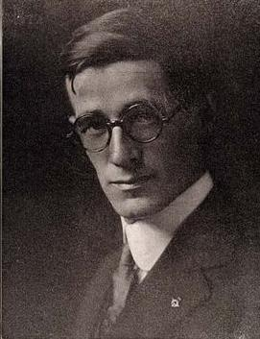
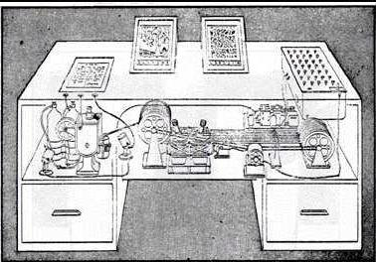
Memex Bush
Concept
Notes:
Lets consider one very early design: Memex as conceived by Vannevar Bush in 1945. His idea is generally considered to be the seminal introduction to the concept of Hypertext.
<CLICK>
His article was a early design concept, where he proposed but did not build a hypertext system based on linking of knowledge stored in microfilm technology.
Now imagine how it would fair under a CHI review:

Slide 31
Unimplemented and untested design. Microfilm is impractical. The work is premature and untested.
Resubmit after you build and evaluate this design.
Reject
Notes:
Reject
<READ>

Slide 32
We usually get it wrong
Notes:
The point I want to make is that we usually get it wrong in our early designs.
Yet these early designs are still valuable.

Slide 33
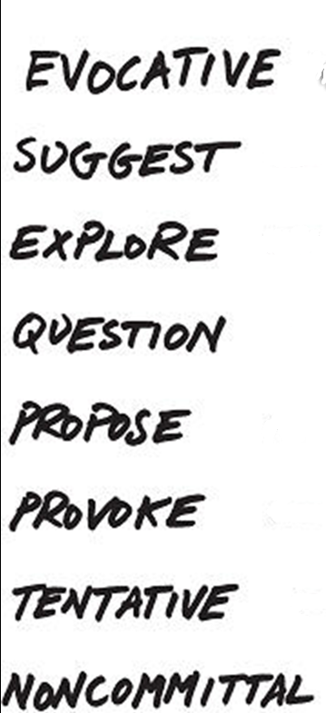
Early design as working sketches
Sketches are innovations valuable to HCI
Notes:
Lets consider early design as working sketches. Most of us think of a sketch as something we do on pencil and paper, but the reality is that many of the systems we build are no more than working sketches.
Bill Buxton, in his book Sketching the User Interface, defines sketches in terms of how they are used. <READ> This list certainly applies to many CHI innovations we mistakenly call prototypes.

Slide 34
Early design
Early usability evaluation can kill a promising idea
  focus on negative ‘usability problems’
idea
idea
idea
idea
Notes:
What can happen if we perform a thorough usability evaluation on an early design idea?
First, it can kill a promising idea. Most evaluations focus on producing a list of negative ‘usability problems’ , which will undoubtedly exist in an early system.
If we are comparing that idea to other more established ones (where there was time to iron out these problems), it is no surprise that the early design often looses out.

Slide 35
Early designs
Iterative testing can promote a mediocre idea
idea1
idea1
idea1
idea1
idea1
Notes:
Second, it can promote a mediocre idea through iterative testing. As problems are found and solve, we can make the idea better. This does not necessarily mean it’s a good idea.
In Computer Science, we call this local hill climbing problems, where we find sub-optimal instead of optimal solutions. There are even algorithms to avoid this.

Slide 36
Early design
Generate and vary ideas, then reduce
idea5
idea5
idea3
idea8
idea6
idea7
idea5
idea2
idea9
idea4
idea1
Usability evaluation the better ideas
Notes:
Instead of jumping into evaluation, early design is better suited to a methodology that promotes idea generation, where testing is done by other methods such as argumentation and reflection of a multitude of ideas. Thorough usability evaluation begins only on the most promising ones.

Slide 37
Early designs as working sketches
Getting the design right
Getting the right design
idea1
idea1
idea1
idea1
idea1
idea5
idea5
idea3
idea8
idea6
idea7
idea5
idea2
idea9
idea4
idea1
Notes:
Bill Buxton calls this the difference between getting the design right vs. Getting the right design.
We argue that usability evaluation promotes getting the design right, and that other methods should be used instead to get the right design.

Slide 38
Early designs as working sketches
Methods:
  idea generation, variation, argumentation, design critique, reflection, requirements analysis, personas, scenarios contrast, prediction, refinement, …
idea5
idea5
idea3
idea8
idea6
idea7
idea5
idea2
idea9
idea4
idea1

Slide 39
Part 6. Science
Sweet spot
Empiricism
Theory
Notes:
Lets move onto the mid part of Science technology development, we are now generalizing guidelines and theories from the lessons learnt from our experiences.
<CLICK> In many ways, this is the sweet spot of Usability Evaluation and the CHI conference.
Yet we mistakenly believe that if we do usability evaluation, particularly through a controlled experiment, it will lead to good science.
This is not necessarily the case. Let me describe a few problems.

Slide 40
I need to
do an
evaluation
Notes:
The first problem is in how we define our research. Consider this dialog which typifies many I have had with students and others.
<Read>

Slide 41
What’s the problem?
Notes:
So I ask ‘what is the problem’, meaning what research problem are you trying to solve

Slide 42
It won’t get accepted if I don’t. Duh!
Notes:
And he replies…

Slide 43
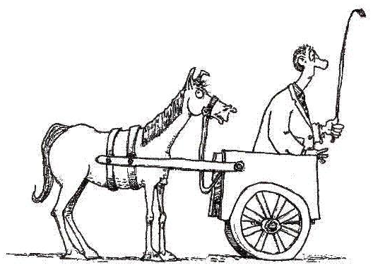
Source: whatitslikeontheinside.com/2005/10/pop-quiz-whats-wrong-with-this-picture.html
Notes:
The issue is that we are putting the cart before the horse, where we begin with our methodology rather than the problem.

Slide 44
Research process
Choose the method then define a problem
or
Define a problem then choose usability evaluation
or
Define a problem then choose a method to solve it

Notes:
How should we define our research? Should we:
<read>
<CLICK>
My opinion is the last one is best

Slide 45
Research process
Typical usability tests
  show technique is better than existing ones
Existence proof: one example of success
Notes:
Yet even if we define a good problem amenable to usability evaluation, problems can occur.
A typical usability evaluation will try to show that some new technique is better than the existing one.
We often do this as an existence proof.
We choose some condition that is likely amenable to our new technique, and we hopefully end up with one example showing success.
Surprise, surprise. We would be poor technologists indeed if we could not find at least one successful case.

Slide 46
Research process
Risky hypothesis testing
  try to disprove hypothesis
  the more you can’t, the more likely it holds
What to do:
  test limitations / boundary conditions
  incorporate ecology of use
  replication
Notes:
This is, at best, weak science.
Good science is all about risky hypothesis testing. We test to <read>
I have seen very few of these at CHI.
There are solutions to this, and this is straightforward science.
We can have stricter tests conditions that try to uncover limitations and boundary conditions of our technique.
We can examine our technique in the complete ecology of use, not just one that is favourable to it.
We can replicate and vary our studies, but unfortunately this is not highly valued as a CHI contribution.

Slide 47
Part 6. Cultural Appropriation
Automation
Maturity
Notes:
Now we turn to Cultural Appropriation, which is what happens when technology matures and leaves the hands of designers, scientists and engineers.
Cultural appropriation occurs when society uses and adapts our technology to their everyday use, often in ways quite different from what the technologists expected.
That it, it is all about how cultures create their own meaning around the technology.
I would argue that CHI and HCI practice rarely predicts cultural appropriation, except to study it after it has happened.

Slide 48
Memex Bush
Notes:
Let me argue this by example, going back to Bush’s Memex. The original idea came about in 1945, and was envisioned as a better way to link and access our stored knowledge.

Slide 49
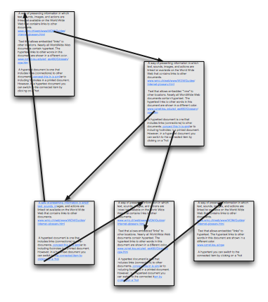
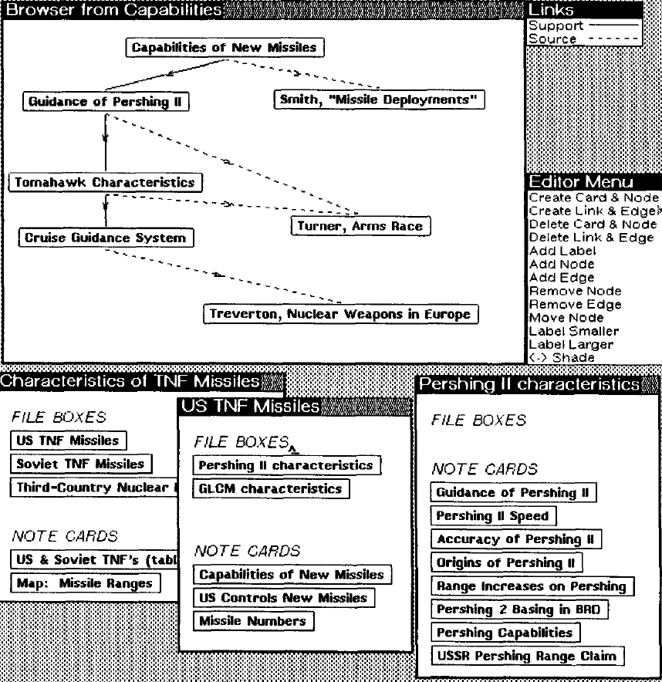
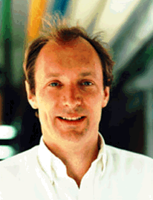
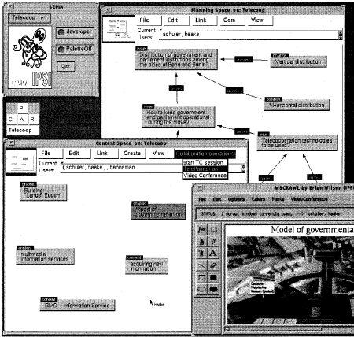
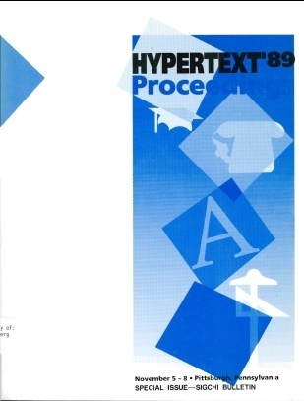
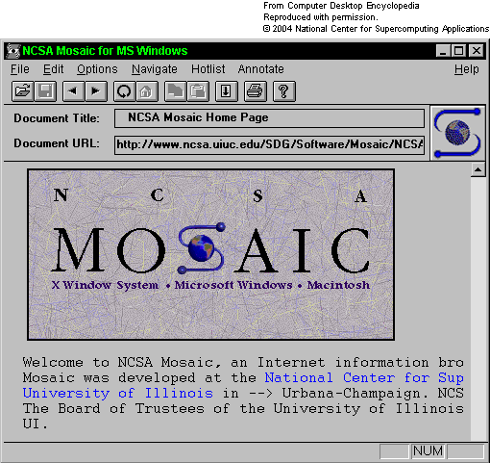
1945 Bush
1987 Notecards
1979 Ted Nelson
1990 HTTP
1989 ACM
1992 Sepia
1993 Mosaic
Notes:
Hypertext as knowledge linking was invented and reinvented several times, from Doug Engelbart’ in1968, Ted Nelson & Project Xanadu in 1979, and many more over the years.
Berners-Lee created the HTTP protocol in 1990, and Mosaic brought hypertext to the public in 1993. The ACM Hypertext Conference began in 1989.
Yet if you go through all these systems and literature, you will find that they all focus on knowledge linking and management.
What happened when Hypertext was appropriated by our cultures via the World Wide Web?

Slide 50
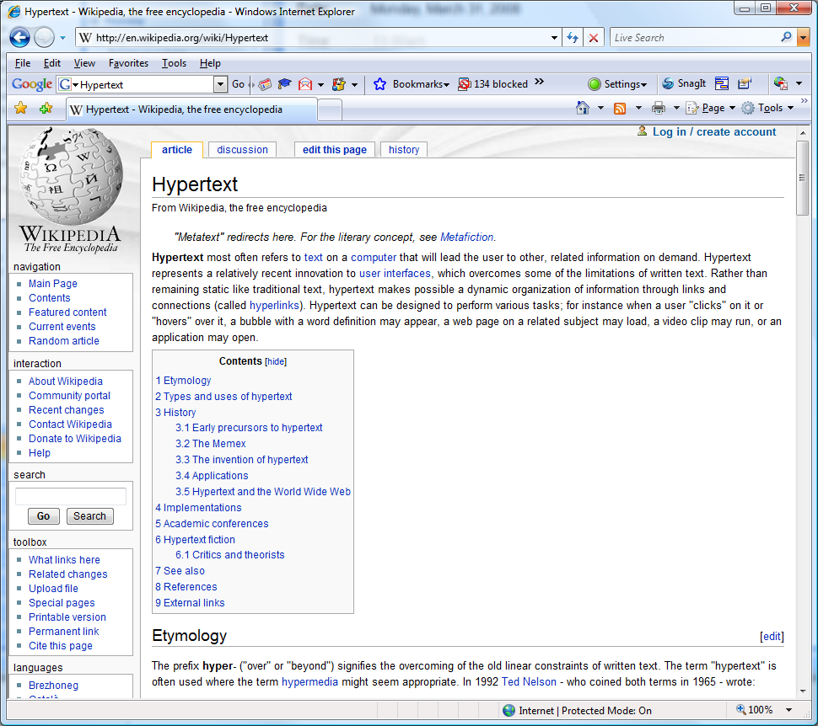
Notes:
Some of it has kept to the original vision of Hypertext as defined by its pioneers, as knowledge linking

Slide 51
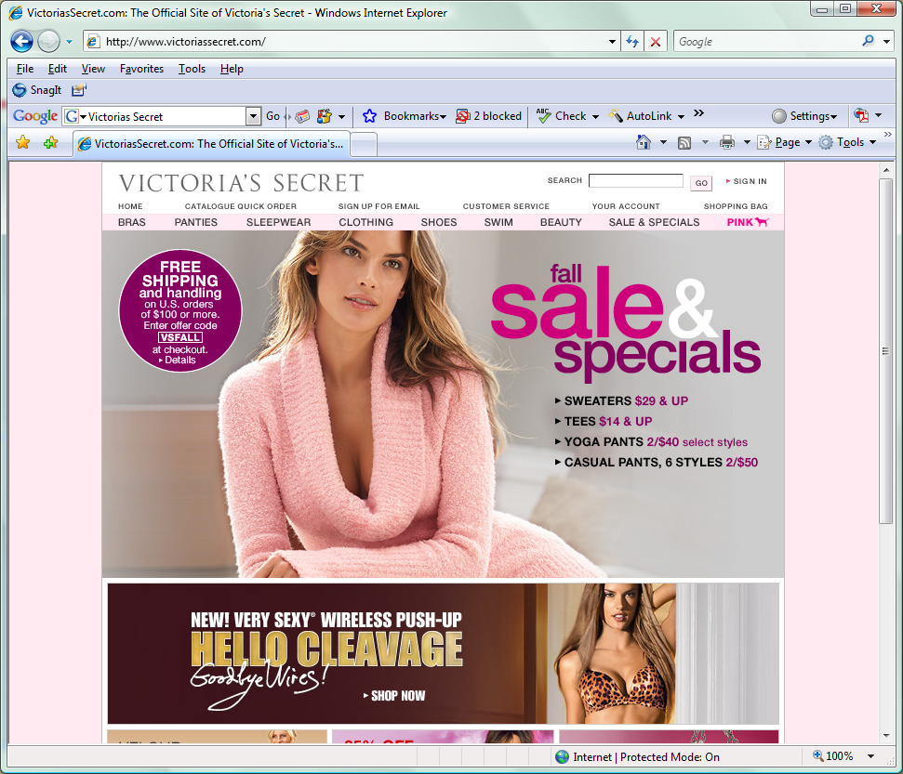
Notes:
But much of the web went elsewhere. Its now the mainstay of e-Commerce,

Slide 52
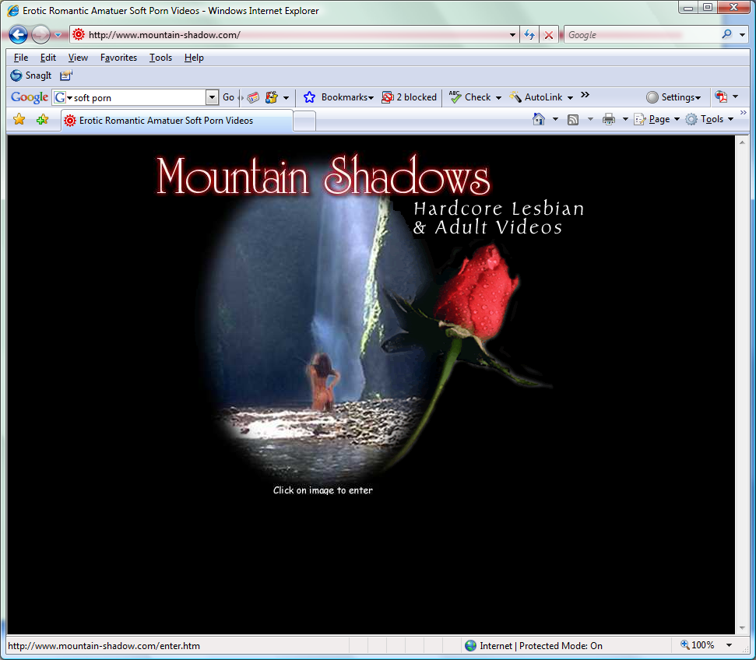
Notes:
Of Pornography dissemination

Slide 53
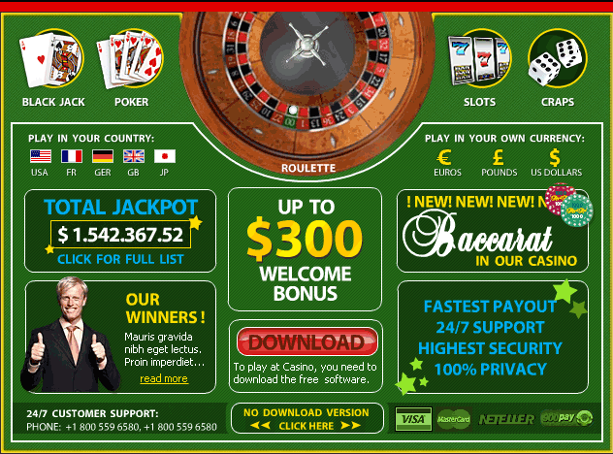
Notes:
Of online gambling

Slide 54
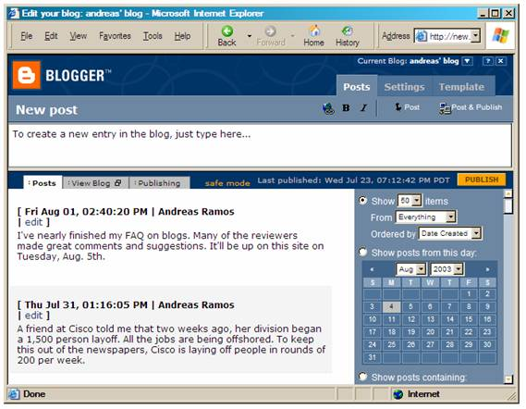
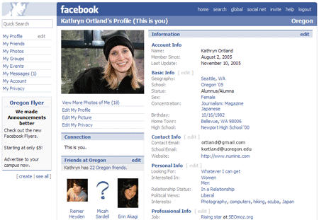
Notes:
And of social networks. These are billion dollar industries with millions of users
I challenge you to find any of this in the prior literature on hypertext.
One of the problem is that usabiliity evaluation as currently practiced does not help predict the future.
Its about discovery: it can only reveal what is, not what will be.

Slide 55
Part 7. What to do
Notes:
What should we do about this?

Slide 56
Evaluation
Notes:
First, let me state clearly that we are not arguing against evaluation.

Slide 57
More
Appropriate Evaluation
Notes:
Rather, we should be doing more appropriate evaluations

Slide 58
The choice of evaluation methodology - if any – must arise and be appropriate for the actual problem or research question under consideration
    argumentation case studies
    design critiques field studies
    design competitions cultural probes
    visions extreme uses
    inventions requirements analysis
    prediction contextual inquiries
    reflection ethnographies
    design rationales eat your own dogfood
    … …
Notes:
Going back to our main message,…
<Read>
We are indeed fortunate in CHI that we have a huge repertory of methods available to us to choose from. It is only recently that we have become biased to a few of them.

Slide 59
We decide what is good research and practice
Notes:
We can change what we do. As a community, <read>

Slide 60
There is no them
Notes:
There is no them, no higher authority telling us how to do our work.

Slide 61
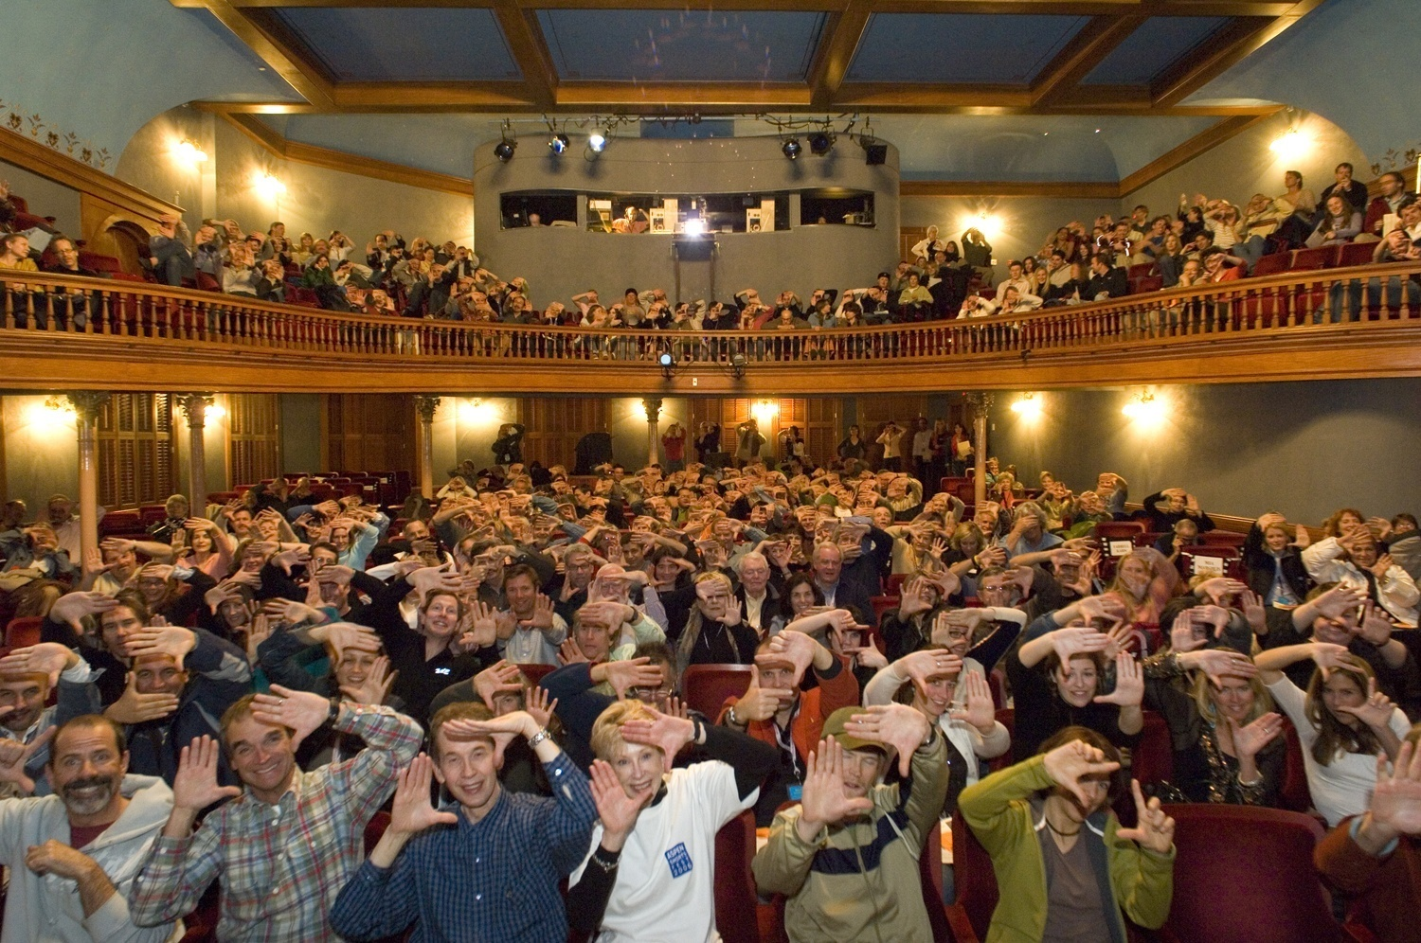
Only us
http://eduspaces.net/csessums/weblog/261227.html
Notes:
Only us. If CHI is to remain relevant, we must go beyond the narrow view of usability evaluation as our primary tool, and develop and accept methods that embrace early design, good science, and cultural appropriation.

