Slide 1
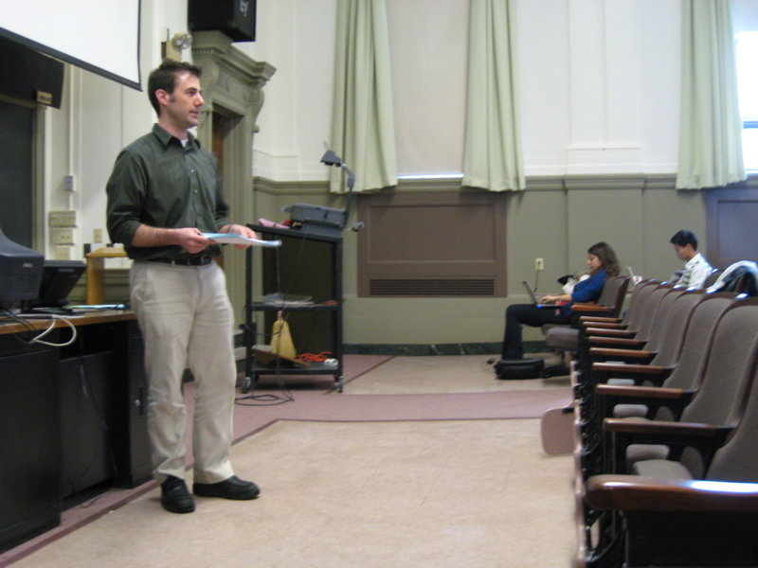



Attention by Proxy?
Issues in Audience Awareness for Webcasts to Distributed Groups
Jeremy Birnholtz
Clarissa Mak
Saul Greenberg
Ron Baecker

Slide 2
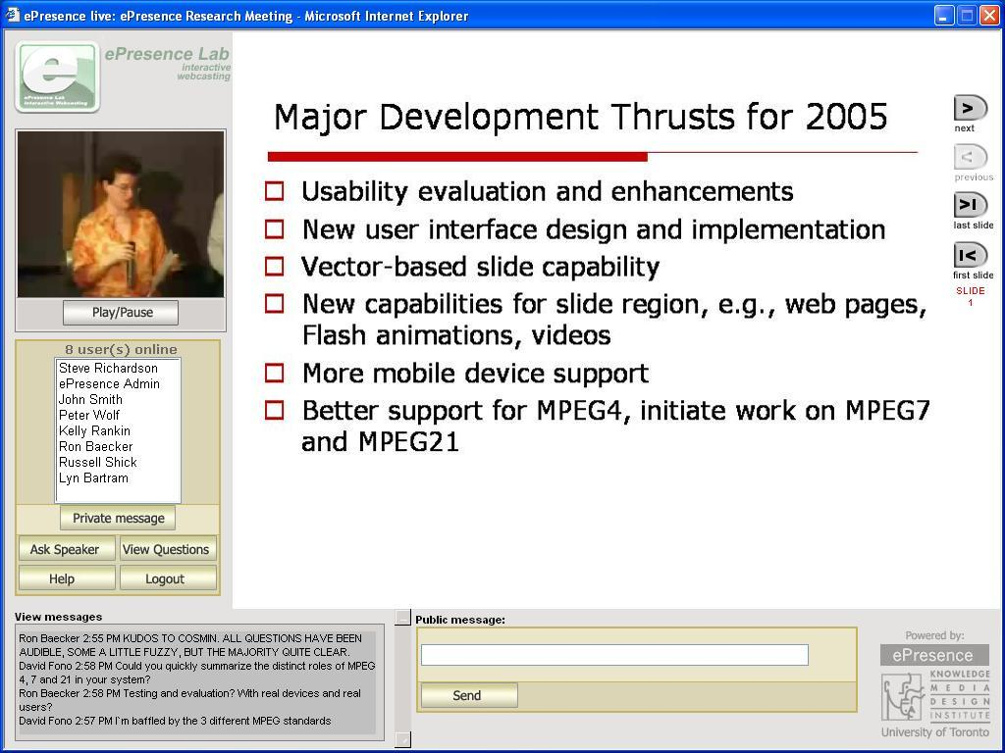
Motivation:
Are webcasts interactive?
Interaction affects:
Effectiveness (Anderson, 2003)
Satisfaction (Shea, et al. 2005)
How do we provide audience awareness?

Slide 3
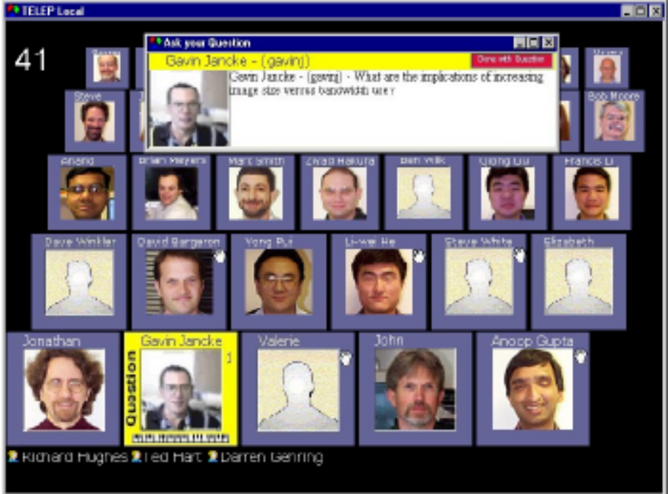
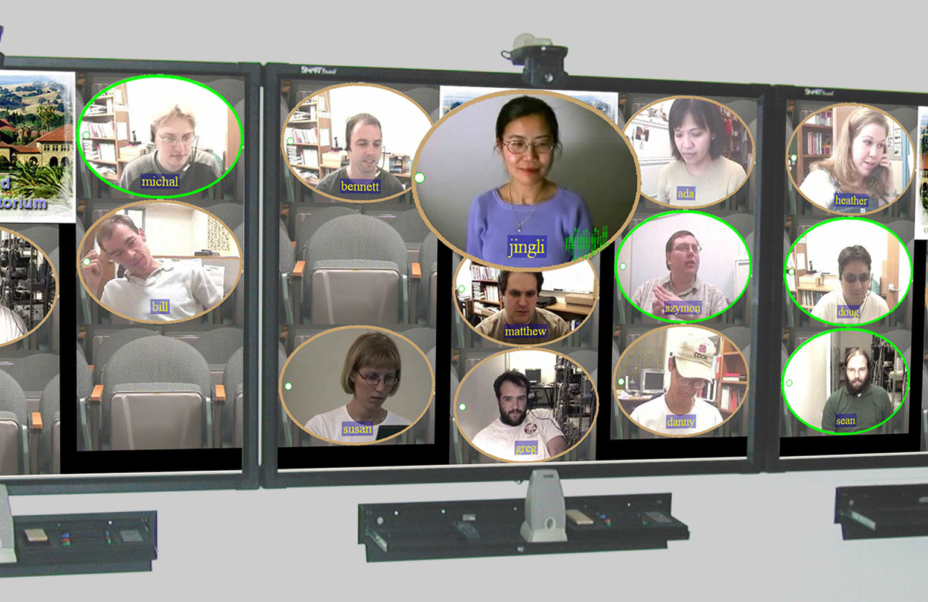
Background
(Jancke, et al., 2000)
(Chen, 2001-3)

Slide 4
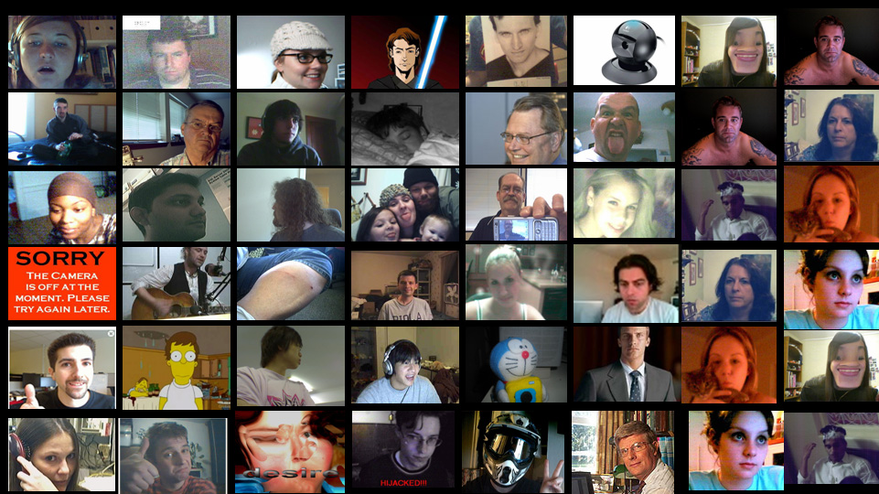

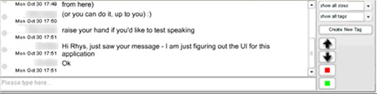
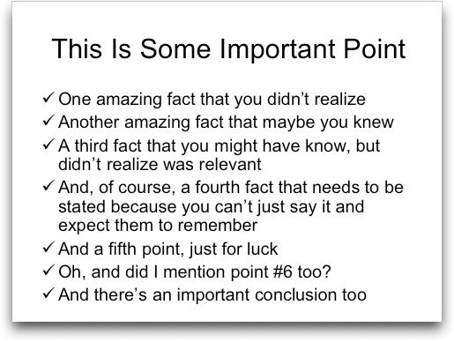
What do instructors want to see?
What information do we provide?
LIVE

Slide 5

An Exploratory Study of
Face-to-Face Instructors
Interviews
  20 instructors
  9 disciplines
  Class sizes 2 - 1,400
Observations
  26 hours
  4 visits to 4 classes
  Detailed field notes

Slide 6

Theme 1:
Looking around the room
“…moving from head to head the whole time”
“…machine-gunning the audience with my eyes”
Making comments to students in different locations

Slide 7
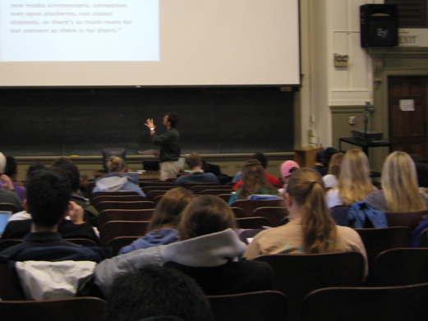
Theme 2:
Focusing on a subset
“I’m probably looking at, you know, 3 or 4 individuals who are actually looking at me.”
“if you have one of these people in different parts of the room, you get good coverage…”
“…because normally you’re getting one kind of feedback and now you’re getting a different kind… which may stand in for feedback from the whole class.”

Slide 8
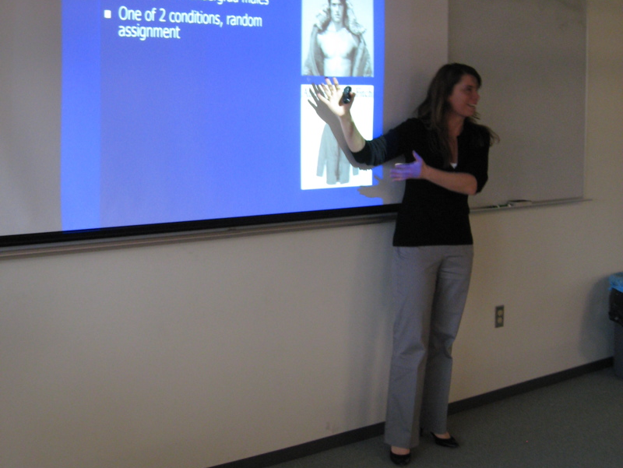
Theme 3:
Chunking of the room
“I try to look at sections…side, side, side, and back, front, side.”
“I’m concerned about those who sit midway or beyond.”

Slide 9
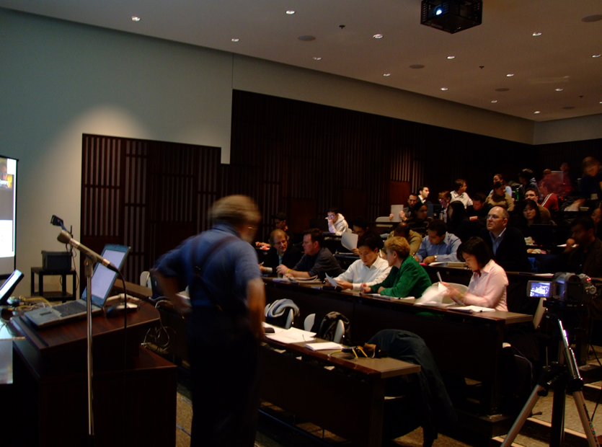
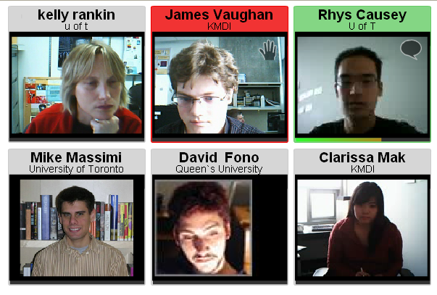
Key Implication:
Attention is Ambiguous
Proxy approach?
Private focus

Slide 10
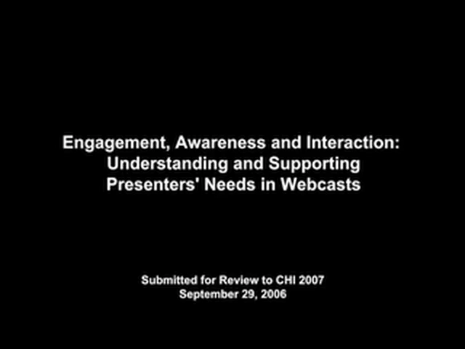

Slide 11
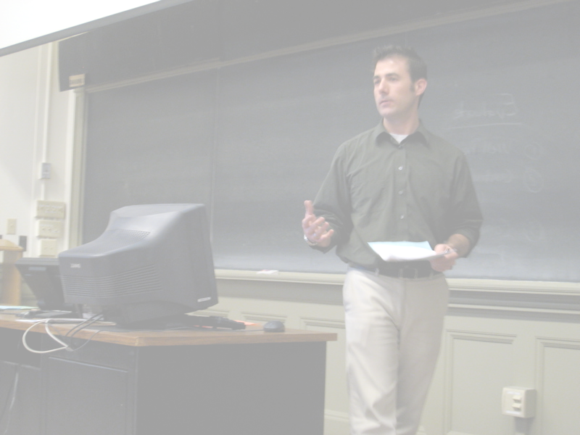
Future Work
Private instructor display
  Wearable?
  Podium PC
Focus plus context
  How to display the whole class?
  Indicators of class attention?

Slide 12
Questions?

Slide 13
The following slides were shown as part of the minute madness presentation

Slide 14
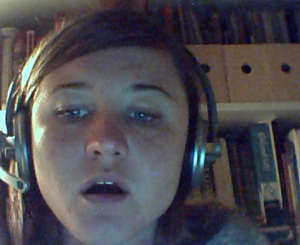


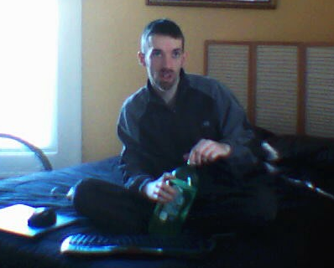
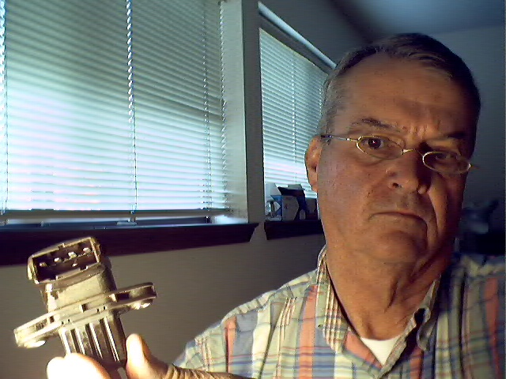
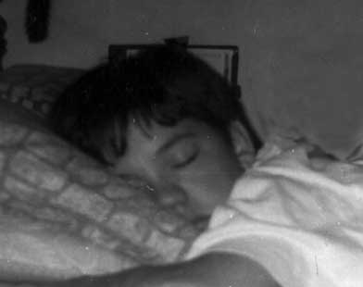
LIVE

Slide 15
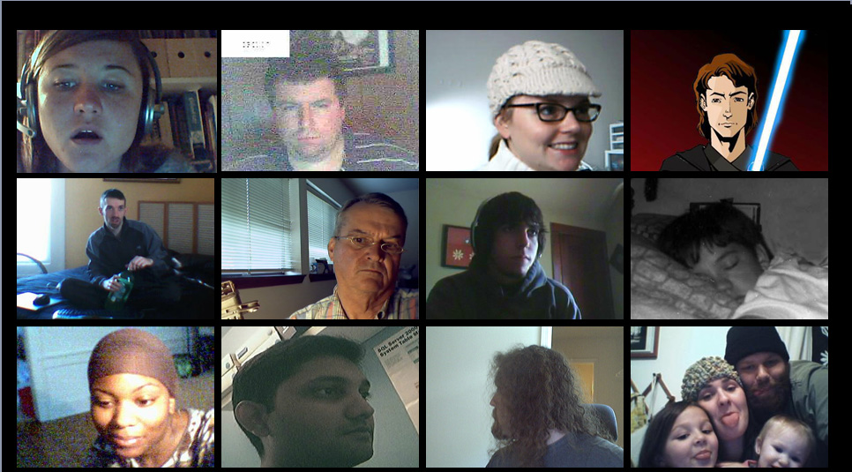
LIVE

Slide 16
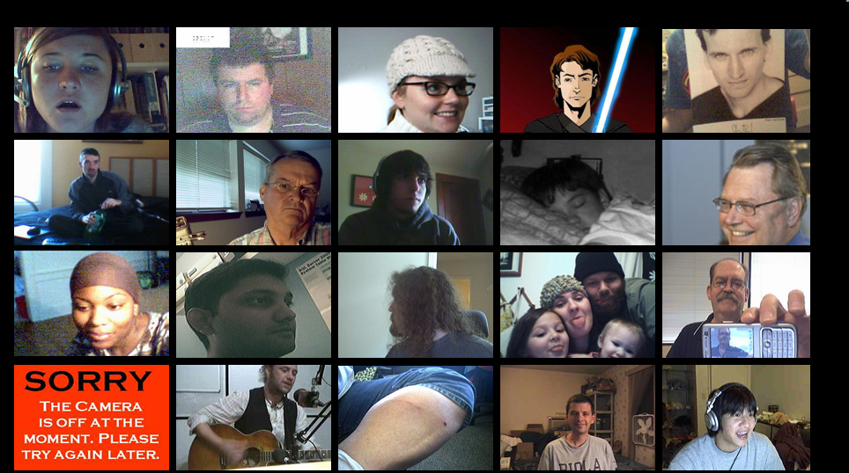
LIVE

Slide 17
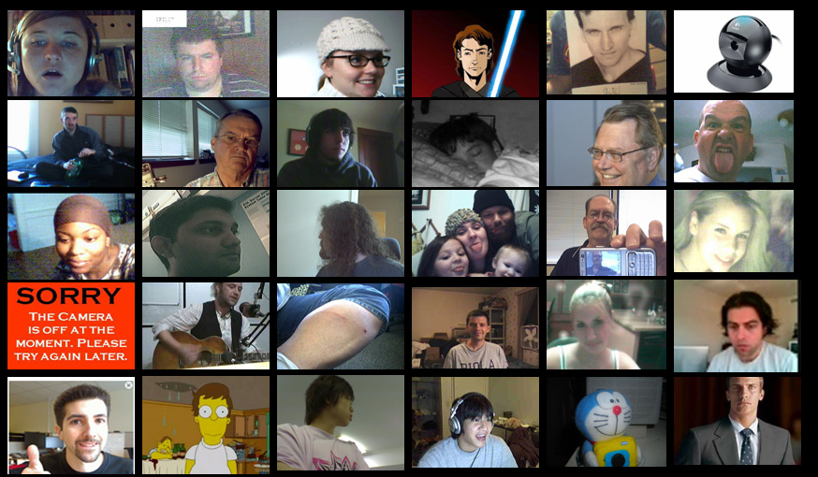
LIVE

Slide 18
LIVE

Slide 19
Attention by Proxy?
Exploring audience awareness for presentations to distributed groups
Jeremy Birnholtz, Clarissa Mak,
Saul Greenberg, Ron Baecker
LIVE

