Slide 1
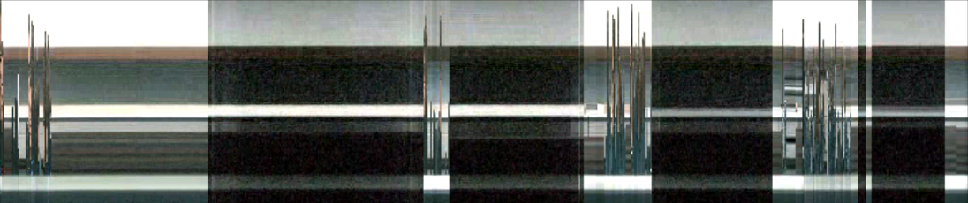
What Did I Miss?
Visualizing the Past through Video Traces
Michael N. Nunes, Saul Greenberg, Sheelagh Carpendale
University of Calgary
Carl Gutwin
University of Saskachewan
Notes:
1

Slide 2
Message
Video trace systems let people easily explore captured video streams.
While they have benefits, they introduce privacy risks that must be debated.
Notes:
2
…

Slide 3
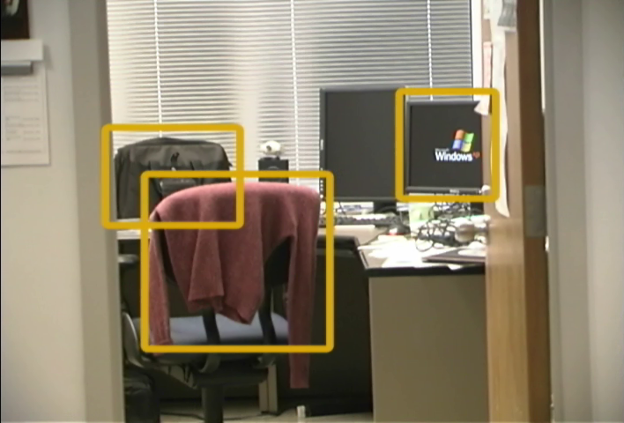
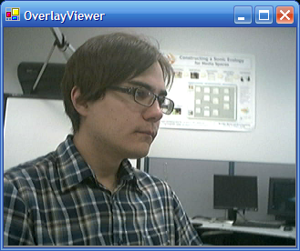
Awareness and Attention
Everyday world background attention
Video media spaces foreground attention
Notes:
3
Our original motivation for investigating video traces – promoting awareness in video media spaces.
In the everyday environment we are able to gain awareness of the presence and activities of coworkers – examples: hearing them come and go, monitors on, coats, office doors open, documents out, etc.
We are able to gather this awareness through our background attention as a result of being in the same place
Always-on video media spaces attempt to provide a similar awareness of coworkers through the use of a video link. However, this awareness can only be gained by foreground attention – one must deliberately look at the video feed to see what is happening, and will likely only do so periodically.
Thus the sense of awareness in a VMS is comparatively poor. Narrow field of view, typically a head shot, provided by the webcam stream. Glancing at this occasionally will only give an indication of weather someone is in or out, rather than having a sense of the patterns of activity over the course of the day.

Slide 4
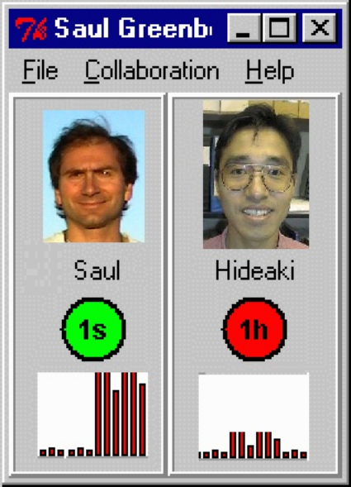
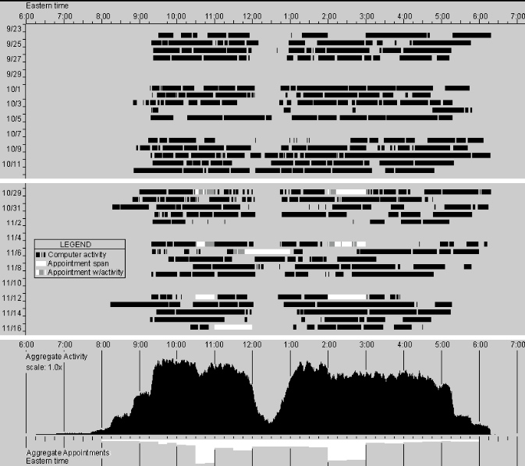
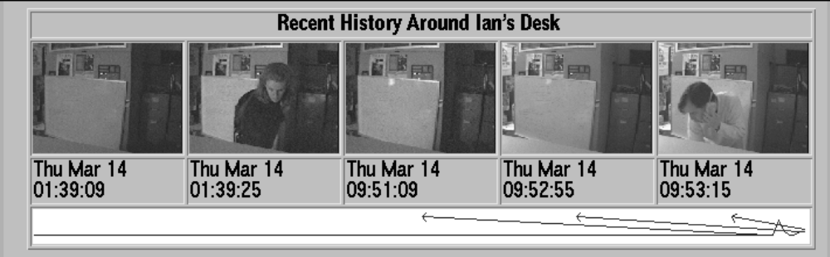
Awareness of Activity
Activity patterns over time
Video Traces visualizations revealing the video history
Greenberg, S. and Kuzuoka, H. (2000)
Begole, J. et al (2002)
Hudson, S. E. and Smith, I. (1996)
Notes:
4
It has been suggested that this rich awareness of the patterns of activity of coworkers is useful in gauging when it is appropriate to interact with them.
Some researchers have suggested providing history of activity in a VMS with the goal of promoting awareness. (Hudson & Smith, etc…)
Examples
Activity graph, one recently returned, one been out for at least 1h
Cumulative graph of activity patterns
Several snapshots showing visual changes
We sought to further explore this idea by considering ways of visualizing the history of a video stream – we call these systems Video Traces.

Slide 5
Awareness of Activity
Activity patterns over time
Video Traces visualizations revealing the video history
Greenberg, S. and Kuzuoka, H. (2000)
Begole, J. et al (2002)
Hudson, S. E. and Smith, I. (1996)
Notes:
5
It has been suggested that this rich awareness of the patterns of activity of coworkers is useful in gauging when it is appropriate to interact with them.
Some researchers have suggested providing history of activity in a VMS with the goal of promoting awareness. (Hudson & Smith, etc…)
Examples
Activity graph, one recently returned, one been out for at least 1h
Cumulative graph of activity patterns
Several snapshots showing visual changes
We sought to further explore this idea by considering ways of visualizing the history of a video stream – we call these systems Video Traces.

Slide 6
Awareness of Activity
Activity patterns over time
Video Traces visualizations revealing the video history
Greenberg, S. and Kuzuoka, H. (2000)
Begole, J. et al (2002)
Hudson, S. E. and Smith, I. (1996)
Notes:
6
It has been suggested that this rich awareness of the patterns of activity of coworkers is useful in gauging when it is appropriate to interact with them.
Some researchers have suggested providing history of activity in a VMS with the goal of promoting awareness. (Hudson & Smith, etc…)
Examples
Activity graph, one recently returned, one been out for at least 1h
Cumulative graph of activity patterns
Several snapshots showing visual changes
We sought to further explore this idea by considering ways of visualizing the history of a video stream – we call these systems Video Traces.

Slide 7
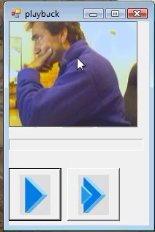
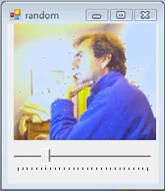
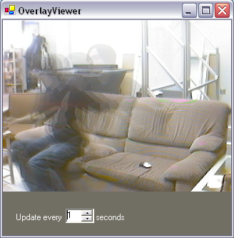
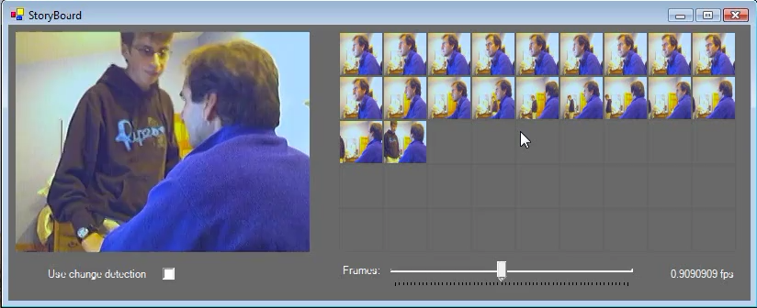
Early Investigations
Rapid Playback
Random Pixel Blend & Alpha Blend
Storyboard
Notes:
7
We explored several techniques for video trace systems, early investigations were:
Rapid playback:
Sequence of recent frames are replayed sped up
Length can be adjusted to provide longer or shorter sequences
Must explicitly check the playback, might not if you don’t know something has happened.
Alpha blend
Several recent frames blended together in a single frame
Displays recent activity at a glance
Difficult to show long periods of time
Random pixel blend
Pixels of the frame randomly updated
Similar to alpha blend, difficult to use for long periods of time
Storyboard
Multiple miniature frames periodically updated to show a storyboard of recent activity
Can be adjusted for longer or shorter periods of time
Many small frames, difficult to read in detail

Slide 8
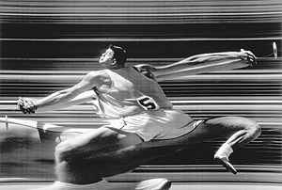
Slit-scanning
“Hammer thrower” by George Silk: www.nga.gov.au/Silk/Gallery.htm
Notes:
8
The basis for the timeline visualiztion is a technique known in photography as slit scanning. In this technique a narrow slit from the scene is exposed creating an image of a narrow slit over time.
Video slicing is the application of this technique to video streams.

Slide 9
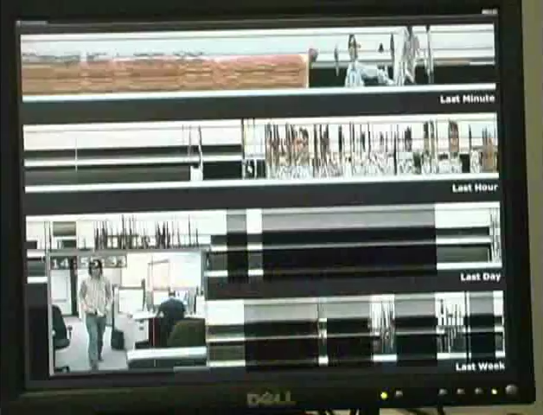
Timeline System
Video not included but shown at the conference
Notes:
9
Following these early investigations we created the Timeline system:
Highly revealing system allowing rapid exploration of a video history
Uses overview and detail approach applied to slit-scanning
Represents a powerful and extreme example of what could be done with video trace systems
With the ease of capturing video, such a system is relatively easy to create.
As such we wish to use the timeline system to encourage debate over video trace systems as we believe video trace systems will appear in the near future.
To begin I will describe how our timeline system works, as well as show a live demonstration.
Begin the debate by discussing preliminary reflections and reactions to this system.

Slide 10
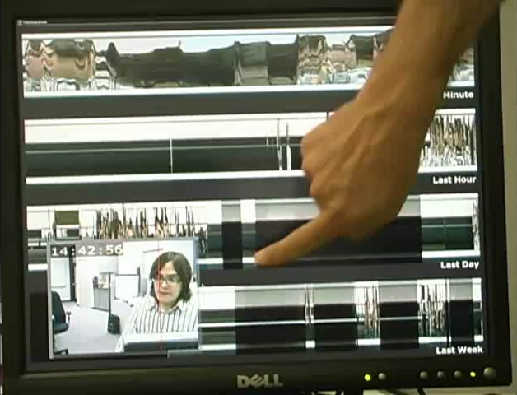
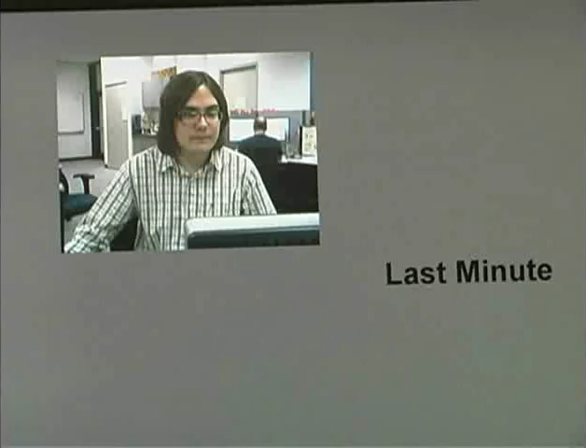
Video Slicing
Video not included but shown at the conference
A column from each incoming frame is abutted to a video slice image
Notes:
10
A column from the incoming frame is sampled and abutted to create a visualization showing the activity under the column over time.
Because this technique visualizes activity using the actual video data, it is easy to recognize people and patterns. For example scans of faces can appear in the visualization as people move across the scene.

Slide 11
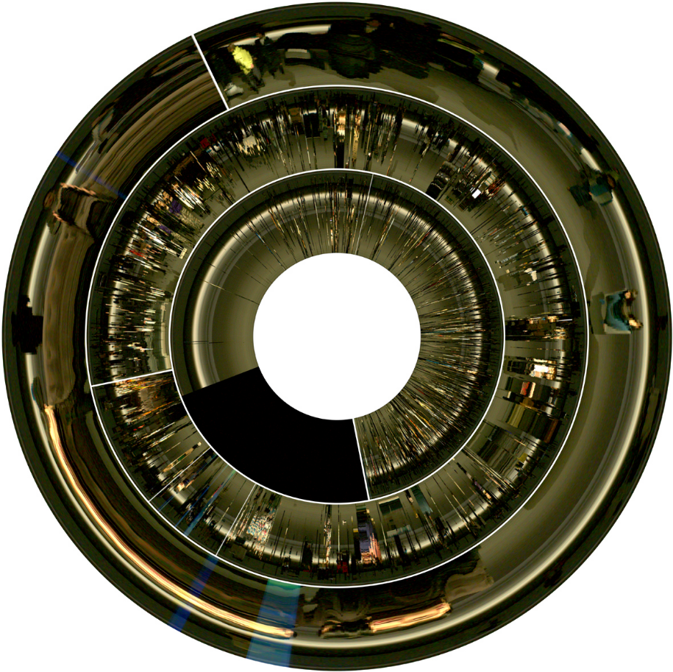
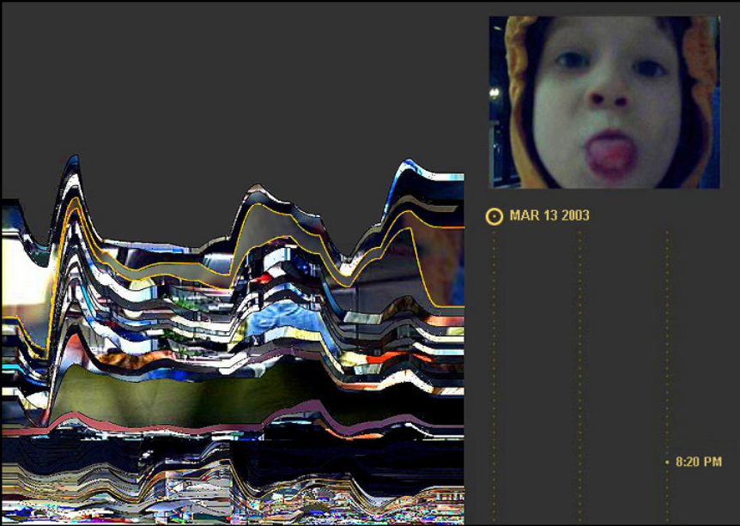
Video Slicing
Used in interactive arts to create dynamic images
“Artifacts of the Presence Era” Viegas et al (2004)
“Last Clock” Angesleva and Cooper (2005)

Slide 12
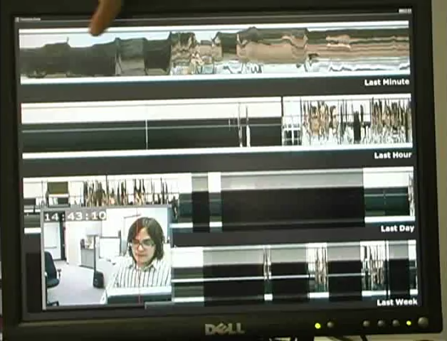
Time Piece
Video not included but shown at the conference
Notes:
12
Similar to last clock, timelines offers multiple views forming a time piece
By adjusting the rate at which new columns are sampled, visualization lines are displayed showing the last minute, hour, day, and week of video data
This offers several granularities at which patterns of activity can be observed (short-long term.)

Slide 13
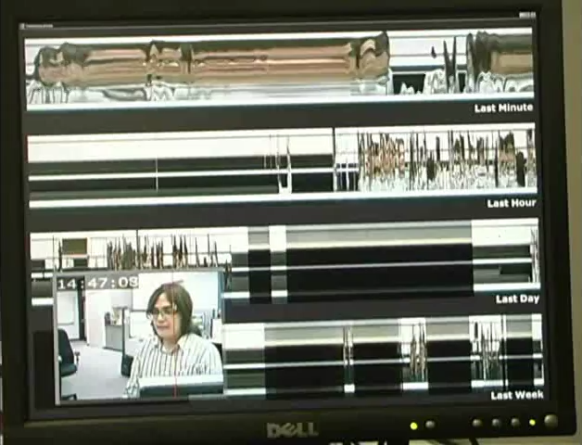
Adjusting the Slit
Video not included but shown at the conference
Notes:
13
An extension on previous slit-scan systems that is present in timelines is that the slit column can be interactively adjusted.
The red line seen in the video window indicates the current column, by clicking in the video window this column is changed, and the entire visualization is updated to show this.
By dragging over the frame, can find areas of activity
Or place over an area of interest (ex doorway)

Slide 14
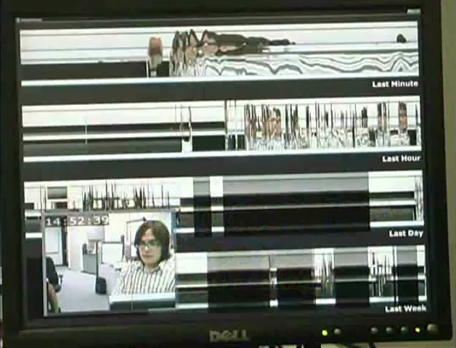
Rapid Replay
Video not included but shown at the conference
Notes:
14
Another addition to timelines is that the visualization lines can be used to rapidly playback the video history.
By scrubbing over a visualization line, the underlying video frames are played back in the video window.
Moments of activity can be spotted easily with the visualization, scrubbing allows to see what happened that caused disturbances in the visualization

Slide 15
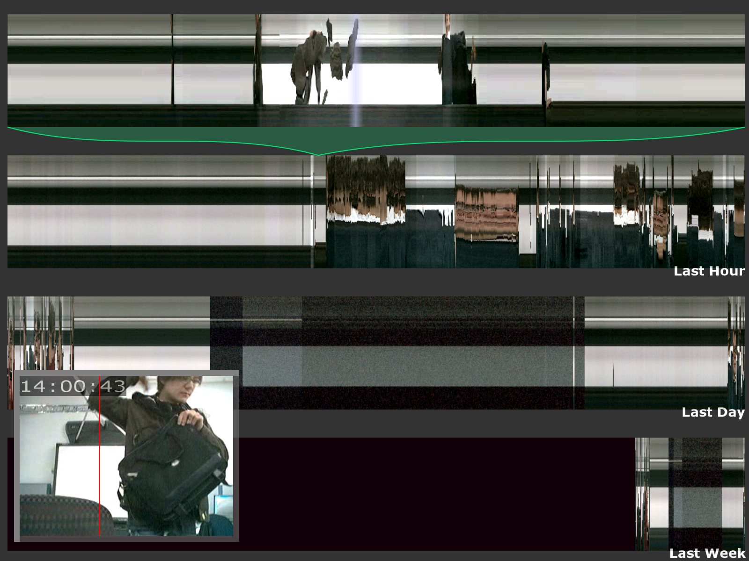
Demonstration
Demonstration shown at the conference
Notes:
15
Demonstrate…

Slide 16
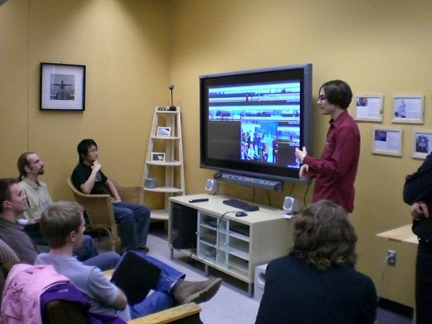
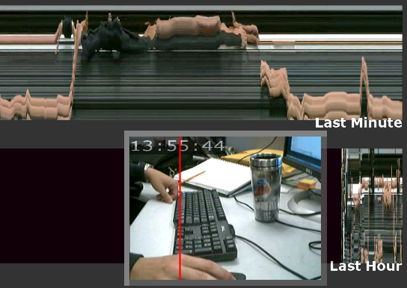
Positive Reactions
Readability
Playfulness
Voyeurism
Rhythms
Control what is captured
Practical applications
Notes:
16
Yet, there are positive aspects of the timeline system
Have used it numerous times as a live installation for demonstration, and in self trials. All as video mirror, not broadcast.
Readability – quickly understood how to read the system,- used the video data itself - see live how actions are reflected, - can explore what is seen
Self-Reflection & playfulness: playful attitude shown toward the system, people tried to “leave their mark”
Voyeurism: also enjoyed voyeuristic properties, being able to find and replay the actions of others in the system
Rhythm: commented on the aesthetic presentation of activity rhythms
Also, is possible to some degree to control what is captured as a measure for privacy protection
Point at desk?
Outside office door?
Potential practical applications were suggested:
Surveillance
Analysis Tool
Video Editing
Low-bandwidth ambient distributed awareness

Slide 17
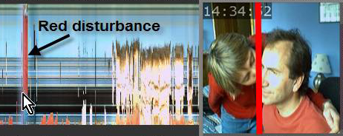
Concerns
The system works too well
Home office:
- other family members
- appropriate behaviour for home/office
Notes:
17
* We designed the Timeline system with the intention of using it to promote awareness.
However, we encountered a problem – the system works too well.
Authors – one commuter works several days of the week at home, conceptually a good test
Problems with using the system in this way
Home office – other family members are around/object to being captured. Behaviours appropriate for home broadcast and discoverable
Research lab – uneasy about recording and broadcast, risk of unintended capture
Tradeoff between privacy and awareness has been the subject of prior research. The timeline system is so effective it becomes a surveillance system, although unintended.
Question arises as to weather we should be presenting and researching such a system at all

Slide 18
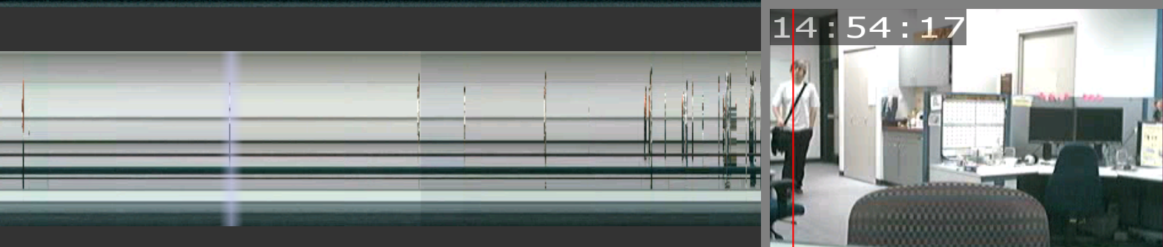
Concerns
The system works too well
Research lab:
- uneasy about recording/unintended capture
Should we bring this system to the research community?
Notes:
18
* We designed the Timeline system with the intention of using it to promote awareness.
However, we encountered a problem – the system works too well.
Authors – one commuter works several days of the week at home, conceptually a good test
Problems with using the system in this way
Home office – other family members are around/object to being captured. Behaviours appropriate for home broadcast and discoverable
Research lab – uneasy about recording and broadcast, risk of unintended capture
Tradeoff between privacy and awareness has been the subject of prior research. The timeline system is so effective it becomes a surveillance system, although unintended.
Question arises as to weather we should be presenting and researching such a system at all

Slide 19
Debate
Video is ubiquitous
  IM, surveillance, nanny-cams
Creating video traces is easy
  Basic program: ½ hour
Privacy is protected by ephemeral properties of action
Notes:
19
However, we wish to use the timeline system as an extreme example to open the debate on video trace systems
This is important because:
Video is ubiquitous – video conferencing applications are appearing, video included in IM systems, surveillance cameras are everywhere, even home monitoring systems/nanny-cams
The capture of video and creation of video trace systems is easy – lab website documents an example video slice system which can be replicated in under ½ hour. Programmers could easily incorporate this kind of technology with video applications
The real danger presented by the timeline system is that privacy is protected by the ephemeral nature of action
Do not present any new information
Simply provide a way of easily searching, even inviting it to be searched.

Slide 20
Conclusion
Timeline system: investigation into the extreme
Difficult to predict best usage & cultural practices
Comparison to other awareness approaches
Security, art, or video analysis
Notes:
20
Presented Timeline, consider it best used as an investigation in to the extreme possibilities for video trace systems
Important to consider video trace systems and their use - likely to appear in the future
Difficult to predict best usage/cultural practices for video trace system use –
suitable in public areas rather than private offices?
Tight teams/social intimates to stay connected?
Or perhaps best used as a comparison to other approaches for awareness
Perhaps potential outside of awareness, for security, interactive arts, or video analysis

Slide 21
Message
Video trace systems let people easily explore captured video streams.
While they have benefits, they introduce privacy risks that must be debated.
Notes:
21
…

