Slide 1
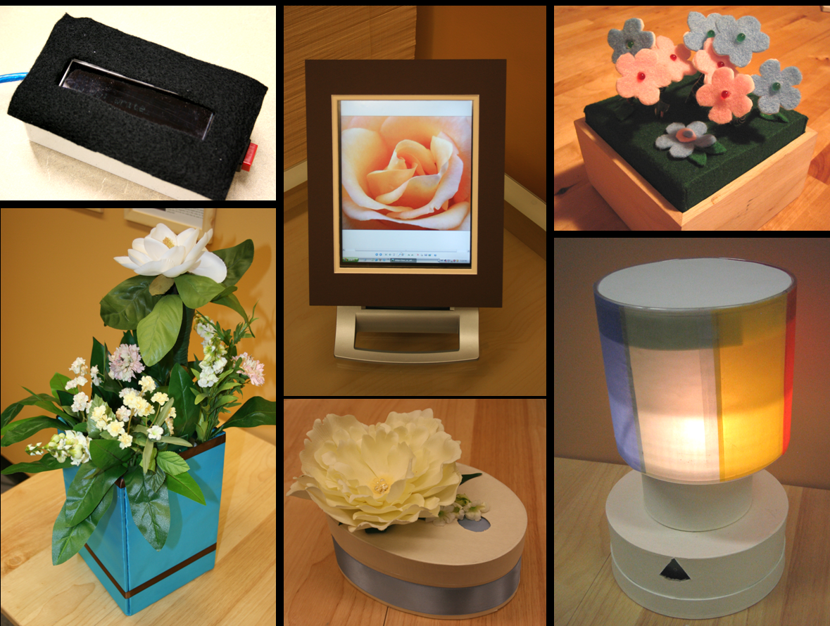
Note: several videos were shown as part of this presentation, but are not included here. The full video was published at Pervasive 2005.
Location-Dependent Information Appliances for the Home
Kathryn Elliot Rounding, Mark Watson, Carman Neustaedter & Saul Greenberg
Interactions Lab, University of Calgary

Slide 2
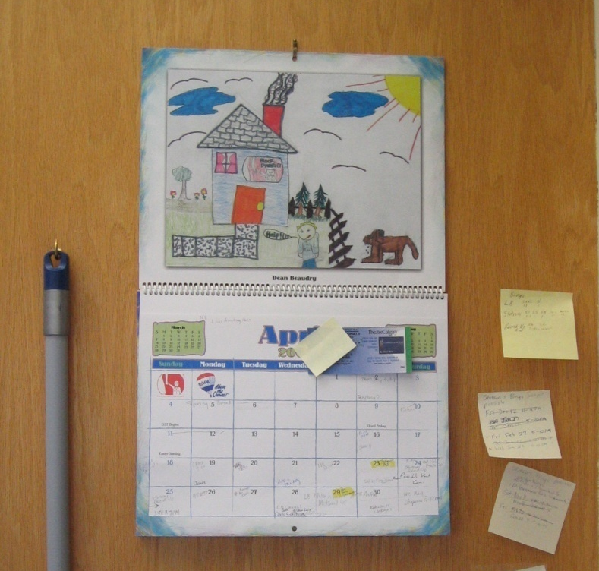
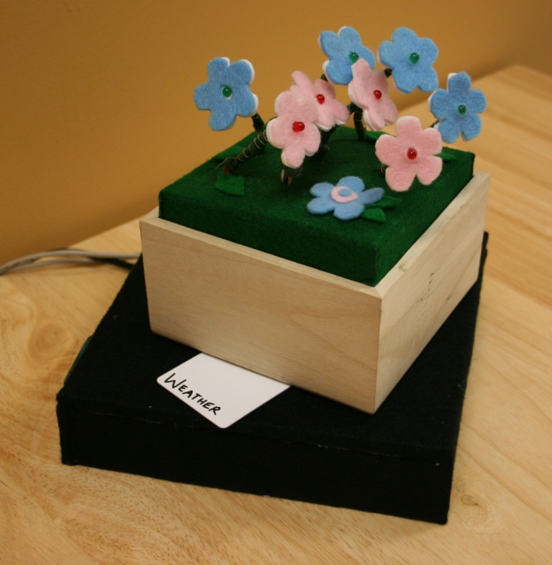
message
Location-dependent information appliances allow digital information to be incorporated into the context & routines of the household.
Notes:
The main message I would like to get across in this talk is that location dependent information appliances allow digital information to be incorporated into the context and routines of the household.
I will first talk about how people currently use location to manage information in their homes and how digital information is not able to support this. Then I will introduce our location dependent information appliances and discuss how they seek to bridge that gap.

Slide 3
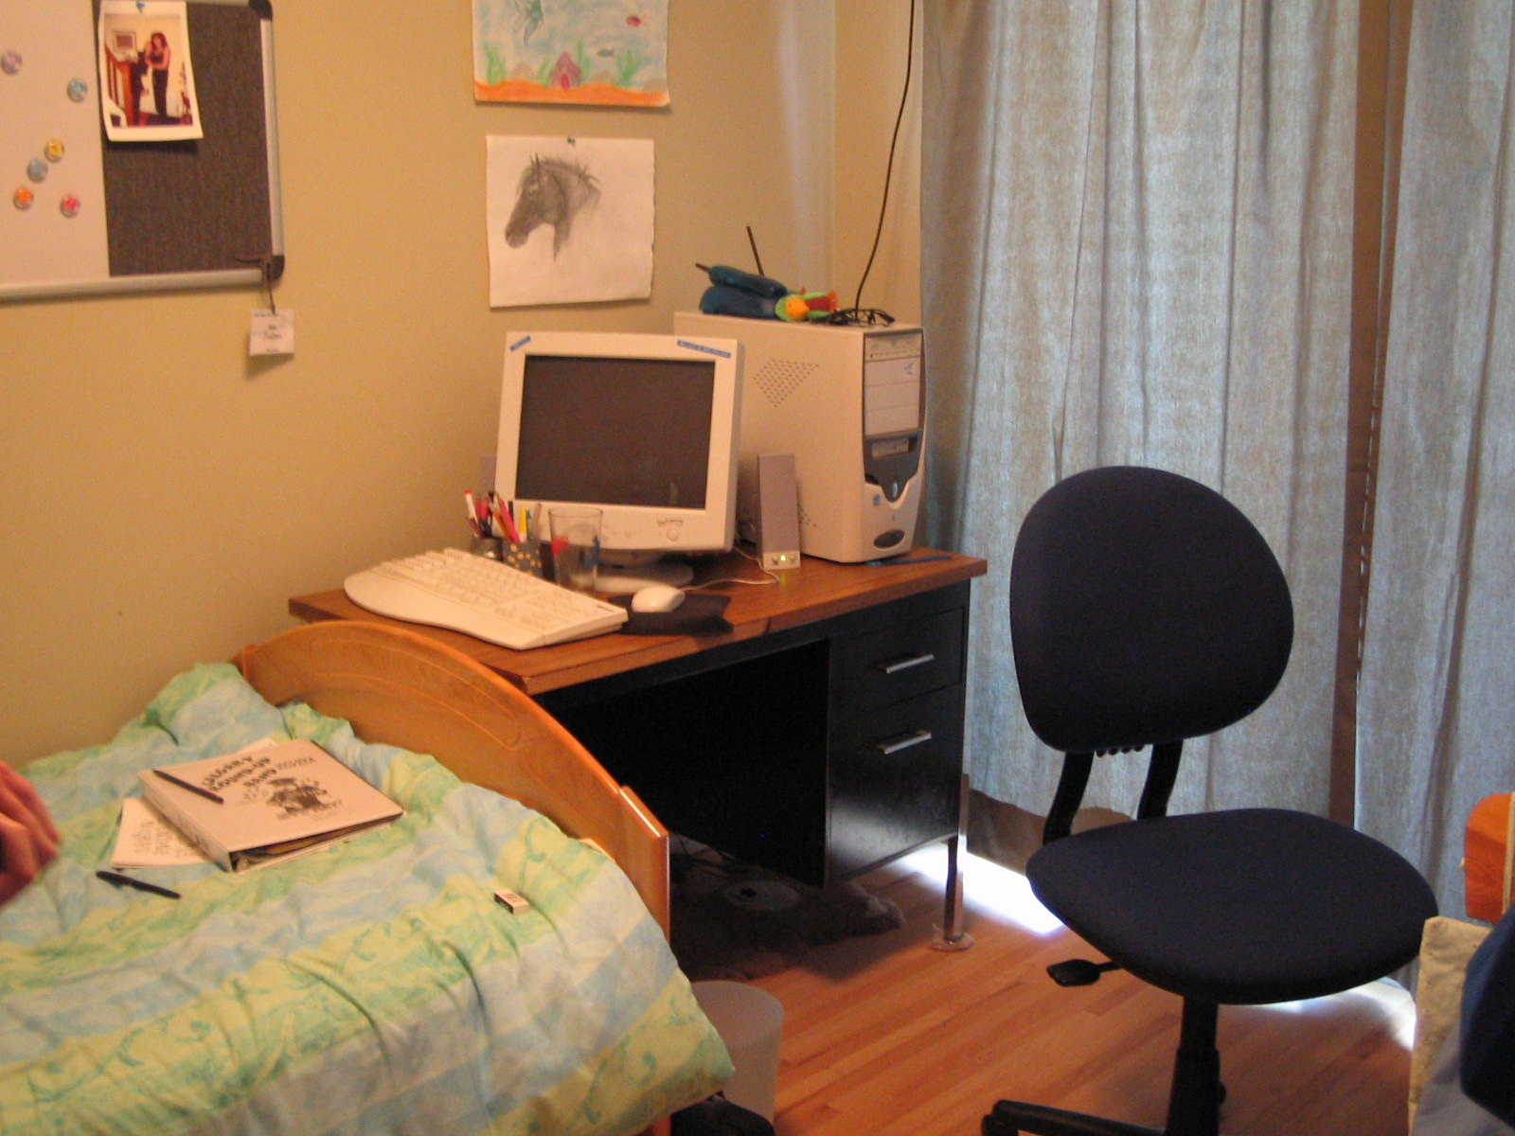
motivation
Notes:
The motivation for our work comes from what you see in this image. Currently, computers in the home more often than not look like this: a machine designed for the office, that is tucked away in a bedroom or corner, isolated from the real “life” of the household. This consequently also means that all the electronic information of interest to households: things like emails, IMs, web pages, schedules, digital pictures etc. are also tucked away in a corner accessible only through this single box.

Slide 4
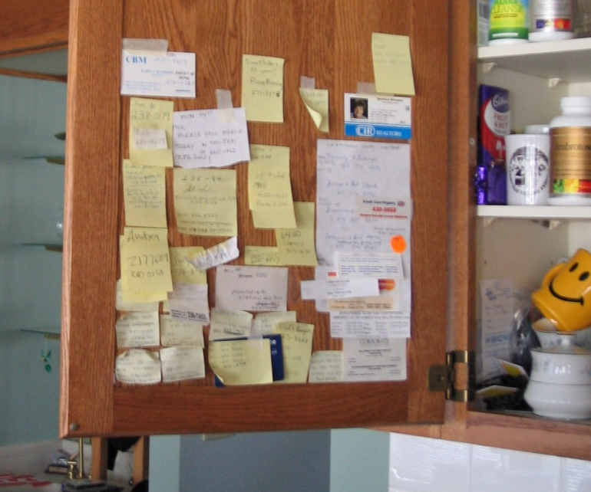
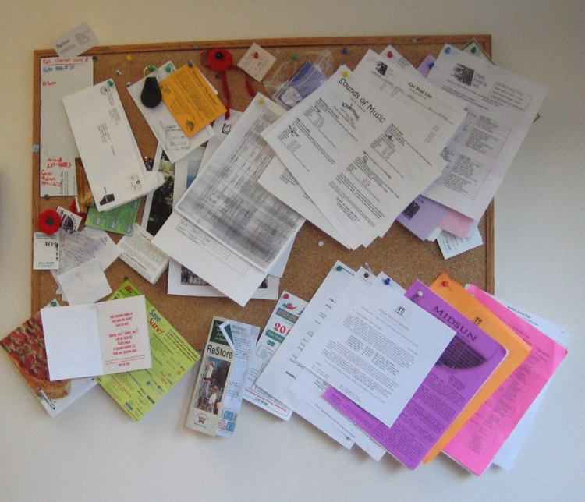
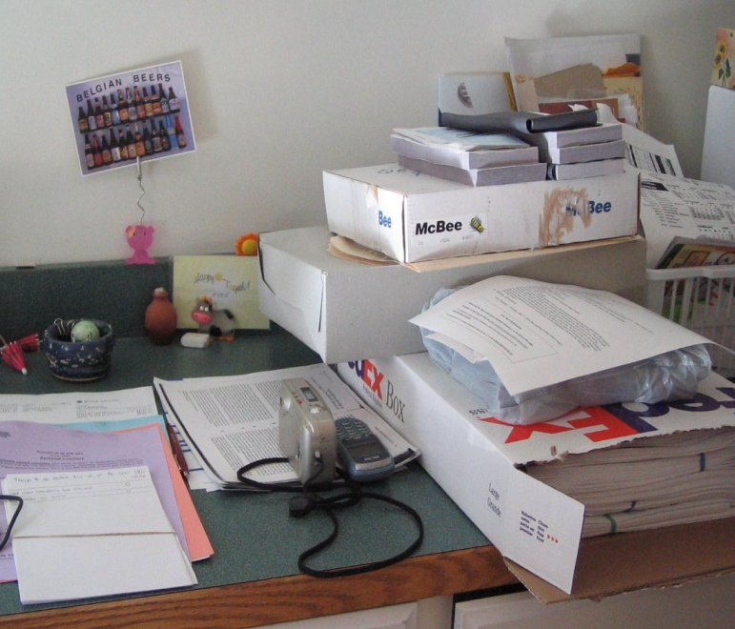
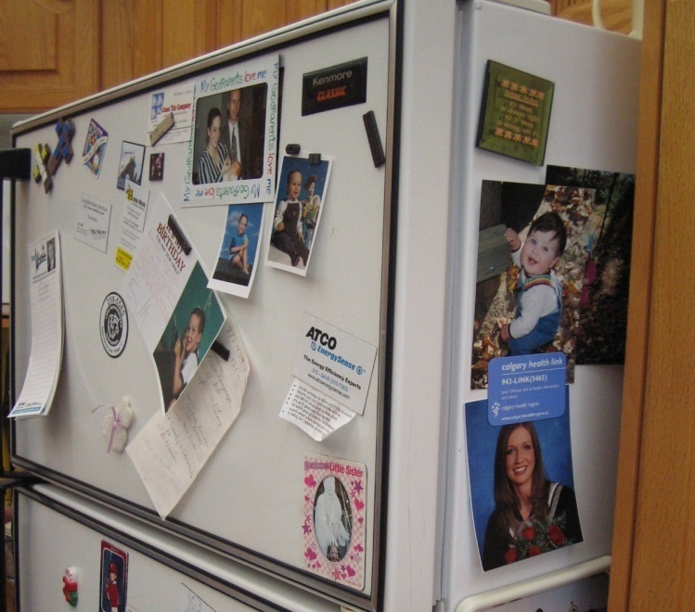
motivation
Notes:
We know however, that this is not how households manage information. Many researchers, including ourselves, have looked at how information is actually managed in the home, and have found that the practices surrounding it are rich, subtle and most importantly, distributed throughout the home. Information moves from one place to another as it is needed or used, and as the household moves through it’s routines.

Slide 5
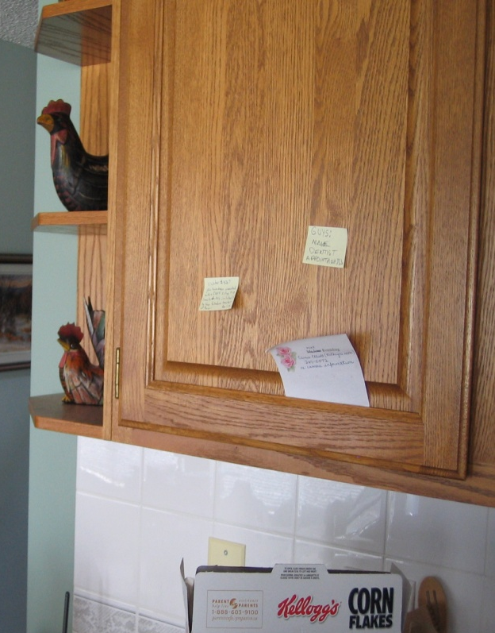

motivation
this is the cupboard above the phone
telephone messages go here
these are ‘keeper’ messages
these
are new messages
dad checks here while he eats breakfast
the messages are mostly for mom or dad
mom checks here when she gets home
Notes:
And these routines are so well-understood by household members, that their knowledge of them imbues locations in the home with rich meaning. Location is not only interwoven with the activities and actions surrounding a message, but also with a complex set of context. This context means that locations in the home are more than just places, but are full of subtle understandings and meta-data.

Slide 6
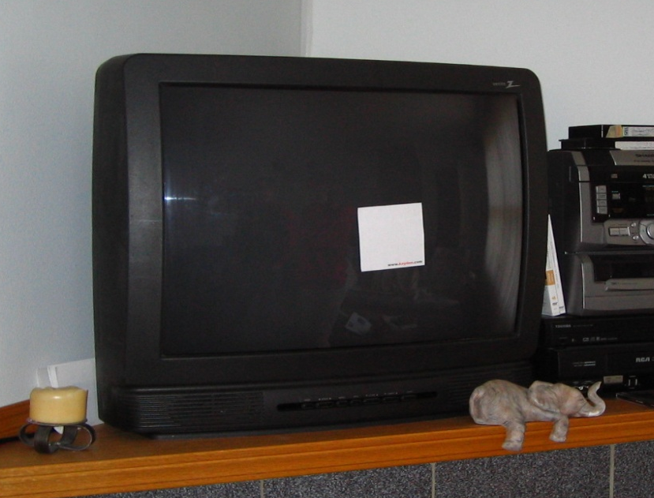
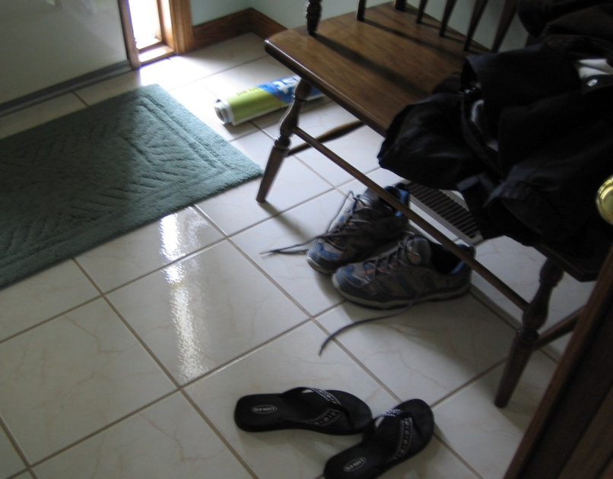
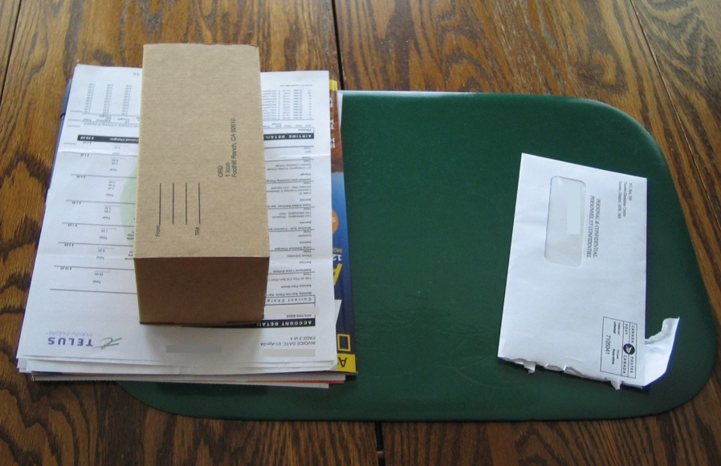
motivation
Time
Awareness
Ownership
Elliot, Neustaedter and Greenberg. Time, Ownership and Awareness: The Value of Contextual Locations in the Home. Proceedings of Ubicomp 2005.
Notes:
Our own previous work showed that people use placement to manage and filter the communication information in their homes, and to provide time, ownership and awareness meta-data about this information. Where a message is placed tells them who it is for, what needs to be done with it, when it should be seen along with additional rich awareness information such as who is home or if a message has been seen yet.

Slide 7

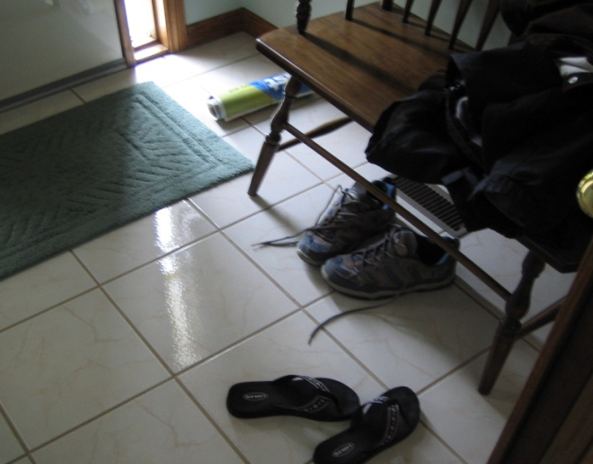


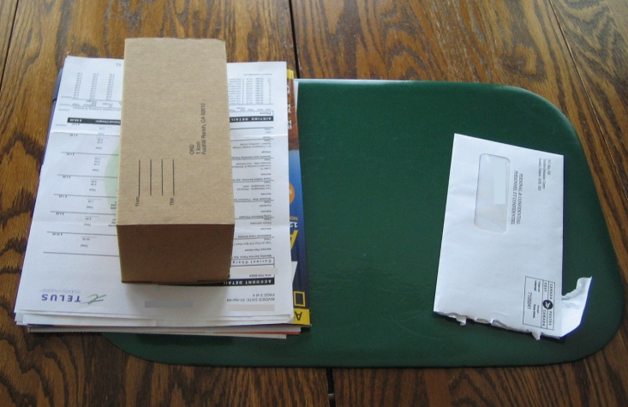
motivation
Notes:
The goal of our project is to allow digital information to be placed in these locations, so that it can fit naturally into home routines and benefit from the context and meaning these routines provide.

Slide 8
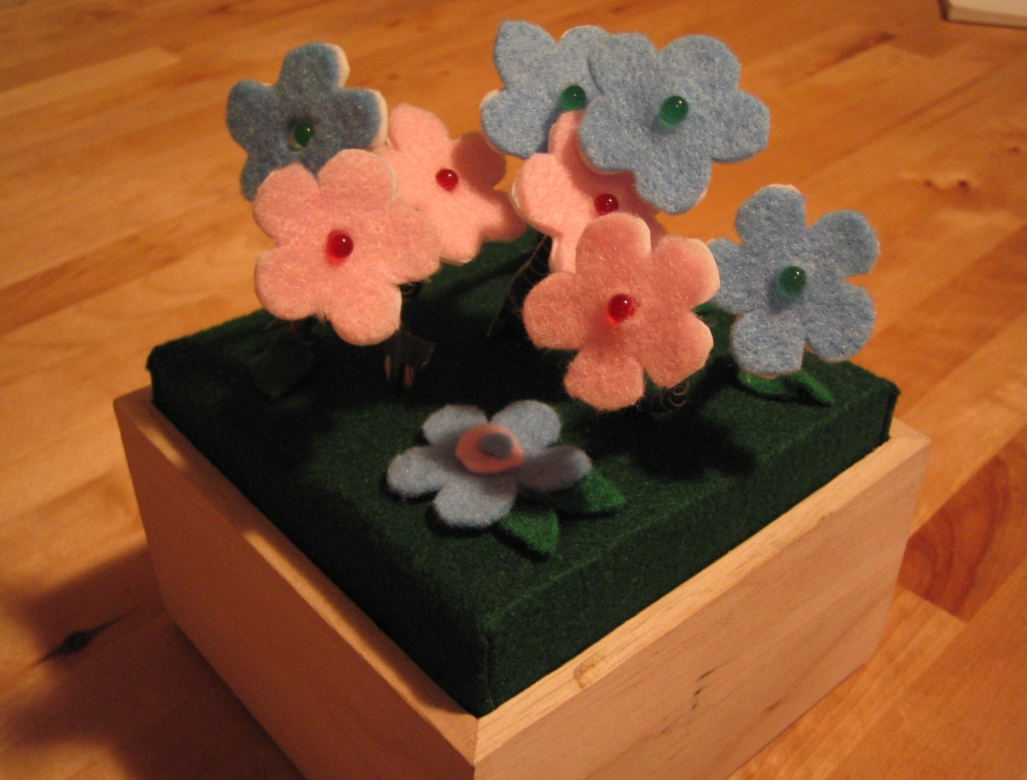
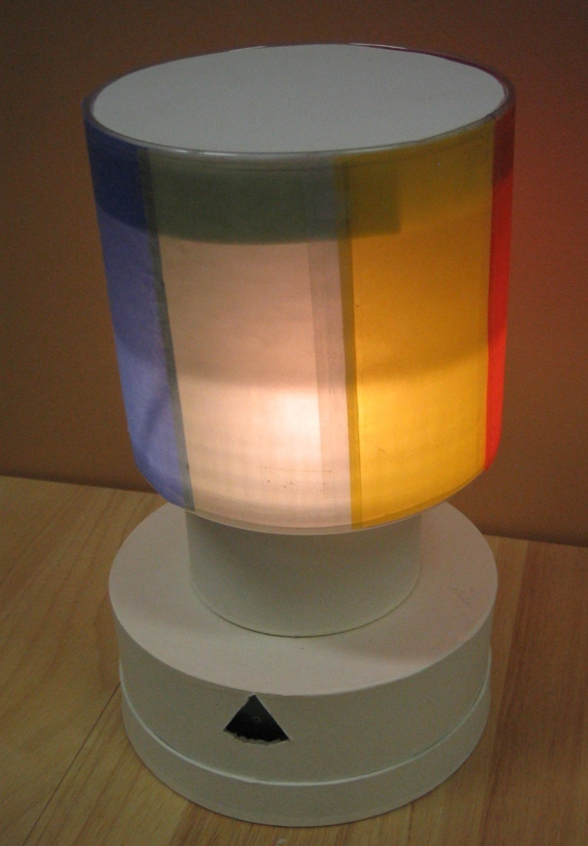
flexible ambient displays
flexible information sources
smooth transition from awareness to interaction
Notes:
We intend to do this by extending an existing set of flexible ambient display devices to be location-dependent. Flexible ambient displays are tangible devices that have been designed around two specific goals: first, they allow for flexible information sources – that is, any of these devices can be mapped to a wide variety of data. Second, each device provides a smooth transition from awareness to interaction – the ambient qualities of the device provide awareness, but more details can be requested by simply touching the device.

Slide 9

ambient displays in the home
awareness without going to the computer
can display personalized information
aesthetics and physicality
abstraction provides natural privacy
Notes:
We believe that these flexible ambient displays can be especially valuable in the home. People are not usually sitting in front of a computer when they are at home, so ambient displays provide people with the ability to both be aware of dynamic digital information and to request more details without having to go to the computer. The displays flexibility means that they could be used to display the specific, personalized information the household is interested in. The aesthetics and physicality of these devices means that they may fit more naturally into the home than traditional computer displays. Finally, the abstraction provided by such displays means that only the household will know how to interpret them providing a natural way to protect the households privacy will still being able to display information.

Slide 10




ambient displays + locations
place information easily
move information easily
display information easily
Notes:
Since we know that location is such a huge part of how people manage the information in their homes, what we want to do is to take these ambient displays and extend them to use these locations in an easy, natural way. To do this we need to be able to place information easily, move information easily, and to display information easily – as easily as moving or glancing at a piece of paper. To put this in more technical terms, we want to make it easy to assign information to a location, easy to move information from one location to another and easy to move and assign one of our ambient displays to a location and to an information source.

Slide 11
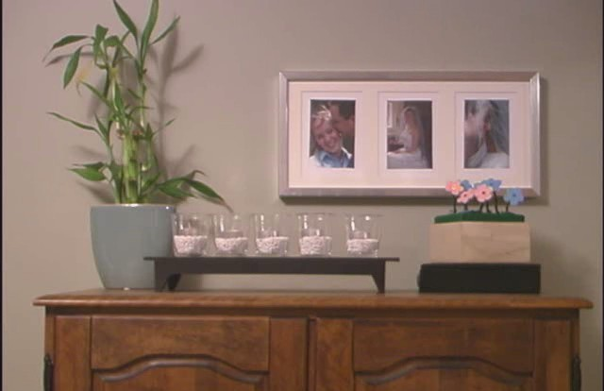
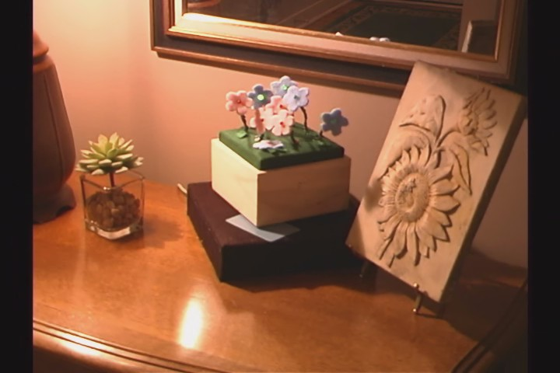
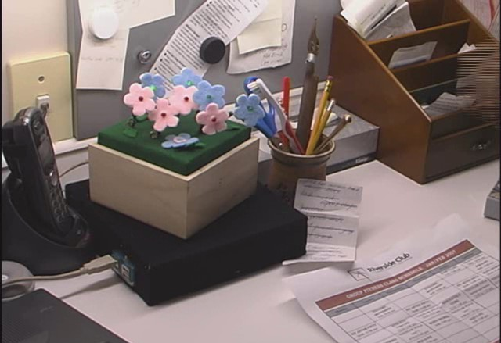
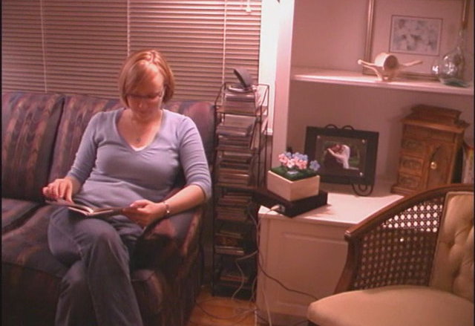
location-dependent information appliances
allow digital information to benefit from the indispensable context that location provides
Notes:
We did this by taking our flexible ambient displays and making them into location-dependent information appliances, thus allowing digital information to benefit from the indispensable context that location provides. By doing this, we allow people to bring the dynamic digital information they are interested in out of the isolated home PC and to incorporate it into their daily routines the same way they would paper information.

Slide 12
appliances
Notes:
We first extended our existing set of flexible ambient displays to include six prototype appliances, With the exception of the picture frame, the appliances were all built using phidgets. Each of these appliances can display a different kind of information.
(5 mins to here)

Slide 13
appliances
text lcd – textual information
Notes:
the text lcd shows simple textual information

Slide 14
appliances
flower in bloom – continuous information
Notes:
the flower in bloom, originally designed by Susannah McPhail, display continuous information. The largest white blossom opens and closes slowly according to the information stream.

Slide 15
appliances
picture frame – multimedia information
Notes:
the picture frame is a multimedia display.

Slide 16
appliances
flowerbud – binary information
Notes:
the flowerbud can display binary information through an LED light in the centre of the flower.

Slide 17
appliances
flowerpot – discrete information
Notes:
the flowerpot displays discrete state information by lighting any combination of its 8 red and green LEDs

Slide 18
appliances
glolamp – discrete state information
Notes:
the glolamp also displays discrete state information through a rotating shade with five different coloured panels

Slide 19
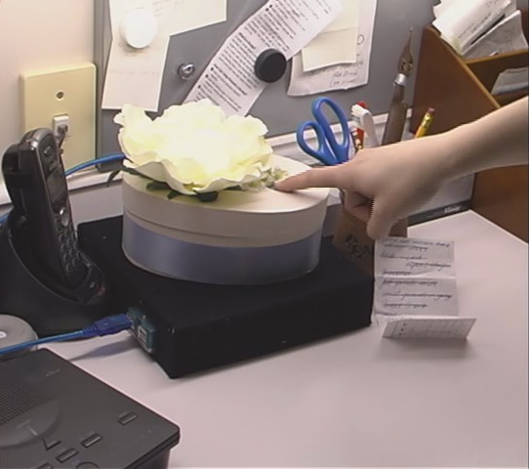
on demand
Notes:
Each of these displays also allows people to request more information through a simple touch. This could include more details, simply more information – such as tomorrow’s forecast instead of today’s, or the subject line and sender of new messages. We call this on demand information.

Slide 20
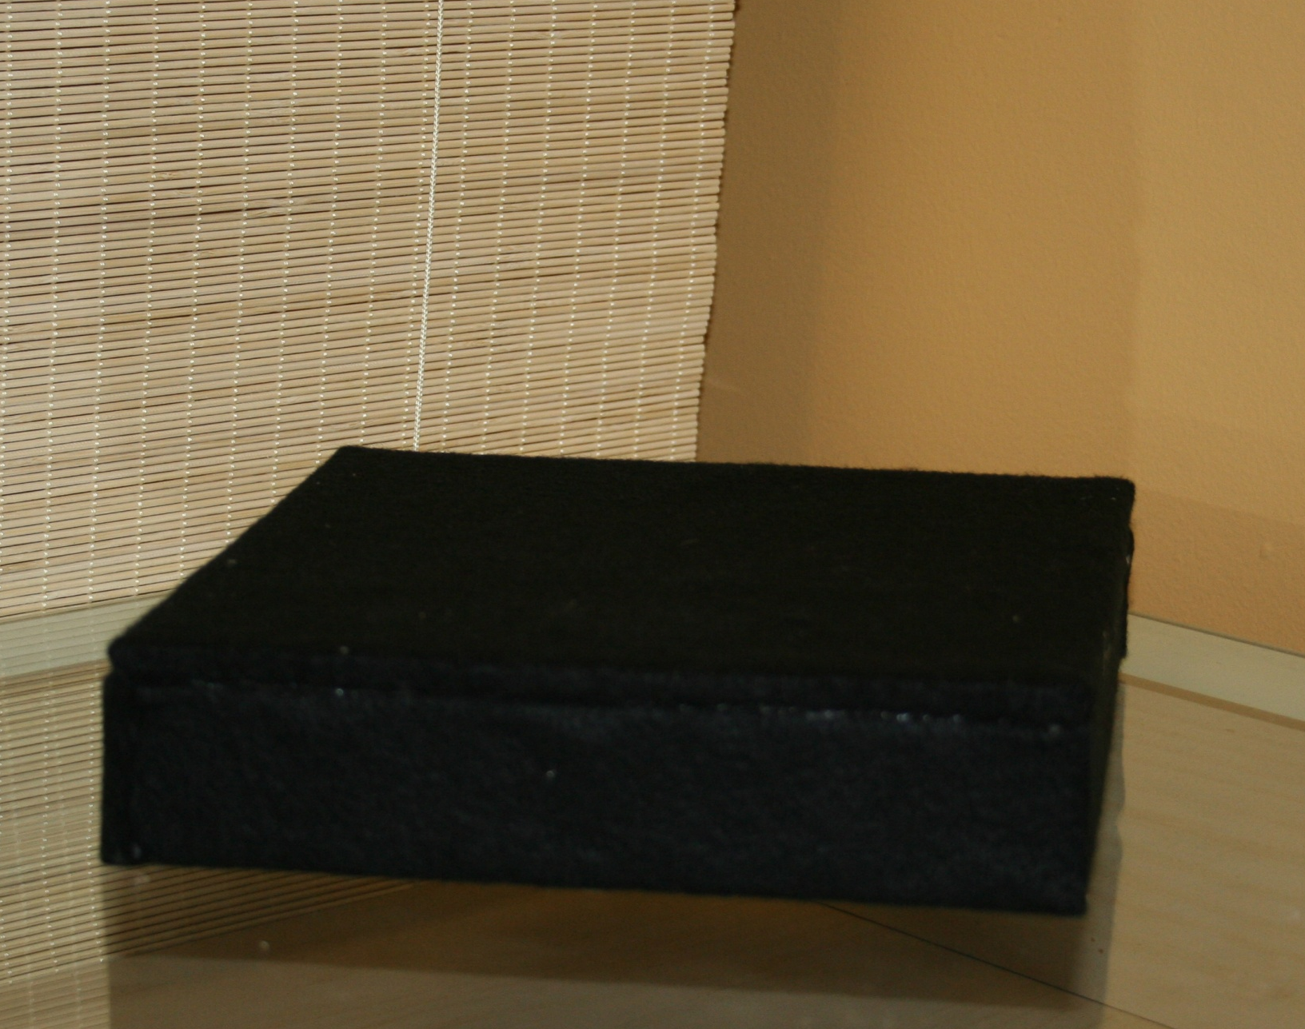
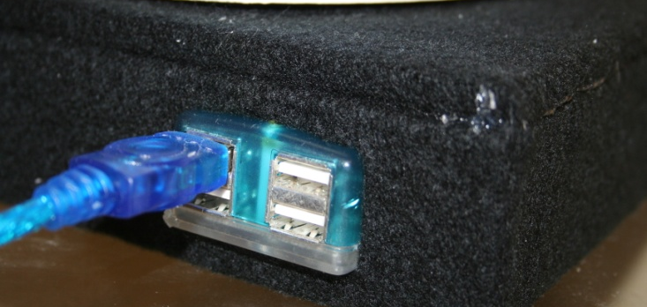
smart locations
Notes:
In order to connect locations, information and appliances, we use a smart location base. This base is basically a flat platform containing a USB hub and an RFID reader. These bases can be placed anywhere in the home. They are currently tied to USB because of the use of phidgets to build our prototypes, but one could imagine these becoming wireless and even becoming charging stations for future battery powered information appliances.

Slide 21
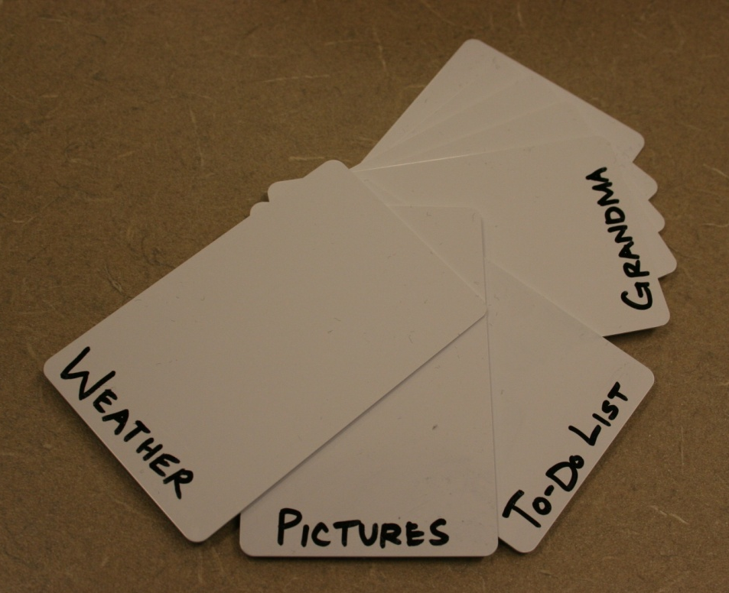
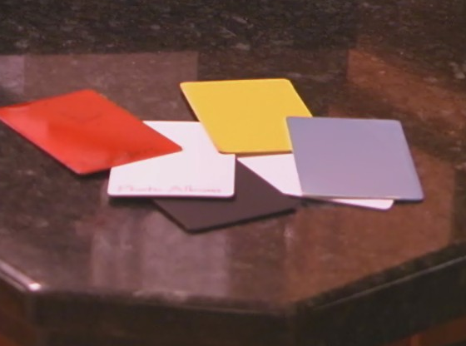
data streams
Notes:
Information sources are represented by RFID tags. Information is assigned to a location by swiping or placing the appropriate tag over the location base. These tags can be left in the location they are assigned to, or they could be kept as a collective set, somewhat like paint chip sets created for color selection.
Data is collected from its source by a small data stream processing program that takes the information and converts it into our five information types (binary, discrete, continuous, text and multimedia). It then places the information in a central server.

Slide 22
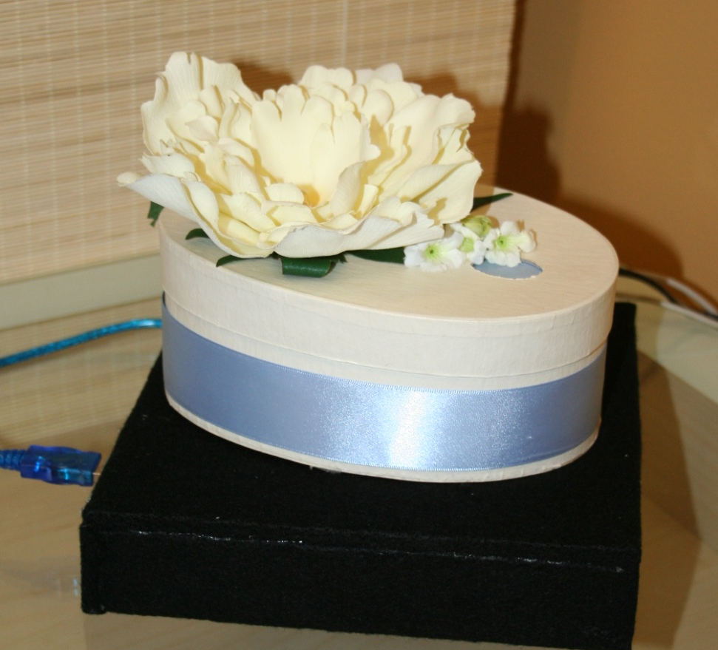

appliance tags
Notes:
Each appliance also contains an RFID tag, so the location base knows what device is connected to it, so that it can request the right information type from the server (text, binary, discrete etc.) and send it to the display. The display does not know what data stream it is displaying or where it is located – all the “smarts” are in the location base.

Slide 23
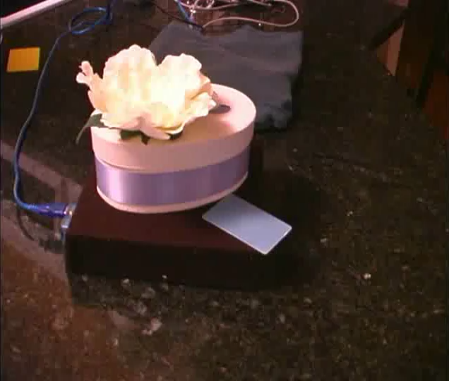
easily moved
Note: video clip shown here. See the full video, published at Pervasive 2005.
Notes:
This video shows how these smart bases make it very easy to swap out devices and to change information sources.
Switching a display is as easy as unplugging it and plugging in the new one. Here we have the flowerbud displaying the weather forecast. To switch to the text lcd, you just unplug the flower and plug in the text lcd.
Changing the information displayed in a particular location is as simple as swiping a new tag over the base. The display will immediately reflect the new information. Here we are switching from the weather display, to a to-do list.
(video, :22, no sound)

Slide 24



scenario
Notes:
To envision how these displays might be used in a real household, imagine a busy family of four. They have several locations within their home that they use for displaying digital information.

Slide 25
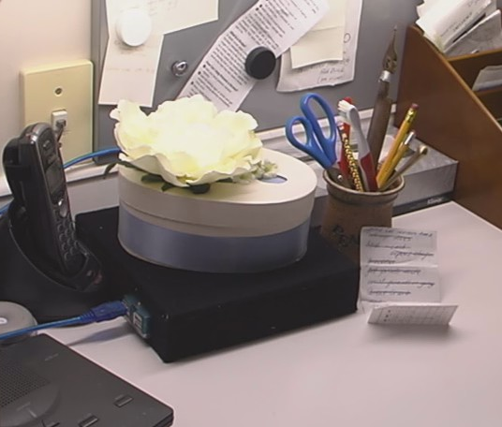
scenario
soccer schedules
Notes:
The flowerbud is placed by the phone desk and glows to indicate when there have been updates to the kids’ soccer schedules. By touching the device, mom and dad can listen to the changes and copy them to the calendar.

Slide 26
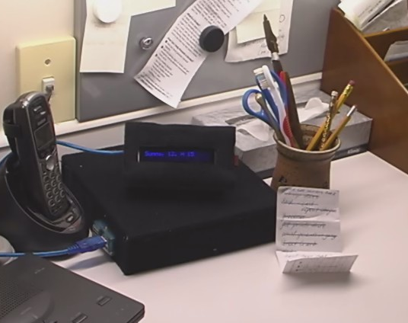
scenario
soccer schedules
Notes:
when the season gets really busy, they put the Text LCD there instead so they can see more detailed changes at a glance.

Slide 27
scenario
reminders
soccer schedules
Notes:
The flowerpot sits by the front door where flowers glow to indicate rental videos and library books that are due or overdue to be returned. Touching the device reads off the titles.

Slide 28
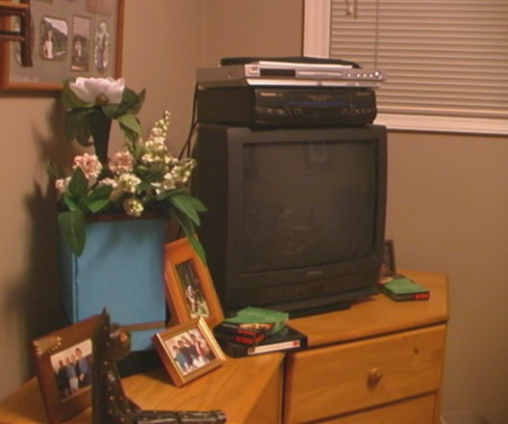
scenario
reminders
grandma
soccer schedules
Notes:
The flower in bloom sits in the family room near pictures of grandma. The bloom of the flower reflects her activity level, so the family is aware of how she’s doing.

Slide 29
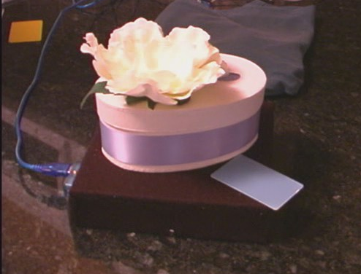
scenario
grandma
reminders
messages from dad
soccer schedules
Notes:
Finally, when dad is away on business, the family moves the flowerbud to his place at the dinner table, where it glows to indicate that he’s emailed them. Touching it reads off the email so they can all share it over dinner.

Slide 30
scenario
the devices become more valuable when they are location-dependent and fit into the household’s natural routines and pathways.
Notes:
In this way, the appliances become more valuable in the domestic setting when they are location-dependant, as they are customized to fit into the family’s natural routines and pathways through the home. It is through the family’s evolved use that each member learns and understands the meanings of the appliances and locations. They then become part of the family’s normal communication exchanges, and their locations help that information make sense.

Slide 31
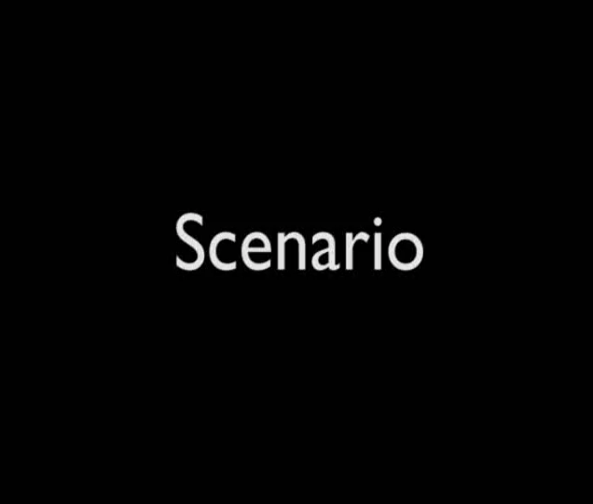
scenario
Note: video clip shown here. See the full video, published at Pervasive 2005.
Notes:
So now I’m going to show a short video of two other quick scenarios for the use of these appliances, that also demonstrates how easy they are to move as part of a household’s natural routines and rhythms.
(video, 1:20)
(~11 min to here)

Slide 32
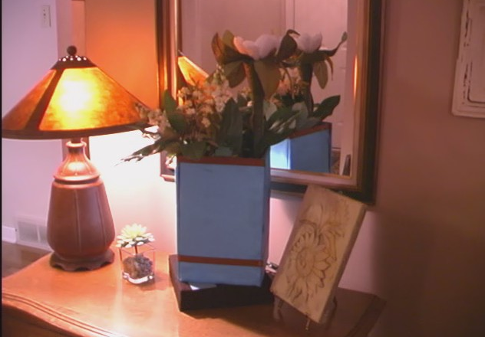
LDIAs
exploit understanding of locations and routines
bring digital information out of the “box”
are easy to place, easy to move, easy to display
provide awareness and on demand information
Notes:
So our location dependent information appliances allow households to use their understandings of routines to place digital information it will be seen by the right person, at the right time, and in the right context – they allow people to still use the locations they already know and understand, and to still take advantage of the priceless context provided by these locations. The appliances therefore bring the digital information that households use and understand out of the single personal computer “box” and allows it to be part of the life of the household, without requiring them to go to the computer.
And they does it in such a way that this digital information becomes easy to place, easy to move and easy to display. And by being flexible ambient displays, the appliances also provide both an awareness of the information and the ability to request details on demand.
(about 11 minutes to here)

Slide 33
value
from ethnography to design
proof of concept prototype
domestic technology case study
use to reflect on design ideas
Notes:
We strongly believe LDIAs to also be valuable as a way to reflect on location-based design of domestic technology, to show how findings from ethnographic studies about domestic routines can be translated to the design of technology, as a proof of concept prototype, a domestic technology case study, and as a tool to reflect on the design of location-based technology.

Slide 34
next steps
redesign and extend
deploy as a technology probe
technical improvements
field evaluation
development of guidelines
Notes:
Our next steps start with extending and refining the design based on our critique. There are several extensions possible – one could be to use time to change the information displayed. For example, weather info is of most use in the morning when choosing clothes for the day. So perhaps in the evening, the same location could be used to display the family’s schedule for tomorrow. A second extension could see these appliances integrated with other home technology systems, such as a home messaging system like StickySpots or HomeNote, or with a family calendar like LINC.
Following that, we would like to use these appliances as a technology probe to explore the idea of location-based technology and ambient information with real households. This would feed back into the design of a new system, along with extensive technical improvements to both the aesthetic quality of the prototypes and to use battery power and wireless connections instead of phidgets. These prototypes would at that point be intended for a full field evaluation. Hopefully, this work could eventually lead to the development of guidelines or heuristics for location-based appliances.

Slide 35
message
Location-dependent information appliances allow digital information to be incorporated into the context & routines of the household.
Notes:
The main message that I hope I got across in this talk is that location dependent information appliances allow digital information to be incorporated into the context and routines of the household.

Slide 36
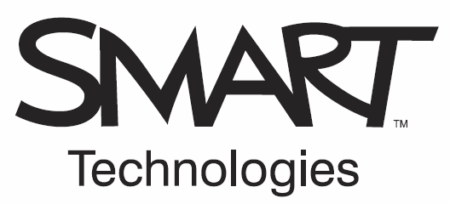




Thank you!
For more information: www.cpsc.ucalgary.ca/grouplab/
elliotk or mwatson or carman or saul@cpsc.ucalgary.ca

Slide 37

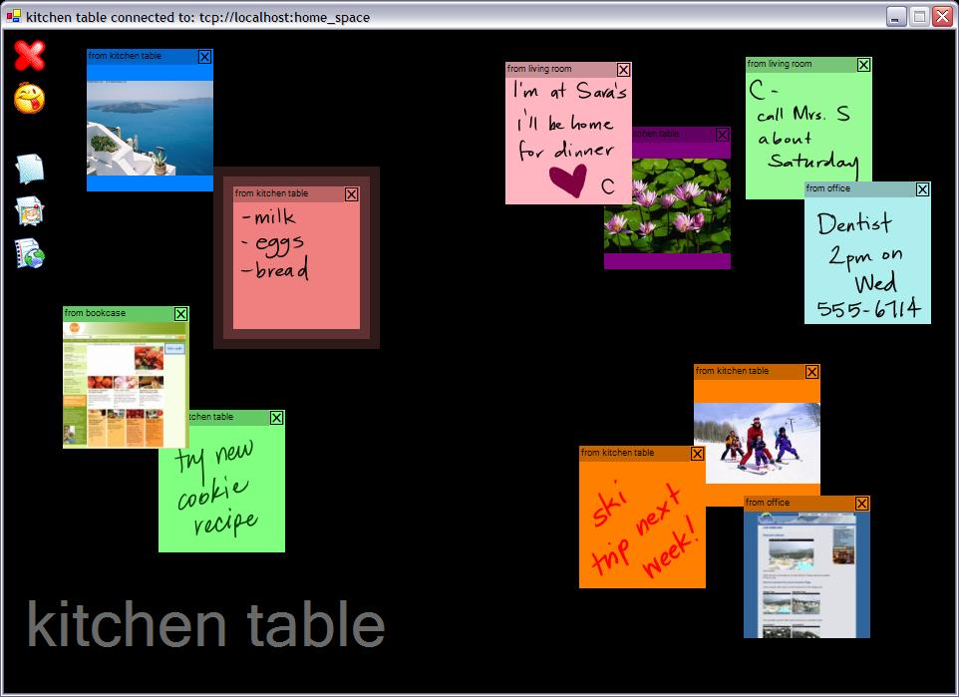
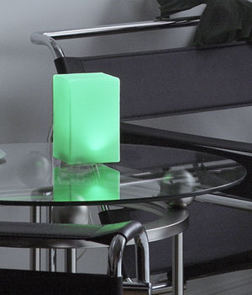
extensions
change information by time
new, improved appliances
combine with other systems
Notes:
There are several ways this work could be extended. The first is to allow people to change the information displayed not only by location, but also by time. Currently this can be done by simply keeping a few data stream tags near a location and swapping them out at different times. This could be extended to allow for automatic shifts – for instance weather information is most important in the morning when selecting clothing for the day. Perhaps that device could change in the evening to show the schedule for the following day.
The second extension involves creating new and improved appliances. Our current prototypes are just examples of what might be, and are limited by the fact that they use phidgets (which ties them to USB) and by the fact that they are made of prototype materials: cardboard, tape, etc. To really have value in the home, one would imagine that such devices should be wireless, and truly aesthetically pleasing. The example here is a weather beacon – a commercially available wireless ambient display.
Finally, LDIAs could be extended by being combined with other home technologies. For instance, if used in conjunction with a home messaging system like StickySpots or HomeNote, a display could be used to extend such a system to another location by indicating when new messages arrive and could provide details of the messages when touched.

Slide 38
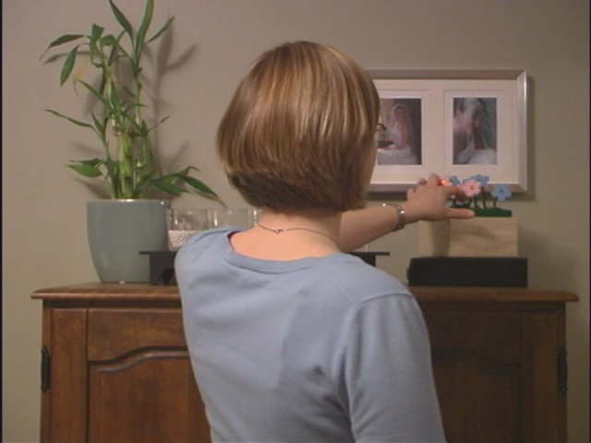
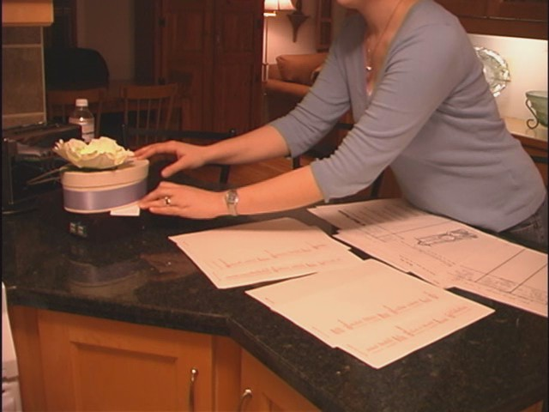
why no evaluation?
intentionally unevaluated
  costly deployment
  extended study time
Notes:
So why haven’t we deployed it to a real home and evaluated it? We have intentionally left our LDIAs unevaluated for several reasons. First, deploying such a system to the home is extremely costly and difficult. You need very robust software, a solid infrastructure, a good network, and expensive hardware including a variety of high-quality appliances. Second, you would need to evaluate the system for a very lengthy period to get any meaningful information – at least several months – as the system would only become truly valuable once it was fully integrated into routines, so we could see how it changes or enhances such routines, and what social changes such a system might introduce.
Both requirements are unreasonable for early prototype testing. While we absolutely believe that such an evaluation (while difficult) is important, such a costly deployment is better suited for a more mature point in the design.

Slide 39
data streams
data source
binary
discrete
data stream
processor
continuous
shared
dictionary
server
text
multimedia
Notes:
the system works as follows, each data source is collected by a small data stream processor program, which parses the information and then sends it to the server (in our case a shared dictionary) in all five information representations.

Slide 40

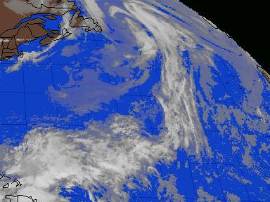
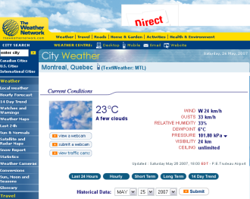
data streams
weather
worse
data stream
processor
+4
shared
dictionary
server
“sunny, 12
high 15”
Notes:
so for example, for a weather forecast data source, the processor would send “worse than yesterday” for binary information, a state of “rain” for the discrete information, “+4” for continuous information, a text description of the forecast, and a satellite image and a detailed webpage forecast as multimedia information. The processor also sends “on demand” information – in this case, tomorrow’s forecast - in the same five formats.

Slide 41
location clients
LDIA tag
reads to
identify
location client (base)
data tag
reads to
identify
Notes:
Second we have the location client, aka the smart location base. The location reads the data tag and the appliance tag in order to identify what appliance is currently located there, and what data source should be displayed.

Slide 42
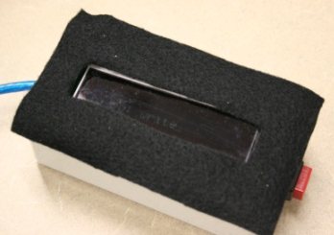
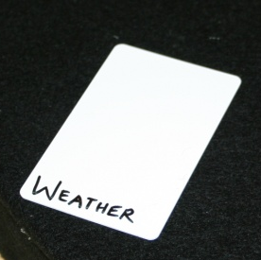
location clients
reads to
identify
location client (base)
reads to
identify
Notes:
So in our example, it would detect the weather information tag, and the text LCD device.

Slide 43
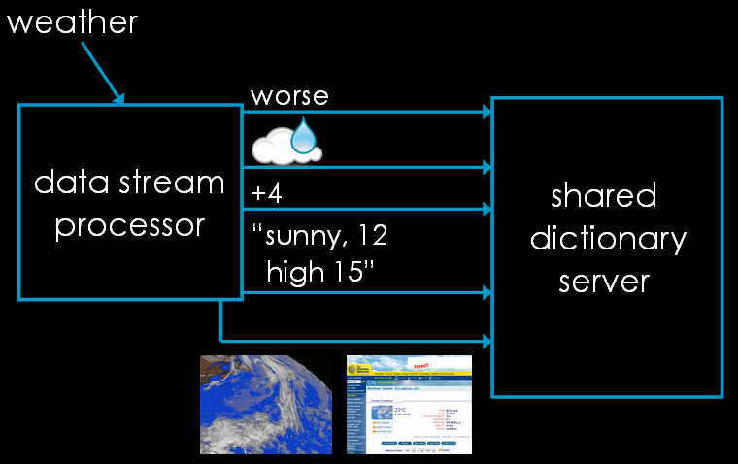
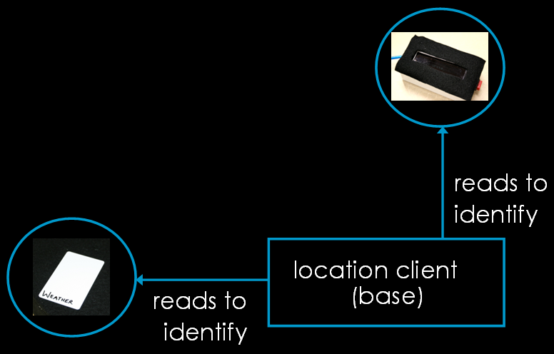
connections
notifies on subscriptions
subscribes to data
sends data to device
Notes:
The location client then subscribes to the right data stream in the right format. The server then sends out the information, and notifies with new information any time it is updated. The base then keeps the device updated with information.

Slide 44
connections
“sunny, 12
high 15”
text weather
“sunny, 12
high 15”
Notes:
So in our example the base would subscribe to the text version of the weather, and the server would send out the appropriate information, which the base would send to the device.

Slide 45
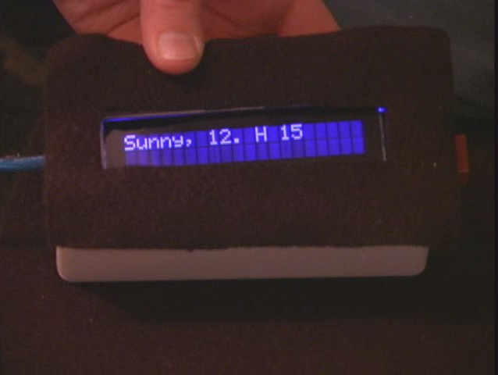
weather
Notes:
So the end result would be a text display of the weather forecast.

