Slide 1
A Digital Family Calendar in the Home:
Lessons from Field Trials of LINC
Carman Neustaedter¹, A.J. Brush², and Saul Greenberg¹
1:University of Calgary, Canada, 2: Microsoft Research

Slide 2
the message
digital family calendars can provide a viable alternative for family coordination

Slide 3

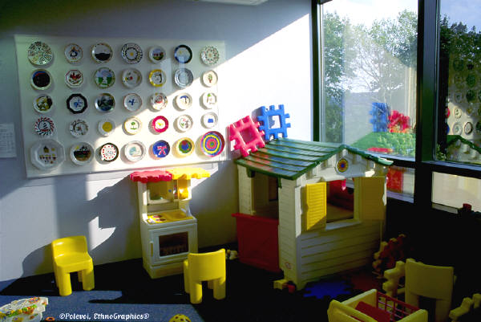

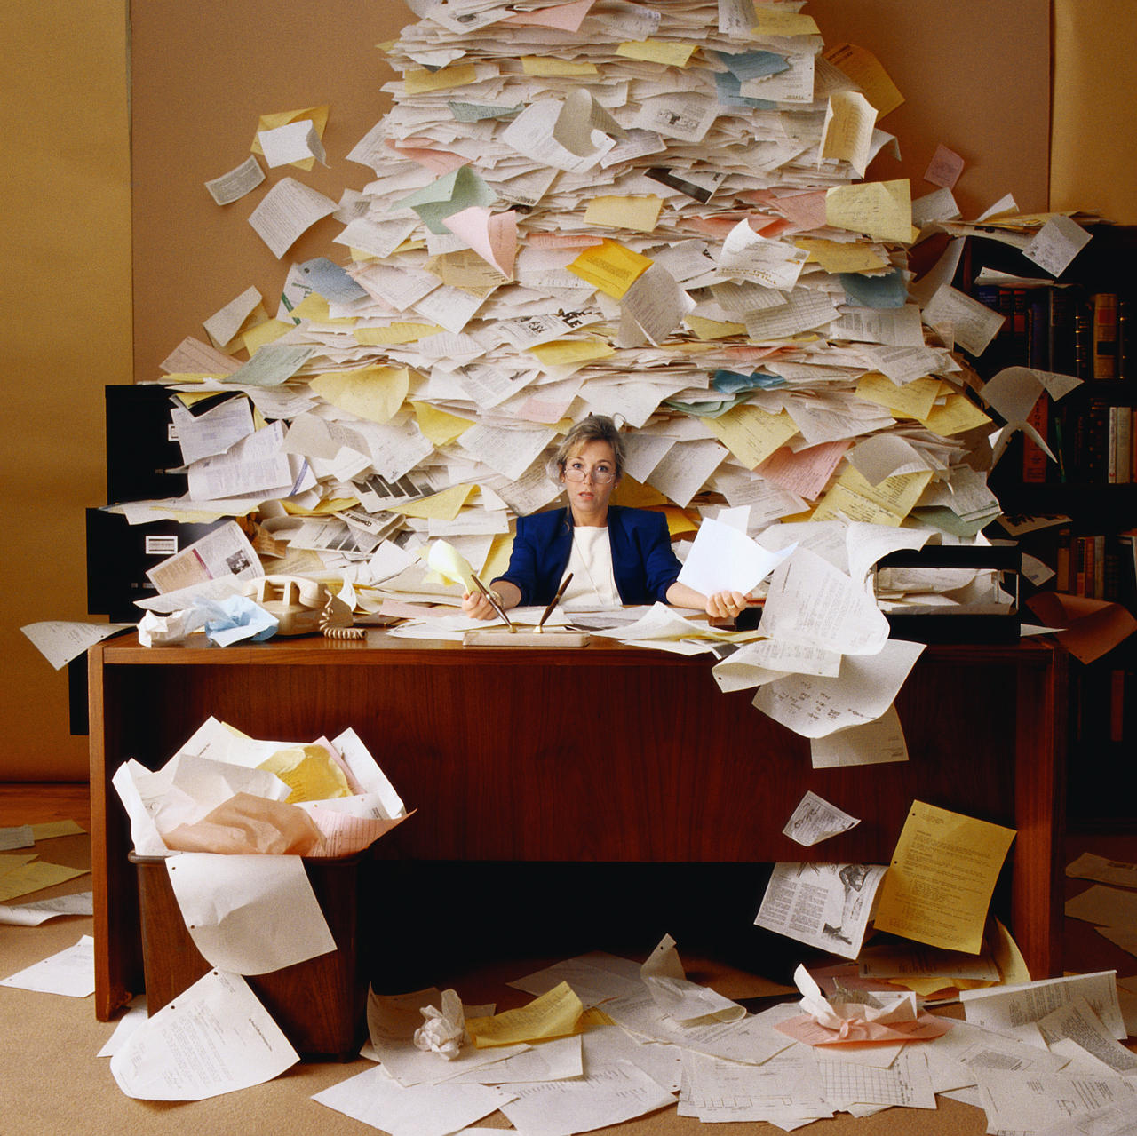



coordination challenges
Notes:
Families face many coordination challenges on a daily basis:
Planning day care or preschool
School events like PTA meetings, clubs, and more
Extra curricular events like ballet practices and recitals, soccer games
Driving kids to and from all of these
Doctor appointments, orthodontists, and the like
And on top of it all, your work schedule that is affected each and every day by family events

Slide 4
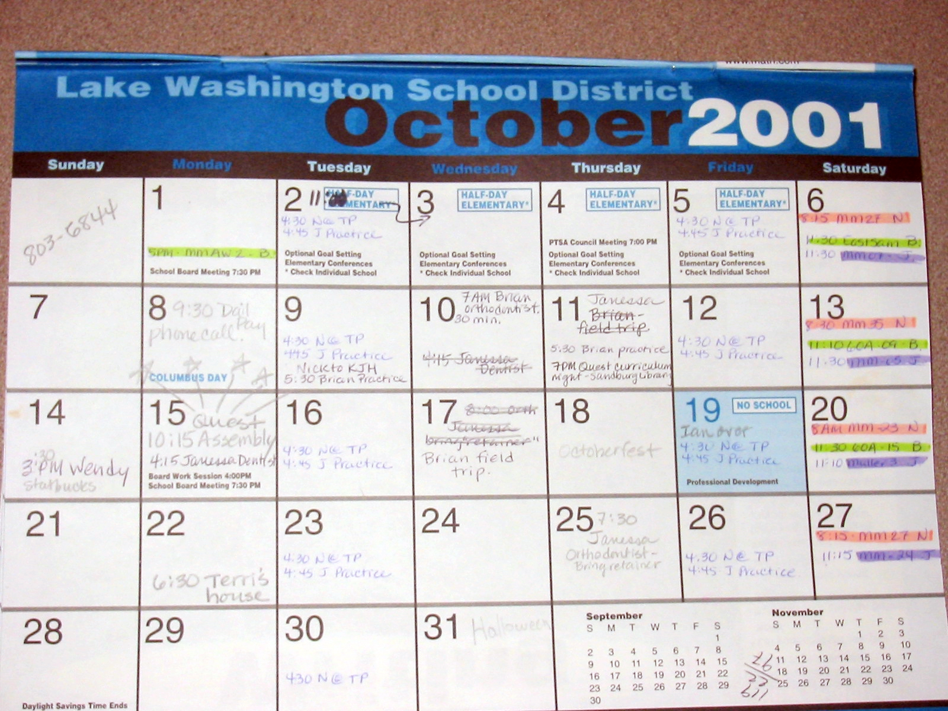

Slide 5
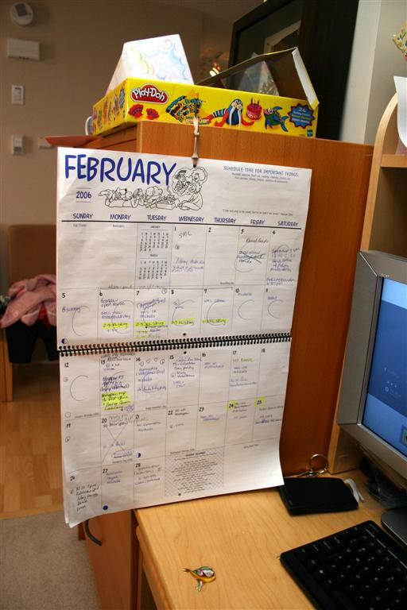
“[The family calendar] is extremely important, we are involved in so many different events I have to be able to map it out or we would forget places, dates, times.”
– Mom and Teacher

Slide 6
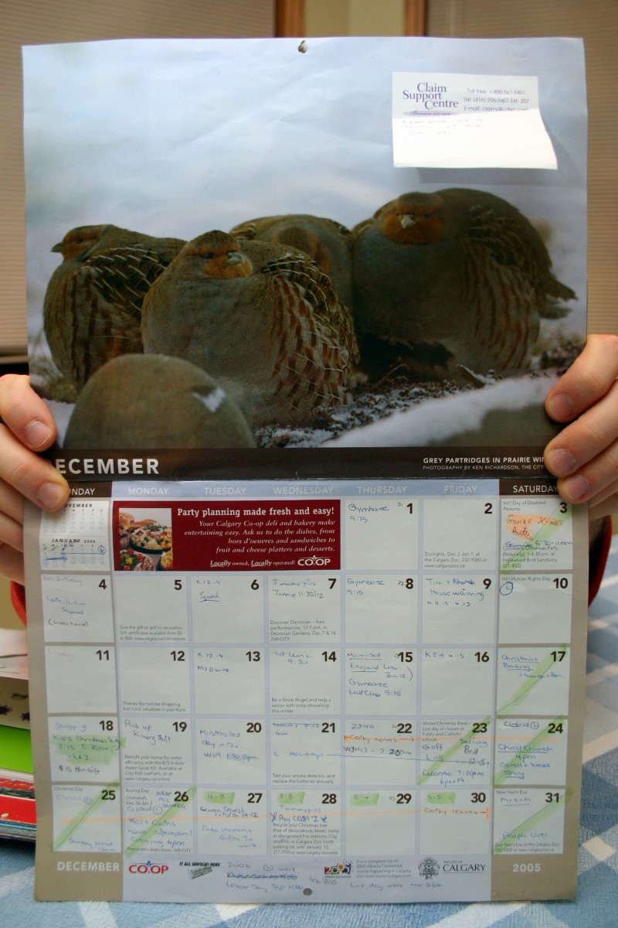
“When you have kids in school you HAVE to have a schedule…there’s just too much…You can’t plan anything without looking at the calendar...”
– Dad / Construction Manager

Slide 7
paper calendar
easy to use
but limited
Brush and Turner, 2005, Neustaedter, 2007
Notes:
Paper calendars present families with many benefits to meet their routines, go through each briefly

Slide 8
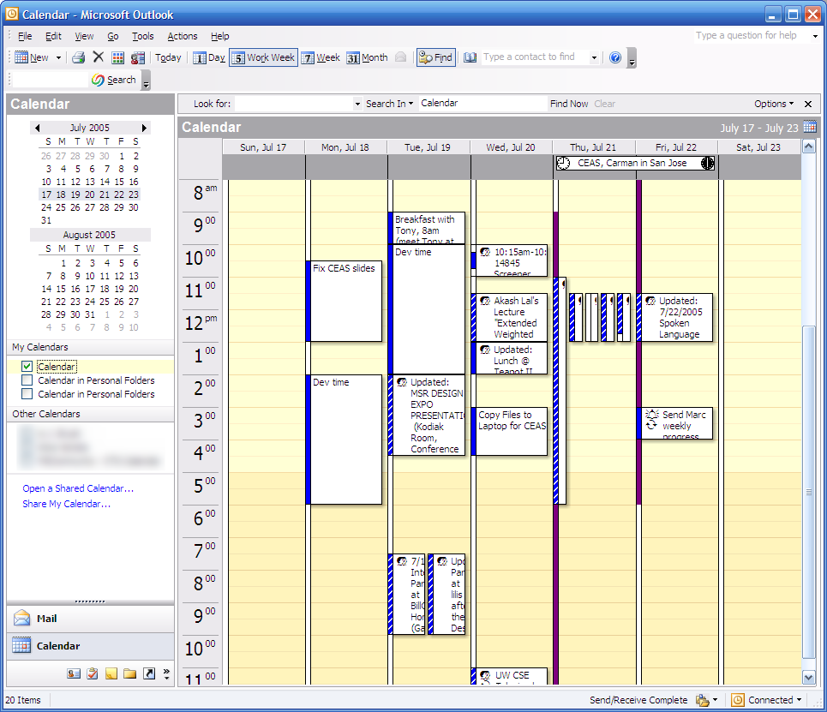
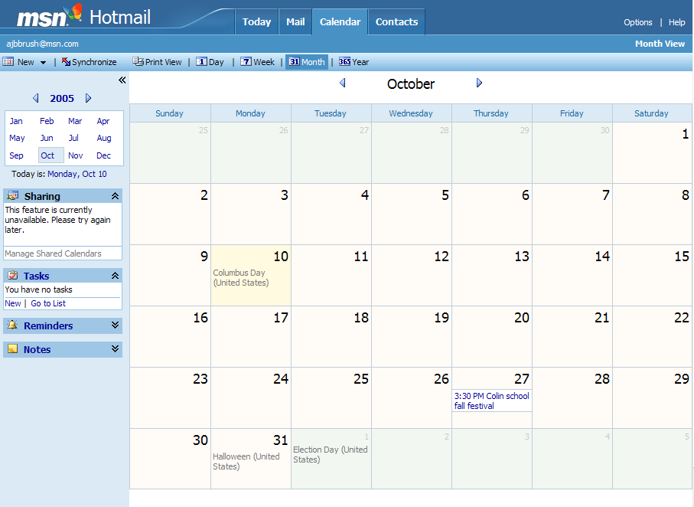
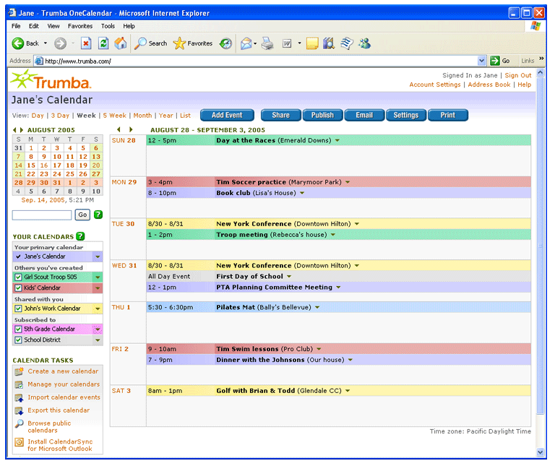
digital calendars exist
Notes:
Digital calendars do exist….. Work calendar, other web calendars, some of which are designed specifically for families, PDAs….
Yet they are often complicated to use and do not necessarily fit within families’ everyday routines (which I hope to highlight in more detail for you)

Slide 9
digital calendars exist
not designed to meet family needs
Notes:
Digital calendars do exist….. Work calendar, other web calendars, some of which are designed specifically for families, PDAs….
Yet they are often complicated to use and do not necessarily fit within families’ everyday routines (which I hope to highlight in more detail for you)

Slide 10
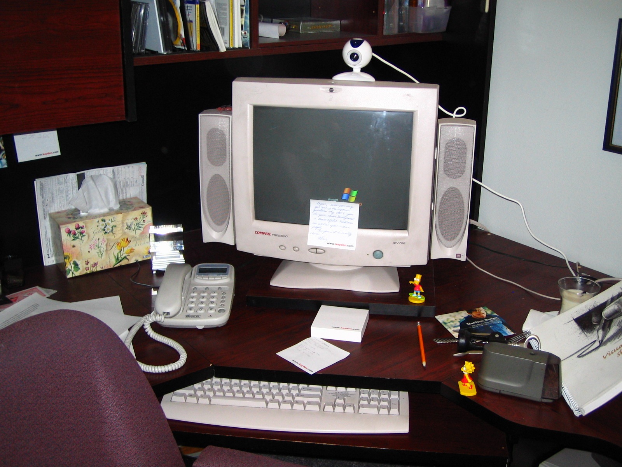

Slide 11
design a digital calendar to meet real family needs

Slide 12
research goal
how to design a digital family calendar that:
  fits within family routines
  extends them to overcome challenges
Notes:
Thus our research goal was two fold:
Design a digital calendar that is as simple to use as a paper calendar …. Or why would people move from paper to digital if it was harder to use?
Leverage technology by making calendar information digital, which can then, in future work, be presented in multiple locations where it is needed

Slide 13
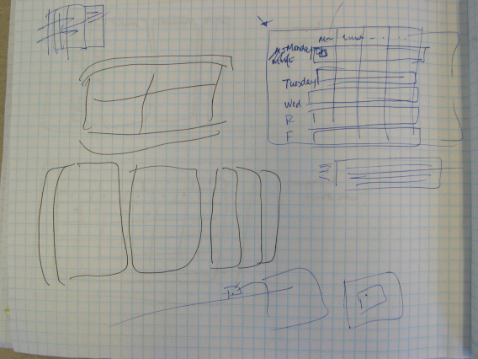
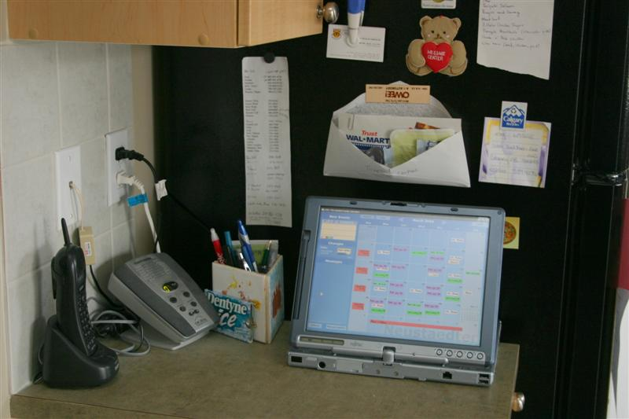
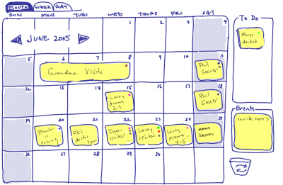
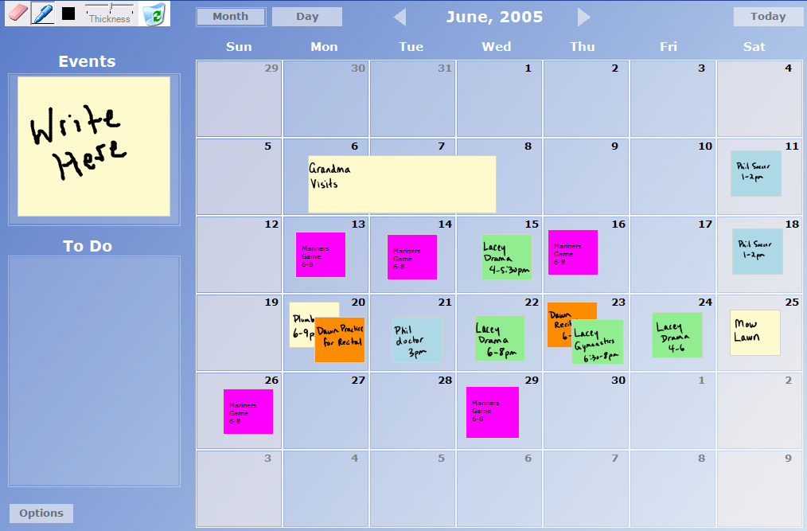
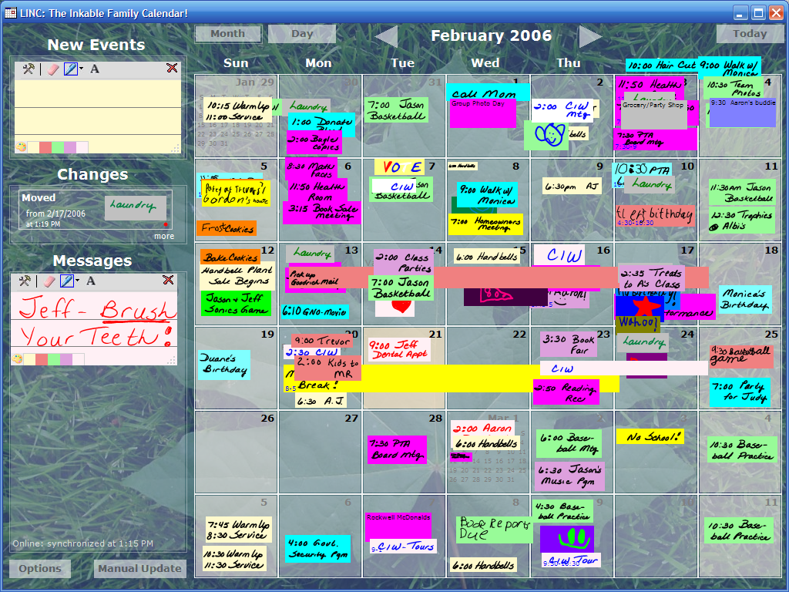
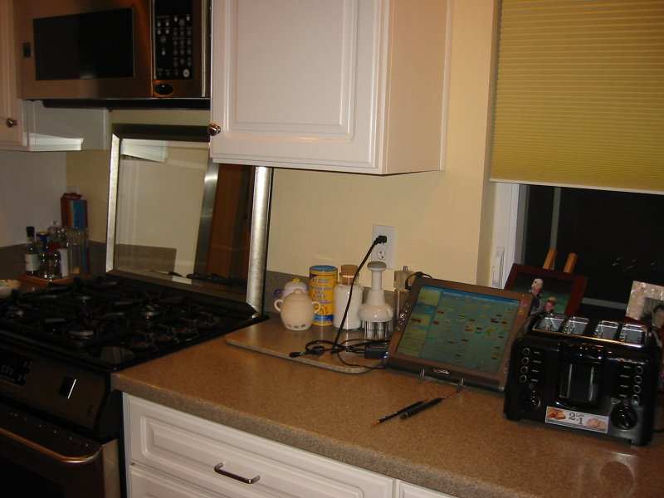
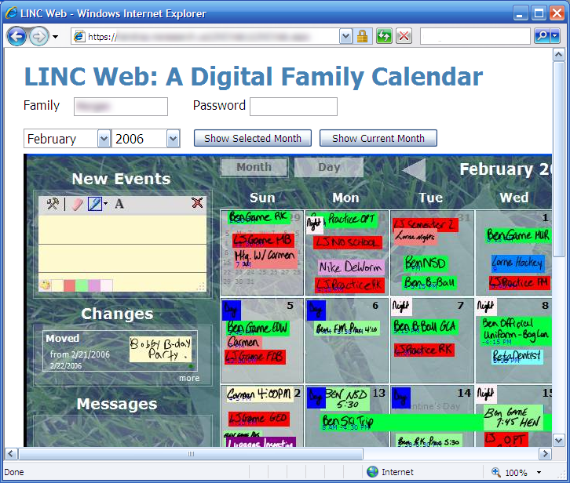
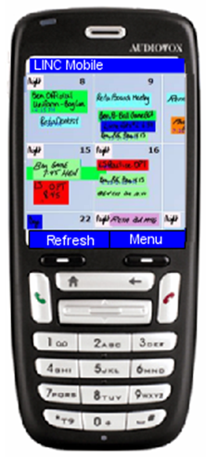
project stages
family
calendaring
LINC digital calendar
LINC
field trials

Slide 14
project stages
family
calendaring
LINC digital calendar
LINC
field trials
journal article /
dissertation

Slide 15
project stages
family
calendaring
LINC digital calendar
LINC
field trials
CHI 2006

Slide 16
project stages
family
calendaring
LINC digital calendar
LINC
field trials

Slide 17
digital calendar design

Slide 18
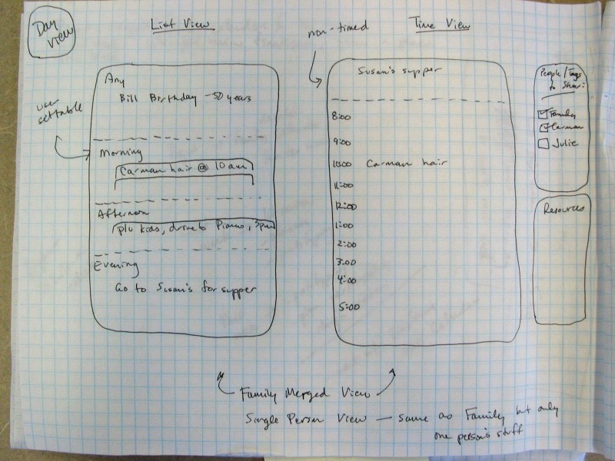
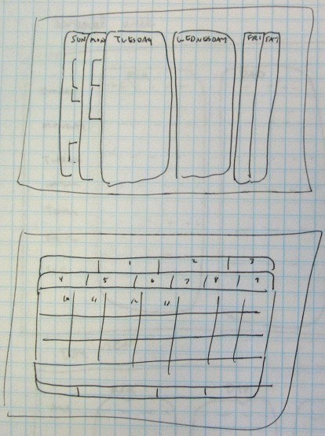
paper prototyping

Slide 19
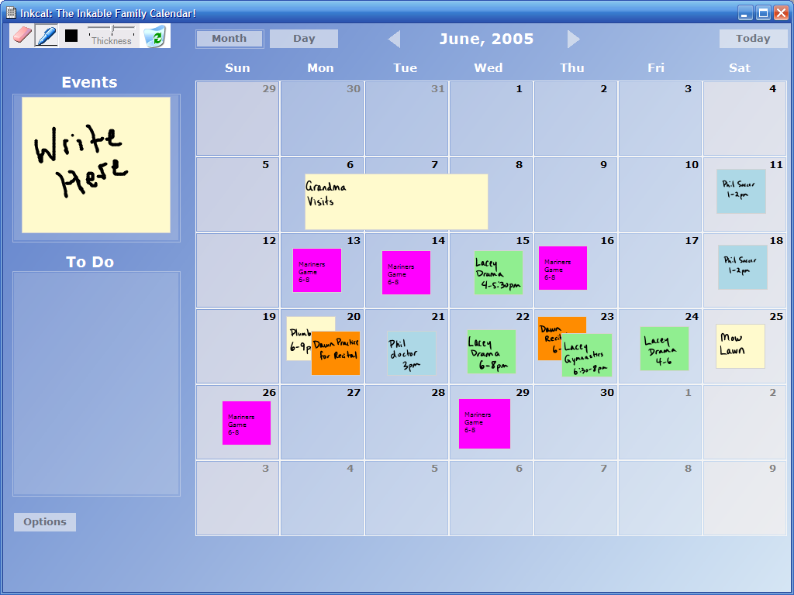
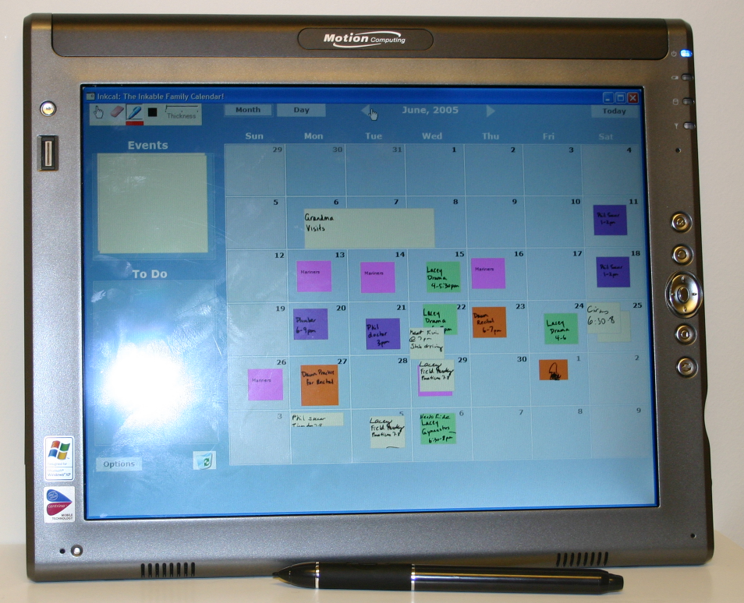
medium-fi prototype

Slide 20
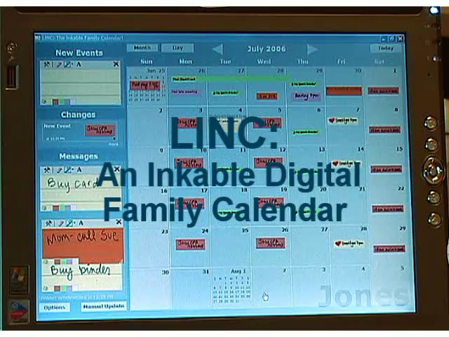
video excerpts, 1 min 30 secs
full video at CSCW 2006

Slide 21
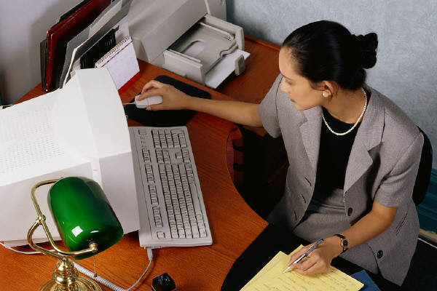
design features
always-on / public
simple interaction
at-a-glance awareness
ubiquitous access

Slide 22
design features
always-on / public
simple interaction
at-a-glance awareness
ubiquitous access

Slide 23
design features
always-on / public
simple interaction
at-a-glance awareness
ubiquitous access

Slide 24
design features
always-on / public
simple interaction
at-a-glance awareness
ubiquitous access

Slide 25
design features
always-on / public
simple interaction
at-a-glance awareness
ubiquitous access

Slide 26
digital calendar evaluation

Slide 27
field trials of LINC
4 families for 4 weeks
used LINC as primary calendar
diaries / weekly interviews

Slide 28
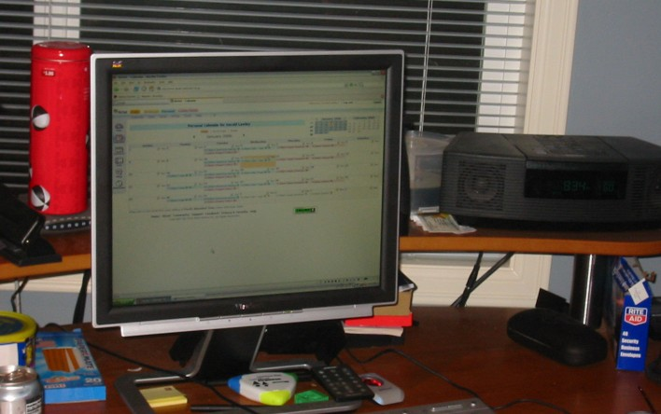
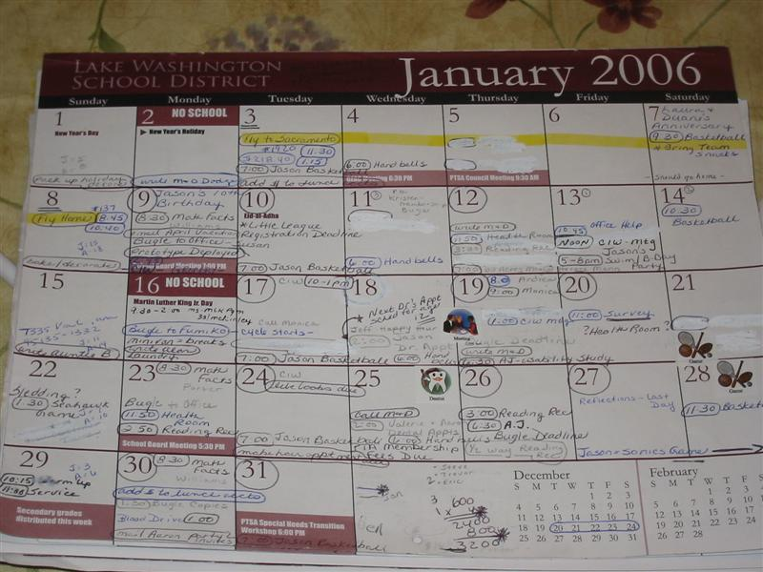
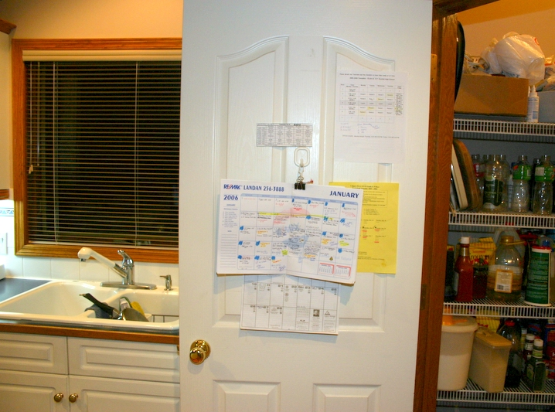
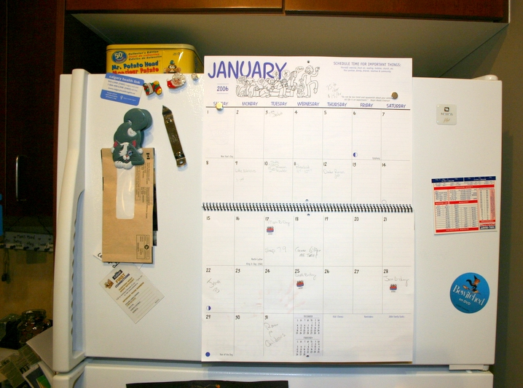
study families
Leonard
Isaacs
Newman
Chambers

Slide 29
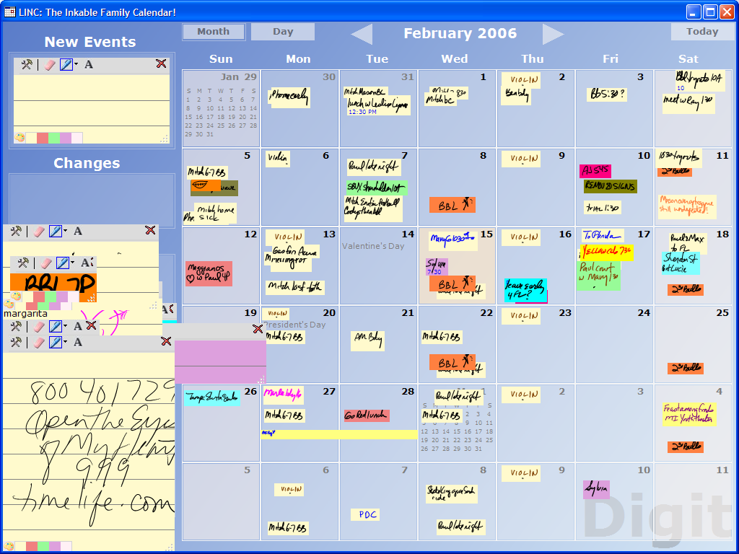
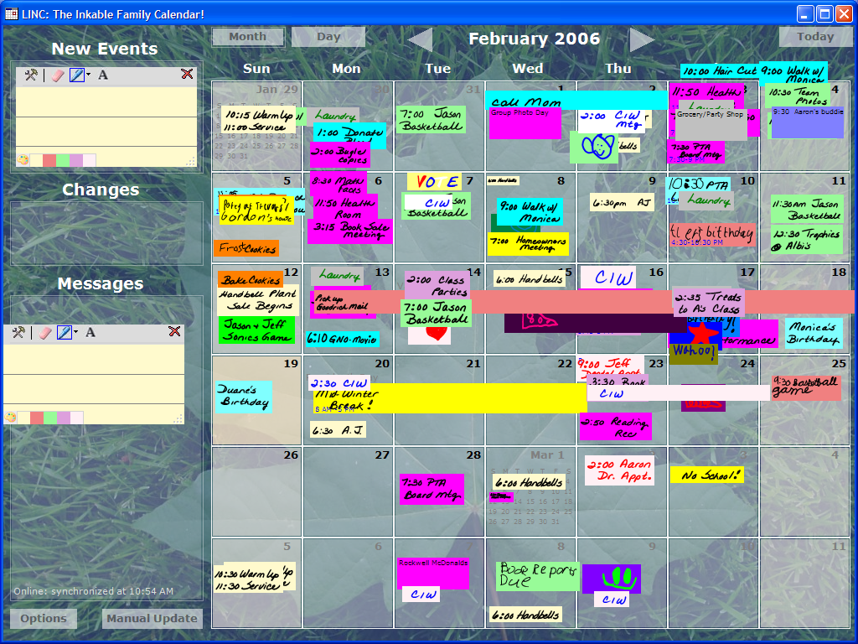
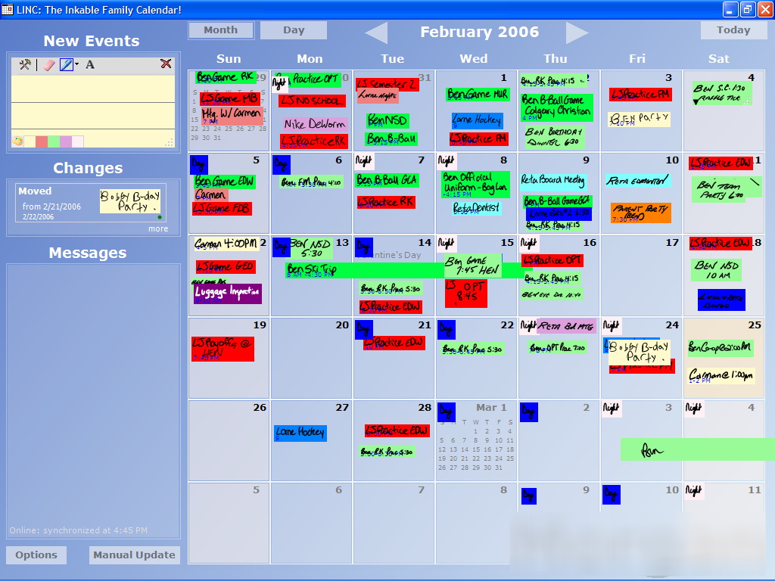
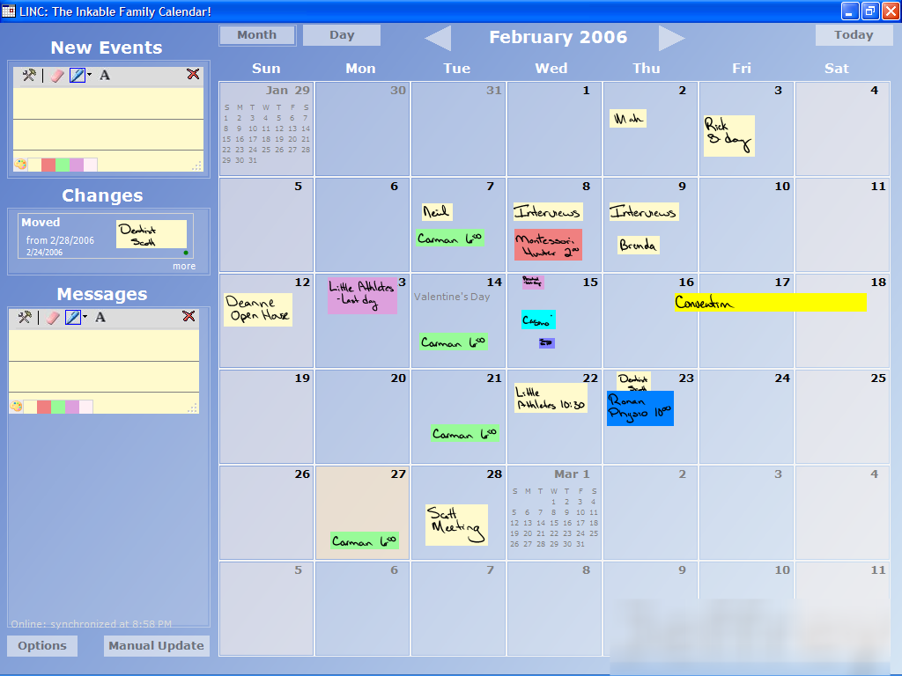
adoption and use
Leonard
Isaacs
Newman
Chambers

Slide 30
public location: leonards
“It makes me more interested in paying attention to the home calendar…I never really accessed the AOL calendar much. [LINC] was something I could access easily without spending a whole bunch of time looking for it…it was very much more visible…”
– Leonard Dad

Slide 31
public location: leonards
“It makes me more interested in paying attention to the home calendar…I never really accessed the AOL calendar much. [LINC] was something I could access easily without spending a whole bunch of time looking for it…it was very much more visible…”
– Leonard Dad
lesson: public availability can increase family involvement

Slide 33
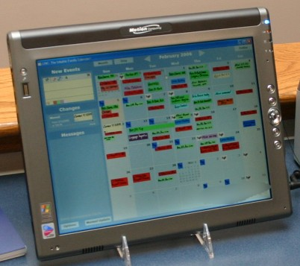
mobile location: chambers
“Honestly if I didn’t have the tablet I know I wouldn’t use it because it’d be on my computer in the other room and why would I go in there…I’m not going to go in [to the other room] to check it because I have kids in here... Mobility is very important, that’s why I like the wireless and the tablet…”
– Chambers Mom

Slide 34
mobile location: chambers
“Honestly if I didn’t have the tablet I know I wouldn’t use it because it’d be on my computer in the other room and why would I go in there…I’m not going to go in [to the other room] to check it because I have kids in here... Mobility is very important, that’s why I like the wireless and the tablet…”
– Chambers Mom
lesson: designs should support mobility within the home
lesson: designs should support mobility within the home

Slide 35
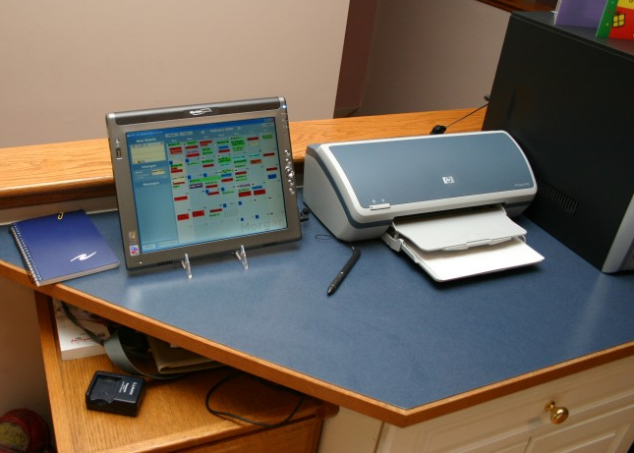
always-on calendar
mixed reviews
walk-up and use
newman family

Slide 36
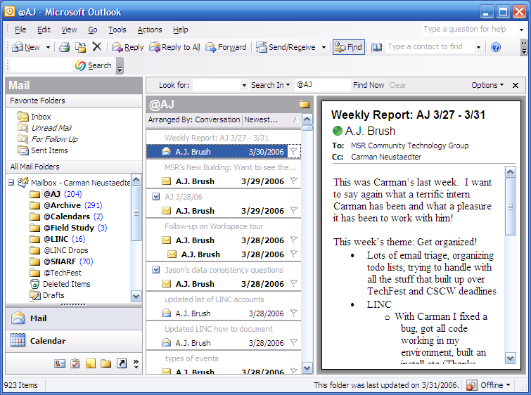
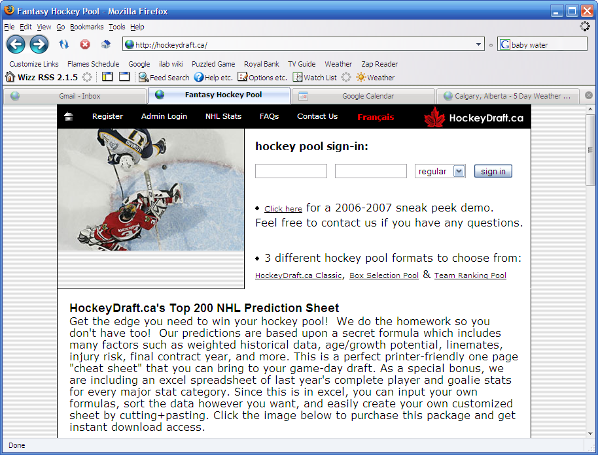
always-on
multi-purpose device is beneficial

Slide 37
always-on
multi-purpose device is beneficial
lesson: designs should balance always-on with easily-accessible

Slide 38
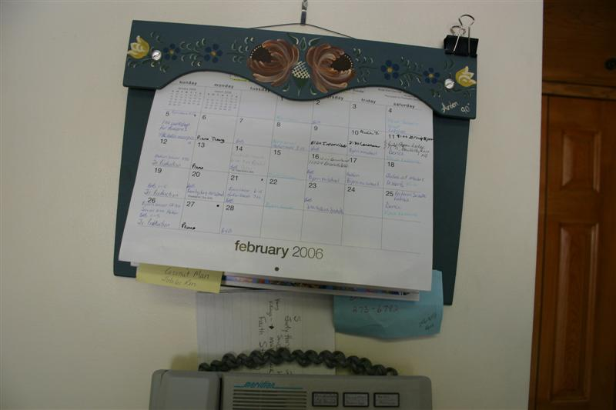

Slide 39
interaction / awareness

Slide 40
at-a-glance awareness
“I just come down in the morning, I look, if there’s no colors on there I don’t worry about the day. If there’s a color on there I know.”
– Chambers Dad

Slide 41
interaction
“I liked the colors…
I liked how you could draw…it really does look a lot more fun.”
– Leonard Mom

Slide 42
interaction
“I liked the colors…
I liked how you could draw…it really does look a lot more fun.”
– Leonard Mom
lesson: flexible interaction to aid at-a-glance awareness is very important
lesson: flexible interaction to aid at-a-glance awareness is very important

Slide 43
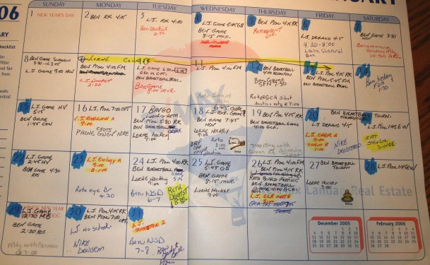

Slide 44

work access beneficial
“I think what works well is that I can pull it up on my work computer. That was definitely a nice thing.”
– Isaacs Dad
“It pulled you into being a part of it more.”
– Isaacs Mom

Slide 45
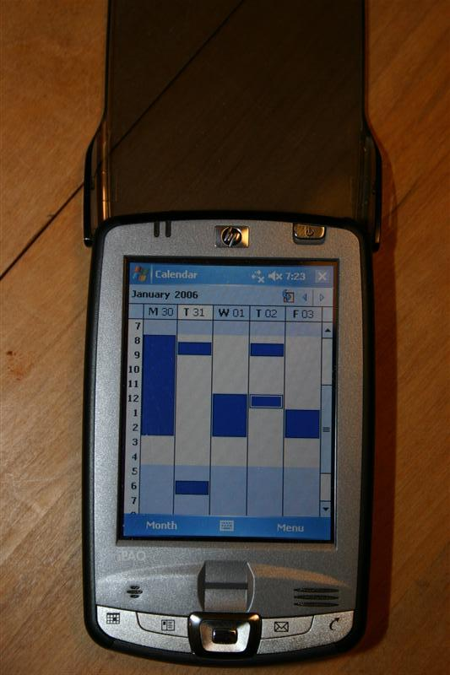
work access limiting
Chambers Dad wanted to integrate the family calendar with his iPaq calendar…
– Chambers Dad

Slide 46
work access limiting
Chambers Dad wanted to integrate the family calendar with his iPaq calendar…
– Chambers Dad
lesson: work access can increase family involvement / better integration is needed

Slide 47
mobile access
“I’m going to need something bigger [when outside the home]…I’ve seen those PDAs, but I’m not sure about the size. I’m used to carrying binders…but thinking about the grocery store I’m not sure I’d want to carry [a tablet]…if I have a PTA meeting I’d take it…”
– Isaacs Mom

Slide 48
mobile access
flexible form factor
full calendar not always needed

Slide 49
mobile access
flexible form factor
full calendar not always needed
lesson: families need flexibility when choosing a mobile device

Slide 50
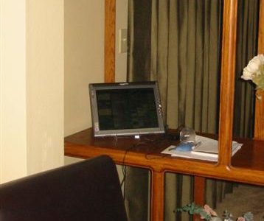
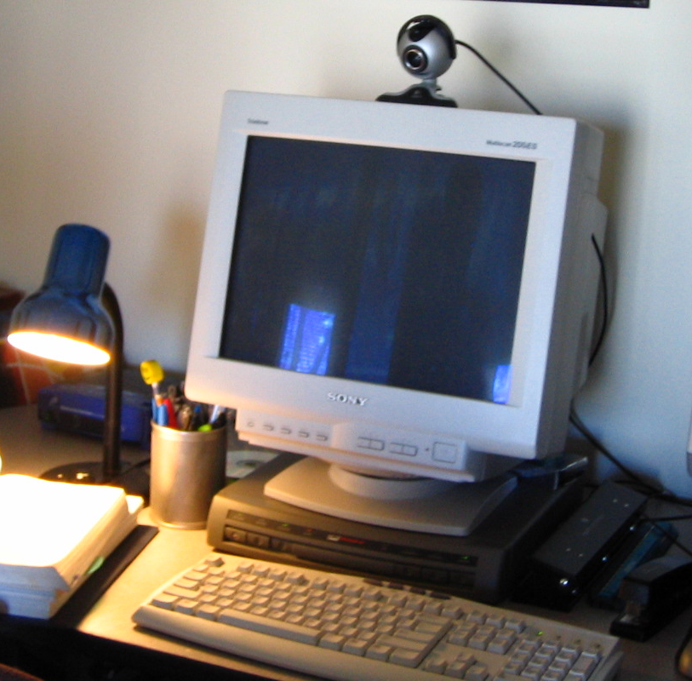
multiple home locations
“Having [LINC] upstairs also was terrific because if things came in email I could modify them right away…I think if anything [multiple locations] helped enhance [our routine] because I am in different locations…I didn’t have to scramble and go and find that paper calendar which may not always be in the place I thought.”
– Isaacs Mom
“Having [LINC] upstairs also was terrific because if things came in email I could modify them right away…I think if anything [multiple locations] helped enhance [our routine] because I am in different locations…I didn’t have to scramble and go and find that paper calendar which may not always be in the place I thought.”
– Isaacs Mom

Slide 51
multiple home locations
“Having [LINC] upstairs also was terrific because if things came in email I could modify them right away…I think if anything [multiple locations] helped enhance [our routine] because I am in different locations…I didn’t have to scramble and go and find that paper calendar which may not always be in the place I thought.”
– Isaacs Mom
“Having [LINC] upstairs also was terrific because if things came in email I could modify them right away…I think if anything [multiple locations] helped enhance [our routine] because I am in different locations…I didn’t have to scramble and go and find that paper calendar which may not always be in the place I thought.”
– Isaacs Mom
lesson: families benefit from multiple fixed locations within the home

Slide 52
summary
paper-like attributes let family calendars fit within routines
ubiquity increased family involvement

Slide 53
the message
digital family calendars can provide a viable alternative for family coordination

Slide 54
key factors
public / accessible
simple interaction
at-a-glance awareness
ubiquitous access

Slide 55
key factors
public / accessible
simple interaction
at-a-glance awareness
ubiquitous access

Slide 56
key factors
public / accessible
simple interaction
at-a-glance awareness
ubiquitous access

Slide 57
key factors
public / accessible
simple interaction
at-a-glance awareness
ubiquitous access

Slide 58
key factors
public / accessible
simple interaction
at-a-glance awareness
ubiquitous access

Slide 59
thank you!
Carman Neustaedter
University of Calgary, Canada
carman@cpsc.ucalgary.ca
A.J. Brush
Microsoft Research
ajbrush@microsoft.com
Saul Greenberg
University of Calgary, Canada
saul.greenberg@ucalgary.ca

Slide 61
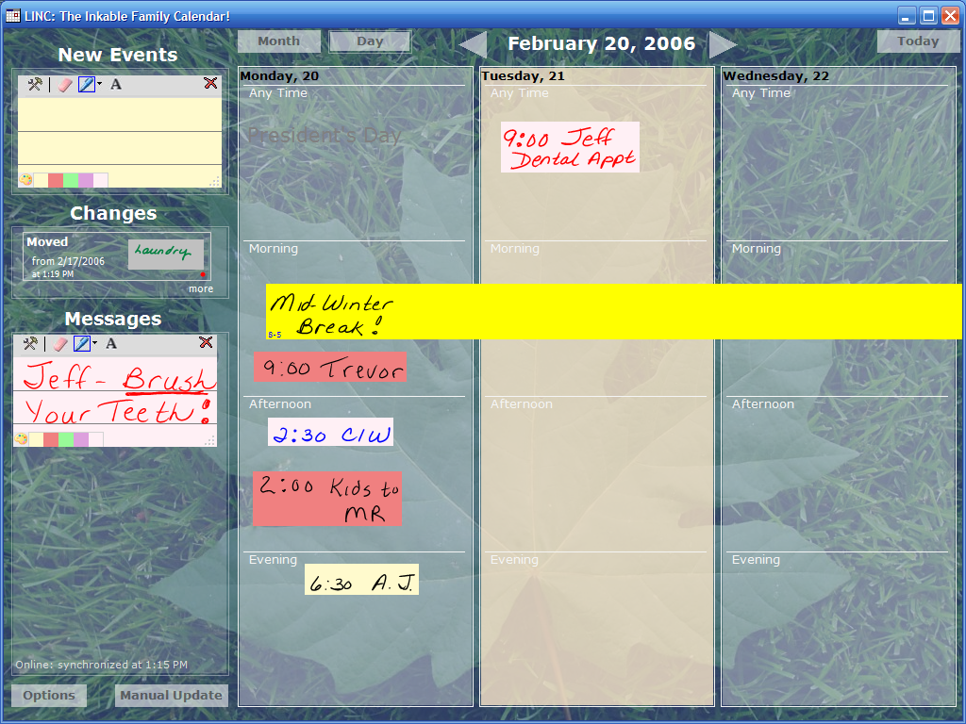

Slide 62
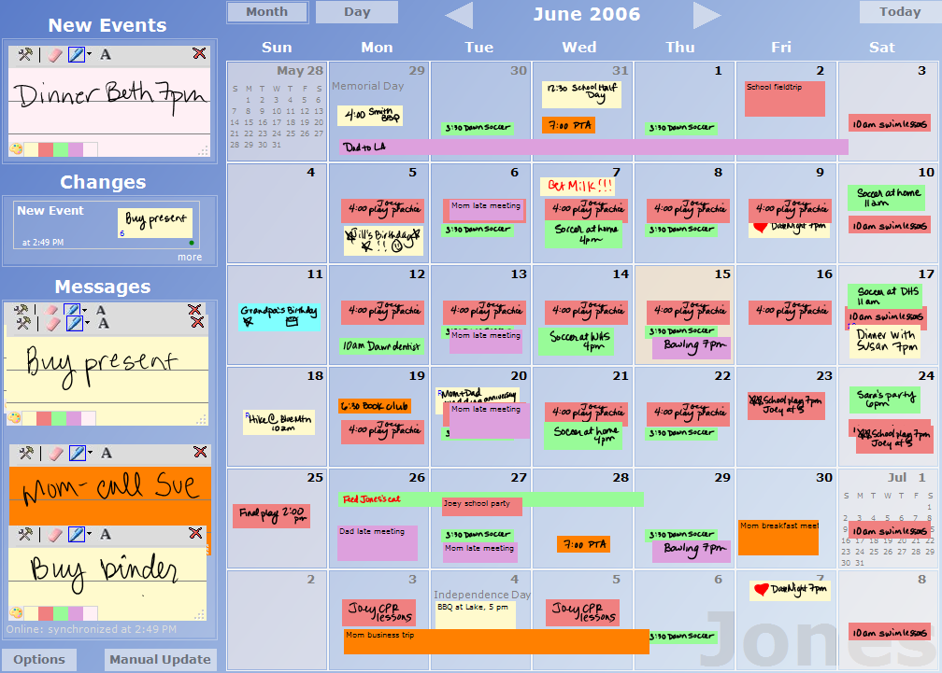
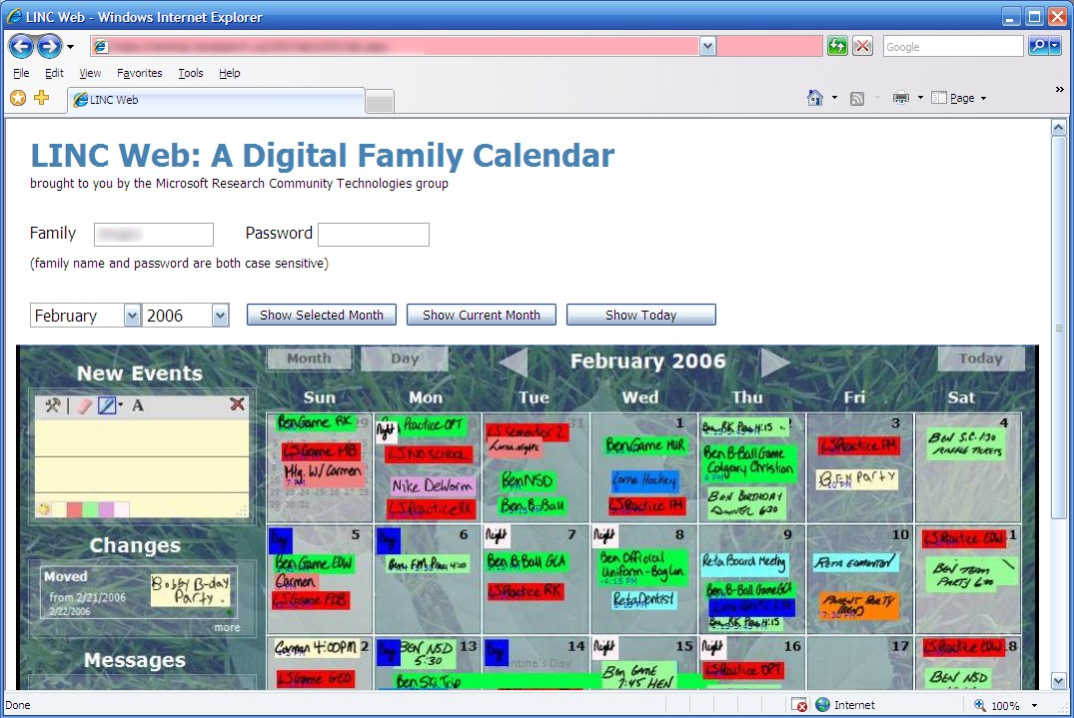
work prototype

Slide 63
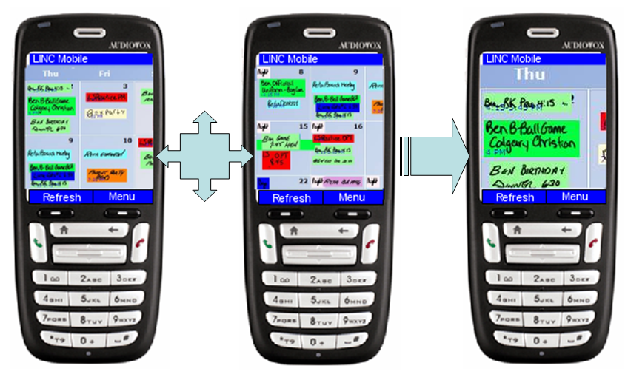
mobile prototype

