Slide 1
A Field Study of Community Bar
(Mis)-matches between Theory and Practice
Natalia Romero Gregor McEwan Saul Greenberg
Eindhoven
University of Technology
HxI Initiative
National ICT Australia
University of Calgary

Slide 2
Message
We can use theory to inform concrete design, but details matter.

Slide 3
Building Community Bar
Theory
Notification
Collage
Design
Principles
SideShow
Community
Bar
Notes:
Why evaluate? What did we evaluate? More detail

Slide 4
Evaluation
Theory
Notification
Collage
Design
Principles
SideShow
Community
Bar
Notes:
Why evaluate? What did we evaluate? More detail

Slide 5
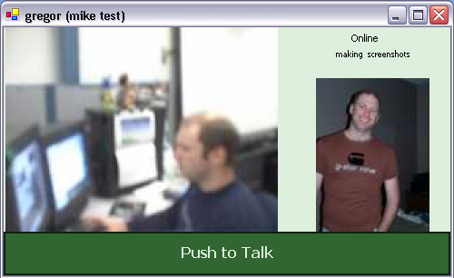

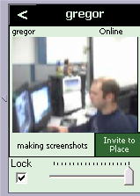

Community Bar
Support for distributed informal awareness and casual interaction
Notes:
Set up what the talk is about before here
Have tool -> evaluated
CB is not main message

Slide 6
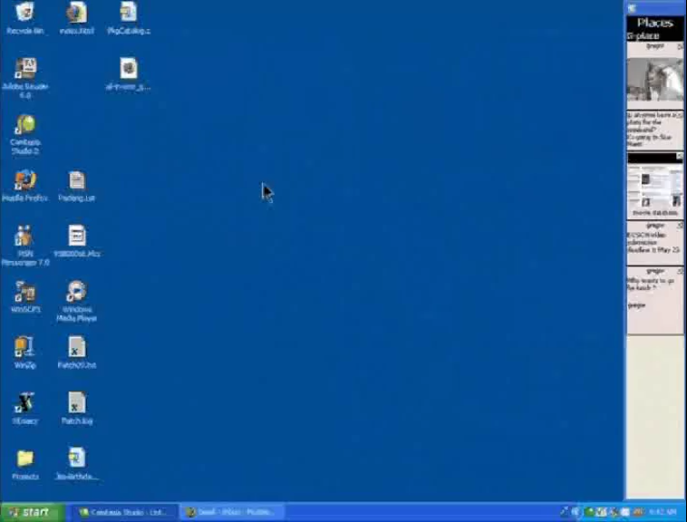

Slide 7
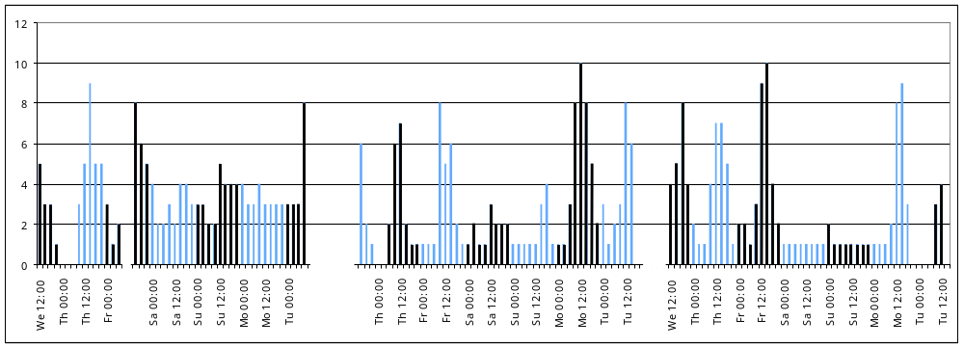
Evaluation: Field Study
15 participants
  3 time zones
  5 sites (+ home locations)
  Calgary graduate student lab
Data collection
  Server and client logging
  Diary media items
  Interviews

Slide 8
Theory and Design Principles
Informal Awareness &
Casual Interaction
2. Locales Framework
3. Focus/Nimbus Model of
Awareness
Notes:
Why these theories?
Want to design an informal awareness tool (motivate this list)

Slide 9
Theory and Design Principles
1. Awareness information should be always visible at the periphery
Informal Awareness &
Casual Interaction
2. Allow lightweight transitions from Awareness to Interaction
3. Support Groups of Intimate Collaborators
4. Provide Rich Information Sources and Communication Channels
2. Locales Framework
5. Provide Locales
6. Relate Locales to One Another
7. Allow People to Manage and stay aware of their evolving interactions over time
3. Focus/Nimbus Model of
Awareness
8. Provide methods for controlling focus
9. Provide methods for controlling nimbus

Slide 10
Theory and Design Principles
1. Awareness information should be always visible at the periphery
Informal Awareness &
Casual Interaction
2. Allow lightweight transitions from Awareness to Interaction
3. Support Groups of Intimate Collaborators
4. Provide Rich Information Sources and Communication Channels
2. Locales Framework
5. Provide Locales
6. Relate Locales to One Another
7. Allow People to Manage and stay aware of their evolving interactions over time
3. Focus/Nimbus Model of
Awareness
8. Provide methods for controlling focus
9. Provide methods for controlling nimbus

Slide 11
Support Easy Transitions from
Awareness to Casual Interaction

Slide 12
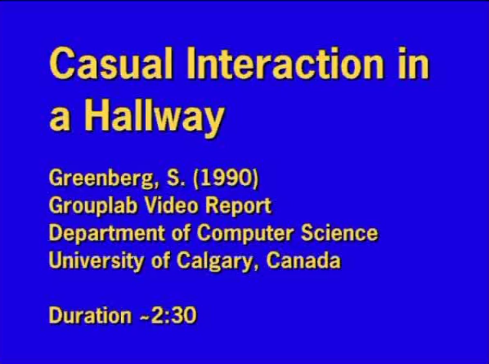

Slide 13

Design

Slide 14
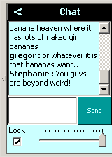
Design

Slide 15
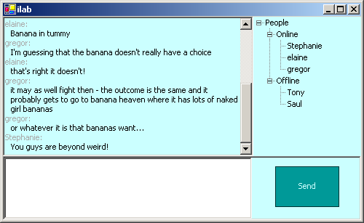
Design

Slide 16
Evaluation: The Chat Item works well
Short
Replies
Long Conversation
Glance

Slide 17
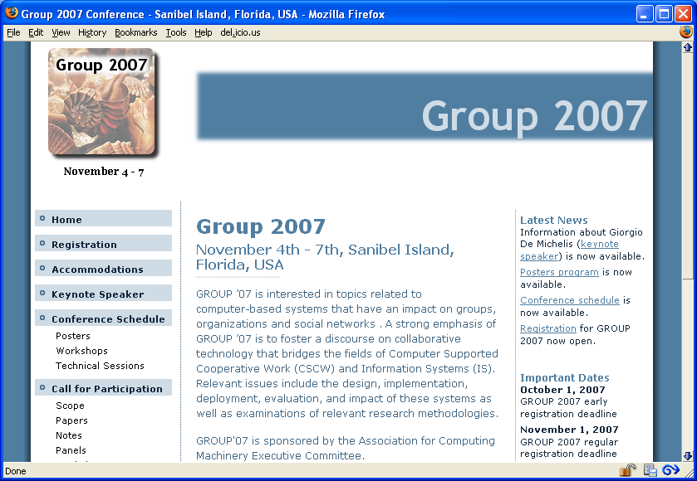
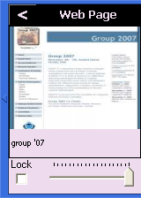

Evaluation: Others not so well…

Slide 18
Implications for Design
Simple drill-down and quick escape* works well
BUT
Presentation levels must match the type of information and interaction.
Each presentation must offer significant value over the others.
*(Cadiz et al, 2002)

Slide 19
Provide Locales

Slide 20
Theory
Collaboration occurs in groups
Individuals are active in multiple groups at
the same time
A Locale is a group and its site and tools
for collaboration

Slide 21
Design
Place = Locale
Easy to create and join multiple Places
Concurrent display of multiple Places
Each new interaction group will have a new Place
Place 1
Place 2
Place 3
Place 4

Slide 22

Evaluation
Locales more dynamic than Places
Places not used
Short lived dynamic sub- groups
Mostly OK but some interactions are bothersome to others
Place 1

Slide 23
Implications for Design
There was simultaneous multi-group interaction
BUT
CB Places are too “room-like”
Remove explicit boundaries between Locales
Locale management must be even more dynamic, perhaps implicit

Slide 24
Provide Methods for Controlling Focus
Provide Methods for Controlling Nimbus

Slide 25
Theory
A
Nimbus
B
Focus
A
B
Awareness
A B
(Benford and Fahlen, 1993) (Rodden, 1996)

Slide 26

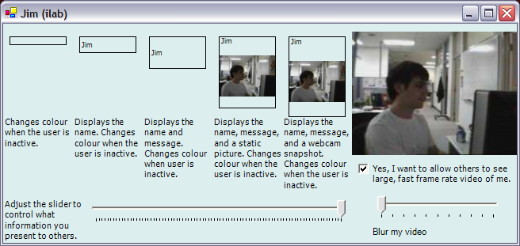
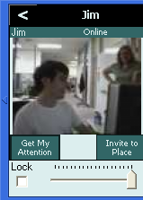
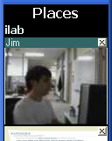
Design
Jim’s CB Nimbus
Kim’s CB Focus
High Focus
High Nimbus
➔ High Awareness

Slide 27

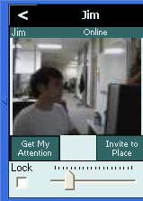

Design
Jim’s CB Nimbus
Kim’s CB Focus
Low Focus
High Nimbus
➔ Low Awareness

Slide 28

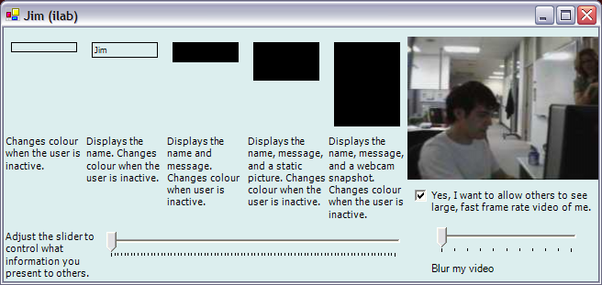
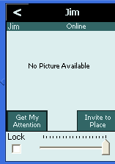
Design
Jim’s CB Nimbus
Kim’s CB Focus
High Focus
Low Nimbus
➔ Low Awareness

Slide 29
Evaluation
Focus controls not used
  only when space is full to maximise videos
  “lots of people log in and it makes everybody smaller … I would go back and make [them] bigger so that I could actually see them”

Slide 30
Evaluation
Nimbus controls not used
  Group social norms discourage reducing nimbus
  “The social environment was such that it would be weird if you [reduced nimbus] … People may ask questions like why”
But people did change their Nimbus
  Changing camera focus,
  camera showing keyboard,
  not capturing passers-by

Slide 31
Implications for Design
Focus and Nimbus are important
BUT
Awareness controls should be lightweight and implicit
Explicit focus and nimbus controls are not useful
Social structures and patterns determine behaviour more than interface functionality

Slide 32
Summary
Theory
  predicts what we saw
  little concrete guidance
Design Principles
  tell us what to do
  don’t tell us how to do it
Implementation
  demonstrates efficacy of theoretical themes
  concrete details are not always successful
Notes:
Summarise evaluation

Slide 33
Message
We can use theory to inform concrete design, but details matter.

Slide 34
Final words
“I really lose out, mostly on this feeling of being connected … there’s no-one else around and it’s very isolating.”

Slide 35
Download and use CB!
http://grouplab.cpsc.ucalgary.ca/CB

