Slide 1
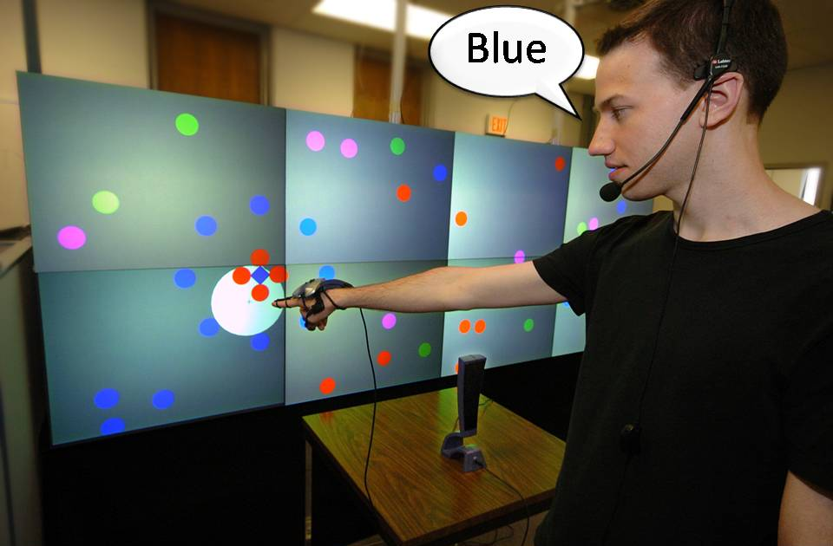
Speech Filtered Bubble Ray
Improving Target Acquisition on Large Display Walls
Edward Tse, Mark Hancock, Saul Greenberg
Notes:
There’s a lot of contention about distant freehand selection techniques over really large digital wall displays.

Slide 2
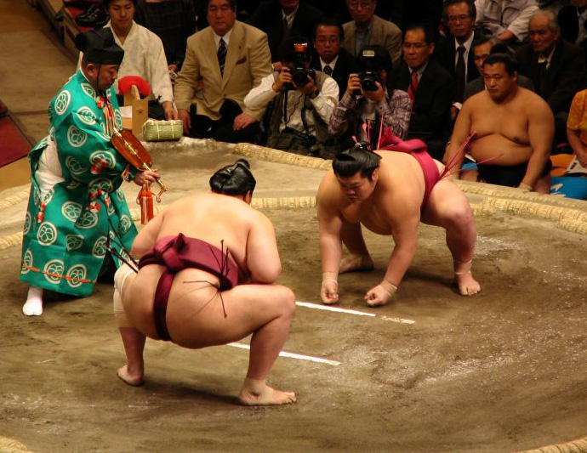
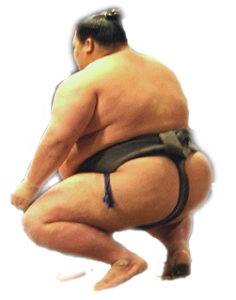

3-Way Sumo Wrestling
Ray
Casting
Bubble
Ray
Speech
Bubble
Notes:
Consequently, we’ve set up a 3 way sumo wresting match to see which technique is better. In the far corner weighing in at 256 pounds we have ray casting using a single finger. On the right we have the 322 pound heavyweight champion bubble ray that always selects the closest target. And finally we have a new contender weighing in at 302 pounds, speech filtered bubble ray that uses speech to filter to the selection space.

Slide 3
Round 1 Speed
Ray
Casting
Bubble
Ray
Speech
Bubble
Notes:
Wrestlers will be evaluated based on three ultimate matches: round 1 will examine speed

Slide 4
Round 2 Accuracy
Ray
Casting
Bubble
Ray
Speech
Bubble
Notes:
Round 2 – accuracy

Slide 5
Round 3 Preference
Ray
Casting
Bubble
Ray
Speech
Bubble
Notes:
And round 3 – user preference.

Slide 6
Speech Filtered
Bubble Ray
Wednesday
10:40am
Notes:
To find out who won, come see our poster at 10:40am on Wednesday.

