Slide 1

Transient Life:
Collecting and sharing personal information
Stephanie Smale and Saul Greenberg
University of Calgary, Canada

Slide 2
Message
Message
Transient Life provides a single interface to collect, consolidate and publish personal information and daily tidbits of interest.

Slide 3
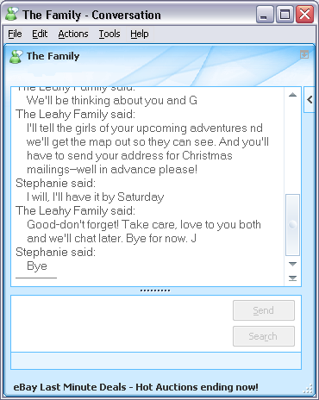
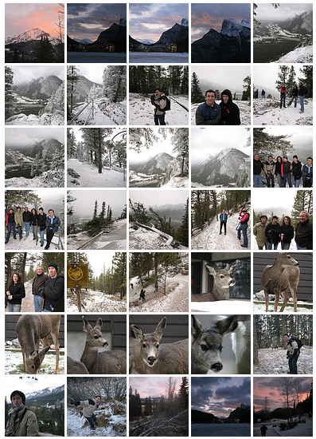
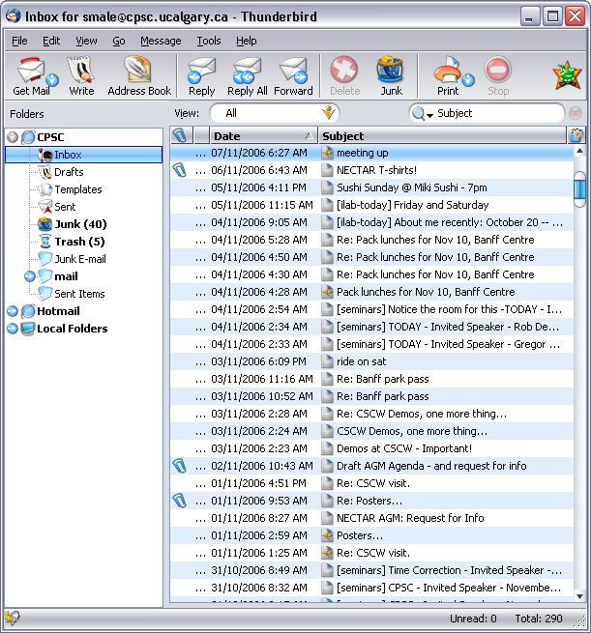
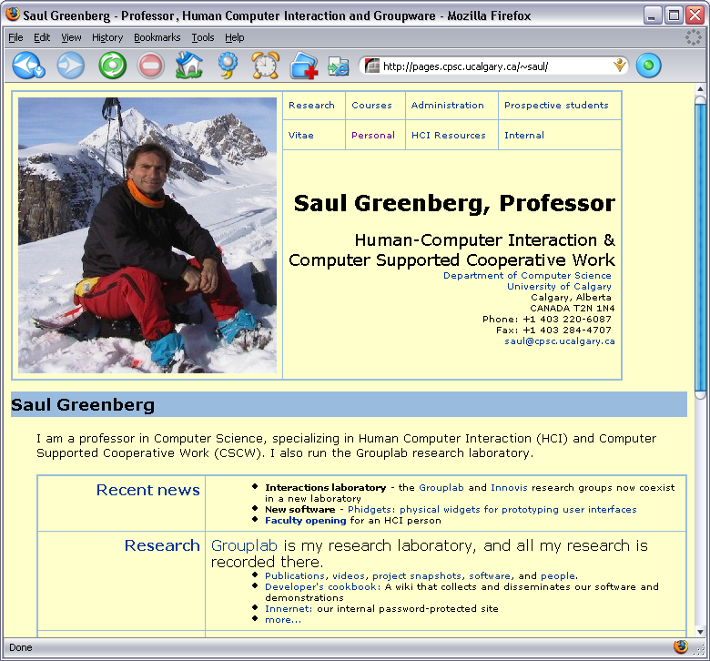
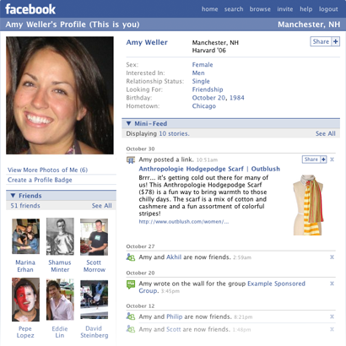
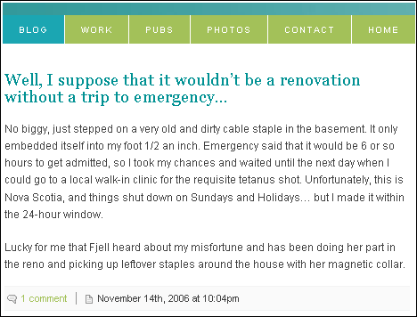
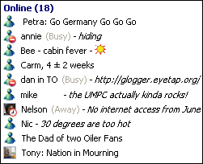
Motivation
Motivation
Many places in internet space where things are posted about self
  Home pages
  Public profiles
  Online galleries
  Email
  Blogs
  IM & Chat

Slide 4
IM Display Names
Mechanisms & Properties
Content
Brief surface information
Update frequency
Up to several times a day
Audience
IM contact list only

Slide 5
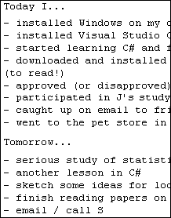
Today Messages [email]
Mechanisms & Properties
Content
Detailed daily activity information
Update frequency
Daily/Every few days
Audience
Specific email recipients, mail list

Slide 6
Blogs
Mechanisms & Properties
Content
Detailed life events, activities and commentary
Update frequency
Daily to weekly to monthly
Audience
General internet public, unless specifically restricted

Slide 7
Now what? – Design Premises
Design Premises
Spontaneous editing of personal status
Publish personal status info in IM
Activity logs and to-do lists
Gathering of information tidbits
Publish logs, to-do lists, collected tidbits
Blog entries
Access to history

Slide 8
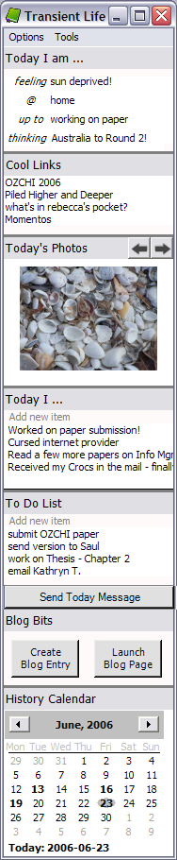
Transient Life
Transient Life
Collect information as it occurs
Distribute information to various outlets
Simple interface controls
7 information tiles

Slide 9
Today I am …
Transient Life
Record personal status information as it changes
Mood Location
Activity Personal Comments

Slide 10
Cool Links, Today’s Photos
Transient Life
Gather information tidbits as they catch your interest
Drag and drop web links and photos

Slide 11
Today I…, To-Do List
Transient Life
Maintain activity logs and
to-do lists
Record an activity as it is completed or add to-do items as they come up

Slide 12
Blog Bits
Transient Life
Create blog text entries
Compose, add to, and edit a text essay over time

Slide 13
History Calendar
Transient Life
View a personal history of gathered information
See status, links, photos and activities from a previous day

Slide 14

Publish
Transient Life
Publish personal status information to the display name field in MSN Messenger

Slide 15
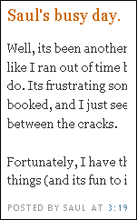
Publish
Transient Life
Have collected links automatically posted as a blog entry
OR
Publish blog entries to an exiting blog site such as Blogger

Slide 16
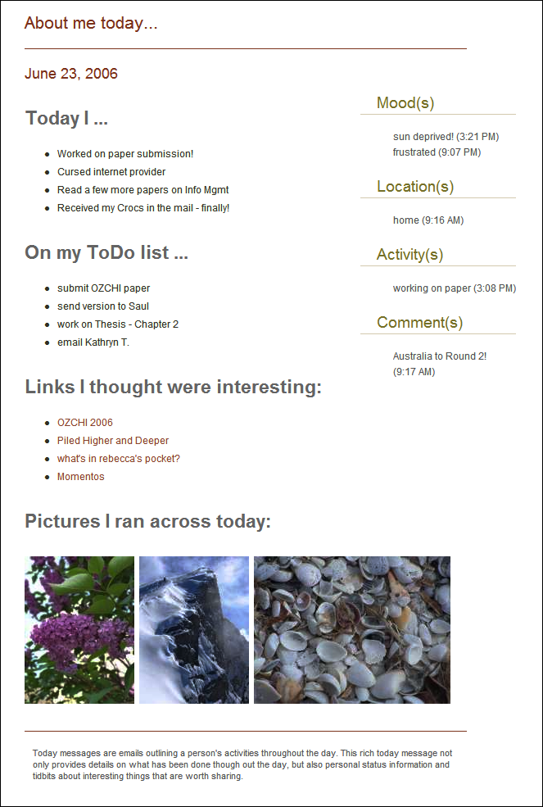
Publish
Transient Life
Generate
and send a
Today Message
Gathering all the information collected throughout the day, a rich, consolidated email is generated for sharing with contacts and collaborators

Slide 17

User Feedback
Feedback
Starter group
  First surprise
Reports, suggestions, new ideas
  New iterations

Slide 18
Comments
Feedback
  "I think it is great that I am now able to bring together a variety of types of information into one repository that I can later use to send a Today message. One of the challenges I faced with Today messages was keeping it around throughout the day so I could add to it as things happened. Transient Life helps to solve this problem by keeping the repository for me."

Slide 19
Comments
Feedback
"I really enjoy navigating to the cool links provided by other people. Some of them are to links I would not have received elsewhere."

Slide 20
Challenges
Challenges
API and linking issues
Conflicting desires
  Awareness and privacy
"Instead of e-mailing today message, just add to a separate blog -- can tell people the RSS feed if they want to be updated".
"I would not want my today messages to be public. If on a blog then only read-protected, I would also want to know who is reading."

Slide 21

Future Work
Future Work
Desire for multi- computer access
Plug-in architecture
Deploy to a larger audience

Slide 22
Message
Message
Transient Life provides a single interface to collect, consolidate and publish personal information and daily tidbits of interest.

Slide 23



This work was funded in part by
Thank you
Notes:
Although I do want to acknowledge those agencies who have supported this research,
I want to leave you with our message.
Thank you.
<click>

