Slide 1
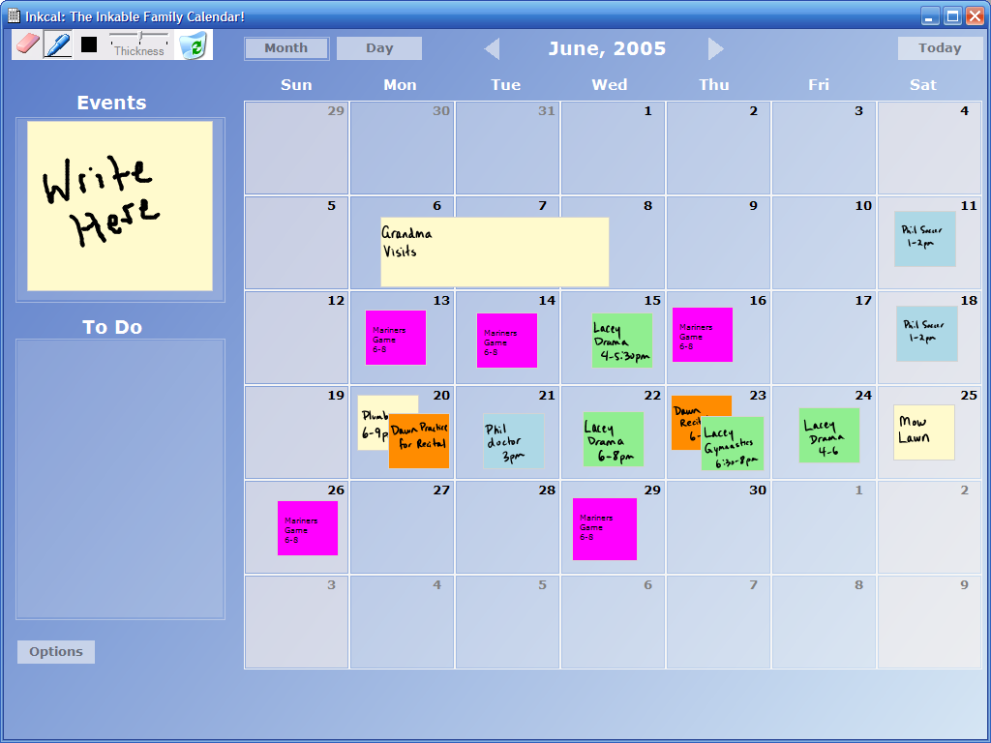
“LINC-ing” the Family:
An Inkable Family Calendar
Carman Neustaedter
University of Calgary, Canada
A.J. Brush
Microsoft Research

Slide 2
The Message
Digital family calendars must be designed to match the coordination needs of families.
Notes:
Family routines are different than the workplace and digital calendars can’t simply migrate into the home from the workplace as a result

Slide 3
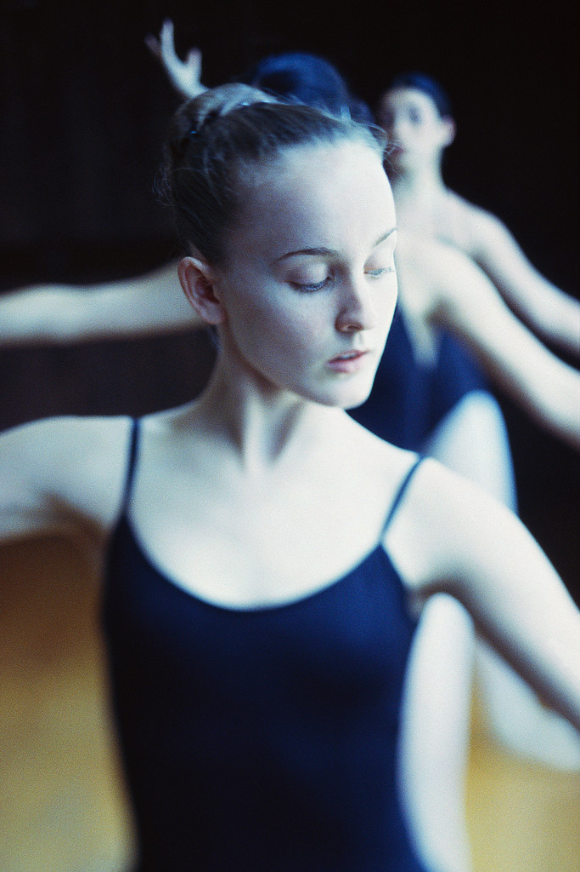
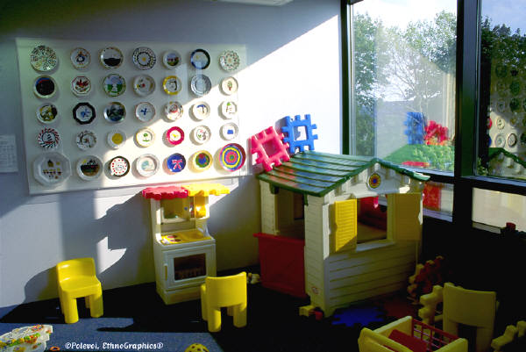
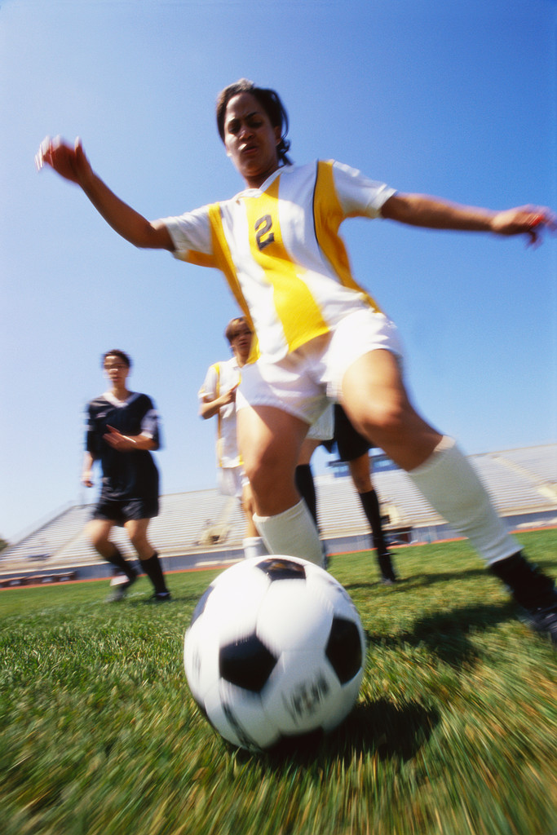
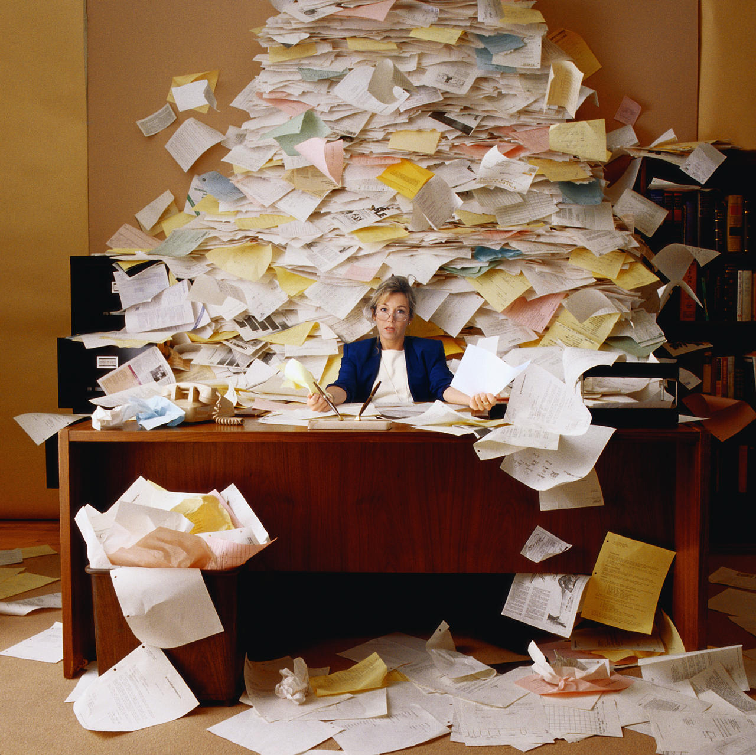
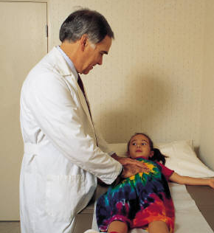
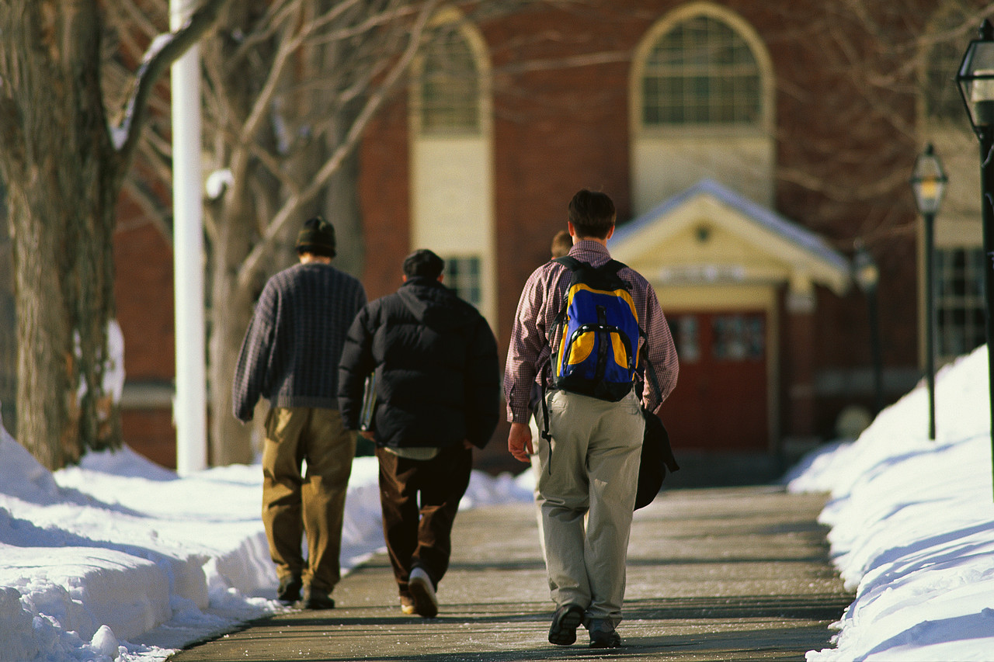
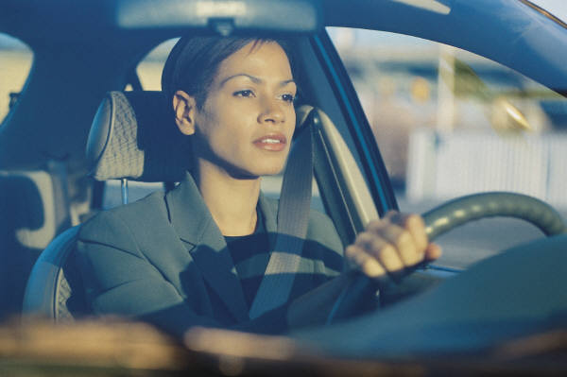
Coordination Challenges
Notes:
Families face many coordination challenges on a daily basis:
Planning day care or preschool
School events like PTA meetings, clubs, and more
Extra curricular events like ballet practices and recitals, soccer games
Driving kids to and from all of these
Doctor appointments, orthodontists, and the like
And on top of it all, your work schedule that is affected each and every day by family events

Slide 4
“Simple” Questions
Are we free for dinner next Saturday?
Can you pick up the kids when I have a late meeting?
Are there conflicts between soccer and music classes?
When do I need a babysitter?
Have we overbooked the van?
Notes:
Family coordination is about answering so-called simple questions
Go through them
While I label them as simple, because they are at first sight, they require complex routines

Slide 5
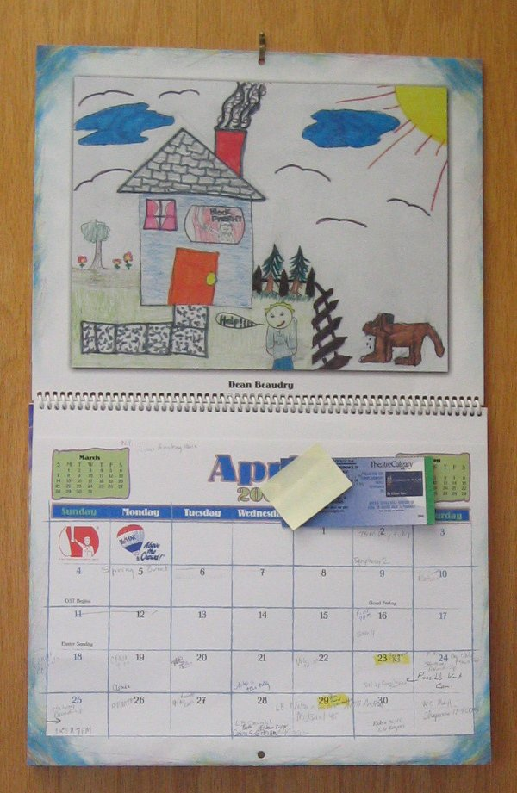
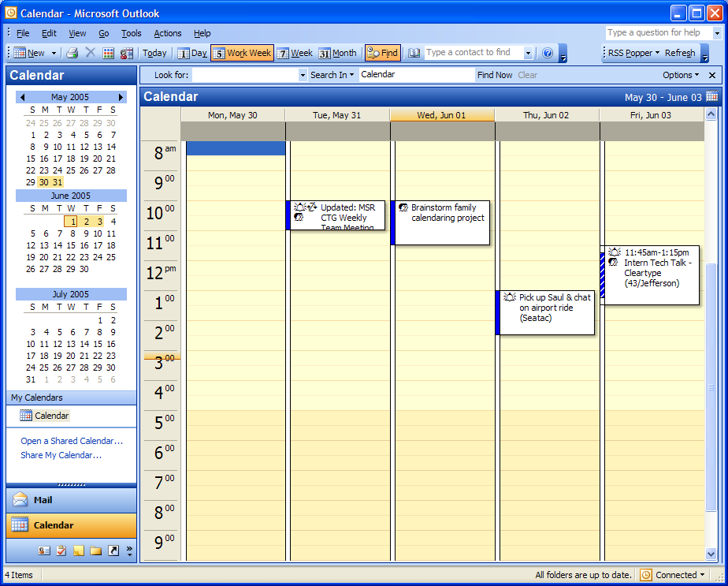
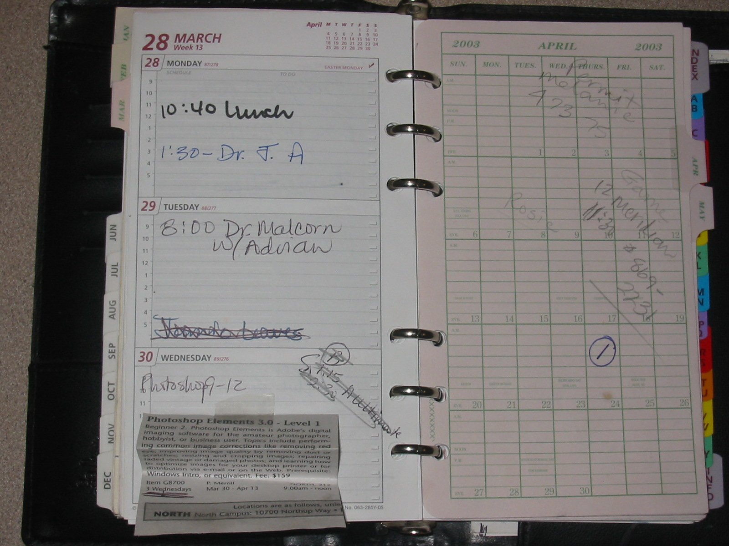
Complex System
Work
Mobile
Home
Notes:
Calendaring is complex and happens in multiple places, we picked the family calendar in the home as a place to start

Slide 6
Complex System
Work
Mobile
Home

Slide 7
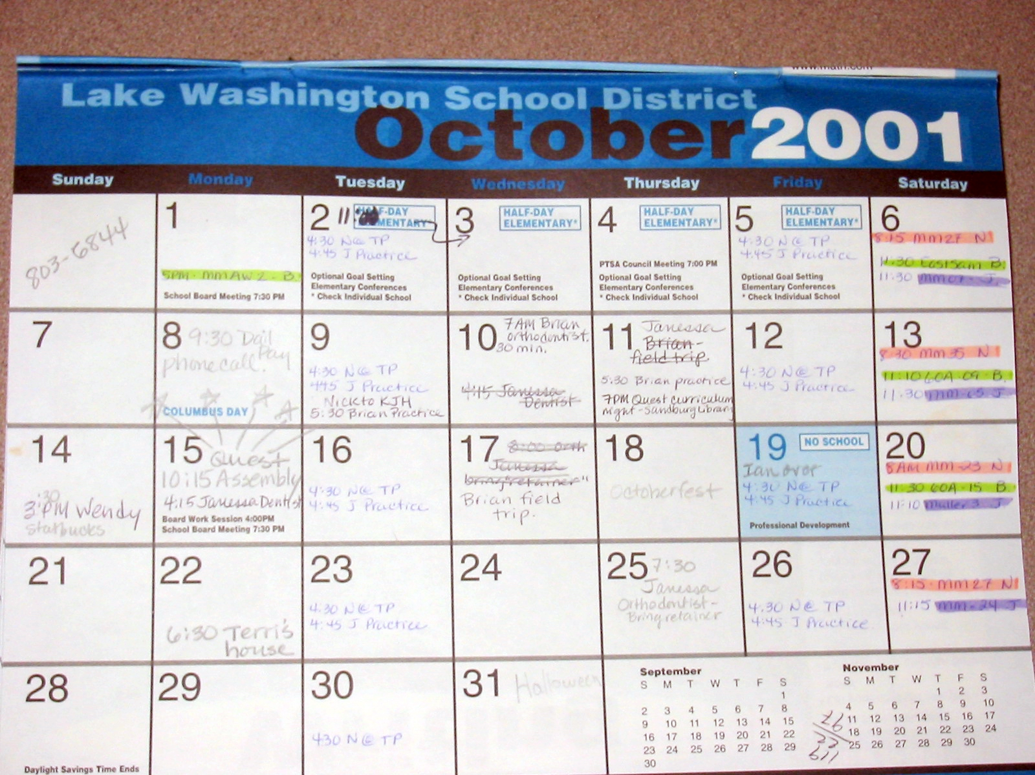
Paper Calendar Benefits
Easy to use
Mobile
Personalize
Archive
Brush and Turner, 2005
Notes:
Paper calendars present families with many benefits to meet their routines, go through each briefly

Slide 8
Paper Calendar Limitations
One location
Hard to synchronize
Can get messy
Brush and Turner, 2005
Notes:
Yet paper calendar pose limitations
You can only access or look at the calendar from one location
multiple calendars let you view it from multiple locations but then you need to manually copy events between calendars (and could easily forget something)
Paper calendars can also get messy (which some people dislike) as events are crossed out or scribbled, or crammed into spaces

Slide 9
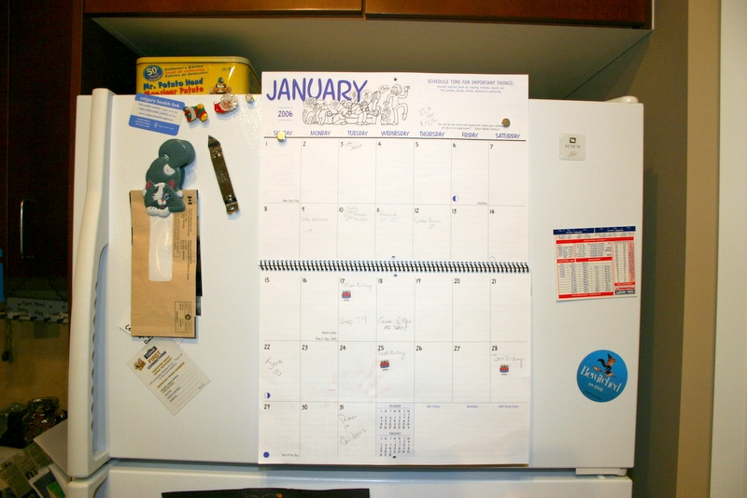
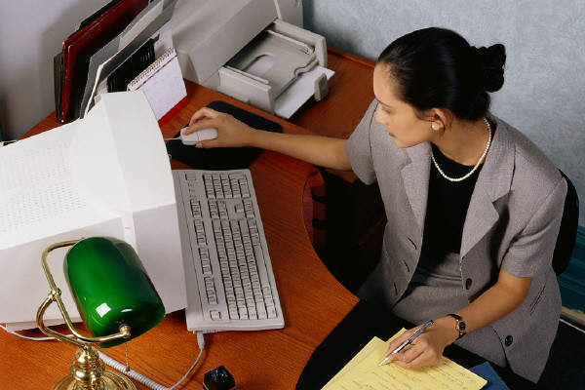
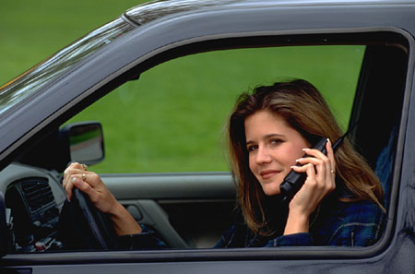
Why Go Digital?
Notes:
One of the main benefits of a digital calendar is information access anywhere
(from multiple locations)
You could imagine being able to access your calendar form the fridge door, at work, or even while mobile (though we don’t condone checking the calendar while driving)

Slide 10
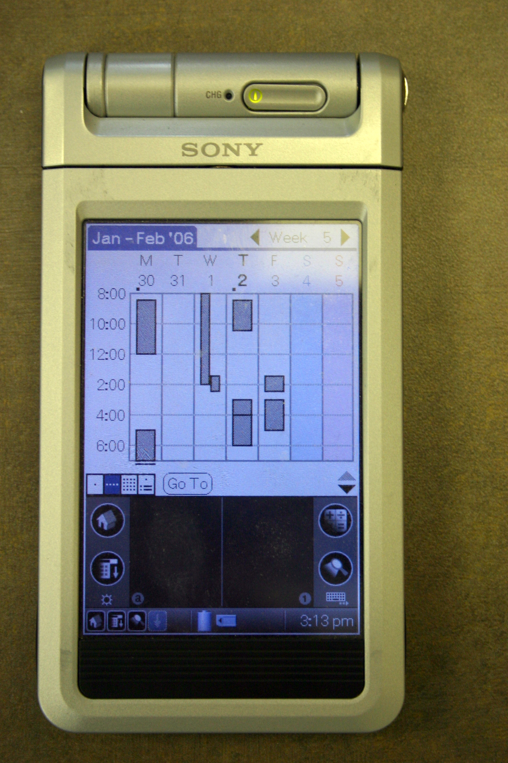
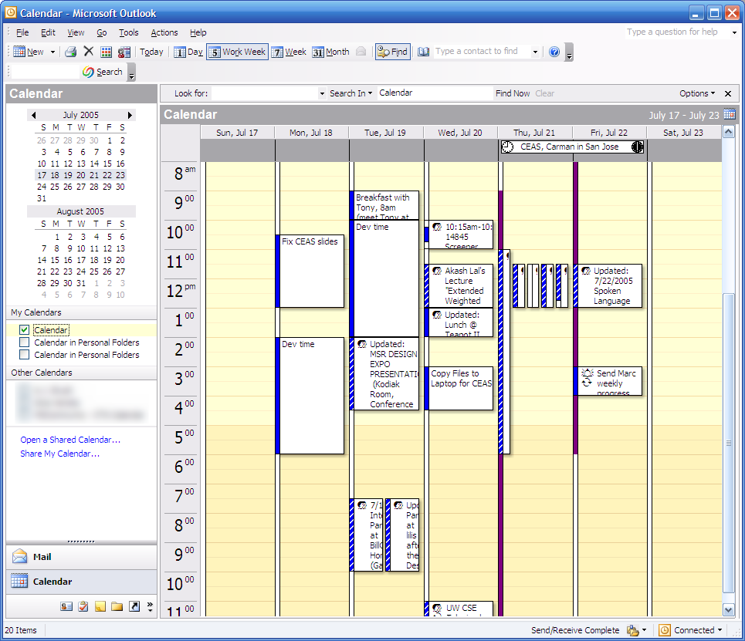
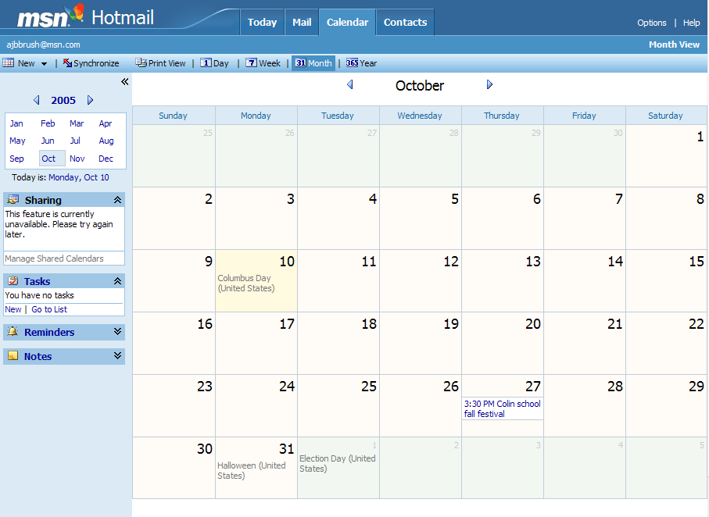
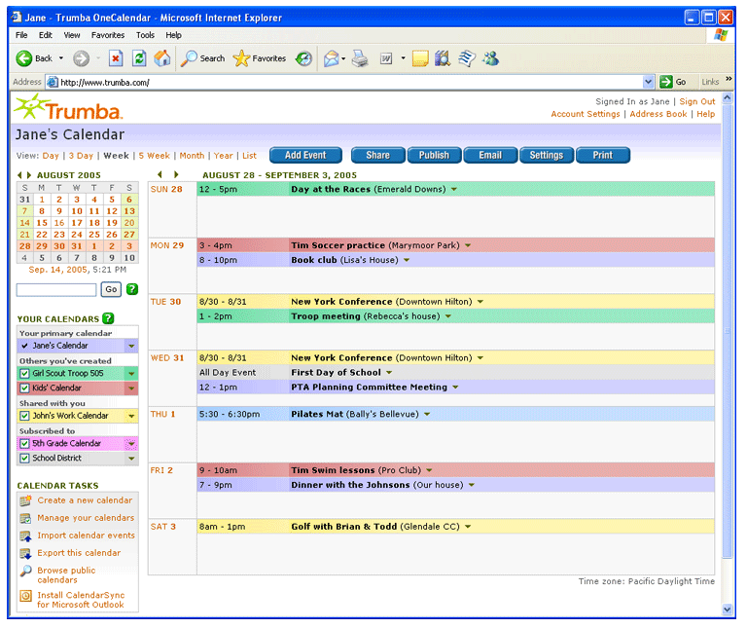
Digital Calendars Exist
Notes:
Digital calendars do exist….. Work calendar, other web calendars, some of which are designed specifically for families, PDAs….
Yet they are often complicated to use and do not necessarily fit within families’ everyday routines (which I hope to highlight in more detail for you)

Slide 11
Research Goal
Design a digital family calendar:
  Simple as paper
  Power of technology
A Digital
Family Calendar
Notes:
Thus our research goal was two fold:
Design a digital calendar that is as simple to use as a paper calendar …. Or why would people move from paper to digital if it was harder to use?
Leverage technology by making calendar information digital, which can then, in future work, be presented in multiple locations where it is needed

Slide 12
Design Principles
Simple awareness appliance
Coordination tools
Flexibility
Location-based
A Digital
Family Calendar

Slide 13
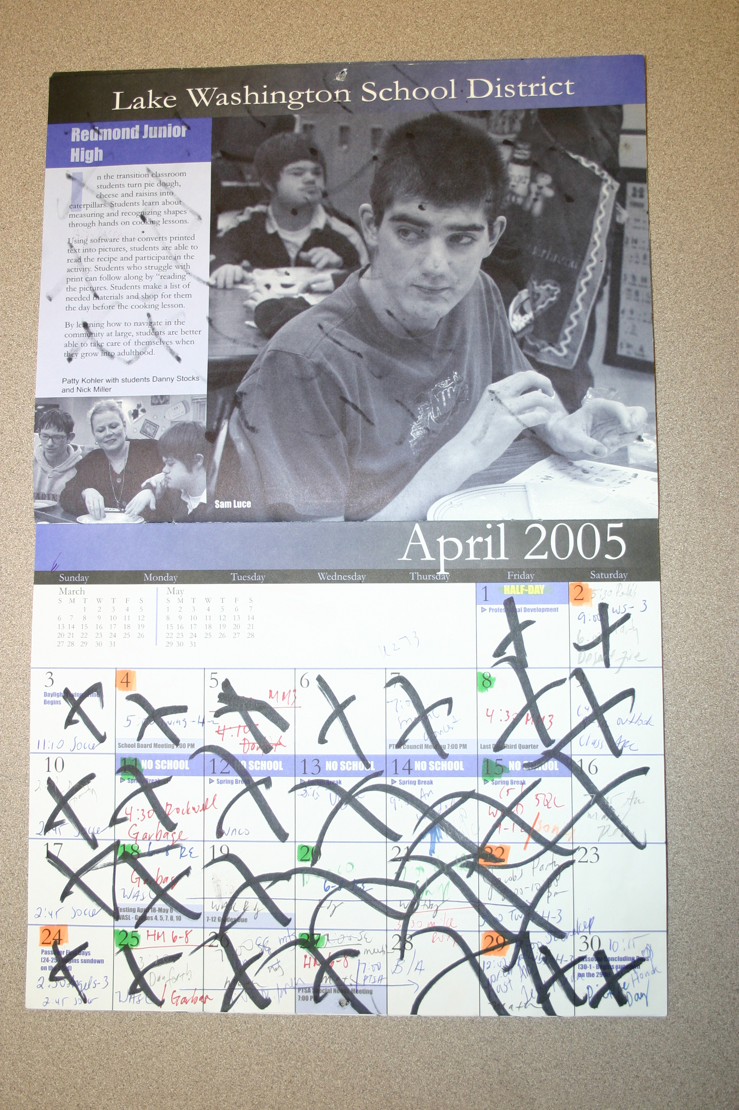
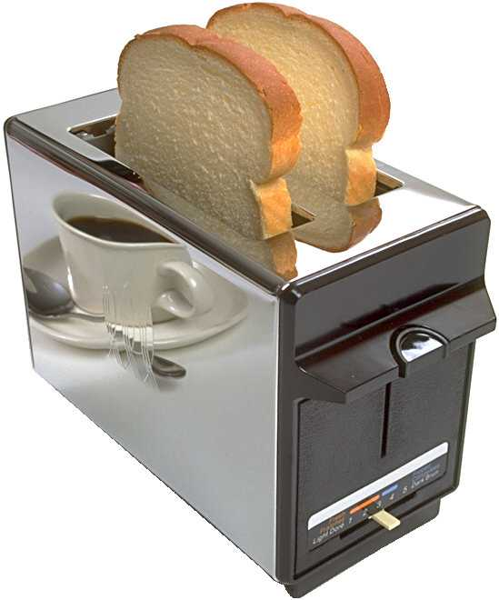
Simple Awareness Appliance
Edwards and Grinter, 2001, Norman, 1998

Slide 14
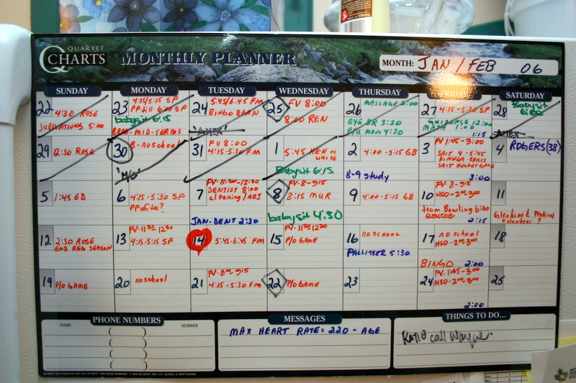
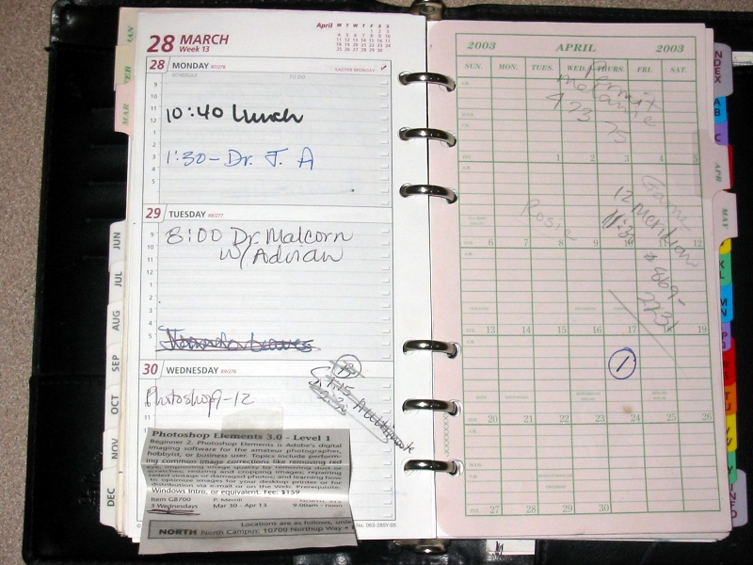
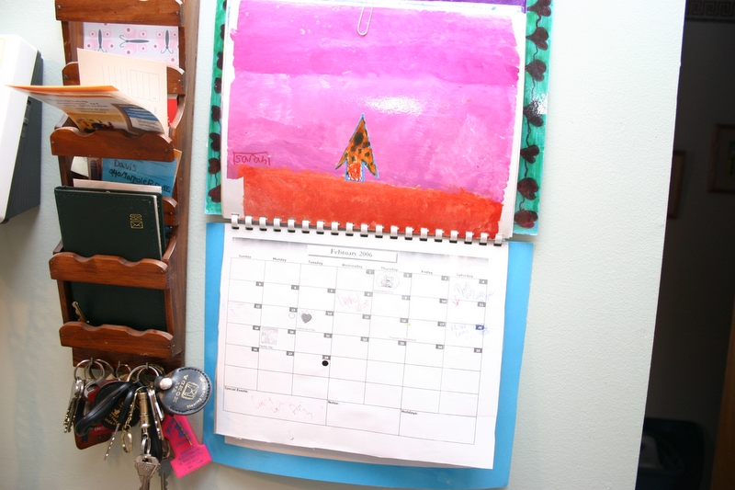
Flexibility
Taylor and Swan, 2005

Slide 15
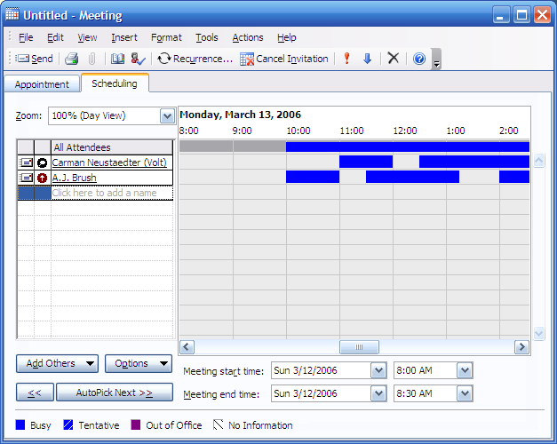
Tools for Coordination
Crabtree et al, 2003

Slide 16
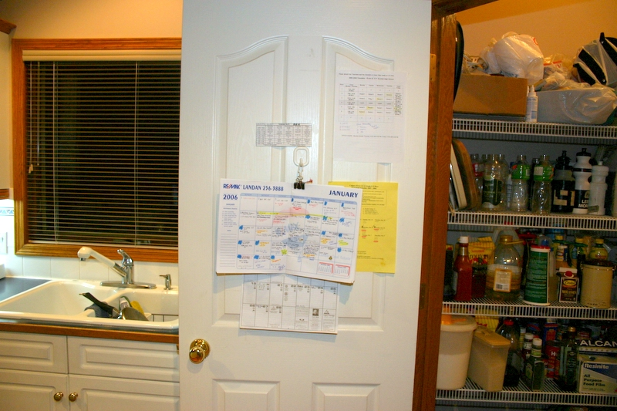
Contextual Locations
Crabtree et al, 2003, Elliot et al, 2005

Slide 17
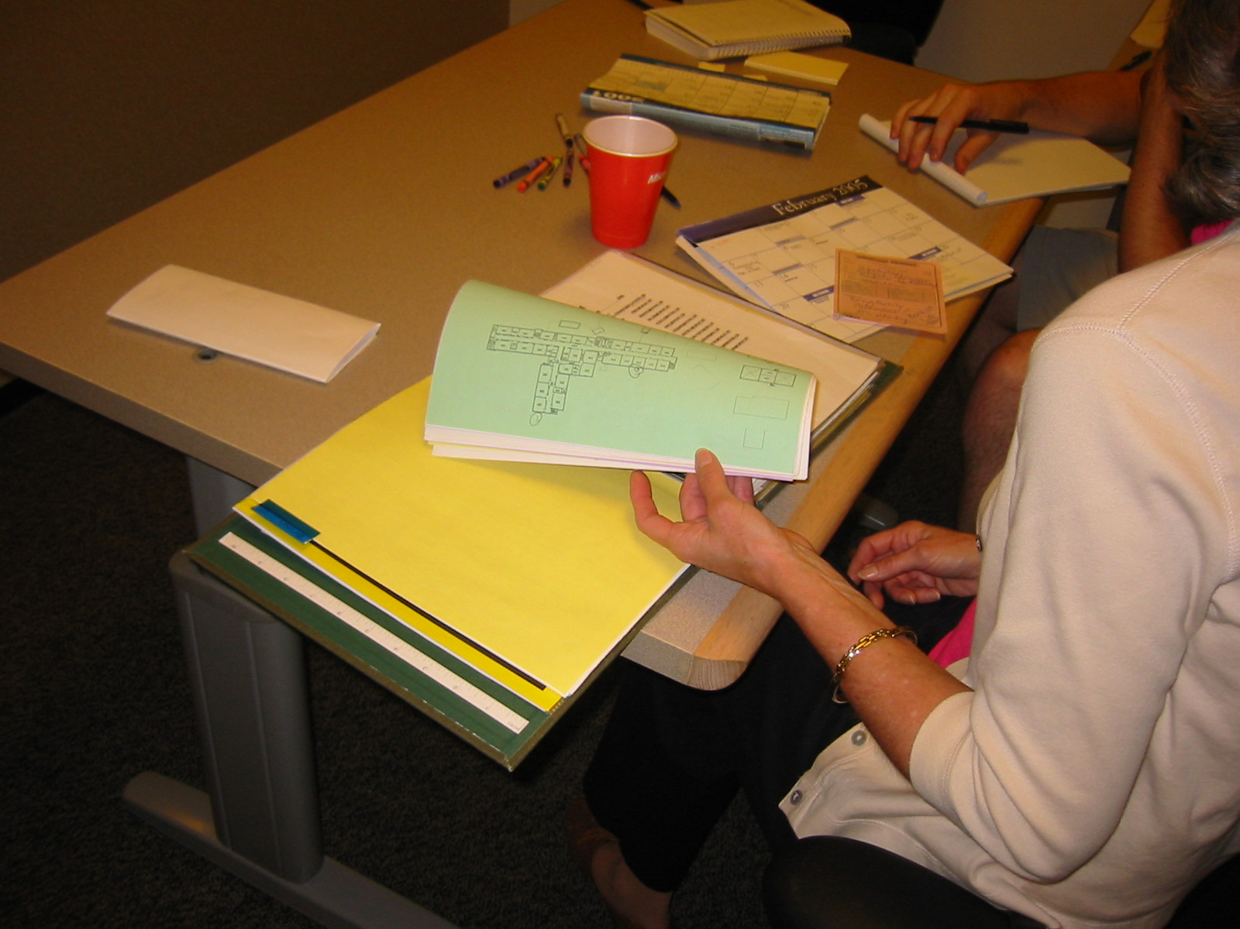
Participatory Design Method
20 mothers, varying backgrounds
Paper prototyping (10 moms)
Digital Med-Fi Prototype
Formative Evaluation (10 moms)
Notes:
To do this we chose a participatory design method involving 20 mothers from a variety of backgrounds
The study had three main stages:
Paper prototyping sessions with 10 moms, where we also interviewed them about their existing calendars and routines
The design of a medium-fidelity digital prototype based on the findings from our paper prototypes
A formative evaluation with another 10 moms of the digital prototype where again we interviewed them about existing routines

Slide 18
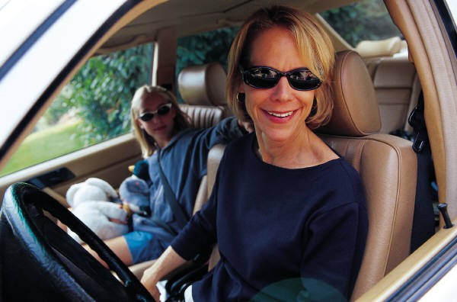
Why Mothers?
Almost always the primary scheduler
Hutchinson et al, 2002, Beech et al, 2004
Notes:
Past research has shown that the mom is typically the primary scheduler in most families
This allowed us to find out the most information that we could about existing routines and whether or not our prototype would meet family needs

Slide 19
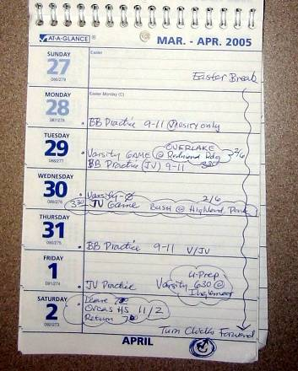
Interview Findings
Variety of calendars
  14 / 20 paper
  6 / 20 digital
Notes:
14 of 20 used a paper calendar
6 used a digital calendar, Outlook, or MSN
One person had a blackberry

Slide 20
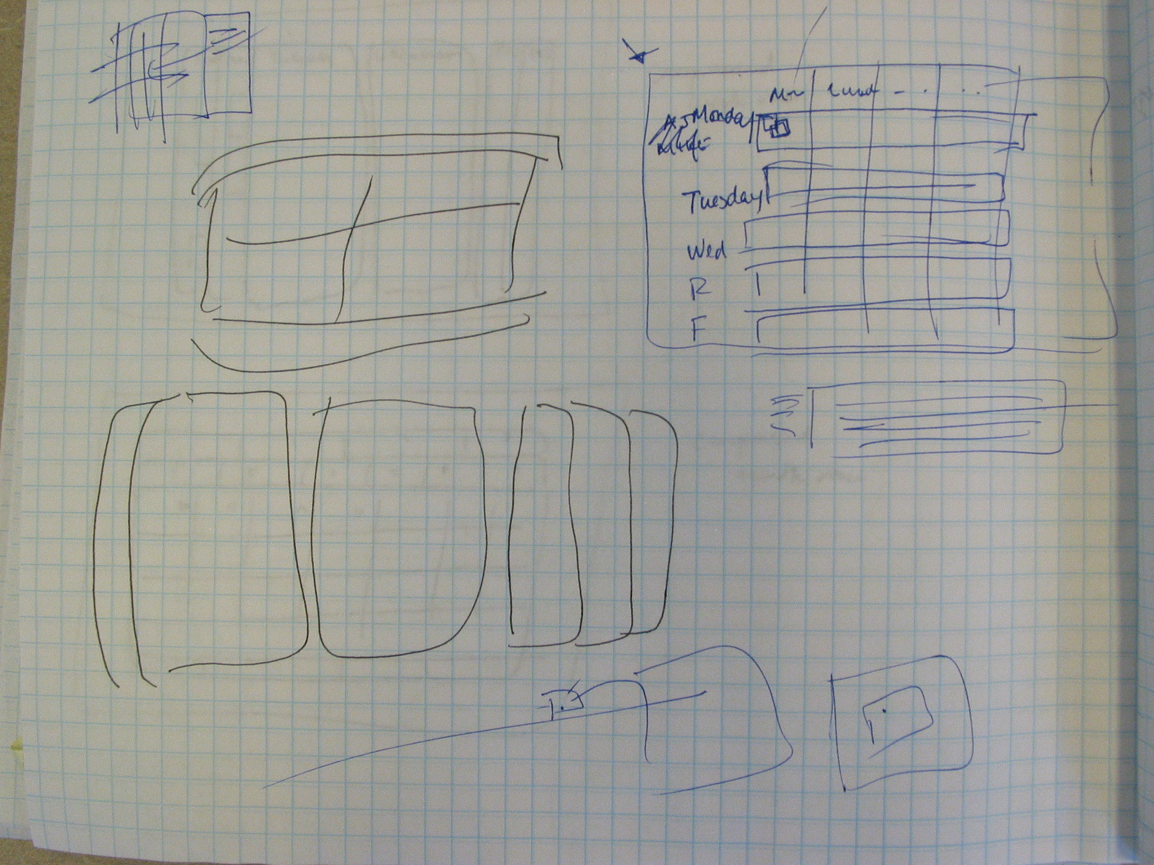
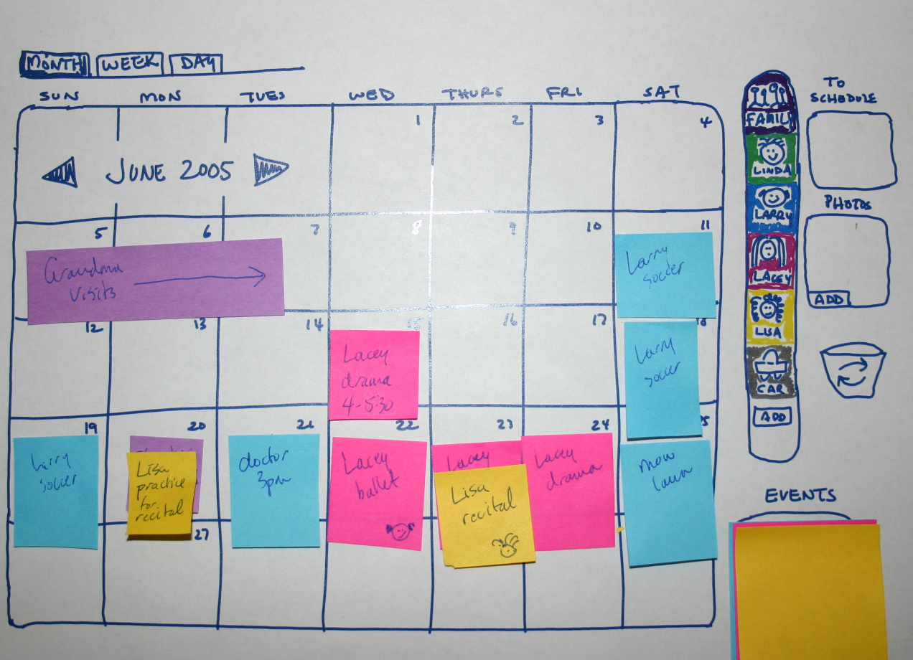
Paper Prototyping
Information appliance
Flexible
Coordination tools
Location-based
Crabtree et al, 2003, Taylor and Swan, 2005, Elliot et al, 2005
Notes:
Before bringing in participants, we iterated through several low fidelity prototypes using sketching and PICTIVE (paper, sticky notes, glue, scissors)
Our design ideas were based on lessons from the existing literature
Info appliance --- we knew people wouldn’t want to have to boot up the family calendar so we wanted to design LINC as an information appliance so the family calendar was just a calendar
Flexible – people have a variety of routines so we need to present a design that doesn’t force them away from their routine
Coordination tools – people need a means to negotiate schedules to help coordinate activities
Location-based – the calendar needs to be designed to be placed in a location particular to the families routines
For these reasons, we decided to design a prototype for a tablet PC or similar mobile, yet dedicated device

Slide 21
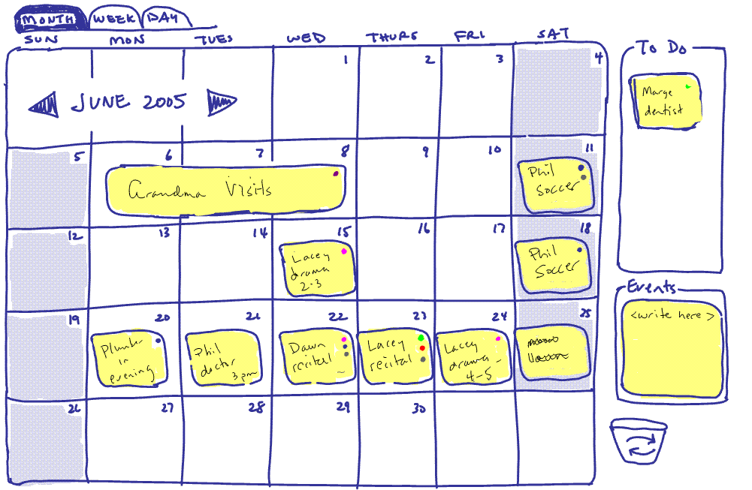
Notes:
Similar in view to a paper calendar

Slide 22
Write, then drag
Notes:
Easy to use, just write and drag the note
The spatial layout of events was left up to the user

Slide 23
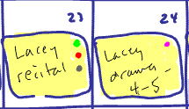
Colored Dots
Notes:
We let the user pick people or resources for events which are shown using colored dots

Slide 24
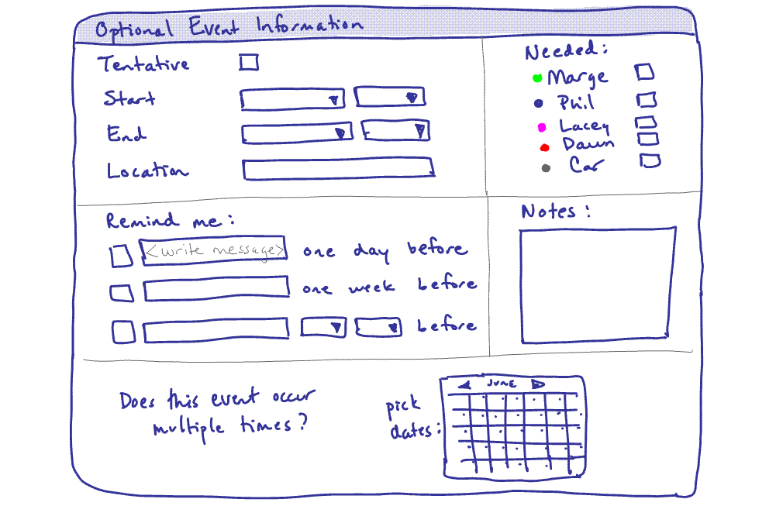
Notes:
You can double tap an event to open an options dialog

Slide 25
Notes:
Where you are able to assign the resources for events

Slide 26
Notes:
You can add specific information if you like, start and end dates for example

Slide 27
Notes:
You can pick multiple reminders

Slide 28
Notes:
Or choose recurring event dates

Slide 29
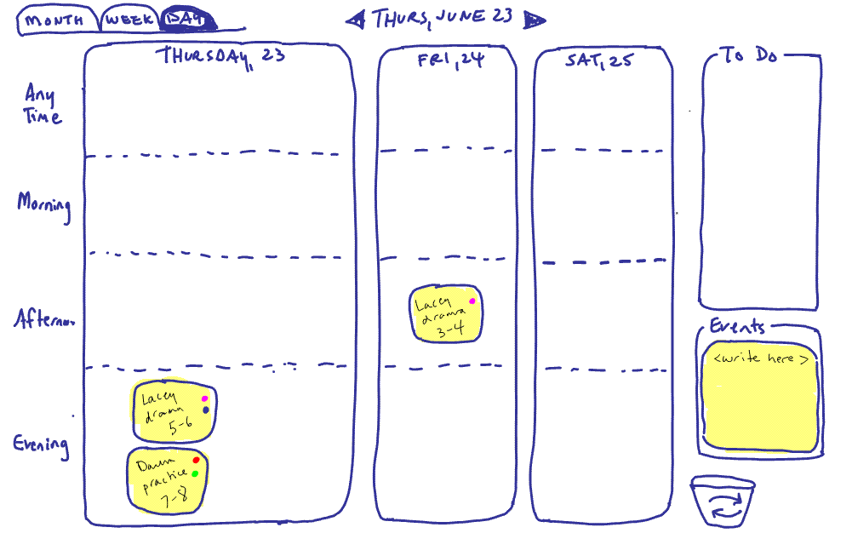
Notes:
We even had a day view showing today, tomorrow and the next day

Slide 30
Notes:
Where events can be placed in different time buckets, as opposed to rigid times like at work

Slide 31
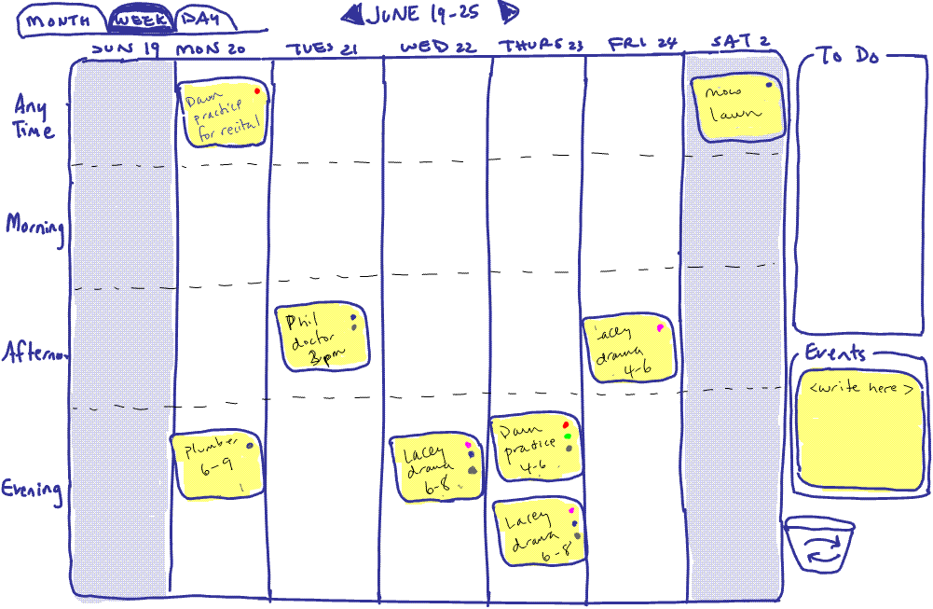
Notes:
Our week view was similar to day view but with more days

Slide 32
Prototype Sessions: Tasks
Notes:
We then had 10 moms come in and perform a series of tasks with the prototype

Slide 33
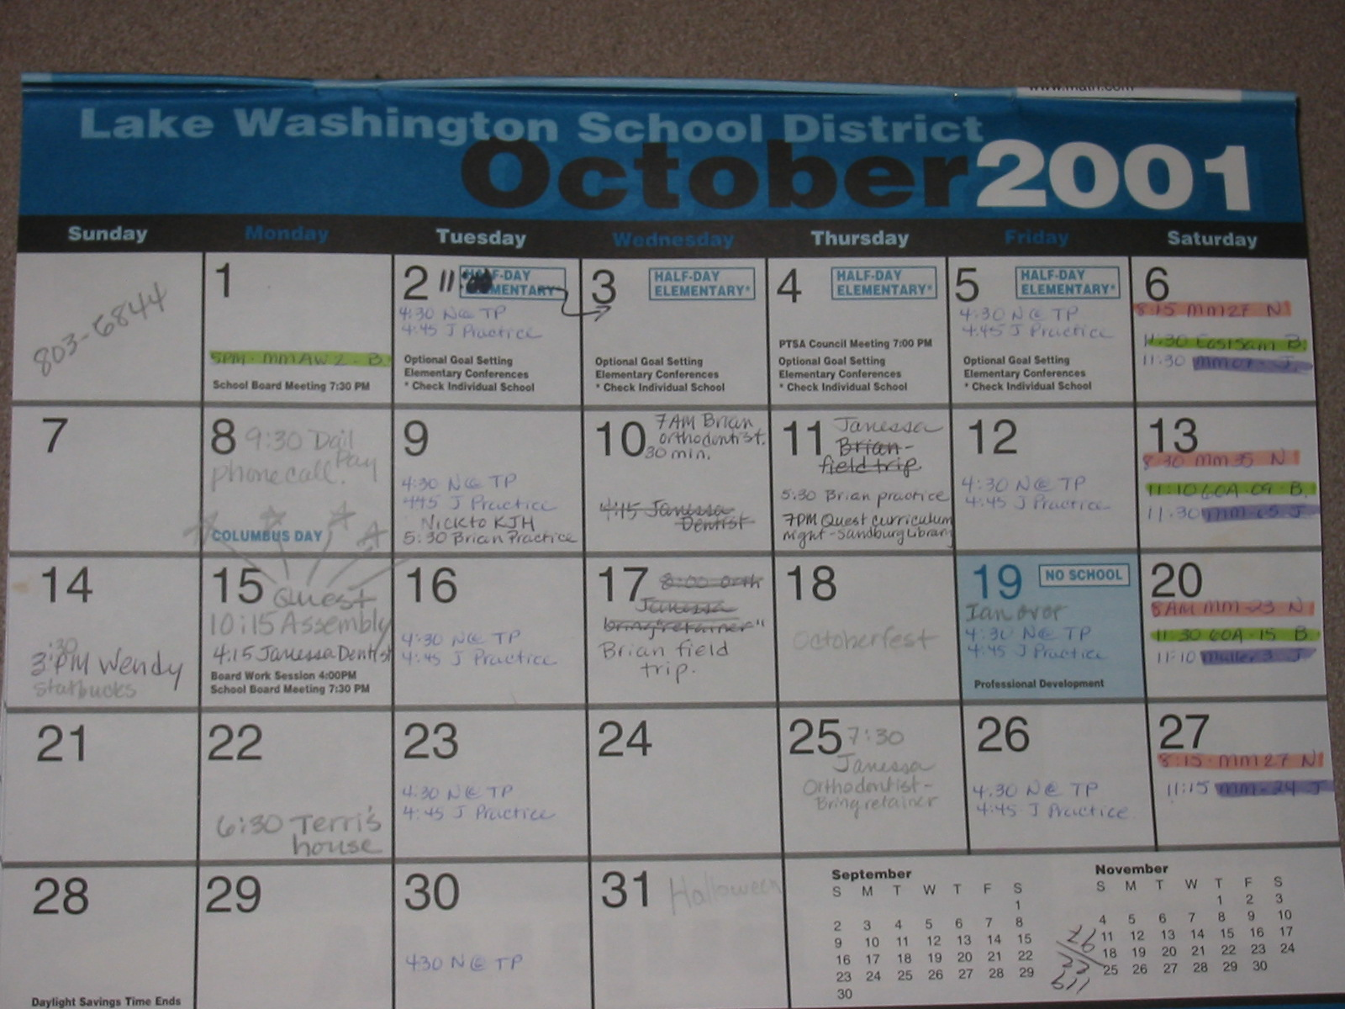
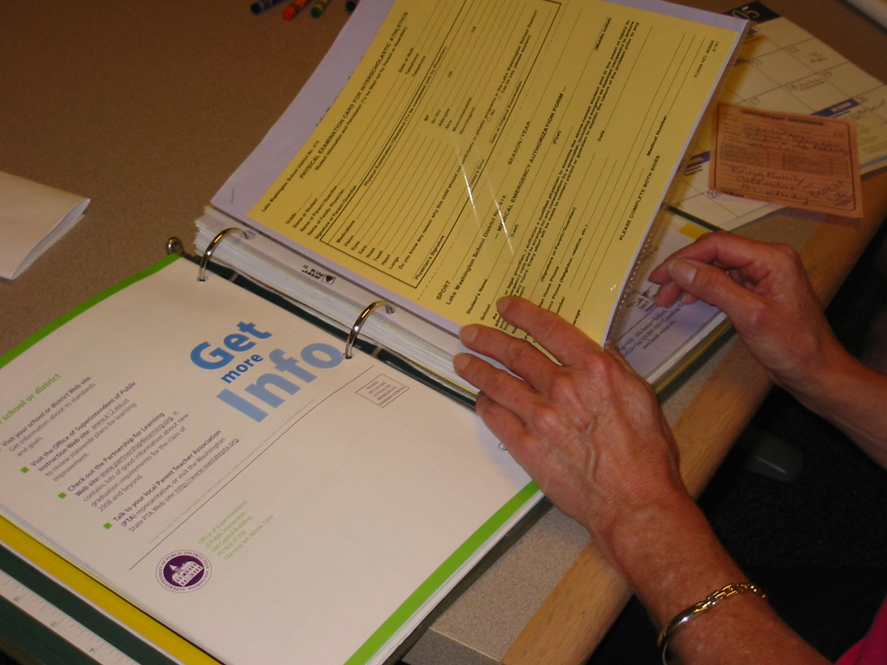
Interviews
Notes:
We also have them bring in their family calendars and anything else they used for coordination
We were trying to draw out from them where I design met or did not meet their family’s needs

Slide 34
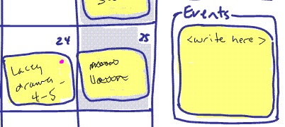
Results: Simplicity & Flexibility
Liked free form event creation
Notes:
MAKE VERBAL TRANSITION to RESULTS
The participants enjoyed the very free from event creation we had enabled, they liked being able to write anything on the notes just like on paper

Slide 35
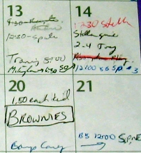
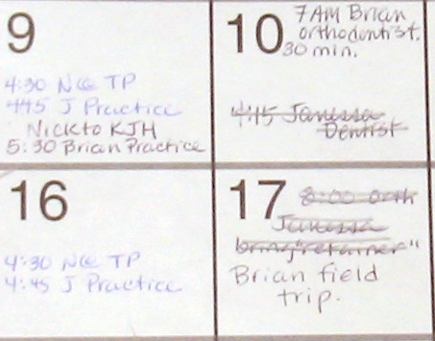
Simplicity & Flexibility
Variety of events
Notes:
If we look at their paper calenadrs we can see this is how they naturally do things already
There are a variety of events where different information is left for each
On the left, Brownies, just contains the event where other information about it is tacit knowledge
In the middle, the two practices contain someone’s initial, the time, and an event description
On the right, the orthodontist again has the time and person’s name, and here even the duration
Our design supported the idea that information is simple to enter and can be of a variety of forms

Slide 36
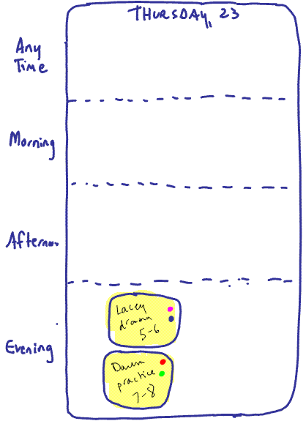
Flexibility
Some expected
chronological
Notes:
We had also provided flexibility by allowing yours to create their own spatial layout with events
Yet some expected the events to be automatically chronological, rather than our ‘place where you want’ strategy
Which highlights a cautionary tale about expectations when moving from paper to digital

Slide 37
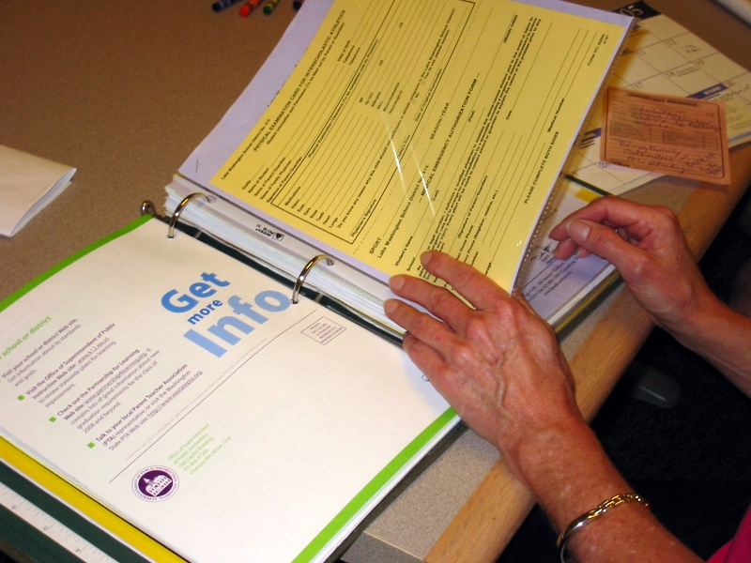
Flexibility
Extra information
Notes:
We also found that many of the moms in our study stored extra information pertaining to events
The mom here had a binder called the Book of Life where she kept notices, maps, phone numbers – all the extra stuff relating to events on the calendar

Slide 38
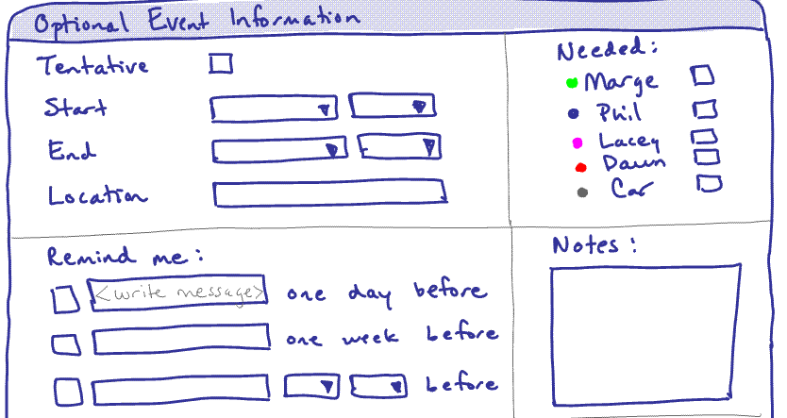
Flexibility
Extra information not well supported
Notes:
We had provided a similar features in the prototype where people could write extra notes in the options of an event
Yet people couldn’t add extra information the way they would have liked
We had made it somewhat secondary and it was not possible to put it right in the note where people wanted it
Even though binders and other items keep the extra information separate, people actually want it right visible with the event

Slide 39
Coordination
Adding resources not needed
Notes:
We found that the colored dots we provided to add resources to an event to facilitate negotiation didn’t work
People instead liked to simply know what was on the calendar in order to coordinate events face to face or on the phone

Slide 40
Coordination
Reminders not like at work
Notes:
We found that reminders will not work in the home like they do at work ---- the default 15 minutes before an appointment like in the office is simply not needed at home
People check calendar in morning or night before, maybe a few times during the day
Reminders are more about bringing things to events or doing something for an event, rather than actually leaving for one

Slide 41
Locations
Reminders to locations
Notes:
People often need to be reminded throughout the day when they are not at the calendar
Participants suggested reminders to cell phones, or work computers

Slide 42
Participatory Design Method
20 mothers, varying backgrounds
Paper prototyping (10 moms)
Digital Med-Fi Prototype
Formative Evaluation (10 moms)
Notes:
Next we used our knowledge from the paper prototype sessions to iterate on our design of LINC and develop a medium-fi prototype

Slide 43
Digital Med-Fi Prototype
Notes:
I’m going to now go through a short demo of the digital version we created (I have a running copy of the study version that I’ll use)
Demo points:
Still easy to write then drop
Notes can be resized to add lots of extra information, though more information creates overlap
Instead of dots we thought we would try providing flexibility with color: users can pick colored notes and ink to help highlight things on the calnedar
Day view is similar to the paper prototype, again using time buckets
Specific information
Reminders
Copies
Background photos for personalization

Slide 45
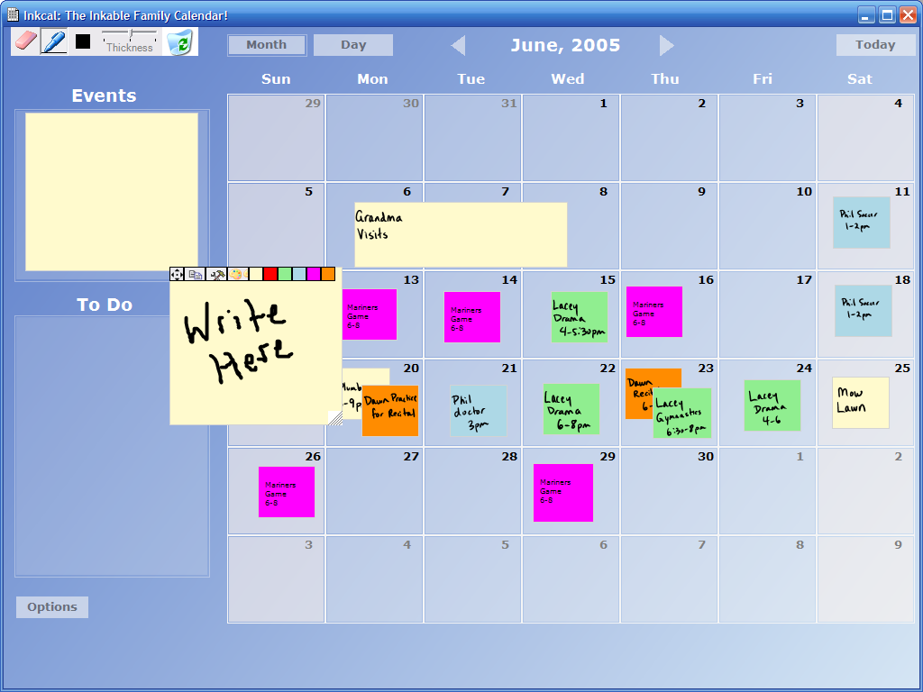
Drag n’ drop

Slide 46
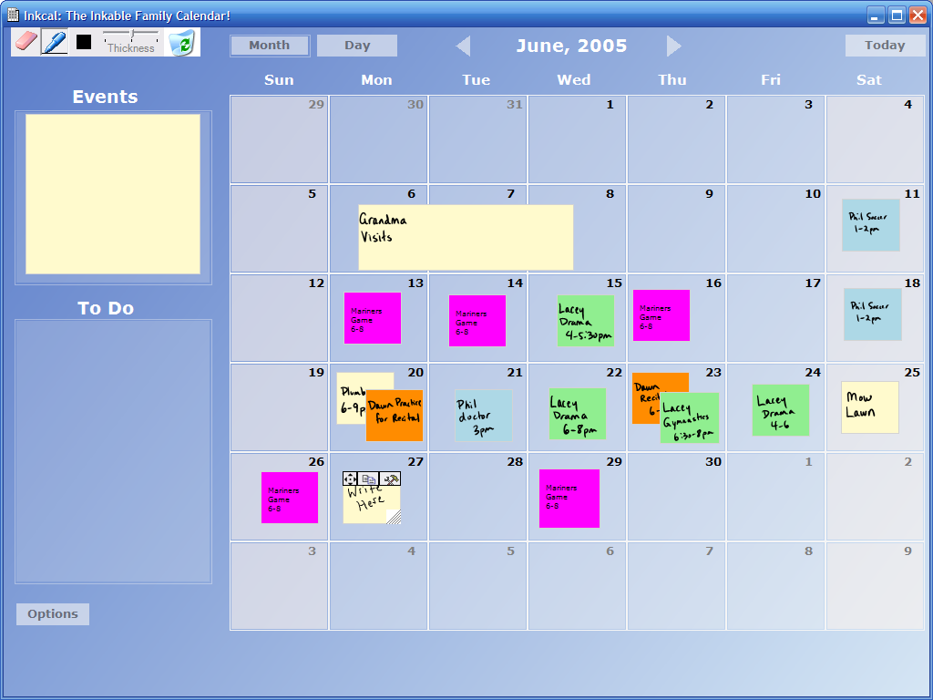
Auto-resizing

Slide 47
Creativity with color

Slide 48
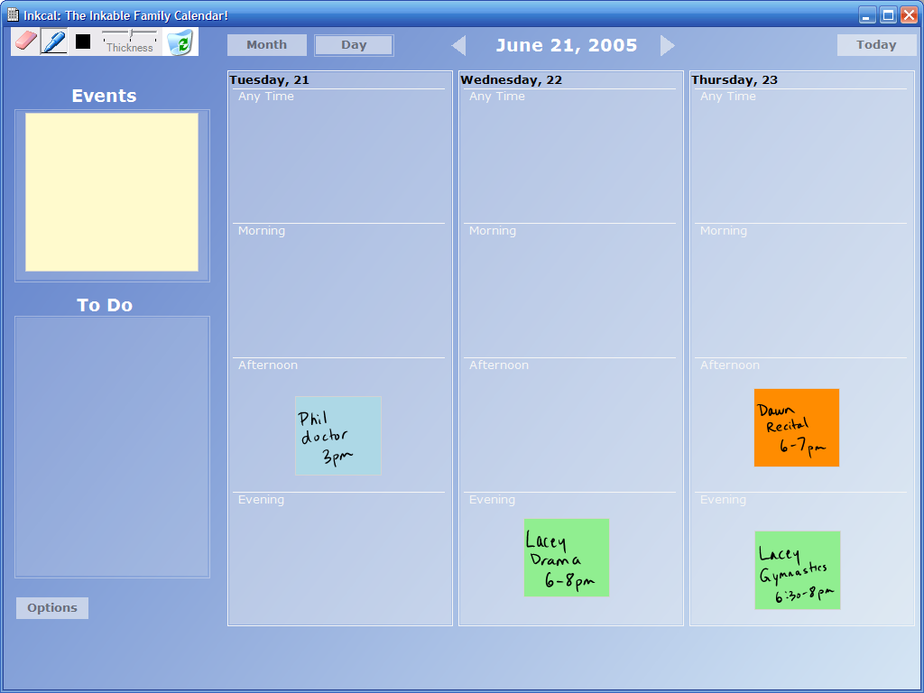

Slide 49
Time buckets

Slide 50
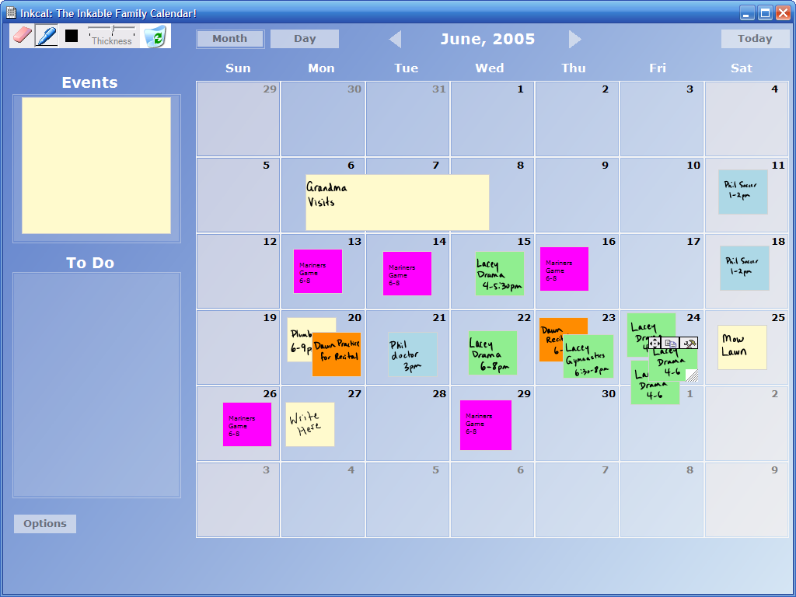
Copy events

Slide 51
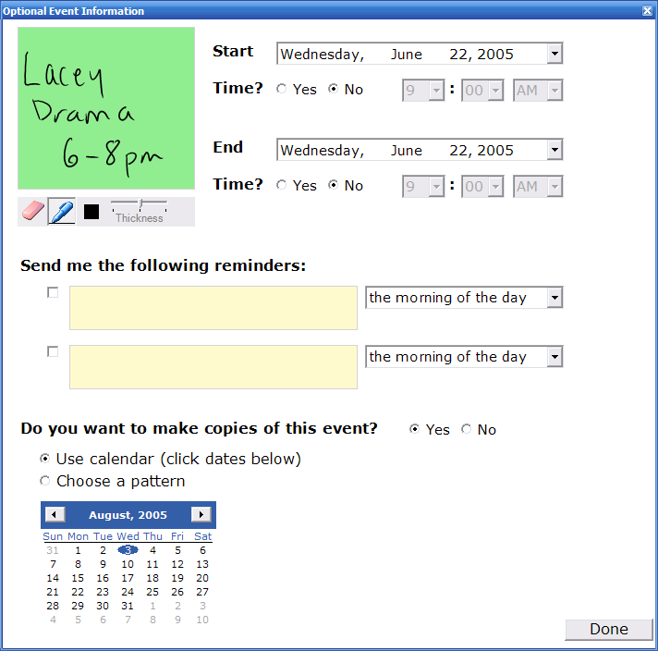
Be specific…if you like

Slide 52
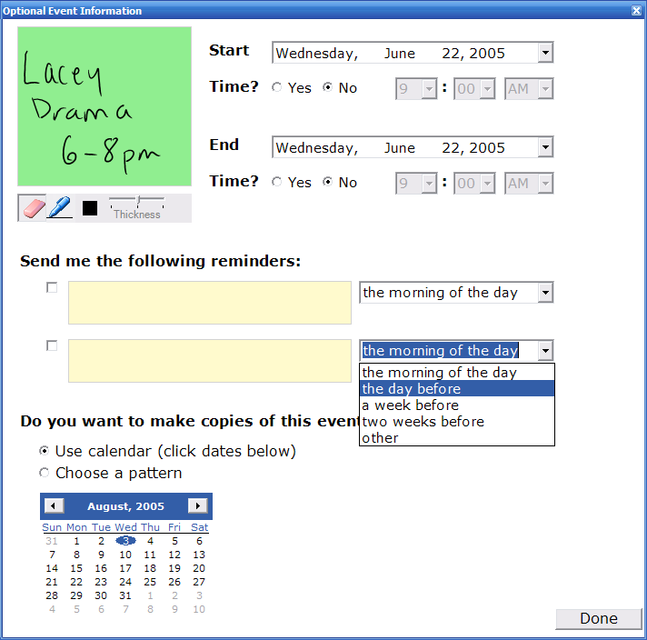
Multiple reminders

Slide 53

Copies of events

Slide 54

Copies of events

Slide 55

Background Photos

Slide 56


Slide 57
Participatory Design Method
20 mothers, varying backgrounds
Paper prototyping (10 moms)
Digital Med-Fi Prototype
Formative Evaluation (10 moms)
Notes:
Next we used our digital prototype of LINC in a formative evaluation involving another 10 moms
Again we asked them to bring in their calendars and any other items, and we interviewed them about their existing routines

Slide 58

Formative Evaluation: Interviews

Slide 59


Formative Evaluation: Tasks
Notes:
Moms performed a series of tasks with the digital prototype, now running on a tablet PC to prototype our idea of an information appliance
Half of the tasks were done standing up (to model a calendar on the wall) and half were done sitting down

Slide 60
Interviews
Notes:
We also have them bring in their family calendars and anything else they used for coordination
We were trying to draw out from them where I design met or did not meet their family’s needs

Slide 61

Results: Coordination
Flexibility with color aided coordination
Notes:
We found that participants favorite feature of LINC was the flexible options for colors
People loved being able to assign colors to different family members or important events
This helped them easily glance at the calendar to see who had what activities
This in turn enabled coordination

Slide 62


Flexibility
Rich annotations
Notes:
If we look at their paper calendars we can see that color is already used in a similar way
People provide rich annotations on the calendar, some use color to highlight who has events (left, pink, green, purple for different people) and others use colored pens for important things (garbage on right and thick black lines to cross out days)

Slide 63
Coordination
Public yet private
Notes:
We also found that in terms of coordination, the family calendar is a public artifact that is available for family to see and mom to remind them of events with

Slide 64
Coordination
Public yet private
“Oh, no no no,
I only put things on.”
Notes:
Yet becomes private in the sense that moms as the primary scheduler often like to be the only ones who add to it

Slide 65

Coordination
Public yet private
Notes:
In another case, family members could only write on post-it notes which mom would then transcribe

Slide 66

Coordination
What’s changed since I last looked?
Notes:
This came out in the digital prototype when participants realized the fact that being digital it may be easier for other family members to change things on the calendar
As a result they said they desired to be able to easily figure out what has changed, and receive some semblance of change awareness

Slide 67
Coordination
What’s changed since I last looked?
Notes:
This came out in the digital prototype when participants realized the fact that being digital it may be easier for other family members to change things on the calendar
As a result they said they desired to be able to easily figure out what has changed, and receive some semblance of change awareness

Slide 68
Coordination
What’s changed since I last looked?
Notes:
Can you see the difference?

Slide 69
Coordination
What’s changed since I last looked?

Slide 70
Locations
High traffic areas
Notes:
The moms also told us that the family calendar is often in high traffic areas of the home like the kitchen

Slide 71

Locations
Liked idea of a kitchen calendar
Notes:
And they liked that our information appliance model could in theory be placed in the same location as their existing calendar

Slide 72
Locations
Not often at the calendar
Note the absence of people
Notes:
Yet they commented that they are often not at the calendar, checking usually in the evening or morning
It can be easy to forget what’s on the calendar when they leave the home often requiring them to write it down or have another copy

Slide 73

Locations
Liked idea of remote access
Notes:
For this reason, they liked the idea of having remote access to the calendar to view it while work or out and about

Slide 74
Conclusions
Simple Interaction
Write then drop
Notes:
To conclude I want to highlight some of the main findings that came out from both our paper prototype sessions and the digital evaluation
First, simple interaction was a big hit along with free form event creation much like people already do things on paper

Slide 75

Conclusions
Complex and restrictive
Notes:
Yet if we look at existing web calendar solutions for families, they are often involve entering restrictive pre-defined information

Slide 76
Conclusions
Coordination through awareness
Who is free tomorrow to drive the kids?
Notes:
Of vital important we found is coordinating through awareness
That is, being able to easily find out who is free tomorrow by looking at the calendar and then coordinating around this knowledge
Our flexible presentation of colors enabled families to easily gather this awareness from the calendar

Slide 77
Conclusions
Assign people to events
Notes:
If we look at an example work calendar, Outlook we see that coordination is much different and this is why we can’t simply migrate from work into the home
Go through example

Slide 78
Conclusions
Assign people to events

Slide 79
Conclusions
Assign people to events

Slide 80
Conclusions
People are not often at the calendar
Nobody is here
still
Notes:
People are also not often at their calendars

Slide 81
Conclusions
Ubiquitous calendar access
Notes:
Which highlights the need for ubiquitous calendar access so the family calendar accessible in the many locations were people frequent throughout the day

Slide 82
Conclusions
Location needs are different at work
Notes:
At work, depending on the job, many people are in a fixed location and only need their calendar accessible from one location as a result
In the home, this is not the case

Slide 83
Conclusions
Best of paper and digital worlds
Notes:
We also found that people desire the best of both worlds:
Simple like paper

Slide 84
Conclusions
Best of digital and paper worlds
Notes:
Yet powerful like technology where things are much more organized, clean, etc

Slide 85
Next Steps
Making LINC ubiquitous
Studying real world adoption and use

Slide 86
The Message
Digital family calendars must be designed to match the coordination needs of families.

Slide 87

It’s Crucial

Slide 88
It’s Crucial
“The calendar is our life line…

Slide 89
It’s Crucial
“The calendar is our life line…
it HAS to work.”

Slide 90
Thank you!
Carman Neustaedter
University of Calgary, Canada
carman@cpsc.ucalgary.ca
A.J. Brush
Microsoft Research
ajbrush@microsoft.com

