Slide 1
Groupware Plugins:
A Case Study of Extending Collaboration Functionality through Media Items
Gregor McEwan, Saul Greenberg,
Michael Rounding, Michael Boyle
University of Calgary

Slide 2
Message
Plugins can allow people to extend and customise groupware for their own collaborative needs.

Slide 3



Scenario
Saul
Mike R.
Mike B.

Slide 4

Scenario
Saul
Mike R.
Server
Mike B.

Slide 5

Scenario
Saul
Mike R.
Server
Mike B.

Slide 6
Scenario
Saul
Mike R.
Server
Mike B.

Slide 7
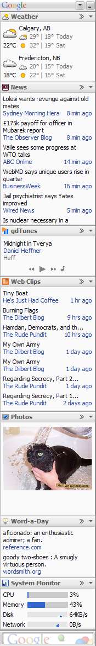
Single user systems use plugins
Example: Google Sidebar
  personal information in sidebar

Slide 8
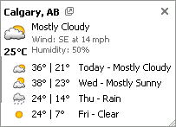
Single user systems use plugins
Example: Google Sidebar
  personal information in sidebar
  expand tooltip for detail

Slide 9
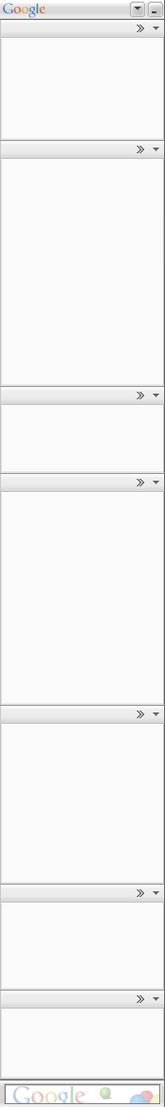
Single user systems use plugins
Example: Google Sidebar
  personal information in sidebar
  expand tooltip for detail
Google provides base application

Slide 10
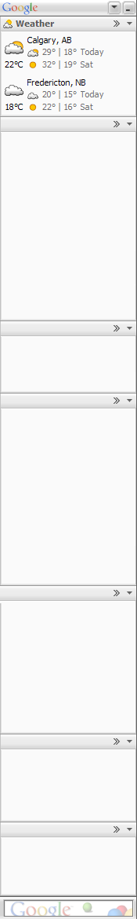
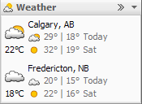
Single user systems use plugins
Example: Google Sidebar
  personal information in sidebar
  expand tooltip for detail
Google provides base application
Plugin developer fills in content

Slide 11
Plugins for groupware
Why not do the same for groupware?

Slide 12
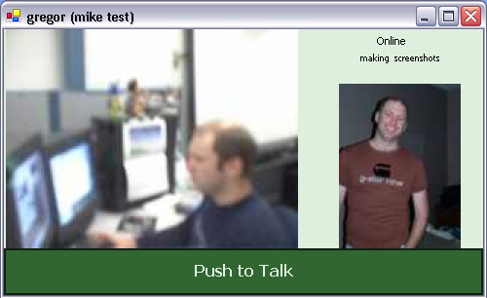
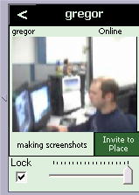
Base system: Community Bar
Place
“CSCW class”
Peripheral side bar
Multiple Places
Transient tooltip grande
Separate full view
Place
“G-place”
Place
“ilab”
Place
“mike test”

Slide 13
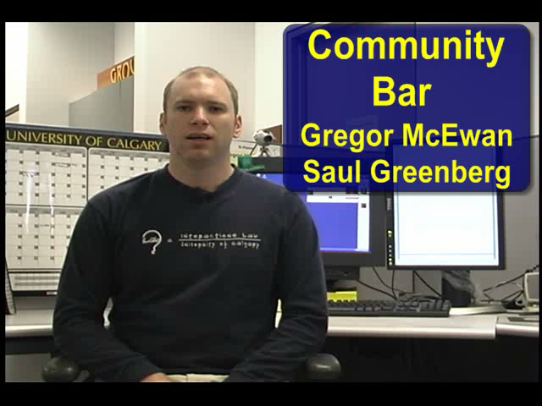
[video]
Video not included here…

Slide 14

[video]

Slide 15

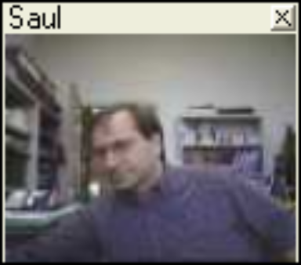
Media Item Views

Slide 16
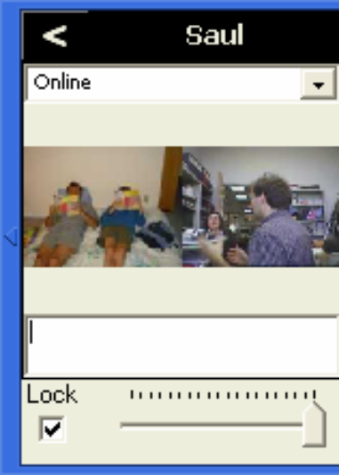
Media Item Views

Slide 17
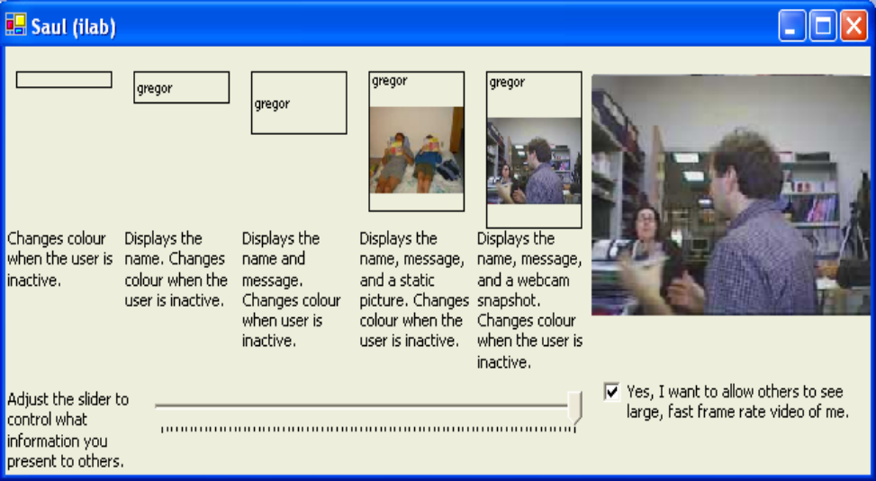
Media Item Views

Slide 18
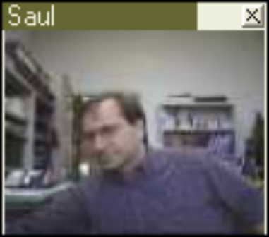
Media Item Views

Slide 19
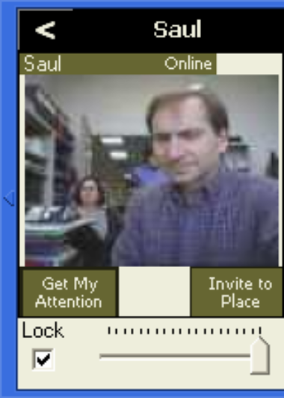
Media Item Views

Slide 20
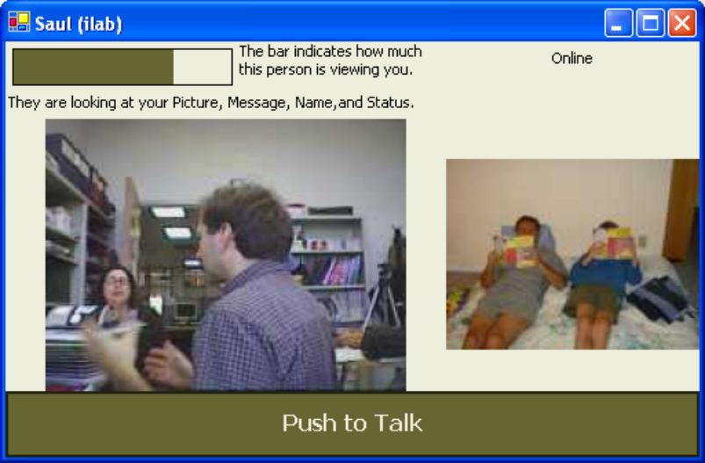
Media Item Views

Slide 21
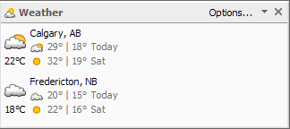
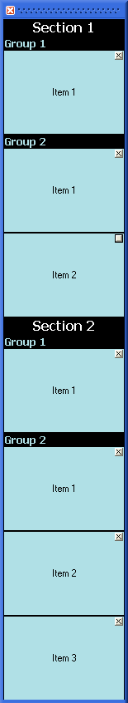
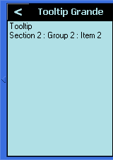
Community Bar Plugins

Slide 22
Scenario
Saul
Mike R.
Server
Mike B.

Slide 23
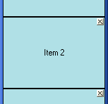
Photo Sharing
Saul
Mike R.
Server
Photo Item
<no data>
Mike B.

Slide 24
Photo Sharing
Saul
Mike R.
Server
Photo Item
<no data>
Server
Photo Item
picture:
Mike B.

Slide 25
Photo Sharing
Saul
Mike R.
Server
Photo Item
picture:
Mike B.

Slide 26
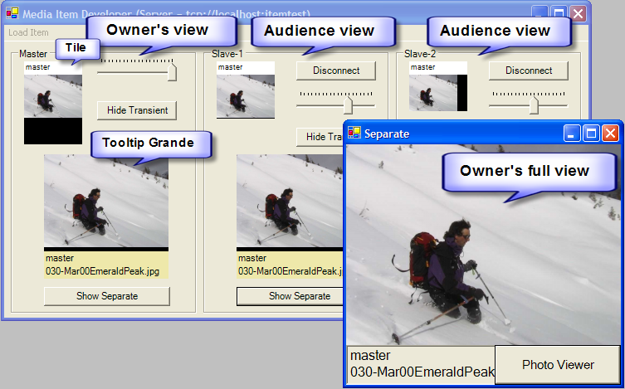
Media Item Testing and Debugging

Slide 27
Testing
Average programmers
  No previous groupware programming experience
Class assignment
  Create an interesting media item
  2 weeks
  Short tutorial to start

Slide 28

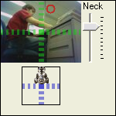
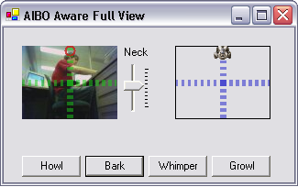

Ex: AIBO Awareness (Jim Young)

Slide 29
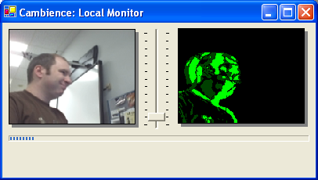
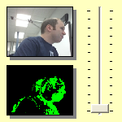



Ex: Cambience Item (Rob Diaz-Marino)
Owner
Audience

Slide 30
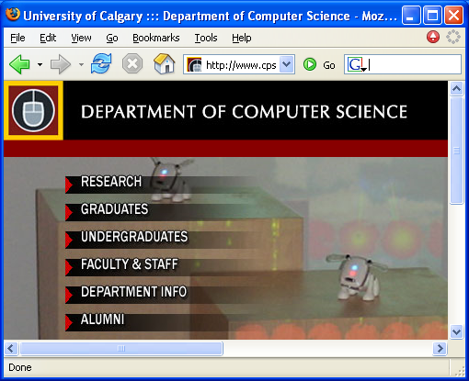
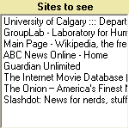

Ex: Public Web Item (Stephanie Smale)

Slide 31
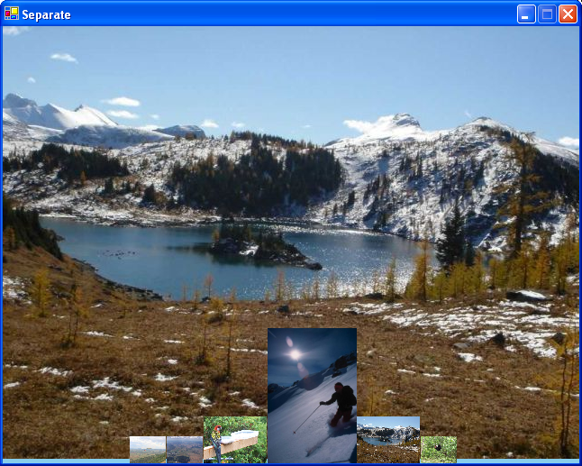
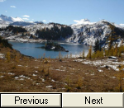

Ex: Photo Gallery (John McDonald)

Slide 32
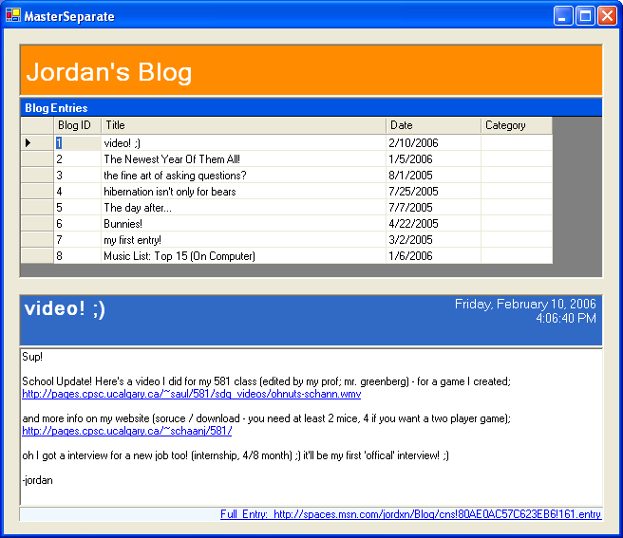
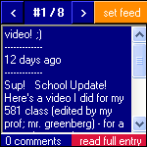

Ex: Blog Reader (Jordan Schaan)

Slide 33

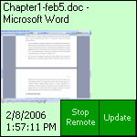
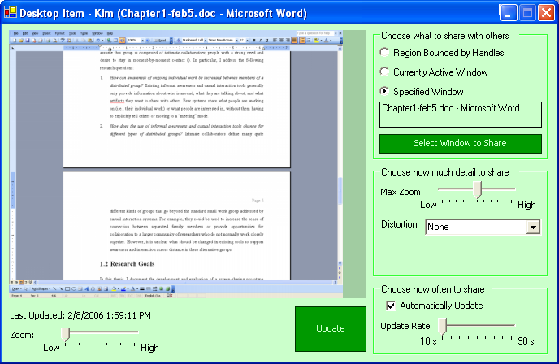
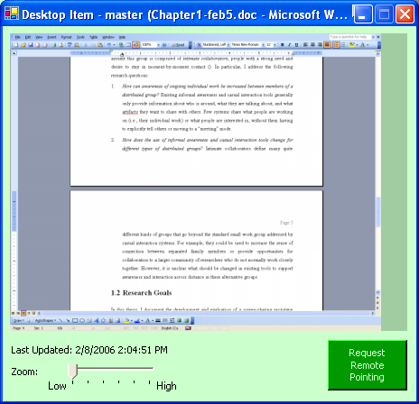
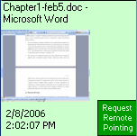
Ex: Screen Sharing (Kimberly Tee, to appear in CSCW 2006)
Owner
Audience

Slide 34
Summary
Easy fundamentals
  place in a groupware application
  networking aspects
Developers can concentrate on interesting interaction functionality

Slide 35
Message
A plugin architecture can enable groups to extend and customise groupware for their own collaborative needs.
Notes:
Motivation
Existing tools
Community Bar
Theory and Design

Slide 36




Download and use Community Bar (and build Media Items!)
http://grouplab.cpsc.ucalgary.ca/CB

Slide 37
Extra slides
These following slides were not used in the presentation

Slide 38
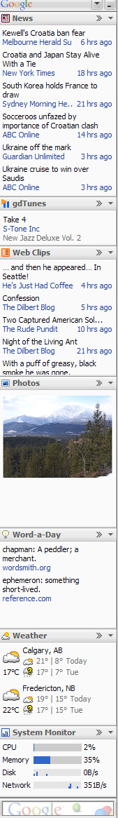
Single user example base systems

Slide 39
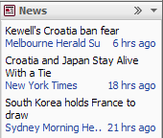
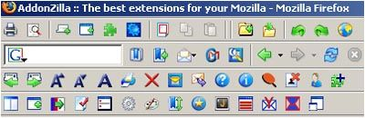
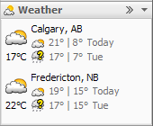


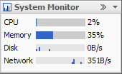
Plugin examples
Firefox (~1500)
  FireFoxMenuButtons
  Forecastfox
  StumbleUpon
Google Sidebar (~100)
  News
  Weather
  System Monitor

