Slide 1
Mapping Multi User Gesture and Speech Interaction by Demonstration
NOTE: Three videos were shown as part of this presentation.
GSI Demo
Edward Tse, Saul Greenberg, Chia Shen
University of Calgary (Canada)
Mitsubishi Electric Research Laboratories (USA)

Slide 2
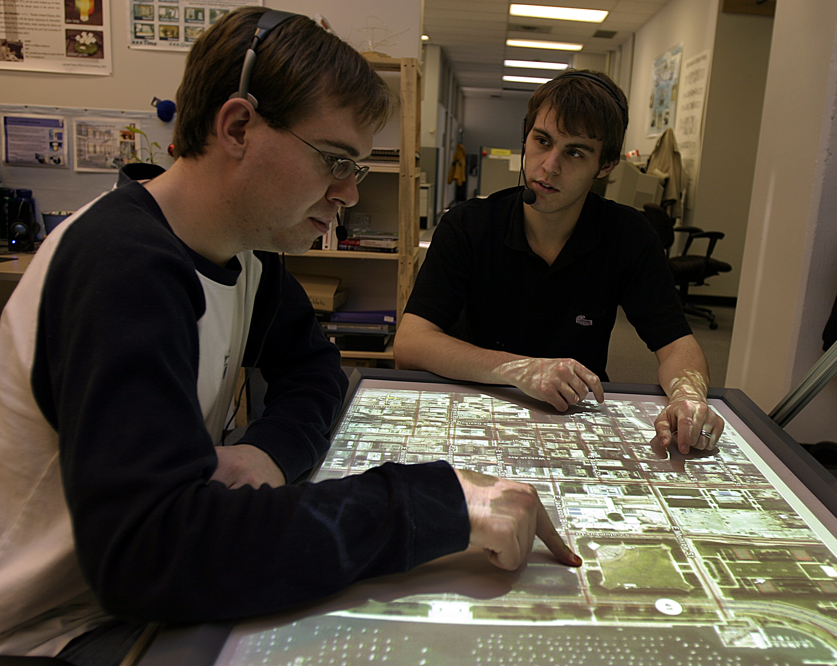
Message
Notes:
GSI Demo is all about converting existing single user applications originally designed for a keyboard and a mouse (!) into a form that is suitable for collaborative interaction by multiple people on a digital table. I’ll start by describing some of behavioural affordances of multi user multimodal interaction by showing a clip from our CSCW video.

Slide 3
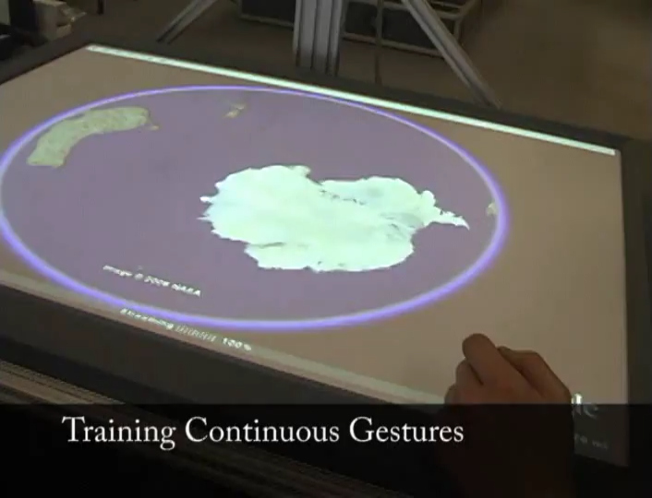
Message
Notes:
GSI Demo is all about converting existing single user applications originally designed for a keyboard and a mouse (!) into a form that is suitable for collaborative interaction by multiple people on a digital table. I’ll start by describing some of behavioural affordances of multi user multimodal interaction by showing a clip from our CSCW video.

Slide 4
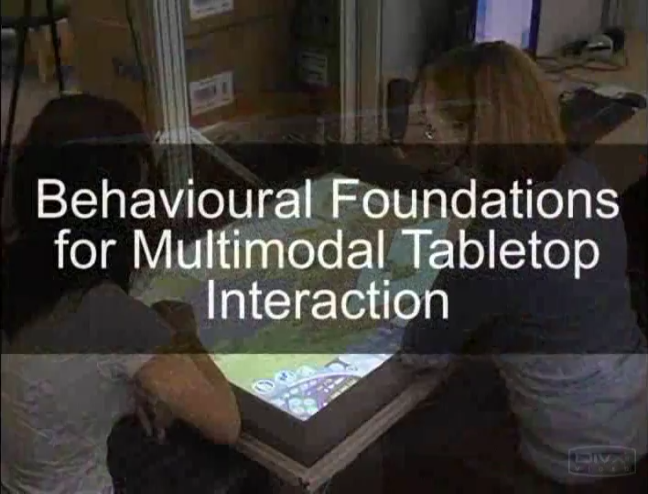
Behavioural Foundations

Slide 5
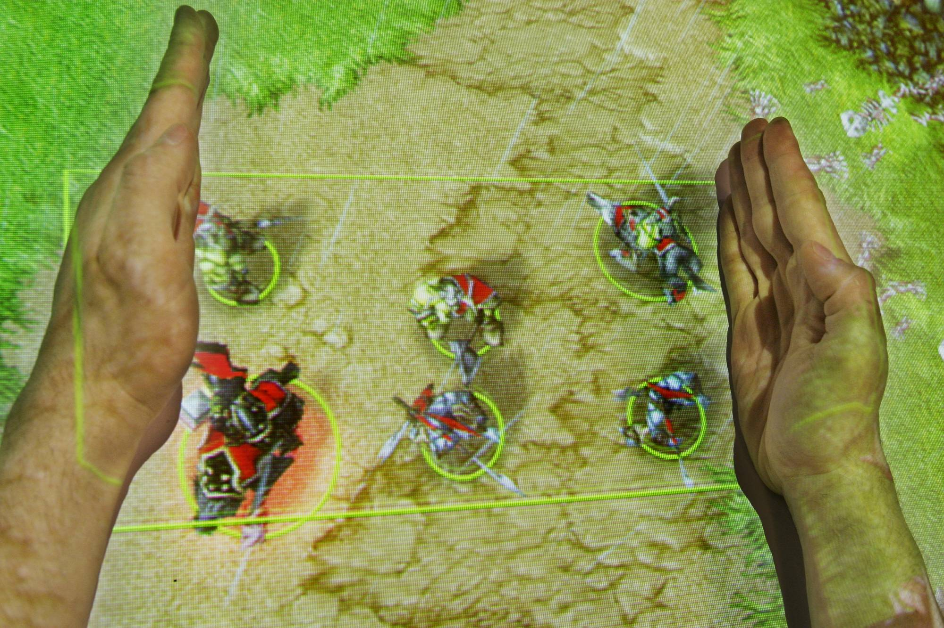
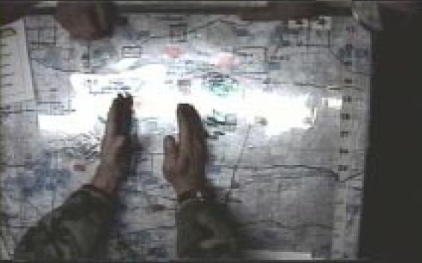
Hand Gestures/Postures
Tse, et al., 2006
Cohen, et al., 2002
Notes:
In our AVI paper this summer, we described the use of expressive hand postures that mimic the hand gestures used by people in real world settings over paper maps. For example, this hand bracketing gesture was used over a paper map in a military commands and control situation, (!) we tried to replicate it over a digital surface over warcraft III. These expressive hand gestures are designed as not only a command to the system but also as awareness to other collaborators.

Slide 6
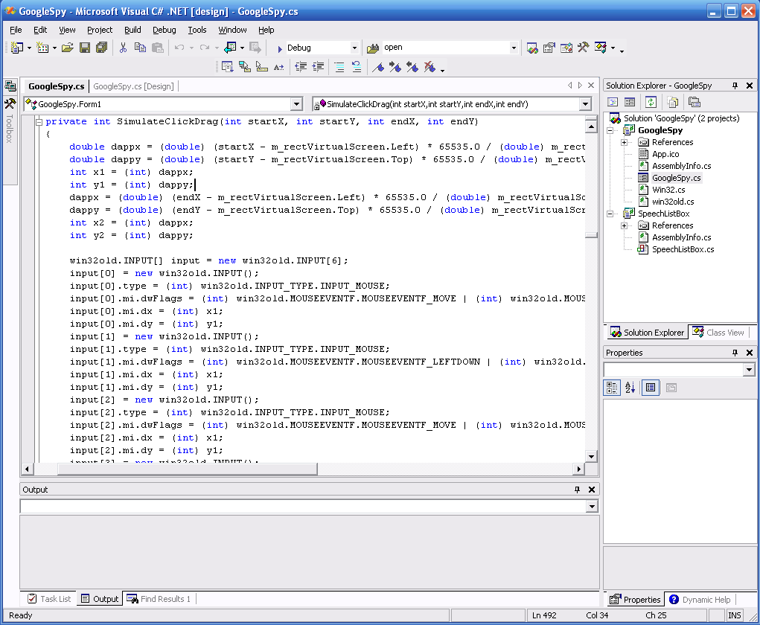
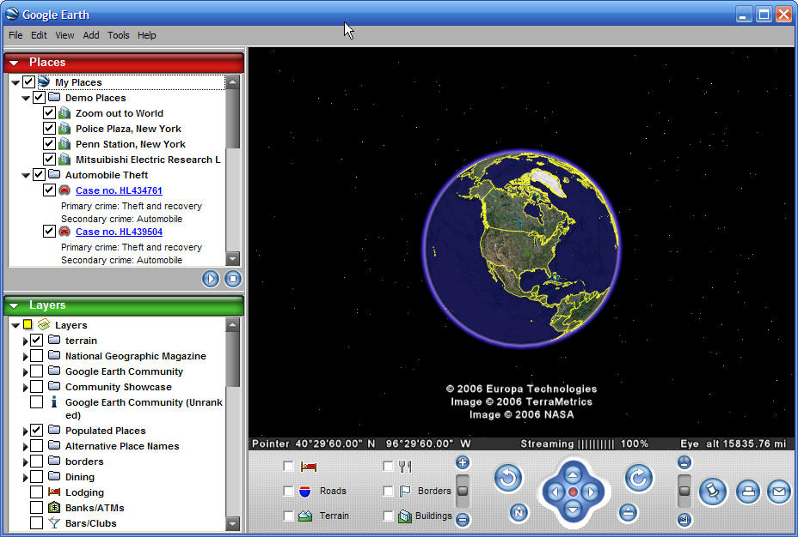
Problem
Multi User Tabletop
Single User Application
Wrapper
Speech Gestures
KeyboardMouse

Slide 7
Problem
1500 – 4000 Lines of Code
Programming Experience
Difficult to Maintain

Slide 8
GSI Demo
GSI by Demonstration
Gesture and Speech Interaction by Demonstration
Notes:
Our Solution is GSI Demo. GSI Demo creates a run-time wrapper around existing single user applications: it accepts and translates speech and gestures from multiple people into a single stream of keyboard and mouse inputs recognized by the application. It also lets people use multimodal demonstration – instead of programming – to quickly map their own speech and gestures to these keyboard/mouse inputs.

Slide 9
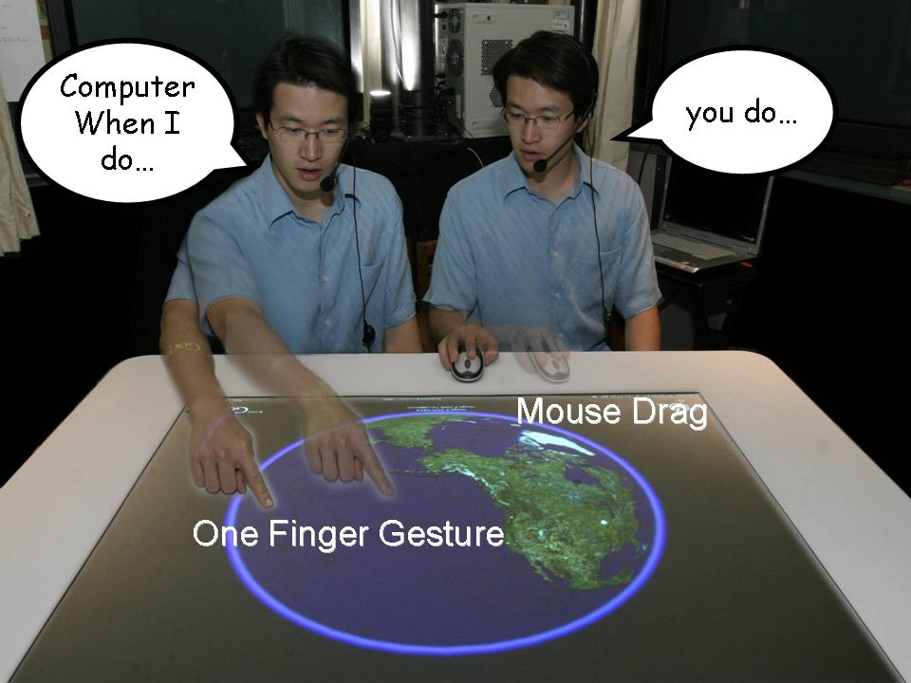
Solution
Code
GSI Demo
Speech Gestures
KeyboardMouse

Slide 10
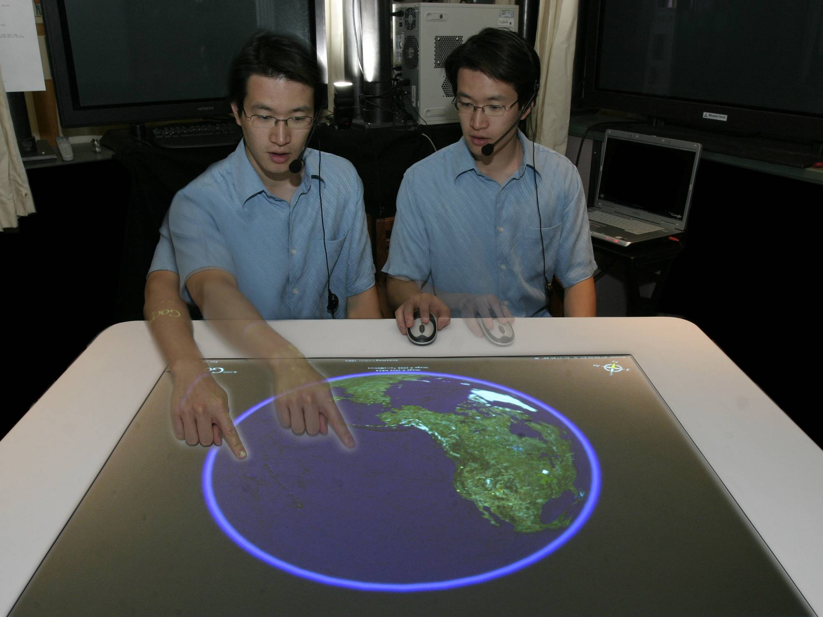
Computer When I do…
you do…
Mouse Drag
One Finger Gesture
Notes:
For example continuous gestures are trained by saying “Computer, when I do [one finger gesture], (!) you do [mouse drag]”.

Slide 11
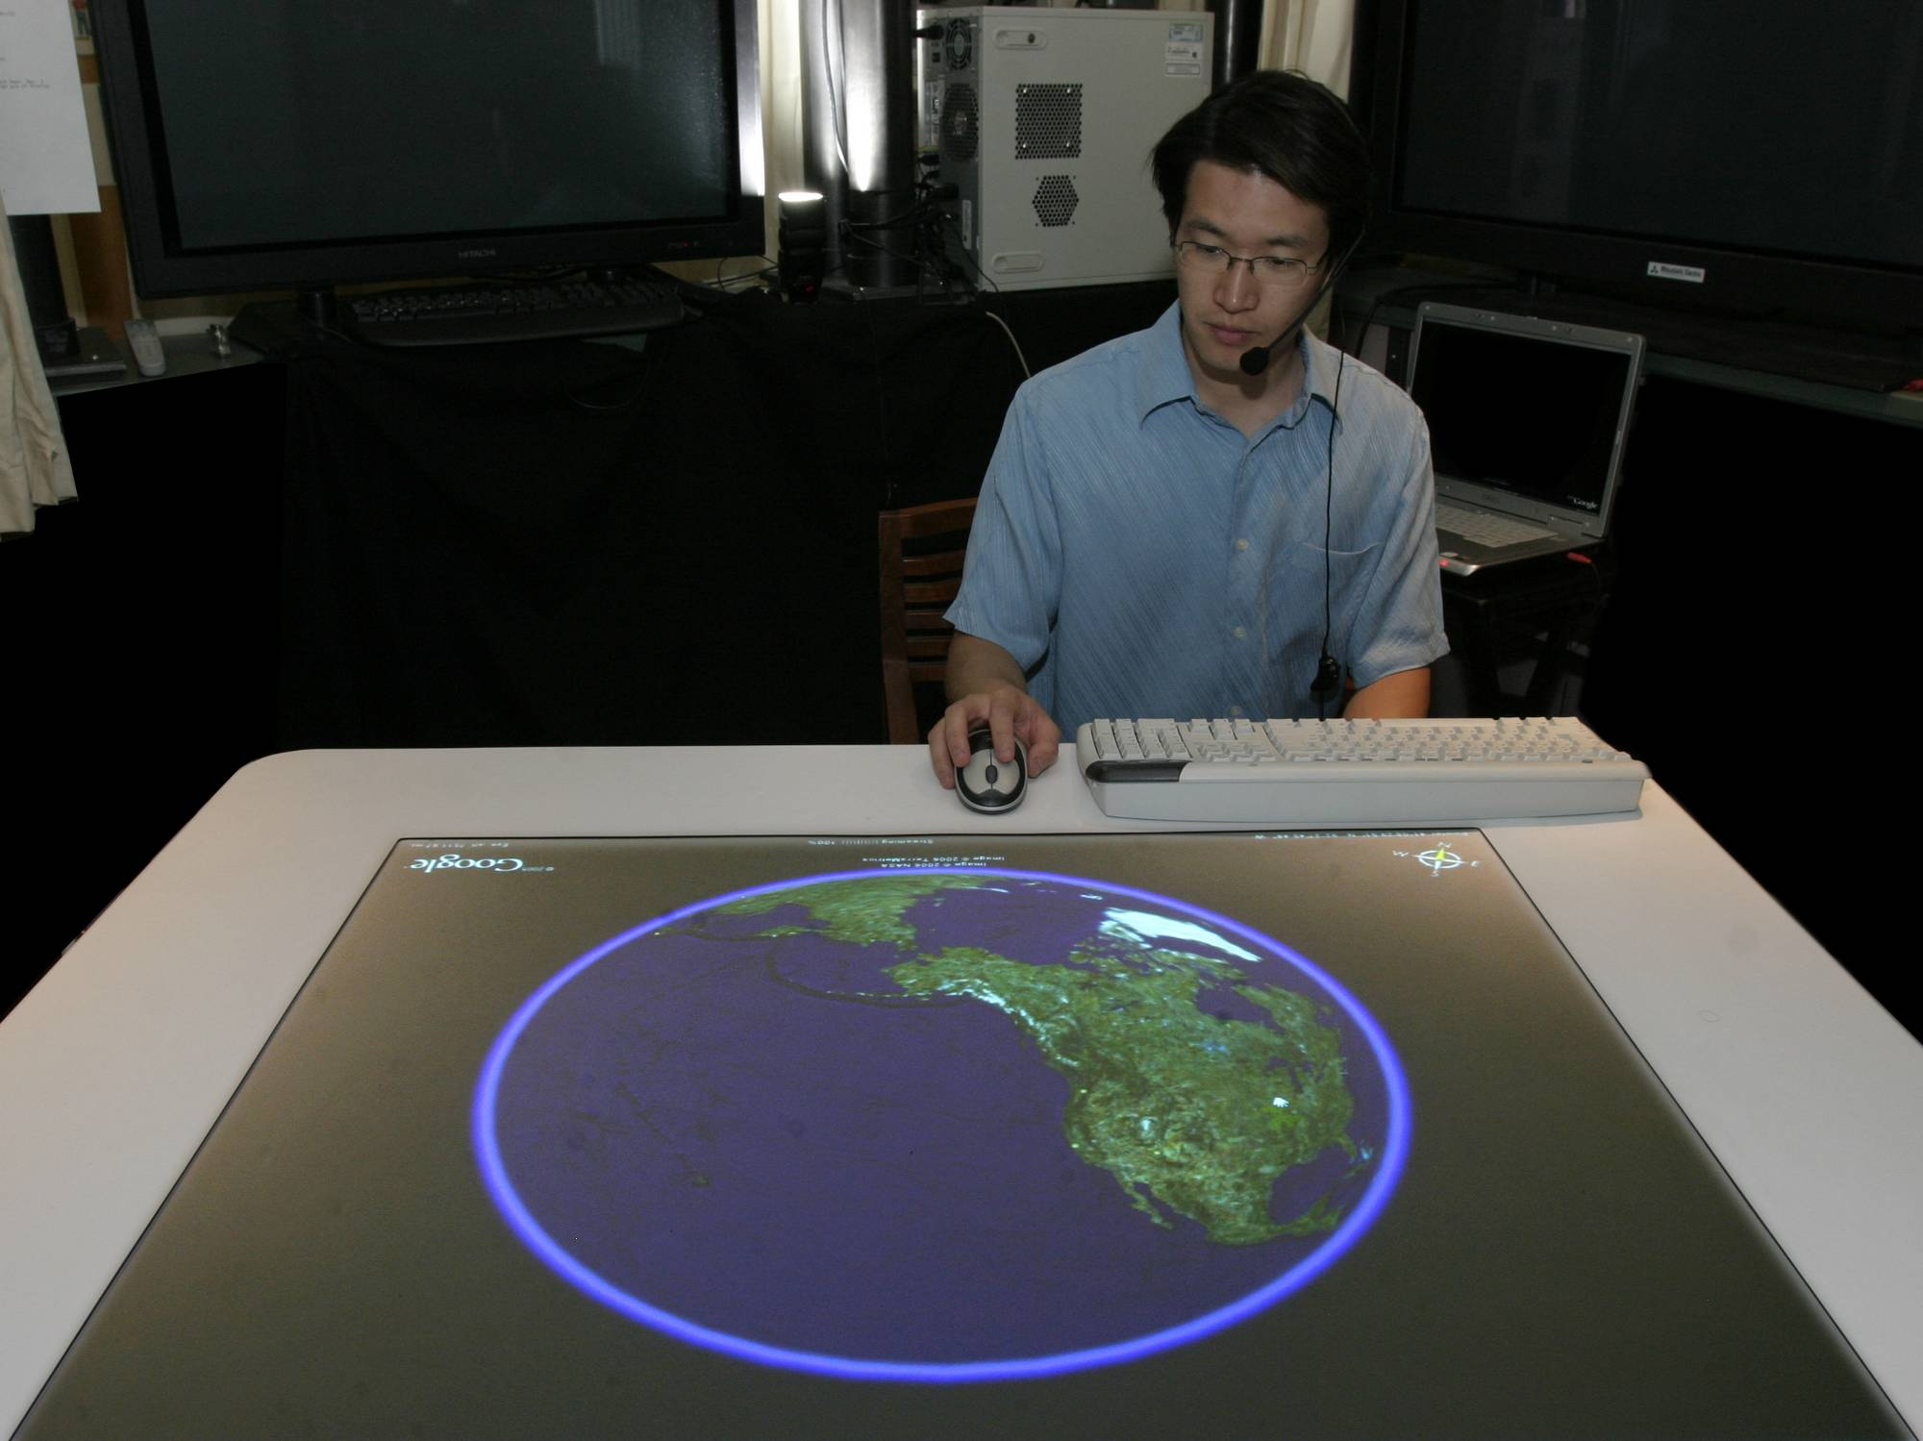
Computer, When I say layer bars
you do…
Key And Mouse Macro
Notes:
Similarly, discrete speech commands can be trained by saying “Computer, when I say [layer bars] (!), you do [keyboard and mouse macro]”

Slide 12
GSI Demo Goals
Can be used by non-programmers
Simple to Train
Can recreate all existing wrappers rapidly
Notes:
We designed GSI Demo with several goals: We wanted it to be usable by non-programmers, with a simple training interface that needed to provide at least enough functionality to recreate all of the existing wrappers that we had built for Google Earth, Warcraft, The Sims and Virtual Surgery. Thus GSI demo provides a starting point based on the success of previous papers

Slide 13

Video
Notes:
Macro system not a machine learning system.

Slide 14
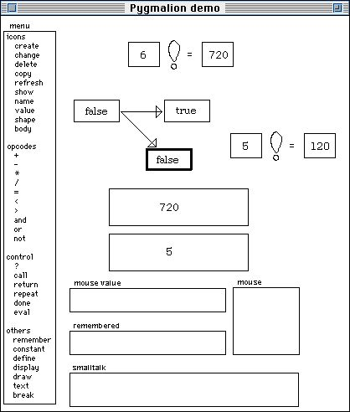
Related Work
Programming by Demonstration
Pygmalion,
Smith, D., 1975
Xerox SmallStar,
Halbert, D., 1984
Watch What I Do,
A. Cypher, 1993
Your Wish is My Command
H. Lieberman, 2001
Notes:
There are many systems that support

Slide 15
Related Work
Customizable User Interfaces
Wincuts, Tan, D., 2003
SUPPLE, Gajos, K., et al 2005
SMARTedit Lau, T., 1998
Multiple Interfaces, McGrenere, J., 2002
Computer User as Toolsmith, Greenberg, S., 81

Slide 16
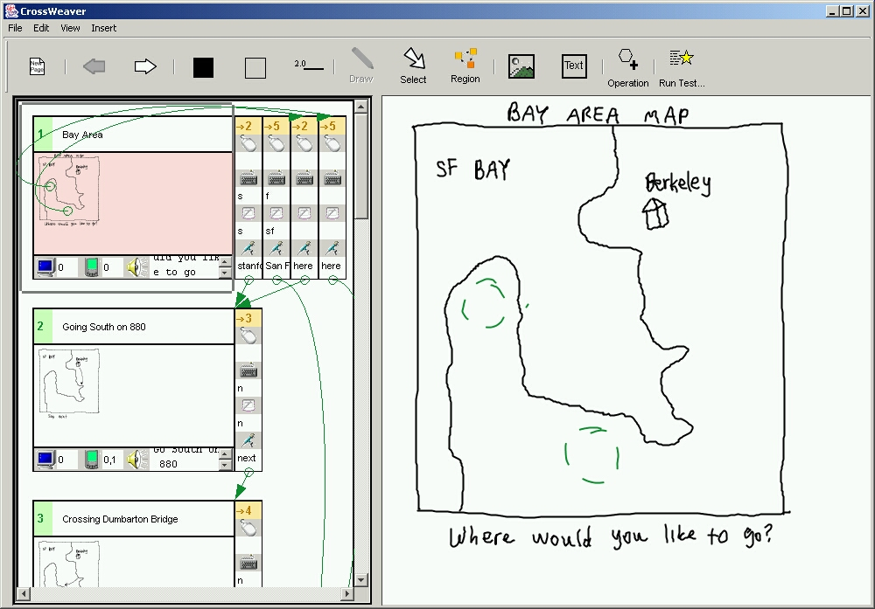
Related Work
Multimodal
Sinha, Landay, 2003
Notes:
Cross Weaver is another related system that allowed a programmer to create multimodal commands using the keyboard and the mouse. The user could (!) draw a frame on the storyboard on the right and then (!) create multimodal transitions by adding links on the left side. Our system extends the interactions provided by cross weaver by allowing programmers to interact with existing single user applications using multimodal input to program the system.

Slide 17
How?

Slide 18
Video

Slide 19
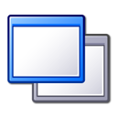






Application
Application
Mapping
Application Mapping Files
Save to File
Load from File
Recorder
Player
Input
Gesture Speech Unifier
Speech
Client
Speech
Client
Diamond Touch
Gesture Engine
Smart DViT
Gesture Engine

Slide 20
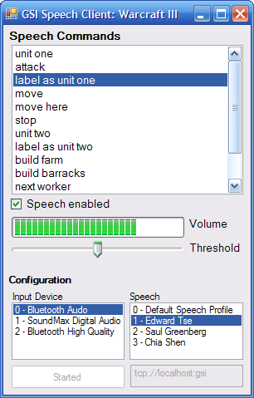
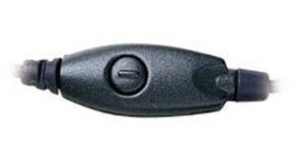
Speech Client
Computer, Layer Bars
Notes:
We designed our speech client using the Microsoft Speech API. And provided support for multiple users by

Slide 21
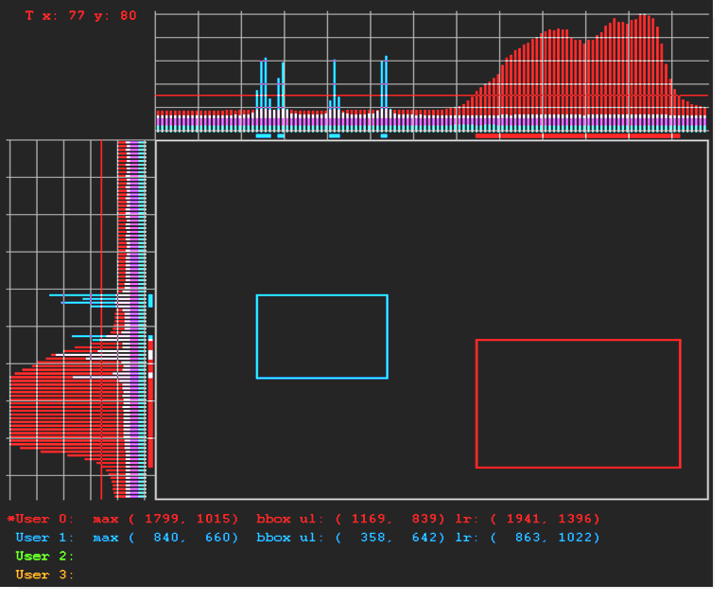
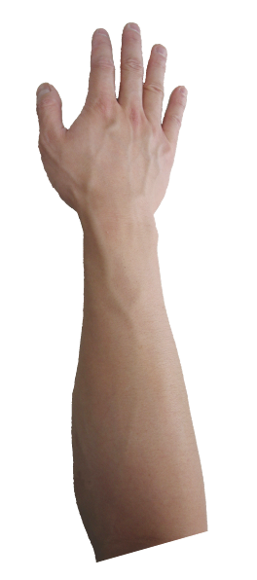
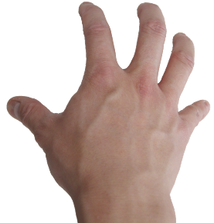
Gesture Engine
Notes:
Using this same technique we can retrain different gestures

Slide 22
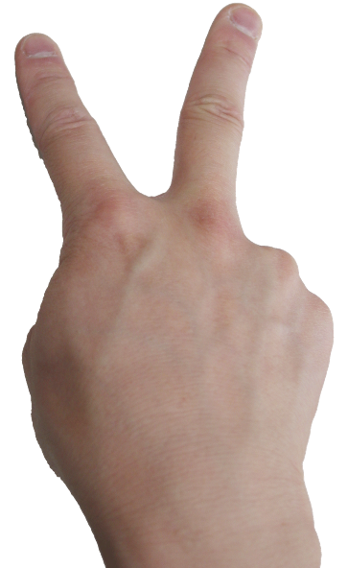
Application
Application
Mapping
Application Mapping Files
Save to File
Load from File
Recorder
Player
Input
Layer Bars
Create Bathtub

Slide 23
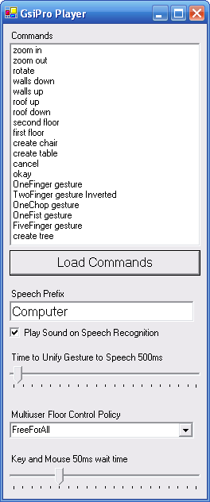
Player
Application Mapping File
Multimodal Cmds
Sound Feedback
Unification Timeout
Floor Control

Slide 24
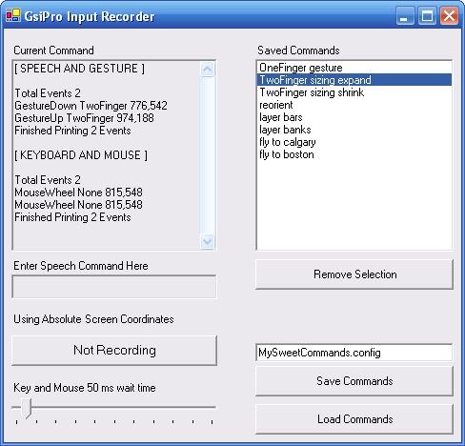
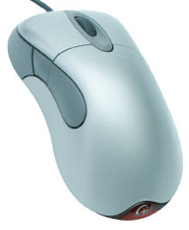
Input Recorder
Computer When I do…
you do…
Mouse Wheel
Notes:
The Input recorder creates the mapping between speech and gestures and keyboard and mouse commands. So, in google earth when someone says computer when I do a two finger gesture you do and mouse wheel zoom in both the multimodal and keyboard and mouse interactions are stored.

Slide 25
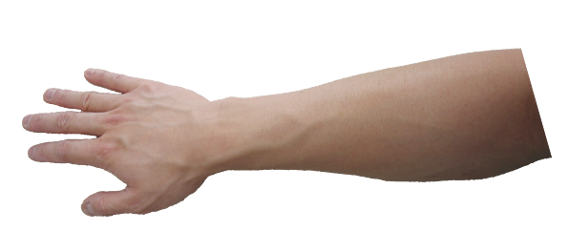
Simplifications
Notes:
In programming by demonstration systems there is the challenge in determining what variables can be modified. GSI Demo reduces this complexity by making simplifications on the types of variables supported. For example, we assume that the location of a users touch is not important. That is a one hand gesture on the bottom left edge of the table is the same (!) as a one hand gesture on the top right of the display. Thus GSI Demo is more a multimodal tool for mapping keyboard and mouse MACROS than a learning by example system.

Slide 26
Simplifications
Notes:
Similarly while we allow two handed gestures over a large area to be mapped to a drag selection, we do not provide a means for using the same gesture to perform a macro of keyboard commands because we assume that gestures will map onto keyboard and mouse commands.

Slide 27
GSI Demo Limitations
Single User Application
Variable Limitations
No Dynamic Information
No Editing
Notes:
GSI Demo is not perfect. First, it is limited by the single user applications it wraps. While some multi-user interaction can be performed by interleaving individual actions, the underlying application is oblivious to this fact. As well, the mechanics of invoking certain application actions have side-effects, e.g., if a speech command invokes a graphical menu selection, the menu may briefly flash on the display.
Second, GSI Demo is a crude programming by demonstration system. It makes many simplifying assumptions on how gestures should be mapped to application actions, and makes no attempt to learn across examples as done in other programming by example systems [5] and even in other gesture recognition systems [2]. For example, it assumes that there will be a simple mapping between a gesture (e.g., a whole hand move) and a mouse click/drag. While this makes it easy to map a hand move to a mouse panning action, mapping a two finger touch to a double tap is not possible. Similarly, complex gestural shapes (e.g., drawing a flower) are not recognized. Of course, an obvious step in this work is to incorporate techniques forwarded by the machine learning and programming by demonstration communities [5][2].
Third, multimodal mappings are currently limited. Only a simple speech + one gesture (e.g., finger, hand) can be mapped to a series of keyboard commands followed by a mouse click. Mouse click coordinates are remapped to the center position of the gesture. This means that complicated multimodal commands that involves clicking a menu before specifying a location would fail.
Fourth, macros and mappings can be deleted and reconstructed, but not edited. This means that long sequences would have to be recreated, even though a small edit would fix it. Again, methods exist to edit macros, e.g., Halbert’s early SmallStar system [5].

Slide 28
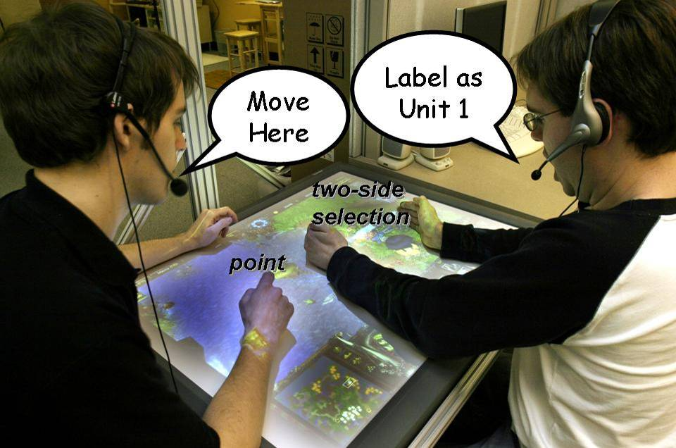
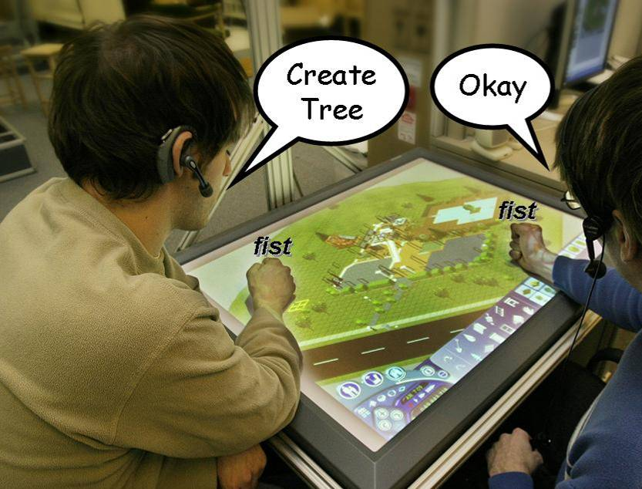
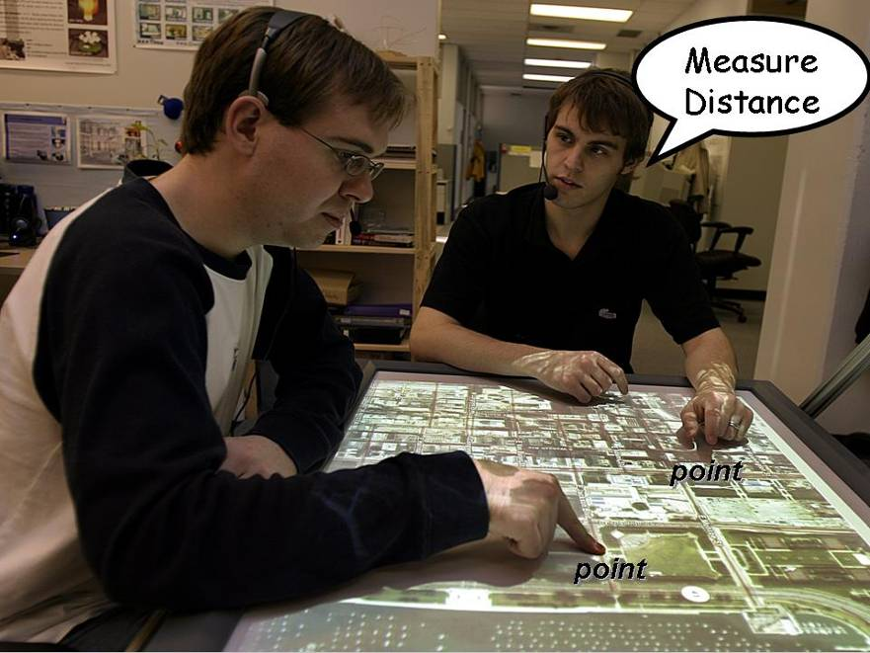
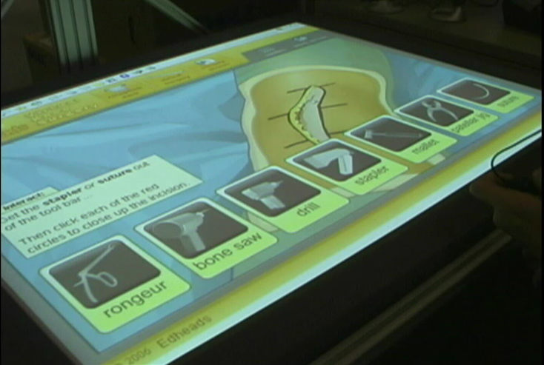
Example Applications
Notes:
In spite of these technical limitations, we were able to define a reasonable working set of rich, natural actions atop our single user applications. Perhaps this is because the actions people want to do when collaborating over a surface are simple and obvious

Slide 29
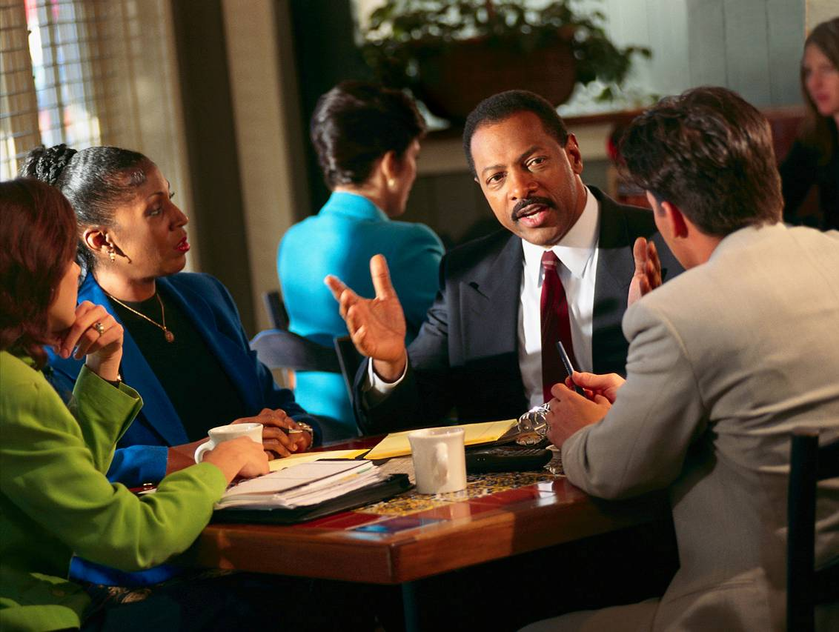
Future Work
User Evaluation
Additional Applications
Advanced Mappings
Notes:
There are several different advanced mappings that we are considering:

Slide 30
Advanced Mappings
Gesture Dynamics
Learning Over Examples
“Create Table Here”
Notes:
There are several different advanced mappings that we are considering:

Slide 31
Message
Sponsored by: Alberta Ingenuity, iCORE and NSERC
Notes:
GSI Demo is all about converting existing single user applications originally designed for a keyboard and a mouse (!) into a form that is suitable for collaborative interaction by multiple people on a digital table. I’ll start by describing some of behavioural affordances of multi user multimodal interaction by showing a clip from our CSCW video.

