Slide 1

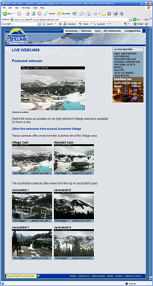
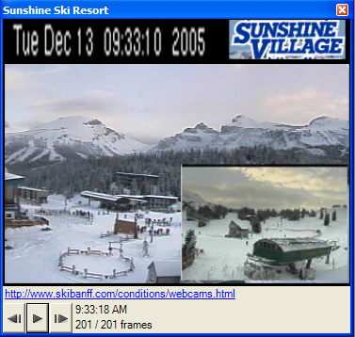
Generating Custom Notifications by Tracking Visual Differences between Web Page Visits
Saul Greenberg
Michael Boyle
University of Calgary

Slide 2
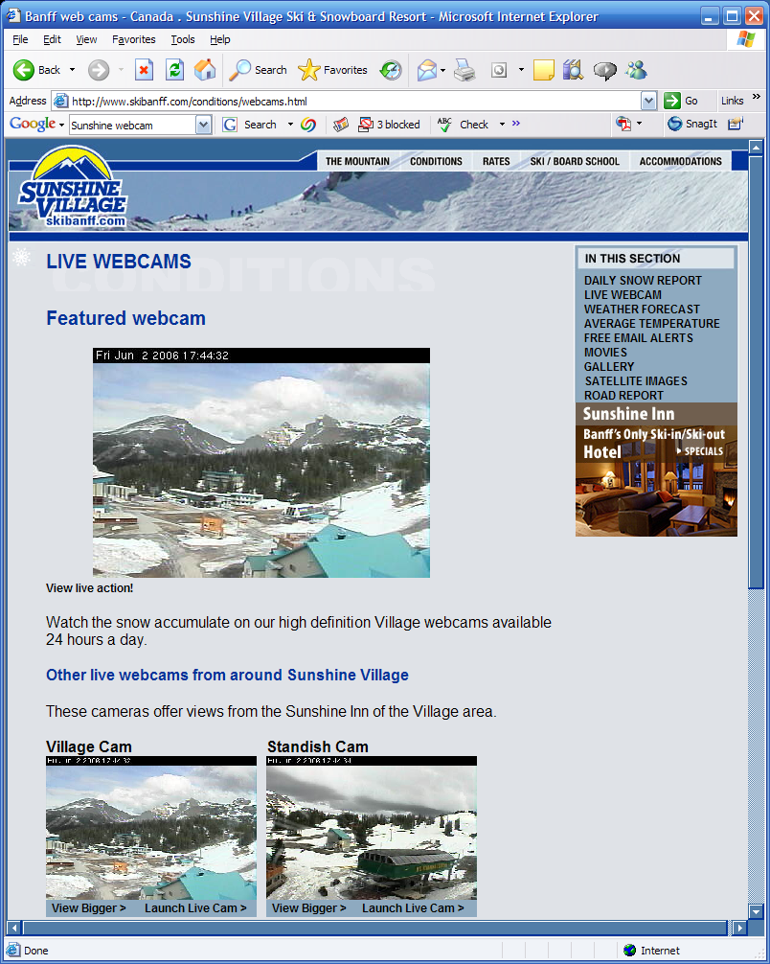
The Message
People can harvest images from web pages to create rich notifications

Slide 3
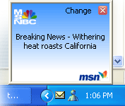
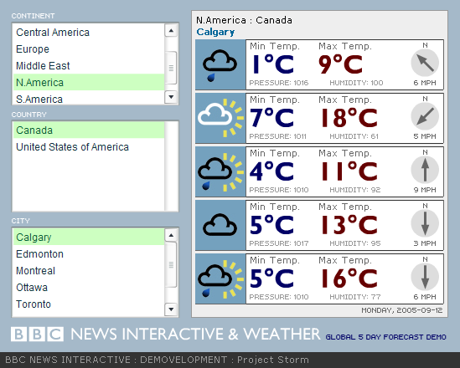
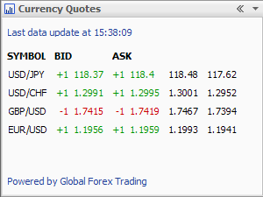
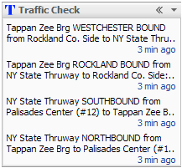
Notifications
Changing information of personal interest
  subscription
  ‘pushed’ to a person by content provider
  gives awareness over time
MS-NBC
Breaking News
BBC News
Interactive
Google Desktop
Currency Quotes
Google Desktop
Traffic Check

Slide 4
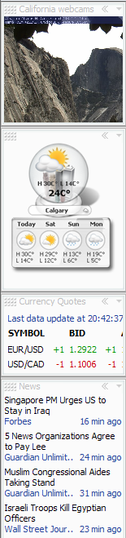

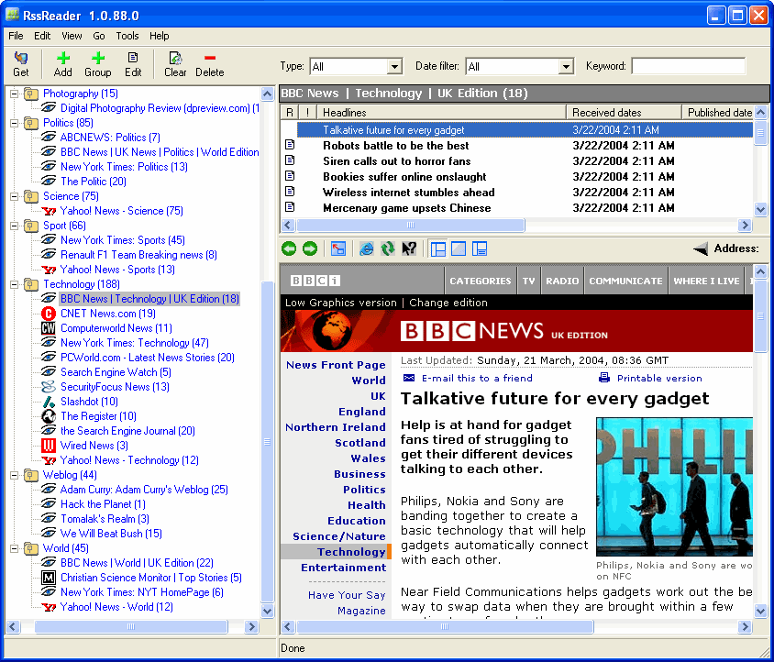
Notification Viewers
Rss Reader www.rssreader.com
Google
Desktop
Microsoft
Sideshow

Slide 5
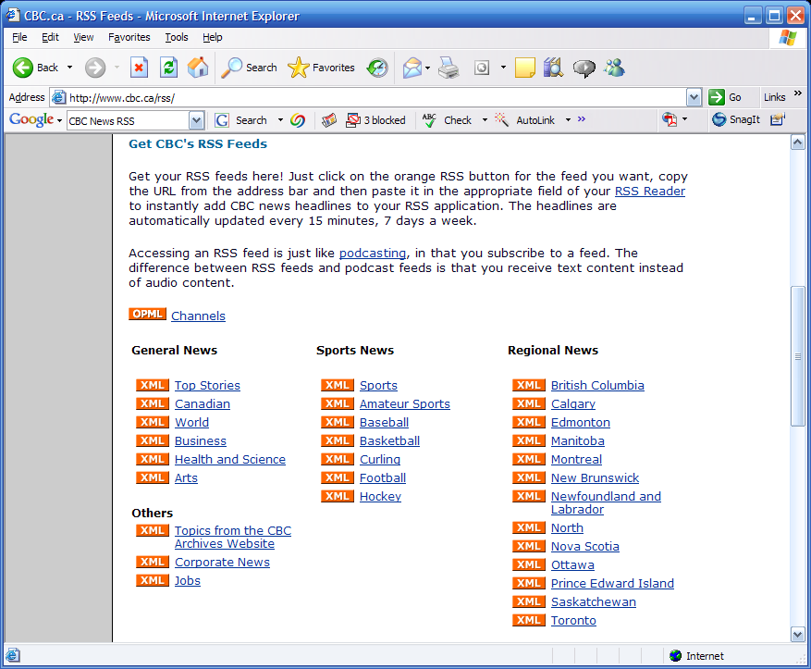
Where do notifications come from?
RSS feeds

Slide 6
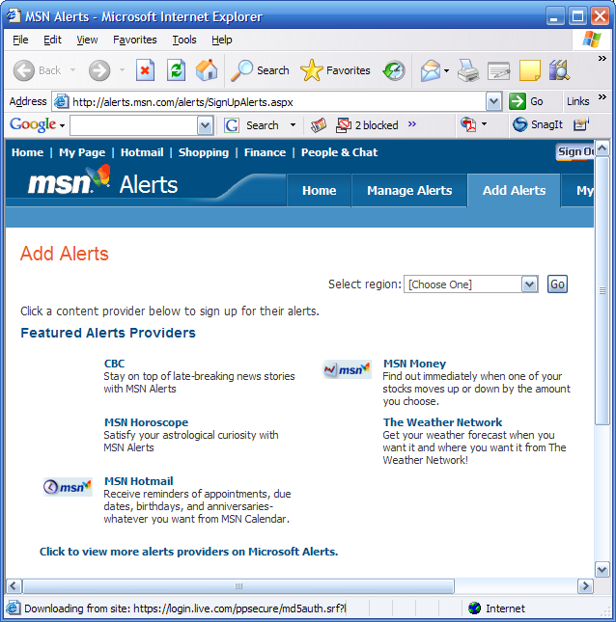
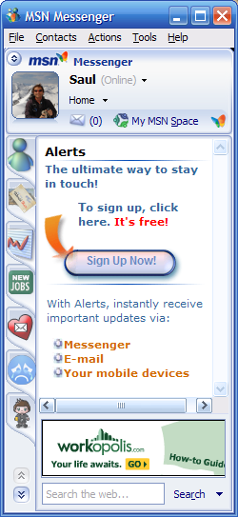
Where do notifications come from?
Commercial
providers

Slide 7
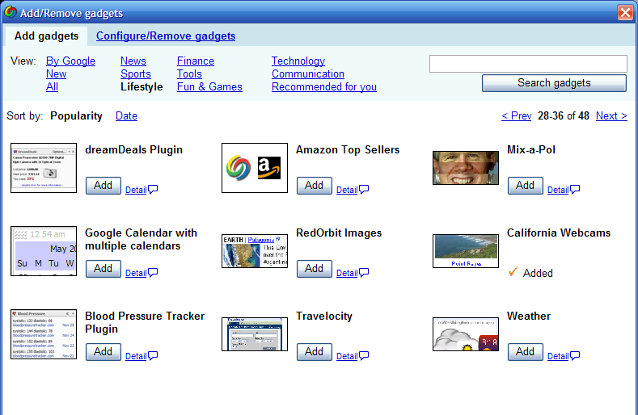
Where do notifications come from?
3rd party developers
Google
Desktop

Slide 8
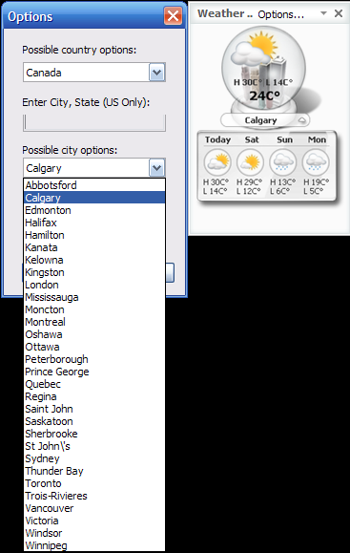
The Problem
Are available notifications what I want?

Slide 9
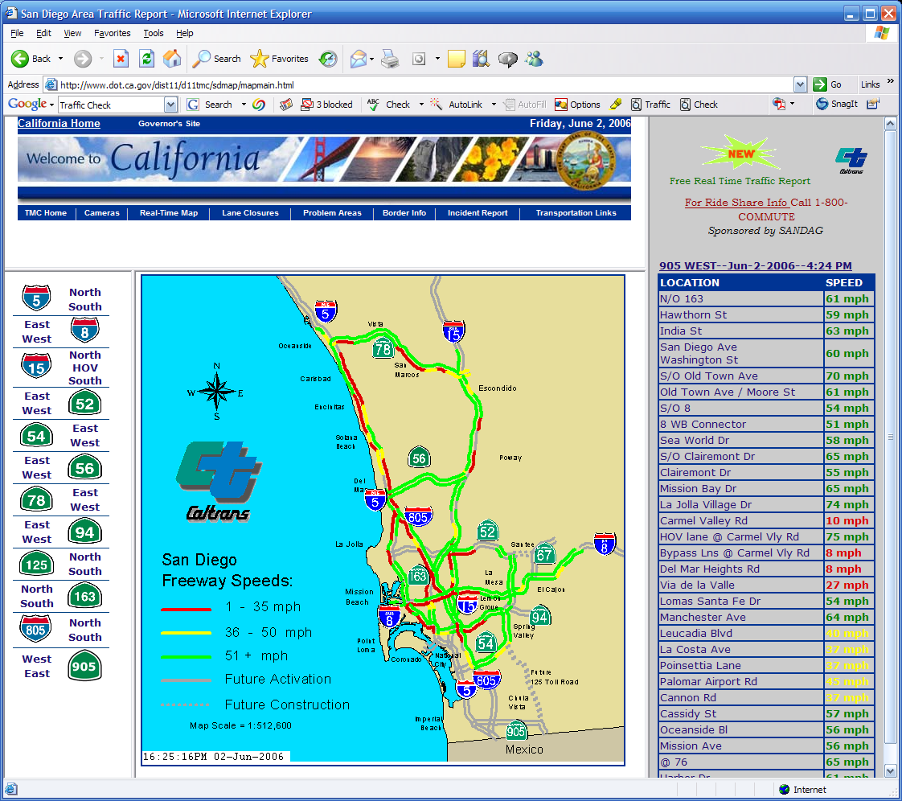
The Problem
Do they display the critical information I need in the form I want?
Google Desktop Traffic Check
http://www.dot.ca.gov/dist11/d11tmc/sdmap/mapmain.html

Slide 10
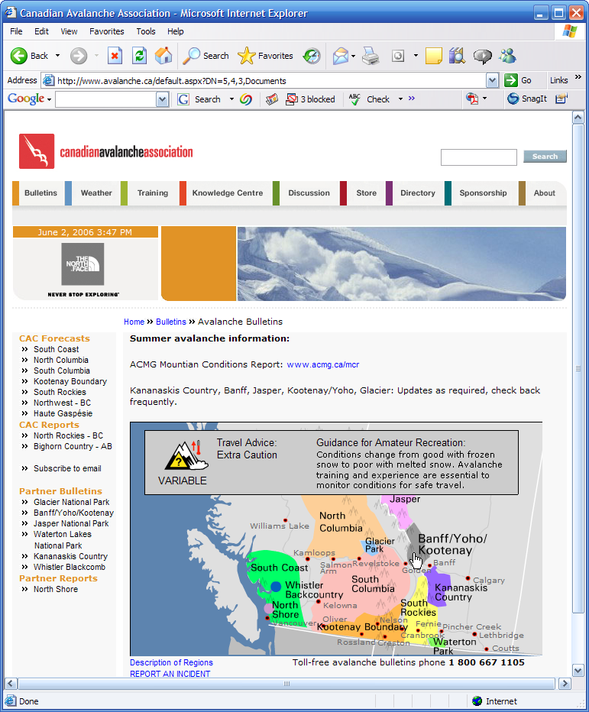
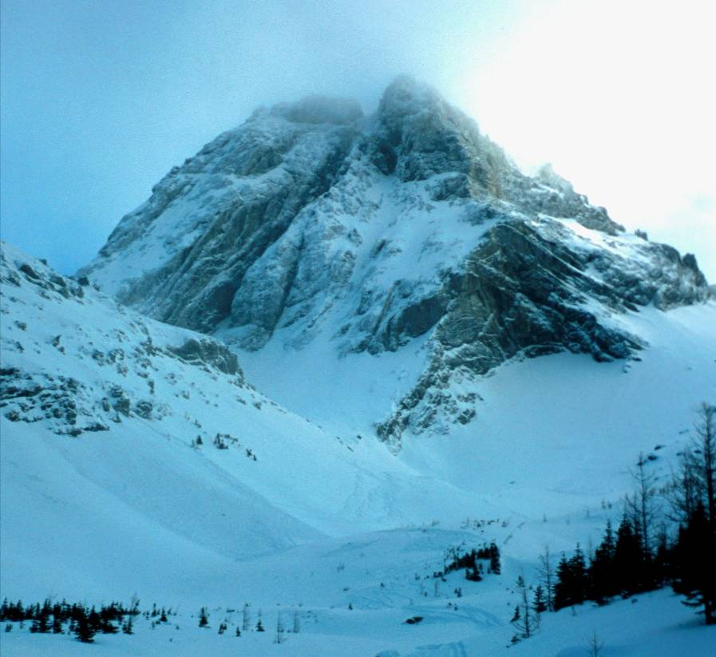
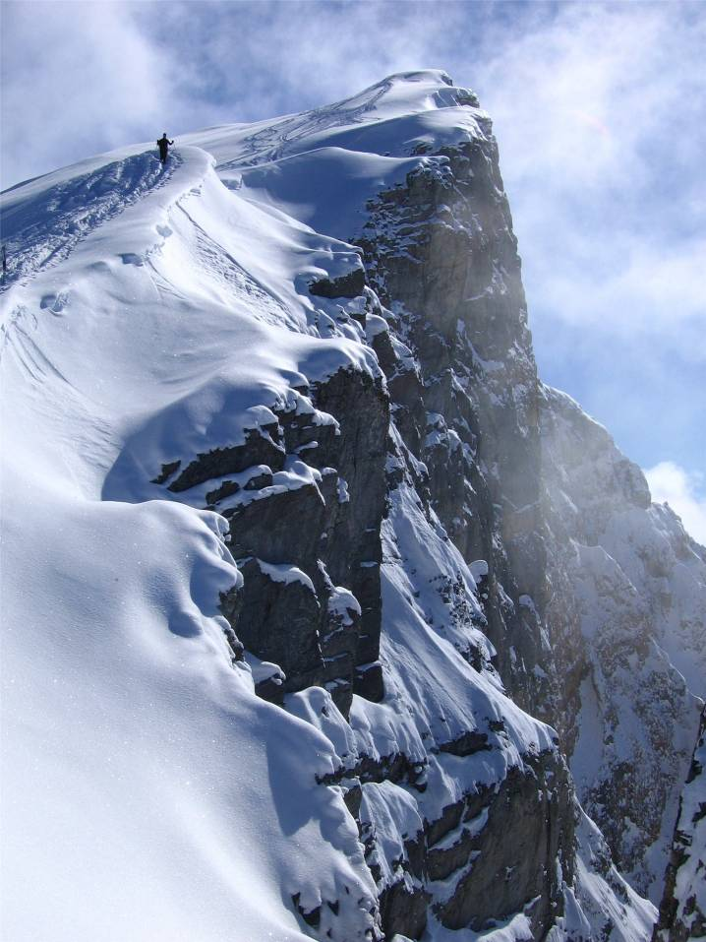
The Problem
Can I wait for someone else to produce them?
X

Slide 11
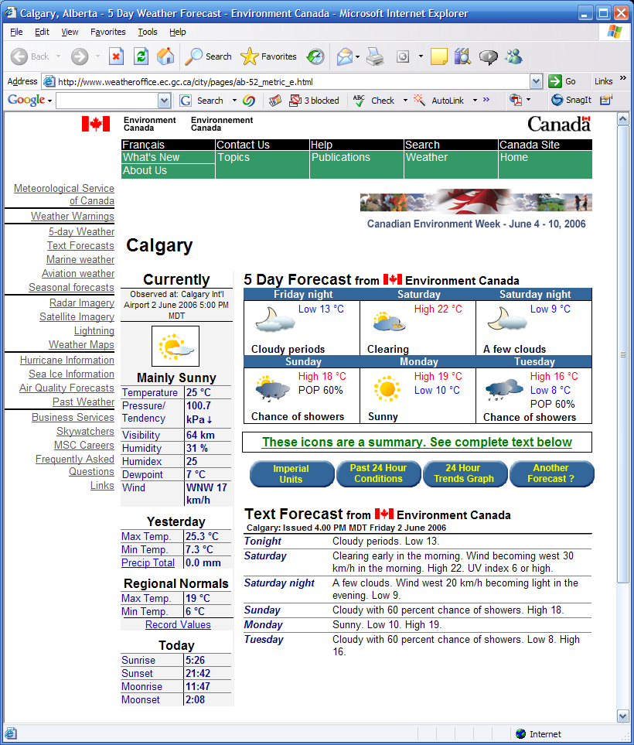
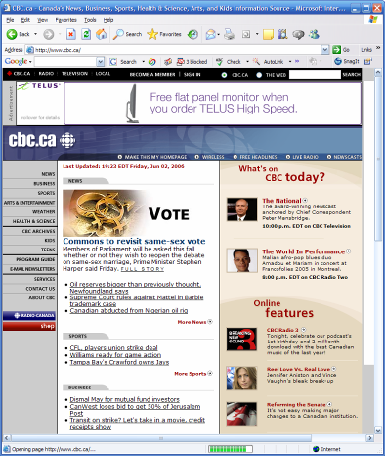
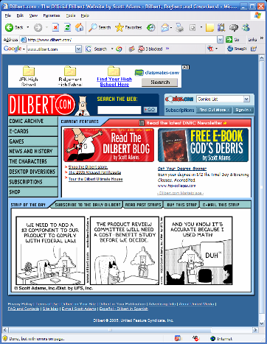
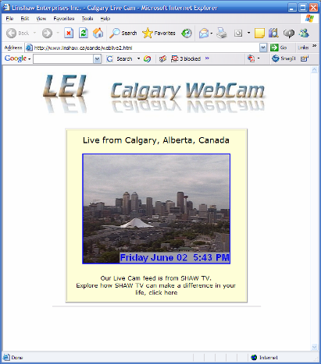
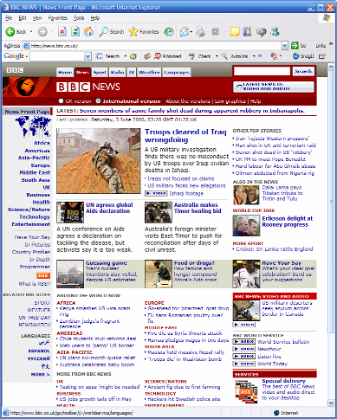
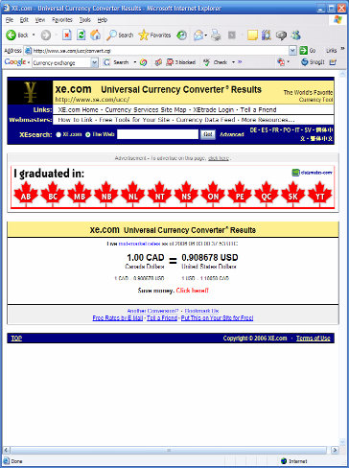
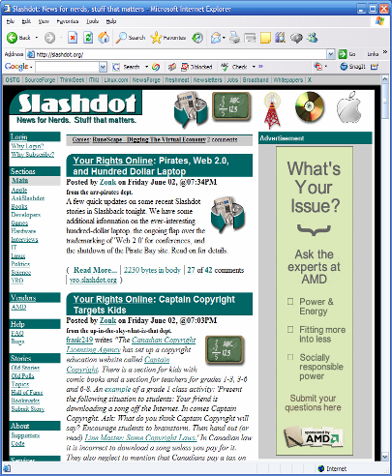
Design Insight
People check web pages for information updates

Slide 12
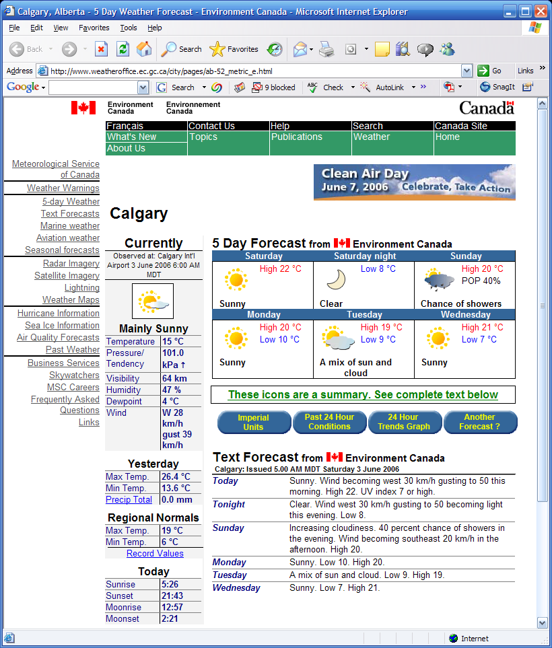
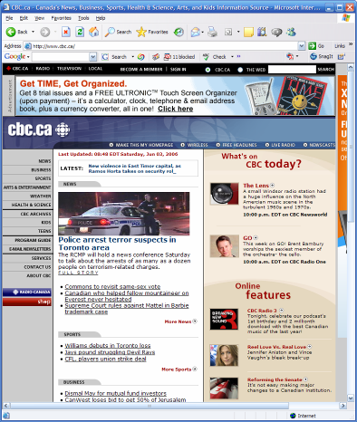
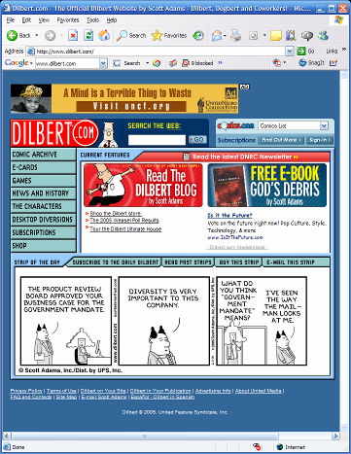
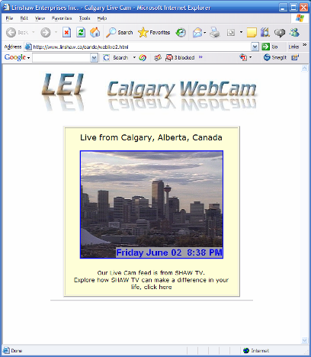
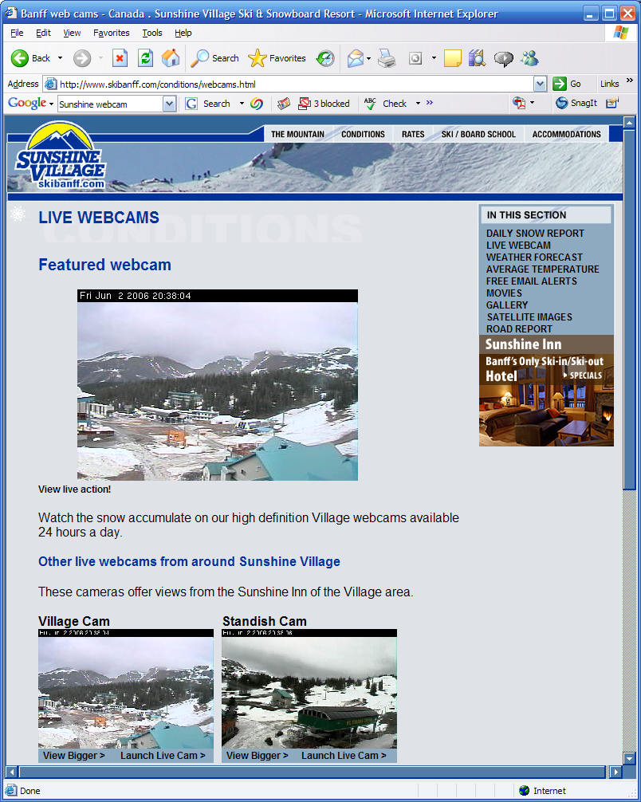
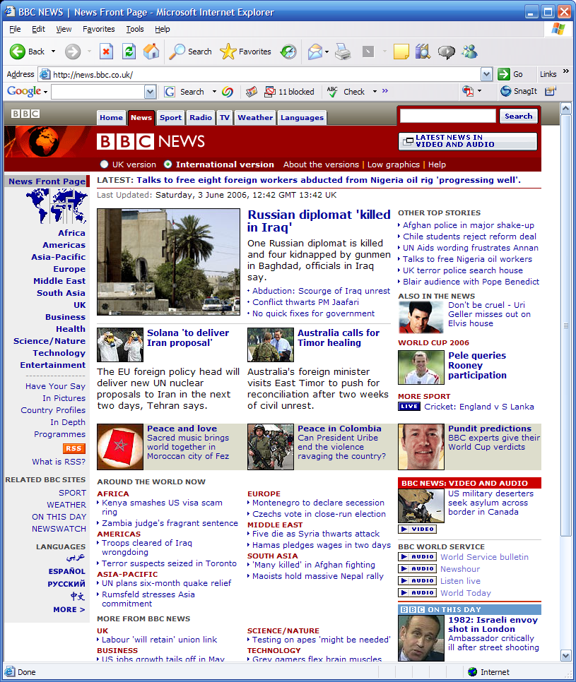
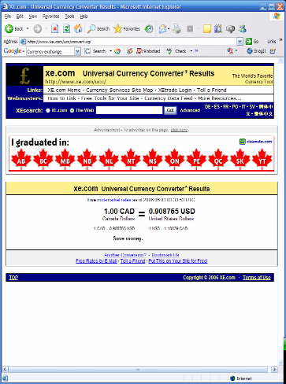
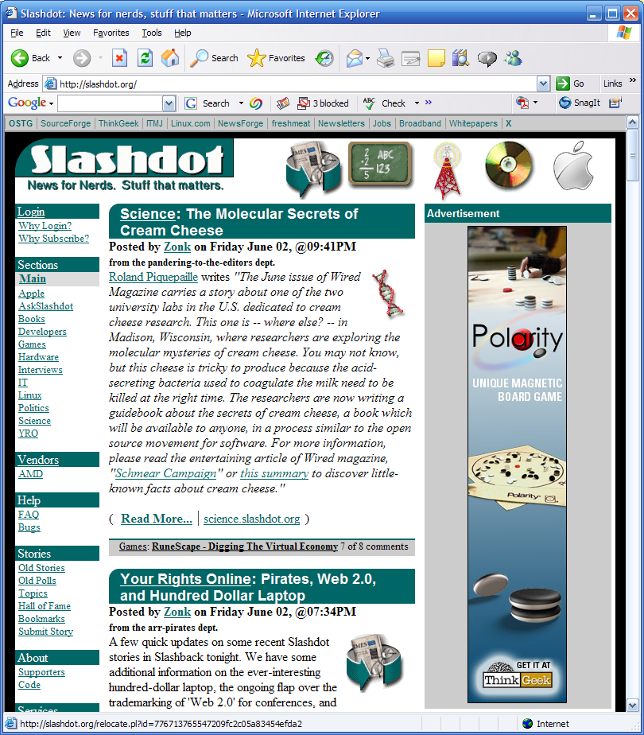
Design Insight
… and information chunks have spatial regularities

Slide 13
Design Insight
…can look for and harvest changed information Wincuts

Slide 14
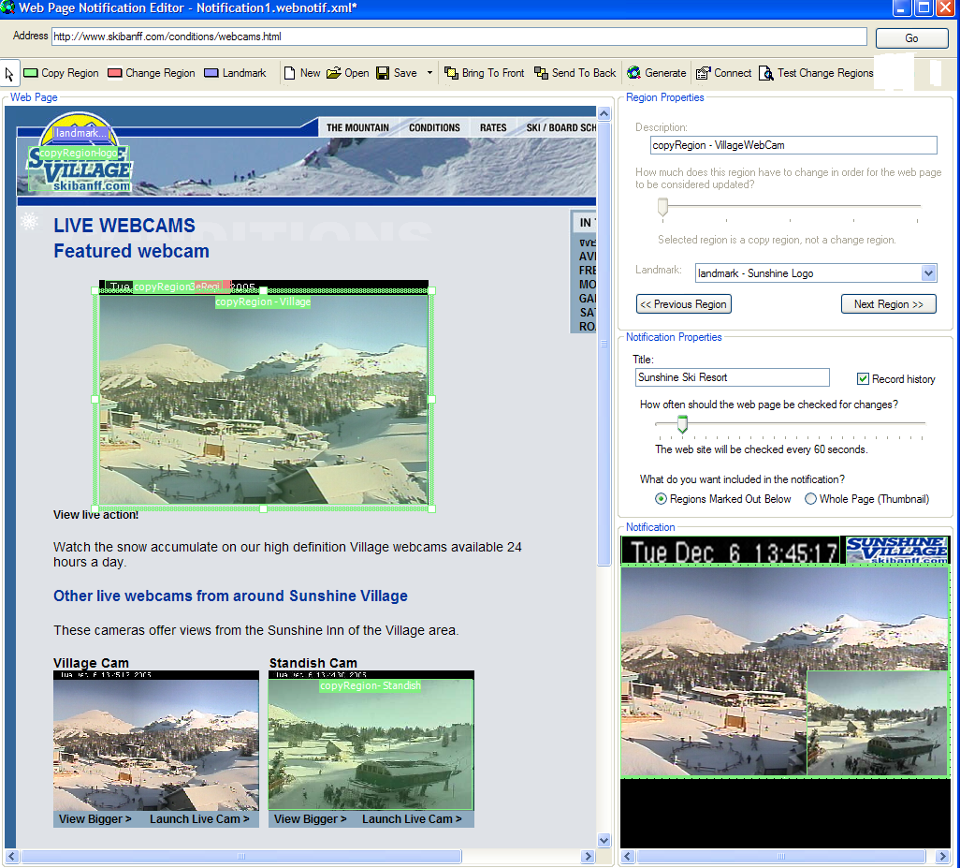
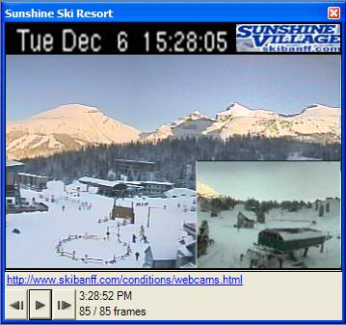
A system demo was provided at this point

Slide 15
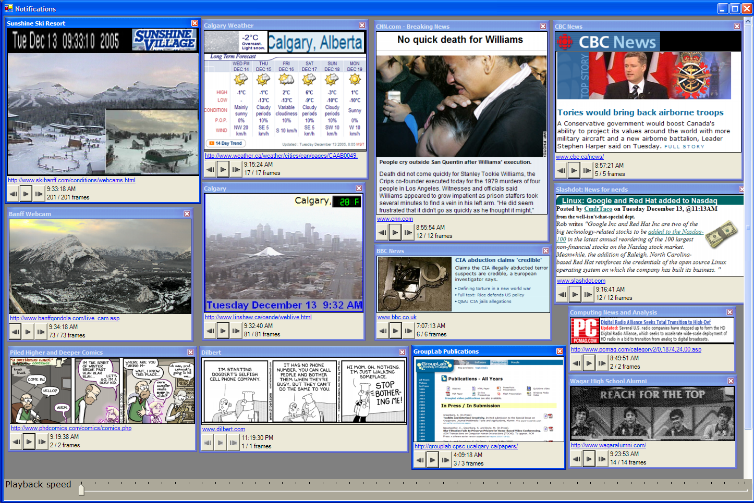

Slide 16


Slide 17
Spatial Regularities
Sugiura and Koseki UIST ‘98
  categorized articles
    predefined spatial clusters

Slide 18
Spatial Regularities
Sugiura and Koseki UIST ‘98
  categorized articles
  top news articles
    same space relative to page top

Slide 19
Spatial Regularities
Sugiura and Koseki UIST ‘98
  categorized articles
  top news articles
  chronological order
    newest on top
    older pushed down
Claim:
  90% success

Slide 20
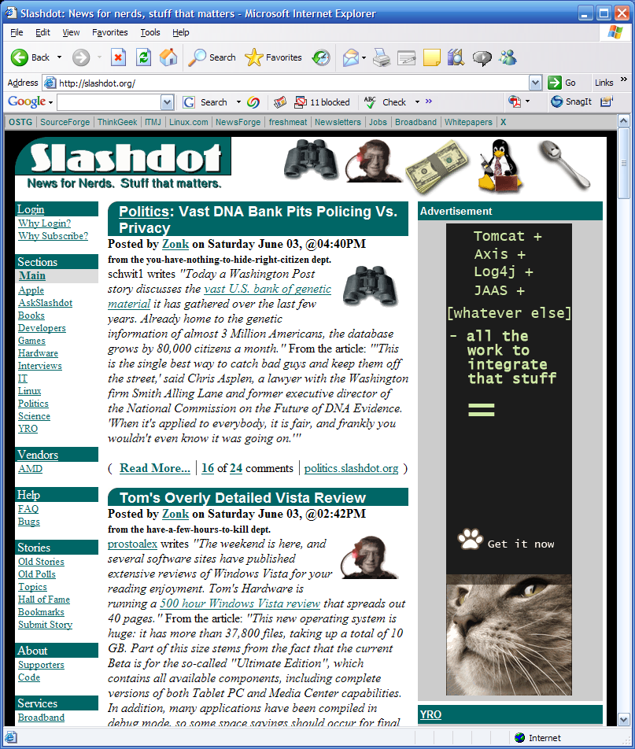
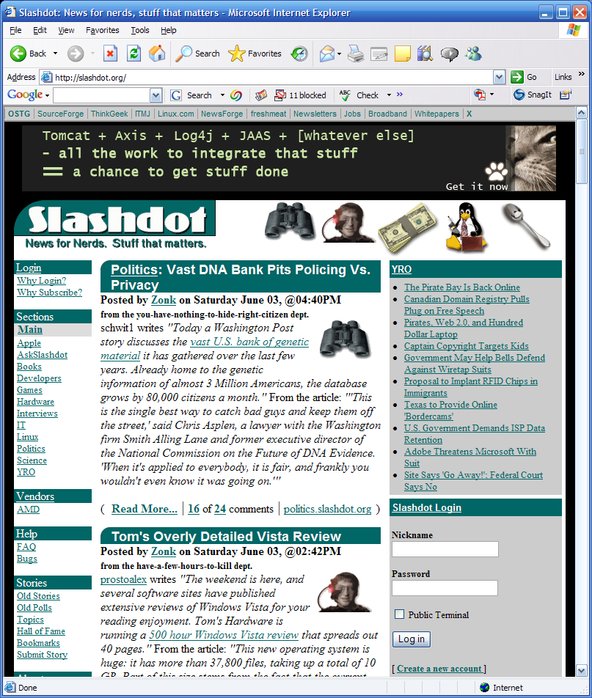
Spatial Shifts
modest sized movements
  banner ads

Slide 21
Spatial Shifts
modest sized movements
  banner ads
  modest typographic resizes

Slide 22
Landmarks
  specify visual landmark near information chunk

Slide 23
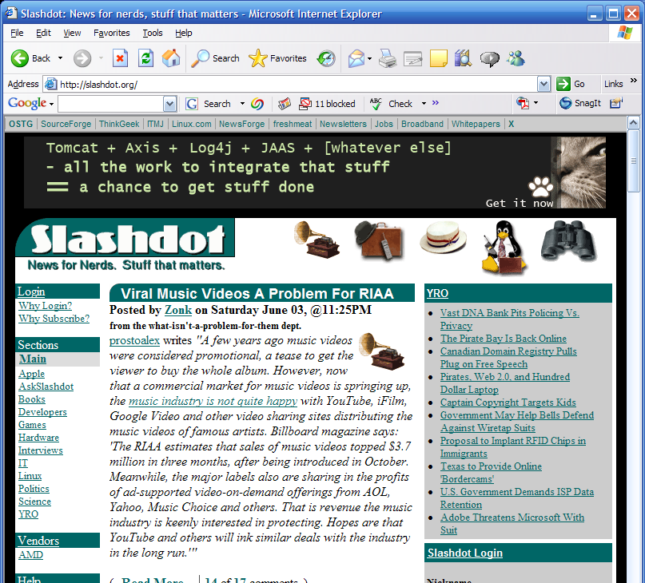
Landmarks
  specify visual landmark near information chunk
  search for that landmark and find information relative to it

Slide 24
Landmarks
Can have several landmarks

Slide 25
Images vs. HTML?
Images
  surface representation
  image editing
HTML Sugiura and Koseki UIST ‘98
  pattern matching
  machine learning
<TABLE cellSpacing=0 cellPadding=0
width=450 border=0>
<TBODY>
<TR>
<TD colSpan=2>
<P><STRONG>Jackrabbit1<BR>
</STRONG></P></TD>
<TD>
<P>&nbsp;</P></TD>
<TD colSpan=2>
<P><STRONG>Jackrabbit 2<BR></STRONG></P></TD></TR>
<TD>
<P>&nbsp;</P></TD>
<TD colSpan=2>
<P>
<STRONG>StandishCam<BR>
</STRONG></P></TD></TR>
…
Copy

Slide 26
Images vs. HTML?
Images
  surface representation
  image editing
  familiar
  data independent
  simple rendering (images, text)
  device independence easy
    cell phones…
  cut/paste/combine any region
  history
    video playback
    step-through
HTML Sugiura and Koseki UIST ‘98
  pattern matching
  machine learning
  unfamiliar
  data dependant
  difficult rendering (html + …)
  device independence hard
    special renderers
  hierarchical scope
  history
    hard as an html stream?

Slide 27
Images vs. HTML?
Images
  surface representation
  image editing
  sensitive to formatting, chronological & spatial moves
  changes from minor edits & typography
HTML Sugiura and Koseki UIST ‘98
  pattern matching
  machine learning
  tolerant (?) to formatting and spatial moves

Slide 28
Next steps
Empirically verify spatial regularities
Study
  how people exploit regularities to create custom notifications
  tolerance to errors

Slide 29
Summary
People can harvest changing image information from web pages to create rich notification histories
Software: http://www.cpsc.ucalgary.ca/grouplab/cookbook/

