Slide 1
interpersonal awareness in the domestic realm
Carman Neustaedter
Kathryn Elliot
Saul Greenberg
University of Calgary, Canada

Slide 2

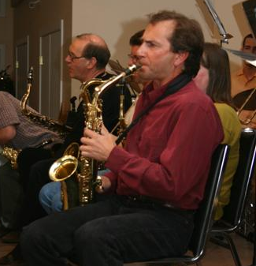
thank you!
Kathryn Elliot
Saul Greenberg

Slide 3
the message
a spectrum of design solutions is needed to address the awareness needs of families and friends
Notes:
---put this slide at the end as well----

Slide 4
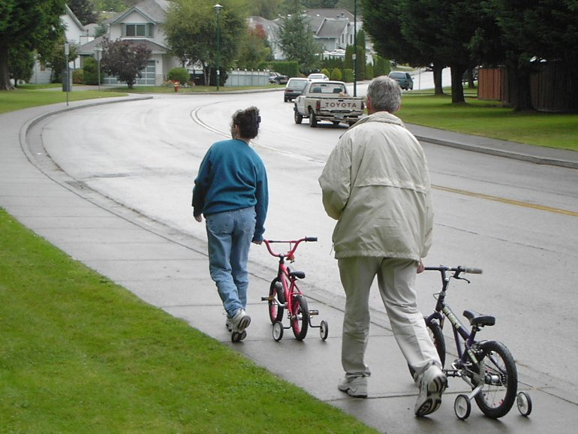
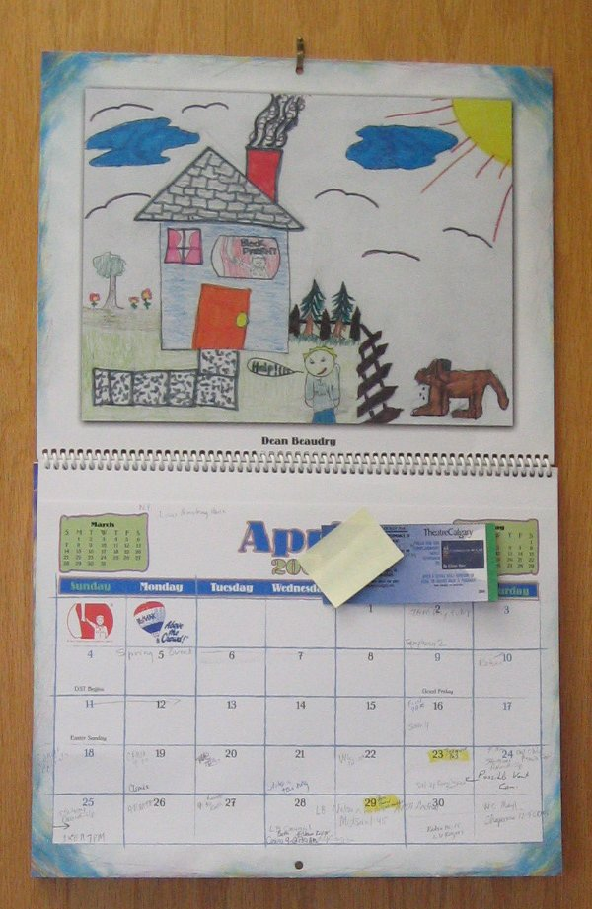

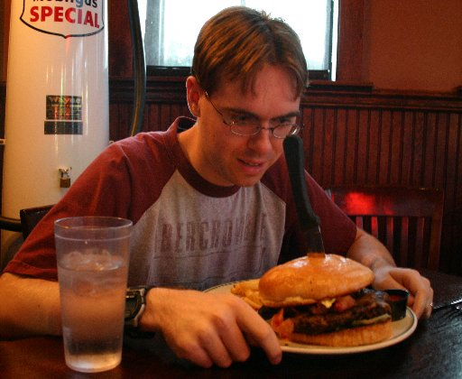
interpersonal awareness

Slide 5
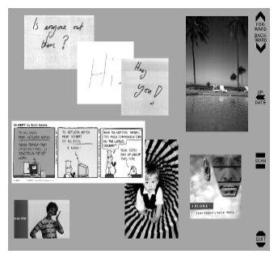
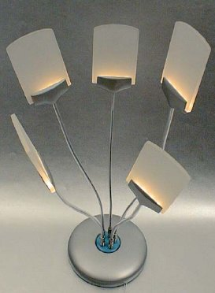
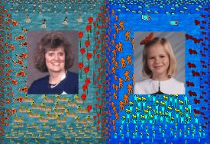
awareness in the domestic
Tollmar and Persson, 2002
Hindus et al., 2001
Mynatt et al., 2001

Slide 6
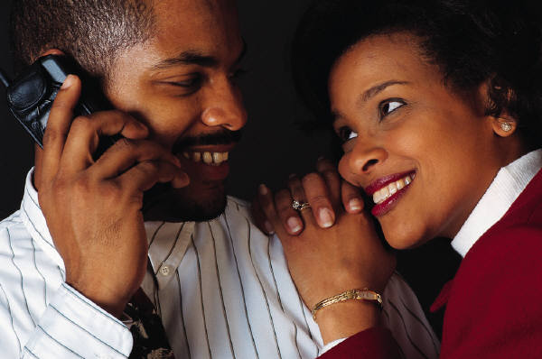
research questions
what is interpersonal awareness?
for whom is it desired?
how do people maintain it?
how to design?

Slide 7
exploratory study
investigate domestic routines
29 individuals from 10 households
paper exercises
contextual interviews
Notes:
The goal of our study was to find out what people currently do in their homes. This knowledge will help us know where technology can be of value, and what kind of characteristics such designs should have.
10 families (29 individuals) with various backgrounds and compositions – including roommates, common law couples, families, even children living under shared custody agreements.
Five participants were teenagers, sixteen were young-mid adults aged 20 to 39, and eight were middle-aged adults aged 40 to 60. We avoided participants under the age of thirteen, as we thought they would be best handled by a methodology better suited to the young. Particiapants came from a wide variety of backgrounds. All participants we at least moderately technically inclined.
We interviewed them in their homes. The interviews took about an hour, and involved 2 stages. The first was focused on awareness, and asked people to complete several exercises in order to help ground our interviews. The second phase was focused on information display, and asked people to show us everywhere in the home where they used communication information. We’re not going to go into our methodology in detail here, but if you are interested it is described in full detail in the two papers.
So next up is Carman, and he’s going to talk about the first part of our results in the area of interpersonal awareness.
-----awareness slides here-----

Slide 8
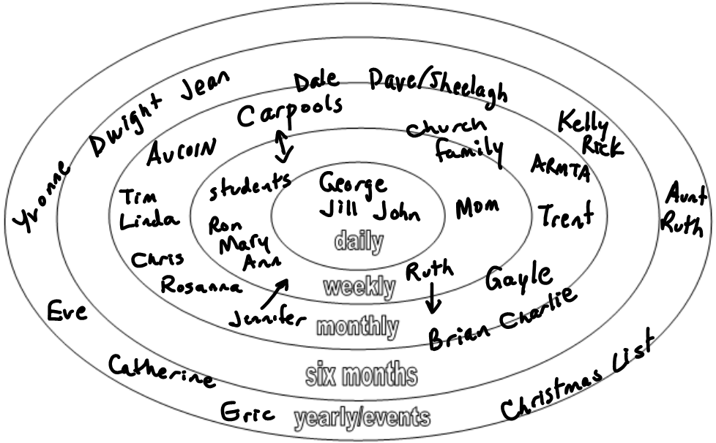
social target
Notes:
Awareness was loosely described to participants as a general sense of an individual’s whereabouts and activities.
People they wanted to stay aware of and how frequently.
Separate piece of paper to write down names / locations.

Slide 9
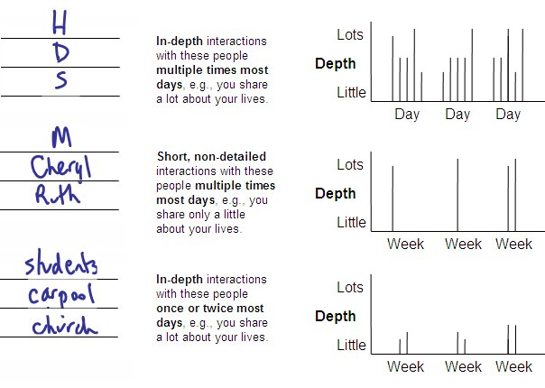
2: Interaction Frequency

Slide 10
individual interviews
awareness needs
maintenance techniques
challenges

Slide 11
key findings
social clusters
awareness information
awareness maintenance

Slide 12












social clusters
home inhabitants
extended socials
intimate socials

Slide 13
social clusters
home inhabitants
intimate socials
extended socials
necessary
low-level details
discretionary
high-level details

Slide 14
home inhabitants

Slide 15
social clusters
home inhabitants
intimate socials
extended socials
necessary
low-level details
discretionary
high-level details

Slide 16
intimate socials

Slide 17
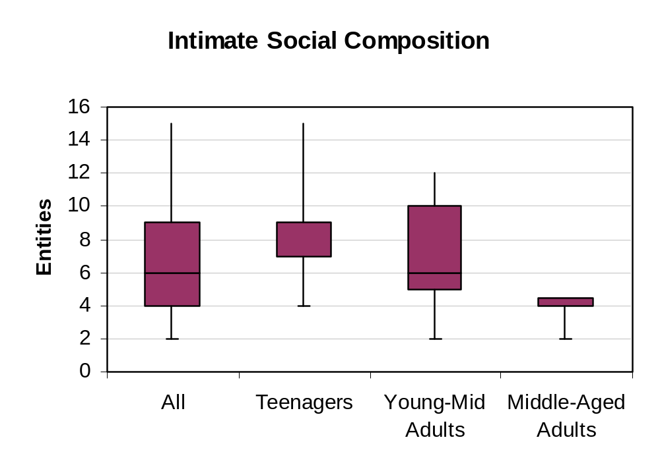
intimate socials
Notes:
in general people have four to ten individuals within their intimate social group for whom they have a strong need for awareness.
all participants was 6, teenagers was 9, young-mid adults 6, and middle-aged adults 4.
The higher number of intimate socials for teenagers can perhaps be attributed to their typical inclusion of immediate family members along with school friends.
Middle-aged adults generally had fewer intimate socials than young-mid adults; most middle-aged adults in our study group had their own children, and their intimate socials typically contained only immediate family members, e.g., a partner and children.
large range for young-mid adults suggests that the number of intimate socials for this group is mostly based on personal preference.

Slide 18
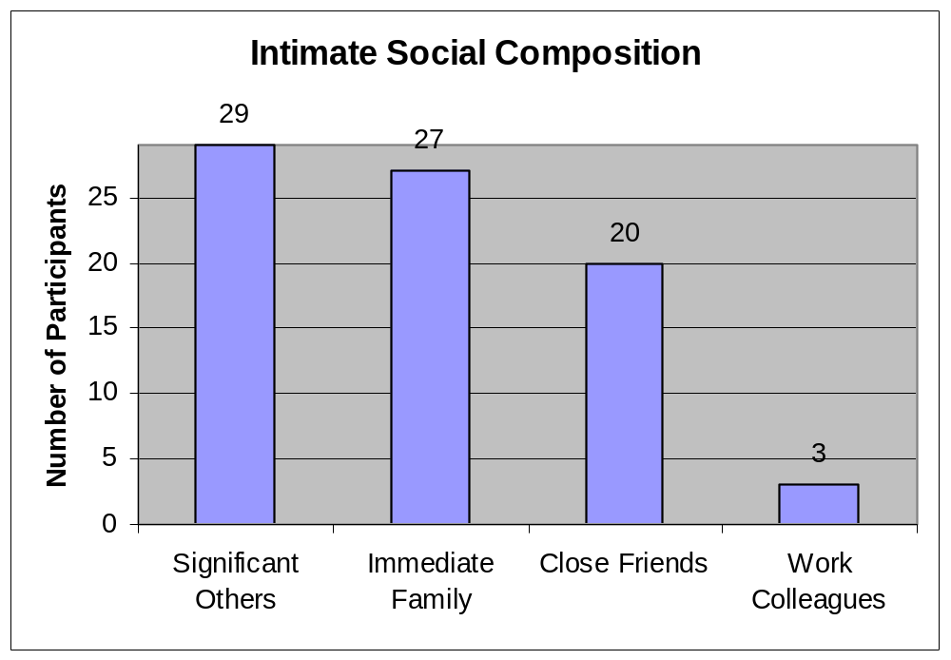
intimate socials
Notes:
CHANGES
PROXIMITY
Home inhabitants were included by all but one participant, and some included only home inhabitants in this group.
Significant others, e.g., husband/wife, fiancé(e), girl/boyfriend, were included by all participants as an intimate social.
Immediate family members—parents, siblings, and children – were included by all but two participants. One individual, who listed only two intimate socials, preferred little family contact. The other was a grade twelve student who, because of his age, preferred awareness of friends over family.
Close friends were included by almost three-quarters (72%) of participants.
Work colleagues were included by only three people.
in general people are intimate socials because they share a close personal relationship, usually being family members, or close friends. A lack of proximity makes it more difficult for someone to be an intimate social member, but it does not prevent it.
the composition of one’s intimate social network is generally only affected by life changes.
A strong need to maintain awareness of an intimate social does not necessarily imply a frequent need.
We conclude that in general, people desire daily awareness of most intimate socials, yet a daily awareness does not make someone an intimate social.

Slide 19
social clusters
home inhabitants
intimate socials
extended socials
necessary
low-level details
discretionary
high-level details

Slide 20
extended socials

Slide 21
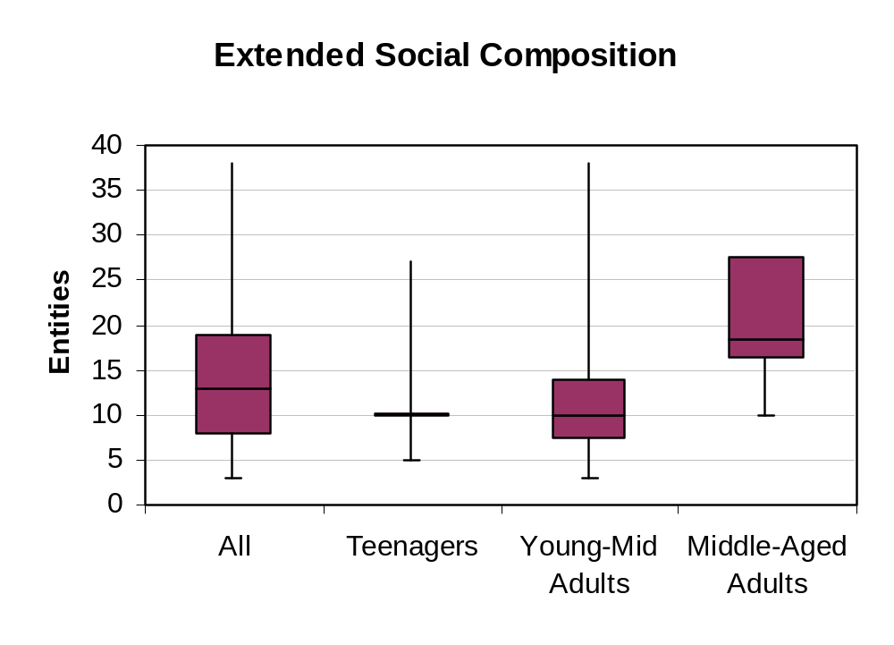
extended socials
Notes:
The median for all participants was 13, teenagers was 10, young-mid adults 10, and middle-aged 18.5. These numbers suggest that as one ages, the number of extended socials for which awareness is desired increases; middle-aged adults tended to list more extended socials than the other age groups.
in general people want to maintain awareness of three to twenty-eight extended socials, but their need for awareness of these people is discretionary.

Slide 22
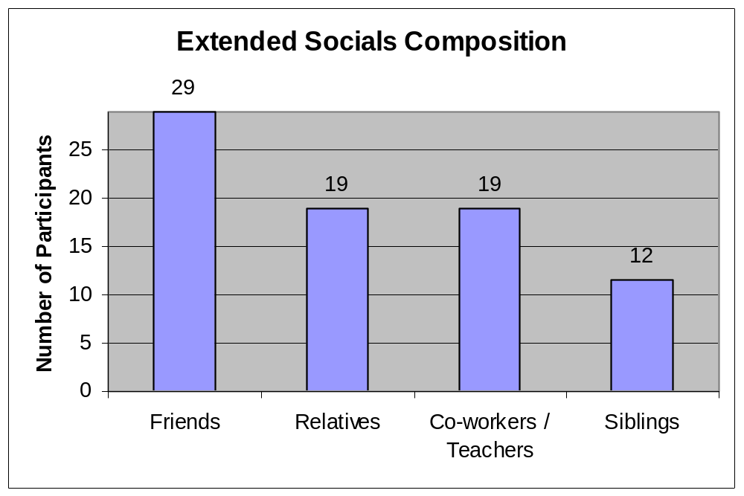
extended socials
Notes:
STATIC
MORE AWARENESS THEN ABLE TO MAINTAIN
All participants included friends as extended socials, about two-thirds (66%) included co-workers/teachers, two-fifths (41%) included siblings, and about two-thirds (66%) included other relatives.
Participants reported that the composition of extended socials is relatively static over time. This was mostly the case because of an inclusion of many family relatives as extended socials.
Changes to the extended socials group were normally a result of changes to the intimate socials group; if participants grew apart from any of their intimate socials, these individuals would typically become extended socials.
We conclude that in general the extended social group is fairly static, but can be affected by changes to the intimate social group.
We conclude that in general the frequency of desired awareness for extended socials differs depending on the person, yet most people desire more frequent awareness for these people then they are able to maintain.

Slide 23
awareness information
location
activity
status
coordination
comfort/connected
shared knowledge

Slide 24

awareness of location
home inhabitants: detailed daily

Slide 25
awareness of location
intimate socials: less detailed / every few days

Slide 26

awareness of location
extended socials: even less detailed / monthly

Slide 27
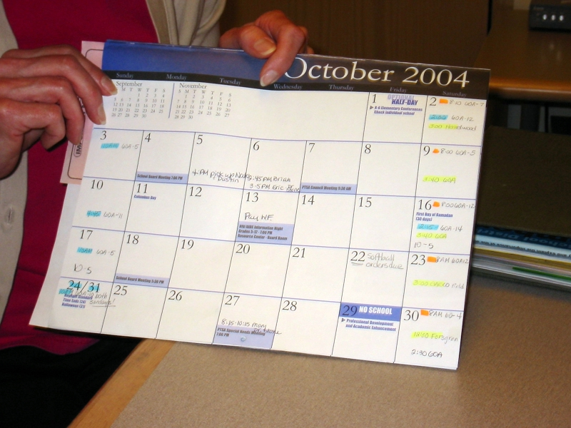
awareness of activity
home inhabitants: current and upcoming

Slide 28

awareness of activity
intimate socials: less detailed, past or upcoming

Slide 29

awareness of activity
extended socials: major life events

Slide 30

awareness of status
home inhabitants: about most aspects

Slide 31
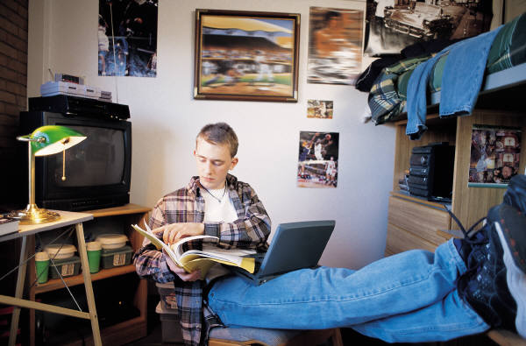
awareness of status
intimate socials: selected things

Slide 32
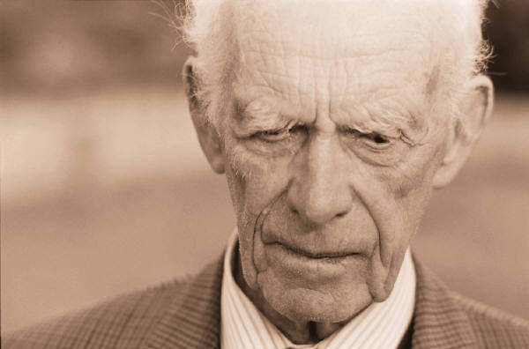
awareness of status
extended socials: health

Slide 33
awareness maintenance
visual cues from domestic artifacts
direct interaction
mediated interaction

Slide 34
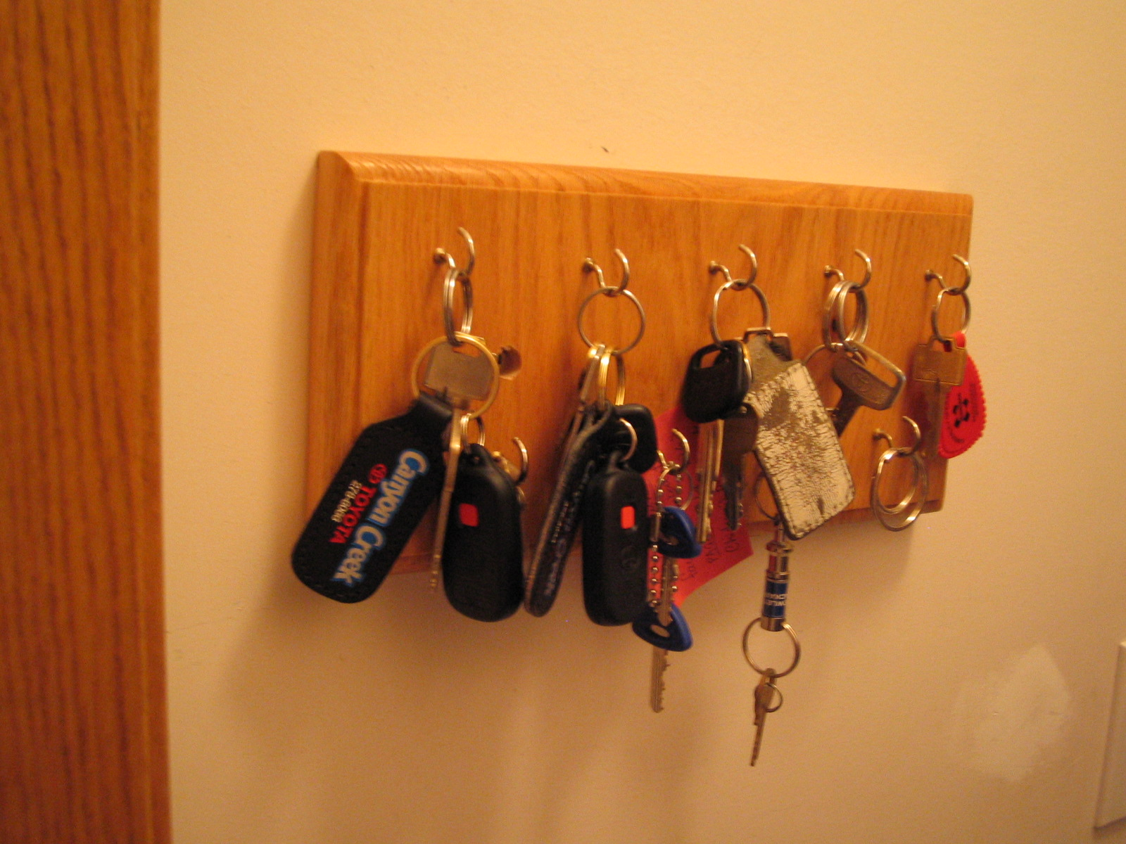
visual cues from domestic artifacts

Slide 35
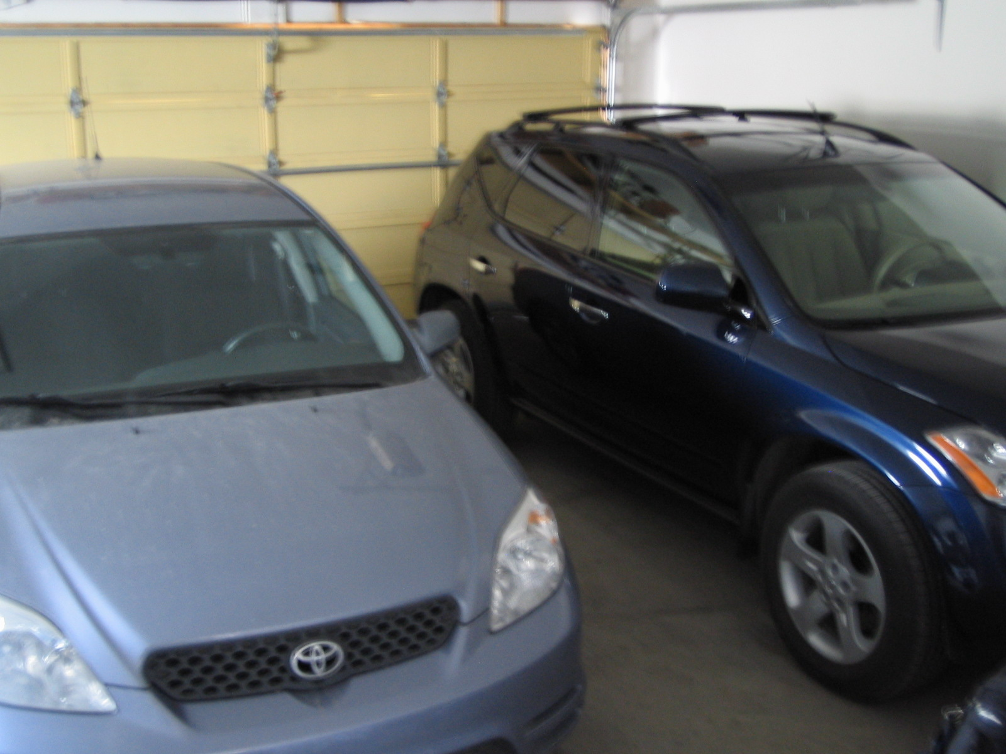
visual cues from domestic artifacts

Slide 36
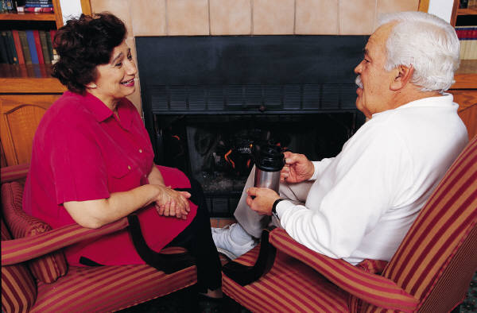
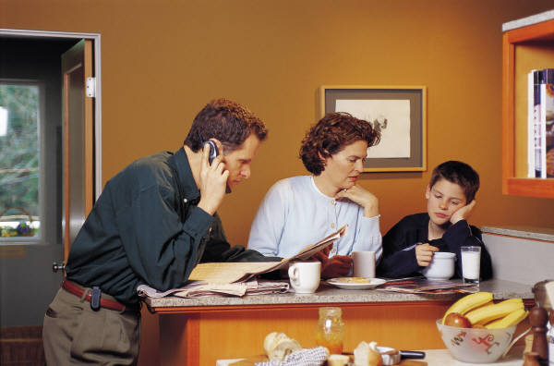
direct interaction

Slide 37



mediated interaction

Slide 38
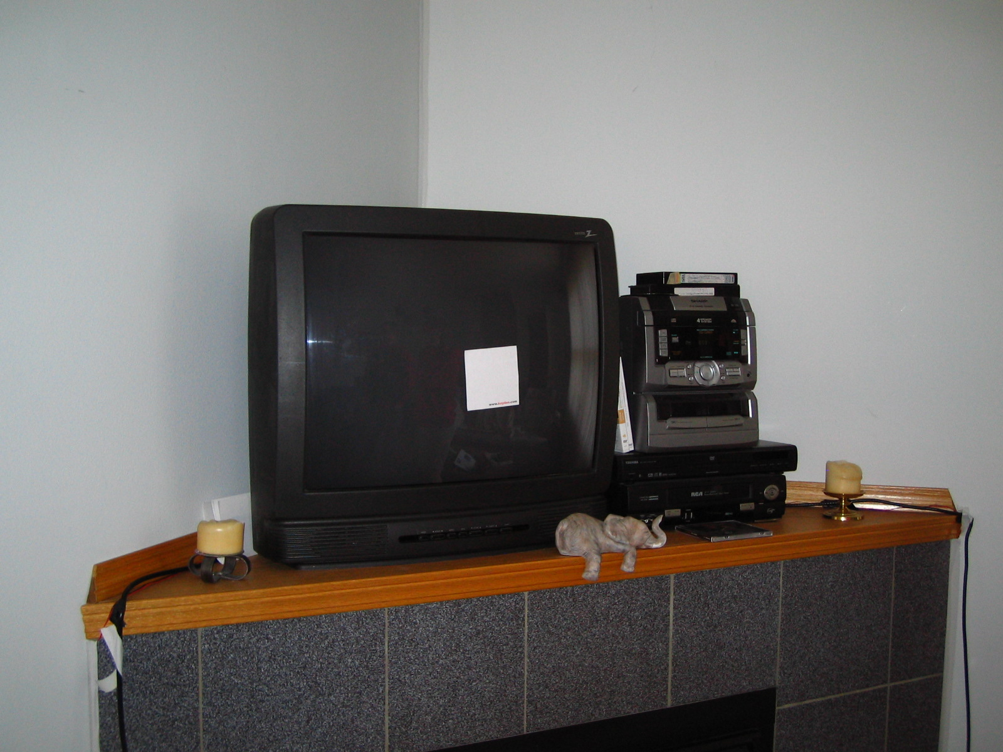
mediated interaction

Slide 39
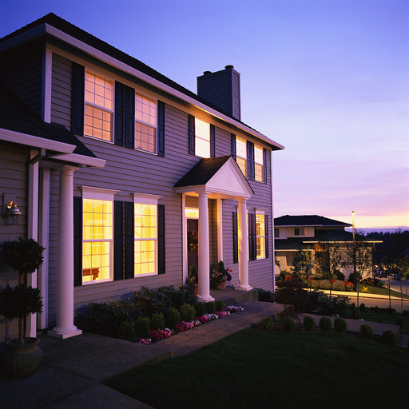

challenges: time separation
Notes:
While the use of direct interaction techniques to gain awareness may not appear to be problematic, these techniques limit the awareness information that is made available to people, the amount of people with whom a person can maintain awareness, and makes it especially difficult or expensive (e.g., long distance phone bills) to maintain over distance. Moreover, technologies that are used by people to gather interpersonal awareness (e.g., email, instant messenger) were not specifically designed with awareness in mind. Rather, they were designed to support interaction.

Slide 40



challenges: distance separation
Notes:
While the use of direct interaction techniques to gain awareness may not appear to be problematic, these techniques limit the awareness information that is made available to people, the amount of people with whom a person can maintain awareness, and makes it especially difficult or expensive (e.g., long distance phone bills) to maintain over distance. Moreover, technologies that are used by people to gather interpersonal awareness (e.g., email, instant messenger) were not specifically designed with awareness in mind. Rather, they were designed to support interaction.

Slide 41
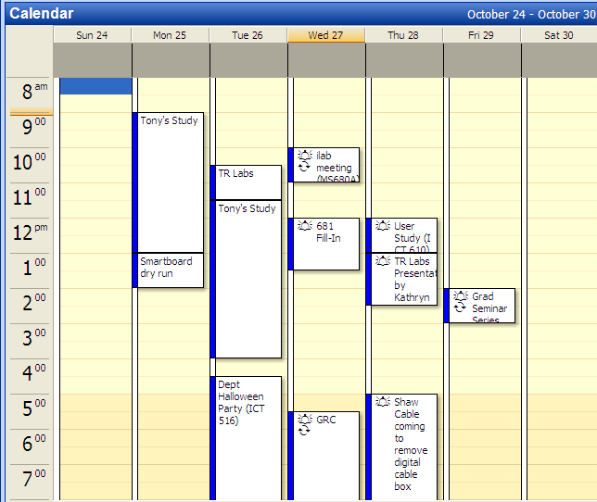
challenges: time limitations
Notes:
While the use of direct interaction techniques to gain awareness may not appear to be problematic, these techniques limit the awareness information that is made available to people, the amount of people with whom a person can maintain awareness, and makes it especially difficult or expensive (e.g., long distance phone bills) to maintain over distance. Moreover, technologies that are used by people to gather interpersonal awareness (e.g., email, instant messenger) were not specifically designed with awareness in mind. Rather, they were designed to support interaction.

Slide 42
implications for design
home inhabitants
intimate socials
extended socials
necessary
low-level details
discretionary
high-level details

Slide 43
implications for design
home inhabitants
intimate socials
extended socials
current, upcoming
location, activity

Slide 44
implications for design
home inhabitants
intimate socials
extended socials
current, upcoming
location, activity
past, upcoming
location, activity, status

Slide 45
implications for design
home inhabitants
intimate socials
extended socials
current, upcoming
location, activity
past, upcoming
location, activity, status
past
status

Slide 46
reflect on existing designs
Tollmar and Persson, 2002
Hindus et al., 2001
Mynatt et al., 2001

Slide 47
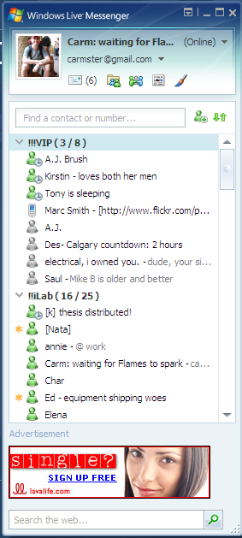
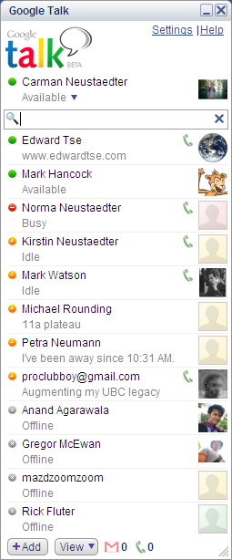
analyze awareness systems

Slide 48
the message
a spectrum of design solutions is needed to address the awareness needs of families and friends
Notes:
---put this slide at the end as well----

Slide 49
thank you
Carman Neustaedter
Kathryn Elliot
Saul Greenberg
http://grouplab.cpsc.ucalgary.ca

