Slide 1


Providing Artifact Awareness to a Distributed Group through Screen Sharing
Kimberly Tee, University of Calgary
Saul Greenberg, University of Calgary
Carl Gutwin, University of Saskatchewan
Notes:
Hi, I’m Kim, and I’ll be presenting our paper on Providing Artifact Awareness to a Distributed Group through Screen Sharing. This is work done in collaboration with Saul Greenberg at the University of Calgary and Carl Gutwin from the University of Saskatchewan.

Slide 2
Overview
background & motivation
Community Bar
screen sharing for awareness
screen sharing within Community Bar
Notes:
I’ll start off talking first about the background and motivation behind our project. I’ll then do a brief overview of Community Bar, talk about screen sharing for awareness, then describe our system for screen sharing within the Community Bar.

Slide 3
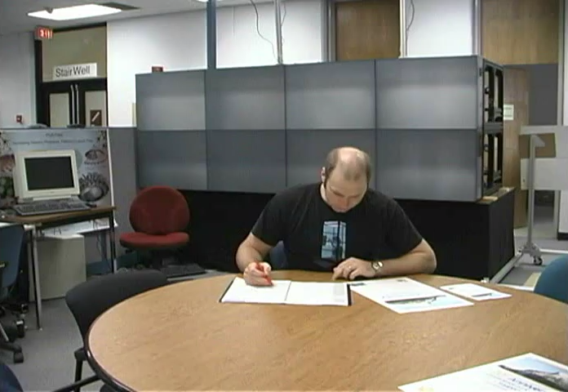
Motivation
Note: a video of this scene was shown at the conference
In a co-located environment
Notes:
This short video clip illustrates some of the motivation behind our project.
In the everyday world, people naturally see what others are working on as they glance around, walk by, or are invited to take a closer look. Being able to see who is around and what they are working on creates opportunities for conversation and collaboration. Sometimes, seeing artifacts such as documents or pictures on another’s desk can also trigger conversation.

Slide 4
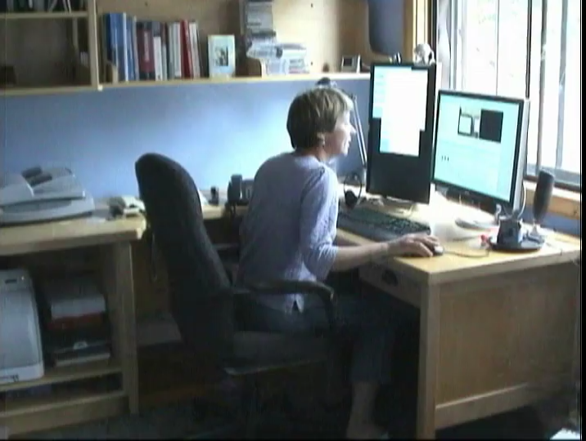
Motivation
Note: a video of this scene was shown at the conference
Working from another location
Notes:
Awareness is harder for distributed groups, though. When people are working together from different locations, it can be difficult for them to get a sense of who is available and what others are working on.
They don’t have the same cues that co-located people get, so it’s harder for them to move into interaction.

Slide 5
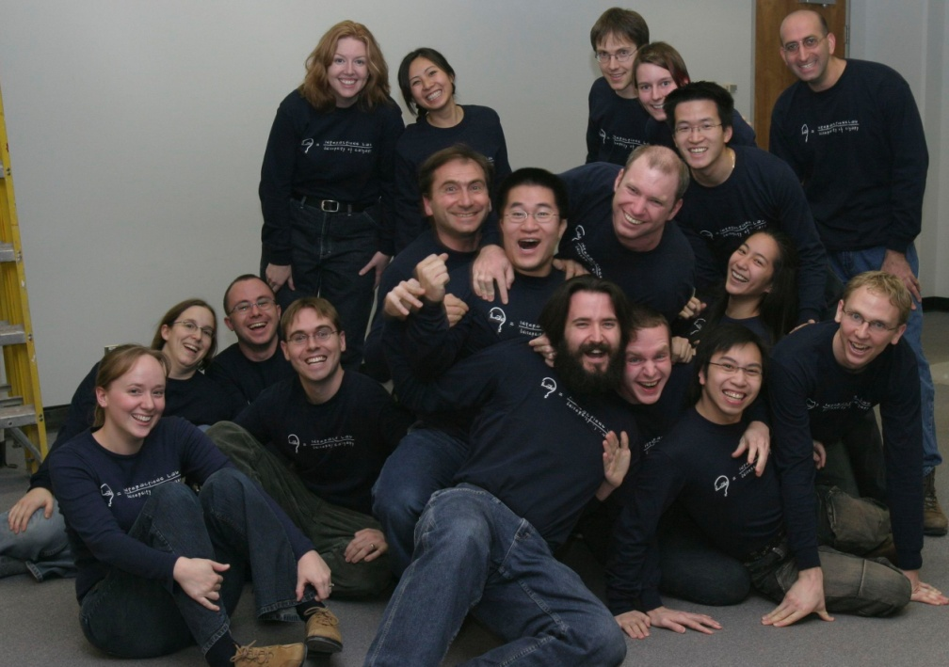
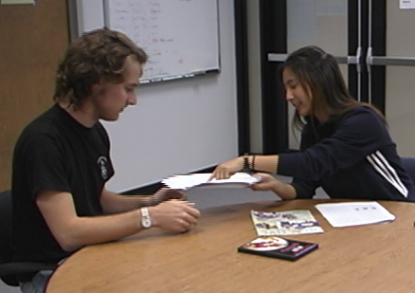
Group Culture
intimate collaborators
share knowledge, information
a community
Notes:
So, as seen in the video, the kind of group that we’re interested in is a group of intimate collaborators, or people who have a real need or desire for close coordination, collaboration, and social interaction.
This is a group that commonly shares knowledge and public information about themselves.
Basically, they make up a community of people who help each other out and work closely together.

Slide 6
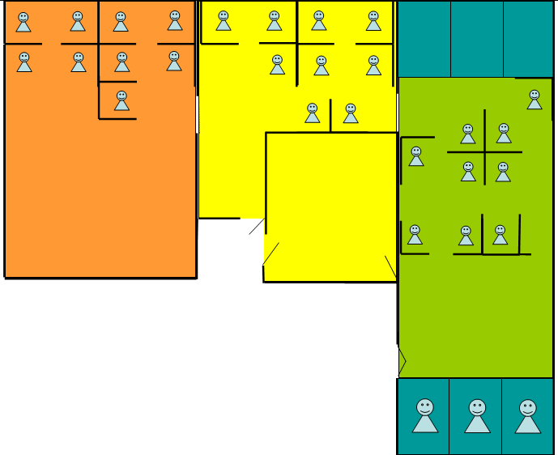
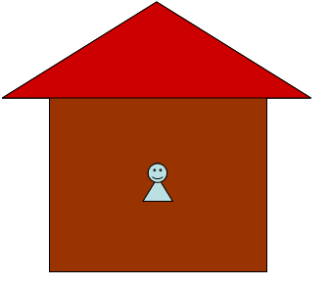
Members’ Location
co-located or distance-separated
Notes:
Group members can be co-located or distance-separated. For example, here is a diagram of our lab, spanning 3 rooms. People in each room can’t necessarily see the people in other rooms when they’re sitting at their desks, but they can walk around and see what’s going on.
Some people even work from home, or from other cities.
Basically, we’re interested in supporting awareness and interaction between these types of groups.

Slide 7
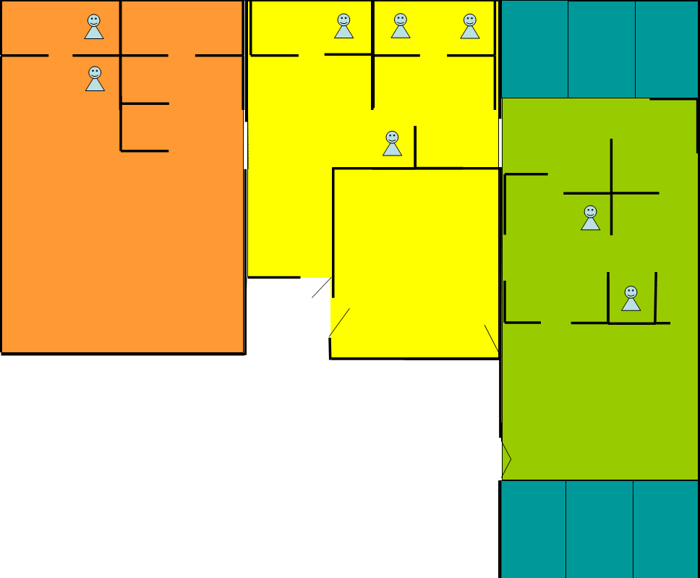
Members’ Location
co-located or distance-separated

Slide 8
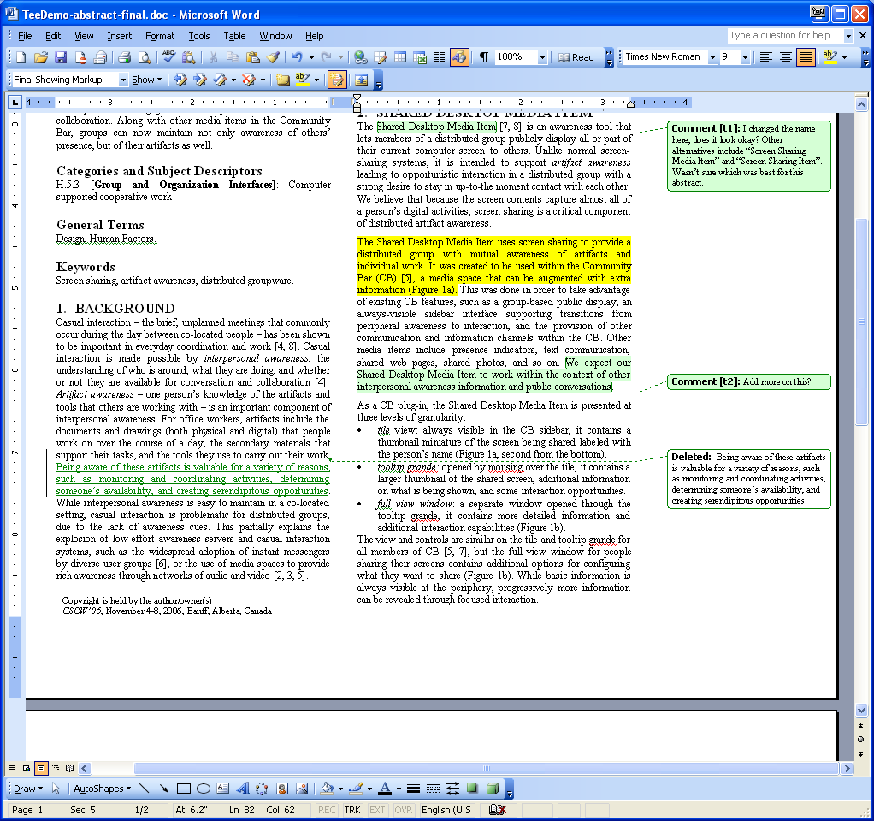
Artifact Awareness
what are they working with/on?
Notes:
Specifically, we are interested in providing artifact awareness to people, or knowledge of the artifacts and tools that others are working with or on.

Slide 9

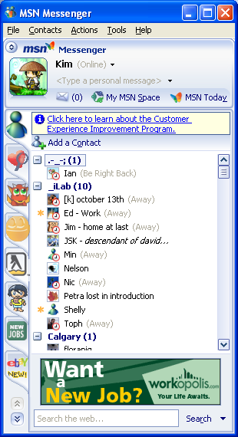
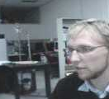
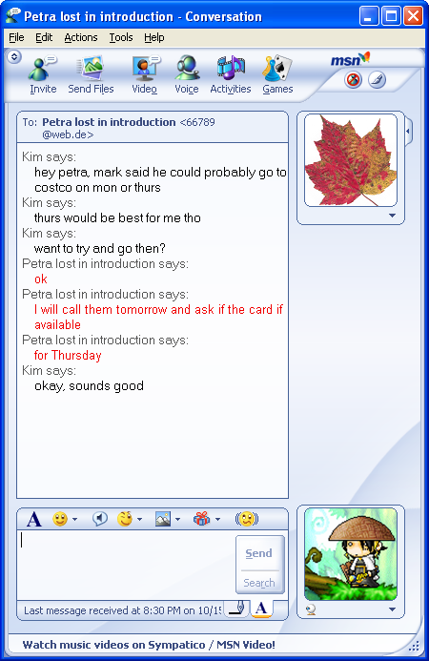
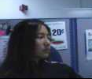
Awareness and Casual Interaction Systems
Instant Messaging Media Spaces
Notes:
Of course, many groupware systems have been designed to support awareness, particularly awareness of people.
Instant messaging has become very popular in the last few years. It generally provides status indicators of whether a person on a buddy list is logged on, busy, away, or off-line. If a “buddy” is online, it’s easy to start a text chat conversation with them. While IM systems provide only basic awareness, they make casual interaction easy.
Media spaces provide rich awareness by linking offices and public spaces through always-on video. People can see who is around and sometimes what they are doing from the video.
Both these types of groupware are about awareness of people – not of their artifacts.

Slide 10

Community Bar
augmented media space
  awareness of people and artifacts
  transitions from awareness to interaction
McEwan, G. and Greenberg, S. (2005). Supporting Social Worlds with the Community Bar.
Notes:
There are also systems that let people post information. One example from our lab is Community Bar, a media space that can be augmented with extra information, such as photos or text chat conversations. Community Bar provides awareness of both people and artifacts, and supports transitions from awareness to interaction.
We’re going to use Community Bar later, so I’m going to show you a video of how it works.

Slide 11
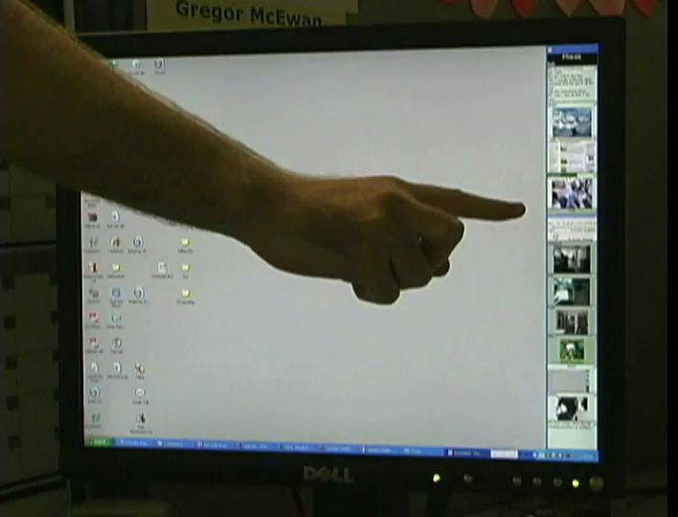
Note: a video of this scene was shown at the conference
Notes:
Community Bar is an example of a media space that can be augmented with extra information, such as photos or text chat conversations. I’ll show a short video now of how it works.

Slide 12
Community Bar Recap
augmented media space with:
  various media items
  group awareness and communication
  transitions
    from awareness
    to exploration
    to interaction
McEwan, G. and Greenberg, S. (2005). Supporting Social Worlds with the Community Bar.
Notes:
For a quick recap, CB is an augmented media space. It has media items for information and communication. Everyone in the same group sees the same information. And, people can transition from awareness, to exploration, to interaction.
As you can see, CB is not just about awareness of people, but also of some of their artifacts.

Slide 13
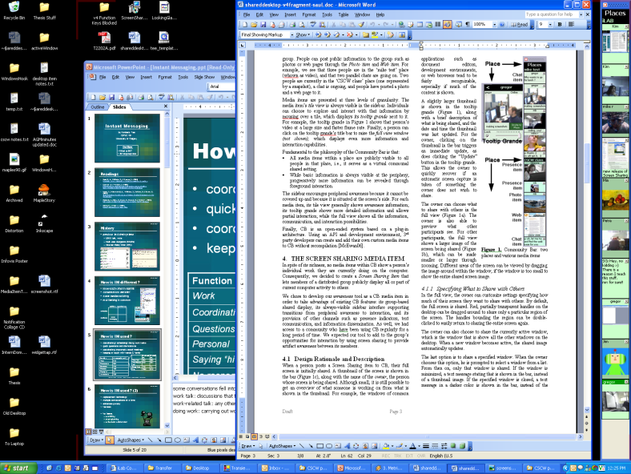

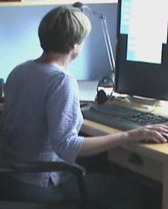
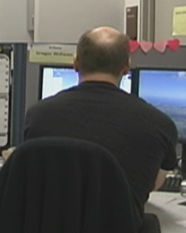
Screen Sharing
share a computer screen/window
What the person sharing sees
What the remote person sees
Notes:
Another way of sharing artifacts is through screen sharing. Basically, screen sharing happens when one person shares their screen or a window with another person, so that both people see the same thing.
Screen sharing is commonly used in desktop conferencing for letting people meet and work together from their own offices.

Slide 14
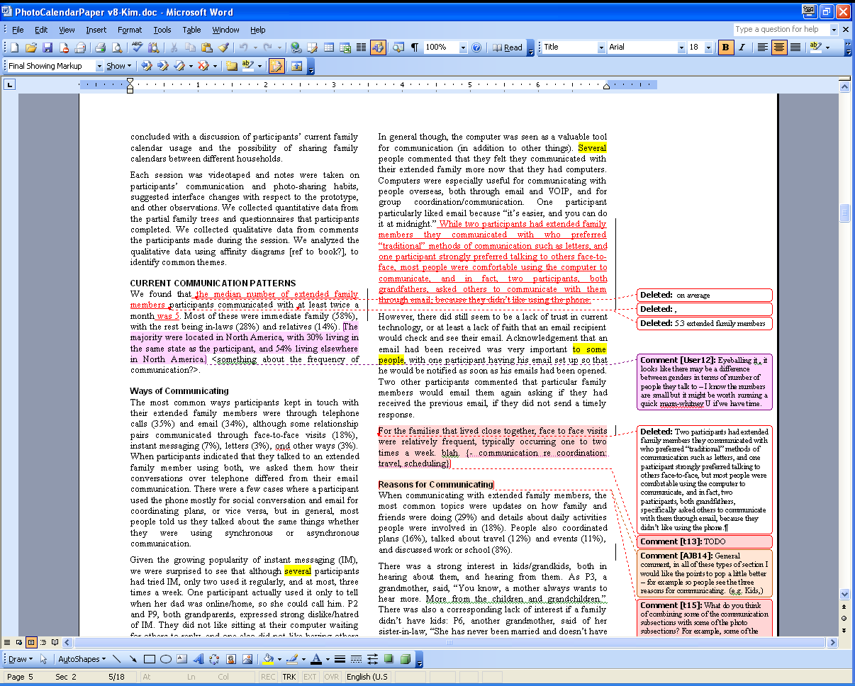

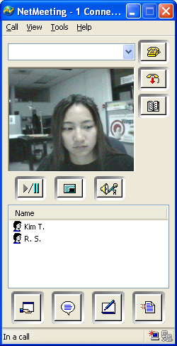
The Problem
people lack awareness of others’ artifacts
Notes:
The problem is that in spite of all the existing awareness and casual interaction systems, distributed groups still lack the easy awareness of others’ artifacts that is normally found in a co-located environment.
IM and media spaces show awareness of people, not artifacts.
In Community Bar, the artifacts being shared are all things that people have to explicitly post, and the artfiacts are also not about someone’s work.
Existing screen sharing systems are designed for focused interaction, rather than artifact awareness leading to casual interaction.
There are groupware systems such as netmeeting, shared editors, and webcast meeting tools that do let a distributed group share artifacts, but they work only after interaction is initiated. That is, they are intended for focused collaborative work rather than artifact awareness.

Slide 15


Insight
use screen sharing
  intimate collaborators
  work primarily on computers
Notes:
for groups of intimate collaborators
who work primarily on computers, because the screen contents capture almost all of a person’s digital activities
Saul, Carl, and their collaborators have done a proof-of-concept prototype of this idea before as part of their communityware project, but this work takes a different approach and looks at providing awareness through screen sharing in more detail.

Slide 16
Artifact Awareness with Screen Sharing
see what others are working on
  coordinate & track joint work
  start up discussion
  offer or ask for help
  discover common interests
Notes:
A lot of work has been done in CSCW on awareness and casual interaction such as by Kraut et al. and Whittaker et al., so we know that awareness leading to casual interaction can have a number of benefits. By using screen sharing to provide artifact awareness, people will be able to see what others are working on and looking at, and potentially share knowledge with each other as well as build relationships.
ex. If I share my screen with others, they will be able to see that I’m programming a screen capturing system. Later on, if they need to capture screen images in their own program, perhaps they may remember that I was working on this before, and that I would be a good first person to go to for help.

Slide 17
Screen Sharing Awareness Tool
design rationale
description
initial experiences
Notes:
In the next few slides, I will talk about the screen sharing awareness tool we developed, and describe the initial experiences people had when using it.

Slide 18
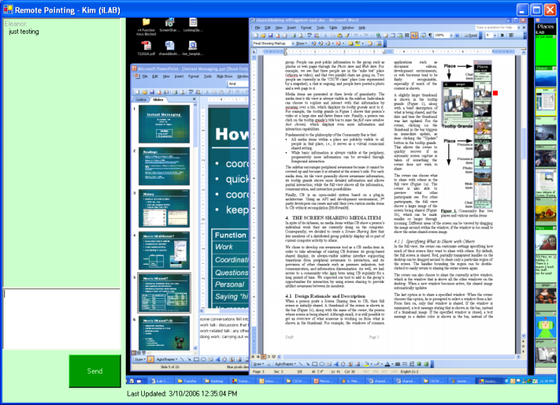
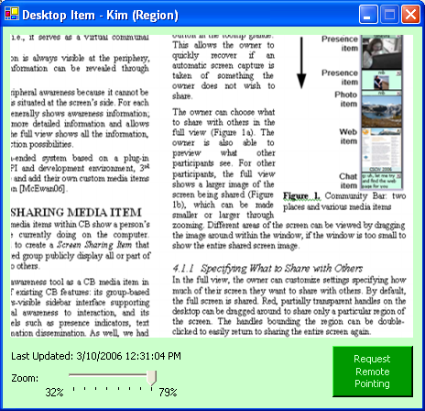
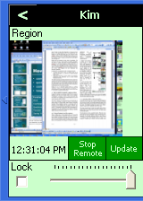
Screen Sharing Item
displays people’s current screens
awareness
exploration
interaction
Notes:
We decided to create a screen-sharing tool within the Community Bar, because we wanted to take advantage of a number of existing CB features:
CB already has various channels for information and communication, such as the text chat media item
everyone in the same group in CB sees the same information
CB’s sidebar interface is always visible, helpful for providing peripheral awareness
and, CB already supports natural transitions from awareness to exploration to interaction
The screen sharing item we created displays all or part of people’s current computer screens. There are varying levels of information and interaction possibilities available. I will now show you a short video describing our screen sharing item.

Slide 19
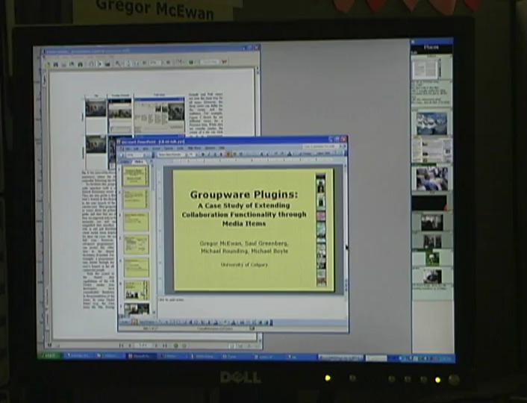
Note: a video of this scene was shown at the conference

Slide 20

Screen Sharing Item Recap
displays people’s current screens
others can:
see thumbnails
view more detail
point at artifacts
Notes:
see thumbnails of shared screens in the bar or expanded view
zoom and pan in the larger view to see shared screens in more detail
discuss and point at artifacts in the remote pointing view

Slide 21
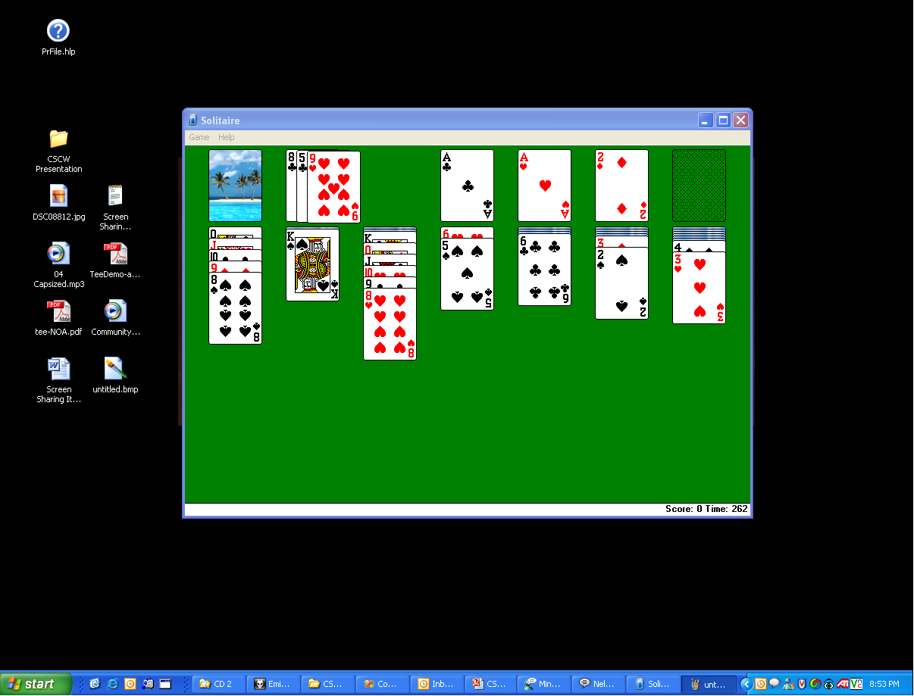
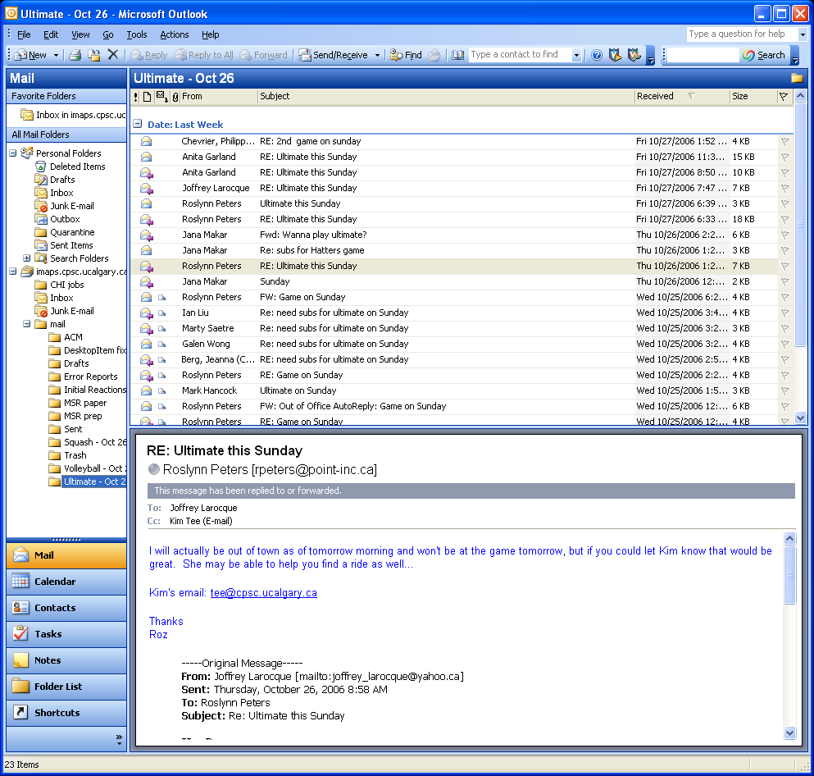
Privacy
balance awareness with privacy needs
Notes:
Naturally, privacy is a concern in an always-on screen sharing system. The challenge is how people can balance the awareness information they want others to have of their work with their own privacy needs.
What I want you to see in this next video clip is that we have controls and feedback for helping people share awareness information while preserving some of their privacy.

Slide 22
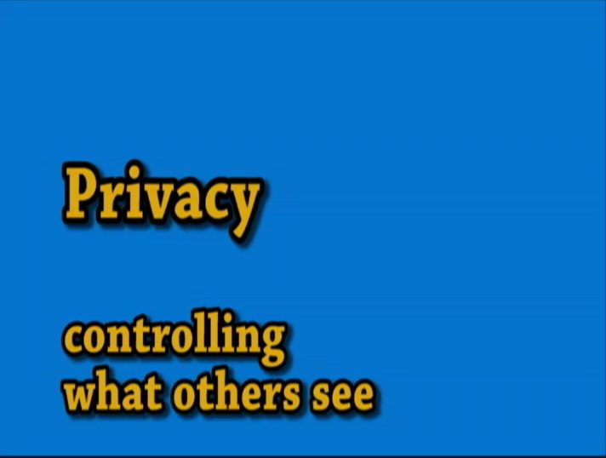
Note: a video of this scene was shown at the conference

Slide 23
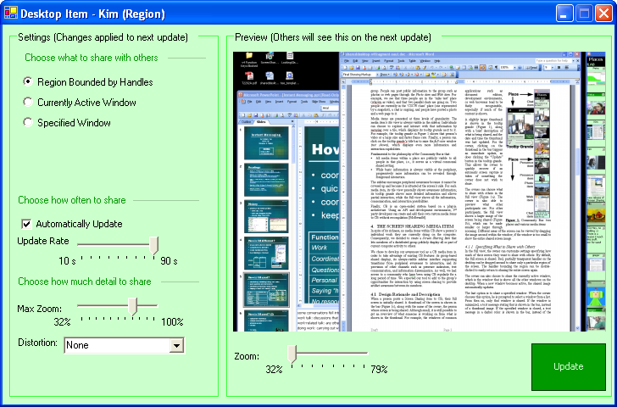
Privacy Controls Recap
specify:
  how often
  how much
  what parts
feedback
control what others see
feedback
Notes:
We also provide feedback; first, if I choose to update my shared screen image automatically, my tile in my bar is outlined in yellow 5 seconds before an image is captured. The outline disappears once the screen has been captured.

Slide 24
Privacy Controls Recap
specify:
  how often
  how much
  what parts
feedback
control what others see
feedback
Notes:
Not shown in the video, if someone else looks at my shared screen in the full view where they can see a lot of details, my tile in my bar is outline in red.

Slide 25
Privacy Controls Recap
specify:
  how often
  how much
  what parts
feedback
control what others see
feedback

Slide 26
Initial Experiences
ten Community Bar users
  students, faculty currently in research group
  former lab members working elsewhere
informal observations
  solicited comments
  interviews to discuss details
Notes:
We introduced the Screen Sharing item to ten CB users who had already been using CB on a daily basis for over a year.
Group members included grad students and faculty from our research lab, and former lab members currently working elsewhere. People worked from various locations, such as in the lab, from home, or from another location.
This was a group that was comfortable with sharing information about themselves with others, and felt that they benefited from sharing.
This was not a formal study; rather, we asked people for comments as they used the system over a two week period, and we interviewed several people to discuss details with them.

Slide 27
Key Experiences and Reactions
artifact awareness
presence awareness
opportunistic interaction
focused collaboration
privacy
Notes:
In the next few slide, I will give brief summaries of the key experiences and reactions we saw.

Slide 28
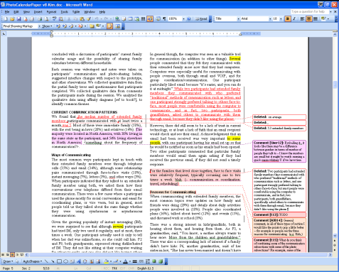
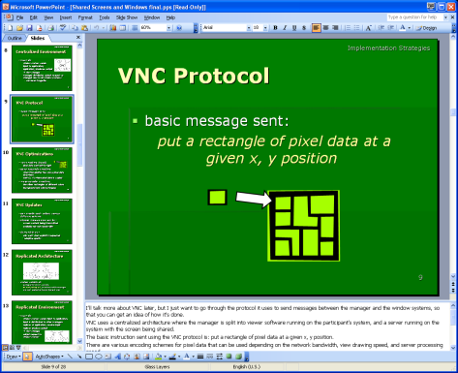
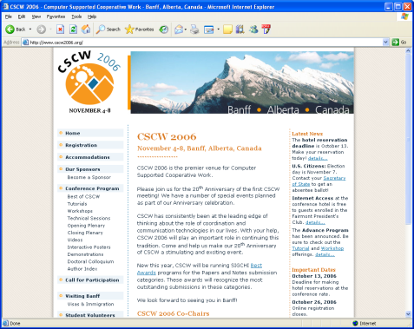
Artifact Awareness
people shared their work
can determine others’ availability
can track the progress of joint work
Notes:
In terms of artifact awareness, most people shared what they were working on, either by sharing their active window, or by sharing the region of their screen that they were working in.
Others commonly used this information to determine people’s availability, and to track the progress of joint work.
For example, several members of the group were writing papers during the deployment period. One person reported that he really liked being able to see when his co-author was working on their paper and, he especially liked seeing what section his co-author was working on, as well as roughly how many changes had been made, since they were using change-tracking.

Slide 29
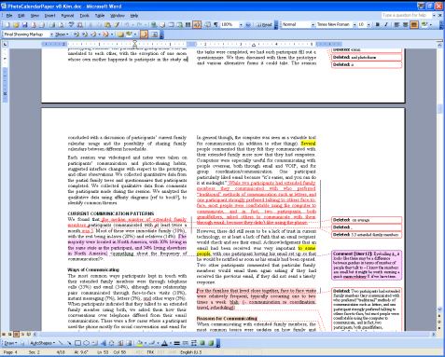
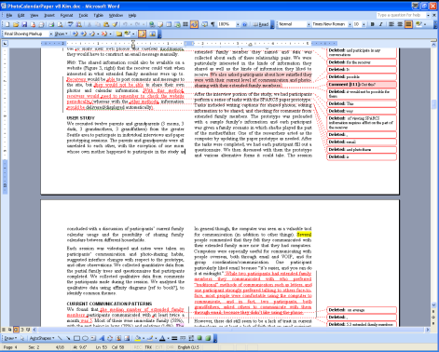
Presence Awareness
can tell when people are at their computer
Notes:
The Screen Sharing item also provided presence information; when the shared screen images were automatically updated, it was possible to tell when people were at their computers from seeing windows being moved around, pages being scrolled, and so on.

Slide 30
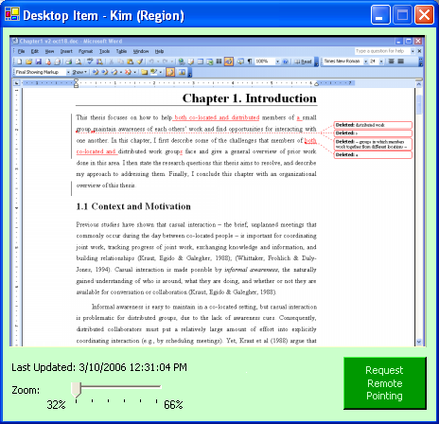

Opportunistic Interactions
conversations triggered by shared screens
some transitions to remote pointing
How is the paper going?
Notes:
Seeing others’ shared screens sometimes triggered conversations – these could be about work, when one member saw his co-author working on their paper, and asked how it was going.
They could also be more social, such as when another member saw some interesting-looking design images on someone’s desktop and asked about them. Conversations sometimes transitioned to remote pointing, when people wanted to discuss a particular artifact they saw on a shared screen.

Slide 31

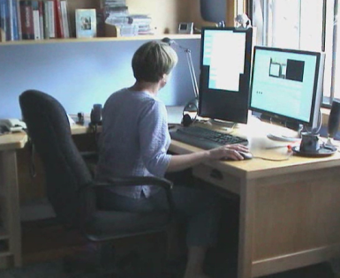
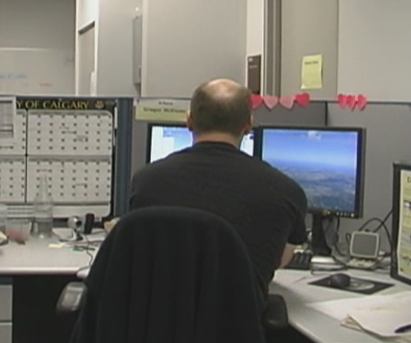
Focused Collaboration
remote pointing also used during an already-initiated conversation or meeting
I’ll show you where I’d like it in remote pointing.
Notes:
Remote pointing was also sometimes used during a conversation or meeting that was already happening. This is how existing screen sharing systems are typically used now, for focused collaboration. This is different from the previous case, where the conversation started as a result of what people saw in a shared screen.

Slide 32
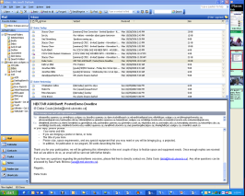
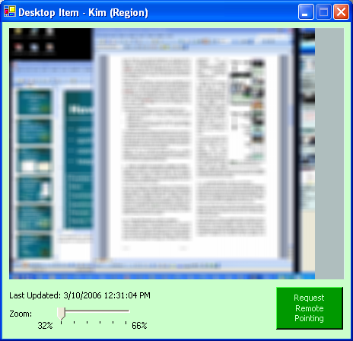
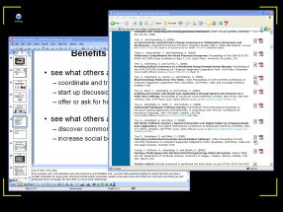
Privacy
common strategies:
concerns:
  seeing too much
  sharing screen (still)
Notes:
People adopted different strategies for protecting their privacy while sharing screens.
Because most members of the group had two monitors, many chose to separate public and private information onto different displays, and just share the public one. Some people already typically kept things like email on one display and did work on the other, so separating information this way came naturally to them, and studies such as Grudin’s have shown this before.
Some people chose to blur the screen image they shared so that text in windows wasn’t legible to others, particularly when they were sharing their active window or if they were working with private data. People also tended to limit the amount that others could zoom in on their desktop. If people moved into conversations or remote pointing about a shared artifact, they would increase the amount others could zoom in. After these discussions, they would then decrease the zoom level again.
The feedback, particularly the auto-update warnings, were found to be very useful for helping people mitigate what others were seeing.
In most cases, people had no problems using the Screen Sharing item, but there were a couple of concerns relating to privacy.
First, there was some concern at times that people were seeing too much on others’ screens. For example, one person reported being a bit uncomfortable being able to see all the details of what others were working on. This was interesting because the viewer was more uncomfortable than the person sharing.
There were also people who were not comfortable sharing their screens using the Screen Sharing item, even with the privacy controls and feedback.

Slide 33
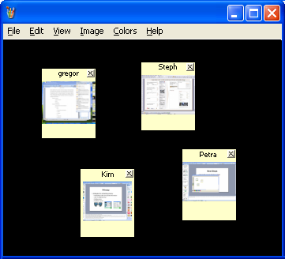
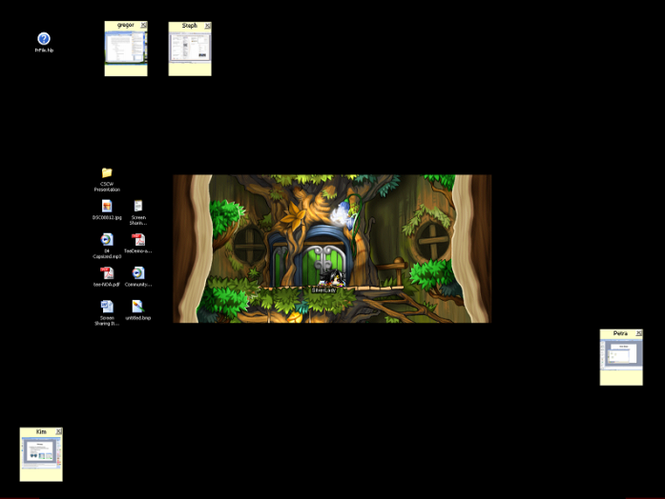
Next Steps
audio channel
link to full screen sharing system
explore different views
outside use & evaluation
Notes:
Our next steps include adding an audio channel so that people can interact more naturally when discussing artifacts and linking the Screen Sharing item to a full screen sharing system in order to provide a more complete transition from awareness to full groupware.
We’d also like to explore different ways of presenting the shared screens – using Community Bar is one way to show shared screens, but you could imagine also having something like a stand-alone interface, or have icons or gadgets on a desktop.
We would also like to deploy the system to outside groups in order to evaluate how they adopt it for their own use.

Slide 34
Summary
Screen sharing can help people maintain awareness of what others are working on.
Notes:
In this presentation, I have shown you how screen sharing can be used for awareness, and discussed some of the initial experiences that people had while using our system.
In summary, we believe that screen sharing can help people maintain awareness of what others are working on.

Slide 35




For More Information
Download and try our software! http://www.cpsc.ucalgary.ca/grouplab/cookbook/
Acknowledgements:
Gregor McEwan
Notes:
For more information and to download our software, please visit our webpage. We’ll also be giving demos tonight at the demo session so please drop by.
Thank you for your attention.

Slide 36
Behind the Scenes
Collabrary
  capturing region and window shots
  image manipulation
WindowsHooker
  detect mouse events across windows
WidgetTap
  find the active window
Piccolo
  panning and zooming
Notes:
Collabrary: for prototyping collaborative multimedia applications
WindowsHooker: provides “hooks” into Windows that lets you detect mouse and keyboard events in other applications
WidgetTap: for building alternative interfaces for applications without having to change their source code
Piccolo: for creating graphical applications with various visual effects such as zooming and animation

Slide 37
Discussion
Future Work
as a viewer:
  what do you want to see?
  how much information is too much?
  do you want to be notified if someone is working in a particular application?
  do you want a recent history of what someone has been working on?
as a sharer:
  how much control over what you share?
  what would you share?
  visual indication to indicate what you are sharing?
  times you don’t want to share?

Slide 38

Informal Awareness
who is around?
what are they doing?
are they available?
Notes:
First,

