Slide 1
Supporting Awareness in Mixed Presence Groupware
Anthony Tang & Saul Greenberg
University of Calgary
Notes:
Hi, my name is Anthony Tang. Today, I’ll be presenting some research that Dr. Saul Greenberg and I conducted at the University of Calgary concerning Mixed Presence Groupware. The purpose of this talk is to highlight an awareness disparity problem that is inherent in the design of these so-called “mixed presence groupware” systems.

Slide 2
Message
Groupware should allow collaborators to be aware of all participants equivalently.
Notes:
If there’s one thing I want you to remember from this talk, it’s this: that “Groupware needs to be designed to allow collaborators to maintain an equivalent level of awareness for all collaborators in the workspace.”
So, if you’re still awake, you’re thinking to yourself: “what is he talking about,” – most groupware represents everyone equivalently.

Slide 3
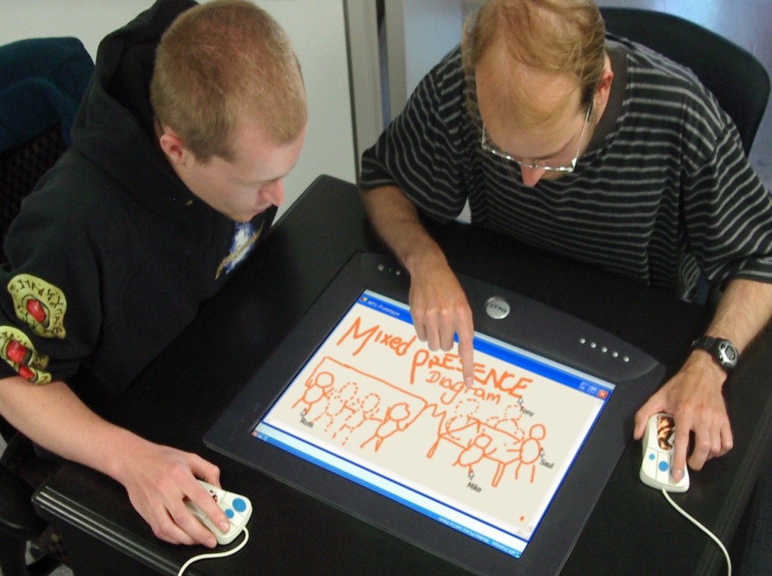
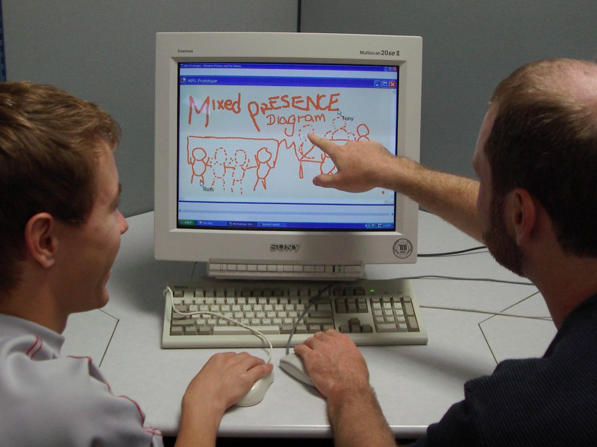
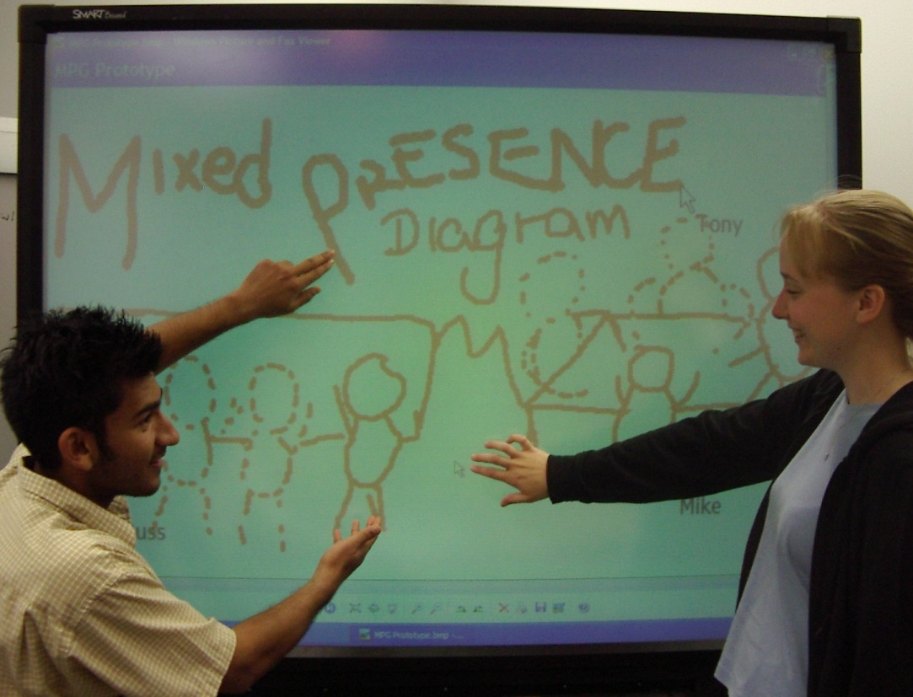
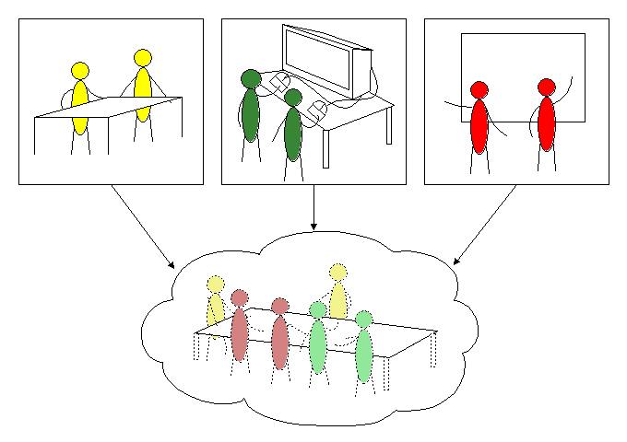
Notes:
It turns out that the design of groupware sometimes does NOT allow collaborators to maintain equal levels of awareness for all collaborators. It occurs, for instance, in “mixed presence groupware.”
What is this so-called “mixed presence groupware,” you ask.
Mixed presence groupware is software that allows groups of collocated collaborators to work together on a shared display, while connecting them to other, physically distributed collaborators so that all may work in the same virtual workspace.
As you can see in this image, each collaborator has his or her own input device. Kathryn and Anand down here are working on a SMARTBoard, while working with Mike and Gregor here who are using mice at a conventional computer.
This kind of software would be useful for groups of designers who need to work with other designers who may be distance-separated.

Slide 4
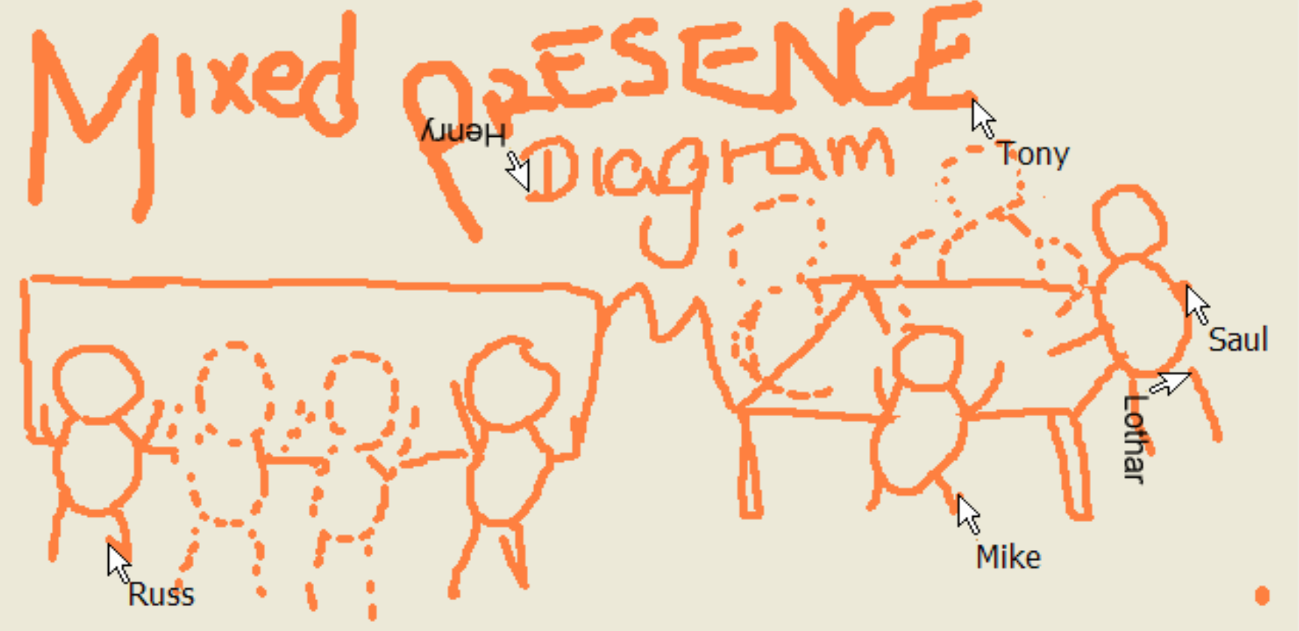
The Problem
Notes:
So, what exactly is the problem? Here, I’ve taken a screenshot of the groupware app as you saw it, and blown it up. As you can see in this image, collaborators are represented to their remote counterparts as telepointers – mouse cursors.

Slide 5

Notes:
This is a problem because in mixed presence groupware, collaborators who are COLLOCATED can maintain an awareness of each other by understanding how their BODIES are used. As you can see here, Anand and Kathryn are communicating via their bodies – gesturing, pointing, and effectively, doing things that cannot be seen effectively by remote collaborators.
Remote collaborators cannot maintain an equal level of awareness of remote participants as they can of local collaborators.
This is a problem because it disrupts natural collaborative dynamics. That is, we wouldn’t see this kind of imbalance if everyone were collocated and working over the same work surface.

Slide 6
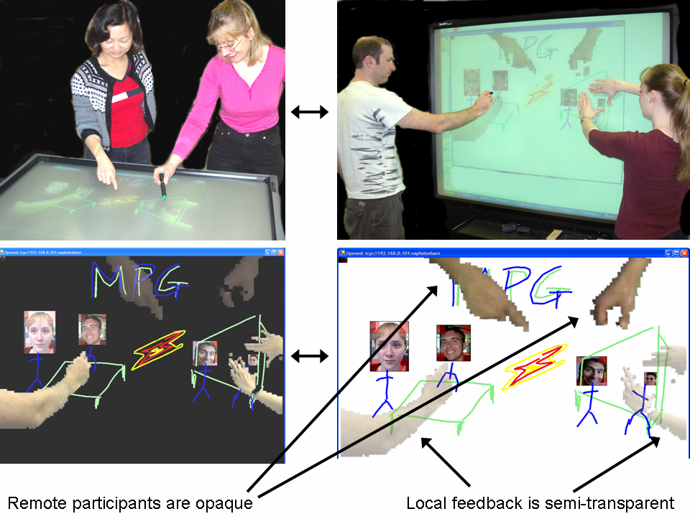
Notes:
Our solution to this problem is VideoArms, a video-based embodiment technique that uses webcams to capture the images of collaborators, and superimposes them on remote workspaces.
Here you see the image of two different physical locations, each with two collaborators. You can also see their workspaces, and how remote collaborators’ hands are re-created at the remote workstation.

Slide 7
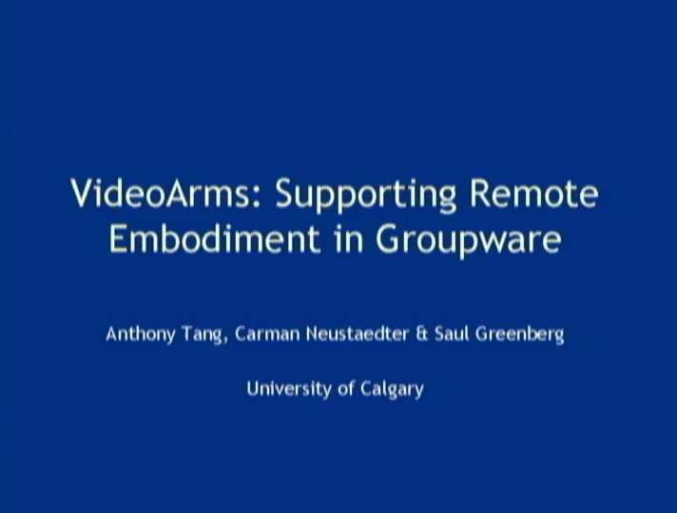
Notes:
Here’s a video of the system at work. It’s sped up, but you can see essentially how it works. Here is a group of two working in front of a whiteboard, and then you’ll see a group working on a tabletop display. Remote collaborators’ arms help you see what they are doing, and you can see the gestures that they’re making much more easily and within the context of the workspace.
VideoArms was a principles-based design. From our review of the social psychological and CSCW literature, we derived four design principles for embodiments in mixed presence groupware.

Slide 8
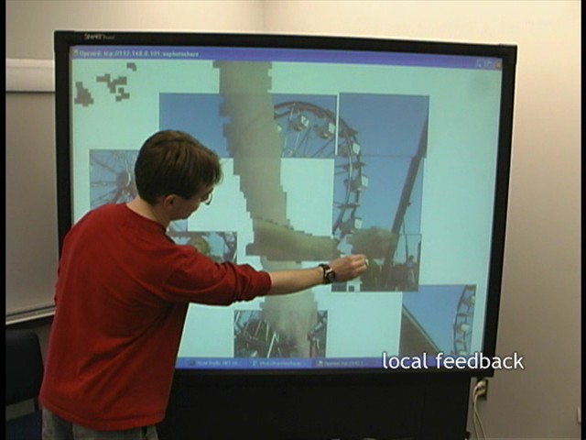
Notes:
The first principle VideoArms was designed to support is local feedback. Being able to perceive ourselves in the physical world helps us to manipulate our bodies to ensure it is doing what we want it to do. Similarly, VA provides local feedback so that we know how our bodies are being presented to others.

Slide 9
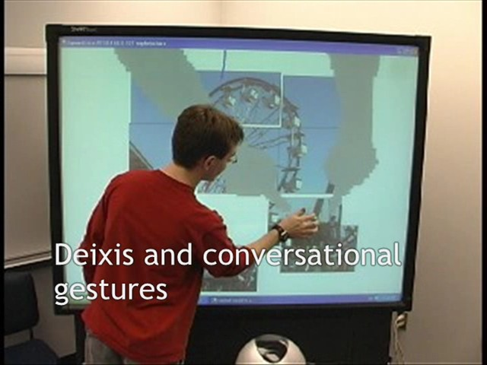
Notes:
As I said earlier, bodies also provide a very rich means for non-verbal communication: particularly deixis and conversational gestures. Previous literature has demonstrated that inhibiting people from gesturing when speaking inhibits speech production; thus, VA implies a non-tethered input system. It also provides a rich means for communicating these conversational gestures.

Slide 10
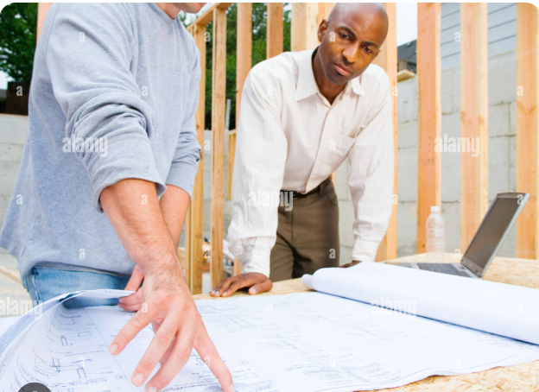
Notes:
VideoArms is also built to support rich consequential communication. Consequential communication is the idea that by watching others work, you can help them without explicit cuing. [Play] Here, you’ll see Ed see Kathryn reaching for a piece of paper, and because he sees this, will help her out. VA provides a rich means for communicating and understanding these implicit gestures. (note: original video not available; this photo shows something similar)

Slide 11
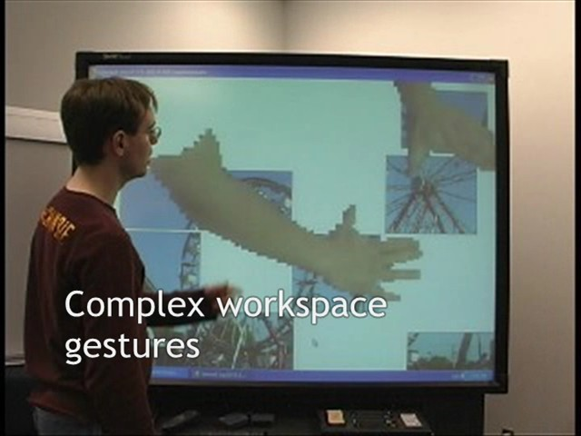
Notes:
Finally, VideoArms places gestures within the workspace so that no contextual information is lost. Many previous systems take video out of the context of the workspace, which removes a good portion of their meaning.

Slide 12
Message
Groupware should allow collaborators to be aware of all participants equivalently.
Notes:
Ultimately, our work in mixed presence groupware uncovers a unique problem in shared distributed-collocated groupware – namely, that it is easier to maintain an awareness of collocated individuals compared to distributed individuals. Yet, this imbalance disrupts natural collaborative dynamics. VideoArms is a partial solution to this problem, allowing collaborators to maintain an equivalent level of awareness about their collaborators’ arms—one of the critical features of bodies in collaborative workspaces.

Slide 13
Extra slides

Slide 14
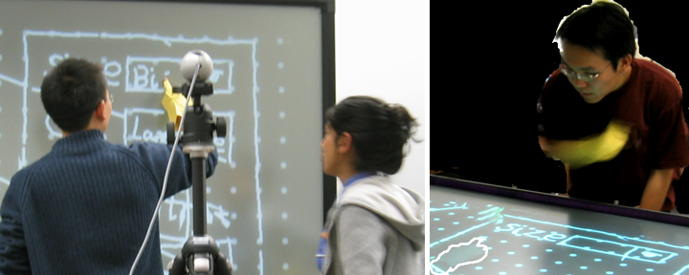
Observational Study
Notes:
Because VideoArms are so rich in communicative information, individuals were seen to observe carefully the actions of others, as you can see here on the left and the right—a behaviour that is also very common in physical workspaces. This image also suggests that VA was successful in supporting some of the behaviour we observe in physical workspaces.
Together though, the design and evaluation of VA demonstrated the utility of the ideas in supporting embodiment in MPG workspaces. VA was also demonstrated to mitigate presence disparity very well.

Slide 15
Results
Natural, complex gestures beyond deixis
Contextualized gestures in the workspace
Gestures continued with a voice link
Gestures intended for both remote and collocated partners
Notes:
The observational study was designed to answer high level questions about the design of VideoArms.
We found that VA supported fairly natural, complex gestures, such as two handed sizing gestures impossible with a mouse. Because these gestures were done within the context of the workspace, remote collaborators could easily observe them. VA proved its utility since the gestures continued when a voice link was added. Finally, gestures were not modified nor replicated for collocated/remote collaborators. Only one was necessary.

Slide 16
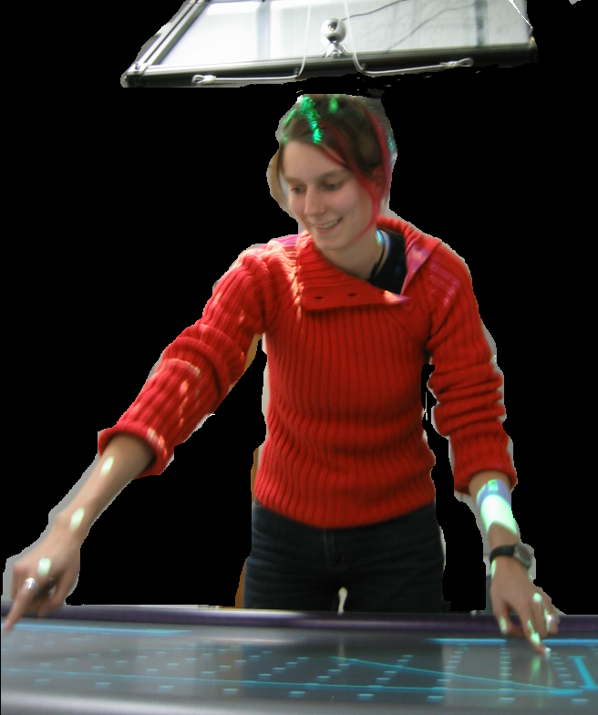
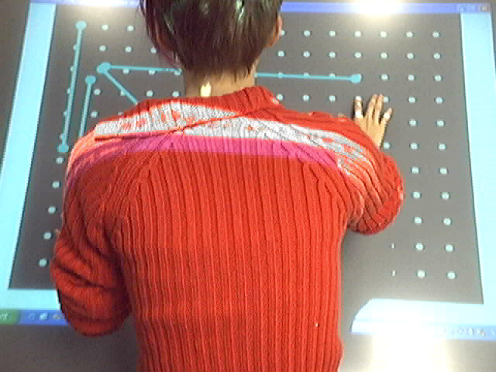
VideoArms as Incomplete
Notes:
Yet VA is not a complete nor perfect solution. As I said earlier, VA uses webcams to capture images of collaborators. Sometimes, out of comfort, people lean over the workspace, obscuring the camera’s view of their hands, as Uta does here. Secondly, this solution does not support eye contact, which has been found to be important in collaborative work.

