Slide 1
Community Bar
Gregor McEwan
Saul Greenberg
University of Calgary

Slide 2
Message
Community Bar supports informal awareness and casual interaction for distributed groups.
  Ad hoc Groups
  Individual views of multiple locales
  Lightweight transition from awareness to interaction
  Focus and Nimbus controls
Notes:
Motivation
Existing tools
Community Bar
Theory and Design

Slide 3
Outline
Why make an informal awareness and casual interaction tool?
Existing tools
Community Bar
Theory and Design

Slide 4
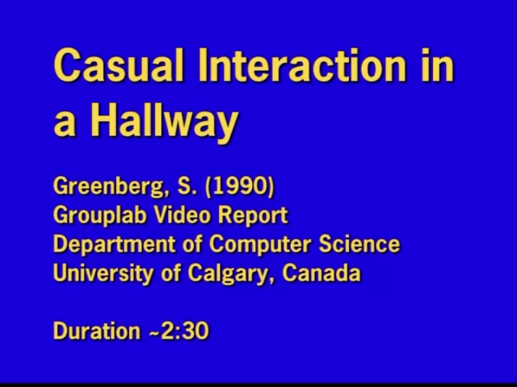
Notes:
This is an example of people maintaining awareness and engaging in casual interaction.
It shows how these concepts are a part of our every day life.

Slide 5
Informal awareness & casual interaction
Unobtrusive awareness
  Presence, activity, availability
Transition from awareness to interaction
Casual Interaction
  Small groups
  Unplanned, brief, frequent
(Kraut et al, 1990) (Whittaker et al, 1994)

Slide 6
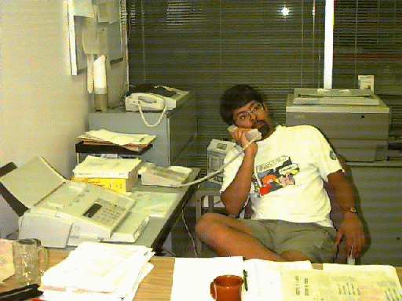


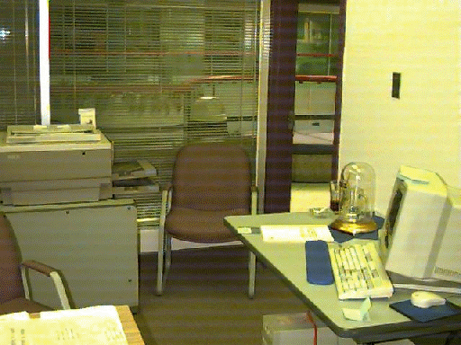
The Distance Problem

Slide 7
We need a tool because…
People work in groups.
Informal awareness and casual interaction are fundamental to group collaboration.
Groups are often distributed.
Distributed groups lack normal channels for awareness and interaction.
We can make tools that create new channels.

Slide 8
Outline
Why make an informal awareness and casual interaction tool?
Existing tools
Community Bar
Theory and Design

Slide 9
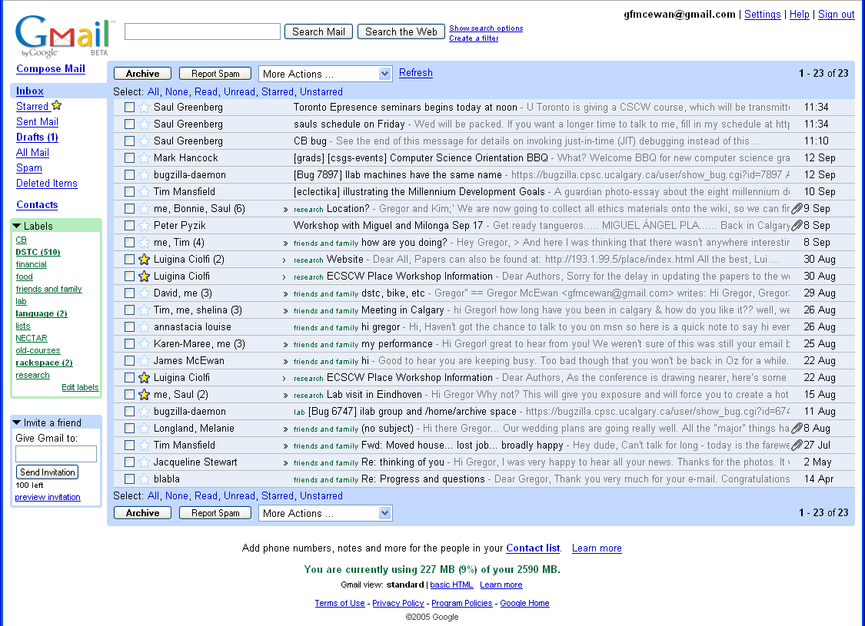
Email
Notes:
High use
Easy interaction
No awareness

Slide 10
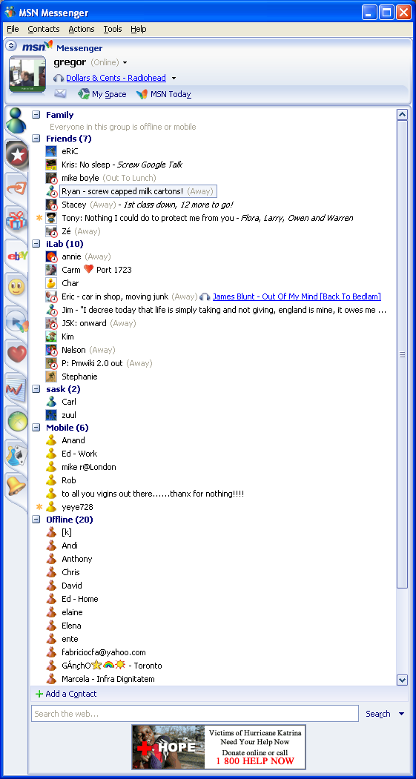
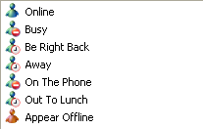
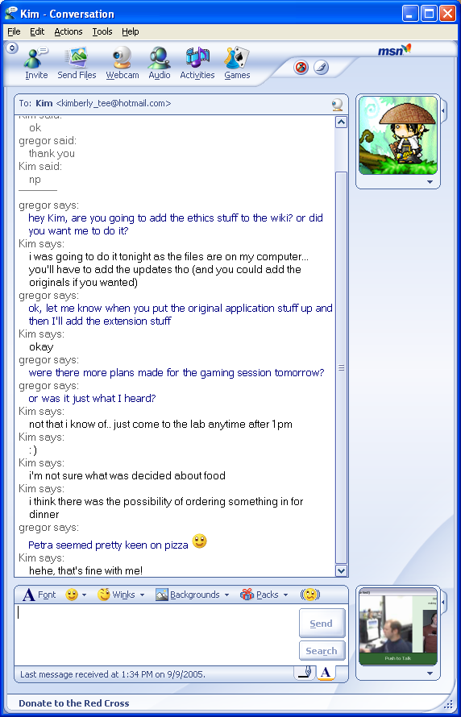
Instant Messenger
Notes:
Minimal awareness
Simple interaction
Dyadic communication

Slide 11
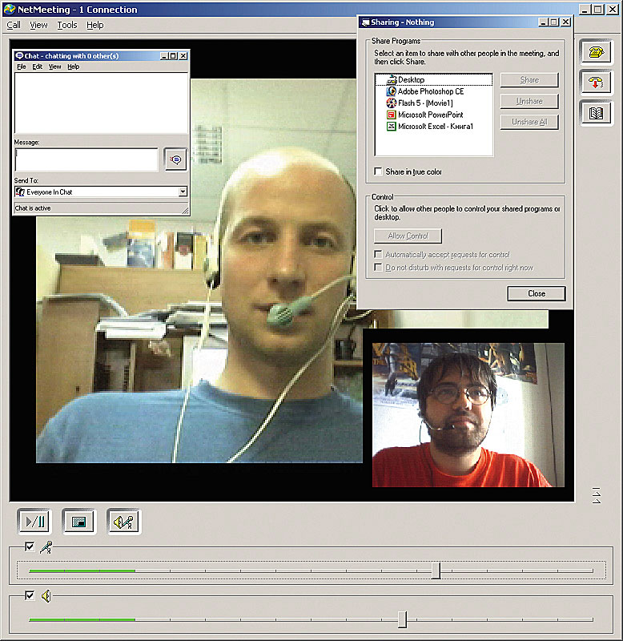
Video Conferencing
Notes:
No awareness

Slide 12
Outline
Why make an informal awareness and casual interaction tool?
Existing tools
Community Bar
Theory and Design

Slide 13
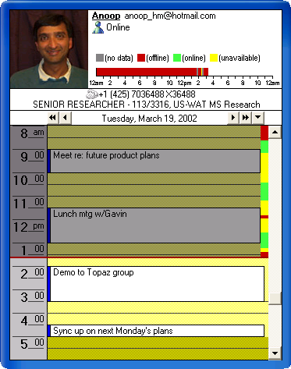
Design Inspirations: Sideshow
Peripheral side bar
Personal information feeds
Quick drill down into information
Notes:
Community Bar differs from these two by focussing on social information and interaction.
Sideshow and Google Sidebar show personal information feeds.

Slide 14
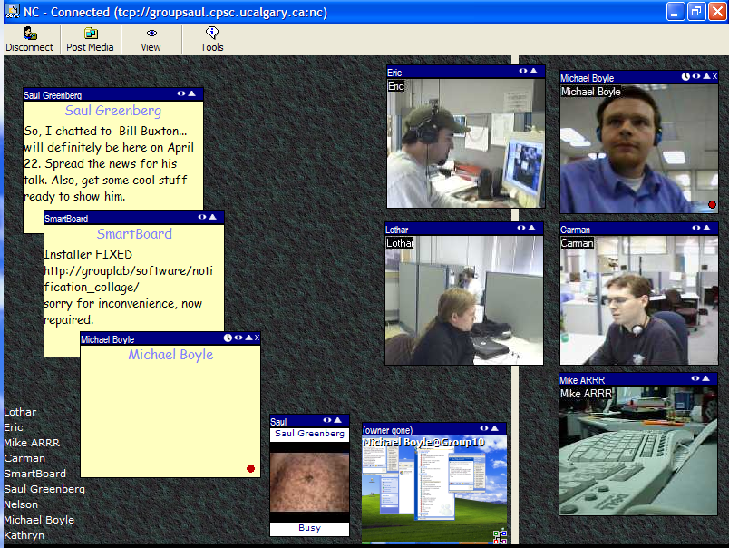
Design Inspirations: Notification Collage
(Greenberg & Rounding, 2001)

Slide 15
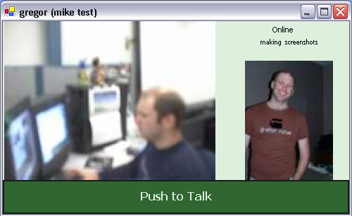
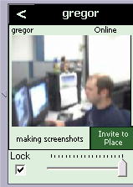
Community Bar
Place
“CSCW class”
Peripheral side bar
Transient tooltip grande
Separate full view
Place
“G-place”
Place
“ilab”
Place
“mike test”

Slide 16
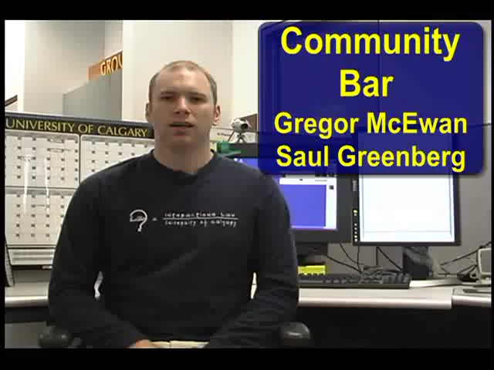
Video omitted.
See http://grouplab.cpsc.ucalgary.ca/papers/2005/05-CommunityBar-Video/CommunityBar.avi

Slide 17
Outline
Why make an informal awareness and casual interaction tool?
Existing tools
Community Bar
Theory and Design

Slide 18
Locales Framework
Comprehensive description of everyday social activities
(Fitzpatrick, 2003)
Notes:
Current situation example
- social world
- site and means
- locales (other group => other locale)
- individual view

Slide 19










Locales Framework
(Fitzpatrick, 2003)

Slide 20
Locales Framework
Social
Worlds
(Fitzpatrick, 2003)

Slide 21
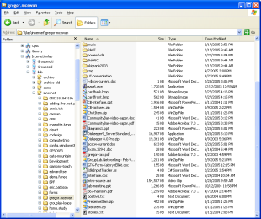
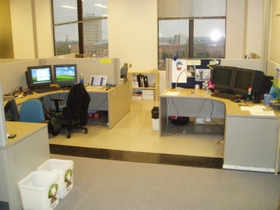
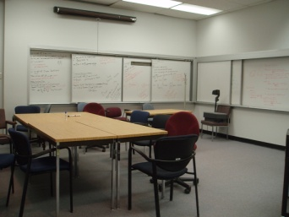
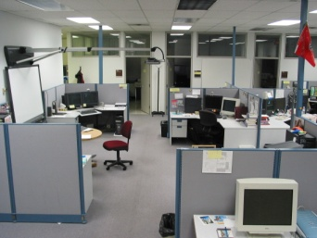
Locales Framework
Social
Worlds
Sites
and
Means
(Fitzpatrick, 2003)

Slide 22
Locales Framework
Social
Worlds
Locales
Sites
and
Means
(Fitzpatrick, 2003)

Slide 23
Locales Framework
Social
Worlds
Locales
Sites
and
Means
(Fitzpatrick, 2003)

Slide 24

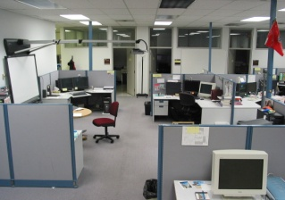
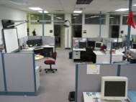
Locales Framework
Individual
View
Social
Worlds
Locales
Sites
and
Means
(Fitzpatrick, 2003)

Slide 25
Awareness: Focus/Nimbus Model
A
Nimbus
B
Focus
A
B
Awareness
A B
(Benford and Fahlen, 1993) (Rodden, 1996)

Slide 26
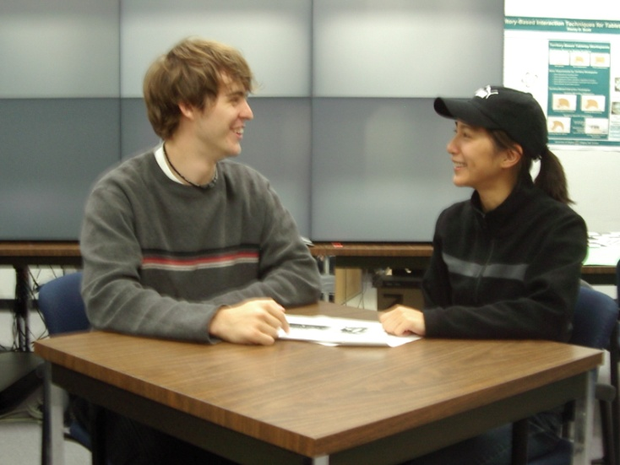
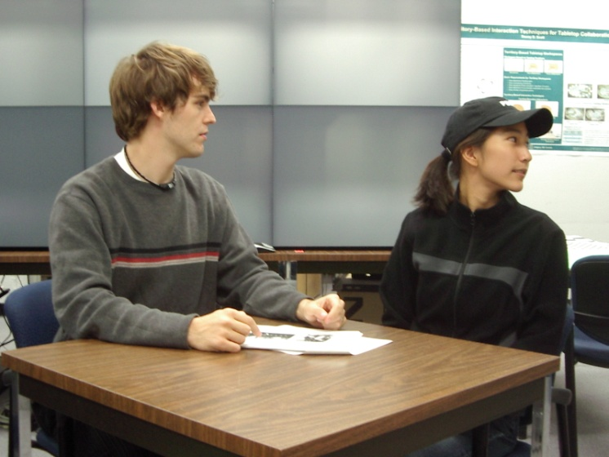
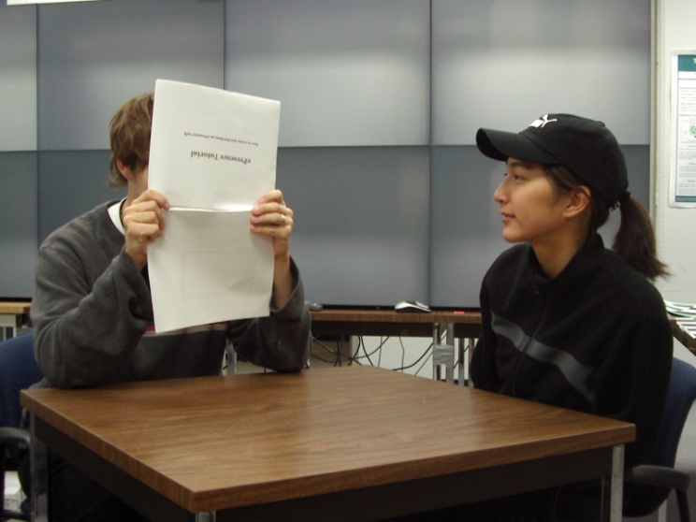
Awareness: Focus/Nimbus Model
High Focus
High Nimbus
=> High Awareness
Low Focus
High Nimbus
=> Low Awareness
High Focus
Low Nimbus
=> Low Awareness
(Benford and Fahlen, 1993) (Rodden, 1996)

Slide 27
Conclusions
Different from existing tools
  Rich awareness
  Public small groups
  Iterative design (design is iterating right now)
Continuous usage over a year and a half
  Preceded by 4 years of Notification Collage use
  Feedback from users and field experts
  Iterative design (design is iterating right now)
Formal evaluation coming soon
  Pilot study already done
  Complete study end of 2005

Slide 28
Future Work
Formal evaluation
  Outside our lab
  In progress now
Continuing development
  Richer activity awareness
  New Media Items
    File transfer, Photo show, Activity Monitor, Video History, etc.
  Deployment in commercial and other research settings

Slide 29
Message
Community Bar supports informal awareness and casual interaction for distributed groups.
  Ad hoc Groups
  Individual views of multiple locales
  Lightweight transition from awareness to interaction
  Focus and Nimbus controls
Notes:
Motivation
Existing tools
Community Bar
Theory and Design

Slide 30
Download and use Community Bar
http://grouplab.cpsc.ucalgary.ca/CB

Slide 31
Extra slides after here…

Slide 32
Ad hoc groups
Support both short and long-term locales
Groups are easy and lightweight to
  Create
  Join
  Populate with people and artefacts
  Leave
  Delete

Slide 33
Multiple Social Worlds through multiple Locales
Provide multiple locales
Show all of a person’s locales concurrently
Provide rich artefacts for awareness and interactions within each locale
Make all artefacts public to the locale

Slide 34
Focus/nimbus control
Continuous, not binary, model of engagement
Locale framework centre/periphery concept
Applies to people, artefacts, locales, and social worlds

Slide 35
Lightweight transitions from awareness to interaction
Awareness information
  Peripheral and always present
  Unobtrusive yet dynamic
Simple transition to explore and interact with the information
Rich communication channels

Slide 36
From groupware sociological theories (Locales Framework and Rodden’s Awareness Model)
Provide multiple places with artefacts
Show how places relate to each other
Allow individual views
Allow awareness of interactions over time
Provide focus control
Provide nimbus (presence) control
Represent changing awareness with changing content

Slide 37
We’re still working on…
Show how places relate to each other
Allow awareness of interactions over time
Evaluation

