Slide 1
The SDG Toolkit
Edward Tse and Saul Greenberg
University of Calgary, Alberta
Canada

Slide 2
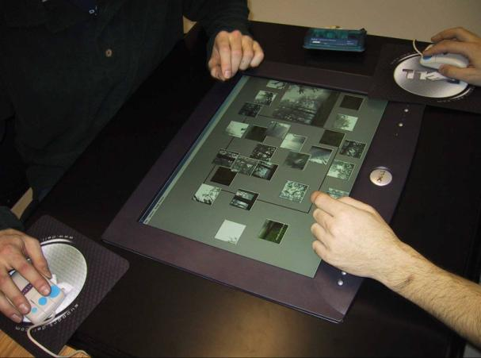
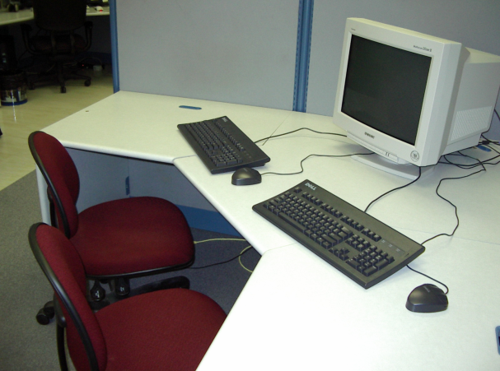
Single Display Groupware (SDG)
Notes:
SDG is investigates how multiple people share a single display such as a vertical or horizontal display using multiple input devices such as multiple keyboards and mice. Research in SDG has increased over the past 5 years due to the opportunities provided by large projected wall and table displays for collaboration. However, SDG applications are hard to build, often researchers will start from the ground

Slide 3

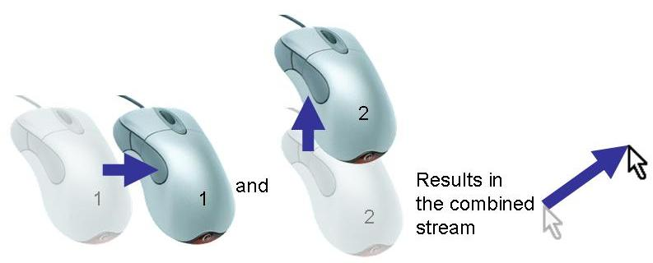
Problems
Notes:
The fundamental problem with developing SDG applications is that computers are designed with the assumption that there will be only one user per computer. This makes it difficult to develop even the most basic SDG applications.
For example, if two mice are connected to a computer and one mouse moves right while the other moves upwards the result on the screen is the combined input of both mice which moves diagonally upward. The same problems occur when multiple keyboards are connected to the same computer. So in order to obtain input from multiple mice we need to either develop our own specialized device drivers or we need to access some low level API to get even the most basic applications going.

Slide 4
Message
With the SDG Toolkit,
programmers can achieve rapid prototyping
of SDG applications by easily implementing
core SDG functionalities
Notes:
So my goal is to explain what basic SDG functionality is and how a toolkit which supports this basic functionality supports rapid prototyping of SDG applications.

Slide 5
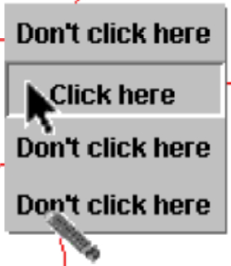
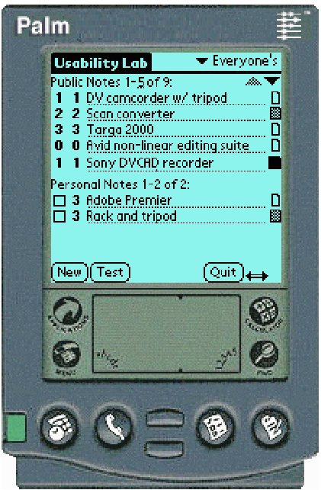
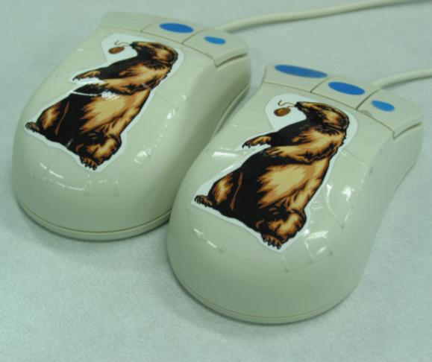
First Experiences with SDG
Zanella and Greenberg, 2001
Greenberg, Boyle, LaBerge, 1999
Greenberg and Fitchett, 2001
Notes:
Our own frustrating experiences in SDG echoed these problems. We began developing SDG interface widgets (Zanella and Greenberg 2001) with the MID (multiple input devices) toolkit (Bederson and Hourcade 1999), but had to abandon it as it worked only with Windows 98. It then proved impossible to get individual mice and keyboard streams from the later Windows 2000 and NT systems.
Seeking alternatives to the mouse, we developed PDA-based input devices (Greenberg, Boyle and LaBerge 1999; see also Myers, Stiel and Gargiulo 1998), and even rewrote the firmware of a USB mouse so that the window system saw it as a Phidget (a physical widget) instead of a mouse (Greenberg and Fitchett 2001). Even then, coordinate tracking and cursor drawing was painful and inefficient. Especially disconcerting was that our time and effort went into infrastructure development vs. our main focus: the design and evaluation of SDG interaction techniques over upright displays and tabletops

Slide 6
Related Work
MID
Pebbles
Phidgets
Bederson, et al., 1999
Myers, et al., 1998
Greenberg and Fitchett, 2001
Notes:
Our own frustrating experiences in SDG echoed these problems. We began developing SDG interface widgets (Zanella and Greenberg 2001) with the MID (multiple input devices) toolkit (Bederson and Hourcade 1999), but had to abandon it as it worked only with Windows 98. It then proved impossible to get individual mice and keyboard streams from the later Windows 2000 and NT systems.
Seeking alternatives to the mouse, we developed PDA-based input devices (Greenberg, Boyle and LaBerge 1999; see also Myers, Stiel and Gargiulo 1998), and even rewrote the firmware of a USB mouse so that the window system saw it as a Phidget (a physical widget) instead of a mouse (Greenberg and Fitchett 2001). Even then, coordinate tracking and cursor drawing was painful and inefficient. Especially disconcerting was that our time and effort went into infrastructure development vs. our main focus: the design and evaluation of SDG interaction techniques over upright displays and tabletops

Slide 7
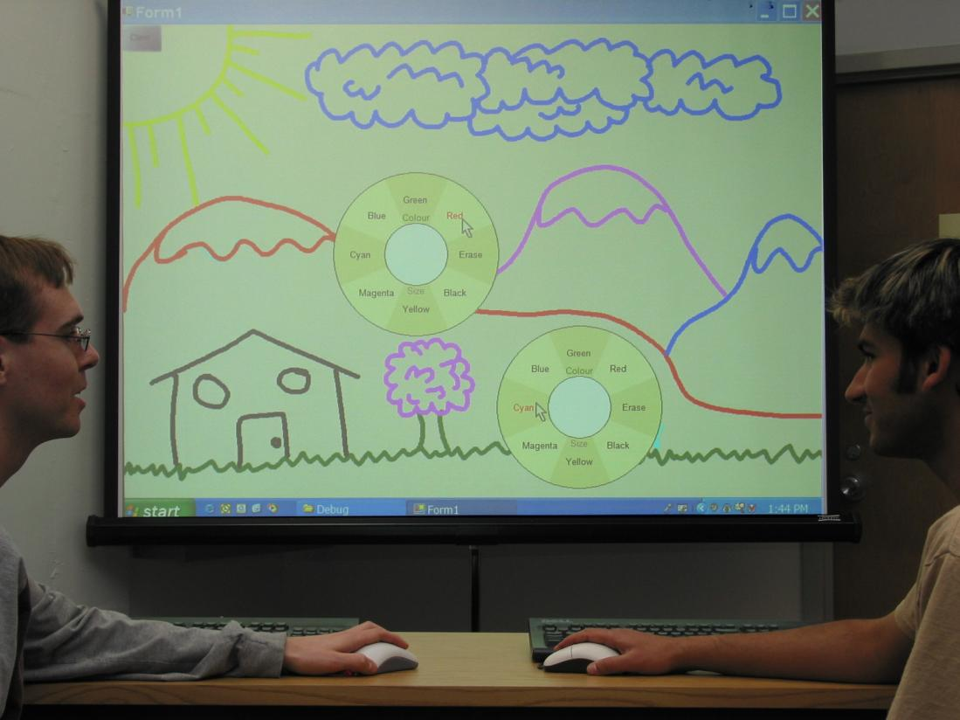
SDG Toolkit
Notes:
Consequently, we decided to design and build a toolkit that would help us and others rapidly develop SDG applications and interface components suitable for upright displays and tabletops. Our driving goal was that the toolkit would be simple enough for average programmers to quickly learn and use, where they can concentrate on SDG application design rather than low level SDG plumbing.
The Solution was to develop a toolkit for the development of Single Display Groupware Applications that would
Multiple input and identification: There is no convenient way to gain and uniquely identify the multiple input streams from mice and keyboards.
Multiple cursors: Systems supply only a single cursor. Yet almost all SDG applications require multiple cursors, one for each attached mouse.
Table orientation: Table top developers face considerable hurdles circumventing orientation issues that occur when end users are seated at different sides of the table, e.g., how the cursor appears, how the mouse behaves, how coordinates are handled.
SDG user controls: Conventional controls (aka widgets) such as buttons, menus and even windows cannot distinguish which SDG user interacted with it, only store a single input focus between them, and are not designed to handle concurrent use.

Slide 8
Core SDG Functionalities
Obtaining Input
Supporting Tables and Vertical Displays
Multiple cursors
Widget Layer
Notes:
These features are the fundamental properties of SDG applications

Slide 9
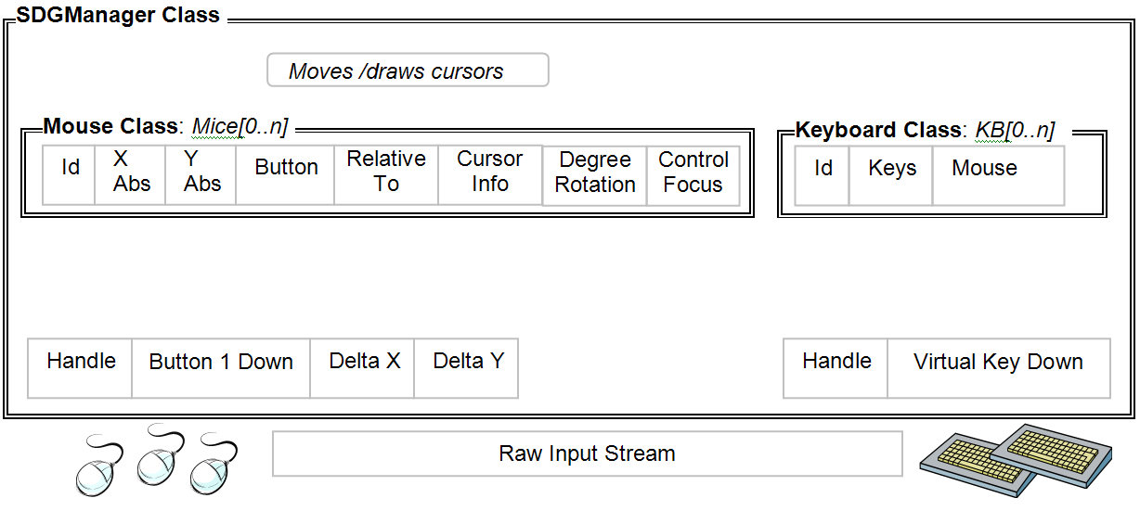
Obtaining Input

Slide 10
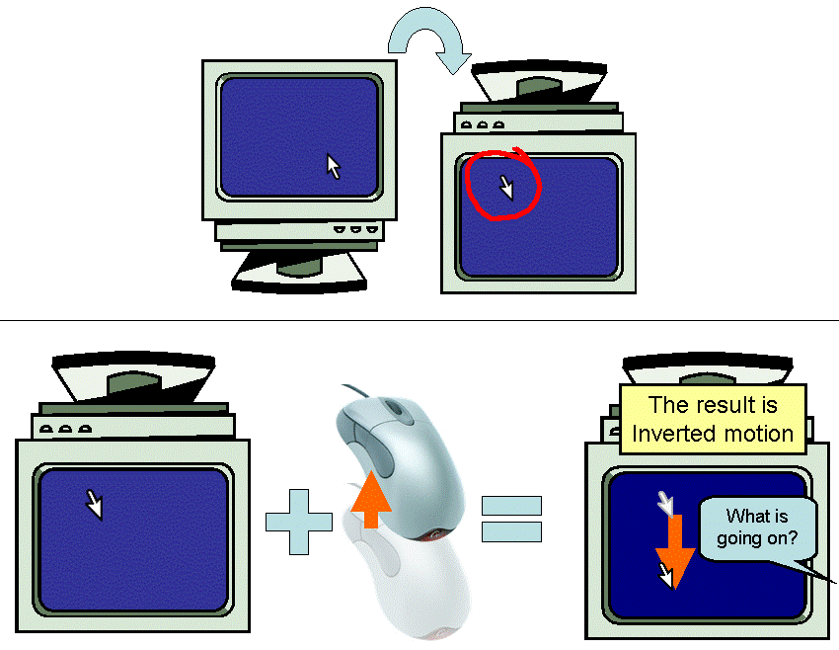

Supporting Tables and Vertical Displays
What is going on?

Slide 11
Obtaining Input
Rotation Matrix

Slide 12
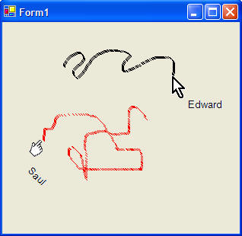
Multiple Cursors
Cursor[] sdgCursors = {Cursors.Arrow, Cursors.Hand};
String[] sdgText = {"Edward", "Saul"};
int[] sdgDegreeRotations = {-90, 0};
for (int i=0; i < sdgManager1.Mice.Count && i < 2; ++i)
{
  sdgManager1.Mice[i].Cursor = sdgCursors[i];
  sdgManager1.Mice[i].Text = sdgText[i];
  sdgManager1.Mice[i].DegreeRotation = sdgDegreeRotations[i];
}
Notes:
So to understand how a programmer would use the SDG Toolkit I will show you how to develop your very own table top SDG application by creating one on the spot.
Note that the same program without the toolkit would require over 588 lines of code
Achieving rapid prototyping here!!!!!!!!!!!!!!!!!!!!!!!!!!!!!!!!!!!!!!!!!!!!!

Slide 13
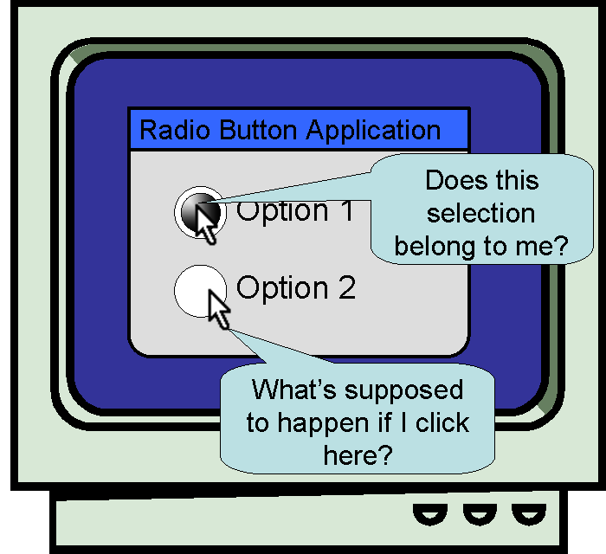
Why Existing Widgets are Problematic

Slide 14
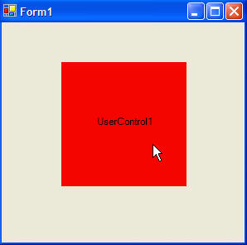
SDG Widget Layer
public class UserControl1 : SdgUserControl
{
//Designer generated code
private void SdgMouseDown(object sender, SdgMouseEventArgs e)
{
if (e.ID > 0)
this.BackColor = Color.Red;
else
this.BackColor = Color.Blue;
}
}

Slide 15
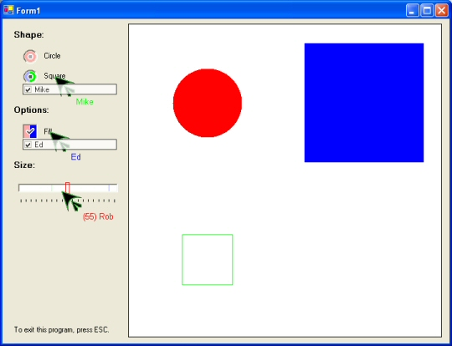
SDG Widget Layer Example
SDG Widgets
Diaz-Marino, Tse and Greenberg, (2003)

Slide 16
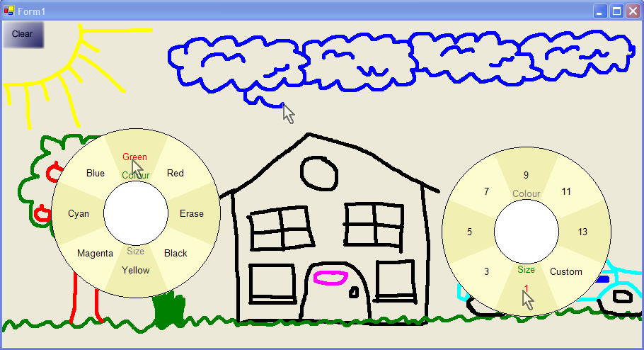
SDG Flow Menu
Notes:
Insert better video

Slide 17
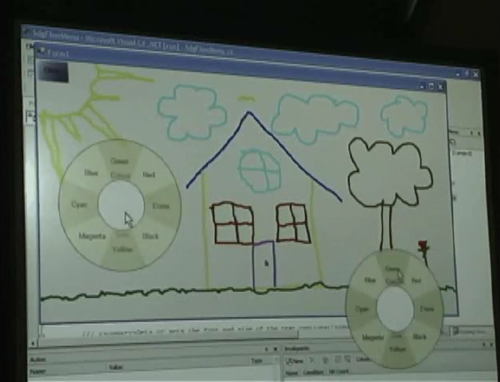
SDG Flow Menu
Notes:
Insert better video

Slide 18
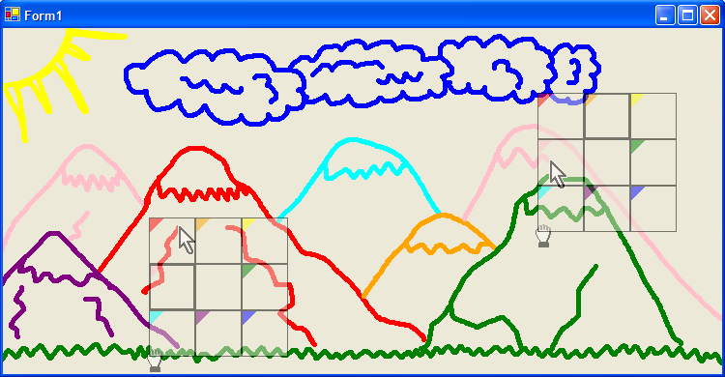
SDG Magic Lenses
Notes:
Insert Better video
Other applications include the Mixed Presence Groupware application developed by Tony Tang who is also presenting at this conference.

Slide 19
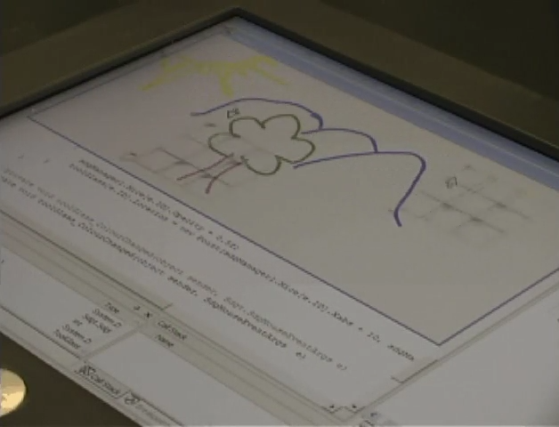
SDG Magic Lenses
Notes:
Insert Better video
Other applications include the Mixed Presence Groupware application developed by Tony Tang who is also presenting at this conference.

Slide 20
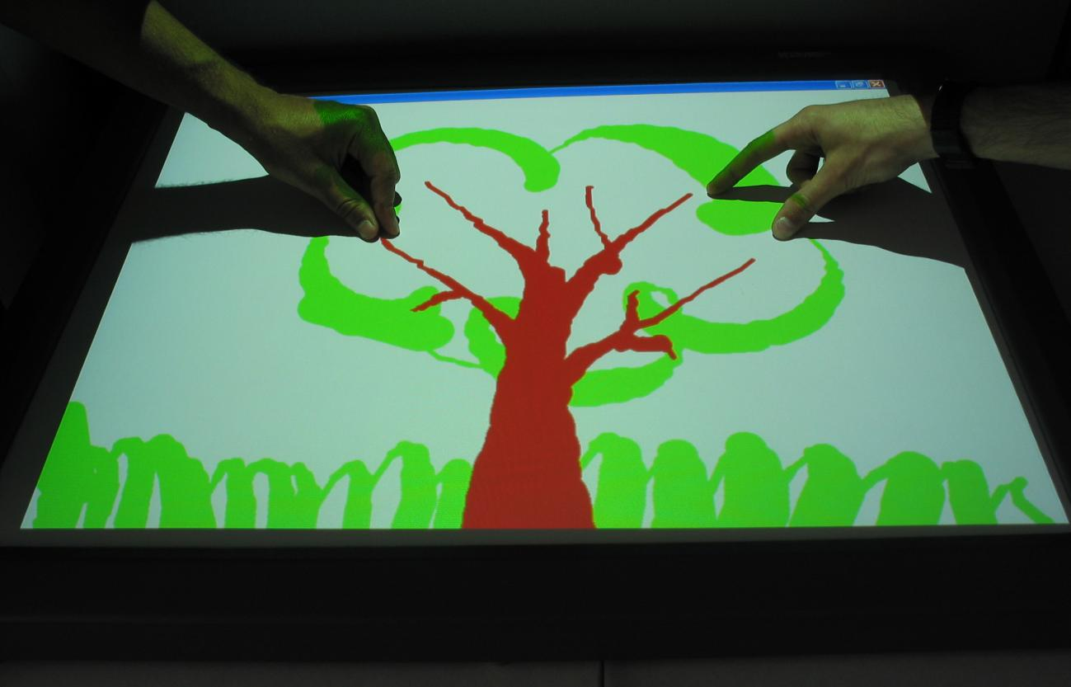
Diamond Touch Toolkit
Extending the SDG Toolkit
Diaz-Marino, Tse and Greenberg, (2003)

Slide 21
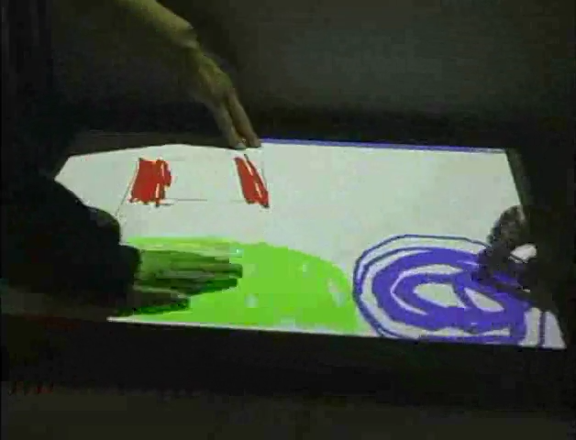
Diamond Touch Toolkit
Extending the SDG Toolkit
Diaz-Marino, Tse and Greenberg, (2003)

Slide 22
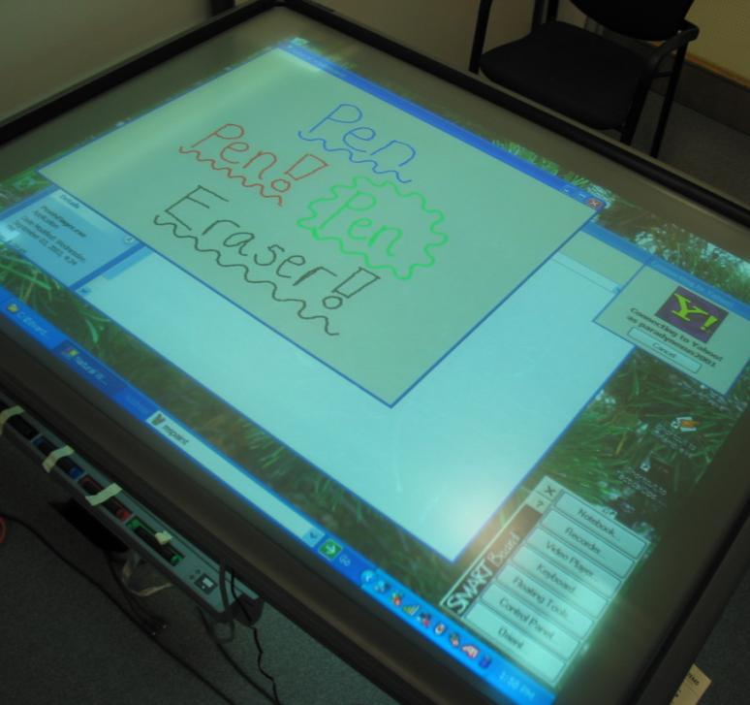
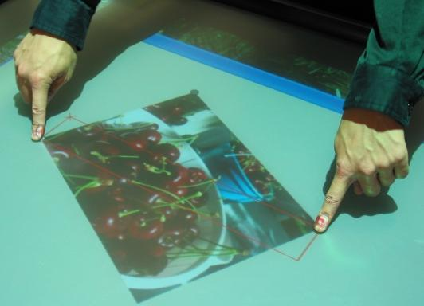
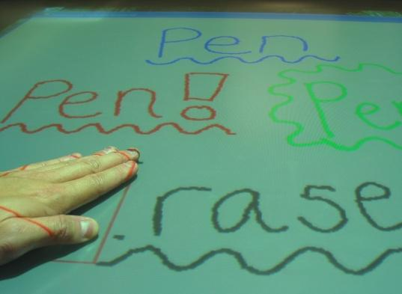
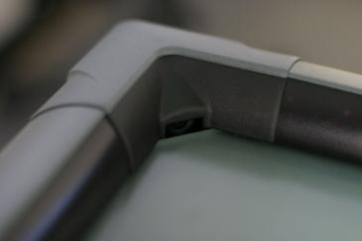
Extending the SDG Toolkit
Digital Vision Technology

Slide 23
Message
With the SDG Toolkit,
programmers can achieve rapid prototyping
of SDG applications by easily implementing
core SDG functionalities
Software available at http://grouplab.cpsc.ucalgary.ca
Thanks to NSERC, SMART Technologies, Alberta Ingenuity and iCore for their financial support

