Slide 1
Building Flexible Displays for Awareness and Interaction
Kathryn Elliot and Saul Greenberg
University of Calgary
The minute madness presentation
Notes:
Hi, my name’s Kathryn Elliot, and along with my supervisor, Dr. Saul Greenberg, at the University of Calgary, I’ve created several flexible ambient devices.

Slide 2
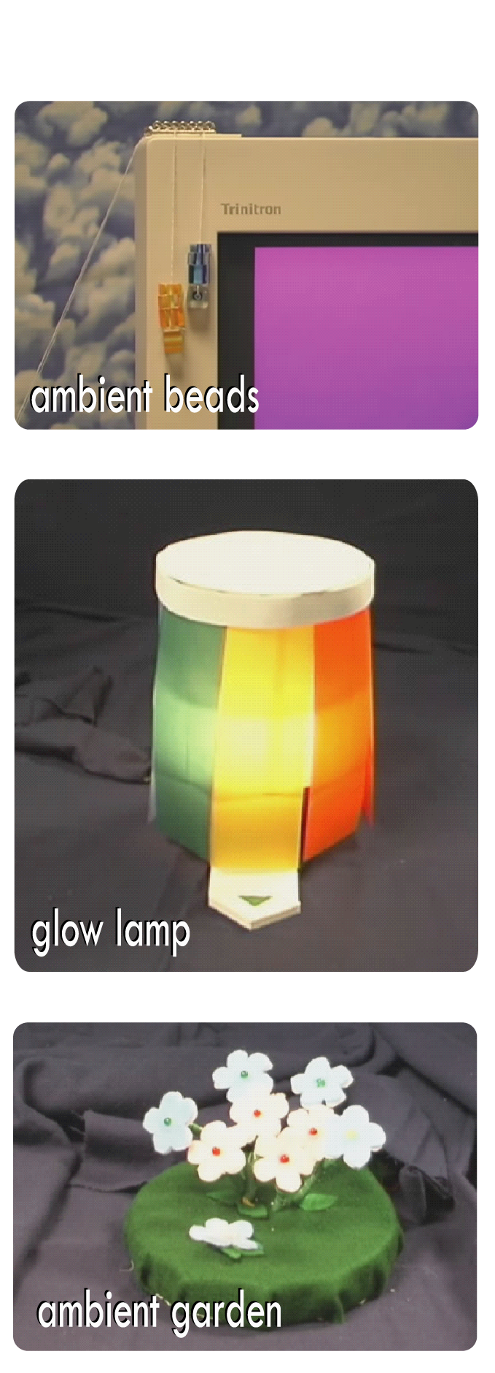
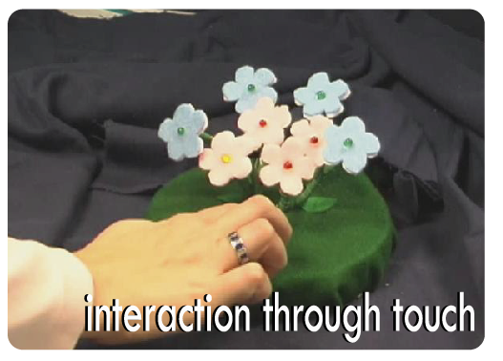
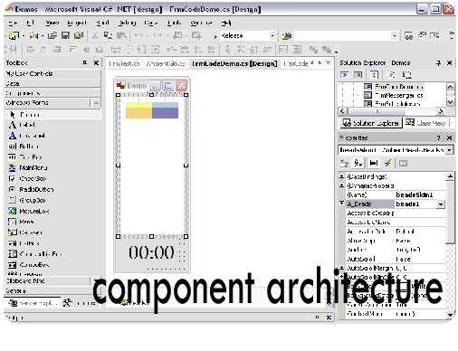
Flexible Ambient Displays
3 prototype devices designed to meet two specific design goals
  To allow customization through flexible information sources
  To allow users to move smoothly from awareness of the information into interaction with it.
Uses component-based design and phidget touch sensors
Notes:
An ambient device is a physical object that displays information in the periphery of a user’s attention. I’ve created these flexible ambient displays to meet two specific design goals. The first goal is to allow for customization through flexible information sources - Our adaptable devices can be easily connected to different information sources.
The second goal is to provide some means of smoothly moving the information from the periphery to the centre of the user’s attention. Our devices allow users to easily access more detailed information.
The devices use a windows component based architecture, with events and properties. Information sources, readily available through web services and program API’s can be easily connected to the device through the properties or in code.
My three prototype devices, shown here, are all constructed using phidgets. Each incorporates one or more touch sensors so that more detailed information is always available to the user through a simple gesture or touch.
For examples and for more information, please check out my video – I guarantee it’ll be the only video here that uses the music from Jaws in the soundtrack!

Slide 3
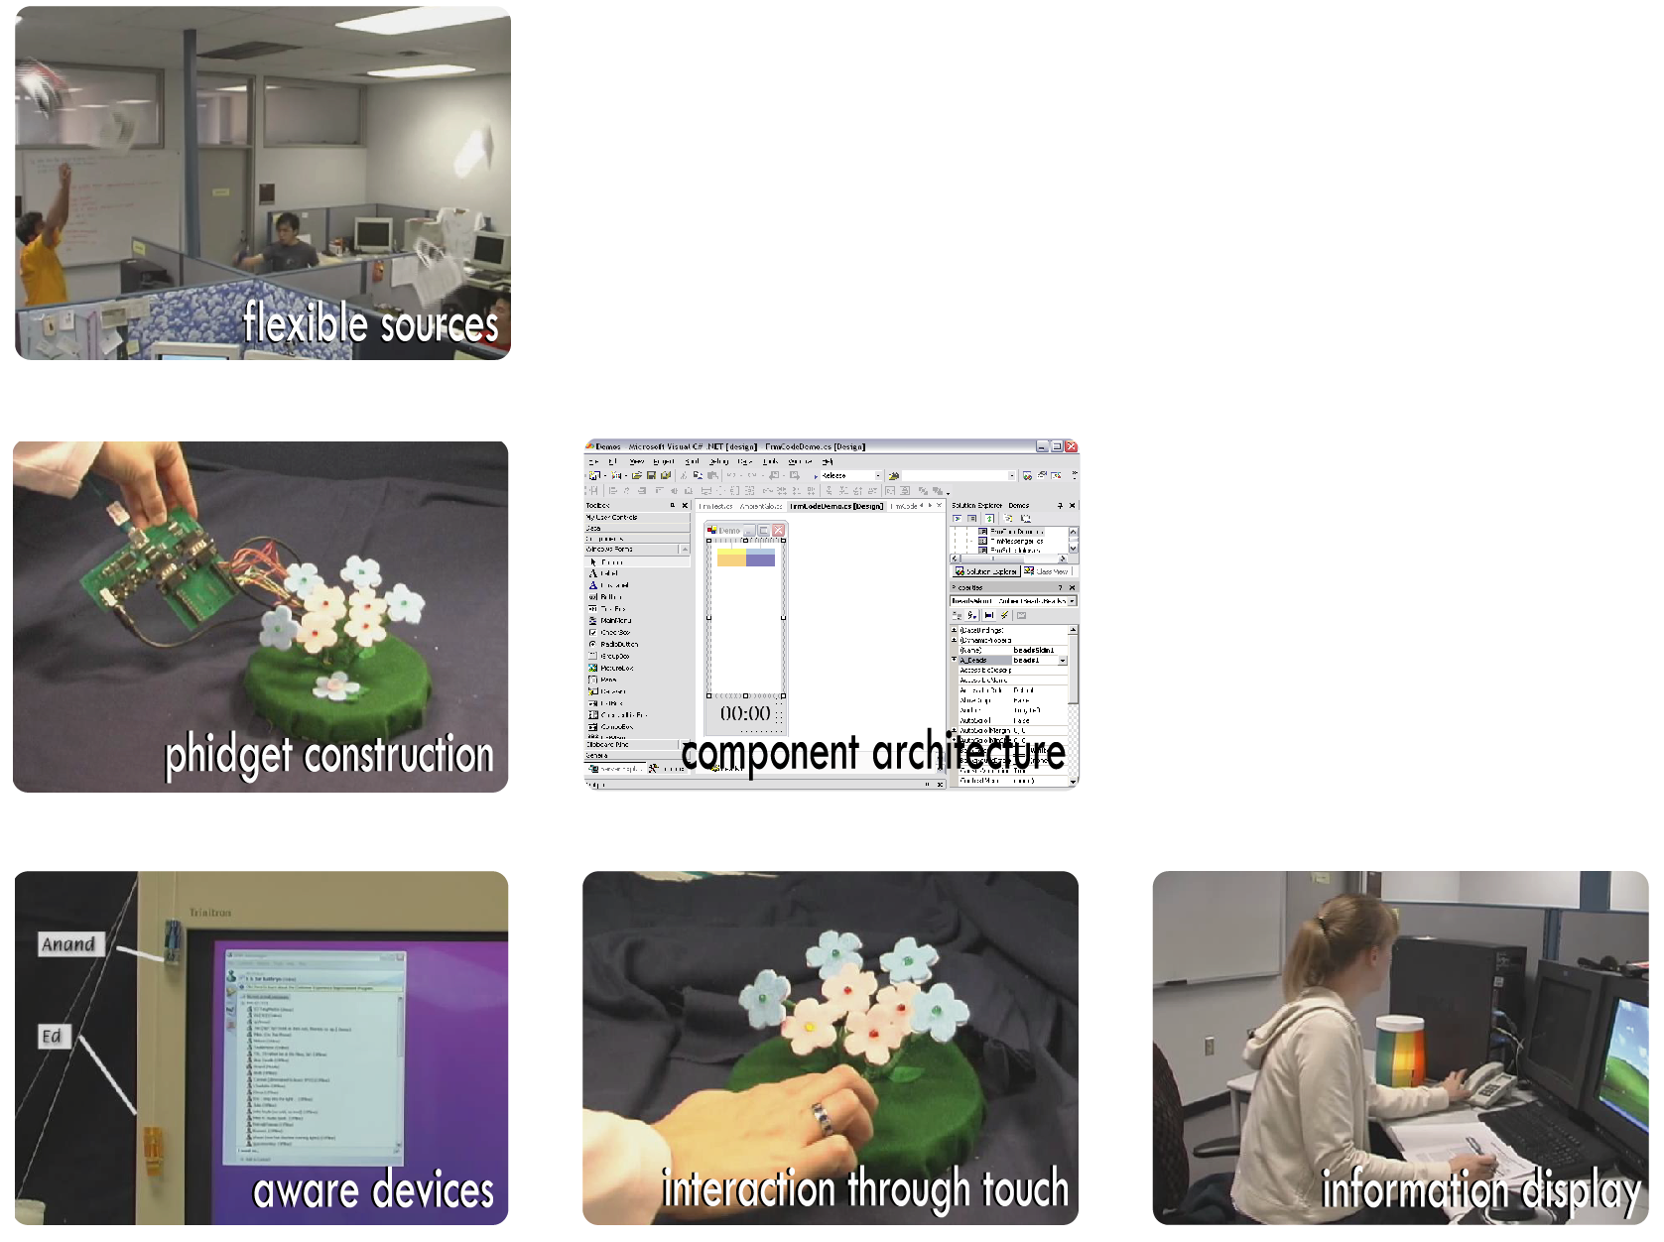
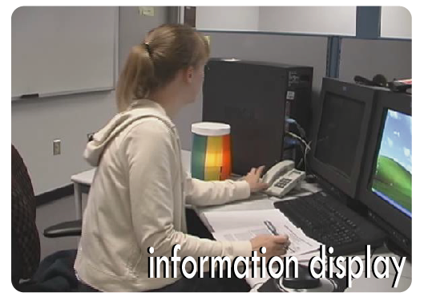
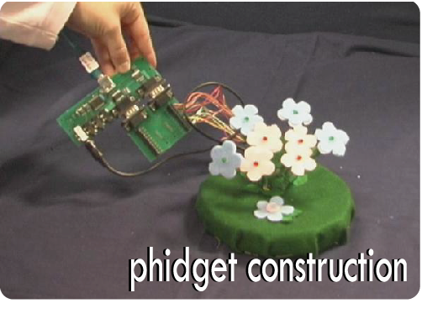
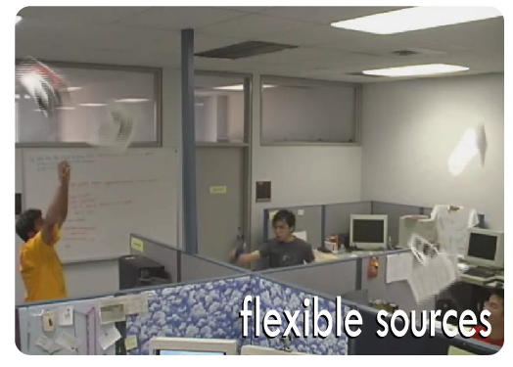
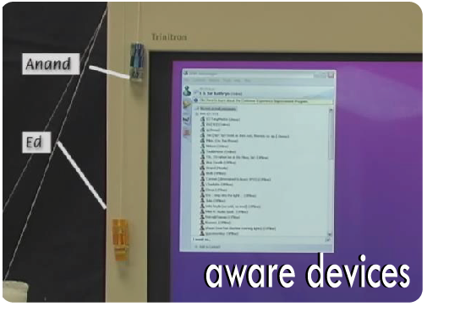
Scratch slide - ignore

