Slide 1
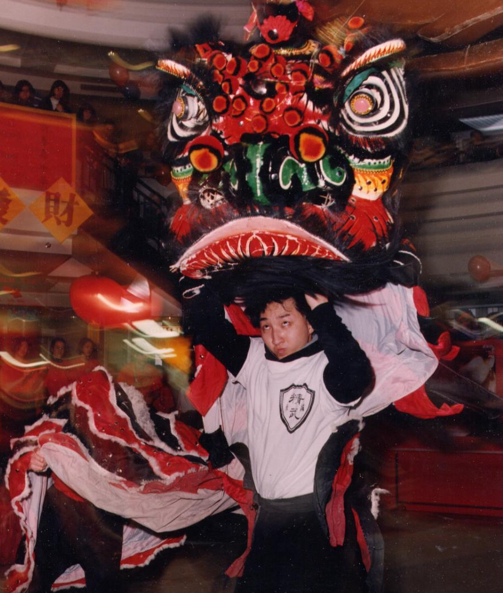
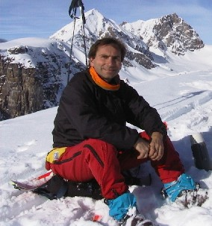
A Framework For Asynchronous Change Awareness
James Tam and Saul Greenberg,
University of Calgary

Slide 2
Our Research
We’ve developed a framework for change awareness

Slide 3
What Is Change Awareness?
The ability to keep up with the changes that others have made in a collaborative project

Slide 4
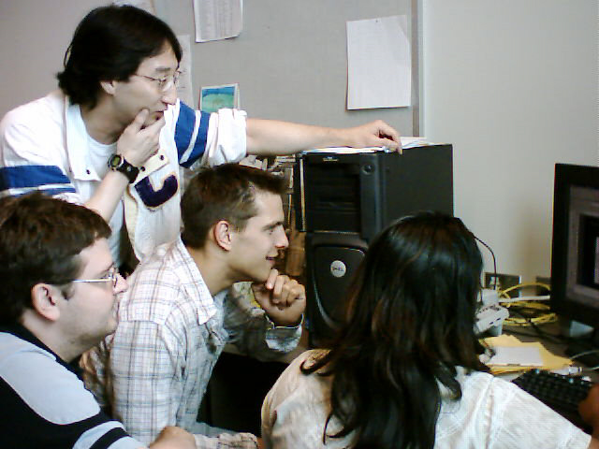
Change Awareness
A group of people are working together on a project

Slide 5
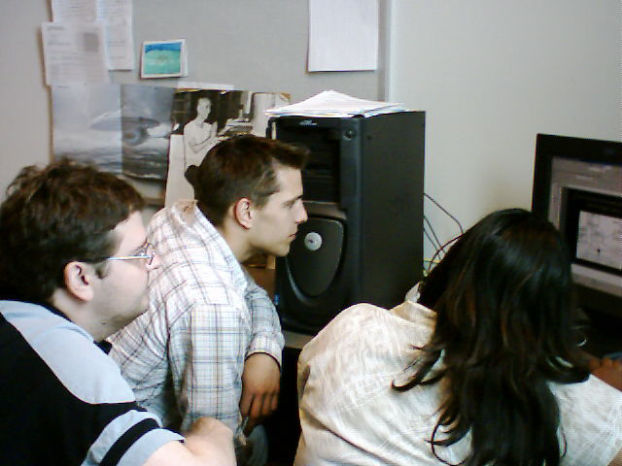
Change Awareness
While one person is away, the others continue working

Slide 6
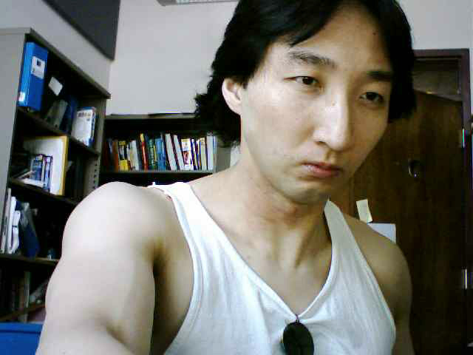
Change Awareness
The absent person comes back

Slide 7
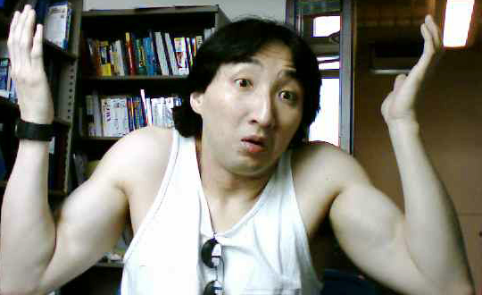
Change Awareness
Now he’s left trying to figure out what’s different
Wav file from the Simpson © Fox

Slide 8
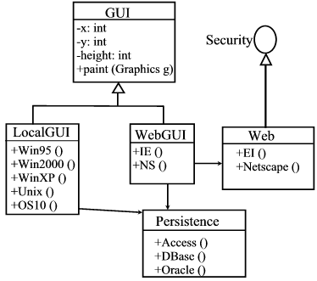
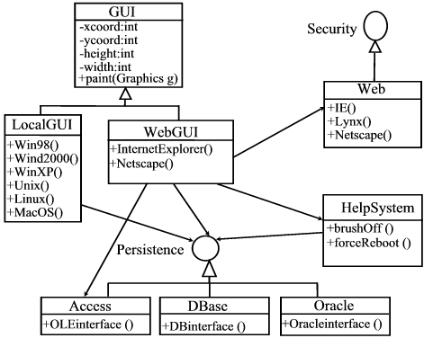
Keeping Up With Changes Is Hard!
Before
After

Slide 9
Keeping Up With Changes Is Hard!
After

Slide 10
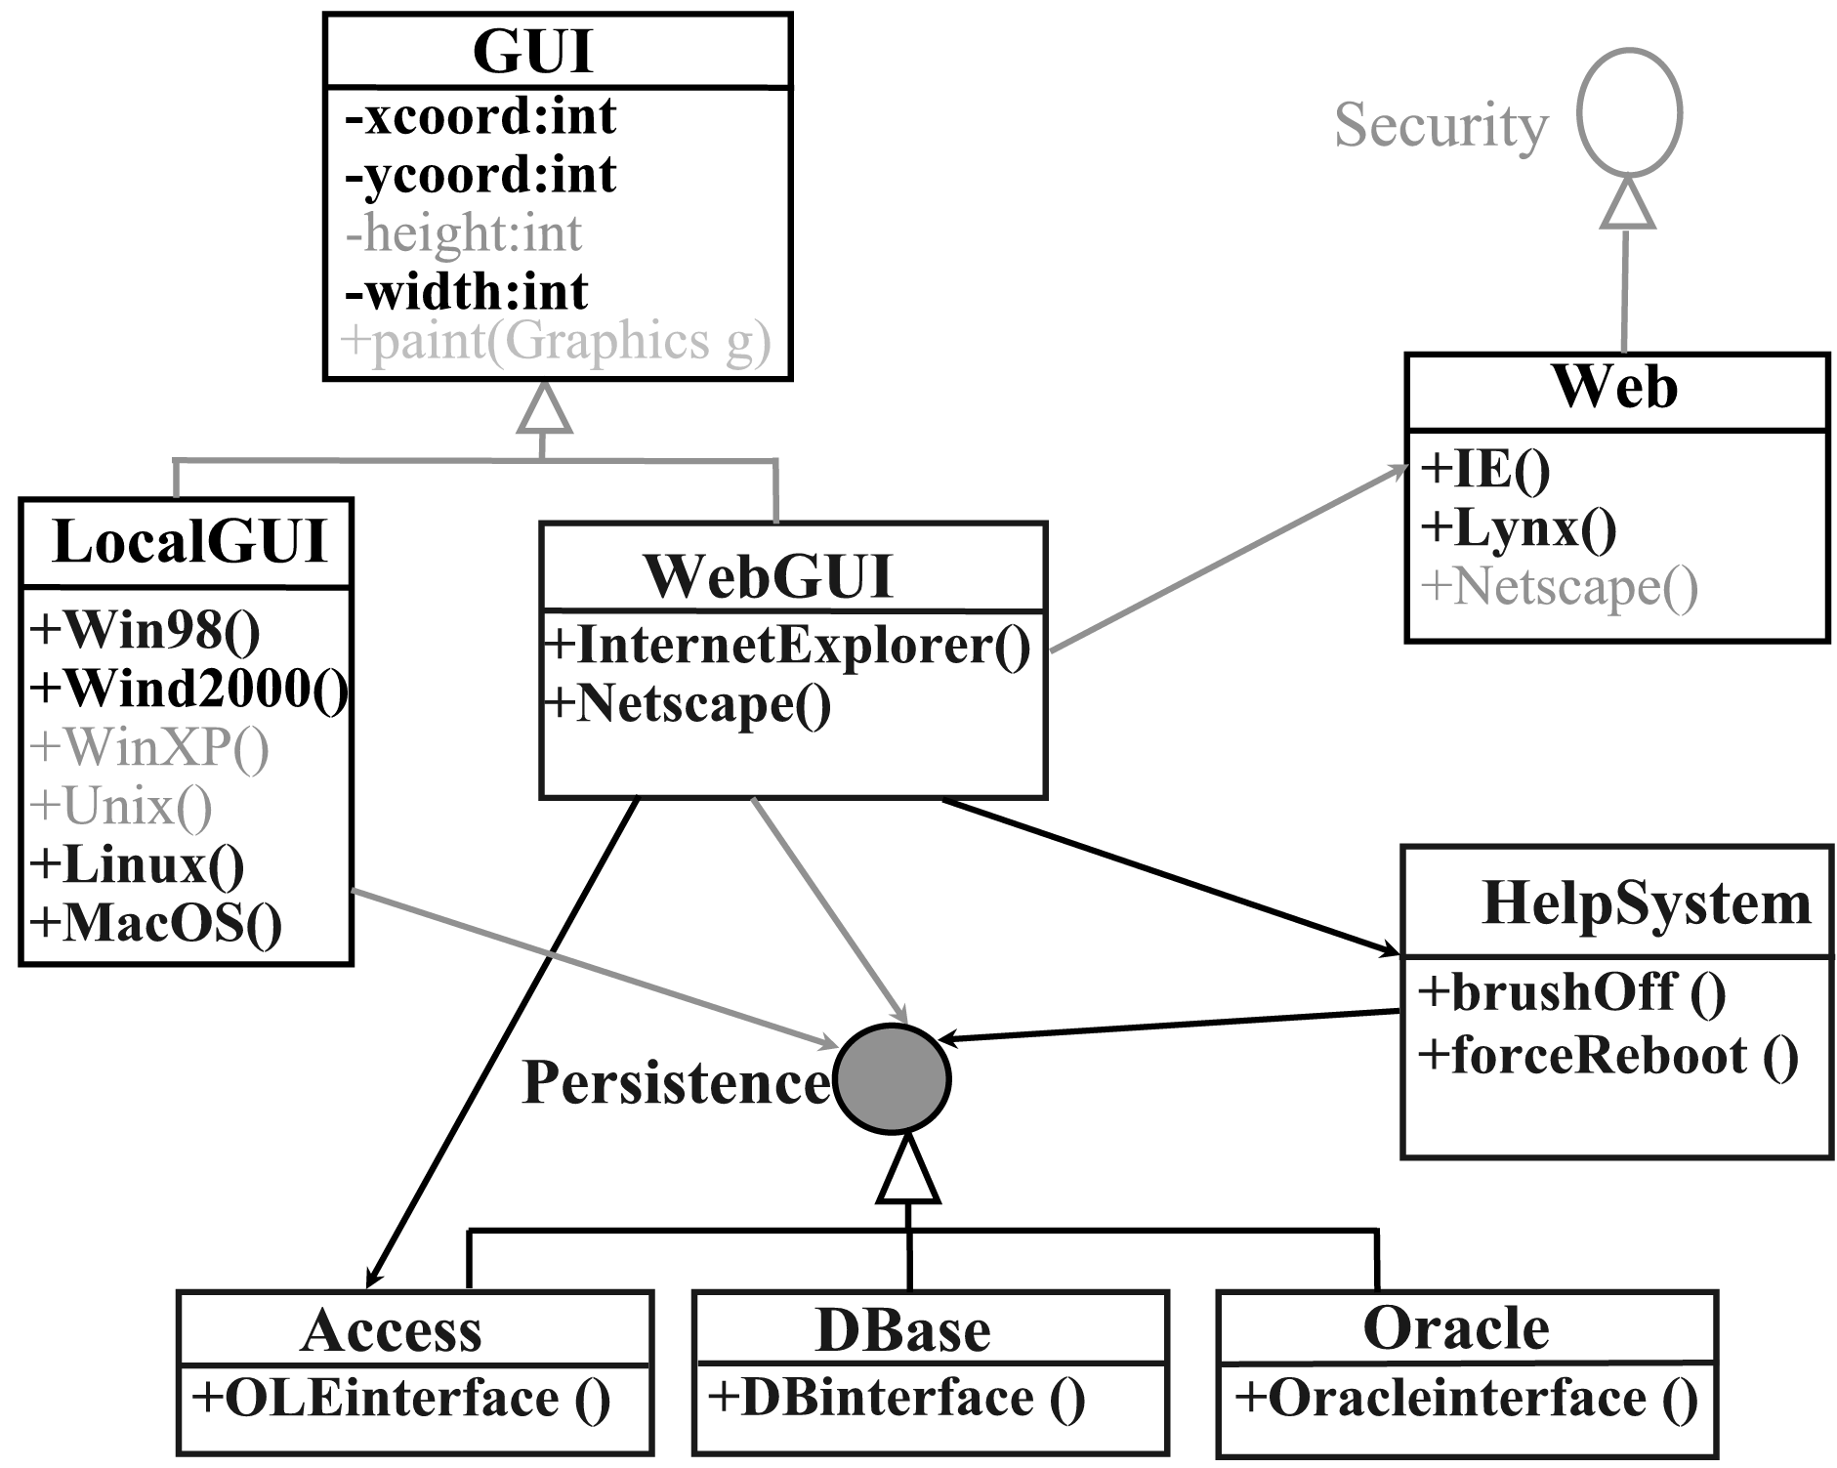
Even Simple Enhancements Can Be Of Great Value

Slide 11
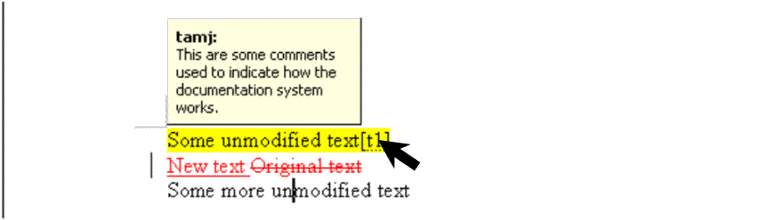
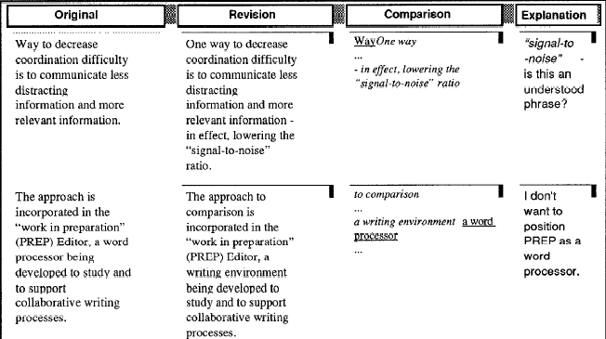
Current Approaches For Displaying Changes
Focus on text
Microsoft Word
(Microsoft 2004)
Flexible Diff (Neuwirth et al. 1992)

Slide 12
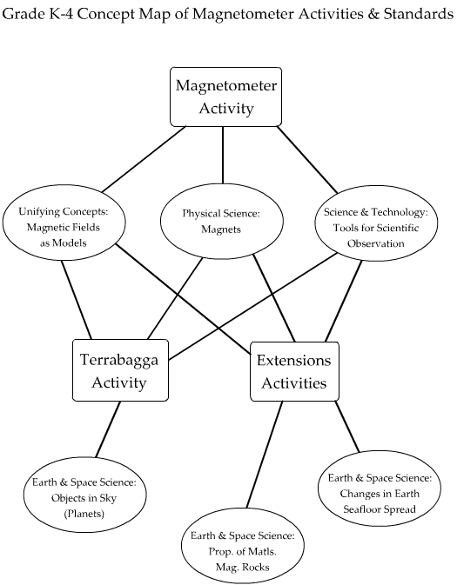
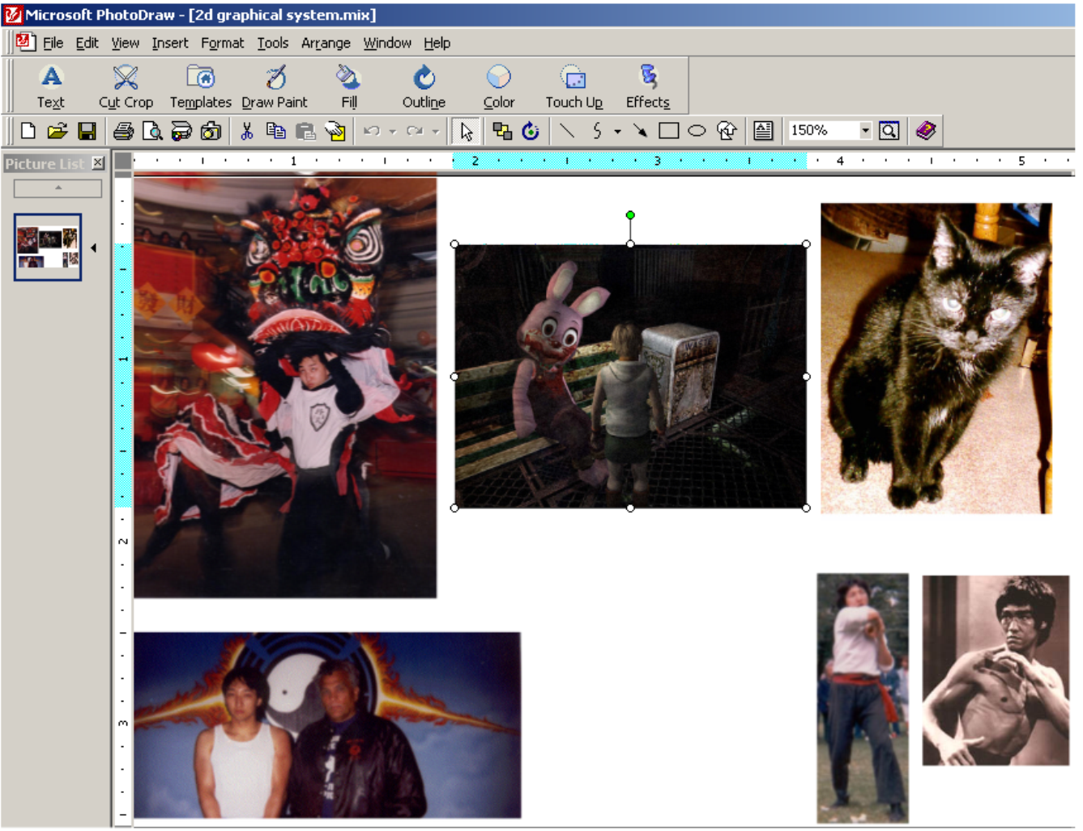
The Focus Of Our Research
Change awareness in two-dimensional graphical systems
Microsoft PhotoDraw (2000)

Slide 13
The Goal Of Our Research
To specify the information needed for someone to catch up with changes

Slide 14
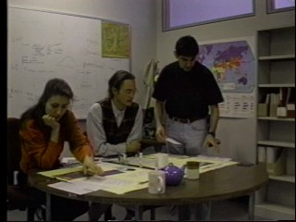
Theoretical Foundations
Gutwin’s framework for workspace awareness (Gutwin 1997)
Image from (Gutwin, Greenberg and Roseman 1996)

Slide 15
Our Focus
Change awareness (not real time)

Slide 16
How Do People Catch Up With Changes?
By asking questions
Before
After

Slide 17
High-Level Questions To Catch Up On Changes
Where?
Who?
What?
How?
When?
Why?

Slide 18
Answers To The High-Level Questions: Informational Elements
Where?
A: Location, gaze, edit history
Who?
A: Identity, presence, readership, authorship
What?
A: Action history
How?
A: Process and outcome history
When?
A: Event history
Why?
A: Cognitive and motivational history

Slide 19
Where?
Location history
Gaze history
Edit history

Slide 20
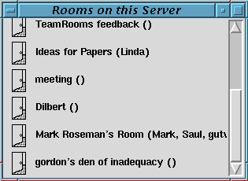
Where?
Location history
TeamRooms (Roseman and Greenberg 1996)

Slide 21
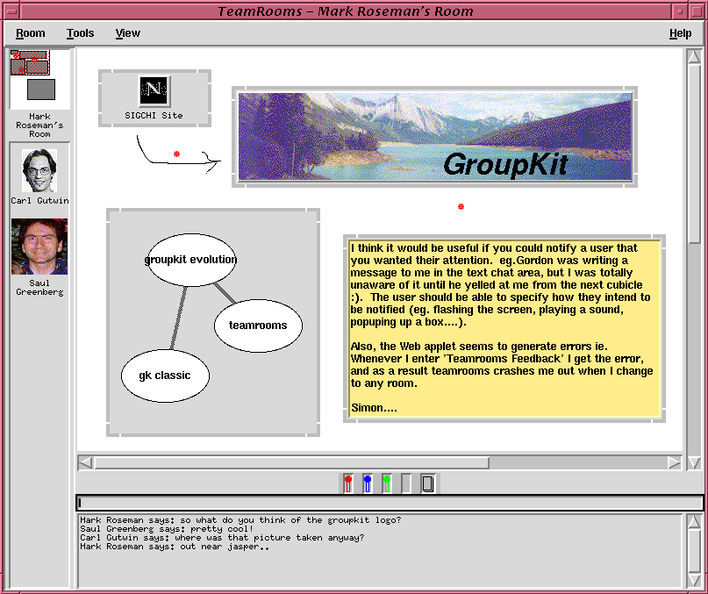
Where (2)?
Gaze history

Slide 22
Where (3)?
Edit history

Slide 23
Who?
Presence history
Identity
Readership history
Authorship history

Slide 24
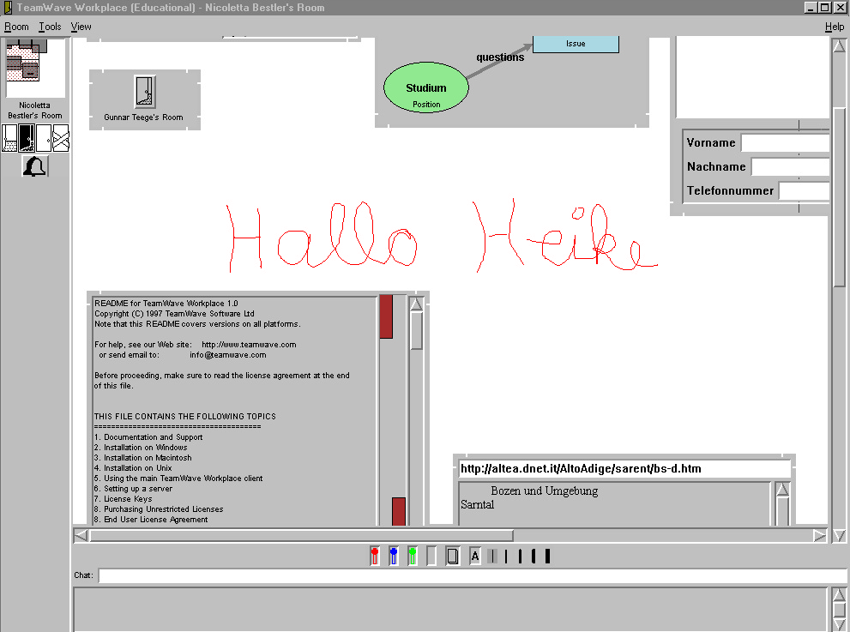
Who (2) ?
Presence history
???

Slide 25
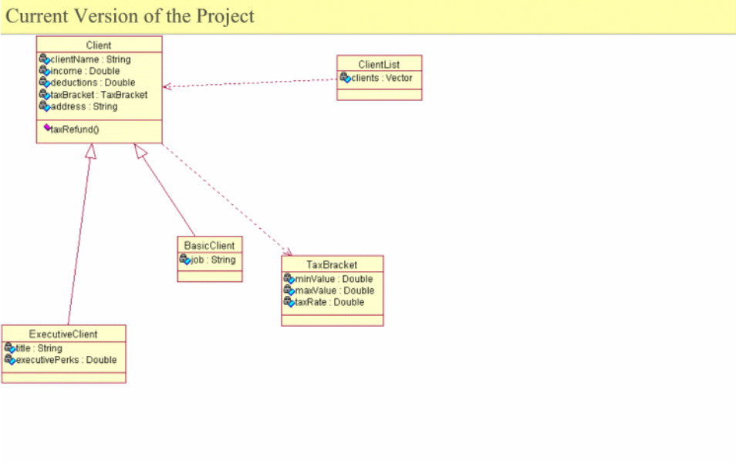
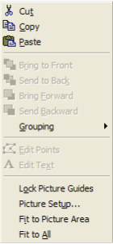
Who (3)?
Identity

Slide 26
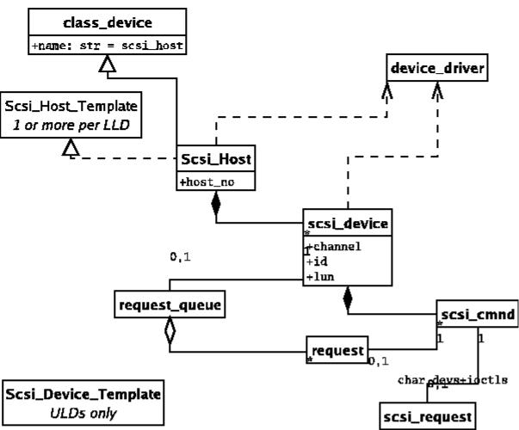
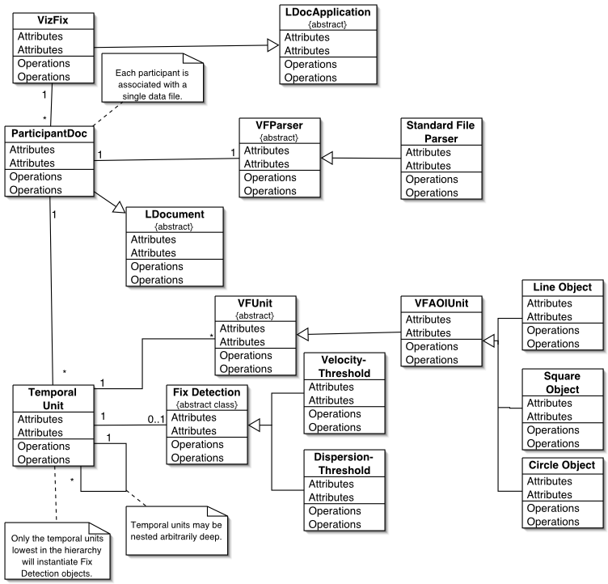
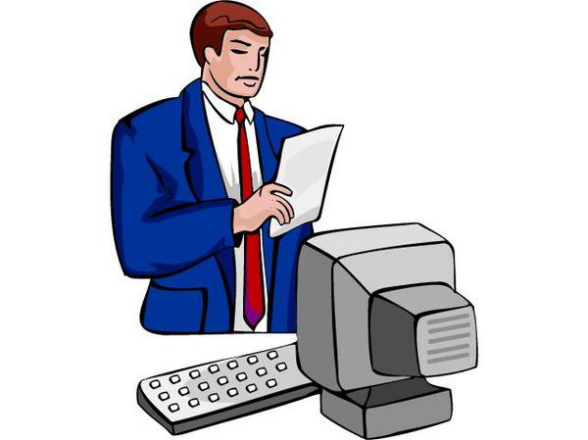
Who (3)?
Readership history
Bob

Slide 27
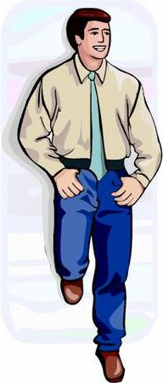
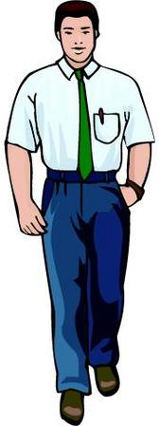
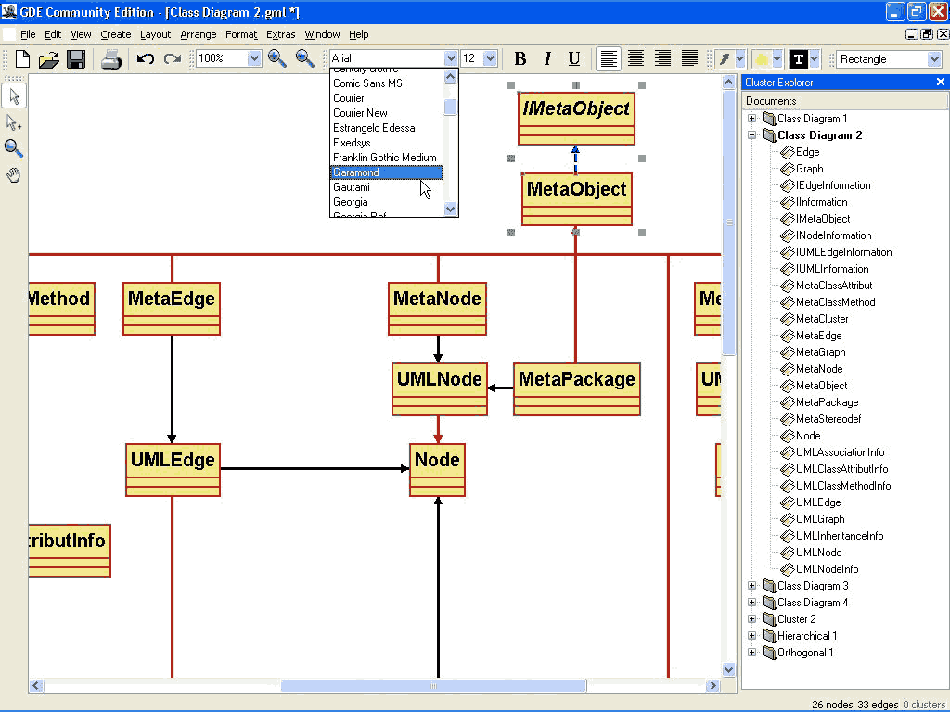
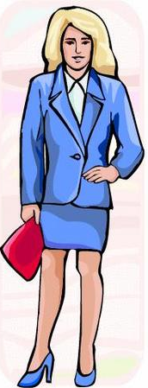
Who (4)?
Readership history
Sam
Fred
Mary

Slide 28
Who (5)?
Authorship history

Slide 29
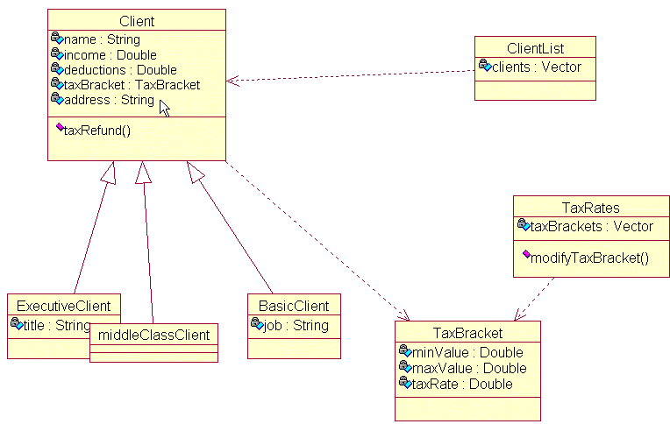
What?
Action history

Slide 30
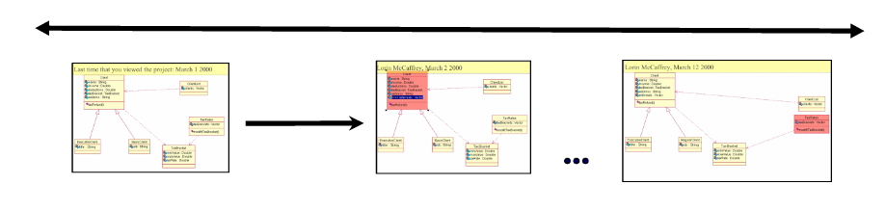
How?
Process history
Add: Attribute
Before
After

Slide 31
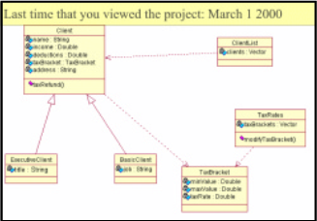
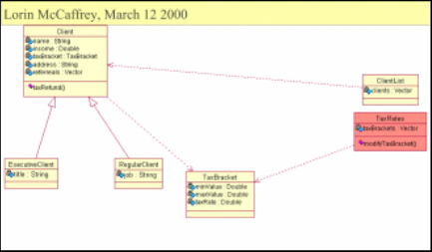
How (2)?
Outcome history
Before
After

Slide 32
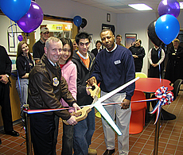
When?
Event history
Today’s news: Sept 6, 2004

Slide 33
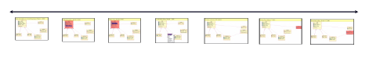
When (2)?
Event history
First
Last

Slide 34
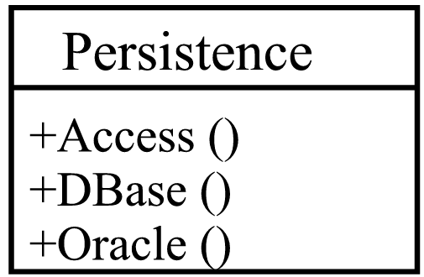
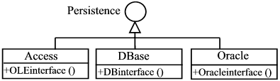
Why?
Cognitive history
Motivational history
Before
After

Slide 35
The Questions And The Informational Elements
Where?
A: Location, gaze, edit history
Who?
A: Identity, presence, readership, authorship
What?
A: Action history
How?
A: Process and outcome history
When?
A: Event history
Q: Why?
A: Cognitive and motivational history

Slide 36
Workspace Perspectives
Artifact-based
Person-based
Workspace-based

Slide 37
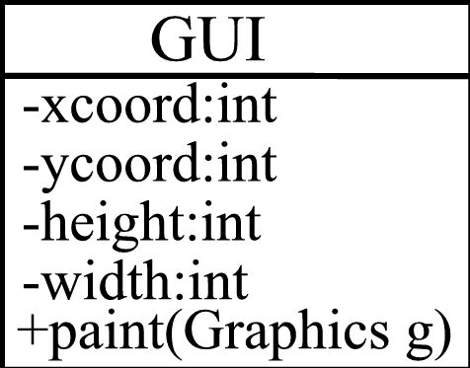
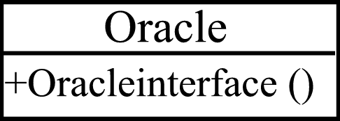
The Artifact-Based Perspective

Slide 38



The Person-Based Perspective

Slide 39
The Workspace-Based Perspective

Slide 40
Relating The Questions To The Workspace Perspectives
It may influence the questions asked

Slide 41
The Artifact-Based Perspective

Slide 42
The Person-Based Perspective

Slide 43
The Workspace-Based Perspective

Slide 44
Filtering Changes
Class WantsaFoo: added a new method called fooEnvy (Color green
Class LittleFoo: attribute nameOfFoo changed to name
Class LittleFoo: method getNameOfFoo changed to getName
Class LittleFoo: method setNameOfFoo now takes a String as an argument
ClassLittleFoo: method setNameOfFoo renamed to setName
Class Foo: added a data field lf of type LittleFoo
ClassFooUAll: added method fun ()
ClassFooUAll: added method fun2 ()
ClassFooUAll: added method noFun ()
Add Comments in the sticky note for class Foo
The realization relation between Class FooOrNotToFoo and class FooUAll was removed
Class FooOrNotToFoo was moved
Interface BlandInterface renamed to NotSoBlandInterface
  : : : : :

Slide 45
Some Of Filters
Basic change filters
Semantic filters
Hierarchical filters

Slide 46
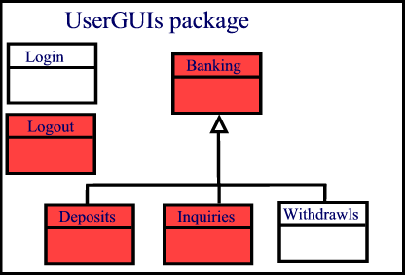
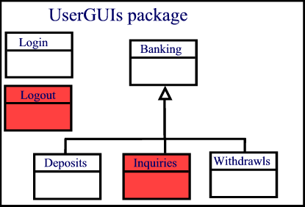
Basic Change Filters
Filtering changes according to the basic questions
Show all changes
Show only Bob’s changes

Slide 47
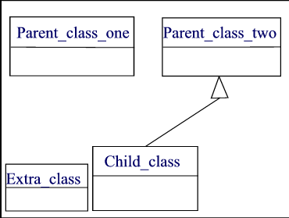
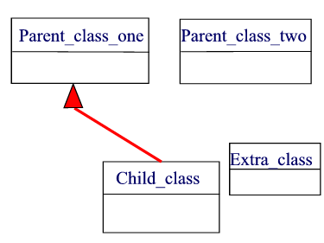
Semantic Filters
Show only changes that are meaningful for the particular task domain
Before
After

Slide 48
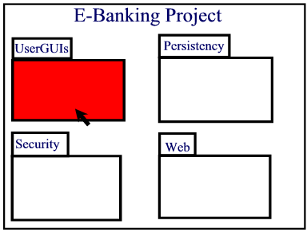
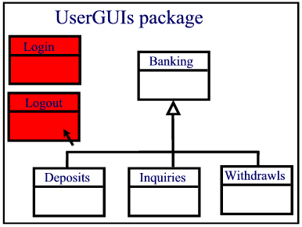
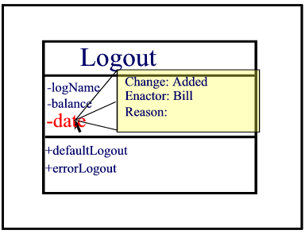
Hierarchical Filters
Displaying changes at different levels

Slide 49
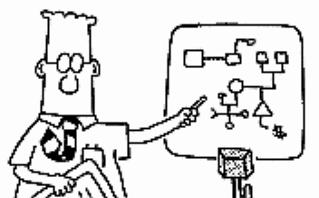
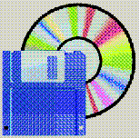
How The Framework Can Be Applied To Groupware
Before: A design guide
After: A critiquing tool
Dilbert © United Features Syndicate

Slide 50
What We Have Done
Created a framework for change awareness:
  High-level questions?
  A: Informational elements
  Workspace perspectives

Slide 51

The Next Challenge
Using the framework to build a 2D graphical system that supports change awareness

