Slide 1

A Taxonomy of Tasks and Visualizations for Multimedia Histories of Casual Interactions
Charlotte Tang, Gregor McEwan & Saul Greenberg University of Calgary

Slide 2
The Message
You can design a tool for visualizing histories of multimedia casual interactions using our taxonomy of tasks and visualizations

Slide 3
Casual Interaction
Background

Slide 4
Casual Interaction
Background
Hi Mary

Slide 5
Casual Interaction
Background
Hi guys! Oh, there’s Sally!
Ask her along.

Slide 6
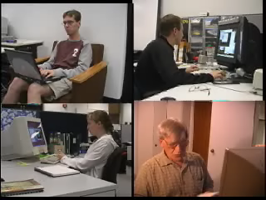
Distance impairs casual interaction
Background

Slide 7
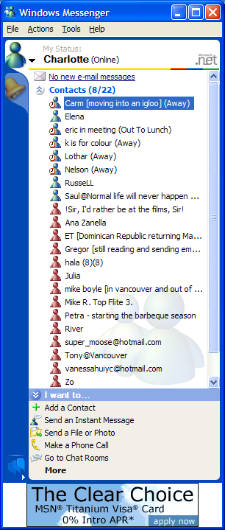
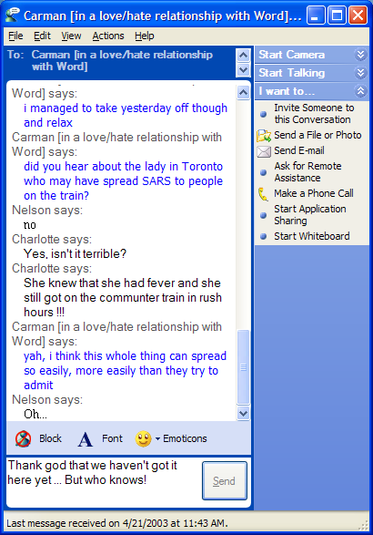
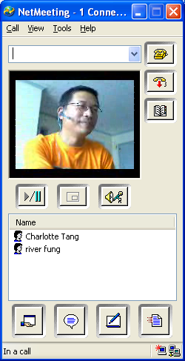
Technologies for casual interaction
Background
Help bring the sense of cohesion and proximity

Slide 8
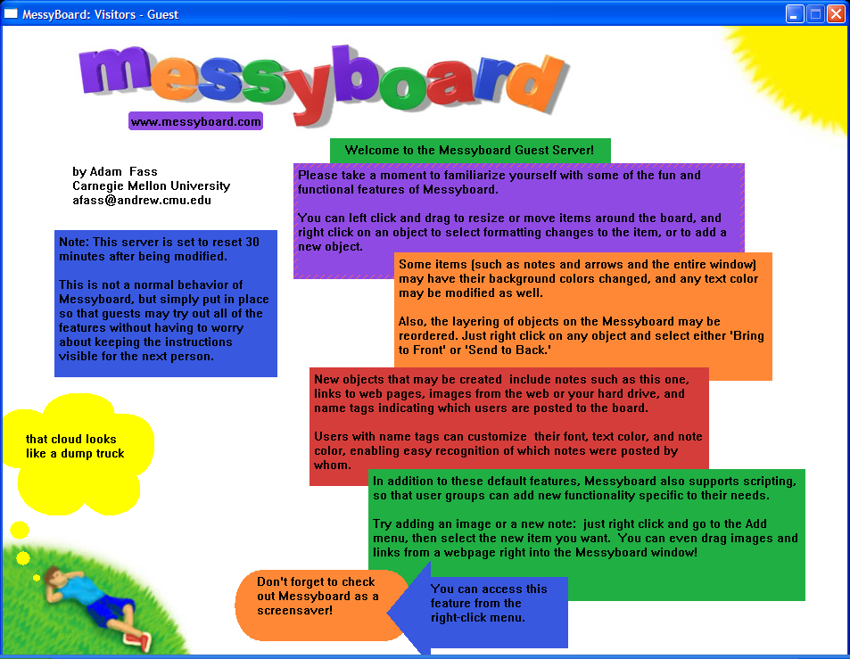
Messy Board
Background
(Fass, 2002)

Slide 9
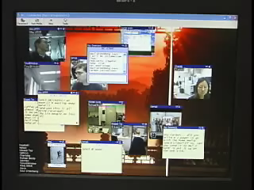
Notification Collage (NC)
Background
(Greenberg & Rounding, 2001)
Note: Video NCclip.WMV is played here

Slide 10

Notification Collage (NC)
Background
(Greenberg & Rounding, 2001)
Note: Video NCclip.WMV is played here

Slide 11
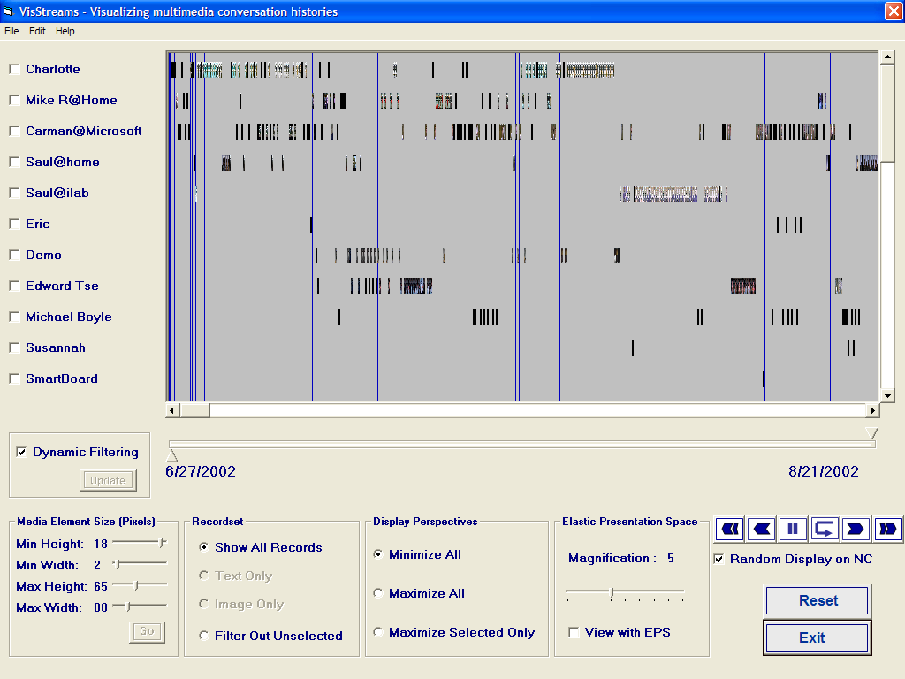
VisStreams
Background

Slide 12
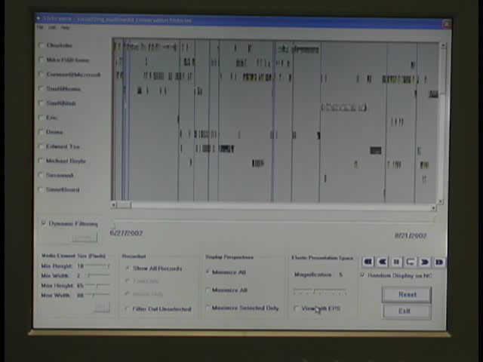
VisStreams
Background
Note: Video VisStreamsWithAudio1.WMV is played here

Slide 13

VisStreams
Background
Note: Video VisStreamsWithAudio1.WMV is played here

Slide 14
The Study
5 days of activities
13 computer science students
All used the NC for communication
All were doing research in HCI or InfoVis

Slide 15
Problem
The Study
What requirements should a tool for visualizing histories of multimedia casual interaction support?
  Tasks
  Visualizations

Slide 16
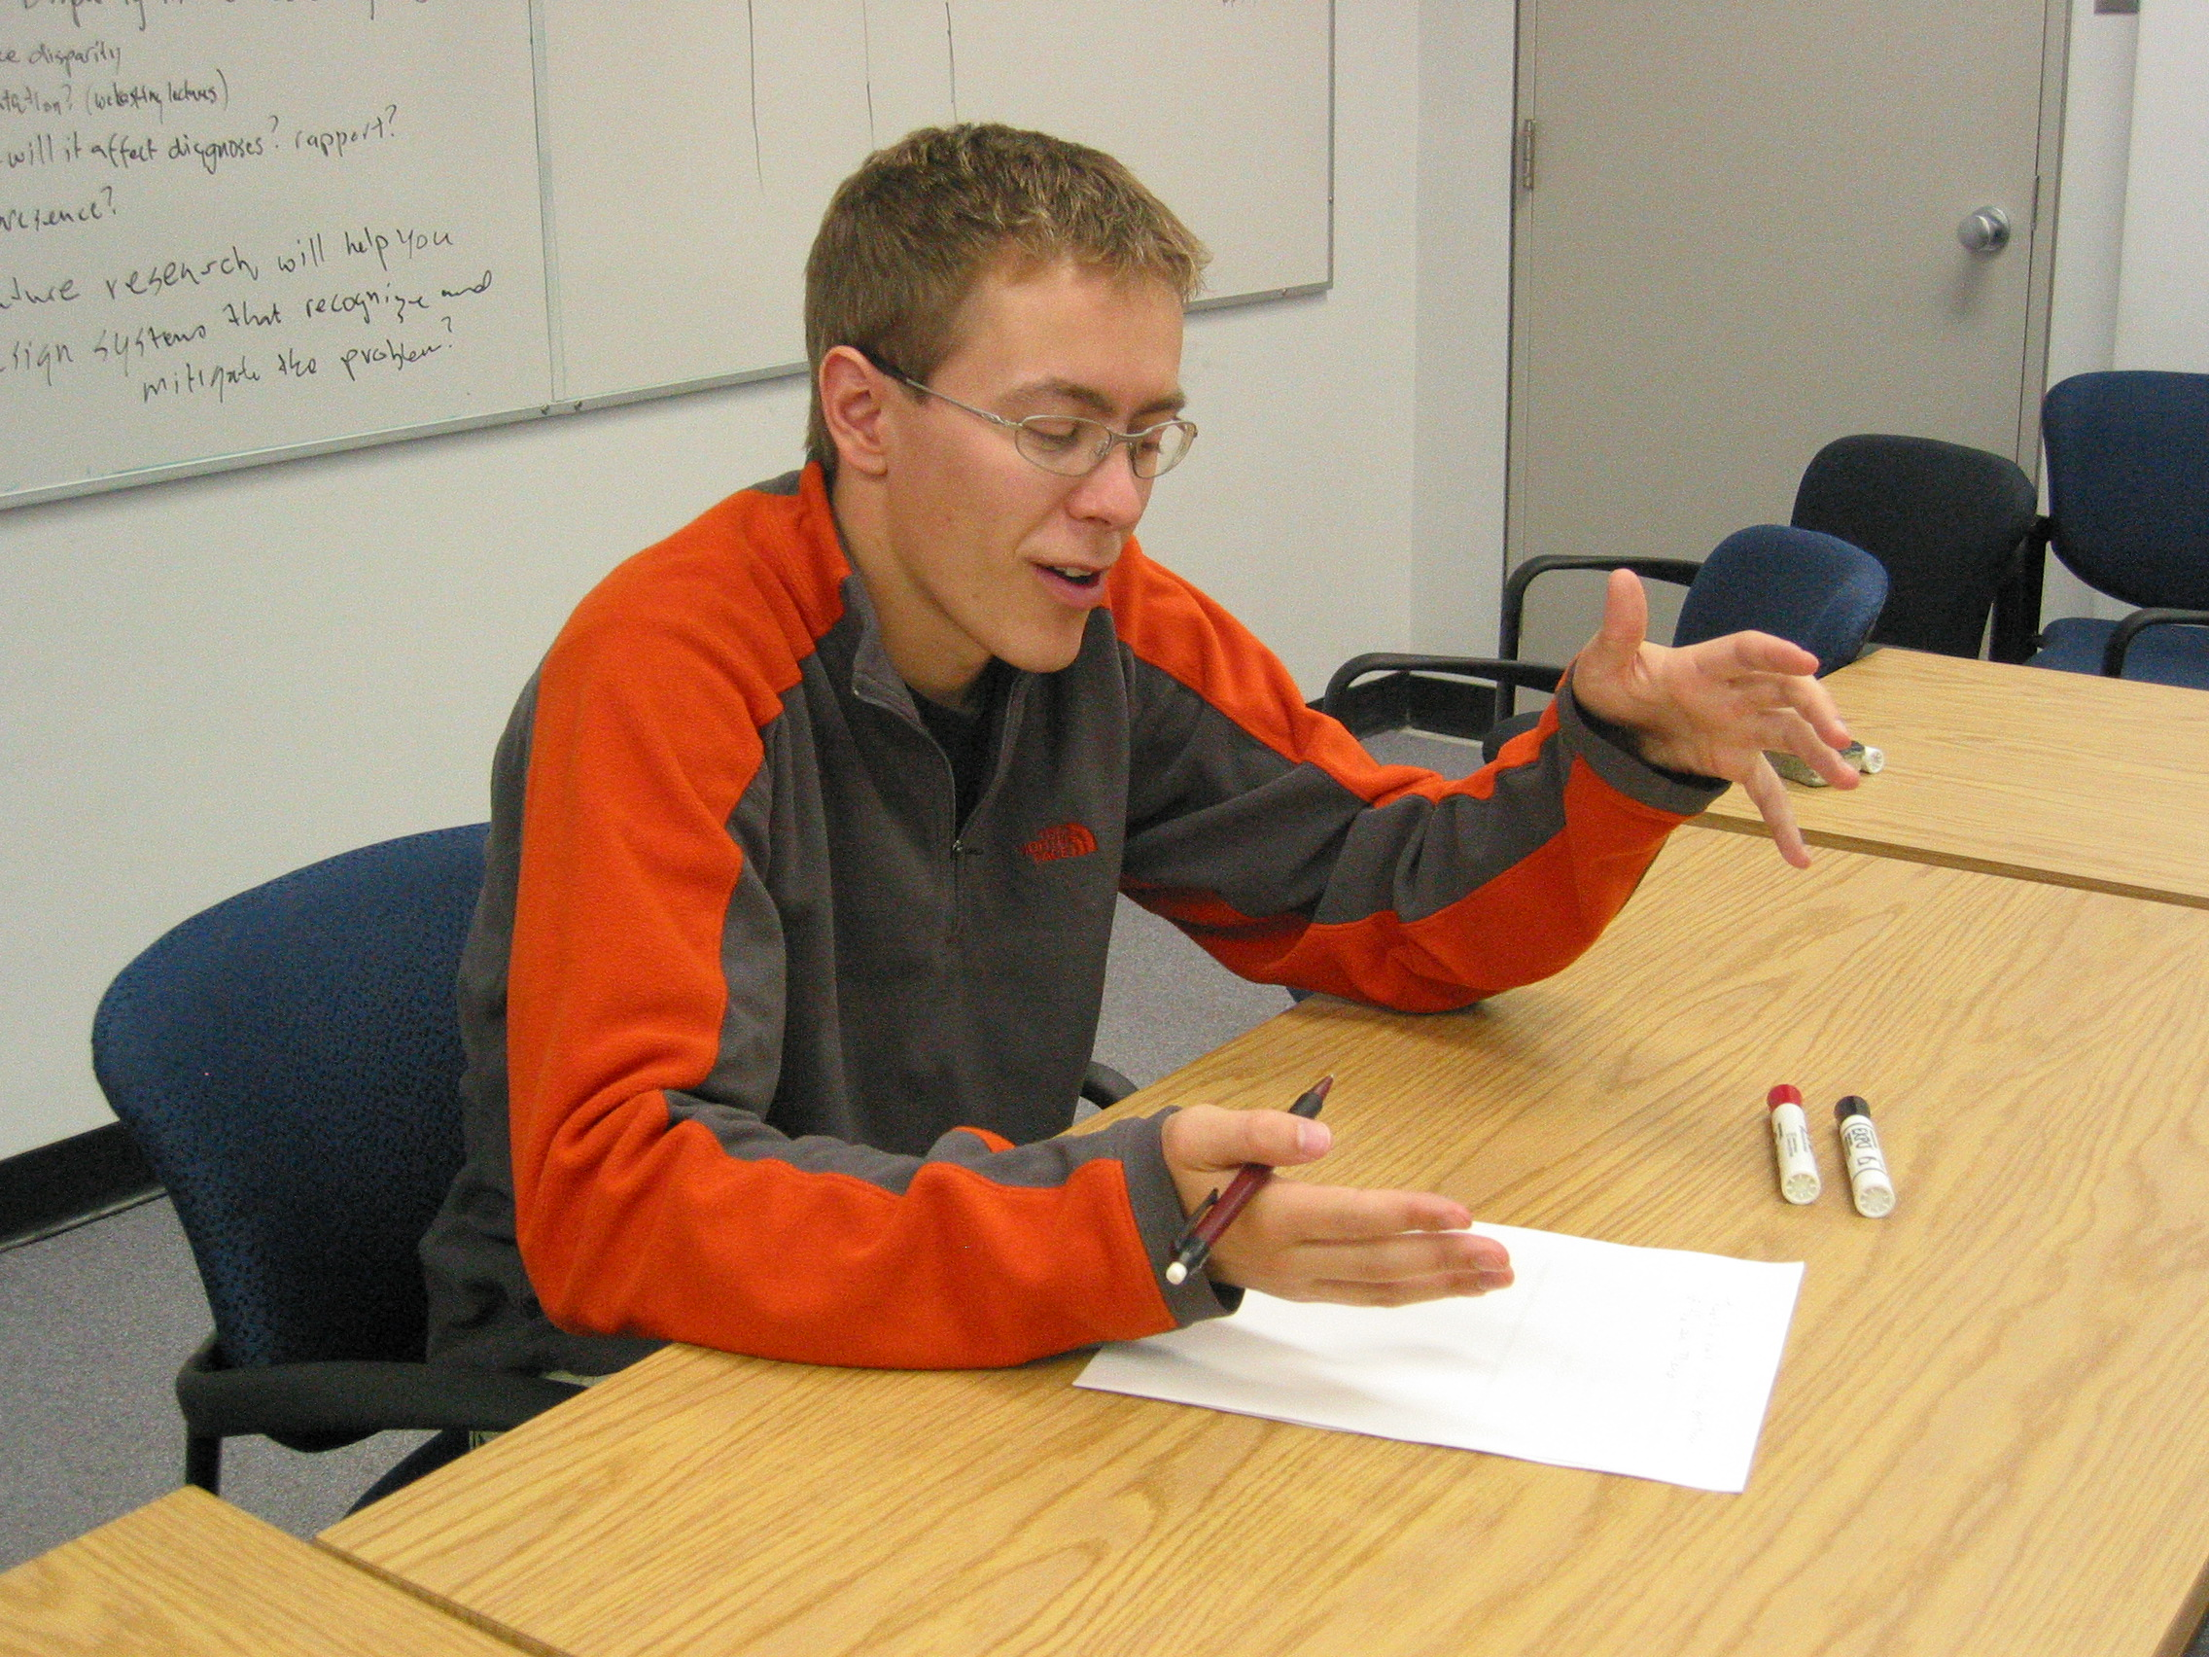
Step 1: Brainstorming
The Study
Tasks to perform
Questions to ask

Slide 17
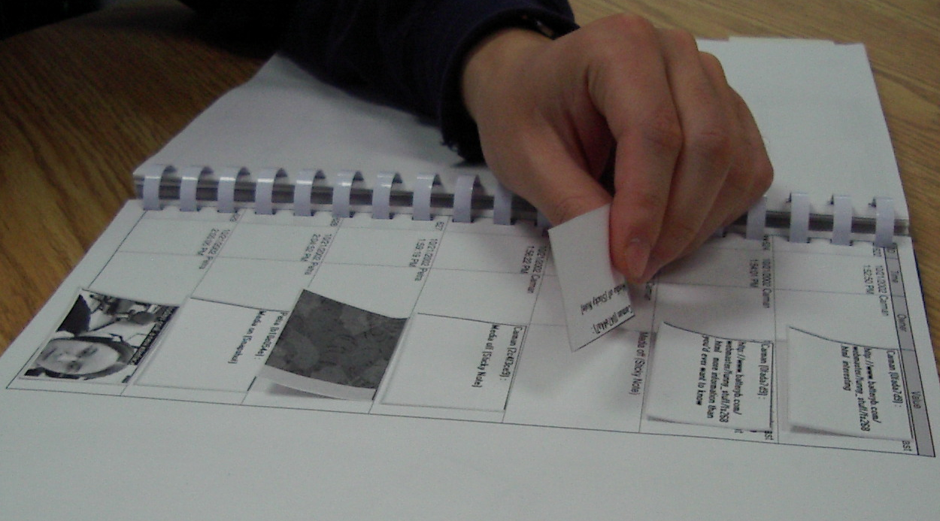
Step 2: Data Visualization
The Study
A booklet of interaction data
PostItTM notes & White board markers

Slide 18
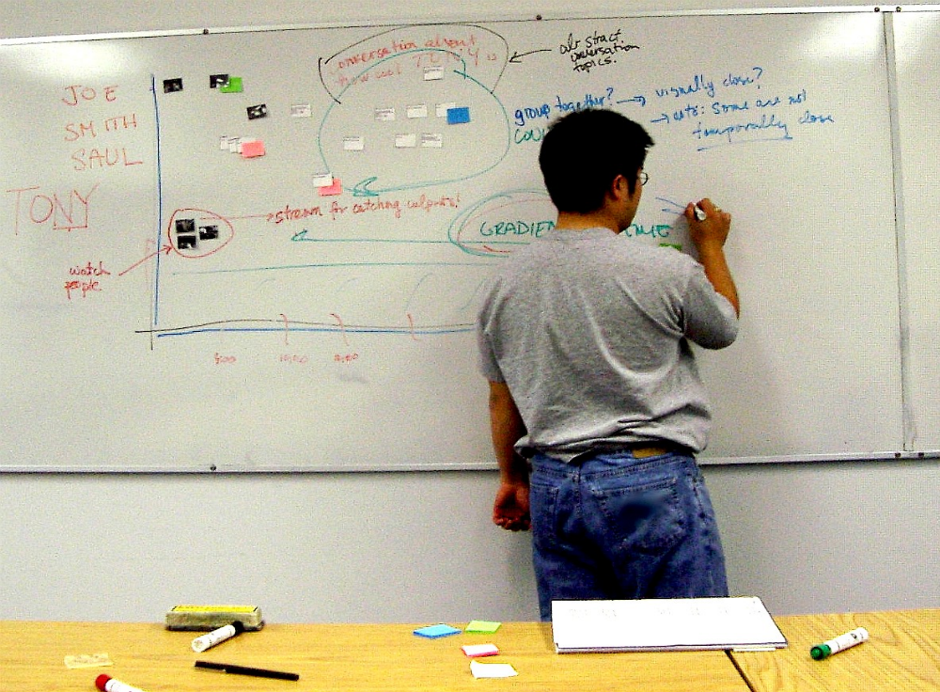
Example Visualization
The Study

Slide 19
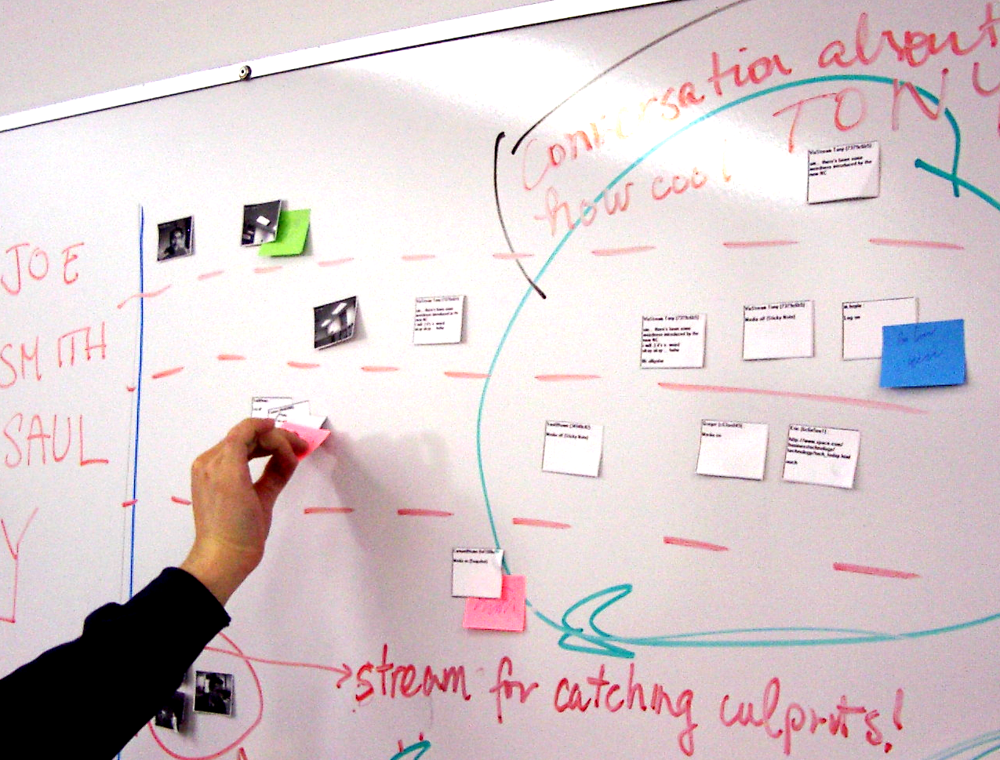
Visualization Close-up
The Study

Slide 20
Analysis
The Study
Task Categories
Visualization parameters
Visualization views

Slide 21
Task Categories
Analysis (1)
Interaction primitives | Conversations | Rhythms & trends | Descriptive statistics | Community & social networks
Perspective
of Group Member
of Researcher

Slide 22

Task Categories
Analysis (1)
Interaction primitives | Conversations | Rhythms & trends | Descriptive statistics | Community & social networks
I’m amazed how the slickness of the wet tarmack on the roads really comes through in the video snapshot....

Slide 23
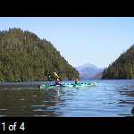
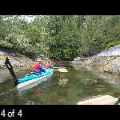
Task Categories
Analysis (1)
Interaction primitives | Conversations | Rhythms & trends | Descriptive statistics | Community & social networks
2 matches in a row this weekend,
Who’s gonna bring the
Soccer practice Monday
Oh, the water there was so clear
Photos taken on picnic day are posted
Picnic
Soccer Game
Photos taken on picnic day are posted here for you to
Soccer practice Monday afternoon
Who’s gonna bring the soccer balls and other
2 matches in a row this weekend, we’ll
Oh, the water there was so clear and blue!

Slide 24
Task Categories
Analysis (1)
Interaction primitives | Conversations | Rhythms & trends | Descriptive statistics | Community & social networks
Break
Lunch
8am
10am
12pm
2pm
4pm

Slide 25
Task Categories
Analysis (1)
Interaction primitives | Conversations | Rhythms & trends | Descriptive statistics | Community & social networks
Mary
John
Eva
Chris
100
Peter
Carrie
Bernard
Amanda
50
# of messages posted

Slide 26
Task Categories
Analysis (1)
Interaction primitives | Conversations | Rhythms & trends | Descriptive statistics | Community & social networks
John
Mike
Chris
Don
Eva
Carrie
Mary
Bernard
Peter

Slide 27
Task Categories
Analysis (1)
Interaction primitives | Conversations | Rhythms & trends | Descriptive statistics | Community & social networks
Perspective
of Group Member
of Researcher

Slide 28
Visualization Parameters
Analysis (2)
Time scale Conversational granularity Level of detail Media element streams Data perspective

Slide 29
Visualization Parameters
Analysis (2)
Time scale Conversational granularity Level of detail Media element streams Data perspective
Jan 2002
May 2003
5 weeks
3 days
12 minutes
8 months

Slide 30
Visualization Parameters
Analysis (2)
Time scale Conversational granularity Level of detail Media element streams Data perspective
Soccer practice Monday afternoon
Who’s gonna bring the soccer balls and other
2 matches in a row this weekend, we’ll

Slide 31

Visualization Parameters
Analysis (2)
Time scale Conversational granularity Level of detail Media element streams Data perspective
I hope he can feedback on it.
Wow, Mike finished his article
It’s in lab site
Char is going to Halifax next

Slide 32
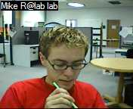
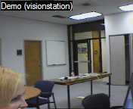
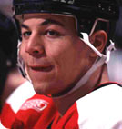
Visualization Parameters
Analysis (2)
Time scale Conversational granularity Level of detail Media element streams Data perspective
Carrie
Peter how are you
Fine, how ae you?
Is Saul around?
I hope he can feedback on it.
Wow, Mike finished his article
It’s in lab site
Char is going to Halifax next
It’s raining bad now ☹
Soccer practice still?
Better weat water-proof outfit
Anyone knows the toolkit?
Peter
Bernard
8:00
10:00
12:00
14:00
16:00

Slide 33
Visualization Parameters
Analysis (2)
Time scale Conversational granularity Level of detail Media element streams Data perspective
Can anyone direct me to appropriate papers for conversation theories?
Sheelagh will know that but she’ll only be back next week.
Why don’t you check the Communications faculty ?

Slide 34
Summary
Task categories
Interaction primitives
Conversations
Rhythms & trends
Descriptive statistics
Community & social networks
Visualization Parameters Time scale Conversational granularity Level of detail Media element streams Data perspective

Slide 35
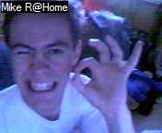
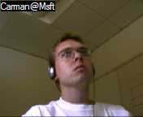
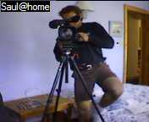
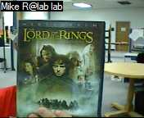
Detail View
Analysis (3) : Task-centered views
Mike R, I’ve brought the tripod back home to use.
Yeah, let me turn the video on.
Ouch!!! When will you bring it back? I want to tape NCWed.
Carman around?
Hey, Saul, what are you taping?
Harry Potter! Movie tonite?
Nice posture ☺
11:15
11:20
11:25

Slide 36
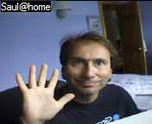
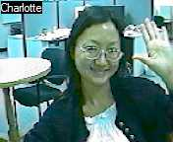
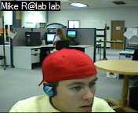
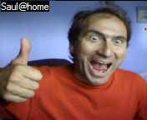
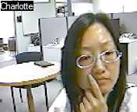
Conversation View
Analysis (3) : Task-centered views
Greeting gestures
Hiking in Canmore
VisStreams development
We’re going to have a pot luck dinner in Canmore
Hey, Mike What do you think about the overview?
It looks good to me! Can I change their height and
Which trail are we going to hike?

Slide 37
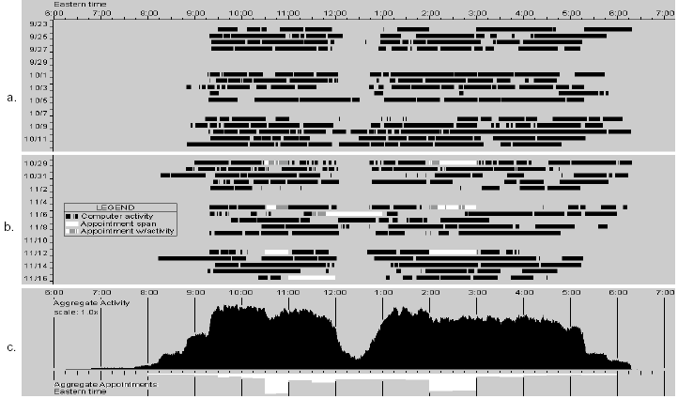
Rhythms and Trends View
Analysis (3) : Task-centered views
(Begole et al., 2002)

Slide 38
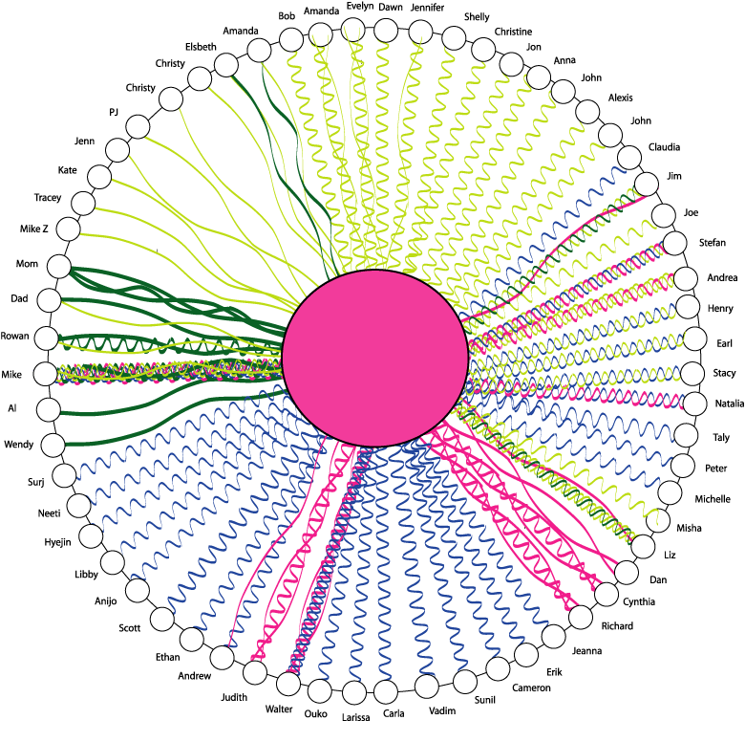
Community and Social Structures
Analysis (3) : Task-centered views
Joanie
(J. DiMicco, 2003)

Slide 39
Future Work
Prototype tools based on the taxonomy
Investigate how the tools actually used

Slide 40
The Message
You can design a tool for visualizing histories of multimedia casual interactions using our taxonomy of tasks and visualizations

