Slide 1
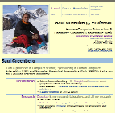


How People Recognize Previously Seen Web Pages from Titles, URLs and Thumbnails
Shaun Kaasten
Saul Greenberg
Christopher Edwards
University of Calgary
www.pages.ca … /index.html
Saul Greenber … d Groupware
A rough transcript of the talk accompanying this presentation is visible in the Edit Slides view
Notes:
My name is Saul Greenberg from the University of Calgary in Canada,
I’m delighted to be here at the British HCI conference.
I will present some work that my co-author Shaun Kaasten did as part of his MSc thesis,
with myself and Christopher Edwards as collaborators.

Slide 2
The Message
We can improve our web browsers by quantifying how people recognize previously seen web pages from its thumbnail, title and URL representation
www.pages.ca … /index.html
Saul Greenber … d Groupware
Notes:
The message of our presentation is that we can improve our web browsers by quantifying how people recognize previously seen web pages from its thumbnail, title and URL representation.
I’ll deliver this message
by first reviewing how revisitation systems in our current browsers represent previously seen pages,
and then I’ll introduce our study that let us quantify how well people recognize different web page representations,

Slide 3
Motivation
All pages
People revisit pages with surprising frequency
  60% of all pages were seen before!
60%
Notes:
First some motivation. Various researchers have found that 60% or more of all pages a person sees are ones they have visited before.
This statistic explains why virtually all browsers supply various revisitation system to help people return to previously seen pages – Back, History, and Bookmarks.

Slide 4

Motivation
All pages
People revisit pages with surprising frequency
  40% were seen 6 or fewer pages ago
60%
~40%
Notes:
Researchers also found that returning to pages follows a strong recency effect.
That is, many of these revisited pages are ones they had just seen a very short time ago.
For example, about 2/3rds of revisits, or 40% of all navigations, are to revisit a page just seen within the last 6 pages.
<Animate>
This explains the high popularity of the Back button, for it makes revisiting these pages just a few clicks away

Slide 5
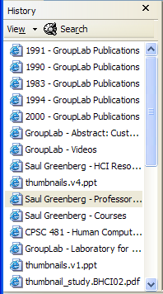
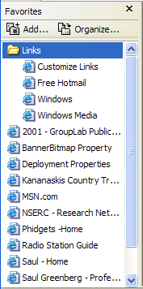
Motivation
All pages
People revisit pages with surprising frequency
  20% were seen further back
60%
~20%
History
Bookmarks
Notes:
But this also means that all remaining pages – about 20% of all navigations – are revisits to pages seen further back in time --- sometimes much further back.
Browsers supply alternatives to visiting these distant pages by supplying
<Animate>
.. a History List which automatically logs which pages you’ve been to, and lets you review and select pages from that list,
…as well as Bookmarks or favorites where people can save important pages for later recall.

Slide 6
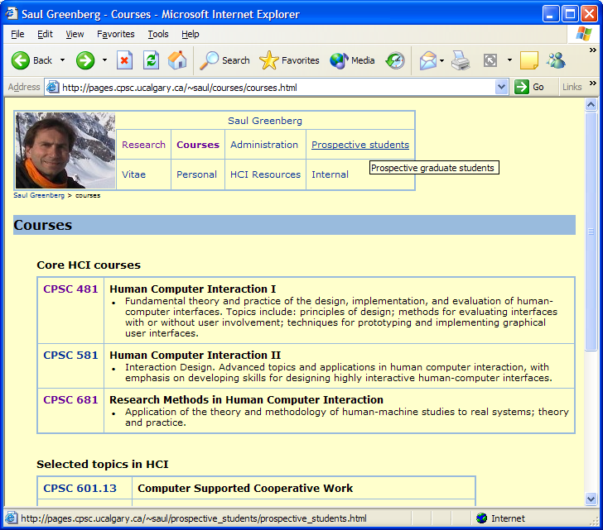
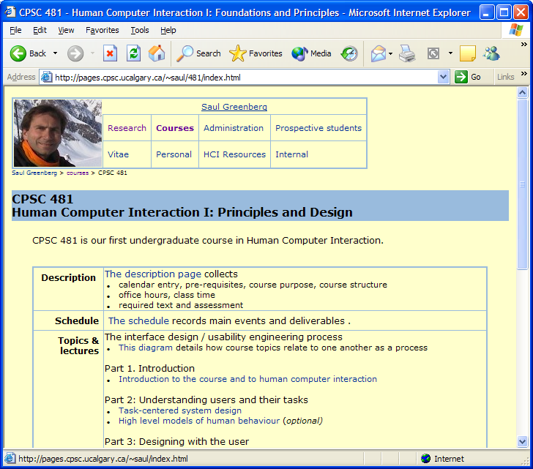
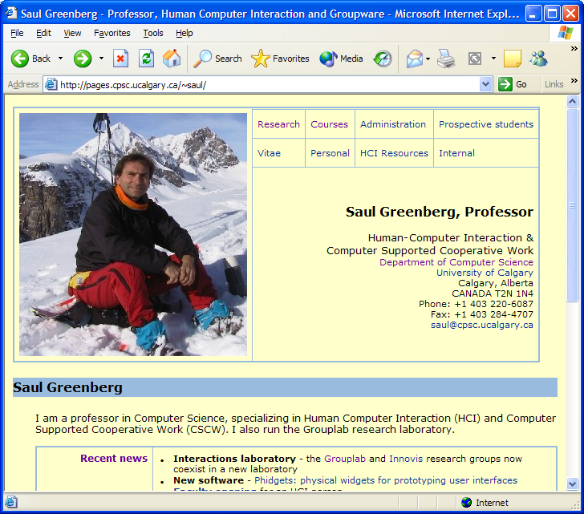
Recognizing previously seen pages
Back/Forward
Click until recognize
Notes:
Our interest is in how people recognize their previously seen pages from the Back, History and Bookmarks offerings?
With the back button, you just have to press it until you recognize the right page, which is easy as it is full size.
For example, if I want to return to my home page, I just click back until I see it.
<ANIMATE>
<ANIMATE>

Slide 7
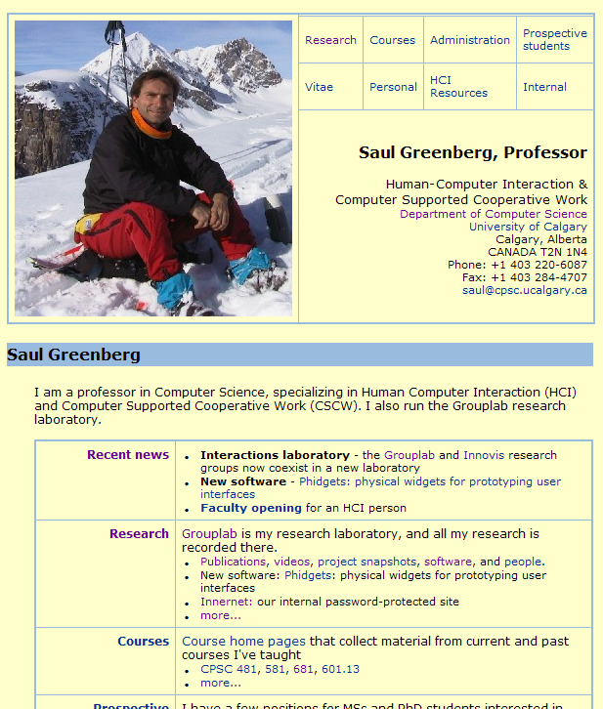
Recognizing previously seen pages
History / Bookmarks
Recognize page abstraction in a list
History
Bookmarks
Notes:
With bookmarks and the history list, though, pages are represented through an abstraction.
You have to recognize and pick that abstracted page from a list.
This can be quite tough – not only because of how these lists are organized, but also due to how the pages themselves are represented.

Slide 8
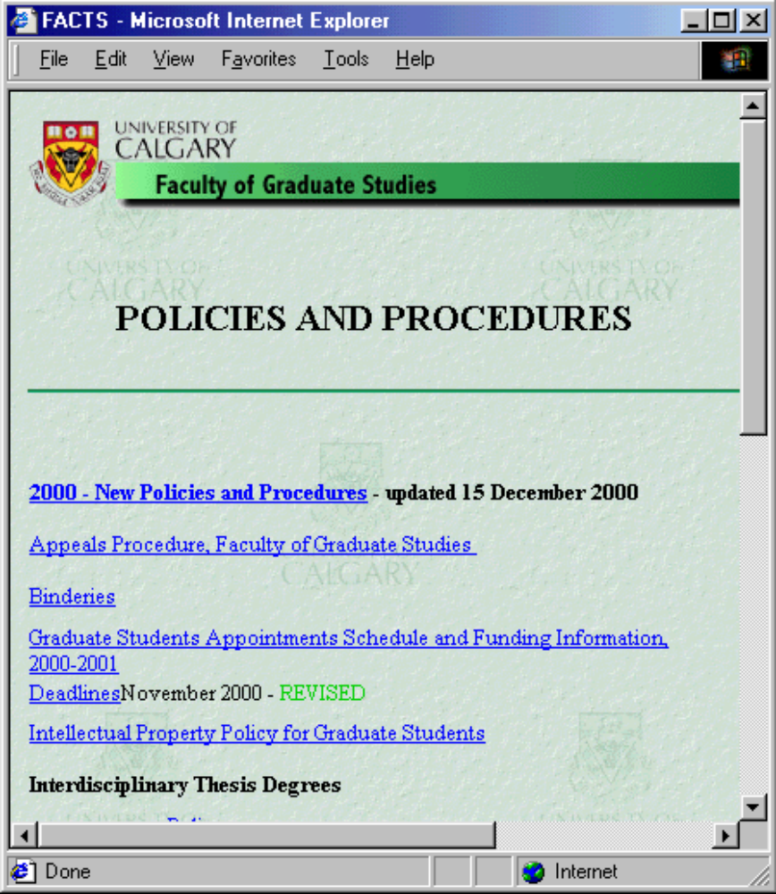
Recognizing titles
FACTS
Notes:
Most history and bookmark systems represent pages as text strings, with titles being the most common abstraction.
Titles are pulled out of a page’s html <title> tag.
Unfortunately, there are many problems with titles.
Many pages don’t have any.
They are often incorrect, often because the web creator copies an old page as a template for a new page, but forgets to change the title
Some web sites even use a single common title for all pages.
They may be uninformative, or
<ANIMATE>
As seen on this page, the title may differ – perhaps considerably - from the prominent text that the user sees on the page itself.

Slide 9
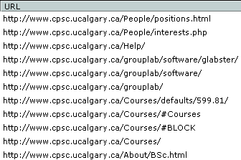
Recognizing URLs
Notes:
History and bookmark lists can also represent pages by their URL.
This too is wrought with problems.
While some URLs are human readable,

Slide 10
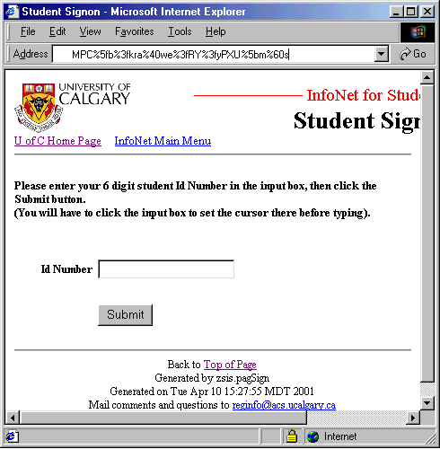
Recognizing URLs
https://dciswp.admin.ucalgary.ca/cgi_bin/ndCGI.exe/zsis_menu?SPIDERSESSION=FF%7cqT%5ddqyTXqApoH%5f%40KzBFJuCrEXVAK%5bFwoE%5dG%5bVK%5f%5b%60fPs%60mpOXFpq%5b%5bdZh%5bDXq%3f%5dcuCy%3fa%40V%7cryRsWgACDLqAy%5bjNh%5bdlq%5bmdQm%7ddqEY%5dw%7efIryVIhbWsUBBnA%5biY%60mNw%5bGwo%5eAPoR%5f%3f%5bqfQCpCtqX%3fQIGFf%5fEDw%5bzHWs%3fMPC%5fb%3fkra%40we%3fRY%3fyPXU%5bm%60s
Notes:
Others can be extremely long and even completely cryptic – especially when they are dynamically generated for web forms.

Slide 11
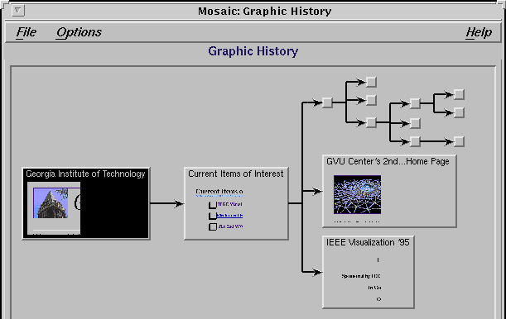
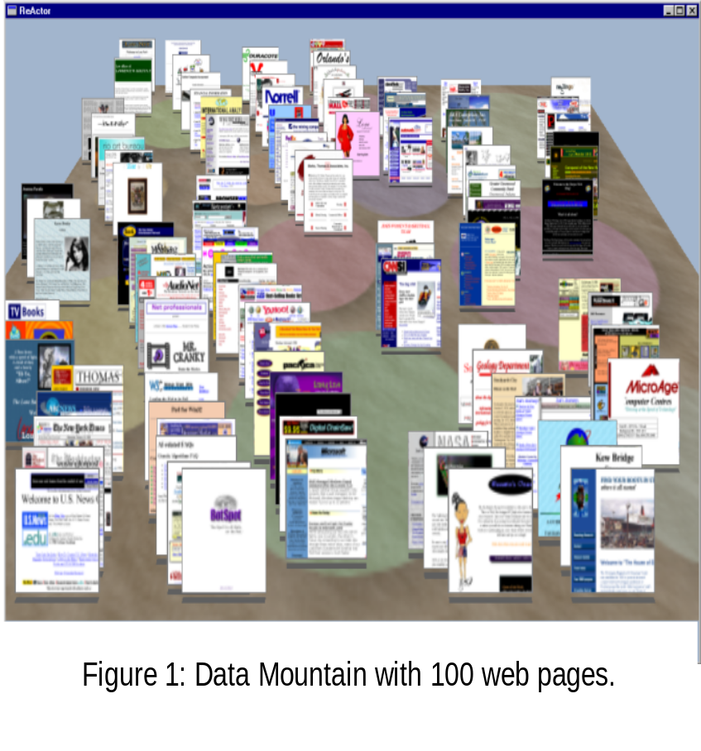
Recognizing page thumbnails
MosaicG
Ayers & Stasko
DataMountain
Robertson et al
Notes:
A third approach now seen mostly in research browsers are visual thumbnails – shrunken images of actual web pages.
These should be quite effective because they are showing what the user actually saw, albeit shrunken down
In most these systems, thumbnails are included in novel visualization schemes,
such as the MosaicG for displaying history hierarchies, or the 3d Data Mountain for organizing favorites by spatial location.

Slide 12
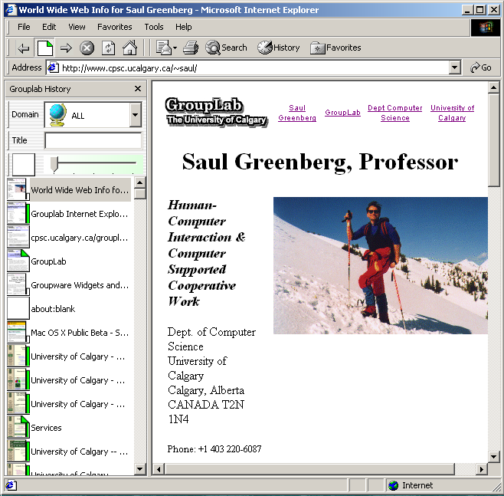
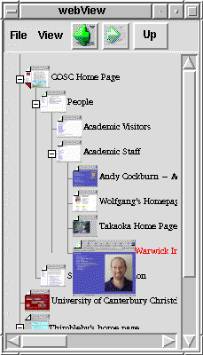
Recognizing page thumbnails
Unified History
Kaasten and Greenberg
WebView
Cockburn, Greenberg et al
Notes:
Part of our own research uses thumbnails in a space-compact integrated history and bookmark list.
We have two versions: our own Unified History system, and WebView done with Andy Cockburn.

Slide 13
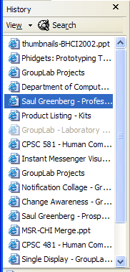
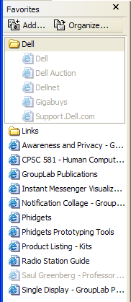
Recognition and representation size
Browsers limit representation size
27 characters
28 characters
Notes:
A major limiting factor for all of these representations is size.
History and bookmark lists are typically confined to a narrow sidebar next the browser window.
This is for good reasons – users aren’t keen on giving up space for helper utilities, and are unwilling to do the extra work manipulating full size pop up windows.
So what happens is that titles and URLs are truncated, limiting their recognizability.
For these examples, we see that the actual text string has to be truncated to fit between 25-30 characters.

Slide 14
Recognition and representation size
Title and URL truncation
Titles URLs
Right University of Calgary -- C... http://www.cpsc.ucalgary.c...
Middle University of...nce Home Page http://www.cp...plab/software
Left ...omputer Science Home Page ....gary.ca/grouplab/software
Notes:
And there are several different truncation methods.
We can truncate text starting from the right, middle or its left portion.
Each of these may lead to Titles and URLs of different recognizability.

Slide 15
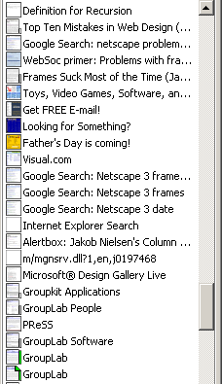
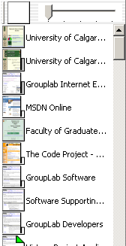
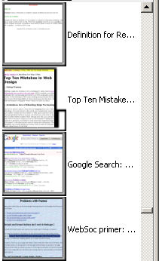
Recognition and representation size
Browsers limit representation size
Notes:
Thumbnails suffer similar sizing problems.
We can fit many small thumbnails into a constrained space as on the left, but they are difficult to recognize, especially when pages have a similar look to them.
But if we make them large as on the right, we can only see a few of them.

Slide 16

Experiment
How well do people recognize previously seen pages from different sizes of its title, URL or thumbnail?
Step 1:
  collect actual pages a subject visited before the study
Notes:
All this begs our research question:
How well do people recognize previously seen pages from different sizes of its title, URL and thumbnail?
If we can quantify this, then we can use it to analyze revisitation systems in existing browsers or guide the design of new ones.
Our methodology follows three primary steps.
First, How do we prime subjects with the web pages that they would have to recognize?
While we could have made our own artificial website, for ecological validity, we test people on pages they actually visited themselves, where they used their own strategies and followed their own goals.
We had subjects send us their actual history list from their browser, where the list contained whatever pages they had visited over the last several weeks.

Slide 17
Experiment
Step 2: find threshold where they can just recognize:
  web site
  exact page
ww
www.
www.cp
www.cpsc
www.cpsc.u
www.cpsc.uca
www.cpsc.ucalg
www.cpsc.ucalgar
www.cpsc.ucalgary.
www.cpsc.ucalgary.ca
www.cpsc.ucalgary.ca/~s
www.cpsc.ucalgary.ca/~sau
www.cpsc.ucalgary.ca/~saul/
www.cpsc.ucalgary.ca/~saul/in
www.cpsc.ucalgary.ca/~saul/inde
www.cpsc.ucalgary.ca/~saul/index.h
www.cpsc.ucalgary.ca/~saul/index.htm
www.cpsc.ucalgary.ca/~saul/index.html
S…e
Sa…ge
Sau…age
Saul…Page
Saul … Page
Saul G…e Page
Saul Gr…me Page
Saul Gre…ome Page
Saul Green…Home Page
Saul Greenb… Home Page
Saul Greenbe…– Home Page
Saul Greenber… – Home Page
Saul Greenberg…r – Home Page
Saul Greenberg,…or – Home Page
Saul Greenberg, …sor – Home Page
Saul Greenberg, P…ssor – Home Page
Saul Greenberg, Pr…essor – Home Page
Saul Greenberg, Professor – Home Page
Notes:
Next, we gave a person a very small title, URL, or thumbnail of their previously seen page – so small that it was virtually unrecognizable.
We then asked them to grow its size until they could just recognize what web site it come from, and then to continue growing it until they could state exactly what page it was.

Slide 18
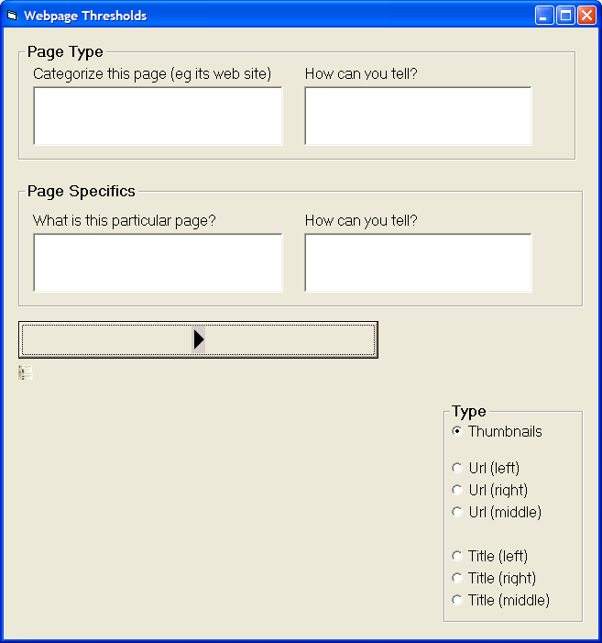
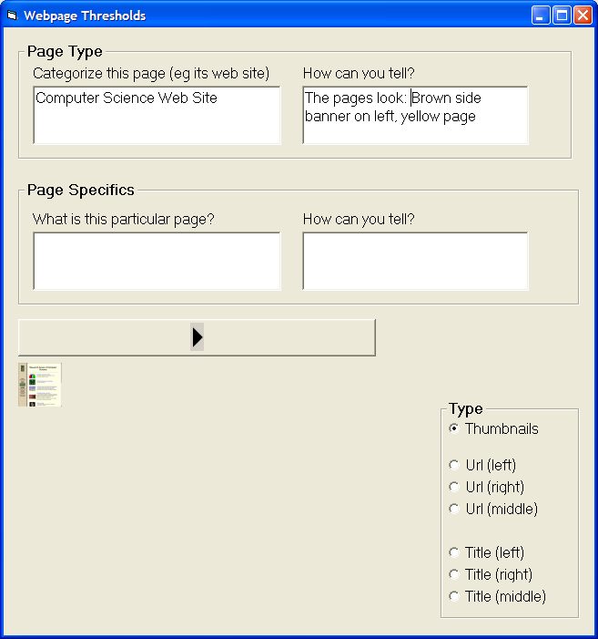
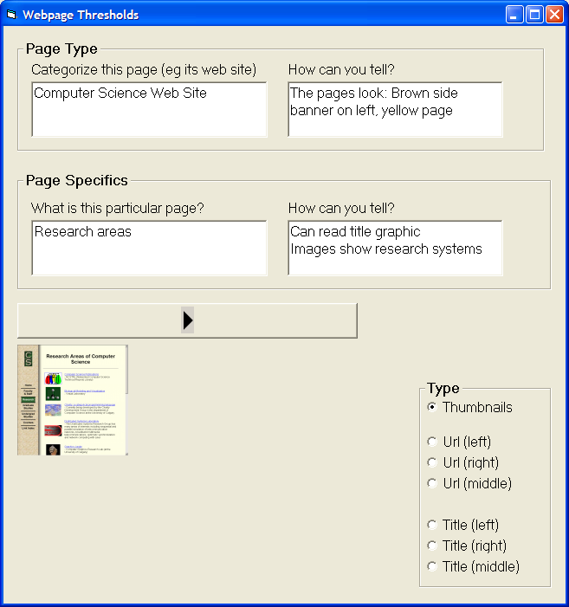
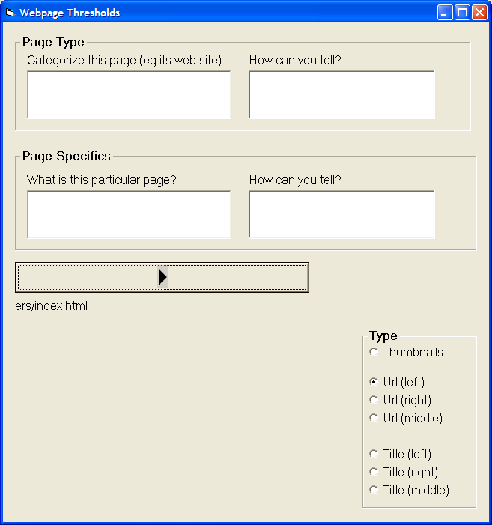
Experiment
A live demo of this system was done during the presentation
Notes:
Here is the software the person saw.
They would click this button, which in this case reveals a very small thumbnail.
<Animate>
They would keep clicking it, and when they could just recognize what web site it came from, they would describe the site as well as listing the attributes of the page that helped them recognize it.
<Animate>
They would keep on going to larger sizes, until they could recognize the exact page.
Again, they would describe it and list what helped them recognize it.
The system would record all this information,
<ANIMATE>
and go onto the next representation of a different page

Slide 19
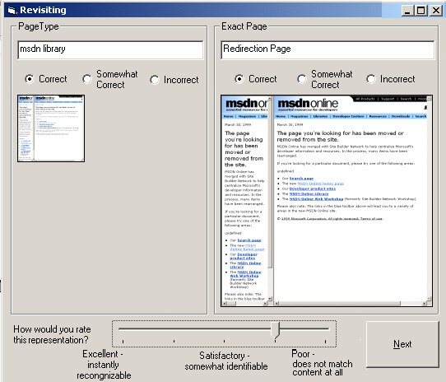
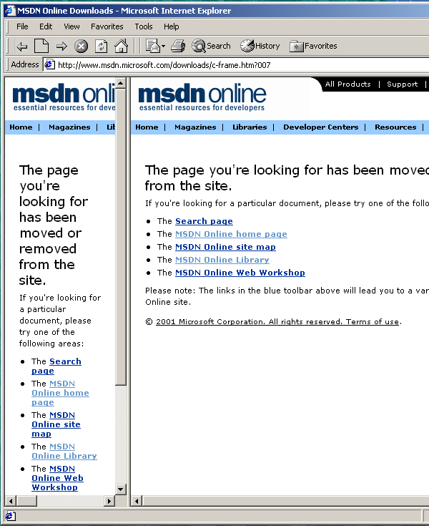
Experiment
Step 3: have them validate their guesses
Notes:
After the making their guesses for all these pages, we had them validate their guesses.
We showed them the size of the representation they stopped at for the web site and the exact page, as well as their answers, and also showed them the full sized page in a web browser.
We then asked them to judge whether the answer they gave was correct, somewhat correct or incorrect.

Slide 20
Research Question #1
What is the tradeoff between
thumbnail recognition vs. image size?
  web site
  exact pages
Notes:
I’ll now summarize some of our key results. The paper has far more details, and I encourage you to read it.
Our first research question was, how recognizable are thumbnails at a given image size?

Slide 21
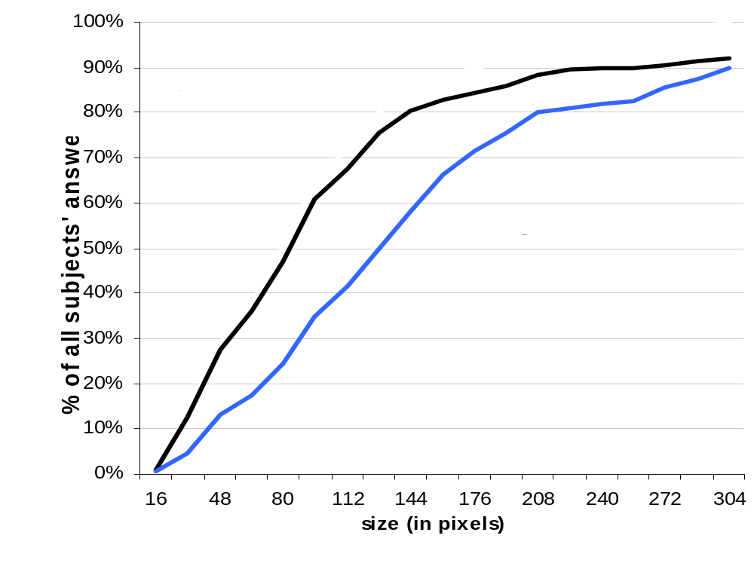
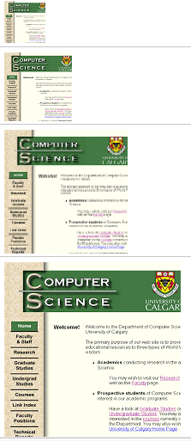
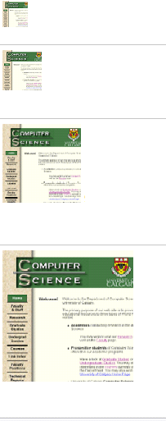
Thumbnails - recognition vs size
Notes:
This graph plots thumbnail image size on the x-axis, and how recognizable they are on the Y-axis.
Since the study is about thresholds, we are displaying the results as running sums – we wanted to see what size gives the best results.
The black line shows how often people could correctly recognize the web site at a given size,
while the blue line shows how well they recognized the exact page at that size.
This gives a cost-benefit. For example, if we are willing to make do with low web site recognition of (say) 30%, then a 48x48 pixel thumbnail would suffice
At the other extreme, if we wanted a high recognition of the actual web page of (say) 80%, then our thumbnail size should be much larger: 208x208 pixels.
The running sums also suggest the point at which increasing thumbnail size gives us diminishing returns by how they flatten out. We see that most of the web sites could be identified by size 144, while guessing the exact page flattens out around size 200.

Slide 22
Thumbnails - recognition vs size
Web site Exact page
15%
32
48
30%
48
80
60%
96
144
90%
160
208
This slide skipped during the live presentation
Notes:
This table shows the same data a bit differently.
If we set our recognition thresholds at 15, 20, 60 and 90% for low to high recognition, we can see at a glance what sizes we need for recognizing the web site (on the left) and the specific page (on the right).

Slide 23
Research Question #2
What makes thumbnails recognizable?
Notes:
Our second research question was what makes them recognizable?
If you remember, we asked participants to tell us which aspects of the thumbnail helped them recognize it.

Slide 24
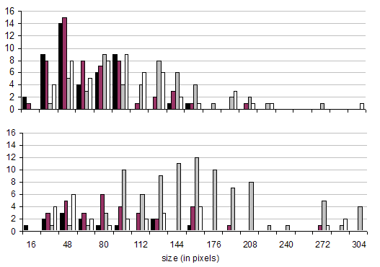

Thumbnails – what makes them recognizable?
Web site
Exact page
Notes:
This graph shows the reasons they gave at different sizes..
At small sizes, gross features such as color and layout --- the dark bars on this graph --- was useful for recognizing the web
While picking out actual text and to a lesser extent seeing image details --- the light bars --- were useful for recognizing exact page details.
We should add that the text we are talking about is NOT the title text, but the graphical headings seen in the actual page.

Slide 25
Research Question #3
What is the tradeoff between
title recognition vs. truncation size?
  web site
  exact pages
Notes:
Our third research question asks a similar question about Titles.

Slide 26
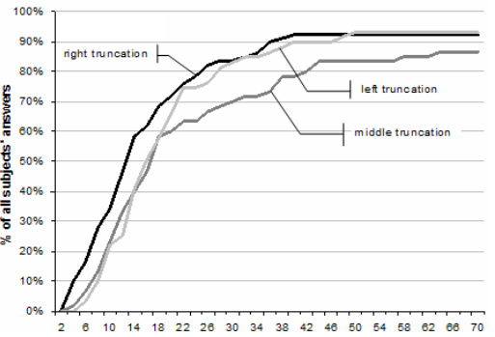
Title – web site recognition vs size
Right truncation
Grouplab Resear…
Notes:
In general, people were very good – about 90% recognition --- at identifying web sites from their titles if they could see almost all of it.
<ANIMATE>
Depending on the truncation method, we get low recognition of around 30% if we can see only 7-12 letters of the title
<ANIMATE>
Things are much better around 26 letters, where left and right truncation gives close to 80% recognition.
Generally, right truncation appears best for web site identification.
This isn’t surprising because many titles begin with the web site name, as in “Grouplab Research – Home Page” and the right-truncation optimizes for this beginning portion.

Slide 27
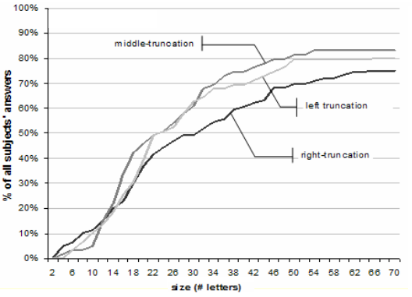
Title – exact page recognition vs size
Middle truncation
Grouplab… ome page
Notes:
People did not do as well recognizing exact pages from its title. Even when they could see most of the title, recognition was only around 80%
<ANIMATE>
To get 30% recognition, they needed to see around 15 letters.
<ANIMATE>
For high (80%) recognition, they needed much more --- about 43 letters with the best method.
<ANIMATE>
It also seems that, except at very low sizes, middle truncation was best for identifying the exact page --- the prefix gives context, while the suffix gives details

Slide 28
Research Question #4
What is the tradeoff between
URL recognition vs. truncation size?
  web site
  exact pages
Notes:
We then repeat the same question but now looking URL recognition vs truncation size.

Slide 29
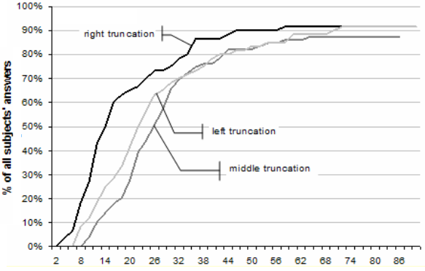
URL – web site recognition vs size
Right truncation
www.ucalgary.ca/...
Notes:
Similar to titles, people could recognize the web site from its URL about 90% of the time if they could see almost all of it..
<ANIMATE>
When size is taken into account, the right truncation method stood out as best for web site identification.
This is expected, as the web site name is often reflected within its URL prefix e.g., www.ucalgary.ca for the University of Calgary.
<ANIMATE>
For 30% recognition, we need to see about 10 letters using right truncation…
<ANIMATE>
while to achieve 80%, we needed 32 letters.

Slide 30
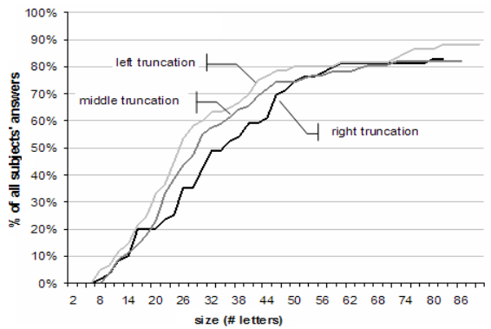
URL – exact page recognition vs size
Left truncation
…/thumbnailstudy.html
Notes:
Moving to exact pages, participants were able to recognize the exact page between 82-88% when they could see most of the URL (which is better than titles).
<ANIMATE>
For identifying exact page, the left truncation method proved best. This makes sense as the suffix is often a meaningful label for the exact page.
<ANIMATE>
When they could only see part of the URL, 30% recognition was achieved with 20 letters.
<ANIMATE>
To achieve 80% they needed need almost 50 letters of the URL.

Slide 31
Research Question #5
What is size distribution of titles and URLs?
Notes:
To put this in context, it would be useful if we knew the size distributions of titles and URLs.
To answer this, we took all the pages that we collected,

Slide 32
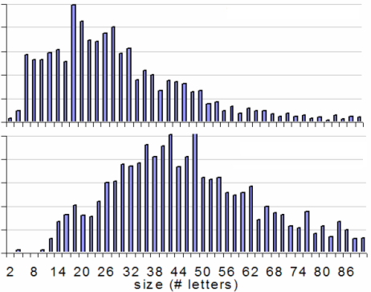
Title and URL length distribution
Titles
URLs
Notes:
And plotted them as a simple distribution.
This graph shows only pages with titles – it does not include the many pages that do not have titles, which range from about 5-30%, depending on how you count them.
Ignoring pages without titles for now, the distributions inform us about how many titles and URLs would be truncated if the revisitation could only display a certain number of letters.
<ANIMATE>
For example, if the system could only display the first 20 letters, users will have to make decisions based on incomplete information for almost half of the items for titles,
<ANIMATE>
and for almost all the items for URLs.
This suggests that our concerns in this study about the effects of size and truncation are valid.

Slide 33
Research Question #6
How correct are people’s guesses about thumbnails, titles and URLs?
Notes:
Our final question asks how correctly people’s guesses were about the thumbnails, titles and URLs

Slide 34
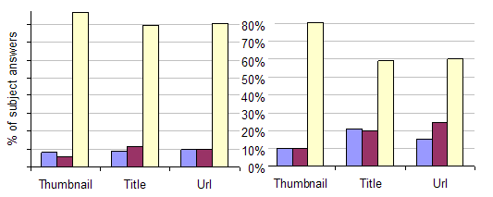

Correctness / Error rates of guesses
Web site
Exact page
Notes:
Our results show that people are fairly good at guessing the web site from all representations,
<ANIMATE>
-- about 80% of their guesses are completely correct.
<ANIMATE>
People are also good at guessing the exact page from its thumbnail at 80% correctness,
<ANIMATE> but have more errors when guessing at Titles and URLs --- about 60% correct.
Overall, thumbnails appear better than titles and URLs, probably because they capture the real image of the web page.

Slide 35
Summary
 | Size required for identification
Recognition rate | Thumbnails |  | Titles
 | web | exact | web site |  |  | exact page
 | site | page | right | middle | left | right | middle | left
Minimal: 15% | 32² | 48² | 6 | 8 | 9 | 12 | 12 | 12
Low: 30% | 48² | 80² | 8 | 12 | 12 | 18 | 16 | 18
Medium: 60% | 96² | 144² | 15 | 20 | 18 | 39 | 30 | 28
High: 80% | 160² | 208² | 25 | 42 | 28 | – | 46 | 50
Maximum | 92% | 90% | 92% | 87% | 93% | 75% | 83% | 80%
Recognition rate | Urls
 | web site |  |  | exact page
 | right | middle | left | right | middle | left
Minimal: 15% | 8 | 14 | 11 | 15 | 16 | 14
Low: 30% | 11 | 20 | 17 | 25 | 22 | 19
Medium: 60% | 16 | 29 | 25 | 43 | 34 | 30
High: 80% | 34 | 43 | 42 | 58 | 65 | 50
Maximum | 92% | 87% | 92% | 83% | 82% | 88%
Notes:
Well, I’ve just gone through a huge amount of data, probably more than you want to see in a talk.
At this point, I’d like to refer you to the paper for more details.
For example, this table, found in the paper, summarizes all our data, where one can look up a desired recognition rate and compare the needed sizes of thumbnails, titles and URLS.

Slide 36
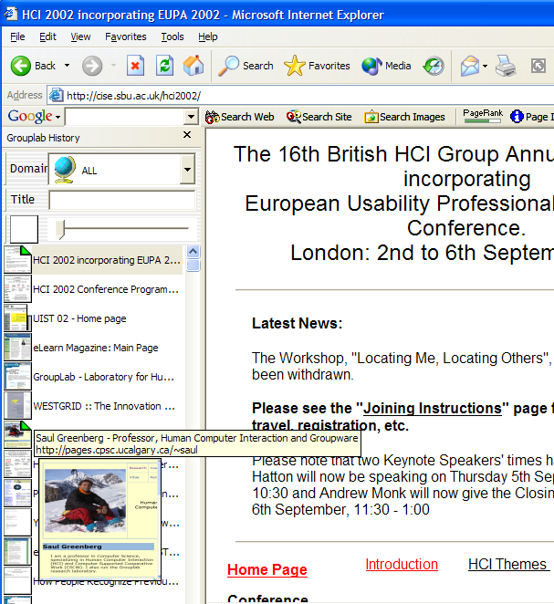
32² thumbnail
15% web site
30 letters
50% page
128² thumbnail
60% page
A live demo of this system was done during the presentation
Notes:
To show how tables like that one can be applied, lets take another look at the integrated history system we had developed prior to this study.
First, we see that the 32x32 thumbnails gives only 15% recognition of the web site, the 128x128 thumbnails gives about 60% page recognition (which isn’t bad), and that the right truncated title gives 50% page recognition.
Second, we also see that we can improve this by making minor adjustments.
Growing the thumbnail from 32 to 48 pixels ( a modes increase) doubles our web site recognition to 30%, and gives us 15% page recognition.
Growing the popup thumbnail from 128 to 160 gives us 80% web site recognition, and around 70% for the exact page.
Using middle truncation instead of right truncation of titles increases recognition of the page from 50 to 60%.

Slide 37
Summary
We quantified how people recognize previously seen web pages from its thumbnail, title and URL representation.
We can use this to analyze or improve our existing browsers.
www.pages.ca … /index.html
Saul Greenber … d Groupware
Notes:
Let me summarize what we did.
In our study, we quantified how people recognize previously seen web pages from thumbanils, titles and URLs.
Designers can use these to analyze existing browsers, or to predict the consequences of using particular configurations of space-conservative displays.
We also show the promise of thumbnails – they have good recognition and low error rates compared to titles and URLs.
Of course, more work needs to be done.
In particular, we need to investigate the interplay and thus recognition between combined thumbnail/title/URL representations, as in our integrated history system.

Slide 38

For more information
www.cpsc.ucalgary.ca/grouplab/
Thanks to NSERC and Microsoft for funding
Notes:
Thanks for your interest in our work, and if you’d like more information, feel free to visit our website and contact us!

