Slide 1
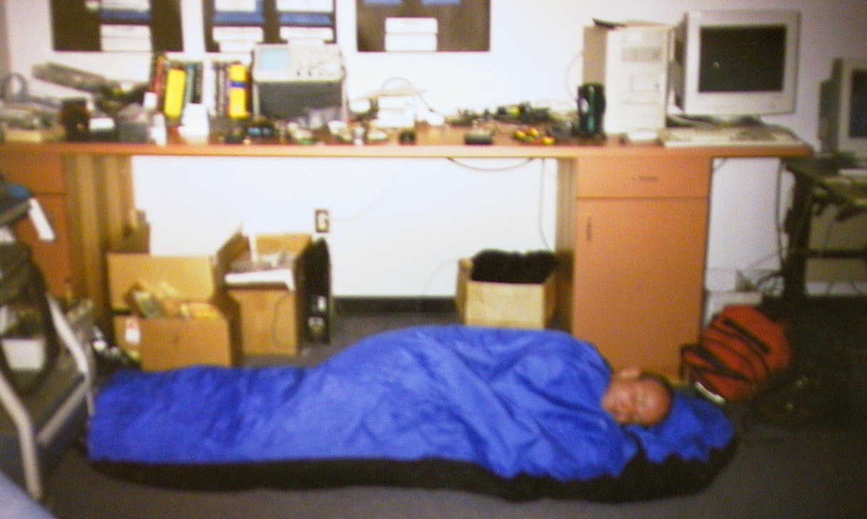
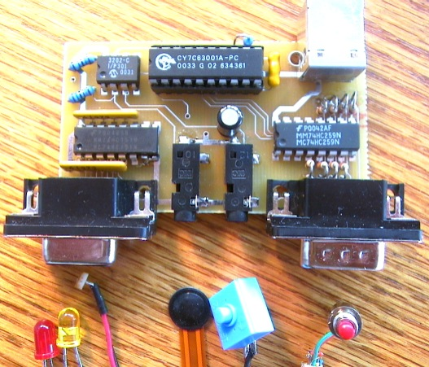
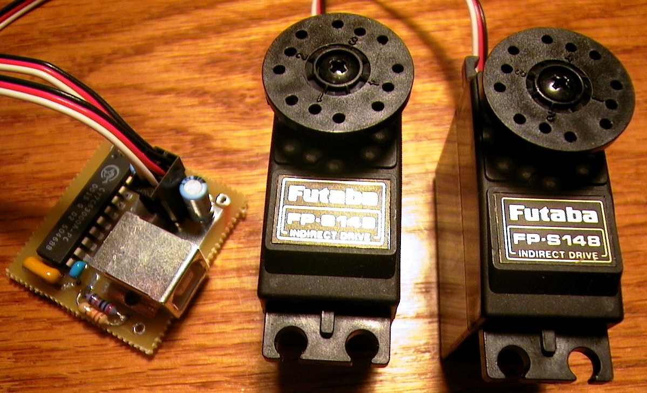
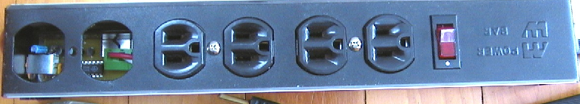
Rapid prototyping of physical user interfaces
Saul Greenberg
University of Calgary
Note: the original presentation included many embedded videos, which due to compatibility issues are not included here. Images are shown instead.
Notes:
Saul Greenberg
U Calgary
Delighted to be giving the invited talk at GI
IN charge of grouplab, lob for HCI and CSCW
Normally I work in groupware and related s/w researc.
Today, I will talk about about what is a fairly new area of research for me –
physcial user interfaces, and in particular I will describe how we can rapidly prototype these physical interfaces.
Even though I am the one up front today..
<ANIMATE>
My collaborator… worked very hard on h/w design/build/manufacturing the things I am going to show you

Slide 2
The Message
Just as Graphical Widgets afford rapid prototyping of GUIs …
…so could Physical Widgets afford rapid prototyping of the new generation of physical interfaces
Notes:
The message of my presentation is…
I’ll deliver this message by
-motivation – what are PUIS and why they are hard to build
-Phidget concept, goals behind them, and examples of phidgets we have built, including demo
-Phidget architercture, and how one programs them, again using a simple example
-Evaluation, where we gave students with no hardware experience phidgets for a course assignment and I will show you what they built with them.
-What we are now using them for

Slide 3
Physical User Interfaces
X
  ubiquitous computing
  pervasive computing
  tangible user interfaces
  information appliances
  context-aware computing
  interactive art
  ambient displays
  …
Notes:
Now wide interest in HCI in physical user interfaces, as illustrated by the contributions we are seeing in places such as CHI, SIGGRAPH and UIST.
Many subfields have sprung up…
While there are differences, all have in common the goal of moving beyond the graphical desktop interface and into our physical environment through physical interfaces
For those of you unfamiliar with this area, I’ll introduce it to you by examples that others have done.

Slide 4
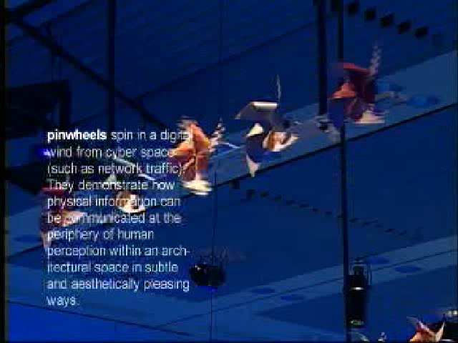
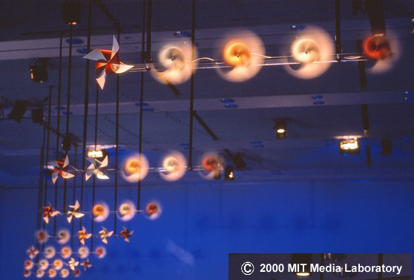
Pinwheels - ambient digital wind
Tangible Media Group, MIT
Extracted from Tangible Media Group web site
Notes:
Ambient displays – display of digital information into a physical form at the periphery of our awareness

Slide 5
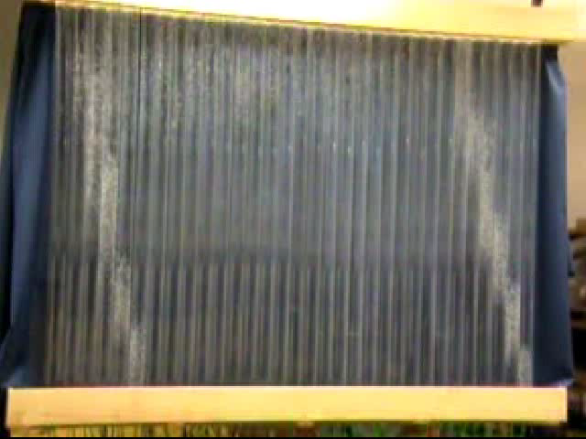
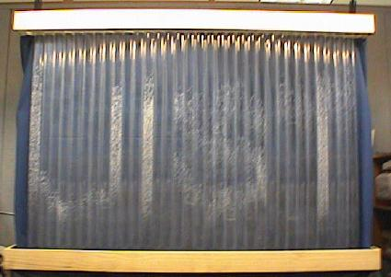
Information Perculator - digital bubbles
Heiner, Hudson & Tanaka

Slide 6
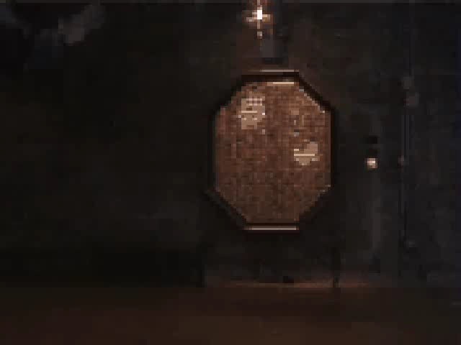
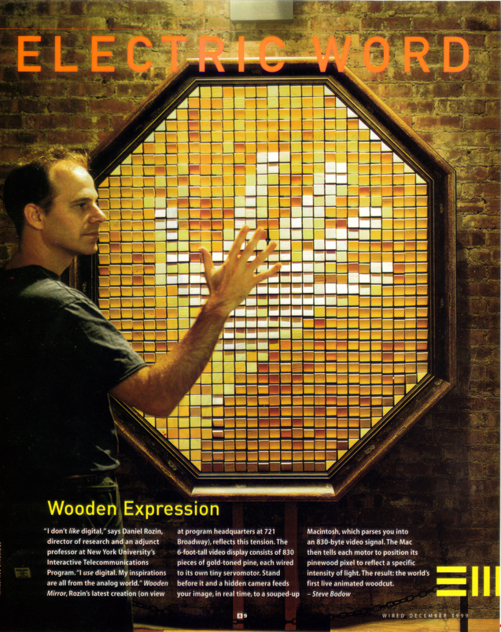
Wooden Mirror - wooden pixels, image
Daniel Rozin, NYU
Ishii, MIT
Notes:
Physical interaction with physical devices or computer information

Slide 7
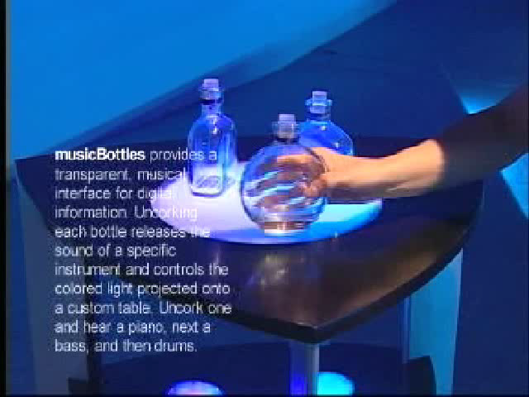

MusicalBottles - controlling sound, light
Tangible Media Group, MIT

Slide 8
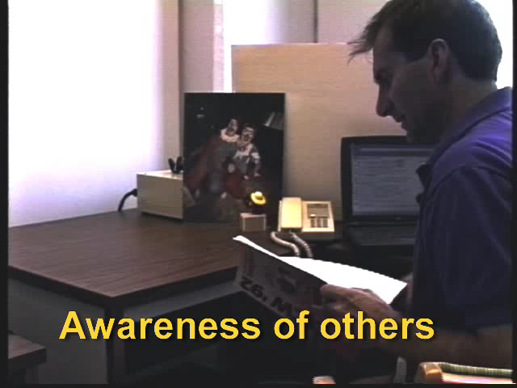
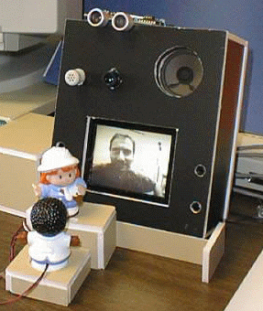
Surrogates – managing media spaces
Greenberg & Kuzuoka
Notes:
Several years ago, Hideaki Kuzuoka from U Tsukuba and I built an always-on video-base media space.
This first clip shows how physical devices can provide awareness of others,
This second clip shows how physical sensors can mediate privacy concerns.

Slide 9
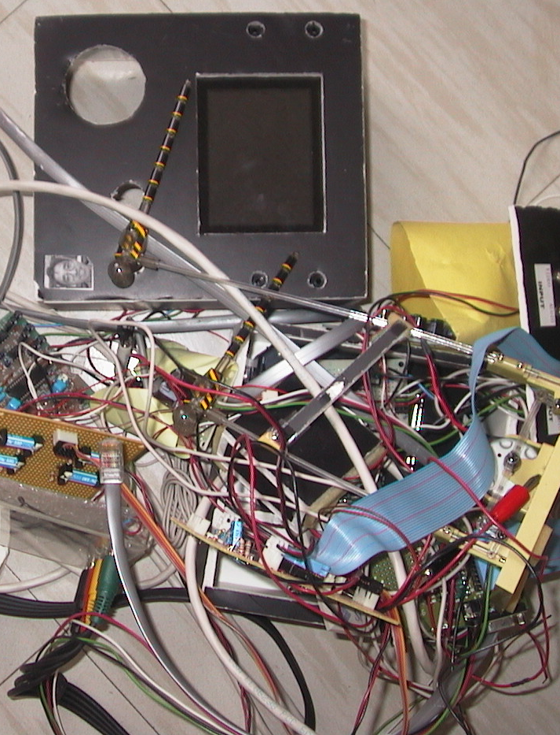
Motivation
Greenberg & Kuzuoka
Notes:
My collaborator Hideaki was the engineer. He built the hardware, which took him
several months of full time effort. We ended up using the system for around 3 months.
After Hideaki returned to Japan, we found the system impossible to extend or maintain.
<animate>
The result is that it is now a mess of parts and wires.
This was because Hideaki did not build the system to be reusable (it was a ‘one of’ design), and as computer scientists specializing in software, we had no expertise in hardware.

Slide 10
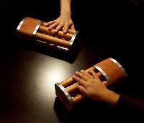
Motivation
No suitable building blocks
One-off pieces
(academics/artists)
inTouch Tangible Media Group
Notes:
We decided to look for available building blocks that would help us develop our physical user interfaces quickly and in a way that they could be maintainable and extensible.
Yet we surprised that ,none were suitable as building blocks for the average programmer’s skill set and the applications I wanted to do.
For example, we found many one-off pieces created by both academics as proof of concepts and artists as interactive installations.
But these are neither obtainable nor reusable to others.

Slide 11
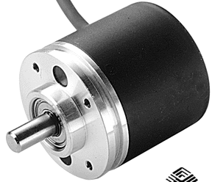


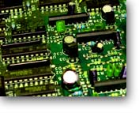



Motivation
No suitable building blocks
Low level parts
(electrical engineers)
Notes:
Its also very easy to find low level parts, but unless you are an E Engineer or hobbyist, the learning curve is too high.
You have to select appropriate devices, create circuit boards, write microcode, worry about wire protocols, etc.

Slide 12

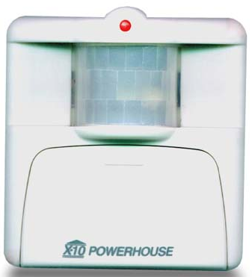
Motivation
No suitable building blocks
Appliances
ActiMates
Security
Notes:
We also found premanufactured devices under computer control, like Microsoft Actimates (Barney).
These, however, had no public API and the only way to get into it is by hacking it (e.g., Dourish)

Slide 13
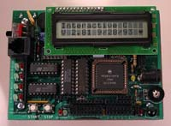
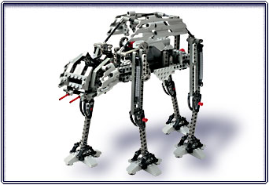
Motivation
No suitable building blocks
Handy Board
Robotics
(kids and hobbyists)
Lego Mindstorms
Notes:
The closest thing out there are robotic kits, usually produced for kids or for hobbyists.
Unfortunately, these are usually intended for stand-alone operation (robots).
The coding is either to simplistic (Mindstorms) or too low level (handyboard – coding microprocess)

Slide 14

Motivation
No suitable building blocks
Will those parts ever arrive?
On critical path…
Notes:
Even if we did try some of these, a frustrating thing was that
we could not start programming/working on the design until the hardware arrived and was assembled.

Slide 15
Research Goal
Create physical devices and software so:
  developers concentrate on physical interface design
  approriate for the average programmer
Notes:
After thinking about these problems, we set ourselves a new research goal
…
Or, as my students like to rephrase this…
<animate>

Slide 16

Research Goal
Create physical devices and software so:
  simple enough for Saul to use

Slide 17
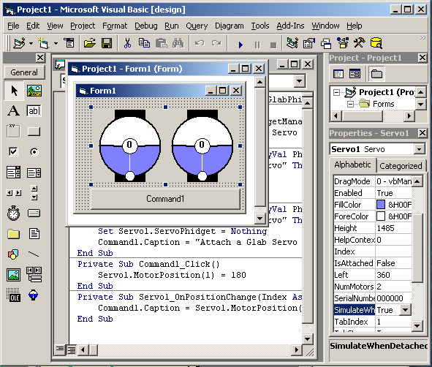
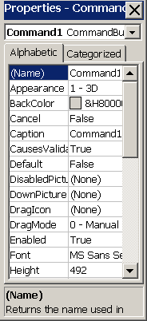
Insight
GUI Widgets
Stock widget set
Easy to add to
program
Well defined API
Notes:
The insight we had came from how we already use graphical user interface widgets.
Stock widget sets are available in virtually every user interface development package (e.g., buttons, listboxes, etc.),
As well, most interact with interface builders, where a programmer can just select and drop it into a program.
Each one is presented as an abstraction: each has a well-defined API that lets a programmer easily track and manipulate it.
They are very easy to try and test: just drop it in, write a bit of code, and execute.

Slide 18

Insight
Phidgets - Physical Widgets
Stock widget set
Easy to add to
program
Well defined API
Notes:
physical widgets, or phidgets should be just as easy to program.
One would program and use one in exactly the same way as widgets!

Slide 19
Insight
Phidgets - Physical Widgets
Requirements beyond widgets
  Connection manager
    device appearance / disappearance
  Identification
    link software with device type / particular devices
  Simulation mode
    program, test, debug without the device

Slide 20
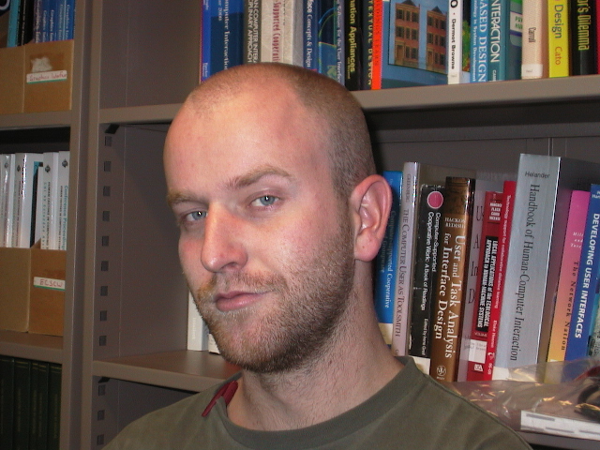
Notes:
I hired Chester Fitchett, one of the few undergraduate computer science students keenly interested in hardware.
His job was to build a phidget infrastructure, as well as several phidget components.

Slide 21
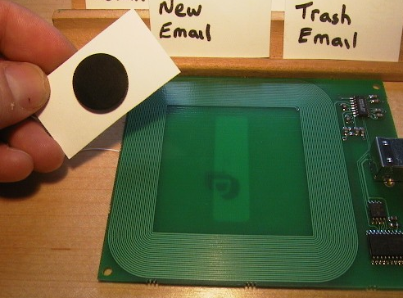
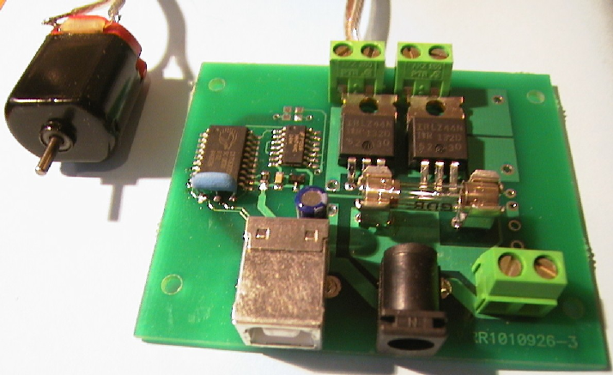
What we built
Servo
1-4 servo motors
InterfaceKit
8 inputs
4 sensors
8 outputs
RFID
rfid tags
Powerbar
6 120 volt outlets
Power
DC devices
Notes:
So far, we have built several phidgets. This includes…

Slide 22
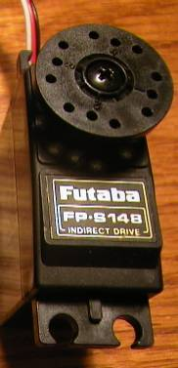
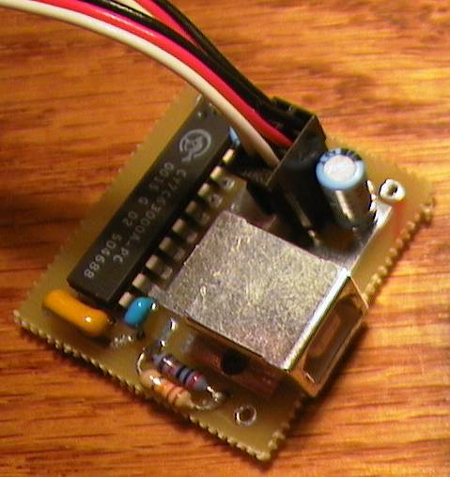

Phidget architecture
Hardware
device
circuit
wire protocol

Slide 23

Phidget architecture
Hardware
Software
device
circuit
wire protocol
wire protocol
communication layer

Slide 24
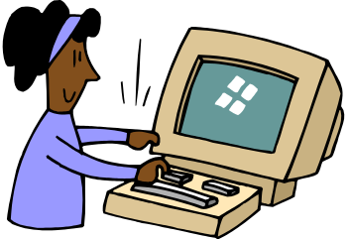
Phidget architecture
Hardware
Software
device
circuit
phidgetManager
Events Properties pm.OnAttach(phidget) pm.DeviceType
pm.OnDetach(phidget) pm.SerialNumber…
wire protocol
communication layer

Slide 25
Phidget architecture
Hardware
Software
device
circuit
phidgetServo
Events Properties
servo.OnPositionChanged servo.MotorPosition=90
phidgetManager
Events Properties pm.OnAttach(phidget) pm.DeviceType
pm.OnDetach(phidget) pm.SerialNumber…
wire protocol
communication layer

Slide 26

Phidget architecture
Hardware
Software
device
circuit
phidgetServo control
phidgetServo
Events Properties
servo.OnPositionChanged servo.MotorPosition=90
phidgetManager
Events Properties pm.OnAttach(phidget) pm.DeviceType
pm.OnDetach(phidget) pm.SerialNumber…
wire protocol
communication layer

Slide 27
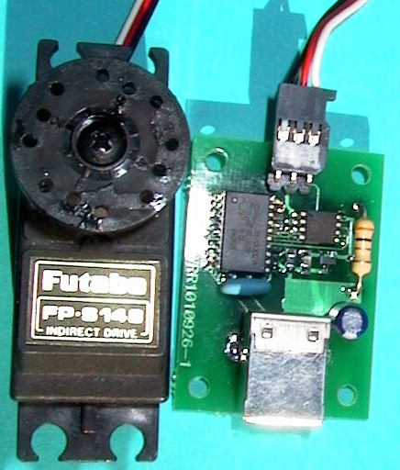
Demonstration
Phidget-Servo
Notes:
What I would like to do now is demonstrate one of the phidgets, the Servo, to show you how easy it is to program.

Slide 28
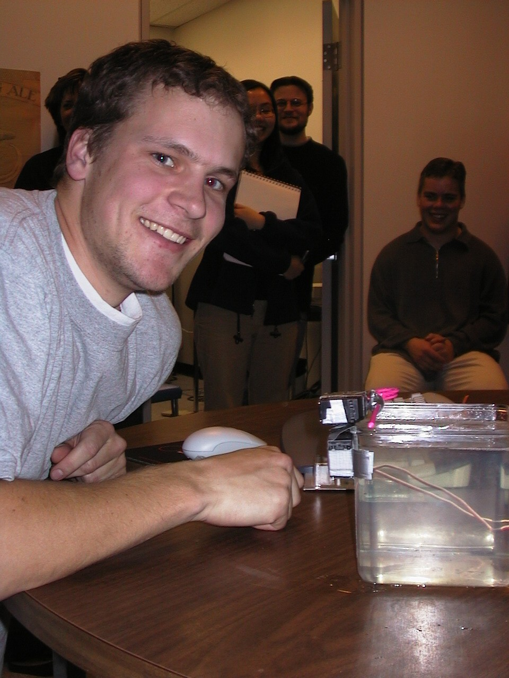
Evaluation
Assignment
  design an imaginative physical interface that I can demonstrate at a conference

Slide 29
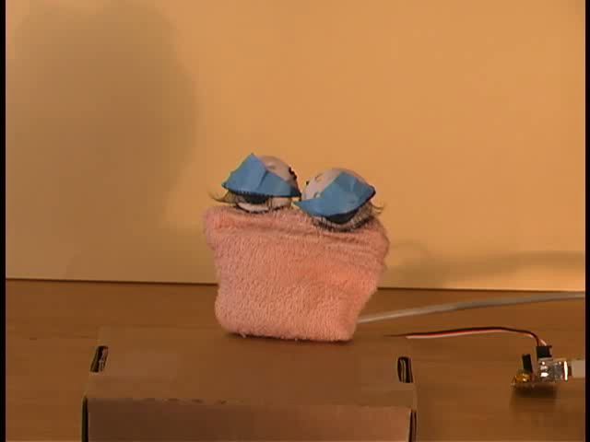
project demonstrations

Slide 30
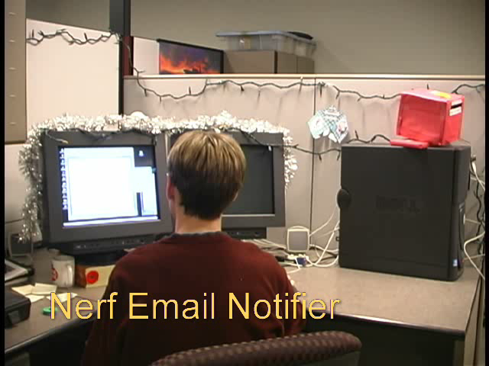
project demonstrations

Slide 31

Halloween Pumpkin Phidget, Chester Fitchett

Slide 32
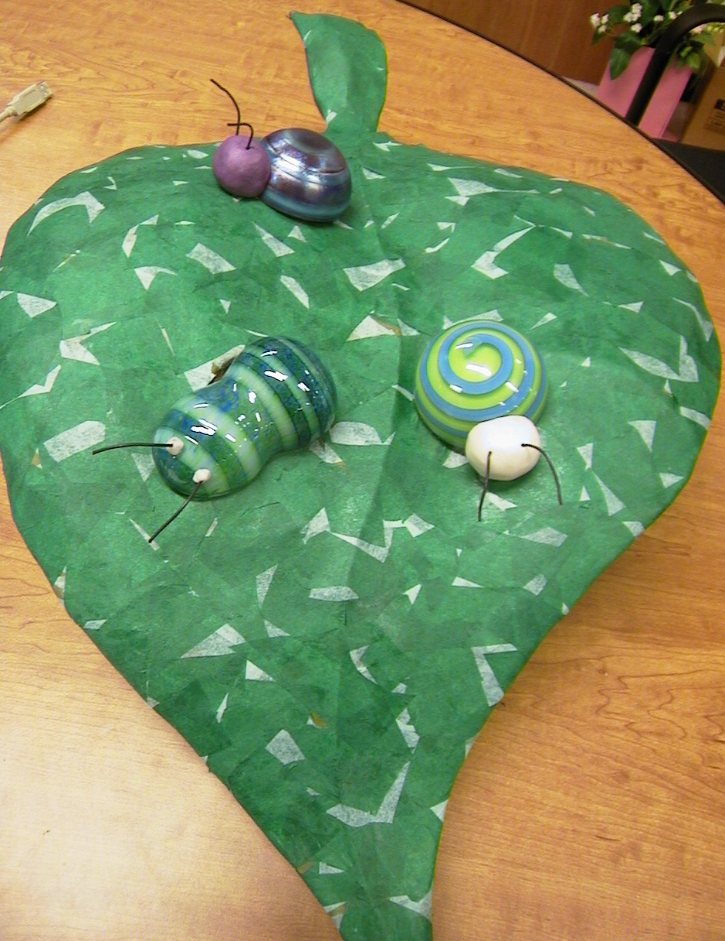
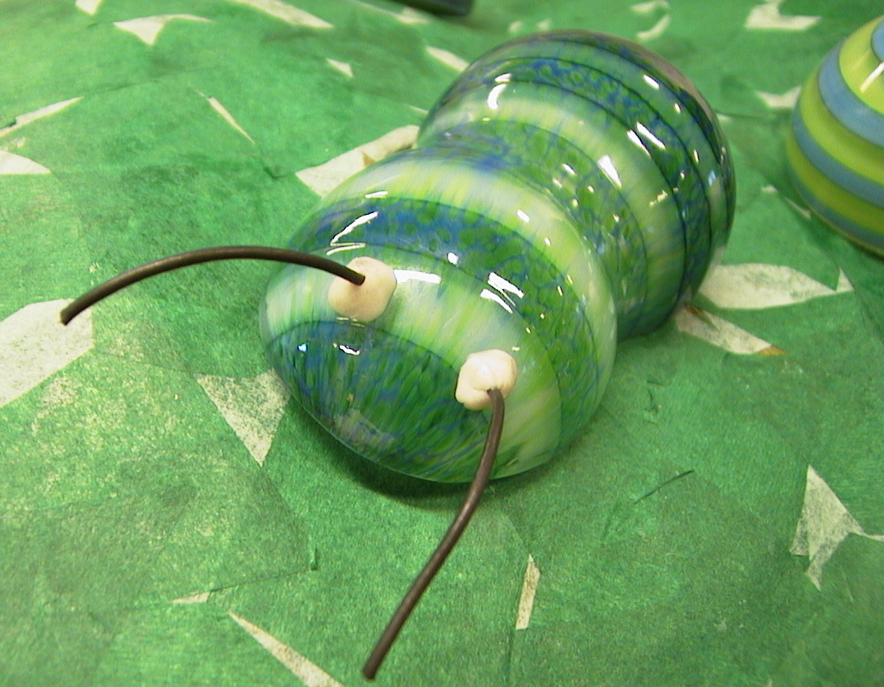
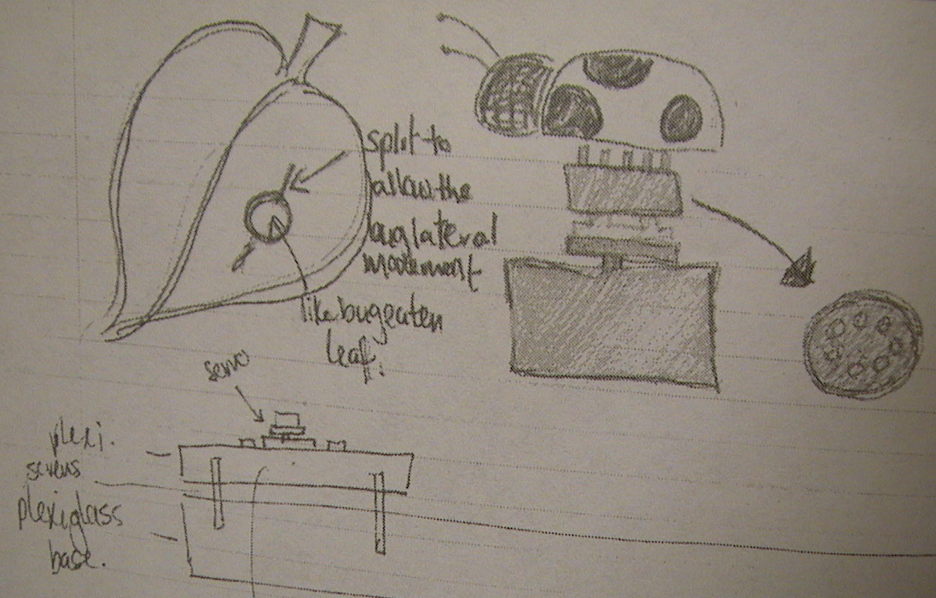
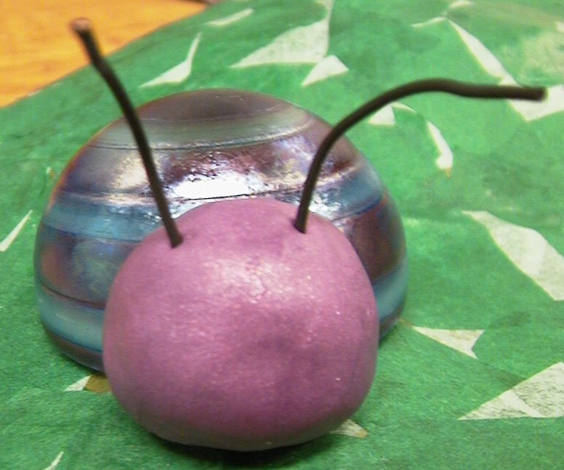
What is next
Getting back to design
Notes:
There is still lots left to be done.
–other wire protocols
(wireless, ethernet…)
distributed data structure – ubicom platform (shared dic)
2) –phidget desing
level of abstraction. If we make phidgets too high-level, they become appliances that may not be flexible enough to assemble into new directions. If they are too low-level, they may be too hard to program and manage.
What is a useful widget set? RFID tags, proximity, motion detectors …
3) Critcal mass for deployment, defacto standards (300 for research use, industrial licenses)
4, Eval (other universities and artists: georgia tech, banff center
5 Standards –existing/new protocols, universal platform access, etc, defacto vs dejure,
.

Slide 33
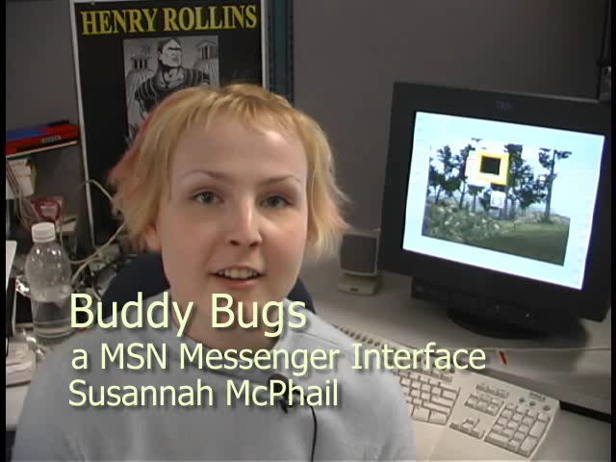
Buddy Bugs, Susannah McPhail
Notes:
There is still lots left to be done.
–other wire protocols
(wireless, ethernet…)
distributed data structure – ubicom platform (shared dic)
2) –phidget desing
level of abstraction. If we make phidgets too high-level, they become appliances that may not be flexible enough to assemble into new directions. If they are too low-level, they may be too hard to program and manage.
What is a useful widget set? RFID tags, proximity, motion detectors …
3) Critcal mass for deployment, defacto standards (300 for research use, industrial licenses)
4, Eval (other universities and artists: georgia tech, banff center
5 Standards –existing/new protocols, universal platform access, etc, defacto vs dejure,
.

Slide 34
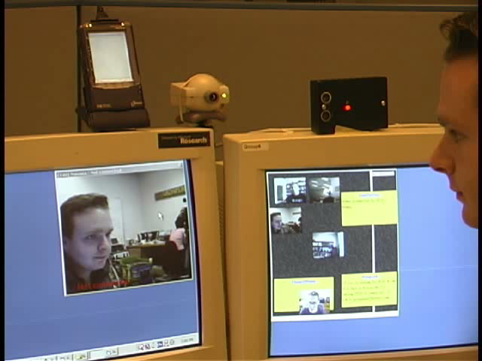
Privacy preserving media space, Mike Boyle

Slide 35
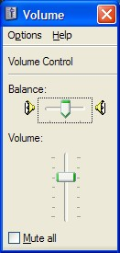
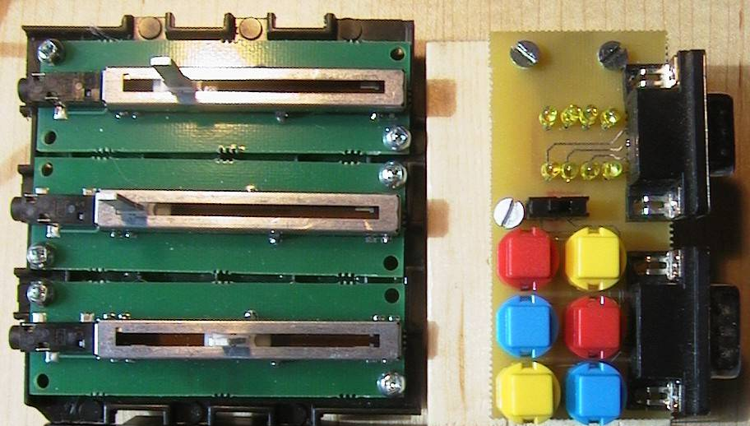
What is next
Getting back to design
Customizable physical interfaces
Notes:
There is still lots left to be done.
–other wire protocols
(wireless, ethernet…)
distributed data structure – ubicom platform (shared dic)
2) –phidget desing
level of abstraction. If we make phidgets too high-level, they become appliances that may not be flexible enough to assemble into new directions. If they are too low-level, they may be too hard to program and manage.
What is a useful widget set? RFID tags, proximity, motion detectors …
3) Critcal mass for deployment, defacto standards (300 for research use, industrial licenses)
4, Eval (other universities and artists: georgia tech, banff center
5 Standards –existing/new protocols, universal platform access, etc, defacto vs dejure,
.

Slide 36

What is next
Research questions on phidgets
What makes a good phidget set?
  proximity & motion detectors
  remote controls…
What makes good infrastructure?
  wireless
  data sharing (ubicomp)
Notes:
There is still lots left to be done.
–other wire protocols
(wireless, ethernet…)
distributed data structure – ubicom platform (shared dic)
2) –phidget desing
level of abstraction. If we make phidgets too high-level, they become appliances that may not be flexible enough to assemble into new directions. If they are too low-level, they may be too hard to program and manage.
What is a useful widget set? RFID tags, proximity, motion detectors …
3) Critcal mass for deployment, defacto standards (300 for research use, industrial licenses)
4, Eval (other universities and artists: georgia tech, banff center
5 Standards –existing/new protocols, universal platform access, etc, defacto vs dejure,
.

Slide 37
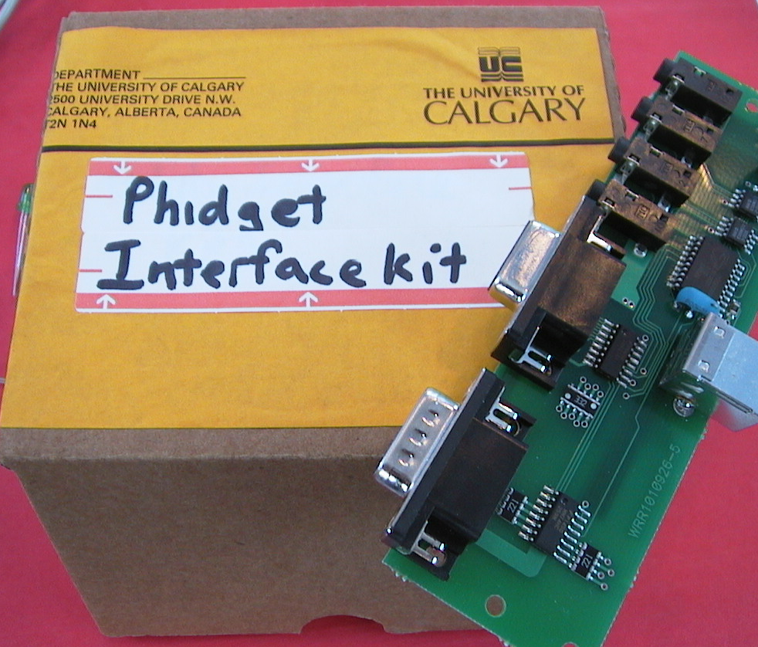
What is next
Achieving critical mass
Notes:
There is still lots left to be done.
–other wire protocols
(wireless, ethernet…)
distributed data structure – ubicom platform (shared dic)
2) –phidget desing
level of abstraction. If we make phidgets too high-level, they become appliances that may not be flexible enough to assemble into new directions. If they are too low-level, they may be too hard to program and manage.
What is a useful widget set? RFID tags, proximity, motion detectors …
3) Critcal mass for deployment, defacto standards (300 for research use, industrial licenses)
4, Eval (other universities and artists: georgia tech, banff center
5 Standards –existing/new protocols, universal platform access, etc, defacto vs dejure,
.

Slide 38
Summary
Just as graphical Widgets afford rapid prototyping of GUIs, so could Phidgets afford rapid prototyping of the new generation of physical interfaces
Phidgets
  hide device implementation details
  use API to expose device functionality
  include on-screen visual representation
  simulate unavailable device

Slide 39

For more information
www.cpsc.ucalgary.ca/grouplab/
Thanks to Microsoft Research
Notes:
Thanks for your interest in our work, and if you’d like more information, feel free to visit our website and contact us!
The new version of the software should be ready in a month or two. I would also like to acknowledge suppport by Microsoft Research.
Thanks again,

Slide 40
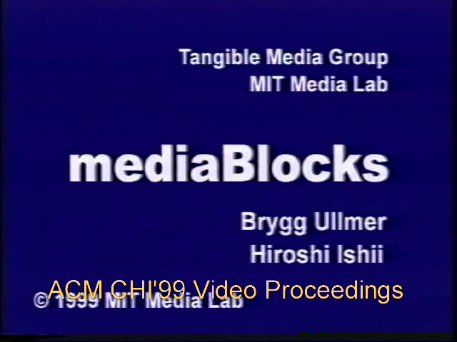
mediaBlocks – managing digital information
Tangible Media Group, MIT
Extracted from Tangible Media Group web site

Slide 41
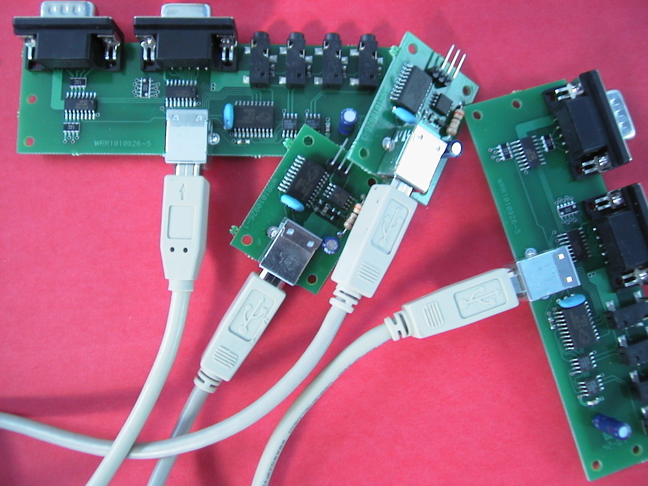
What is next
The wire mess

Slide 42
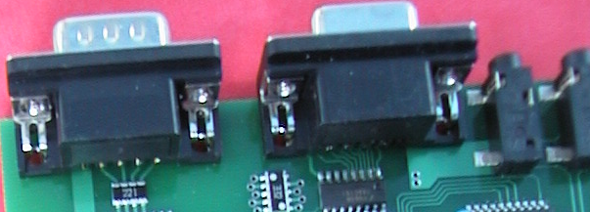
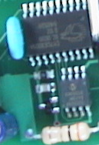
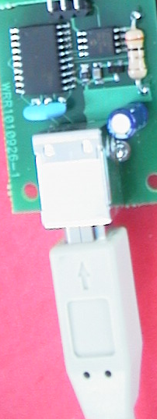
What is next
The wire mess

Slide 43

What is next
Other wire protocols
USB
RF
IEEE…

Slide 44
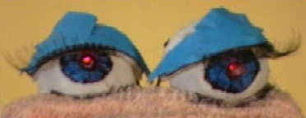

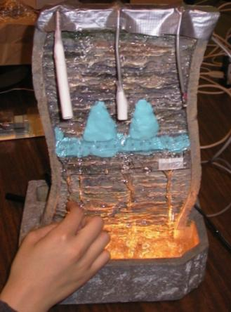
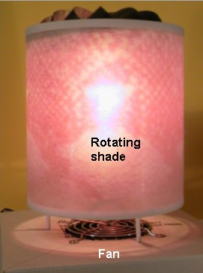
What is next
Distributed data structure
Shared
Dictionary

