Slide 1
Customizable Physical Interfaces for interacting with conventional applications
This is the powerpoint of the talk presented at UIST 2002.
  The transcript of what was said is included in the powerpoint file.
  The original presentation includes three videos, which are omitted here.
  However, the most important video can be downloaded from www.cpsc.ucalgary.ca/grouplab/papers/videos/customizable_phidgets.wmv
Notes:
My name is Saul Greenberg from the University of Calgary in Canada,
<and I’m Mike Boyle>
We’re delighted to be here at the UIST conference in Paris.
Today, Mike and I will present some work that we did on a concept called customizable physical interfaces

Slide 2
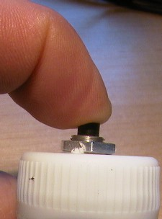
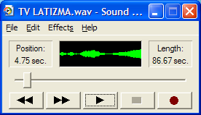
Customizable Physical Interfaces for interacting with conventional applications
Saul Greenberg
Michael Boyle
University of Calgary
Notes:
My name is Saul Greenberg from the University of Calgary in Canada,
<and I’m Mike Boyle>
We’re delighted to be here at the UIST conference in Paris.
Today, Mike and I will present some work that we did on a concept called customizable physical interfaces

Slide 3
The Message
With customizable physical interfaces, a person can bind any graphical widget to a physical control
Notes:
The message of our presentation is that
With customizable physical Interfaces, a person can bind any graphical control to a corresponding physical widget
We’ll deliver this message
by briefly reviewing some history of how physical devices worked with computers
then I’ll introduce this concept of customizable physical interfaces,
Next, Mike will take over and talk about how we implemented this idea as well as its limitations.

Slide 4
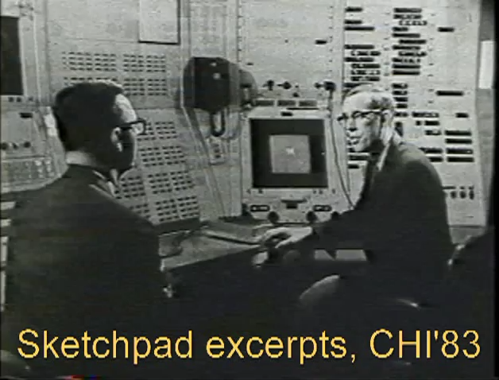
Historical background
1963 Sketchpad - rich but crude physical interfaces
Notes:
To set the scene, lets go back in time about 40 years to Ivan Sutherland’s Sketchpad, the very first interactive graphical user interface.
In Sketchpad people used a light pen as a pointing device,
but what is often forgotten is that people also used physical controls
<CLICK VIDEO>
such as buttons, toggles and knobs to modify their light pen actions.
Lets take a look at a video for a quick demonstration
<END VIDEO>
What you just saw was that Sketchpad users used physical controls, not graphical widgets, to interact with the system.

Slide 5
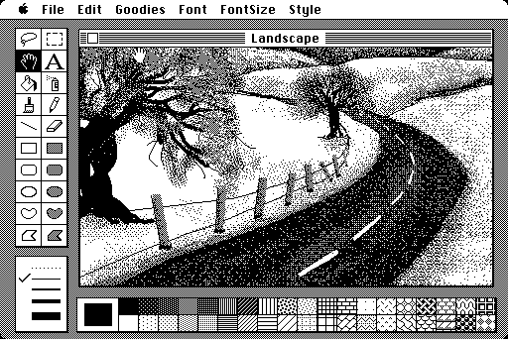
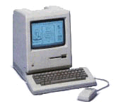
Historical background
1984 Apple Macintosh – GUI widgets
Notes:
Lets jump ahead about 20 years.
Desktop computers, as introduced by the Xerox Star and popularized by the Apple Macintosh,
replaced almost all physical controls with the now-familiar on-screen graphical interface widgets.
From this point on, graphical user interface widgets reigned supreme on desktop computers, and physical controls all but disappeared.

Slide 6
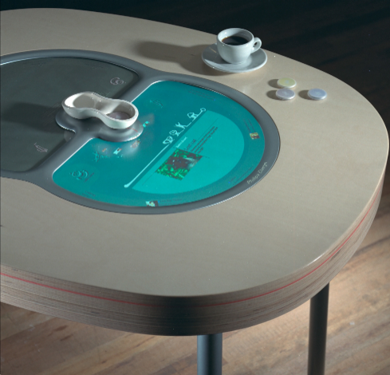
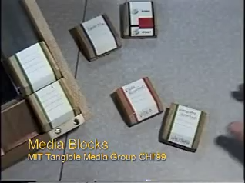
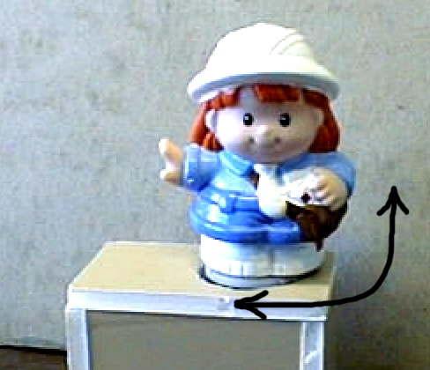

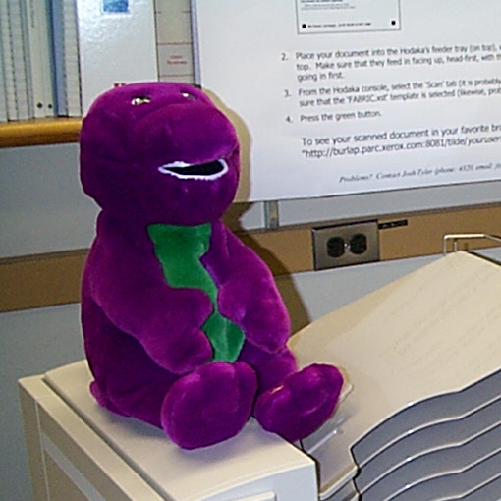
Historical background
1996-now: Tangible Interfaces
Tokens
Philips Lime Project
Surrogates-Greenberg/Kuzuoka
Media Blocks-Tangible Media Group
SenseTable-Tangible Media Group
Hacking Barney-Dourish
Notes:
Recently tangible UI reintroduced the notion that physical media can be attached to digital information, both for input and output.
An excellent example is seen in this video of mediaBlocks where a person can use electronically tagged blocks of wood to control a graphical interaction.
<Click on media blocks video>
More generally, tangible interface projects have exploited tags, trackers, switches, accelerometers and many other basic sensor technologies for input,
For output, we see physical displays based on motors, lights, fans, solenoids, figurines, plush toys, and so on.

Slide 7
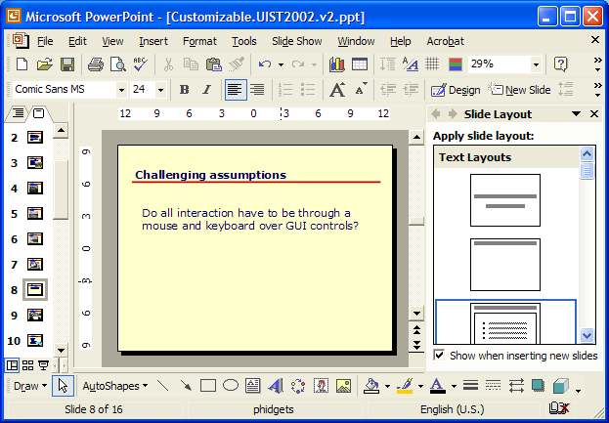
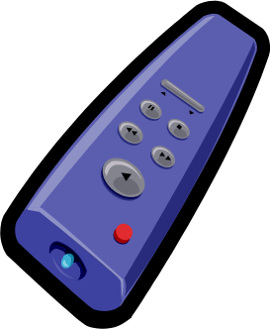


Getting Real with Physical Interfaces
specialized
controls
special needs
physical
metaphors
universal
remotes
ambient displays
Notes:
In spite of this research, graphical interfaces such as that I used to make this slide, are still the standard.
If we want to reintroduce physical controls, we need to get real with physical interfaces, where real people can use them in real situations for real tasks
One good opportunity is to try to instrument our conventional graphical applications with physical controls
There are many potential advantages to this
<animate each in turn>
We can have specialized controls to particular applications to make people more efficient,
Or create universal remotes that act upon all applications with generic commands
Or show an applications output on an ambient display
Or perhaps create physical instruments to applications around physical metaphors
Or even create low cost input and output devices adapted to special needs people

Slide 8
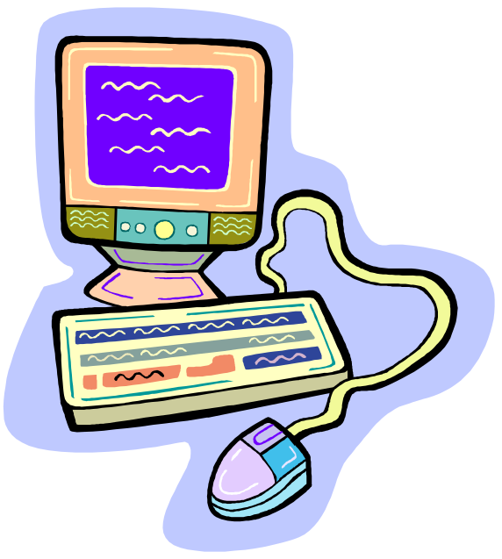
The Problem
Current applications recognize only mice and keyboards
  do not understand other devices
  source unavailable for modification
Notes:
Even if we decided to bring physical controls back into our interfaces, we have one big problem
Our current conventional applications only recognize mice and keyboards
Even if we could plug other devices into our computers, the applications won’t know what to do with them
Even if we were willing to modify the source, its often unavailable to us.
This is why almost all research in Tangible Interfaces worked with specially designed software rather than commonly used applications,

Slide 9
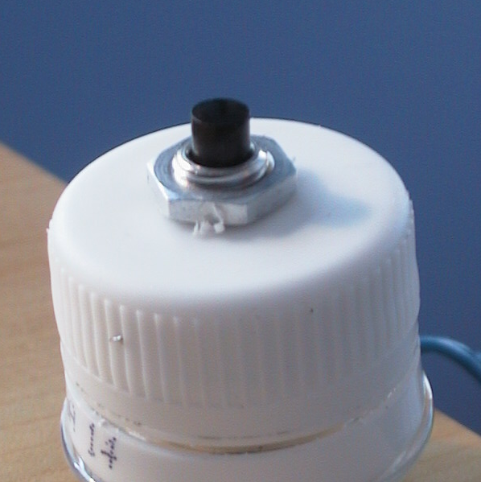
The Idea
With customizable physical interfaces, a person can
  Bind a GUI widget to a
  physical control
Notes:
To solve this problem, we came up with the idea of Customizable Interfaces, where a person can first
<read>

Slide 10
The Idea
With customizable physical interfaces, a person can
  Bind a GUI widget to a
  physical control
  2. Invoke the widget’s function
Notes:
<read 2nd point> … or display the widget’s output

Slide 11
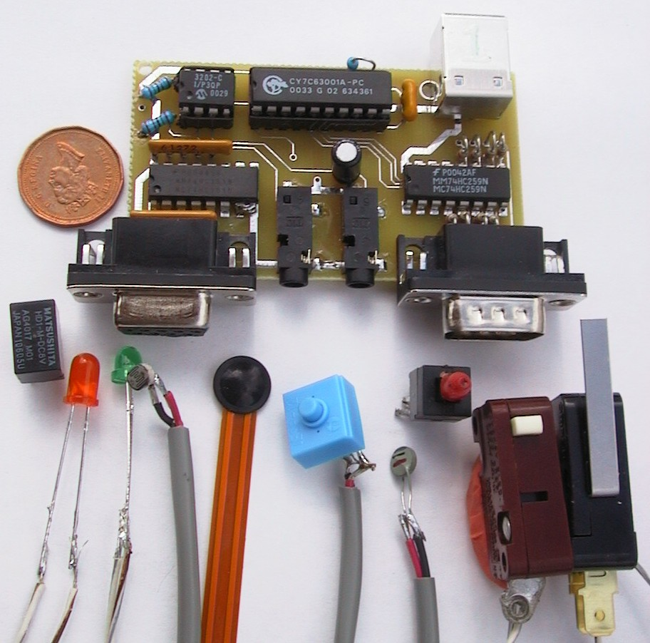
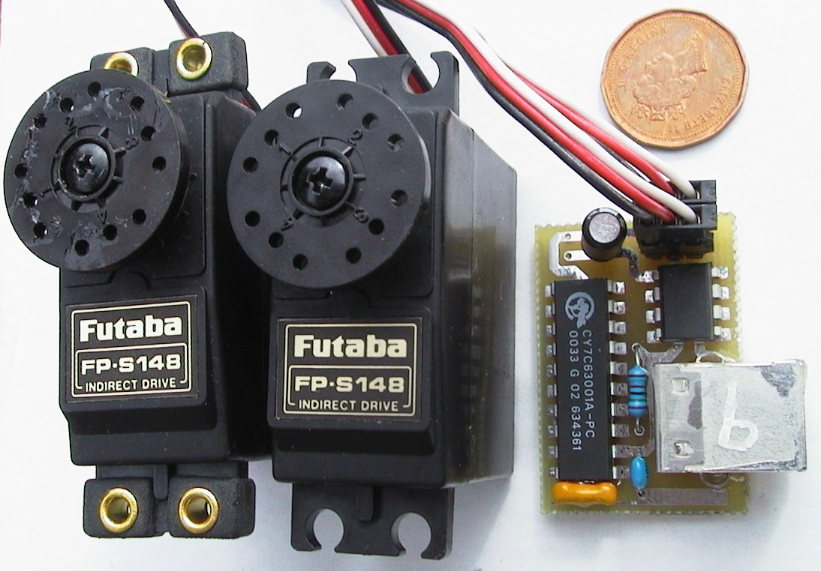
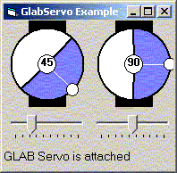
Implementing the idea
Phidgets
  easy to program physical devices [UIST 2001]
Notes:
To implement this idea, we put together two toolkits, one to handle the physical devices, the other to link into graphical widgets.
First, Phidgets, or physical widgets are very easy to program physical devices, which we presented at UIST last year. This gives extremelly easy to program input devices such as sensors and switches, as well as outputs including motors, lights, and so on.

Slide 12
Implementing the idea
Phidgets
  easy to program physical devices [UIST 2001]
  +
Semantic snarfing [Myers]
  link into functions of GUI widgets
  WidgetTap toolkit
Notes:
The other toolkit extends Brad Myers idea of Semantic Snarfing, a method to link into the functions of GUID widgets.
We created a toolkit around this which we call the WidgetTap.

Slide 13
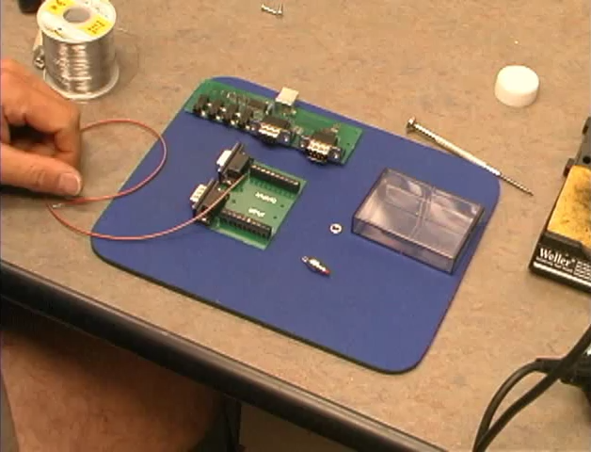
Notes:
To introduce how this all works, I’ll show a video that illustrates various scenarios of how customized applications are built.

Slide 14
Programming Customizable PUIs
Developers create customizable PUIs through two toolkits
  Phidgets: programming physical devices
  WidgetTap: accessing GUI widgets
Notes:
I’ll next show you in greater detail how we build customizable physical interfaces.
As you’ve seen in the video, programming customizable physical user interfaces requires two toolkits.
Phidgets, or physical widgets, take care of programming the physical interface devices, while our WidgetTap library takes care of accessing GUI widgets in existing applications.
The developer building a physical interface customization for an existing application writes software that uses both these toolkits together.
The relationship between the two toolkits is best seen in a simple example which I will demonstrate in action first, and then discuss in source code later.

Slide 15
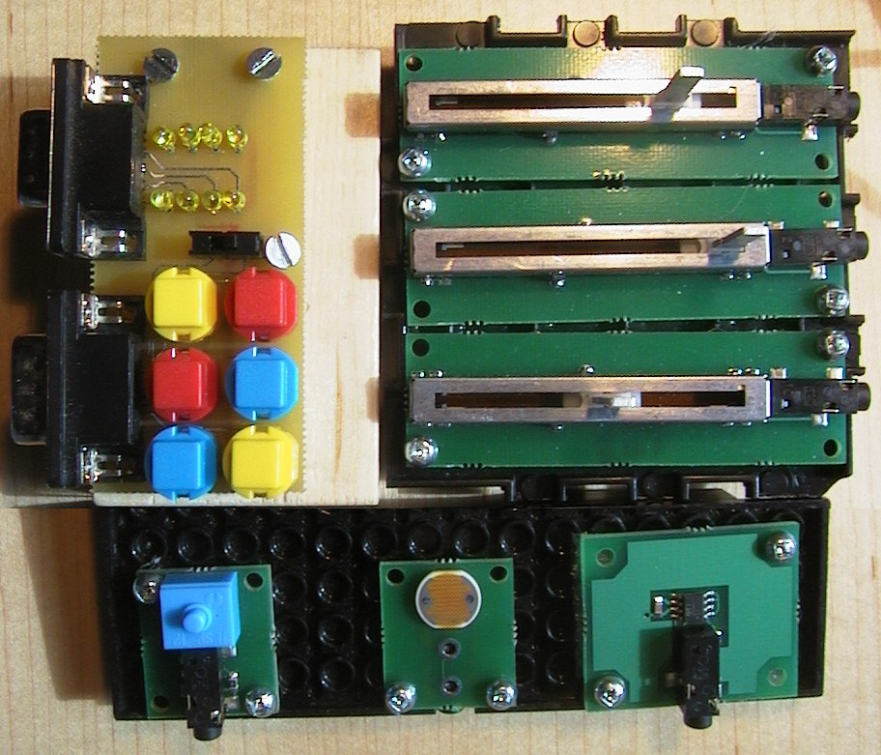
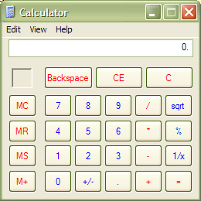
A Simple Example
A live demonstration was done here
Notes:
<LIVE DEMONSTRATION>
Here is the standard Calculator application that ships with Windows. I will customize it by associating this physical button <<hold up button>> with the ‘5’ button on the calculator.
I have written this separate program to do this customization. The customization takes place in three steps. As I perform each step, keep an eye on the Status line to see what’s going on.
First, my customization software is waiting for me to attach a phidget interface kit so I’ll do that. <<Plug in phidget>>
Now my software is prompting me to select a GUI button to customize. Note that as I move the mouse over a GUI buttons they are highlighted, but when I move the mouse over other kinds of widgets the highlight disappears. <<Move mouse on display to show and hide the highlight.>>
I’ll now highlight and click to select the ‘5’ button. <<Select the GUI widget>> The status line now shows that the button is customized. Indeed, if I push the physical button, the counter is incremented just as though I had clicked the graphical button.
<<Push the physical button three or four times.>> If I close the Calculator application… <<Close the GUI button>> …the widget tap toolkit will automatically restart it and re-establish the connection with the button widget. <<Push the physical button>>

Slide 16
Programming the WidgetTap Library
CommandTap tap = null
phidgetMgr_OnAttach(Phidget p)
if p.DeviceType = "PhidgetInterfaceKit"
this.tap = CommandTap.Pick()
phidgetIK_OnInputChanged(int i, bool state)
if state = true
this.tap.Click()
Notes:
Here is some condensed pseudo-code for the previous example..
At the heart of the WidgetTap tookit are ‘tap’ objects. Each ‘tap’ object wraps a widget on the display, allowing you to modify or query widget properties and invoke widget actions programmatically. For example, the CommandTap class wraps widgets like GUI buttons. Behind the scenes, techniques similar to those used by Myer’s and colleagues semantic snarfing are also used here.
When the phidget manager tells us that an interface kit phidget has been attached, we have the user pick a GUI button to customize and get a WidgetTap object for it.
Then, when the interface kit phidget tells us that the physical button has been pressed, we invoke the graphical button’s action by mimicing what would happen if the graphical button had been clicked. Properties of widgets, such as the current value of a slider widget, are just as easily accessed.
In the next few slides, I will discuss some of the problems that make writing a toolkit for semantic snarfing difficult, and how WidgetTap overcomes these problems.

Slide 17
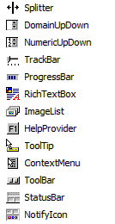
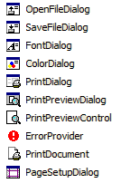
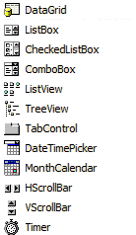
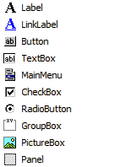
Problem 1: Many kinds of widgets
E.g., stock widget set for Visual Studio .NET
Notes:
First, a toolkit for customizable physical interfaces has to work with typical desktop applications.
But, these applications reveal a wide variety of widgets.
Here you see the stock widget set for GUI applications built using Visual Studio .NET.
Trying to support this diversity will make our toolkit extremely complex and possibly difficult to use.

Slide 18
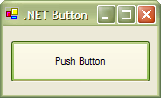
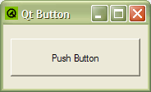
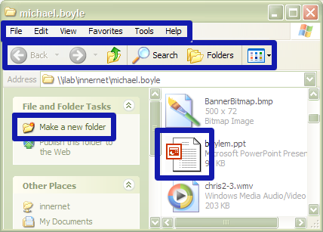
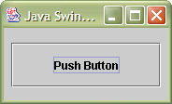
Problem 1: Observations
Different implementation; same API
Different implementation and API
Same widget, different implementation
Different widgets, same semantics
Notes:
There are, however, two key observations about graphical widgets that can be used to reduce complexity. First, similar widgets are often implemented differently in various applications and toolkits. Sometimes, though, these different implementations share a common API. In the case of the .NET Button and QtButton shown in the green box on the upper-left, both are based on the system-supplied push button widget and so share a common API. The Java Swing JButton shown in the blue box on the lower-left is implemented with a different API and we must treat it as a separate case.
Second, different widgets may share the same semantics. For example, menu items, toolbar buttons, task pane hyperlinks, icons, and push buttons all use click-to-invoke-an-action semantics. So, we can abstract this different widgets into a single semantic meta-class.

Slide 19
Problem 1: Solution
WidgetTap
CommandTap
Push Buttons
Toolbar
Buttons
RangeTap
Track Bars
(Sliders)
Scroll Bars
Configurable class hierarchy
Programmers
use these base classes
Notes:
WidgetTap solves this first problem by using a configurable class hierarchy. Base classes present the semantic meta-classes that programmers normally work with.
For example, the CommandTap class has one implementation specific to push-buttons, and another implementation specific to toolbar buttons.
Second, an XML configuration file associates windowing system widget classes with the individual WidgetTap object classes that support them.
For example, although the.NET Button and QtButton widgets go by different names under the windowing system, the WidgetTap configuration file associates both with the CommandTap-derived class that implements support for them.

Slide 20
Problem 2: Finding re-created widgets
If a tapped widget is destroyed and recreated, we must find it again
?
Notes:
Our first version of our customizable physical interfaces toolkit did not have a means to restart the tapped application if it was closed. We found this to be a nuisance that severely hampered the functionality of the toolkit.
<<Click to animate>>
A big problem with accessing widgets in another process is that if the widget is destroyed and then recreated, a connection to the new widget instance needs to be established automatically.

Slide 21
Problem 2: Observations
Windowing system identifiers for widgets change each time the widget is created
Many windowing system properties can be used to distinguish widgets from each other
Notes:
Again, some observations about this problem yield a useful insight.
First, the windowing system uses unique identifiers to distinguish widgets from one another. Indeed, the WidgetTap objects wrap this identifier and pass it to operating system functions to interact with the widget. These identifiers change, however, each time the widget is created. Thus, we cannot use these identifiers to find widgets when recreated.
By contrast, people distinguish widgets from one another through various visual properties such as appearance and location on the display relative to other widgets. These properties often remain the same each time the widget is recreated, and are how people find widgets each time they restart their applications.
Curiously enough, the windowing system tracks many of these properties, too. And, indeed, it is possible for them to be used to programmatically distinguish widgets from each other.

Slide 22
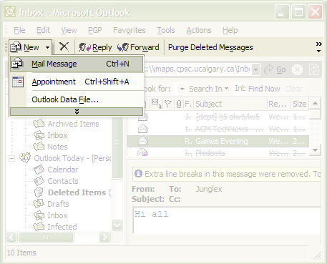
Problem 2: Solution
WidgetTap “paths”
outlook:Standard,MsoCommandBar:New/Mail Message
Notes:
In WidgetTap, we solved the problem of finding widgets by giving each widget names that does not change when it is recreated. We call these names “paths.” They are compact, human readable text strings split into three parts.
<<Click to animate>>
The first part says which process created the widget, and we can use this information to restart the process if the widget is destroyed.
<<Click to animate>>
The second part presents information needed to locate a heavyweight widget, or the heavyweight container of a lightweight widget. This second part encodes only information that can be obtained from the windowing system. Moreover, the path includes only the minimum information needed to reasonably assure uniqueness among all widgets on the display. If necessary, additional levels up in the windowing system widget hierarchy may be specified.
<<Click to animate>>
An optional third part describes information needed to find a lightweight widget, relative to its container.
<<Click to animate>>
WidgetTap paths are extremely powerful. Given the path, one can quickly enumerate all widgets on the display to find a suitable match, and make it possible for our toolkit to find a widget picked out by the user, even if the widget is destroyed.

Slide 23
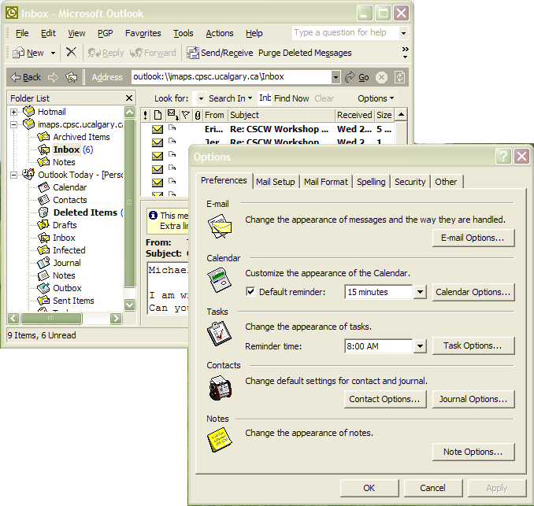
Where WidgetTap Fails…
Some GUI widgets aren’t created when app is first started
E.g., Options dialog box in Outlook
Notes:
Let’s talk about some of the ways the widget tap library fails, and indeed, some of the hardest problems a programmer must solve when trying to build a toolkit for semantic snarfing.
First, the WidgetTap library assumes that a widget will be created as a direct consequence of restarting the application that provides it.
Often this is not the case.
Sometimes widgets exist in short-lived dialog boxes and floating tool palettes, where widget creation is deferred until the widget is actually needed In these circumstances, WidgetTap will fail to find the widget after it has been recreated.

Slide 24
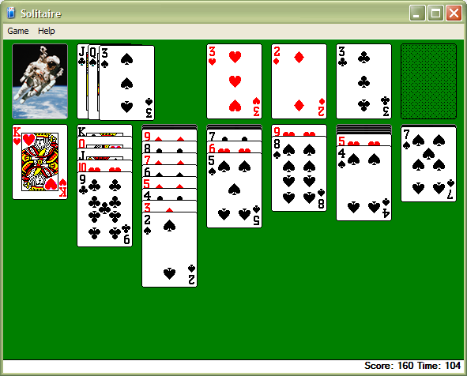
Where WidgetTap Fails…
Widget APIs often unpublished
Windows Solitaire game
Notes:
Secondly, WidgetTap relies on understanding the API used at the widget level. But, these APIs are often unpublished.
This can make it very hard to build a WidgetTap class to wrap a widget, particularly if it is a highly specialized one like the cards in the Windows Solitaire game.
Trial and error experimentation is often the only way to discover the API used for such widgets.

Slide 25
Summary: Building Customizable PUIs
Two toolkits for customizable PUIs:
  Phidgets: programming physical devices
  WidgetTap: accessing GUI widgets
Widget access is impossible in the general case, but definitely possible in the majority case
Notes:
So, in summary, I’ve illustrated that how we can use Phidgets and our WidgetTap software to build customizable physical interfaces for existing applications.
I’ve briefly discussed how the WidgetTap technology is used, how it is implemented, and some of the problems facing its implementation.
This work distinguishes itself from earlier work in Semantic Snarfing by Myers and Colleagues in two key ways.
First, we’ve provided in in a toolkit form and address the complexity issues there, and
Second, we have given widgets names that do not exist elsewhere and can be used to find widgets between invocations of an application.
More generally, we’ve shown that while widget access is impossible in the general case, our WidgetTap library demonstrates that it is certainly possible in the majority case.

Slide 26
Summary
With customizable physical interfaces, a person can bind any graphical control to a physical control
Notes:
Stepping back somewhat, our overall message is that <read slide>

Slide 27

For more information
www.cpsc.ucalgary.ca/grouplab/
Thanks to NSERC and Microsoft for funding
Notes:
Thanks for your interest in our work, and if you’d like more information, feel free to visit our website and contact us!

