Slide 1
Buddy Bugs
A Physical Interface for Windows® Instant Messenger
Susannah McPhail
University of Calgary

Slide 2
The Message
Buddy Bugs is a peripheral physical user interface that represents a Windows Instant Messenger Contact List

Slide 3
Contents
Why I Made This
Motivation
Design
What I Made
Video
Conclusion

Slide 4
Assignment
To design and implement a physical user interface

Slide 5
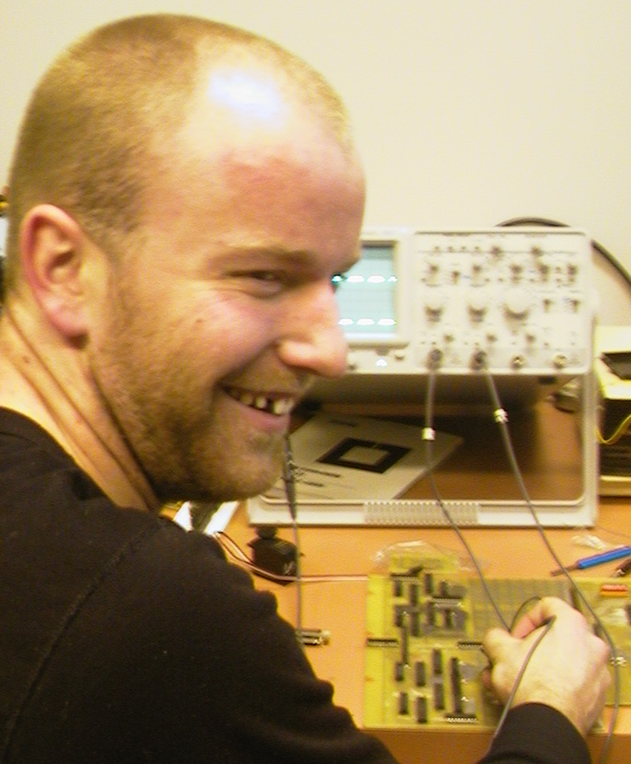
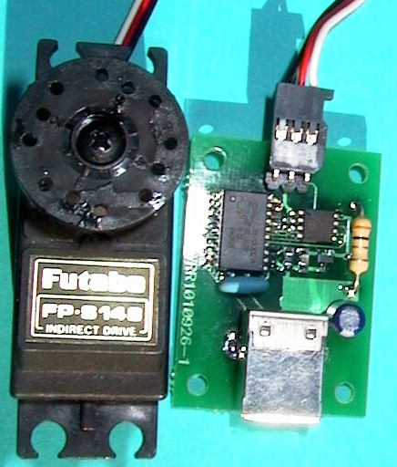
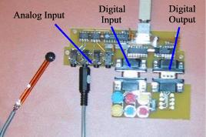
Phidgets
Notes:
Phidgets, or physical widgets, are building blocks that help a developer construct physical user interfaces. The philosophy behind phidgets is:
… just as widgets make GUIs easy to develop, so could phidgets make the new generation of physical user interfaces easy to develop.

Slide 6
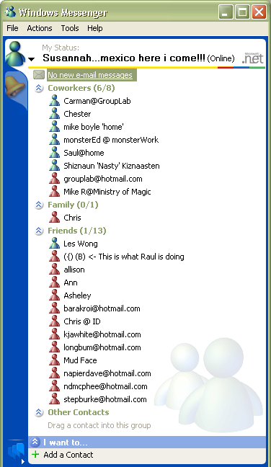
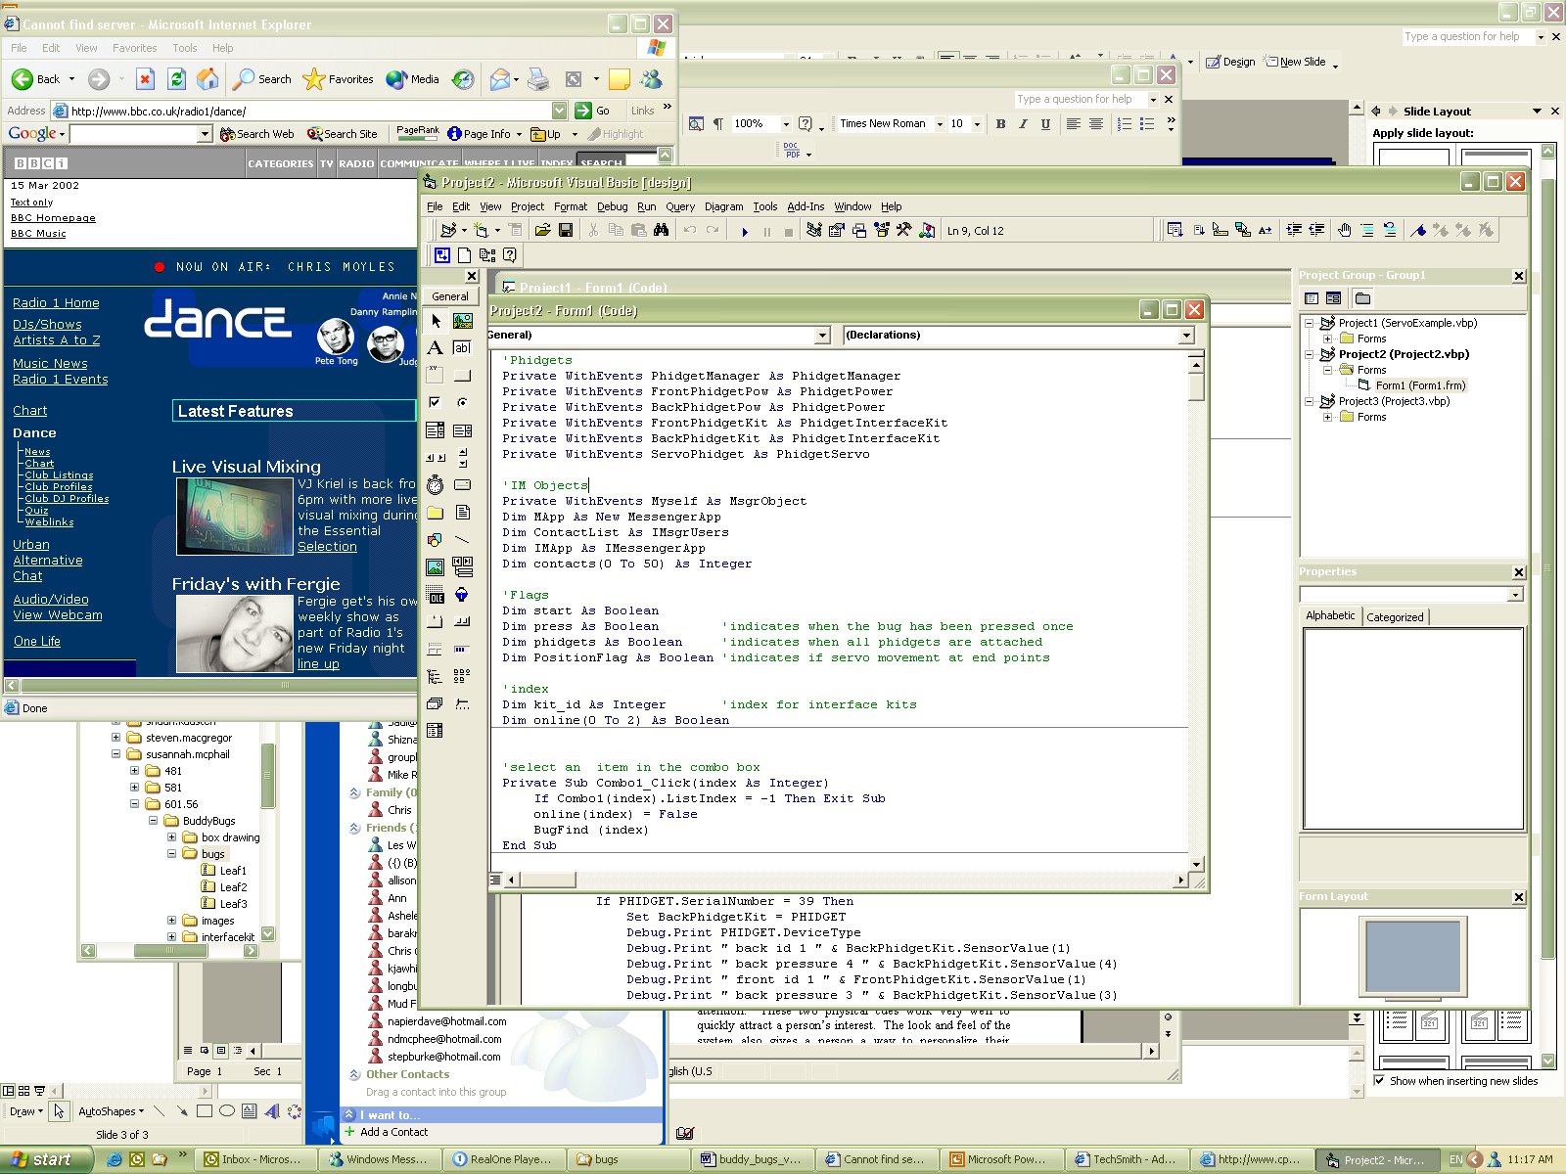
Motivation

Slide 7
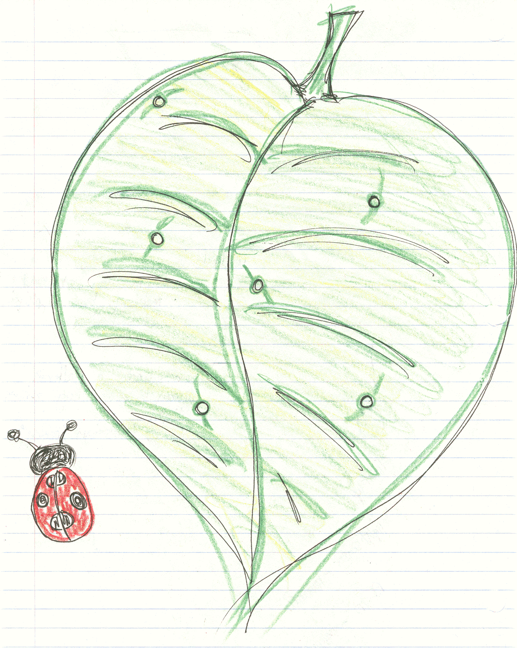
Bugs on a Leaf

Slide 8
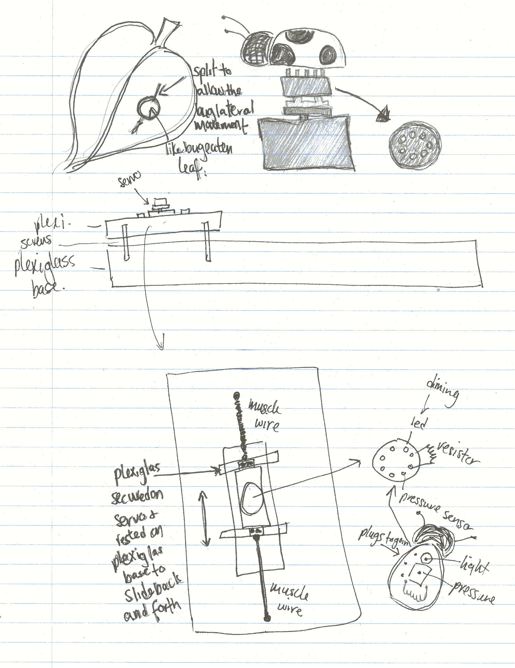
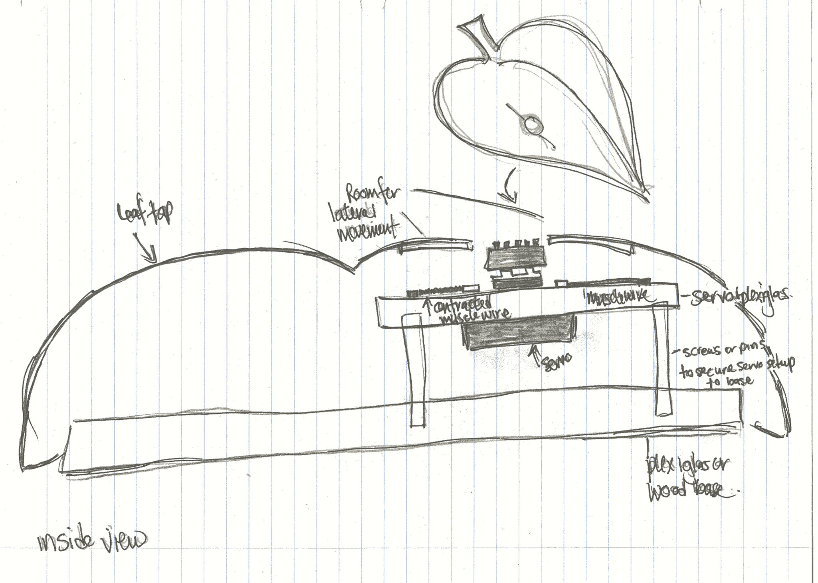
Design

Slide 9
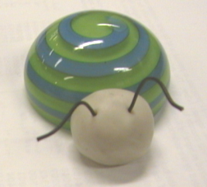
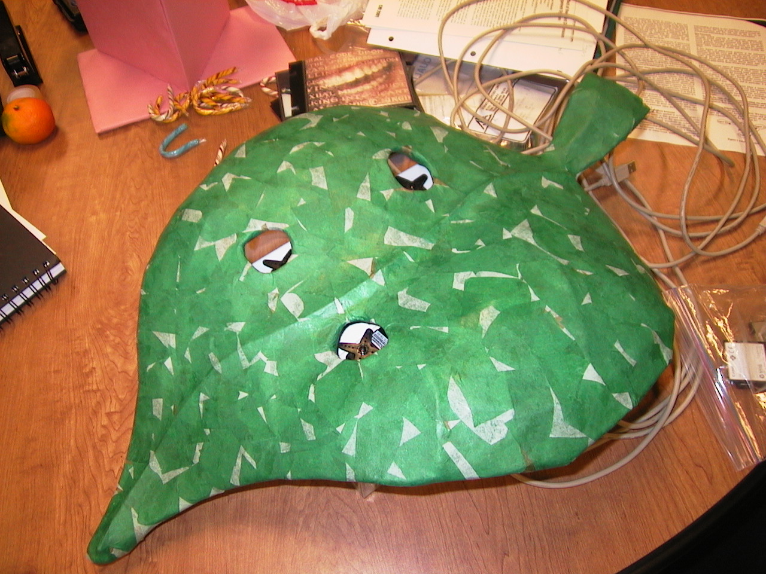
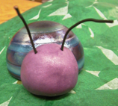
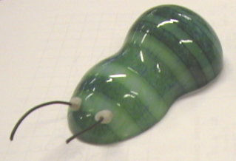
What I Made

Slide 10
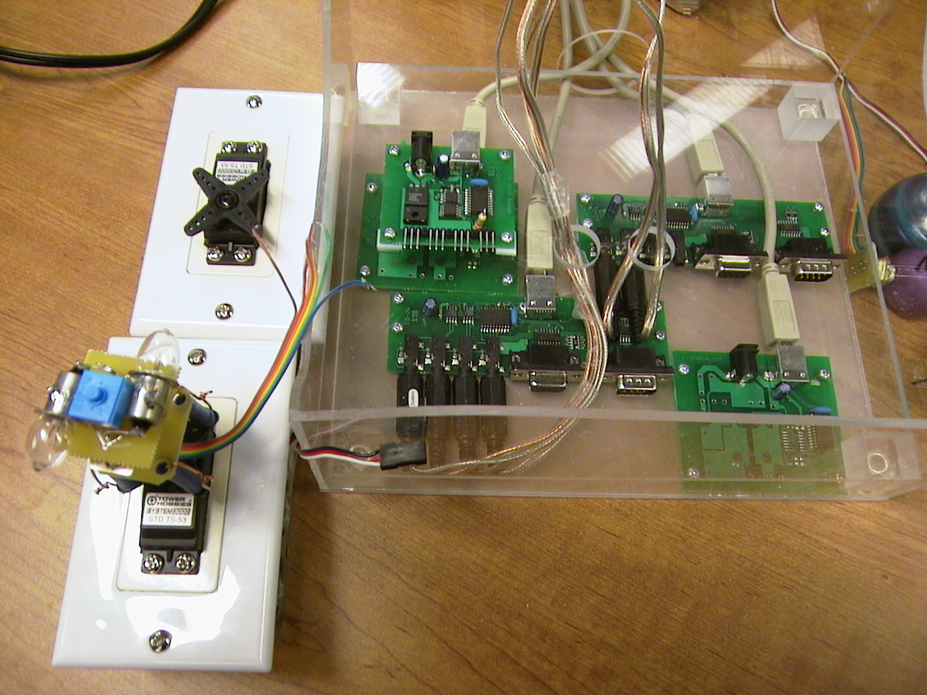
What I Made

Slide 11
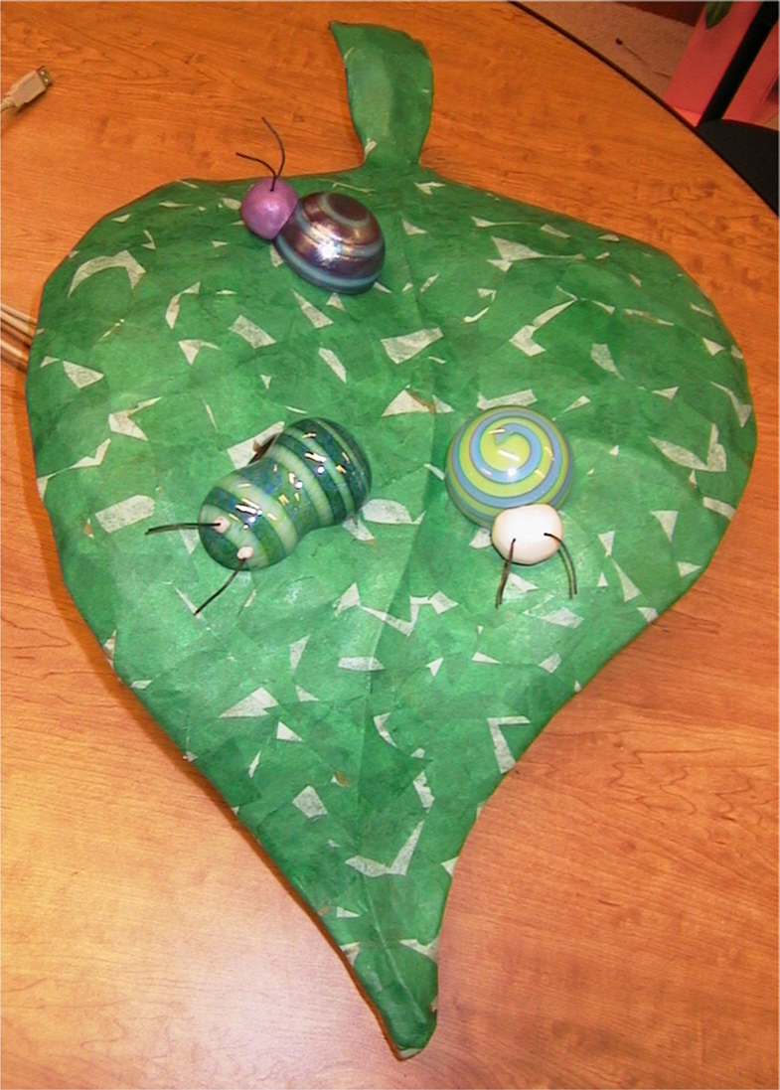

Slide 12
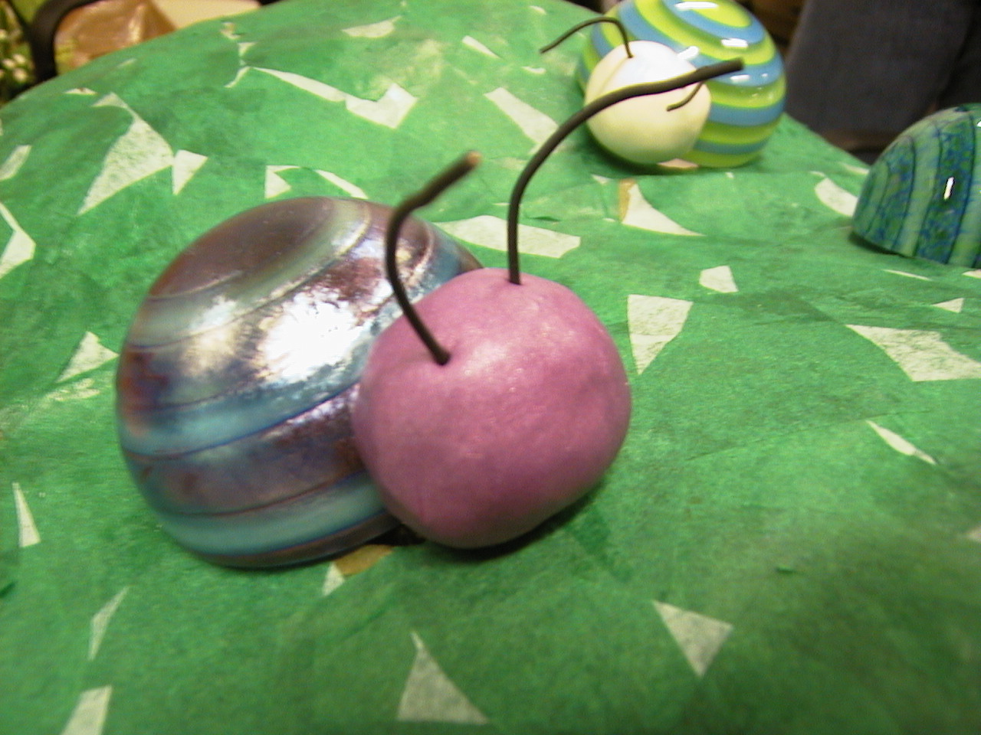
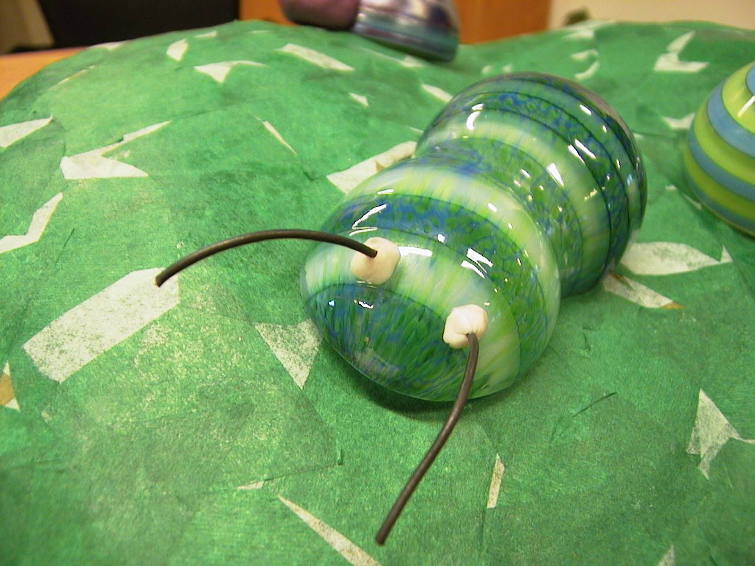


Icons

Slide 13






States
Available/Online
On the Phone
Busy
Be Right Back
Away
Out to Lunch
Offline
Available/Online
Be Right Back
On the Phone
Out to Lunch
Away
Busy
Offline

Slide 14
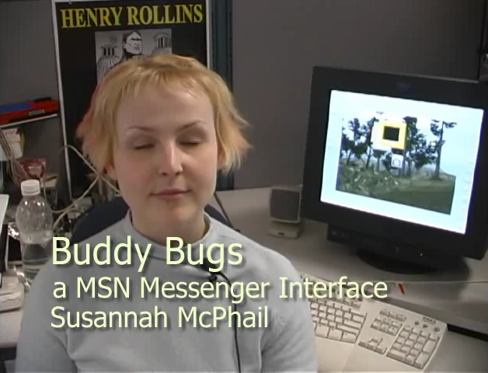
Buddy Bugs Video
A video of buddy bugs was shown here

Slide 15
The Message
Buddy Bugs is a peripheral physical user interface that represents a Windows Instant Messenger Contact List

Slide 16
References
www.cpsc.ucalgary.ca/grouplab/phidgets

