Slide 1
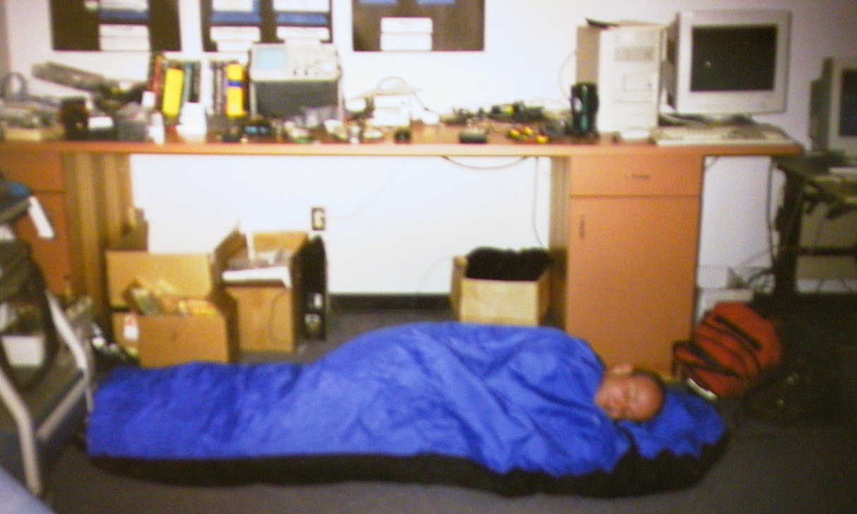
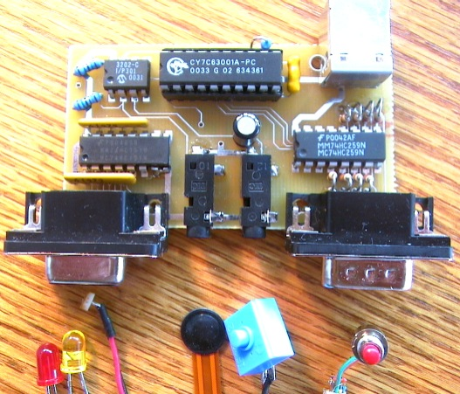
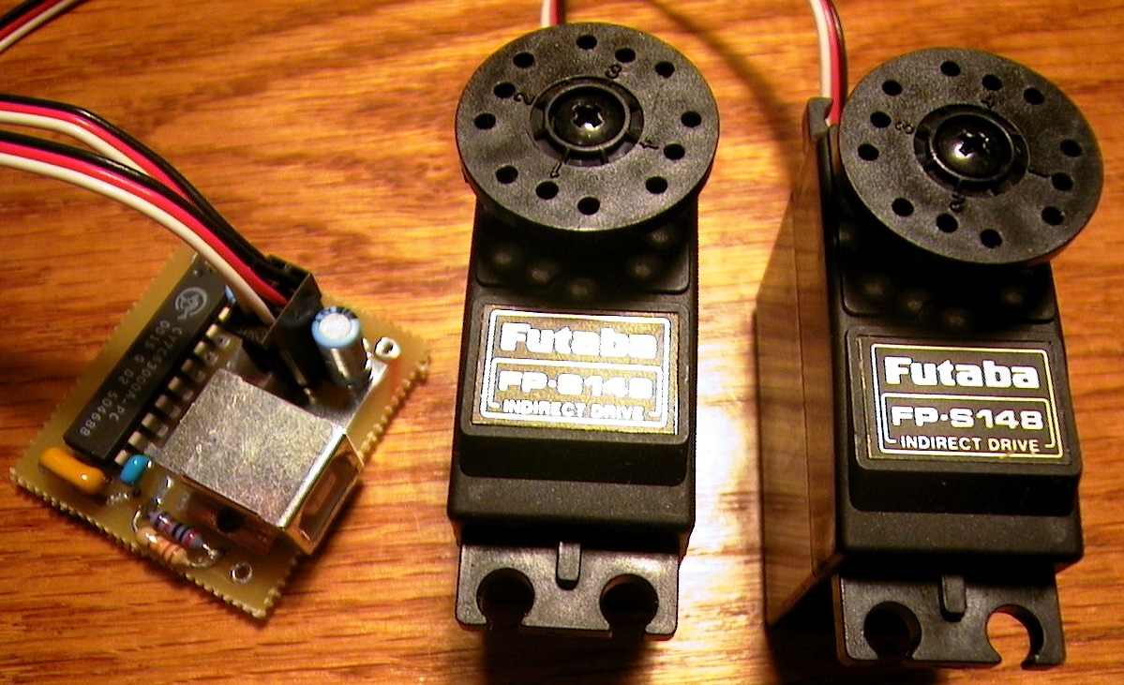
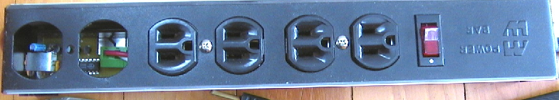
Phidgets
Easy development of physical interfaces through physical widgets
Note: This slide deck does not include the live
demonstrations and videos shown during the
actual presentation
Saul Greenberg
Chester Fitchett
University of Calgary
Notes:
These notes roughly paraphrase my presentation at the UIST conference.
Saul Greenberg
U Calgary
Talking about…
<ANIMATE>
My collaborator… worked very hard on h/w design/build/manufacturing

Slide 2
The Message
Just as graphical Widgets make GUIs easy to develop…
…so could Phidgets make the new generation of physical interfaces easy to develop
Notes:
The message of my presentation is…

Slide 3
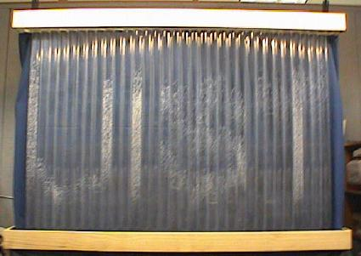
Physical User Interfaces
X
  ubiquitous computing
  pervasive computing
  tangible user interfaces
  information appliances
  context-aware computing
  interactive art
  ambient displays
  …
Heiner, Hudson,Tanaka UIST’99
Notes:
Now wide interest in HCI in physical user interfaces
Many subfields have sprung up…
While there are differences, all have in common the goal of moving beyond the graphical desktop interface and into our physical environment through physical interfaces

Slide 4
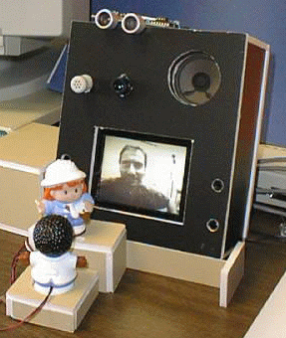
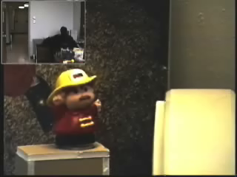
Motivation
Proximity detector
ultrasonic sensor
Hydra unit
video, camera,
speakers, microphone
Rotating figurine
servo motor
Tippable figurine light sensors
Notes:
Several years ago, Hideaki Kuzuoka (an engineer) and I built a ubiquitous media space.
It was a reactive environment, and included proximity and light sensors as well as a servo motor to move one of the figurines.
He built the hardware, and I concentrated on the software side.
It tooks several months of full time effort for Hideaki to build this, but we ended up using the system for around 3 months.
After Hideaki returned to Japan, we found the system impossible to extend or maintain.
This was because Hideaki did not build the system to be reusable (it was a ‘one of’ design), and as computer scientists specializing in software, we had no expertise in hardware.
The result is that the system is now a pile of wires and components.

Slide 5
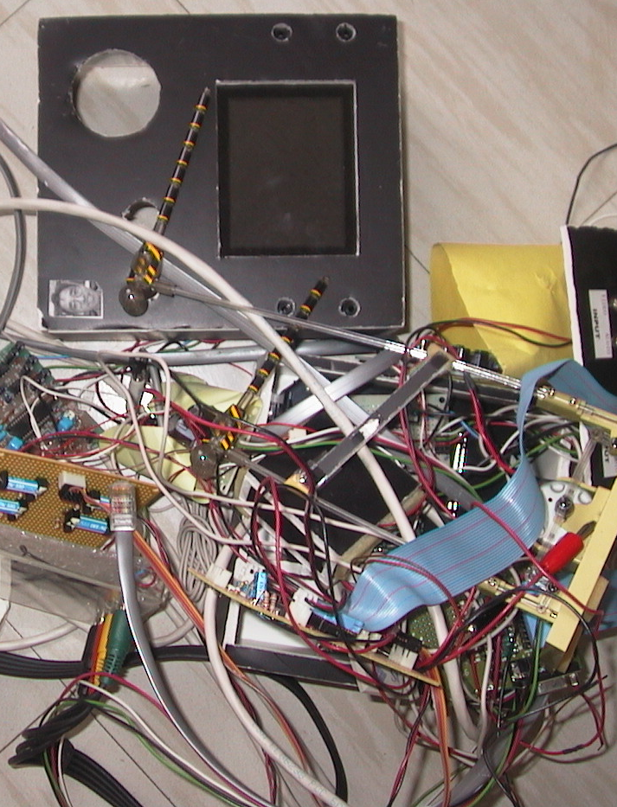
Motivation
Proximity detector
ultrasonic sensor
Hydra unit
video, camera,
speakers, microphone
Rotating figurine
servo motor
Tippable figurine light sensors
Notes:
Several years ago, Hideaki Kuzuoka (an engineer) and I built a ubiquitous media space.
It was a reactive environment, and included proximity and light sensors as well as a servo motor to move one of the figurines.
He built the hardware, and I concentrated on the software side.
It tooks several months of full time effort for Hideaki to build this, but we ended up using the system for around 3 months.
After Hideaki returned to Japan, we found the system impossible to extend or maintain.
This was because Hideaki did not build the system to be reusable (it was a ‘one of’ design), and as computer scientists specializing in software, we had no expertise in hardware.
<ANIMATE>
The result is that the system is now a pile of wires and components.

Slide 6
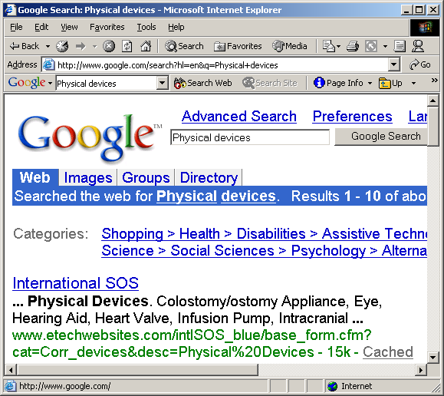

Motivation
No suitable building blocks for the
average programmer
Notes:
Because we wanted to continue our work in reactive enviroments,
I spent time looking around the web for things I could buy that would help me easily develop physical user interface.
To my surprise, there was little out that that was in a form I could use.

Slide 7
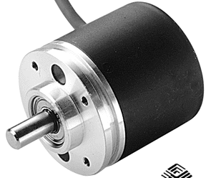


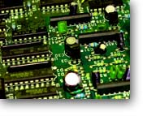


Motivation
No suitable building blocks
Low level parts
(electrical engineers)
Notes:
The basic problem is that while there where many things out there, none were suitable as building blocks for my skill set and what I wanted to do.
For example, its very easy to find low level parts, but unless you are an E Engineer or hobbyist, the learning curve is too high.
You have to select appropriate devices, create circuti boards, write microcode, etc.

Slide 8

Motivation
No suitable building blocks
No API
(hackers)
ActiMates
Notes:
Others things were premanufactured devices under computer control, like Microsoft Actimates (Barney).
These, however, had no public API and the only way to get into it is by hacking it (e.g., Dourish)

Slide 9
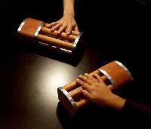
Motivation
No suitable building blocks
One-off pieces
(academics/artists)
inTouch Tangible Media Group
Notes:
There are, of course, many one-off pieces created by both academics as proof of concepts and artists as interactive installations.
But these are neither obtainable nor reusable to others.

Slide 10
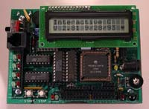
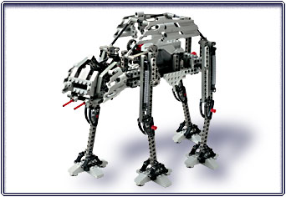
Motivation
No suitable building blocks
Handy Board
Robotics
(kids and hobbyists)
Lego Mindstorms
Notes:
The closest thing out there are robotic kits, usually produced for kids or for hobbyists.
Unfortunately, these are usually intended for stand-alone operation (robots).
The coding is either to simplistic (Mindstorms) or too low level (handyboard – coding microprocess)

Slide 11
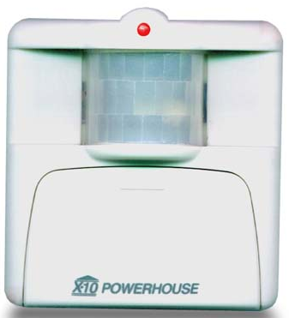
Motivation
No suitable building blocks
Appliances-X10
(smart homes)
Indoor motion sensor
Notes:
I did find X10, a protocol that works over a home’s standard electric wiring.
However, what I found were appliances e.g., security devices and so on that are somewhat too high level to adapt to my purposes.

Slide 12

Motivation
Even if you went through the effort…
Will those parts ever arrive?
On critical path…
Notes:
Even if we did try some of these, a frustrating thing was that
we could not start programming/working on the design until the hardware arrived and was assembled.

Slide 13
Research Goal
Create physical devices and software so:
  developers concentrate on physical interface design
    use, recombine, and modify devices as needed
  appropriate for the average programmer
    easy to program and extend
Notes:
After thinking about these problems, we set ourselves a new research goal
…
Or, as my students like to rephrase this…
<animate>

Slide 14

Research Goal
Create physical devices and software so:|
  simple enough for Saul to use

Slide 15
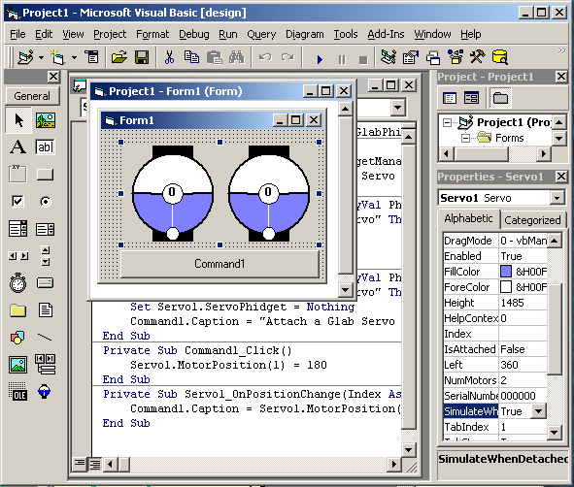
Insight
GUI Widgets
Stock widget set
Easy to add to
program
Well defined API
Easy to try
Notes:
The insight we had came from how we already use graphical user interface widgets.
Stock widget sets are available in virtually every user interface development package (e.g., buttons, listboxes, etc.),
As well, most interact with interface builders, where a programmer can just select and drop it into a program.
Each one is presented as an abstraction: each has a well-defined API that lets a programmer easily track and manipulate it.
They are very easy to try and test: just drop it in, write a bit of code, and execute.

Slide 16

Insight
Phidgets - Physical Widgets
Stock widget set
Well defined API
Easy to add to
program
Easy to try
Notes:
Phdigets, or physical widgets, should be just as easy to program.
One would program and use it in exactly the same way as widgets!

Slide 17
Insight
Phidgets - Physical Widgets
Requirements beyond widgets
  Connection manager
    device appearance / disappearance
  Identification
    link software with device type / particular devices
  Simulation mode
    program, test, debug without the device

Slide 18

Notes:
I hired Chester Fitchett, one of the few undergraduate computer science students keenly interested in hardware.
His job was to build a phidget infrastructure, as well as several phidget components.

Slide 19
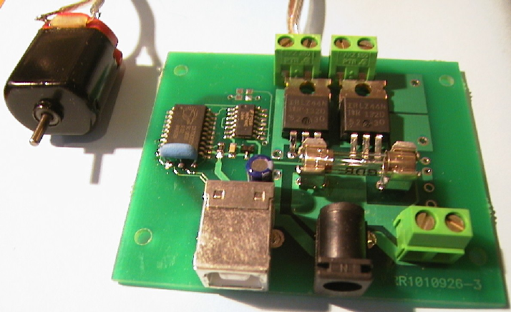
What we built
Servo
1-4 servo motors
InterfaceKit
8 inputs
4 sensors
8 outputs
Power
DC devices
Powerbar
6 120 volt outlets
Notes:
So far, we have built several phidgets. This includes…

Slide 20
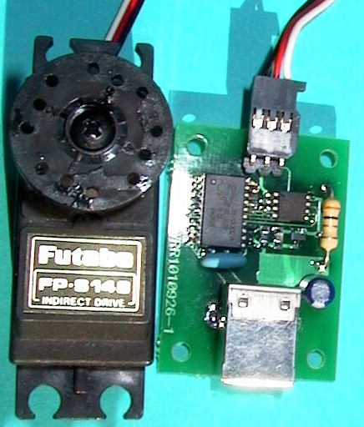
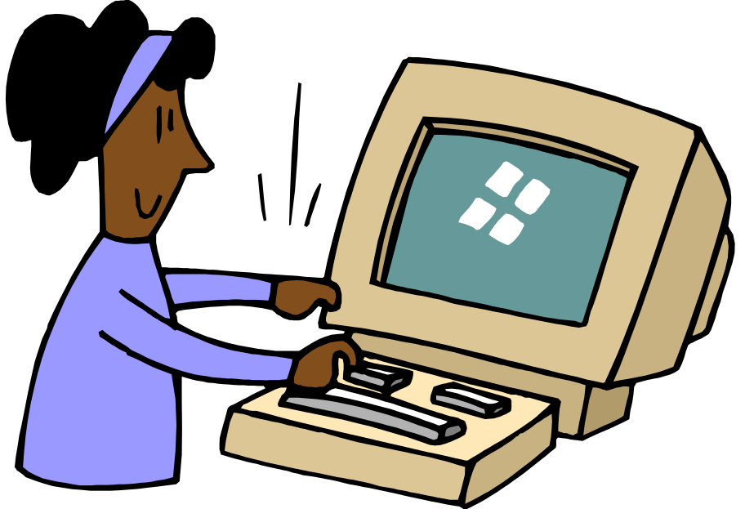
Phidget architecture
Hardware
Software
communication layer
Notes:
What we came up with is shown above.
Every phidget has two parts: a ‘Phidget Device’ and matching ‘Phidget Software’.
The phidget device is presented to the programmer as a black box:
the programmer does not need to consider how it is assembled internally
(just as a GUI programmer does not need to know how the graphics of (say) a listbox is internally coded).

Slide 21
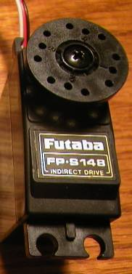
Phidget architecture
Hardware
device components
device

Slide 22
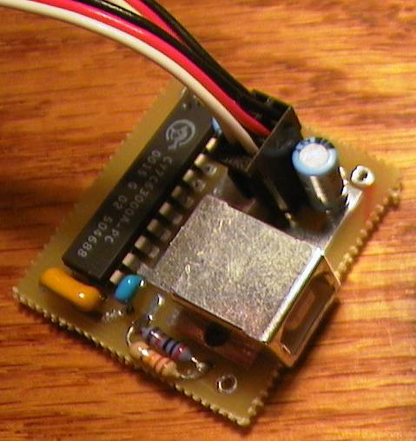
Phidget architecture
Hardware
circuit board
device
circuit

Slide 23


Phidget architecture
Hardware
Software
device
circuit
wire protocol
wire protocol
communication layer

Slide 24
Phidget architecture
Hardware
Software
device
circuit
phidgetManager
Events Properties pm.OnAttach(phidget) pm.DeviceType
pm.OnDetach(phidget) pm.SerialNumber…
wire protocol
communication layer

Slide 25
Phidget architecture
Hardware
Software
device
circuit
phidgetServo
Events Properties
servo.OnPositionChanged servo.MotorPosition=90
phidgetManager
Events Properties pm.OnAttach(phidget) pm.DeviceType
pm.OnDetach(phidget) pm.SerialNumber…
wire protocol
communication layer

Slide 26

Phidget architecture
Hardware
Software
device
circuit
phidgetServo control
phidgetServo
Events Properties
servo.OnPositionChanged servo.MotorPosition=90
phidgetManager
Events Properties pm.OnAttach(phidget) pm.DeviceType
pm.OnDetach(phidget) pm.SerialNumber…
wire protocol
communication layer

Slide 27
Demonstration
Phidget-Servo
Notes:
What I would like to do now is demonstrate one of the phidgets, the Servo, to show you how easy it is to program.

Slide 28
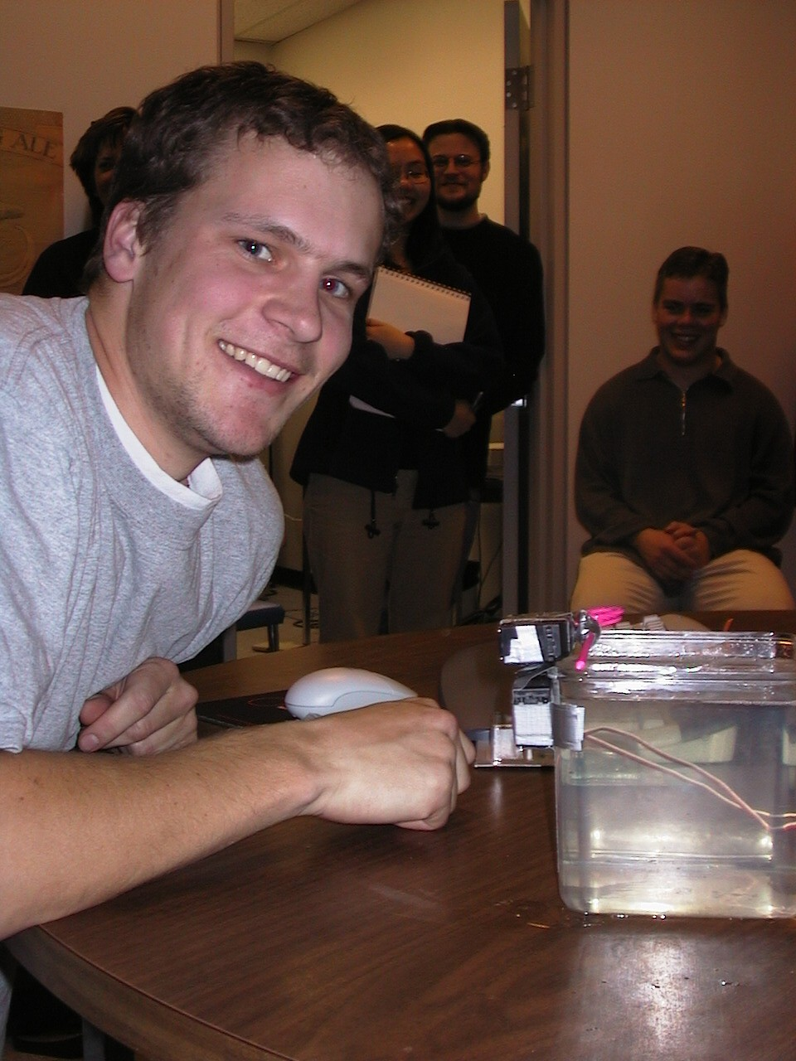
Evaluation
Phidget assignment
  undergrad HCI design class
  minimal instruction
  1.5 weeks
Goal:
  design an imaginative physical interface that I can demonstrate at a conference

Slide 29
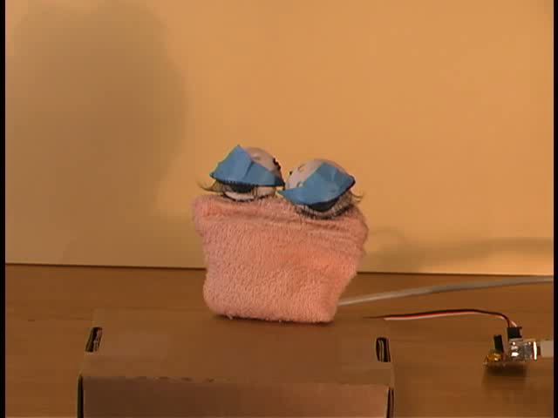
project demonstrations

Slide 30
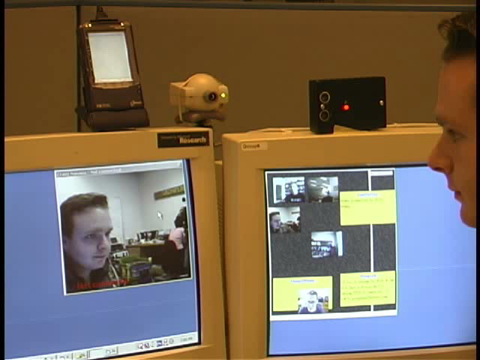
Privacy preserving media space, Mike Boyle

Slide 31

Halloween Pumpkin Phidget, Chester Fitchett

Slide 32
What is next…
Phidgets
  technical factors
  phidget & phidget set design
  achieving critical mass
Notes:
There is still lots left to be done.
–other wire protocols
(wireless, ethernet…)
distributed data structure – ubicom platform (shared dic)
2) –phidget desing
level of abstraction. If we make phidgets too high-level, they become appliances that may not be flexible enough to assemble into new directions. If they are too low-level, they may be too hard to program and manage.
What is a useful widget set? RFID tags, proximity, motion detectors …
3) Critcal mass for deployment, defacto standards (300 for research use, industrial licenses)
4, Eval (other universities and artists: georgia tech, banff center
5 Standards –existing/new protocols, universal platform access, etc, defacto vs dejure,
.

Slide 33
What is next…
Physical user interfaces
  getting back to design!
Notes:
There is still lots left to be done.
–other wire protocols
(wireless, ethernet…)
distributed data structure – ubicom platform (shared dic)
2) –phidget desing
level of abstraction. If we make phidgets too high-level, they become appliances that may not be flexible enough to assemble into new directions. If they are too low-level, they may be too hard to program and manage.
What is a useful widget set? RFID tags, proximity, motion detectors …
3) Critcal mass for deployment, defacto standards (300 for research use, industrial licenses)
4, Eval (other universities and artists: georgia tech, banff center
5 Standards –existing/new protocols, universal platform access, etc, defacto vs dejure,
.

Slide 34
Summary
Just as graphical Widgets make GUIs easy to develop so could Phidgets make the new generation of physical interfaces easy to develop
Phidgets
  hide device implementation details
  use API to expose device functionality
  include on-screen visual representation
  simulate unavailable device

Slide 35

For more information
www.cpsc.ucalgary.ca/grouplab/
Thanks to NSERC, Microsoft Research, ASERC
Notes:
Thanks for your interest in our work, and if you’d like more information, feel free to visit our website and contact us!
The new version of the software should be ready in a month or two. I would also like to acknowledge suppport by Microsoft Research.
Thanks again,

Slide 36
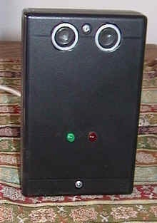

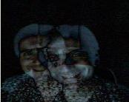
Phidgets we are revising
This slide was not shown at the workshop
Proximity Sensor
Uncle Touch
Motion detector
Notes:
This slide was not shown at the workshop

Slide 37
Current / future work
Technical
  other wire protocols
  shared dictionary
Phidget design
  level of abstraction
  phidget set
    RFID tags
    DC Power
    proximity
    motion detectors
Critical mass
  ~300 for research use
  industrial licenses
Evaluation
  other universities
  artists
Standardization
Notes:
There is still lots left to be done.
1) tech (wireless, ethernet…) (distributed data structure – ubicom platform)
2) we do not yet know the right level of abstraction. If we make phidgets too high-level, they become appliances that may not be flexible enough to assemble into new directions. If they are too low-level, they may be too hard to program and manage.
What is a useful widget set?
3) Critcal mass for deployment, defacto standards
4, Eval (georgia tech, banff center
5 Standards –existing/new protocols, universal platform access, etc, defacto vs dejure,
.

Slide 38
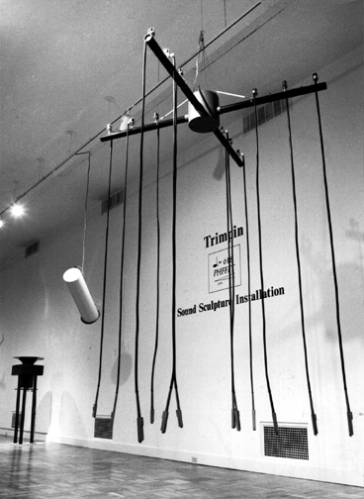
Motivation
No suitable building blocks
One-offs
(art)
Trimpin Leonardo Gallery

Slide 39
Motivation
No suitable building blocks
Robotics - educational
(kids)
Lego Mindstorms

Slide 40
Motivation
No suitable building blocks
Robotics - hobbyist
(adults)
Handy Board

