Slide 1
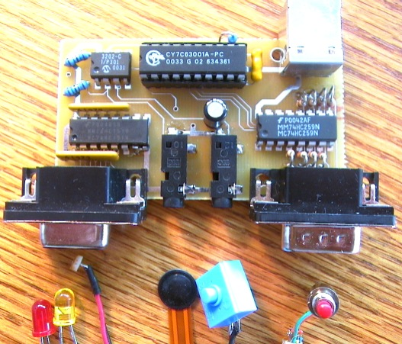
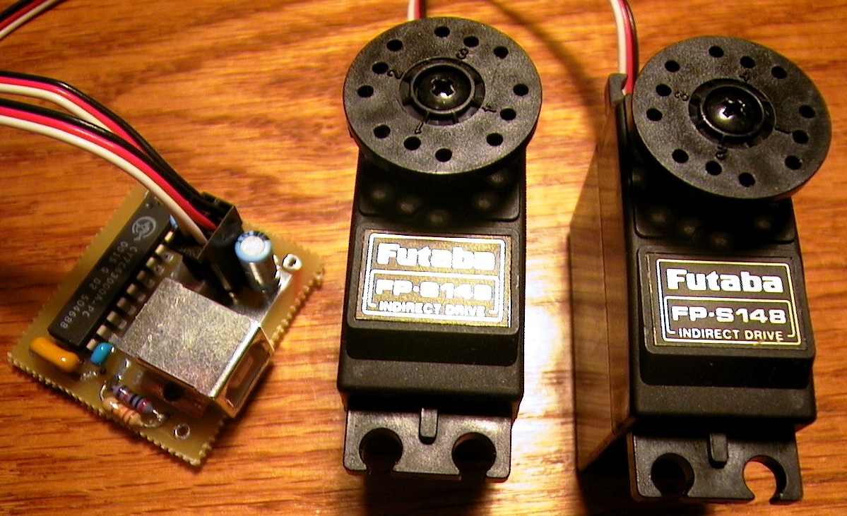
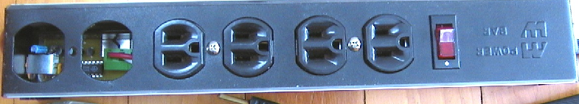
Phidgets
Incorporating Physical Devices into the Interface
Saul Greenberg
Chester Fitchett
University of Calgary
The Message
Just as widgets make GUIs easy to develop, Phidgets (physical widgets) make
UbiComp easy to develop.
Notes:
These notes roughly paraphrase my presentation at this workshop.

Slide 2
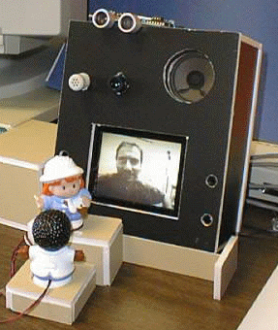
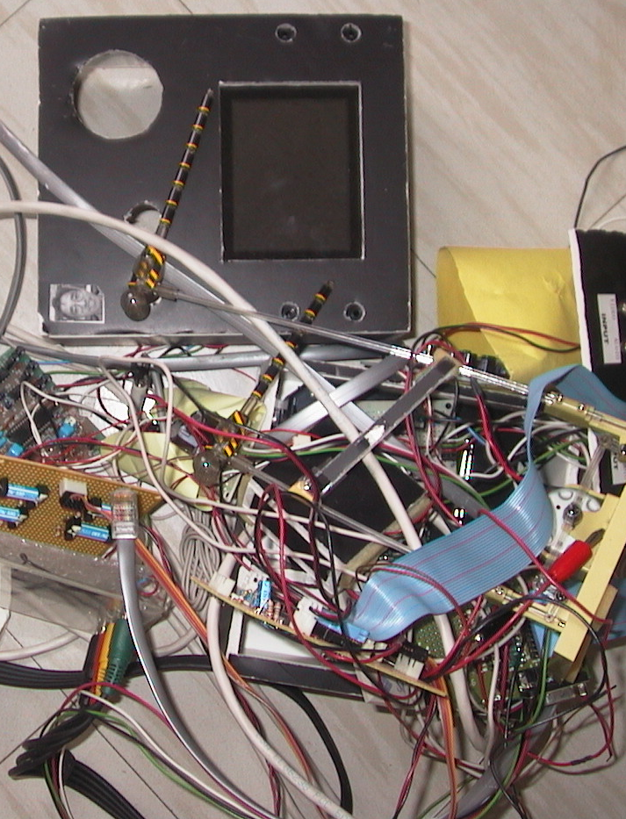
Motivation
Proximity detector
ultrasonic sensor
Hydra unit
video, camera,
speakers, microphone
Rotating figurine
servo motor
Tippable figurine light sensors
Notes:
Several years ago, Hideaki Kuzuoka (an engineer) and I built a ubiquitous media space. It was a reactive environment, and included proximity and light sensors as well as a servo motor to move one of the figurines. He built the hardware, and I concentrated on the software side. It tooks several months of full time effort for Hideaki to build this, but we ended up using the system for around 3 months. After Hideaki returned to Japan, we found the system impossible to extend or maintain. This was because Hideaki did not build the system to be reusable (it was a ‘one of’ design), and as computer scientists specializing in software, we had no expertise in hardware. The result is that the system is now a pile of wires and components.

Slide 3
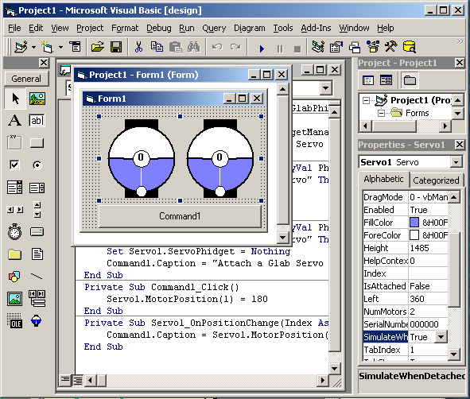
GUI Widgets
Stock widget set
Well defined API
Easy to add to
program
Notes:
Because we wanted to continue our work in reactive environments, we began to think about how we could make hardware such as what we had built before reusable. The insight we had came from how we already use graphical user interface widgets. Stock widget sets are available in virtually every user interface development package (e.g., buttons, listboxes, etc.), and each one is presented as an abstraction: each has a well-defined API that lets a programmer easily track and manipulate it. As well, most interact with interface builders, where a programmer can just select and drop it into a program.

Slide 4

Phidgets
Stock widget set
Well defined API
Easy to add to
program
Notes:
We wanted to do the same thing with physical devices. Therefore, we came up with the notion of a phidget, or physical widget. As with graphical widgets, there would be a stock phidget set, each would have a well defined API, and they would be very easy to add to a program.

Slide 5
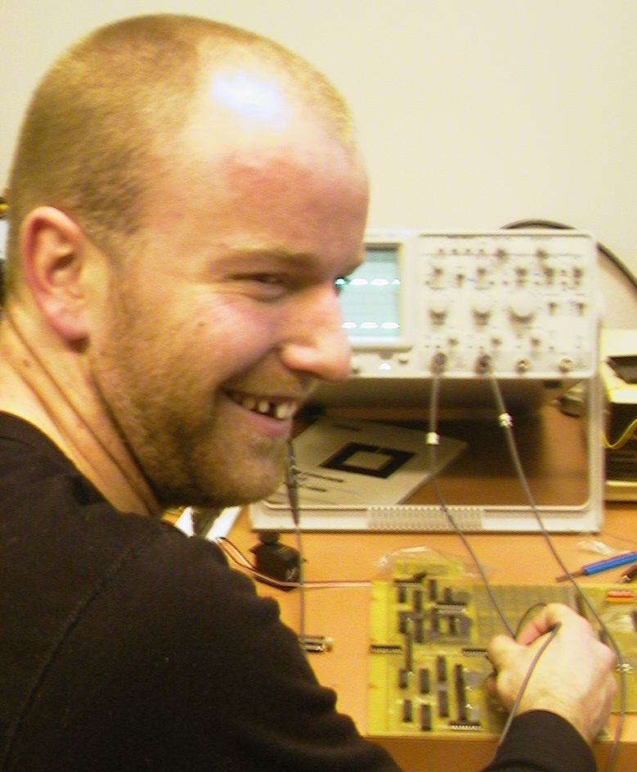
Notes:
I hired Chester Fitchett, one of the few undergraduate computer science students keenly interested in hardware. He job was to build a phidget infrastructure, as well as several phidget components.

Slide 6
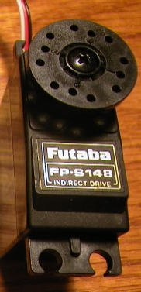


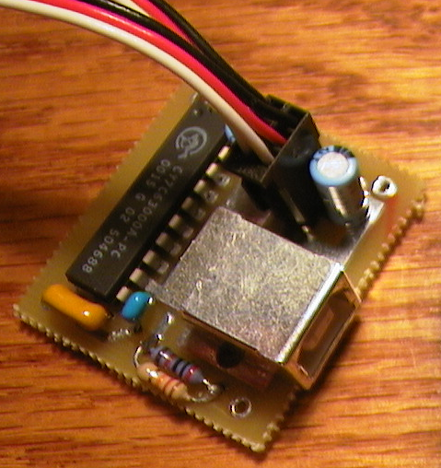
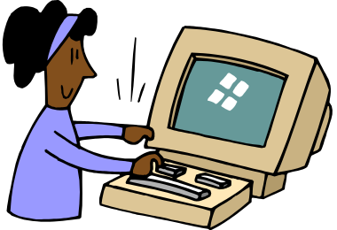
Phidget architecture
Phidget Device
Phidget Software
Events:
OnAttach(P)
OnDetach(P)
Properties:
P.DeviceType
P.SerialNumber
P.IsAttached
device
low-level s/w
phidgetManager API
Graphics
circuit
wire
protocol
phidget API
Events:
OnPositionChanged*(I) Properties:
MotorPosition(I)
NumMotors
Notes:
What we came up with is shown above. Every phidget has two parts: a ‘Phidget Device’ and matching ‘Phidget Software’. The phidget device is presented to the programmer as a black box: the programmer does not need to consider how it is assembled internally (just as a GUI programmer does not need to know how the graphics of (say) a listbox is internally coded). The device contains the things being controlled (e.g., a servo motor), the circuit board for interacting with this piece of hardware (e.g., microprocessor, AtoD convertor), and the hardware/software wire protocol (e.g., USB connector plus protocol). On the actual computer, there is low level software for detecting and interacting with the phidget device (e.g., USB software that talks to the hardware). The programmer sees only the higher-level Phidget Software. This includes a phidgetManager (which raises events whenever a new phidget is detected (or attached) and when one leaves), and an API specific to the phidget (e.g., a method for rotating the servo motor). It optionally includes a graphical representation for the phidget. This can be used to give on-screen feedback of the phidget state (e.g., the current position of the servo motor) or to interact with it directly (one can interactively rotate the graphics to rotate the actual device). If a phidget property is set, it can also optionally simulate the phidget. That is, the programmer can program and use the simulated graphics device even if no corresponding physical device is available.

Slide 7
Demonstrations
Servo
-2 servo motors
InterfaceKit
-8 inputs
-2 sensors
-8 outputs
Powerbar
-4 120 volt outlets
Notes:
I did not show this slide, as I demonstrated these phidgets live at the workshop. This included showing how a servo phidget can be quickly dropped into a Visual Basic program.

Slide 8
Phidget Questions
What is a ‘standard’ phidget set?
What is the right level of abstraction?
What is the risk of creating ‘poor’ Ubicomp?
Notes:
There are, of course, several outstanding research questions. The first is that we do not know what a standard phidget set comprises. GUIs have evolved so that virtually everyone of them has a standard set: buttons, labels, text boxes, etc, but its still unclear what a standard phidget set should be. The second question is that we do not yet know the right level of abstraction. If we make phidgets too high-level, they become appliances that may not be flexible enough to assemble into new directions. If they are too low-level, they may be too hard to program and manage. The third question is that that making phidgets easy to program introduces risk. While current work in ubicomp is done by just a few researchers well aware of ubicomp issues, putting this into the hands of joe programmer may make it just too easy to create bad ubicomp environments.

Slide 9
Summary
Just as widgets make GUIs easy to develop, Phidgets (physical widgets) make UbiComp easy to develop
Phidgets
  hide device implementation details
  use API to expose device functionality
  include on-screen visual representation
  simulate unavailable device
www.cpsc.ucalgary.ca/grouplab/developers/USBPhidgets

Slide 10
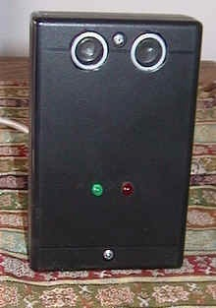


Phidgets we are revising
This slide was not shown at the workshop
Proximity Sensor
Uncle Touch
Motion detector
Notes:
This slide was not shown at the workshop

