Slide 1
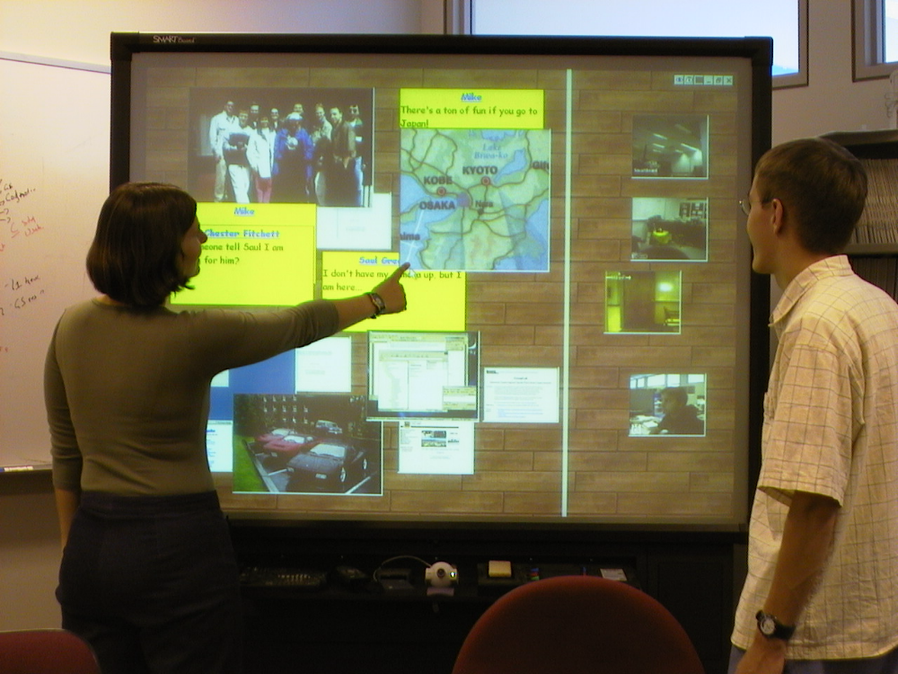
The Notification Collage
Posting Information to Public and Personal Displays
Saul Greenberg
Michael Rounding
University of Calgary
Notes:
Good afternoon! My name is Saul Greenberg from the University of Calgary
<Mike R.: and I’m Michael Rounding, a graduate student of Saul’s>
We’re both delighted to be here at this last paper session of CHI.
Today, we will introduce you to a groupware system we built called the Notification Collage,

Slide 2
The Message
Intimate collaborators can post
multimedia elements to a Notification Collage to encourage casual interaction.
Notes:
The message we will deliver over the next 20 minutes is that Intimate collaborators can post multimedia elements to a Notification Collage to encourage casual interaction
I’ll start delivering this message by explaining the concepts of intimate collaborators and casual interaction.
Mike will then take over.

Slide 3
Notes:
He’ll describe the Notification Collage and how its elements provide:
-awareness of people
-awareness of their artifacts
-entry points into conversation
-interaction over artefacts.
He will then summarize how the Notification Collage encouraged casual interaction within our group of both colocated and distributed collaborators.

Slide 4


Intimate Collaborators
Friends, family, work groups
Real need for close
coordination and collaboration
Notes:
Ok, lets begin with intimate collaborators.
These are people who know each other well: family, friends, work groups.
What makes this group special is that its members have a real need or desire for close coordination, collaboration, and social interaction.

Slide 5

Intimate Collaborators
Friends, family, work groups
Real need for close
coordination and collaboration
Sometimes co-located,
sometimes distance-separated
Notes:
Groupware has potential to support these intimate collaborators, for in today’s society, it is common for its members to be sometimes co-located, sometimes distance-separated. A good example is a work group that included telecommuters.

Slide 6
Casual Interaction
Lightweight coordination and communication
Notes:
The second concept is Casual interaction. CSCW researchers in the late 1980s described the importance of the lightweight coordination and easy
communication that happened through casual hallway encounters, in coffee rooms, over photocopy machines, and when they worked together in common areas.

Slide 7
Casual Interaction
Lightweight coordination and communication
Hi Mary
Notes:
The glue behind these casual interactions is awareness, where people constantly but subconciously ask and answer questions such as
-who is around
-are they available now
-can they be interrupted
-how can I initiate contact

Slide 8
Casual Interaction
Goal
  support smooth transition from awareness to casual encounters to conversation and work
Hi guys! Oh, there’s Sally!
Ask her along.
Notes:
When we move to settings that includes distant collaborators, the design goal for groupware then becomes to support the smooth transition from awareness to casual encounters to conversation and work.
And you will see that this is exactly what we built the Notification Collage for.

Slide 9
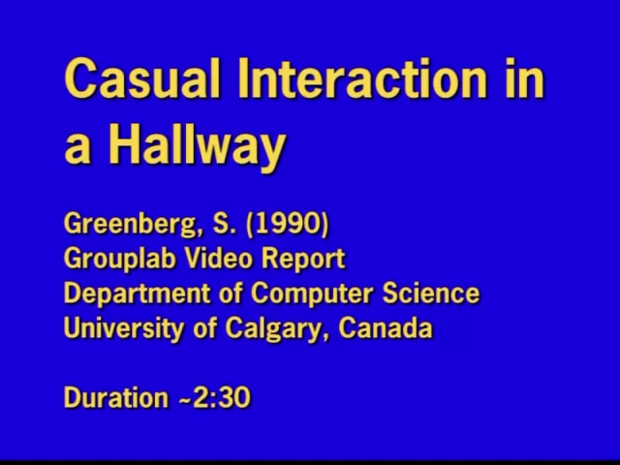

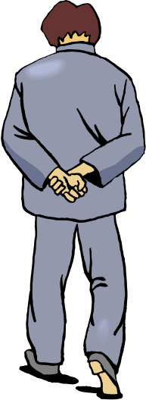
Casual Interaction
Video: a hallway over lunchtime
  idea from Bellcore
Notes:
To illustrate this idea, I’m going to show you a video that I made several years ago.
Copying the idea I had seen in a video produced by Bellcore researchers, I put a camera in a public hallway for one hour over lunch.
What you will see is a part of this hour where I just cut out the bits where no-one was in the hall.
You will notice that people constantly seek awareness information---people are simply unable to pass by an open doorway without looking in.
You will also see that people often act on that information to move into casual interaction.

Slide 10
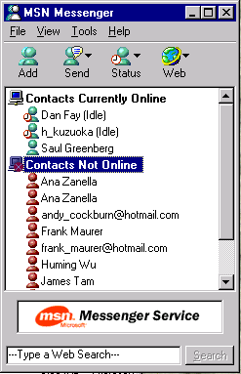
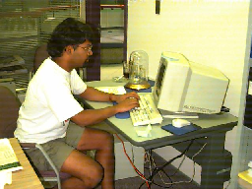
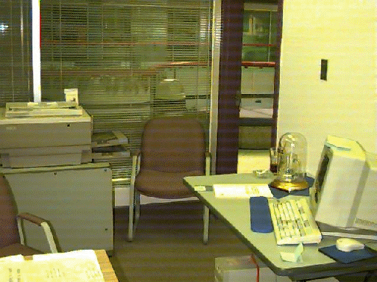
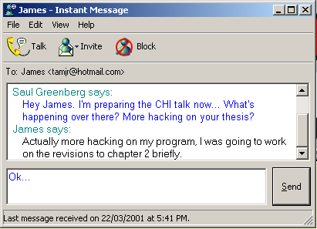
Related Work
Instant Messaging
Media
spaces
Notes:
Of course, many groupware systems have been designed to support casual interaction.
Perhaps the most well-known is instant messaging, where one can select their friends (or intimate collaborators), see if they are on-line, and then easily enter into a text chat conversation. While these systems provide only a few bits of awareness information, they have become the 2nd killer app of groupware (with email being the first) because they make casual interaction over computers accessable to the many.
At the other extreme we have media spaces that provide an always on video portal between places. In media spaces, people gather awareness through the video channel, and use the same channel to move into communication.

Slide 11

Awareness Information
Rich
Compete for our attention
Shared resource
Socially produced
Socially manipulated
Notes:
While these systems work, we wanted groupware to recognize other characteristics of awareness information now present in the every day world.
First, Awareness information is rich: we are aware of many things, including not only people, but of the events occuring around us and of the things, or artifacts within our environment.
Second, Information competes for our attention: our environments contain huge amounts of information: noticing information is often a function of its personal importance, its salience, and serendipity
Other important points come from considering awareness information as a social phonomenon.
When people cohabit a place, the information becomes a shared resource that many can perceive.
Awareness information can also be socially produced. One person can intentionally create information for others (such as a message placed on a visible whiteboard). Similarly, conversations and interactions by people in a group can be overheard by others.
Finally, awareness information can be socially manipulated. One person may position it so another can see it. For example, I am sure all of you have experienced a postit note stuck to your monitor that was placed there by another person. As well, if one person sees some information that may be relevant to another, he or she may inform them about it.

Slide 12
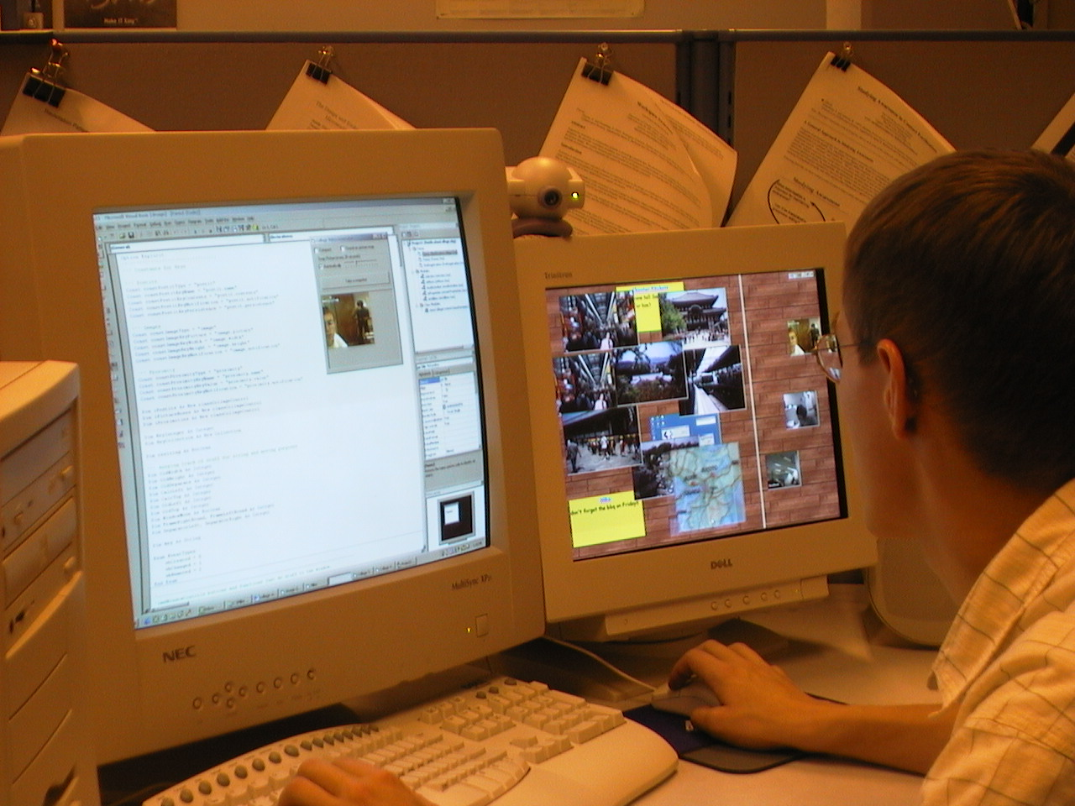
Notification Collage
Personal display
Public display
Notes:
We developed the Notification Collage to recognize these characteristics.
I do want to acknowledge that our design was heavily influenced by two other systems: University of Queensland’s TickerTape, and Andruid Kerne’s Collage Machine. These are detailed in the paper.
Mike will now take over.
He will describe the Notification Collage and its elements, and then detail how its been used by our group of colocated and distant collaborators.
The NC is a public forum for group members to post multimedia information about themselves and their things
It encourages casual interaction by allowing others to view this information and act on it.
We wanted this information on the periphery of peoples’ attention, hence its presence on both large public displays and secondary personal displays

Slide 13
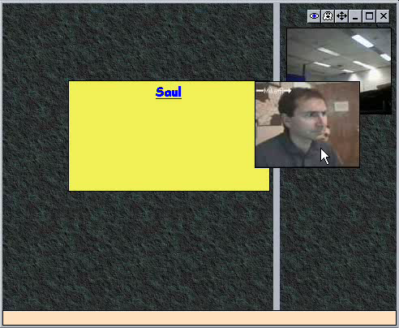
Notification Collage
Metaphor:
A collage of multimedia information
Notes:
The nc follows the metaphor of a bulletin board of overlapping elements.
just like in the real world where people post postcards, photos, notices and other stuff to public boards for others to see and react to at their leisure, people can post multimedia in a similar fashion on the nc
We chose this metaphor for its convenient display of large amounts of diverse and possibly ephemeral information
When new elements are posted, they appear at random locations on the left side of the board, possibly overlapping elements that are already there
People can take any information they’re interested in keeping uncovered and set it aside in the reserved space on the right side of the board

Slide 14
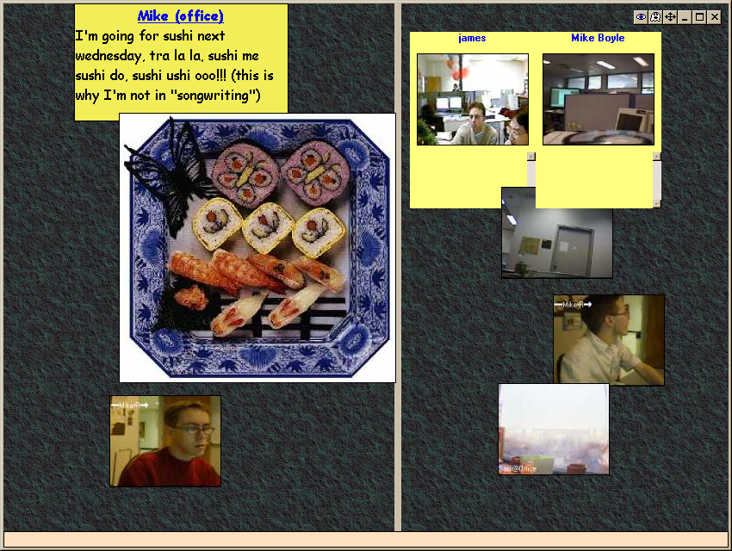
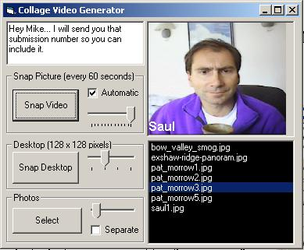
Notification Collage
Posting elements
Notes:
so from the brief video, you can see a diverse number of media elements all interacting in this environment.
Posting of new media is done through a simple client interface that I won’t really cover here
However, it’s worth mentioning that most media elements are posted with the simple click of a button,
This keeps posting and viewing media simple and lightweight

Slide 15
Notification Collage
Element types
Notes:
In the next few slides, I’m just going to run through a brief description of the media elements currently available.

Slide 16
Notification Collage
Element types
  sticky notes
Mike @home
Hey everyone! Don’t forget Sushi on Friday!!
Mike @home
Hey everyone! Don’t forget Sushi on Friday!!
Notes:
Sticky notes are textboxes that allow a user to post text messages in real time
So, everyone sees the text as it’s typed in letter by letter

Slide 17

Notification Collage
Element types
  periodic video
Mike @home
Hey everyone! Don’t forget Sushi on Friday!!
Notes:
Periodic video can be sourced from any pc camera and will take and post a snapshot to the nc every 20 seconds or so
That interval can be changed, however.
Typically, pc cameras are pointed at workstation users or into a large public areas.

Slide 18
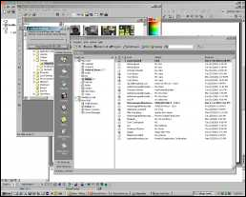

Notification Collage
Element types
  desktop snapshots
Mike @home
Hey everyone! Don’t forget Sushi on Friday!!
Notes:
* A desktop snapshot simply allows you to grab a picture of your virtual desktop and post it to the nc to show others what you’re doing.

Slide 19
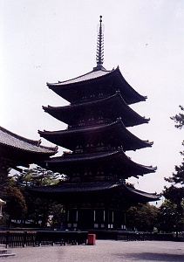
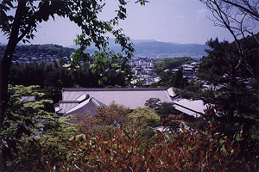
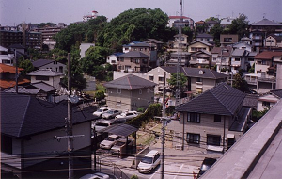
Notification Collage
Element types
  slide shows
Mike @home
Hey everyone! Don’t forget Sushi on Friday!!
Notes:
Slide shows let you post a series of digital photos, likely taken from a digital camera, to the collage
Those photos usually appear as a single changing image element, although they can appear as separate image elements if specified

Slide 20
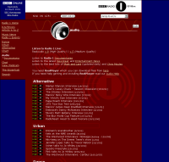
Notification Collage
Element types
  webpage thumbnail
Mike @home
Hey everyone! Don’t forget Sushi on Friday!!
Notes:
If you’re browsing the web and find a page that you think everyone might find interesting, the webpage thumbnail is a way to pass along the link to the collage community.
It takes a snapshot of the page you’re viewing and posts a thumbnail of it to the nc which can be used by anyone to navigate to that site.

Slide 21

Notification Collage
Active elements
Mike @home
Hey everyone! Don’t forget Sushi on Friday!!
Mike @home
Hey everyone! Don’t forget Sushi on Friday!!
Notes:
All of our media elements are also active.
So, by right-clicking on any of them, you can get a context menu of possible action items that can range from starting a private versus a public chat with the element owner to element-specific interactions such as navigating to a website from a webpage thumbnail

Slide 22

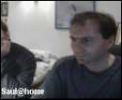
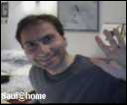


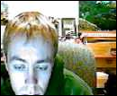
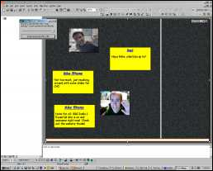


Saul
Heya Mike R, what’cha up to?
That looks good so far but have you thought about showing what a webpage thumbnail looks like?
Mike R@home
Mike R@home
Not too much, just mucking around with some slides for CHI
Not a bad idea, I’ll add one to this slide that I’m working on.
Mike B@home
It might also be good to have more than two people… btw, the essential mix is good right now!
Mike @home
Note for all: BBC Radio 1 Essential Mix is on and awesome right now! Check out the website thumb!
Notes:
Okay, in this slide I just want to present a mocked up sequence of events that’s fairly typical of what we’ve seen in our group over the last while.
<echo the sequence by talk>

Slide 23

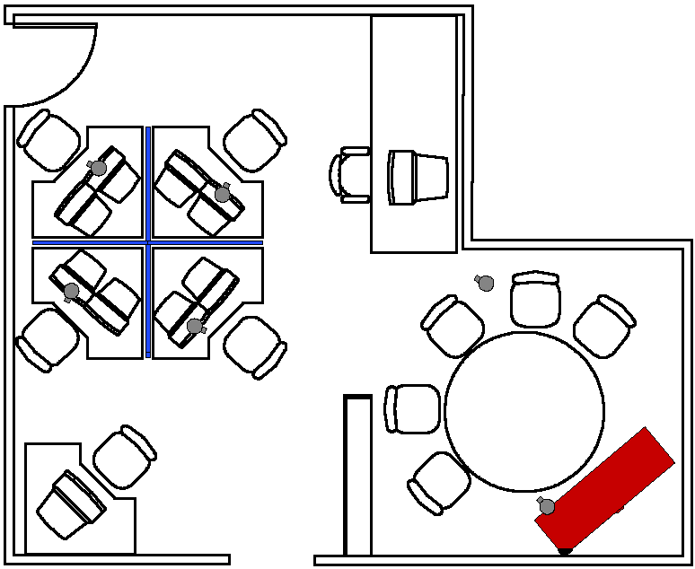
Notification Collage - Use
Notes:
Okay this is a pretty good lead into a discussion about what we’ve seen.
The notification collage has been in active use in our group for about six months now.
Even though it’s been an evolving prototype throughout that period, it’s caused a significant shift in how we collaborate as a group, and I really want to highlight that point.
As soon as people working from outside the lab began using it, everyone else immediately wanted in on the action.
Several people - and especially telecommuters - have commented that it’s made a fundamental difference in how they feel connected with the rest of the group.
It’s allowed us as both colocated and remote collaborators to maintain a strong group relationship through informal interaction, and is the only groupware prototype we have that sees regular everyday use.
In the next few slides, I just want to illustrate these points by presenting a few observations we’ve taken note of along the way.

Slide 24
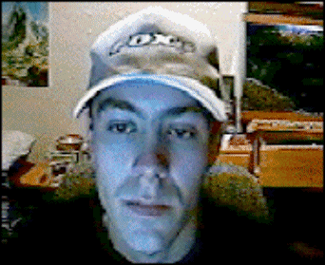
A Sense of Presence
I’m here, who else is around?
Remote sense of presence
Communication through video
Notes:
Video was definitely seen as the most important media element.
People used it to post their own presence almost as soon as they started up the nc.
The video snapshots served a strong purpose: they gave everyone a really clear picture of ‘who was around’ and roughly what they were doing.
As an example of this,
Saul telecommutes on some days during the week
He also teaches an undergraduate course on the days when he’s in
Students drop by the lab often to find Saul to ask a question or get consultation on something or other.
They’ll walk in after not finding him in his office and ask “Hey is Saul around?”
We’ve found that frequently that our answer in the lab will be “yep, I think I’ve seen him around” even though he’s actually an hour outside of Calgary in the town of Canmore
We see him on a daily basis on nc and have gotten used to the fact that we can find him there, so we talk about him “being around” even if it’s only his collage video presence.
The simple video snapshots really convey a sense of some physical proximity that we can actually see and feel
We have also seen instances of pure video communication where one person will make a face or wave or some other gesture , followed by other people who notice responding in their own snapshot with a similar gesture

Slide 25
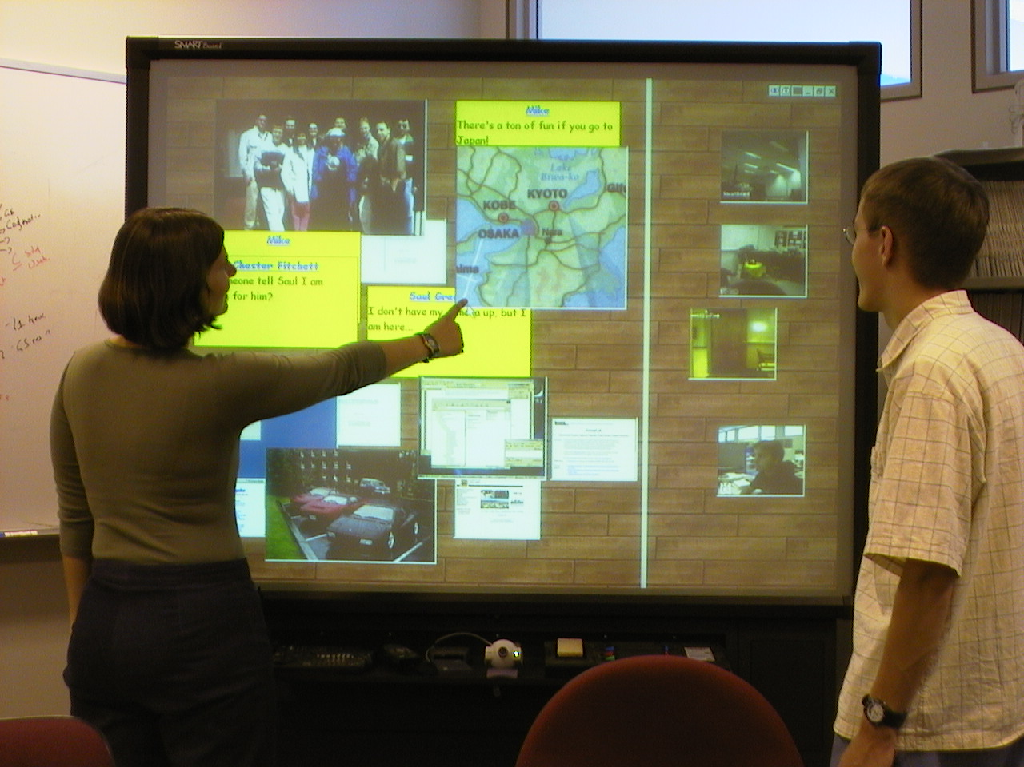
The Public Display
Shared public resource
Eyes into the public space
Notes:
The public display was our initial target for where the NC would sit as a public resource for everyone posting information to it.
As it appeared and its use expanded, an interesting thing started happening to the public display.
The notification collage was highly visible to those entering the space, but mostly transparent to those of us already in the lab
This led to lab visitors and those walking away from their workstations sometimescommenting on something on the display and moving into a discussion with the rest of us about what was happening
Telecommuters also used the public display, since it had its own eyes in the form of a pc-camera as well as a face, to contact members or visitors of the lab seated in the open meeting area in front of it

Slide 26
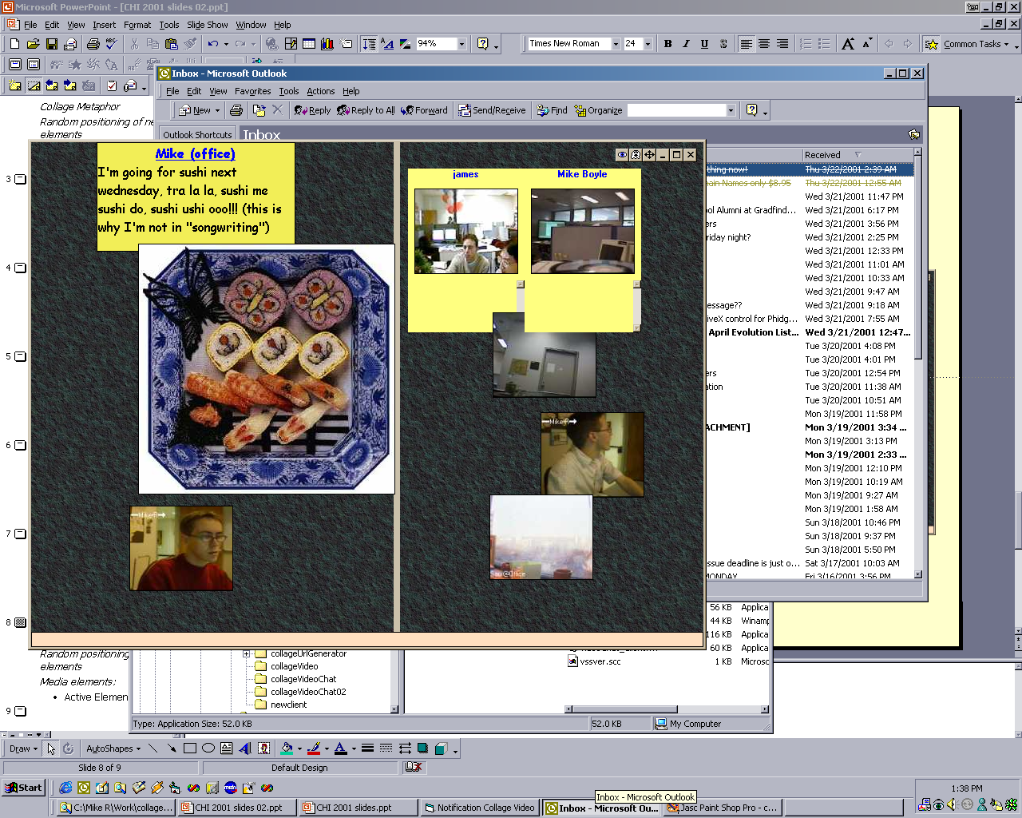
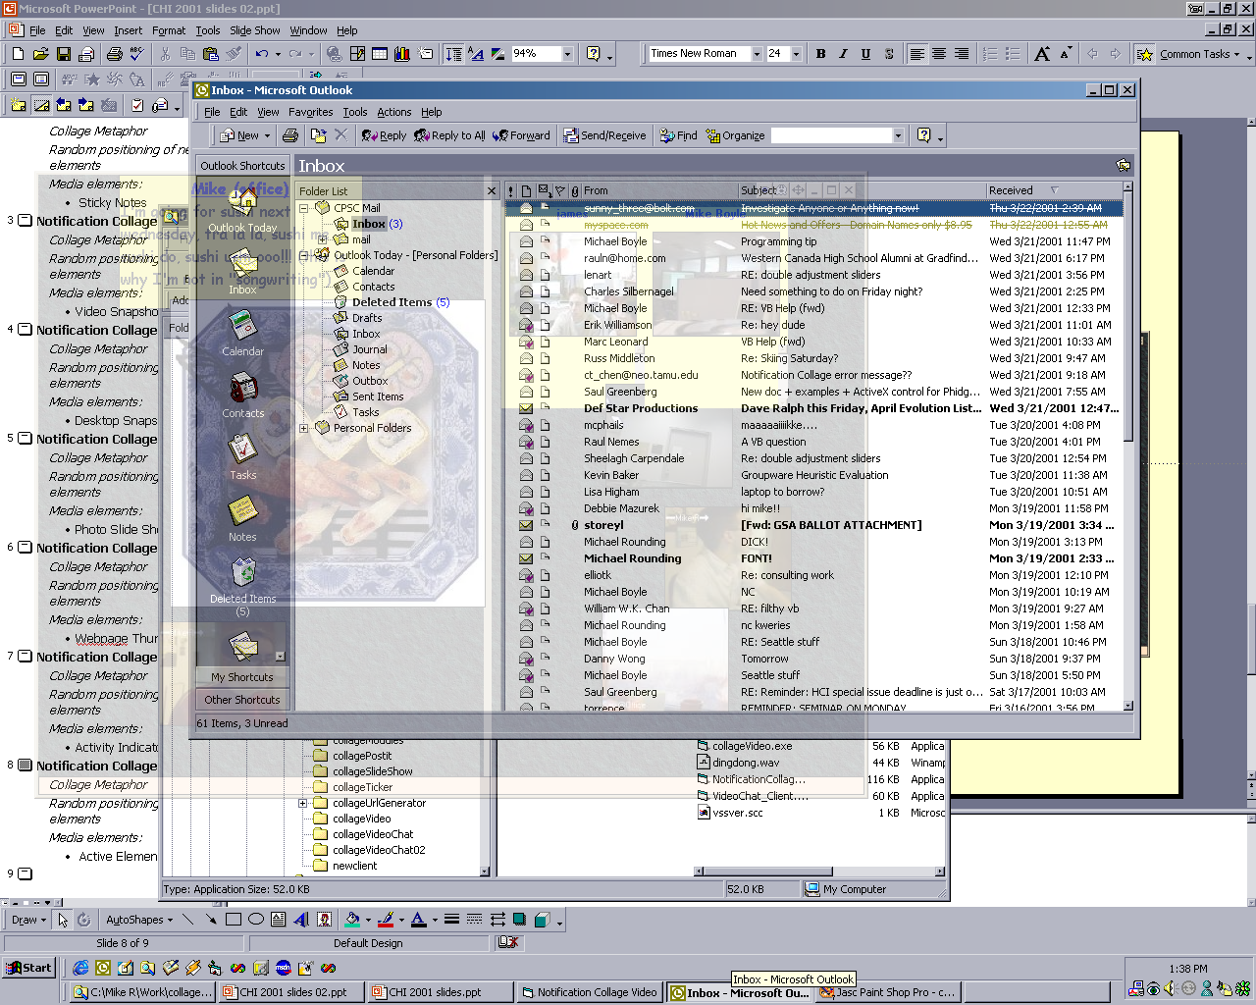
The Personal Display
Readily available
Peripheral display
  dual monitors
  transparency
Notes:
While the public display worked well for people wandering about the lab, people seated at workstations also wanted it readily available , as they wanted it to be easy to viewable and easy to act upon.
The consequence is that it made it an important collaboration tool between co-located group members and distributed ones
The Notification Collage acts as a peripheral source of information.
Thus, it does not work well as a normal window, for it competes poorley with foreground applications such as word processors I.e., it gets covered up.
The first solution was to put it on a secondary monitor: As Jonathan Grudin mentioned, this is an appropriate way to display peripheral and secondary information.
The second solution uses transpacrency. All you have to do is hit the little ghost button, and it becomes translucent and transparent to mouse clicks.
As a side note, the suggestion for this feature as well as the transfer of a snippet of code to make it possible were all made by a telecommuter (some kms) away from me through the notification collage.

Slide 27
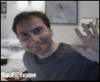
Conversations
Person to person
Overhearing
Broadcast
Mike
Hey Saul, how are you?
Saul
Great Mike! How goes the work?
James
Shaun
Hey guys, this reminds me, did you get my email re: travel plans?
Bruce Lee movie-fest on Thursday!!
Notes:
While context menus were used to set up private one-on-one chat sessions, after a while people started just posting their conversations directly to the nc,
These conversations frequently went one of three ways:
First, they were often a simple two-way conversation was started using two sticky notes, although video was often used to accentuate a message contents e.g., through gestures, facial expressions, and so on.
Second, because people could overhear these conversatons, these led to further interaction where we often saw others join in.
Third, people would sometimes just broadcast events as messages for others to see and to react to..

Slide 28
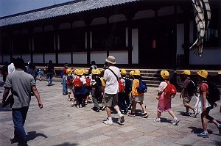
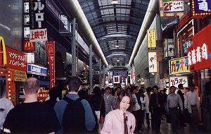
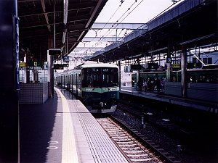
Artifact Awareness
Informing others
Conversations about things
Mike
Check out some Photos from Japan!
Notes:
People also informed others of things by posting artifacts to the display.
This could just be the artefact itself, although we frequently saw people post an annotation to their artifacts using sticky notes.
For exmaple, one person may post some photos and an annotation explaining where they were taken.
These artifacts and annotations became opportunities for informing others and for starting conversations, that is, people began conversations about things on the Collage.

Slide 29
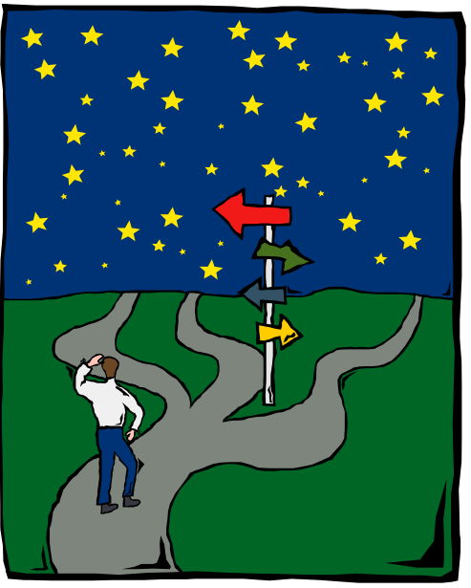
Next Steps
Redesign & implement
Expand scope: work
Outside use and evaluation
Notes:
So far we’ve seen a lot of use on this system and here I’m just going to mention what we’d like to do next.
We’re currently redesigning and re implementing the system to be a little more substantial and robust.
We’re also hoping to expand the scope of the software to include bridges into real work and collaboration.
What we want is for media elements to become active links into collaborative environments.
So for example, clicking on a video link would raise a one-on-one video conference with audio.
As another example, if we clicked on a desktop snapshot, it would raise a shared window application.
The idea is that you would get richer interaction with little or no more effort than it took to download the collage in the first place.
When we get a new implementation ready, we’d like to have a wider distribution and have more people than just us using it and reacting to it.
This would give us a lot more insight into new directions to move the software.

Slide 30
Summary
Intimate collaborators can post
multimedia elements to a Notification Collage to encourage casual interaction.
Elements provide
  people awareness
  artifact awareness
  conversations
  interaction over artifacts
Notes:
Okay so in summary, our goal was to deliver the message that
<read>
What we’ve shown you is our software and how it provides:
<read>

Slide 31

For More Information
http://www.cpsc.ucalgary.ca/grouplab/software/
Notes:
Thanks for your interest in our work, and if you’d like more information, feel free to visit our website and contact us!
The new version of the software should be ready in a month or two. I would also like to acknowledge suppport by Microsoft Research.
Thanks again,

