Slide 1
Integrating Back, Bookmarks and History
Shaun Kaasten
Saul Greenberg
University of Calgary
Notes:
Before I start, I want to say that this was my first CHI, and I’ve had a great time. Everyone has been really nice to me.

Slide 2
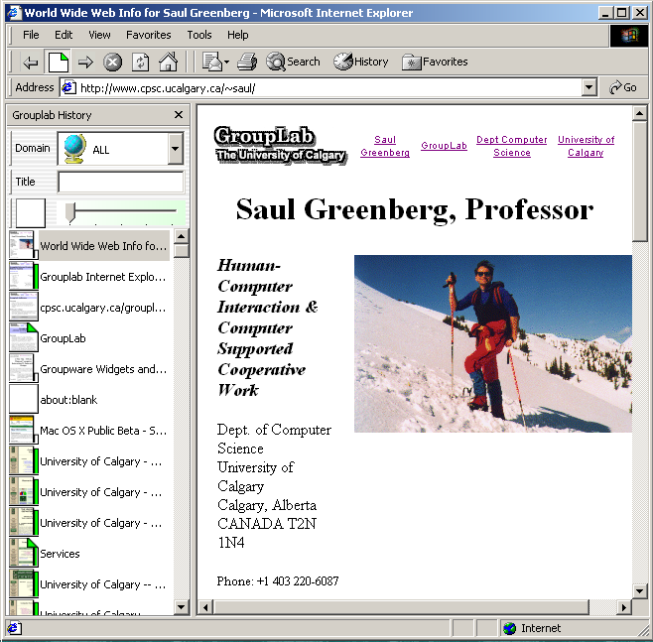

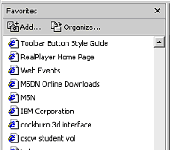
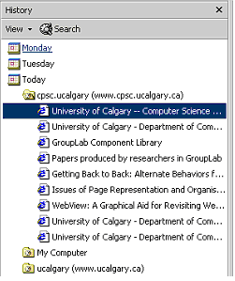
The Message
A single system can integrate back, bookmarks, and history
Notes:
So the message for my talk is, “A single system can integrate back, bookmarks, and history in today’s web browser”.

Slide 3

Revisiting
People constantly revisit web pages
Percentage of navigations:
    58% (Tauscher, Greenberg, 1997)
    81% (Cockburn, McKenzie, 2000)
Notes:
Many studies have looked at how people use the web. These studies find that continually ‘revisit’. That is, they constantly return to pages they’ve seen before. In 1997, Tauscher and Greenberg found that 58% of users’ navigations are revisits. A more recent study, in 2000 by Cockburn and McKenzie found this number to be even higher, at 81%. So, you can see that the majority of our navigations are revisits.

Slide 4
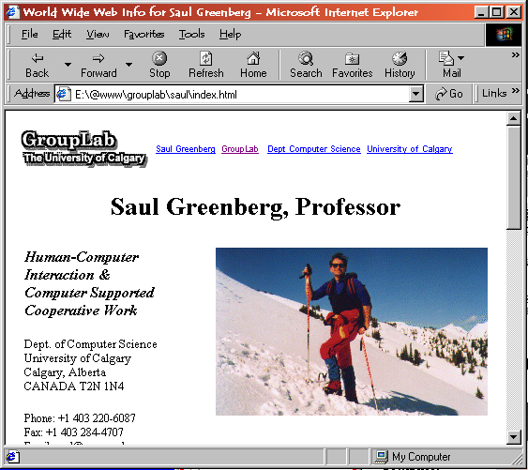
Notes:
The makers of web browsers acknowledge this – web browsers have several features designed just for revisiting. These include the back/forward buttons.

Slide 5
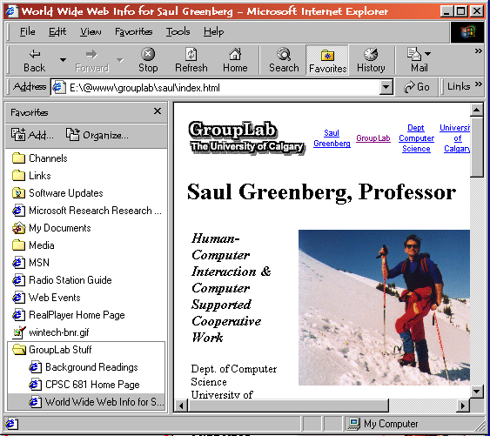
Notes:
Bookmarks (Favorites)

Slide 6
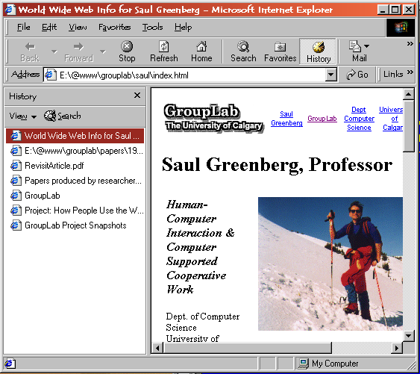
Notes:
And the History List – if you’re not familiar with this, it is a listing containing all pages that you’ve ever gone to

Slide 7
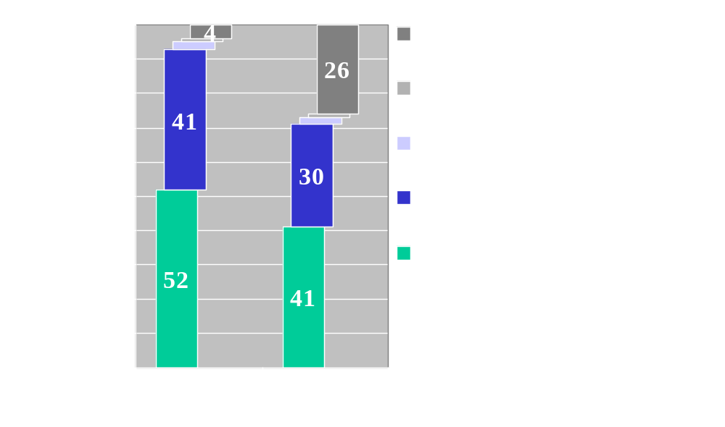
How Users Navigate
Notes:
‘hidden’

Slide 8
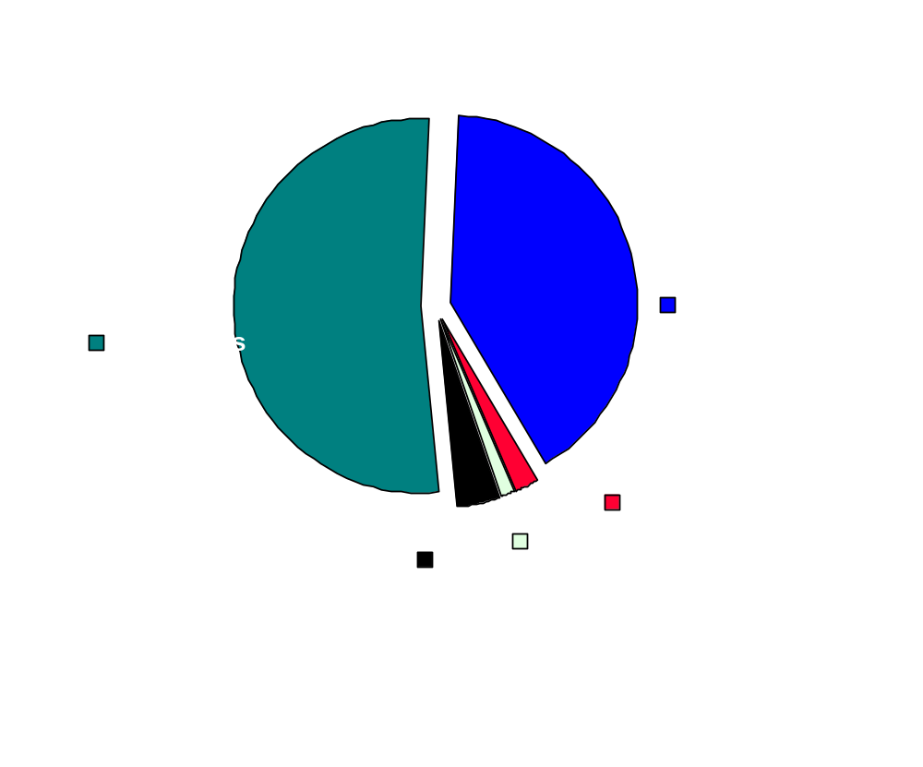
1995 Web browser Study
Catledge, Pitkow
Notes:
Studies also have looked at, “Well, which of these features do people actually use?”
A 1995 study by Catledge and Pitkow logged users actions to see what functions they used. They found that, not surprisingly, the most prevalent action was clicking on hyperlinks. Somewhat surprising, though, was how often the back button was used. It accounted for 41% of all actions. In contrast, the history and bookmark features were hardly used.

Slide 9
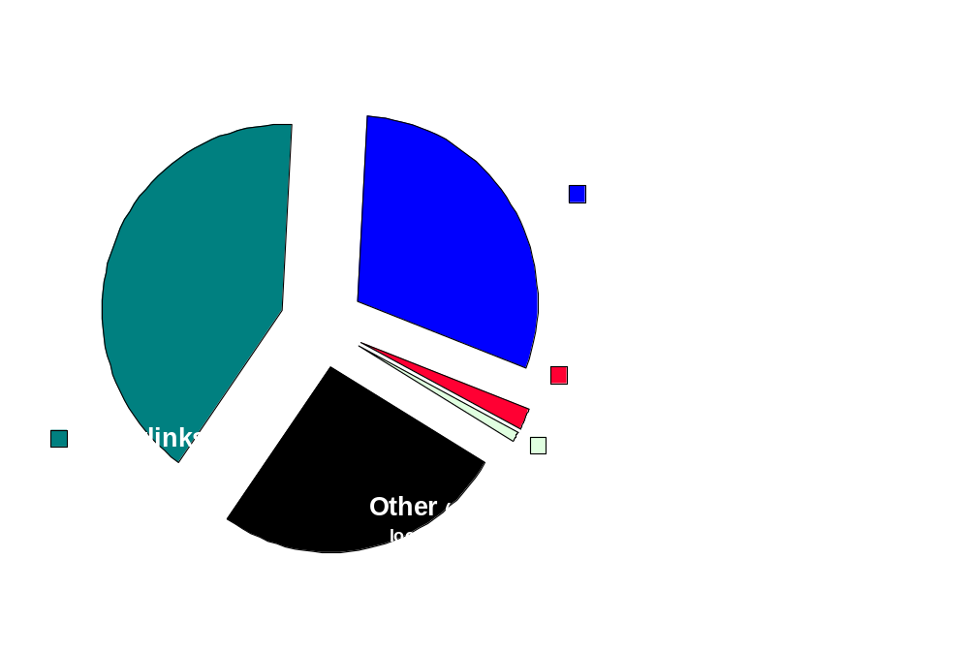
1997 Web Browser Study
Tauscher, Greenberg
Notes:
A later study, in 1997, performed by Tauscher and Greenberg found very similar results. People used hyperlinks and the back button, while ignoring history and bookmarks. You may notice a large category called, ‘other’ – this is conglomerate of many features that were not significantly used.

Slide 10
Usability Issues
Many functions based on different models
Misconceptions about back/forward
Titles, URLs often unrecognizable
Bookmark collections grow out of control
Notes:
Hidden

Slide 11
Why Don’t People Use Bookmarks and History?
Instead, relying on simpler methods of revisiting
Notes:
So the question is, “Why don’t people use bookmarks and history”- why do people rely on simpler forms of revisiting?
We believe that this is related to several serious usability issues with the current systems. While we are going to show screenshots from Netscape and Internet Explorer, these issues apply to all commercial browsers- as they do the same thing and have since the earliest versions such as NCSA Mosaic.

Slide 12
Too Many Different Models
Notes:
First, we think there are too many models. You have a listing for the back/forward buttons, another one for bookmarks and yet another one for history. Each of these systems has a different underlying model, way of representing pages, and rules about what the user can and cannot do inside of it. Somehow the user is expected to know not only how to use each one, but when they should.

Slide 13
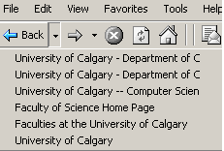
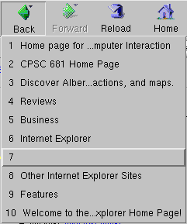
Page Representation
Notes:
Current systems represent pages by title and sometimes by URL. Both of these have been found to be problematic. Some web sites will use the same title for all pages, so you can’t tell which page one refers to in a listing such as this. Some pages don’t have titles at all. Other titles are overly vague or even misrepresentative of the content.

Slide 14
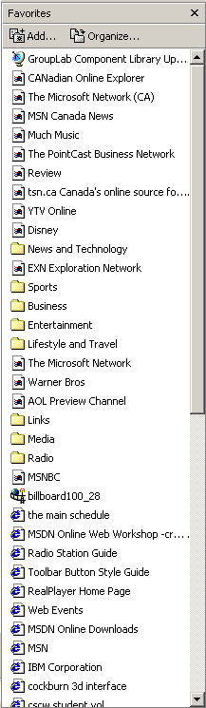
Managing Bookmark Collections
Abrams, Baecker and Chignell, 1998
Notes:
Then there are bookmarks. Firstly, bookmarks are not useful unless you remember to make it the first time you see the page. There are always those pages you wish you had made a bookmark. Studies have looked at how people use bookmarks. Abrams, Baecker and Chignell found that while browsers have many features for renaming and reorganizing bookmarks, people don’t use them. They prefer to make the bookmark and get on with their web task. So what you end up with is a long list of badly titled, unorganized bookmarks. So finding a page in this listing is a challenge to say the least.

Slide 15




Back Button Confusion
A
B
I
C
Cockburn &Jones,1996
Notes:
The back button, while it is heavily used – there is actually a lot of confusion out there about how it actually works. For example, lets suppose I am at a music page. Now I find a link to a page about the beatles. From here, I link to a page about one of their albums. Now I want to go back, so I press the back button, and sure enough I return to the beatles page. Now I click back again, and I am at the music page again. Now, I find a new link to a page about Elvis. The question is, if I want to return to those pages about the beatles and yellow submarine, how do I do it? Most users believe that if you keep pressing the back button, you will eventually see them. This is wrong. These buttons work on a stack metaphor – when the new link is taken to Elvis, the other pages are removed from the stack.

Slide 16
Back Button Confusion
A
I
Cockburn &Jones,1996
Notes:
So, I can press back to return to the music page, but the other pages are gone from the stack. I have to re-find their links in order to return to them.

Slide 17
Integrated System
Recency ordered list
Dog ears
Dynamic Query
Thumbnail images
Notes:
We believe these issues can be addressed by integrating these systems to agree on a single model. The model we propose is a simple ‘recency ordered list – which I will demonstrate soon. For bookmarks, we use a system called ‘dog ears’ where we mark pages as being important. For finding pages in an often lengthy list, we use dynamic queries, made famous by Ben Schneiderman. Finally, for representing pages, we use ‘thumbnail images’. I will now show a demo which illustrates these ideas.

Slide 18
The Message
A single system can integrate back, bookmarks, and history
www.cpsc.ucalgary.ca/grouplab/software
Notes:
So to recap, the message of this talk is that “a singe system can integrate back, bookmarks and history in today’s web browser”. The system you have seen works with standard internet explorer, and can be downloaded from our web page. We encourage you to try it out – it captures the thumbnails for you – you don’t need anything special.
Thank you.

