Slide 1
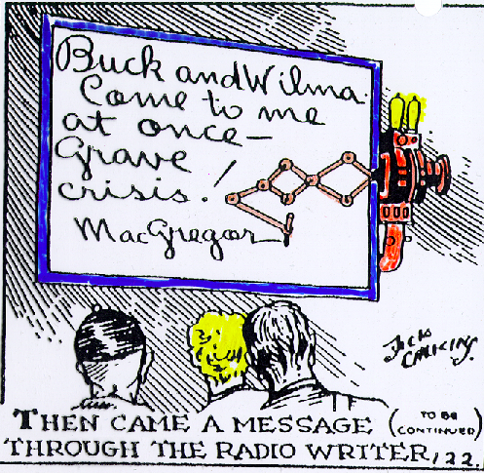

Supporting Casual Interaction between Intimate Collaborators
Note: this powerpoint copy does not included the many videos that were presented during the talk. If you need these, contact Saul Greenberg
Saul Greenberg
Notes:
Saul Greenberg
University of Calgary
Delighted to give the opening talk…
In charge of Grouplab…
Research in human computer interaction and computer supported cooperative work.
Credit others
Today’s talk is on …
Work we have been pursuing in a variety of projects as part of our on-going investigations into social and technical aspects of groupware

Slide 2
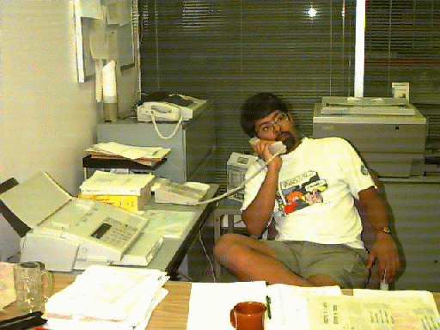

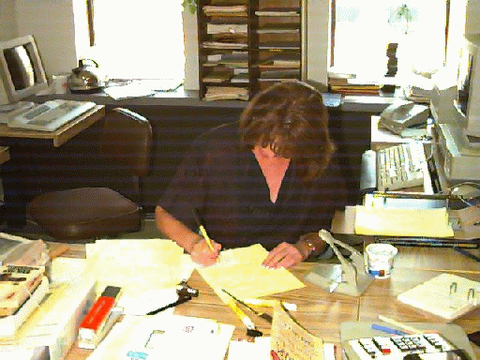
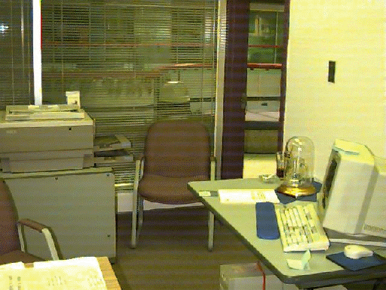
The Message
Groupware can help intimate collaborators smoothly move from awareness to casual encounters to conversation and work
Notes:
The message I am going to deliver over the next hour is that…

Slide 3
Outline
Intimate collaborators / problem with groupware
Casual interaction & awareness
Supporting casual interaction
  systems
  studies
awareness information
low
high
privacy risks
Notes:
I’m going to deliver this message by first describing what I mean by

Slide 4


Intimate collaborators & groupware
Friends, family, work groups
Real need for close
coordination and collaboration
Notes:
Ok, lets begin with intimate collaborators.
There are many kinds of social groups that groupware can address.
These range from strangers around the world (internet) to corporate workers (intranet).
Intimate collaborators are much smaller groups. These are people who know each other well: family, friends, work groups.
What makes this group special is that its members have a real need or desire for close coordination, collaboration, and social interaction.

Slide 5
Intimate collaborators & groupware
Friends, family, work groups
Real need for close
coordination and collaboration
Sometimes co-located,
sometimes distance-separated
Notes:
Groupware has potential to support these intimate collaborators, for in today’s society, it is common for its members to be sometimes co-located, sometimes distance-separated.
A good example is a work group that included telecommuters.
My feeling is that if I cannot make groupware work for these people, it is unlikely that I can make it work for strangers or more loosely-knit grips.

Slide 6

Shared visual workspaces
Notes:
When I first started investigating groupware for intimate collaborators in the late 1980s, I was primarily interesting in how small groups of intimate collaborators worked together over shared visual workspaces: whiteboards, table tops and any other visual surface.

Slide 7
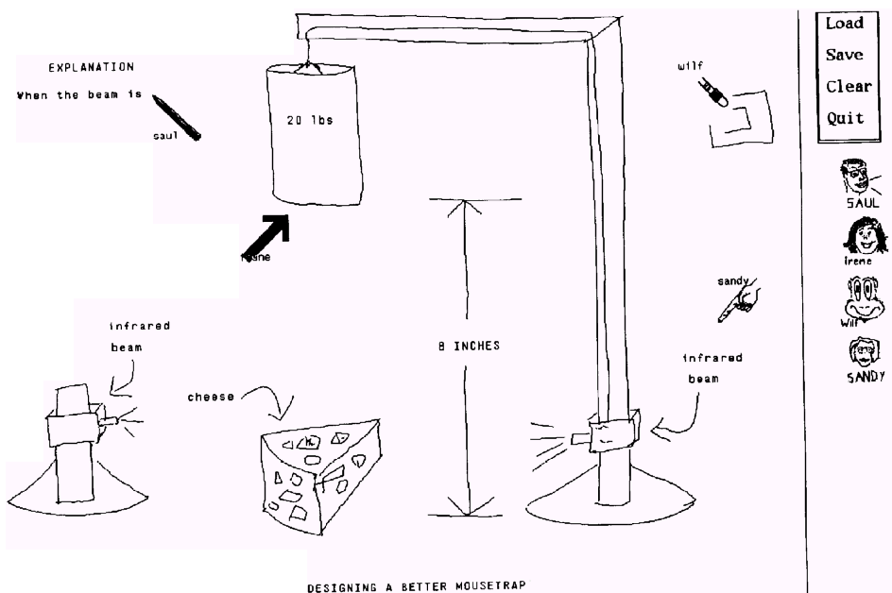
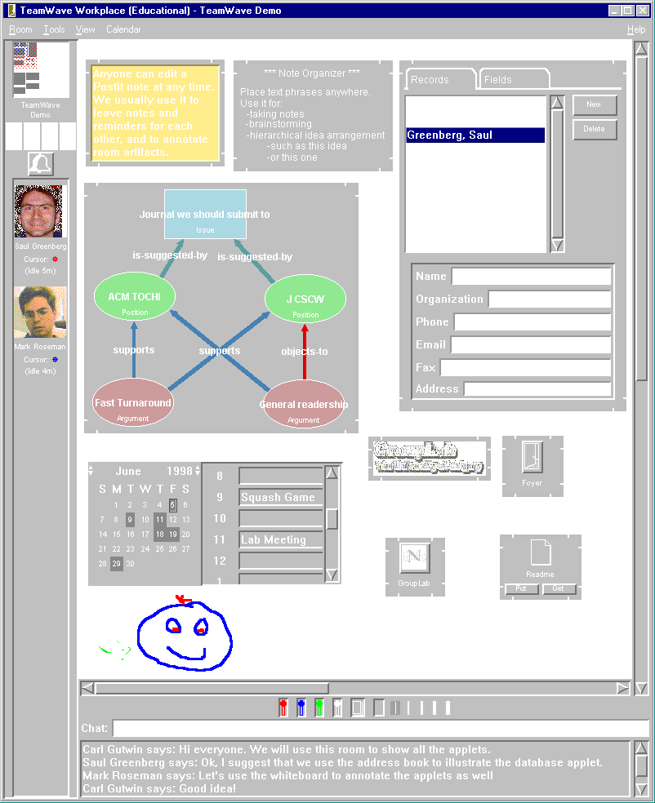
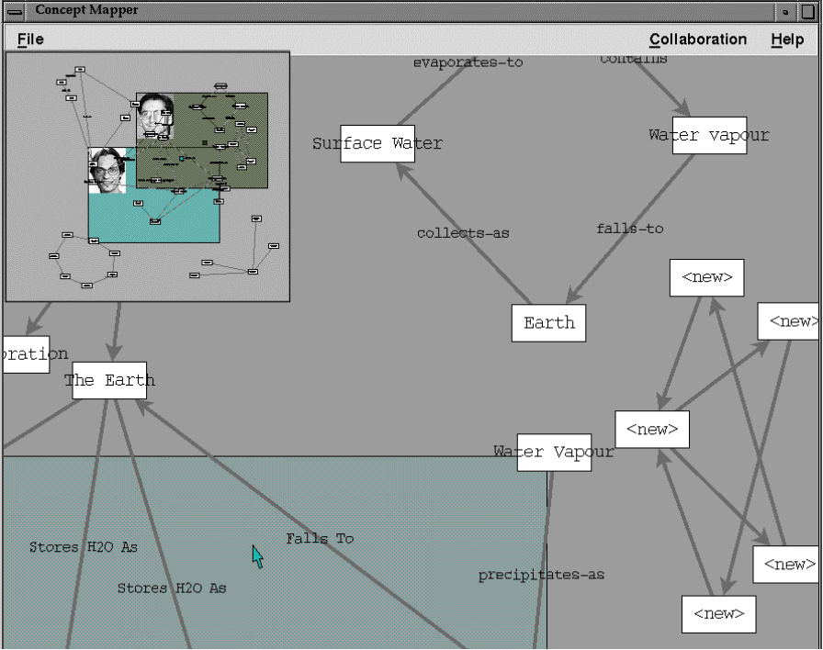
Shared visual workspaces
Notes:
Over the years we built a variety of groupware systems where distributed collaborators could share an electronic visual worksurface.
These let us study many social nuances of shared work.

Slide 8
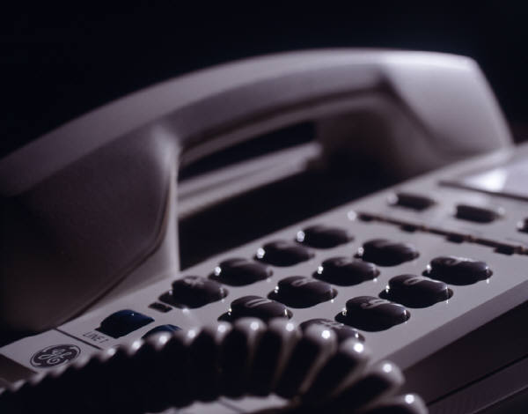
A persistent problem
Real time distributed groupware can only work after people make contact with each other
?
Notes:
While this systems look good, we had a persistent problem with all of them.
In spite of our careful attention to human factors in crafting these systems, we found that we rarely used them except for demos.
We realized no matter how good the software, it can only work after people make contact with one another.

Slide 9
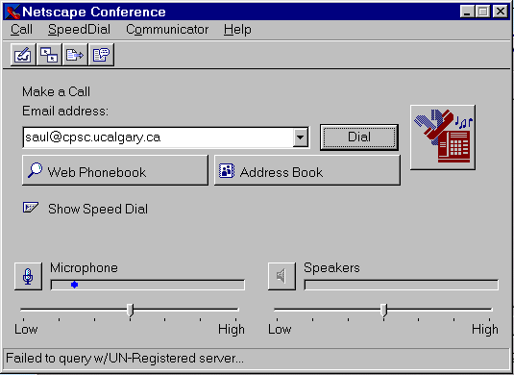
can I reach the person through software?
Time
Notes:
This is Netscape Conference, and the way it works is fairly similar to many applications.
These are the things that people have to do to get a groupware session going.
First, they ask…
…email and other handles

Slide 10
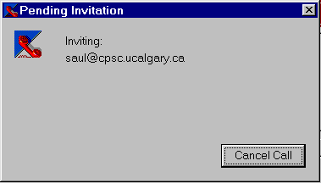
can I reach the person through software?
is the person there?
Time
Notes:
If they get through this, success will only happen if the person answers.
Fails almost always:
-not there
-software not installed or the wrong version
-software not turned on
-person not looking at computer
If you think telephone tag is bad, computer tag is far far worse.

Slide 11
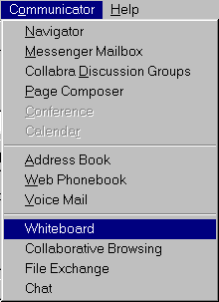
can I reach the person through software?
is the person there?
start a communication channel
start 1 or more groupware applications
load information...
Time
Notes:
Third, they then have to go through extra work to …
The result is that systems like these are used only by:
-early adaptors willing to put up with this heavyweight approach
-people with great needs
-formal meetings where things are scheduled and set up ahead of time.

Slide 12
Casual interaction
Lightweight coordination and communication
Notes:
There is a better way for the rest of us.
CSCW researchers in the late 1980s described the importance of the lightweight coordination and easy communication that happened through casual casual encounters and resulting interactions in hallways, coffee rooms, over photocopy machines, and whenever people worked together in common areas.

Slide 13
Casual interaction
Lightweight coordination and communication
Awareness
  who is around
  are they available now
  can they be interrupted
  how can I initiate contact
Hi Mary
Notes:
The glue behind these casual interactions is awareness, where people constantly but subconsciously ask and answer questions such as
-who is around
-are they available now
-can they be interrupted
-how can I initiate contact

Slide 14
Casual interaction
Goal
  support smooth transition from awareness to casual encounters to conversation and work
Hi guys! Oh, there’s Sally!
Ask her along.
Notes:
When we move to settings that includes distant collaborators, the design goal for groupware then becomes to support the smooth transition from awareness to casual encounters to conversation and work.

Slide 15
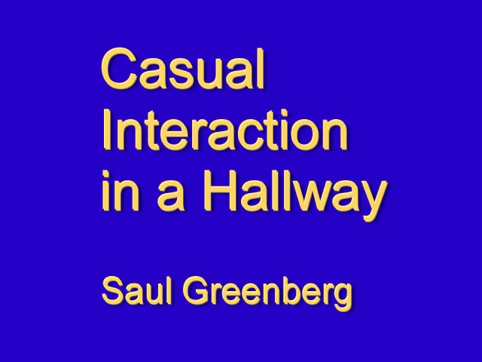
Casual interaction: Video
Note: video deleted in this presentation copy
idea from Bellcore
Notes:
To illustrate this idea, I’m going to show you a video that I made several years ago.
Copying the idea I had seen in a video produced by Bellcore researchers, I put a camera in a public hallway for one hour over lunch.
What you will see is a part of this hour where I just cut out the bits where no-one was in the hall.
You will notice that people constantly seek awareness information---people are simply unable to pass by an open doorway without looking in.
You will also see that people often act on that information to move into casual interaction.

Slide 16
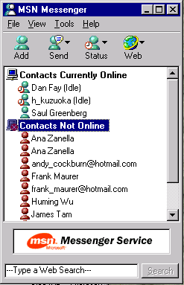
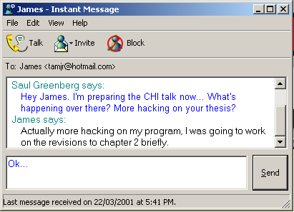
Supporting casual interaction
low
awareness information
high
Notes:
Of course, many groupware systems have been designed to support casual interaction.
Perhaps the most well-known is instant messaging, where one can select their friends (or intimate collaborators), see if they are on-line, and then easily enter into a text chat conversation.
While these systems provide only a few bits of awareness information, they have become the 2nd killer app of groupware (with email being the first) because they make casual interaction over computers accessable to the many.

Slide 17
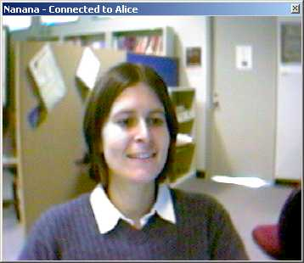
Supporting casual interaction
How do people
judge availability?
low
low
awareness information
privacy risks
high
high
Notes:
At the other extreme we have media spaces that provide an always on video portal between places.
In media spaces, people gather awareness through the video channel, and use the same channel to move into communication.
However, these are fraught with privacy concerns, which I will talk about shortly.
<animate>
What we were interested is in the design space between these two. That is, we wanted to know what awareness information people really needed, and how they used that to judge availability.

Slide 18
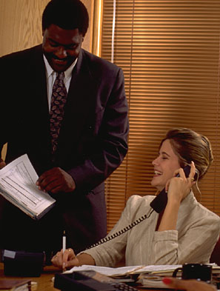
How do people judge availability?
Inter-personal relationships, needs, context
Notes:
How do people judge availability?
If you introspect, you will realize that many decisions on how you contact another is based on the …
This is very difficult to capture via a computer.

Slide 19
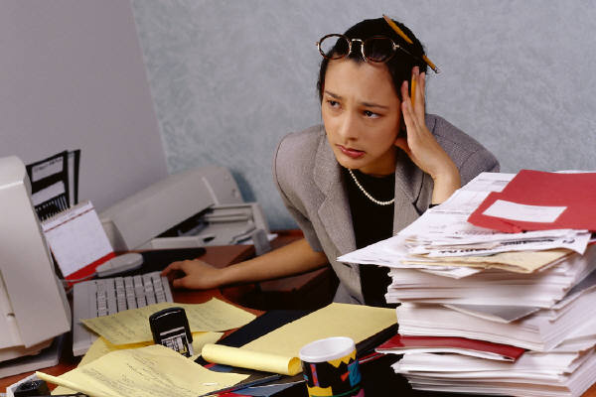
How do people judge availability?
Awareness of state of the other person
Notes:
But we also use the state of the other person to judge availability, and this is something that computers can capture.

Slide 20
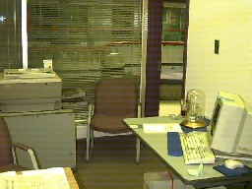
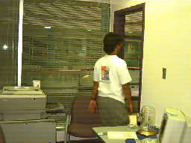
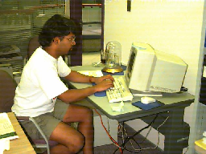
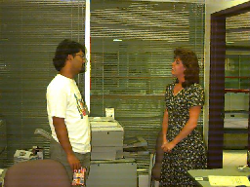
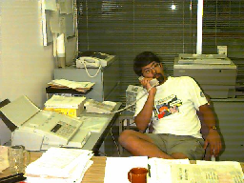
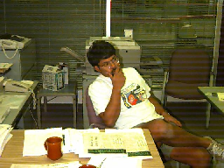
How do people judge availability?
Awareness of state of the other person
empty room
in transition
working
in conversation
idle
with Brad Johnson
Notes:
To give us some insight to how awareness of state is used, we ran a study on how people interpretted availability on what we considered typical situations.
We took photos of different actors in similar situations.
These were…
We then gave people these photos and asked them how willing they would be to interrupt them.

Slide 21
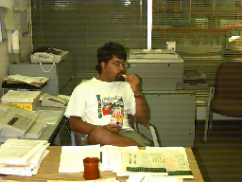
How do people judge availability?
Absent
Conversation
At work
In transition
Idle
availability
Notes:
Our results show that state information is correlated with interpretations of availability.
However, they are somewhat mixed.
This line shows where people roughly ranked particular scenes.
We see that…

Slide 22
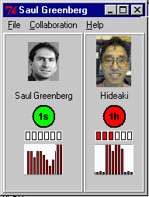
Application: Peepholes
last seen…
motion
ambush
low
awareness information
high
Notes:
Still, we can apply these results. Our first strategy was just to augment an instant messaging-type system with extra information.
So here we see a system that captures presence. It uses motion detectors instead of keyboard activity.
We see that

Slide 23
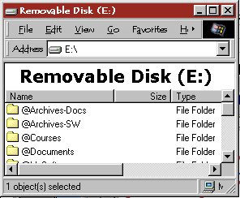
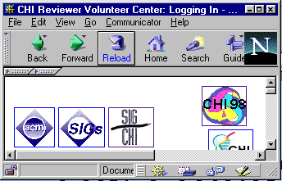
Problem: My computer is a busy place!
low
awareness information
high
Notes:
There is a big assumption in these kinds of systems that peope be looking at the screen.
The problem is that in reality,

Slide 24


Problem: …and I don't always use it!
low
awareness information
high
Notes:
There is a big assumption in these kinds of systems that peope be looking at the screen.
The problem is that in reality,

Slide 25
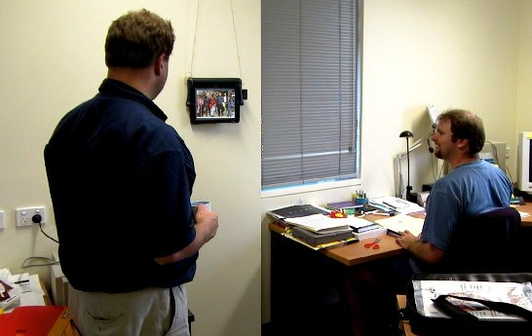
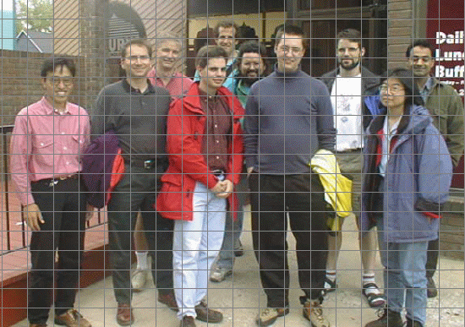
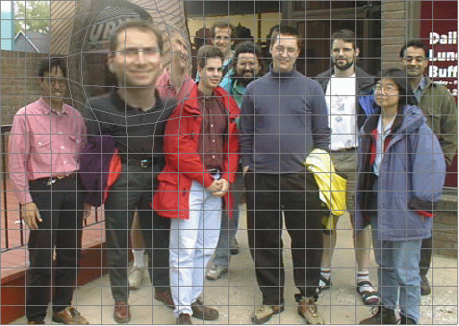
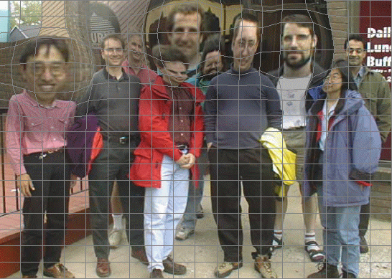
Peripheral display: GroupPhoto
low
awareness information
high
with Sheelagh Carpendale
Notes:
To solve this, we can take the information off the computer screen, and put it at the periphery of people’s attention.
This is important: instead of demanding people’s foreground attention, we put it in their background attention, where it becomes part of the peripheral hum that people subconciously monitor.
This is similar to the way we know what is going on as we work in a common area: by sounds, by glancing around, by seeing motion, etc.
Here is a prototype of GroupPhoto, a way to take simple awareness information, to map it on a portrait-sized display, and to make that information more perceivable at a glance.

Slide 26
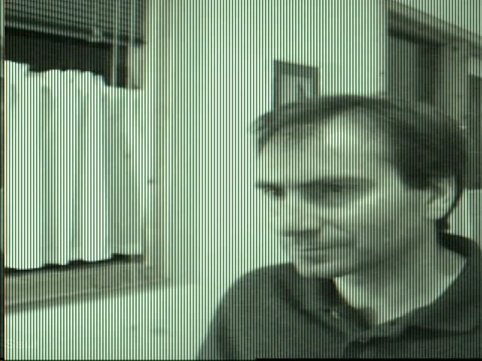
Peripheral display: GroupPhoto
Note: video deleted in this presentation copy
low
awareness information
high
with Sheelagh Carpendale

Slide 27
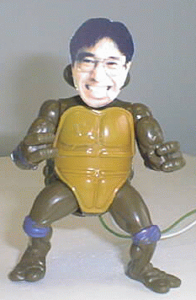
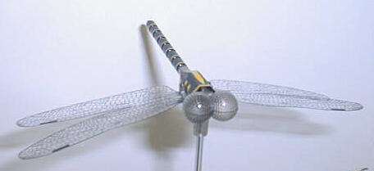
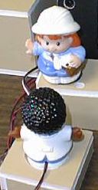
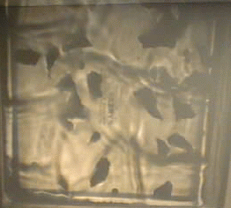
Physical but digital surrogates
low
awareness information
high
Greenberg and Kuzuoka 2000
Notes:
Another way to design peripheral awareness displays is to get awareness information off the screen and into a physical domain.
We did this in our physical but digital surrogates project, where we created physical devices that present awareness information of remote people, and that allows us to control what is transmitted.
I’m going to show you a video of these.

Slide 28


Physical but digital surrogates
Privacy safeguard?
  limited information capture and abstraction
human activity
surrogate activity
transformation
Notes:
…What you will see is that they both capture and present awareness information. They can also mitigate privacy concerns by abstracting and restricting information.

Slide 29
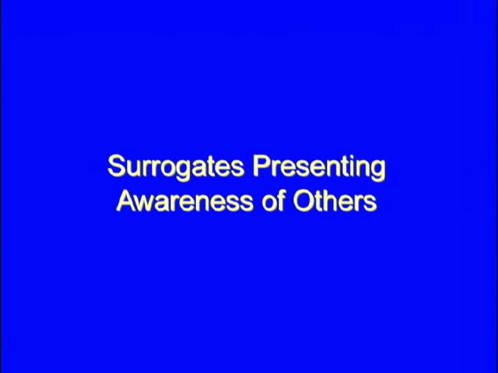
Surrogates: Video
Note: video deleted in this presentation copy
Greenberg and Kuzuoka 2000

Slide 30
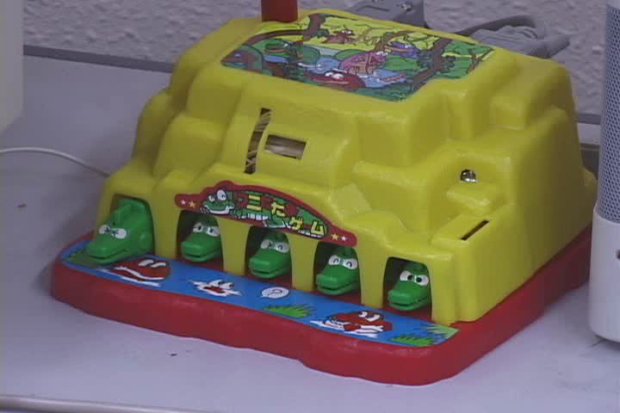
Physical surrogates: Video
Note: video deleted in this presentation copy
By Hideaki Kuzuoka
Notes:
Here is another example created by my colleague Hideaki Kuzuoka.
-multiple collaborators
-leads into one on one video communication.

Slide 31
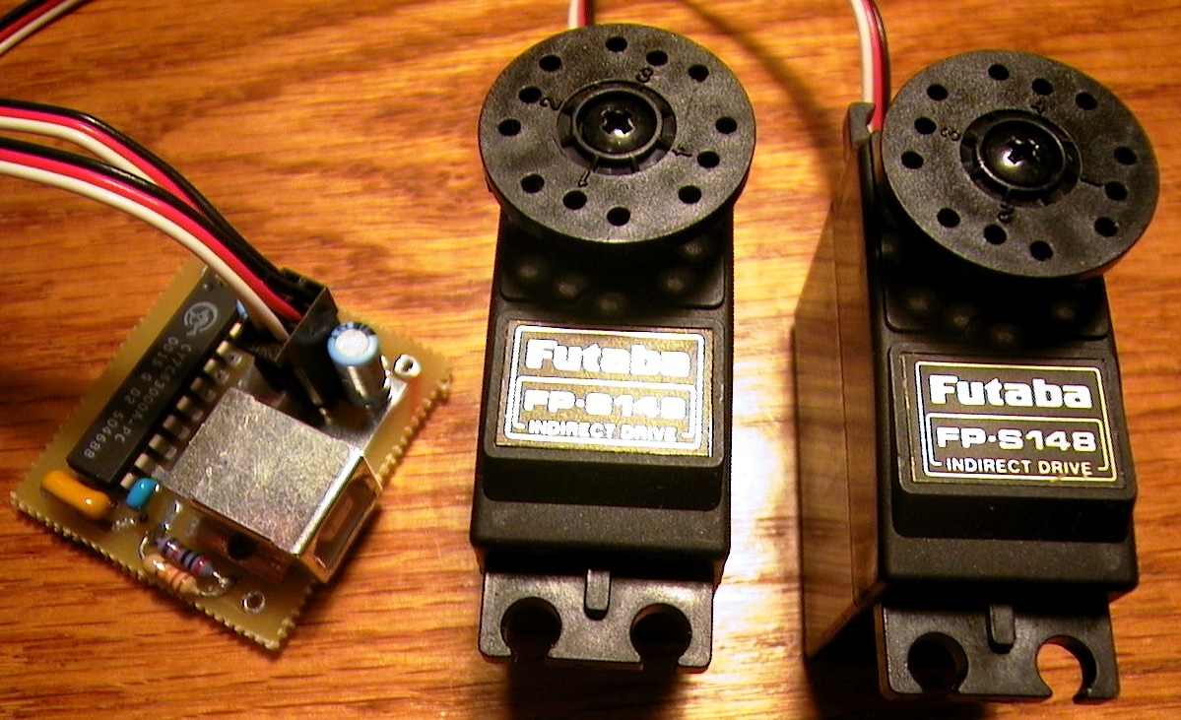
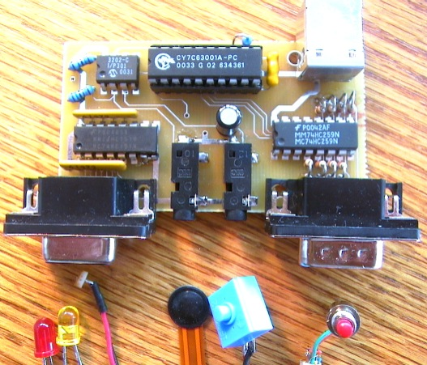
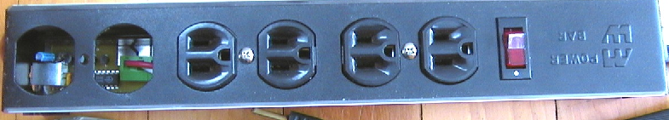
Digression: Phidgets
Servo
2 servo motors
InterfaceKit
8 inputs
2 sensors
8 outputs
Powerbar
4 120 volt outlets
with Chester Phidgett
Notes:
I just want to digress a moment and talk about how to prototype with physical devices.
We’ve built special hardware and software that makes it extremely easy to build these kinds of things.
What we do is create Phidgets, or physical widgets.
Just as programmers assemble graphical interfaces through graphical widgets, so can designers assemble physical interfaces through our phidgets.
For example, here we see several phidgets…

Slide 32
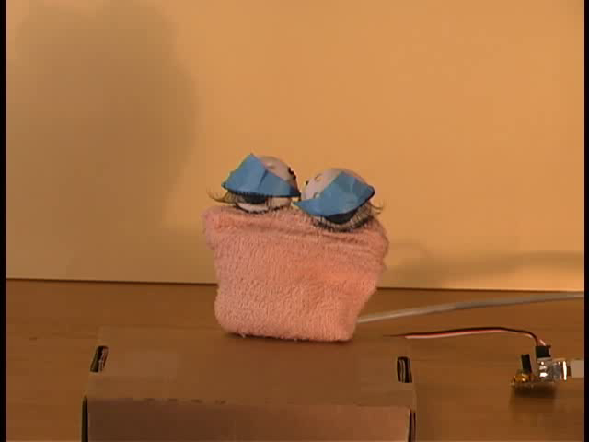
Phidgets: Student awareness projects
Note: video deleted in this presentation copy
Notes:
I gave these phidgets to an HCI class as a design exercise, and asked them to be creative.
What I am going to show you is what they built, where I selected student projects could be used as physical devices that display awareness information of others

Slide 33
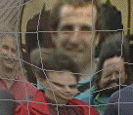
Awareness information
Rich
Compete for attention
Shared resource
Socially produced and manipulated
low
awareness information
high
Notes:
Our next exploration was to revisit awareness information, where we wanted to recognize other characteristics of awareness information now present in the every day world.
First, we need to recognize that most awareness information is far more than a few bits of information.
It is media rich: we are aware of many things, including not only people, but of the events occuring around us and of the things, or artifacts within our environment.
Second, Information competes for our attention: our environments contain huge amounts of information: noticing information is often a function of its personal importance, its salience, and serendipity
Other important points come from considering awareness information as a social phonomenon.
When people cohabit a place, the information becomes a shared resource that many can perceive.
Awareness information can also be socially produced. One person can intentionally create information for others (such as a message placed on a visible whiteboard). Similarly, conversations and interactions by people in a group can be overheard by others.
Finally, awareness information can be socially manipulated. One person may position it so another can see it. For example, I am sure all of you have experienced a postit note stuck to your monitor that was placed there by another person. As well, if one person sees some information that may be relevant to another, he or she may inform them about it.

Slide 34
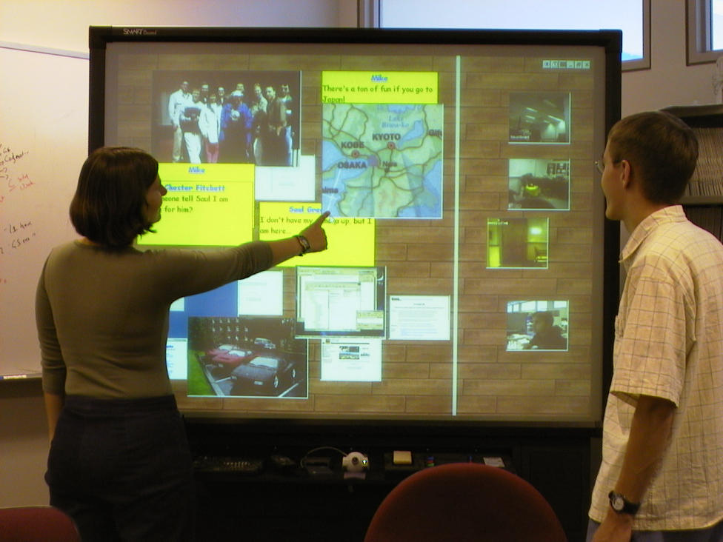
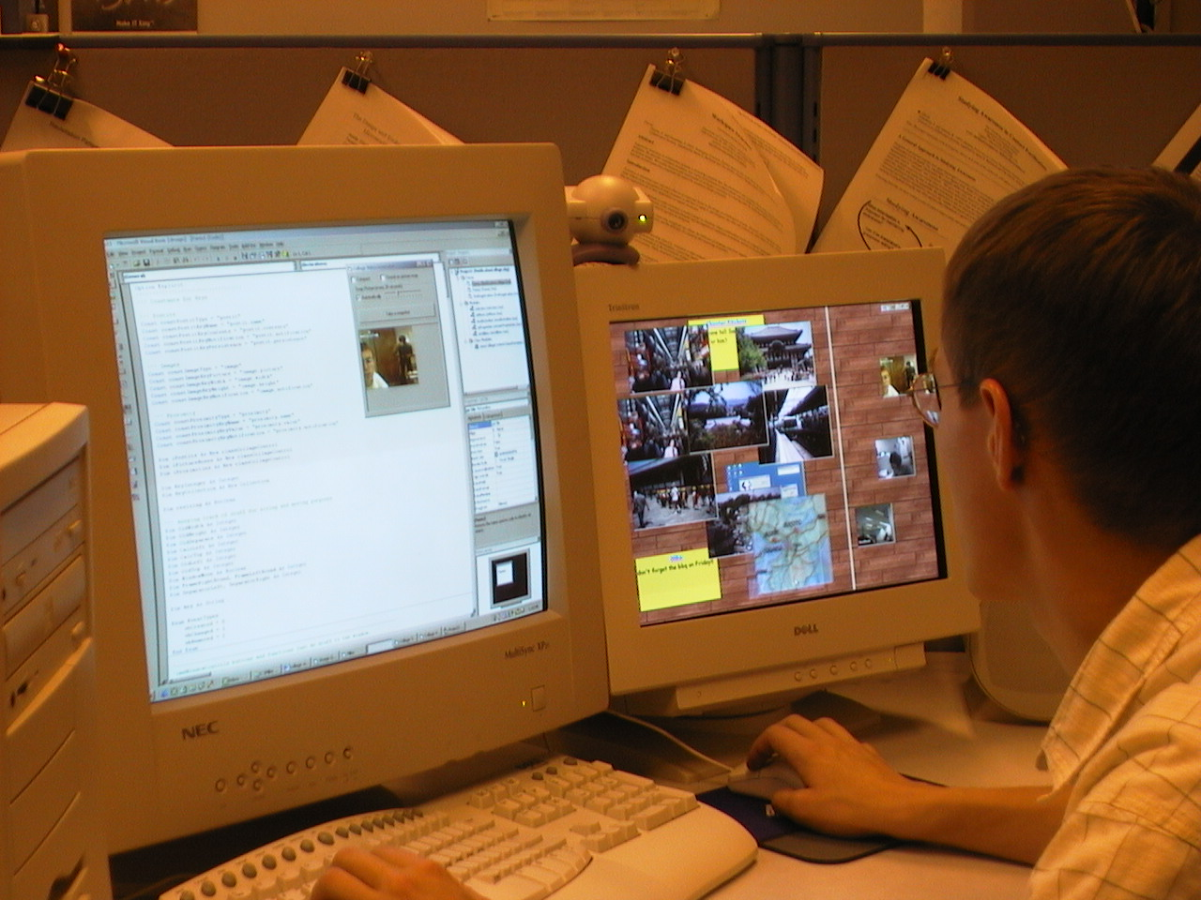
Notification Collage
low
awareness information
high
Notes:
We developed the Notification Collage to recognize these characteristics.
The NC is a public forum for group members to post multimedia information about themselves and their things
It encourages casual interaction by allowing others to view this information and act on it.
We wanted this information on the periphery of peoples’ attention, hence its presence on both large public displays and secondary personal displays

Slide 35
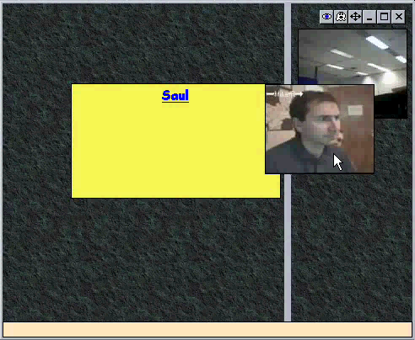
Notification Collage
Metaphor:
A collage of multimedia information
Note: video deleted in this presentation copy
Greenberg & Rounding CHI 2001
Notes:
The nc follows the metaphor of a bulletin board of overlapping elements.
just like in the real world where people post postcards, photos, notices and other stuff to public boards for others to see and react to at their leisure, people can post multimedia in a similar fashion on the nc
We chose this metaphor for its convenient display of large amounts of diverse and possibly ephemeral information
When new elements are posted, they appear at random locations on the left side of the board, possibly overlapping elements that are already there
People can take any information they’re interested in keeping uncovered and set it aside in the reserved space on the right side of the board

Slide 36
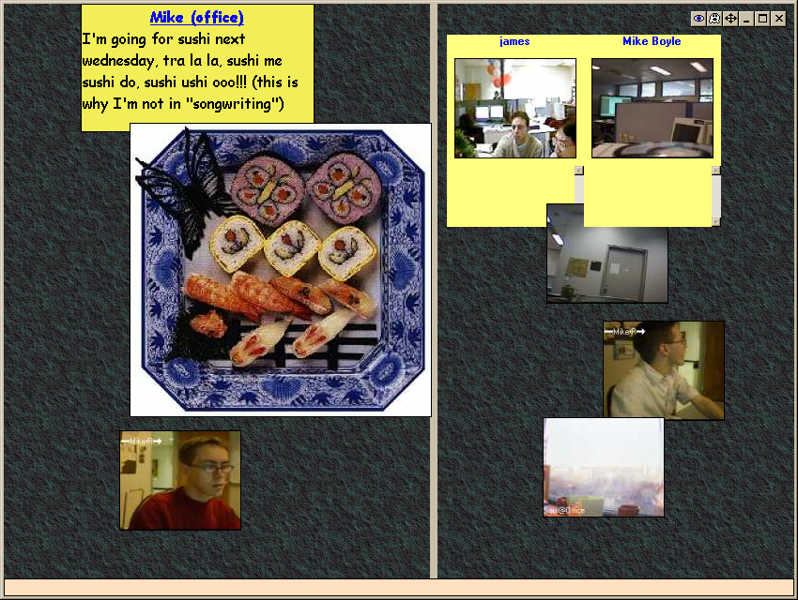
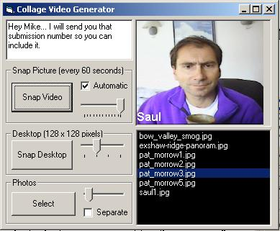
Notification Collage
Posting elements
Notes:
so from the brief video, you can see a diverse number of media elements all interacting in this environment.
Posting of new media is done through a simple client interface that I won’t really cover here
However, it’s worth mentioning that most media elements are posted with the simple click of a button,
This keeps posting and viewing media simple and lightweight

Slide 37
Notification Collage
Element types
Notes:
In the next few slides, I’m just going to run through a brief description of the media elements currently available.

Slide 38
Notification Collage
Element types
  sticky notes
Mike @home
Hey everyone! Don’t forget Sushi on Friday!!
Mike @home
Hey everyone! Don’t forget Sushi on Friday!!
Notes:
Sticky notes are textboxes that allow a user to post text messages in real time
So, everyone sees the text as it’s typed in letter by letter

Slide 39

Notification Collage
Element types
  periodic video
Mike @home
Hey everyone! Don’t forget Sushi on Friday!!
Notes:
Periodic video can be sourced from any pc camera and will take and post a snapshot to the nc every 20 seconds or so

Slide 40
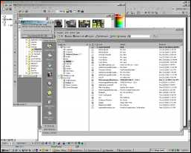

Notification Collage
Element types
  desktop snapshots
Mike @home
Hey everyone! Don’t forget Sushi on Friday!!
Notes:
* A desktop snapshot simply allows you to grab a picture of your virtual desktop and post it to the nc to show others what you’re doing.

Slide 41
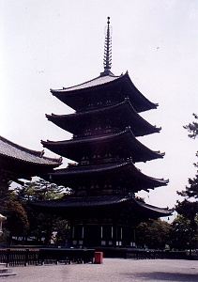


Notification Collage
Element types
  slide shows
Mike @home
Hey everyone! Don’t forget Sushi on Friday!!
Notes:
Slide shows let you post a series of digital photos, likely taken from a digital camera, to the collage

Slide 42

Notification Collage
Element types
  webpage thumbnail
Mike @home
Hey everyone! Don’t forget Sushi on Friday!!
Notes:
If you’re browsing the web and find a page that you think everyone might find interesting, the webpage thumbnail is a way to pass along the link to the collage community.
It takes a snapshot of the page you’re viewing and posts a thumbnail of it to the nc which can be used by anyone to navigate to that site.

Slide 43

Notification Collage
Active elements
Mike @home
Hey everyone! Don’t forget Sushi on Friday!!
Mike @home
Hey everyone! Don’t forget Sushi on Friday!!
Notes:
All of our media elements are also active.
So, by right-clicking on any of them, you can get a context menu of possible action items that can range from starting a private versus a public chat with the element owner to element-specific interactions such as navigating to a website from a webpage thumbnail

Slide 44









Saul
Heya Mike R, what’cha up to?
That looks good so far but have you thought about showing what a webpage thumbnail looks like?
Mike R@home
Mike R@home
Not too much, just mucking around with some slides for EHCI
Not a bad idea, I’ll add one to this slide that I’m working on.
Mike B@home
It might also be good to have more than two people… btw, the essential mix is good right now!
Mike @home
Note for all: BBC Radio 1 Essential Mix is on and awesome right now! Check out the website thumb!
Notes:
Okay, in this slide I just want to present a mocked up sequence of events that’s fairly typical of what we’ve seen in our group over the last while.
<echo the sequence by talk>

Slide 45

Notification Collage - Use
Strong sense of presence
Many conversations
Artifact awareness and action
Saul
Hey guys, Check this out
Notes:
Okay this is a pretty good lead into a discussion about what we’ve seen.
The notification collage has been in active use in our group for about six months now.
Its caused a significant shift in how we collaborate as a group, and I really want to highlight that point.
Several people - and especially telecommuters - have commented that it’s made a fundamental difference in how they feel connected with the rest of the group.
It’s allowed us as both colocated and remote collaborators to maintain a strong group relationship through informal interaction, and is the only groupware prototype we have that sees regular everyday use.
We found that…

Slide 46

Video is here
Note: video deleted in this presentation copy
low
awareness information
high
Notes:
What about the other end, where we use media spaces and other video systems?
These are becoming more and more a part of our work and social environments.
We know from the previous work done by many researchers of video-mediated communication that always-on video links hold promise for supporting casual contact among intimate collaborators.
Video is believed to be a useful medium for supporting casual contact because provides collaborators with a strong sense of one another’s presence, and for interaction the video channel itself becomes the communication channel

Slide 47

Video is here
Intrusive
Note: video deleted in this presentation copy
low
privacy risks
high
Notes:
But, these initial usage experiences revealed an important problem: privacy.
Even in the relaxed and friendly research environments into which these video media spaces were deployed, some users felt the ubiquitous video technology to be disruptive or intrusive.

Slide 48
Video is here
“Big Brother”
Note: video deleted in this presentation copy
low
privacy risks
high
Notes:
while others had fears of “Big Brother” style abuses of video.

Slide 49

Video is here
Home accidents
Note: video deleted in this presentation copy
low
privacy risks
high
Notes:
We run far larger risks when we take intimate collaborators out of office settings and into the home, as with telecommuters.
Most home offices are in rooms that serve multiple purposes (e.g., mine is in our spare bedroom).
While video is fine when one is working, forgetting to turn it off is dangerous when the room suddenly shifts to another purpose.
Also, other people living in the home who likely get no benefit whatsoever from the video tools will be using that room as well. For example, my wife…
Although there are many issues at work here---quite possibly only a handful yet understood---it is supposed that one reason for people’s concern is the fact that the full-fidelity video and audio provided in a video media space provides a lot of information: much more than may be required to provide informal awareness needed to facilitate casual interactions.

Slide 50

Restricting what people see
low
privacy risks
high
Notes:
One solution to this privacy dillema is to restrict what people can see and hear over the media space.
What I’d like to show you next is a system which we call the Active Hydra that tries to find a balance between privacy and awareness.

Slide 51
Restricting what people see
Active Hydra
  Adjusts audio/video quality
  by proximity
Proximity detector
ultrasonic sensor
Hydra unit
video, camera,
speakers, microphone
Rotating figurine
servo motor
Tippable figurine light sensors
Notes:
I;’ll show you a video of it in a moment.
The active Hydra is a physical surrogate that embodies a camera, video unit and a microphone (mimicking what Bill Buxton did several years ago).
To this we ad a proximity sensor and several of our surrogates that mediate what people hear and see over the channel…
We detect proximity……

Slide 52

Active Hydra: Video
Note: video deleted in this presentation copy
with Hideaki Kuzuoka

Slide 53



What should we show in video?
Distortion filters
  obscure detail
low
privacy risks
high
Notes:
The ActiveHydra was based on analog video, so they only thing we could do was turn it on and off which probably isn’t that effective.
With digital video, we can apply distortion filtration---algorithmically modifying the real-time video so as to obscure some aspects of it-.
This might be a better technique for striking a balance between providing awareness and preserving privacy.
Moreover, by providing people with just the appropriate amount of awareness of others, they can make good judgements about the availability of their coworkers and thereby respect one another’s solitude.
In fact, Zhao and Stasko showed that is possible to filter video so some aspects of the scene remain visible, while others are masked and that this in turn can be used to control the amount of awareness information that can be extracted from the filtered video stream.

Slide 54










What should we show in video?
Can we find a level where privacy and awareness are adequately balanced?
Boyle, Edwards & Greenberg, CSCW 2000
Notes:
Consequently, we turned our attention to both awareness and privacy and the tension that exists between them.
In our next study, we looked at using two simple distortion filters---the blur filter and the pixelize filter---applied across a wide range of levels.
We were particularly interested in finding the threshold levels where awareness cues could be perceived in the video and the threshold levels where privacy was compromised.
Our goal was to find a range of levels at which privacy and awareness could be adequately balanced.

Slide 55
Balance Awareness and Privacy
Note: video deleted in this presentation copy
Balance?
No Awareness
Awareness
Privacy
No Privacy
Notes:
When we take a look at a video scene that has been distortion filtered, we can see that there are some levels to which it could be applied where it is difficult to tell much of anything that might be going on in the scene.
These levels could protect the privacy of video media space users who filter the video they send out at that level.
But, extremely low-fidelity images will be of little use to coworkers looking for awareness cues to assess availability.
By a similar token, at extremely high levels of image fidelity, while awareness gathering is adequately supported, privacy will not be preserved at all.
We are most interested in the levels in between the extremes.
We are keen to find a balance on image fidelity at which sufficient awareness cues may be discerned to decide availability and facilitate casual interactions while still preserving privacy.
However, we don’t know if such a balance is possible.

Slide 56




Conditions
Notes:
We ran a study where we gave people five different video sequences depicting typically office and work locales, including a coffee room, private offices, and a public main office.
However, these scene do not test extreme cases where privacy must at all costs be preserved; this is somewhat of a limitation to our study results.
We then started with the most distorted video, and asked people what they saw in it as well as how they felt that privacy was protected.
We then progressively diminished the distortion

Slide 57
Results: Blur Filter
Note: video deleted in this presentation copy
Levels 1-2
Levels 3-4
Levels 5-6
Levels 7-10
No Awareness
Presence
Basic Awareness
Total Comprehension
Balance
Awareness
Privacy
Total Privacy
Some Privacy
No Privacy
Notes:
With the blur filter, levels 1-2 offers total privacy but no awareness information: this makes it rather useless.
Around levels 3-4, we get some basic sense of presence I.e., that someone is around, while people still felt that their privacy was protected.
Arould levels 5-6 fidelity is increase to the point that people have some basic awareness info for making contact decisions, privacy is still protected.
Levels 7 and up gives total comprehension and awareness information, but no privacy.
Thus we see a good balance, where there are a broad range of levels (from ~3-6) where awareness information is present but privacy is maintained.

Slide 58
Results: Pixelize Filter
Note: video deleted in this presentation copy
Levels 1-4
Levels 5-6
Level 7
Levels 8-10
Balance
Awareness
Privacy
Notes:
The pixelization filter did not fair as well. While there is a balance that provides awareness while preserving privacy, it is much smaller and thus its more prone to reveal and/or hide information in inaapropriate ways.

Slide 59

Note: video deleted in this presentation copy
low
privacy risks
high
with Michael Boyle
Notes:
We are currently working on a privacy-preserving media space.
As with the active Hydra, you will see that what is visible in the video depends on how close people are to their cameras, thus mirroring how people see and hear each other in real life.
You will see some other features, which I will discuss afterwards.
We noticed that people often blocked video by rotating the camera. Thus we use natural blocking – covering the lens, to do something similar.
The rotation of the camera gives a clear indication of how the camera responded, and is also a strong cue for others who come into view about whether they are on camera or note.
We could alsp protect home users by automating camera rotation further.
If someone leaves the room for a while, the camera will rotate away. However, It will not rotate back until the person explicitely unblocks it.

Slide 60
Digression: Engineering Groupware
Goal
  simple to prototype groupware, multimedia and physical devices
Our solutions
  groupware toolkit
  groupware services: shared dictionaries
  video toolkit
  physical widgets (Phidgets)
Notes:
Because this is a conference on engineering human computer interaction, I just want to take a moment to discuss our technology.
Because we are both builders as well as experimentors, we have this long-standing goal that…

Slide 61
Summary
Groupware can help intimate collaborators smoothly move from awareness to casual encounters to conversation and work
Hi Mary

Slide 62
Summary
Groupware can help intimate collaborators smoothly move from awareness to casual encounters to conversation and work
How do people
judge availability?
low
awareness information
high

Slide 63
Summary
Groupware can help intimate collaborators smoothly move from awareness to casual encounters to conversation and work
low
awareness information
high

Slide 64
Summary
Groupware can help intimate collaborators smoothly move from awareness to casual encounters to conversation and work
low
awareness information
high

Slide 65
Summary
Groupware can help intimate collaborators smoothly move from awareness to casual encounters to conversation and work
low
awareness information
high

Slide 66
Summary
Groupware can help intimate collaborators smoothly move from awareness to casual encounters to conversation and work
low
awareness information
high

Slide 67
Summary
Groupware can help intimate collaborators smoothly move from awareness to casual encounters to conversation and work
low
privacy risks
high

Slide 68
Summary
Groupware can help intimate collaborators smoothly move from awareness to casual encounters to conversation and work
low
privacy risks
high

Slide 69
For more information
www.cpsc.ucalgary.ca/grouplab/
Thanks to NSERC, Microsoft Research, ASERC
Notes:
Thanks for your interest in our work, and if you’d like more information, feel free to visit our website and contact us!
The new version of the software should be ready in a month or two. I would also like to acknowledge suppport by Microsoft Research.
Thanks again,

