Slide 1
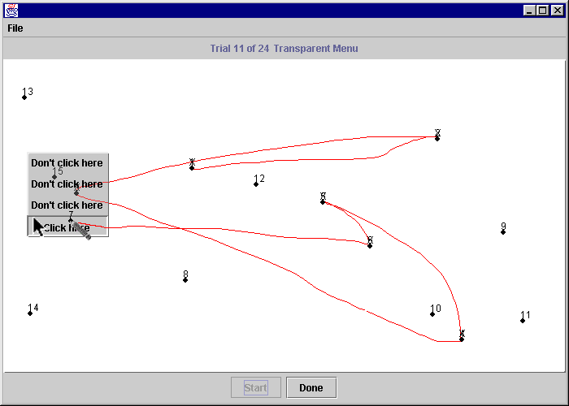
Avoiding Interference Through Translucent Interface Components in Single Display Groupware
Ana Zanella & Saul Greenberg
University of Calgary
Notes:
I am here today to talk about a user study we did to test the usability of translucent popup menus to avoid or minimize interference in Single Display Groupware

Slide 2
The message
Translucent interface components can be used in Single Display Groupware to help minimize interference among users.
Notes:
The results of our study show that translucency can be used to mitigate interference in SDG
To be able to show you that this is true I will talk about 3 things:
1) I’ll tell you what Single Display Groupware systems are
2) I’ll define and exemplify the issue of interference in SDG
3) I’ll in introduce the idea of translucent interface components and
4) I will present our user study and results - to then come back to this main message as the conclusion for our study

Slide 3
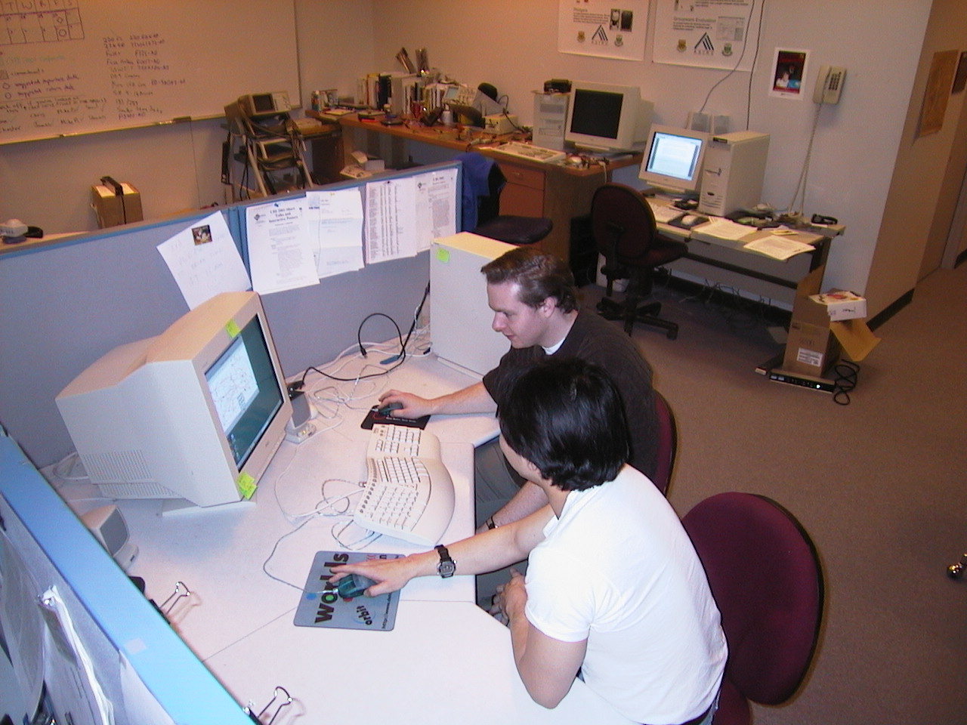
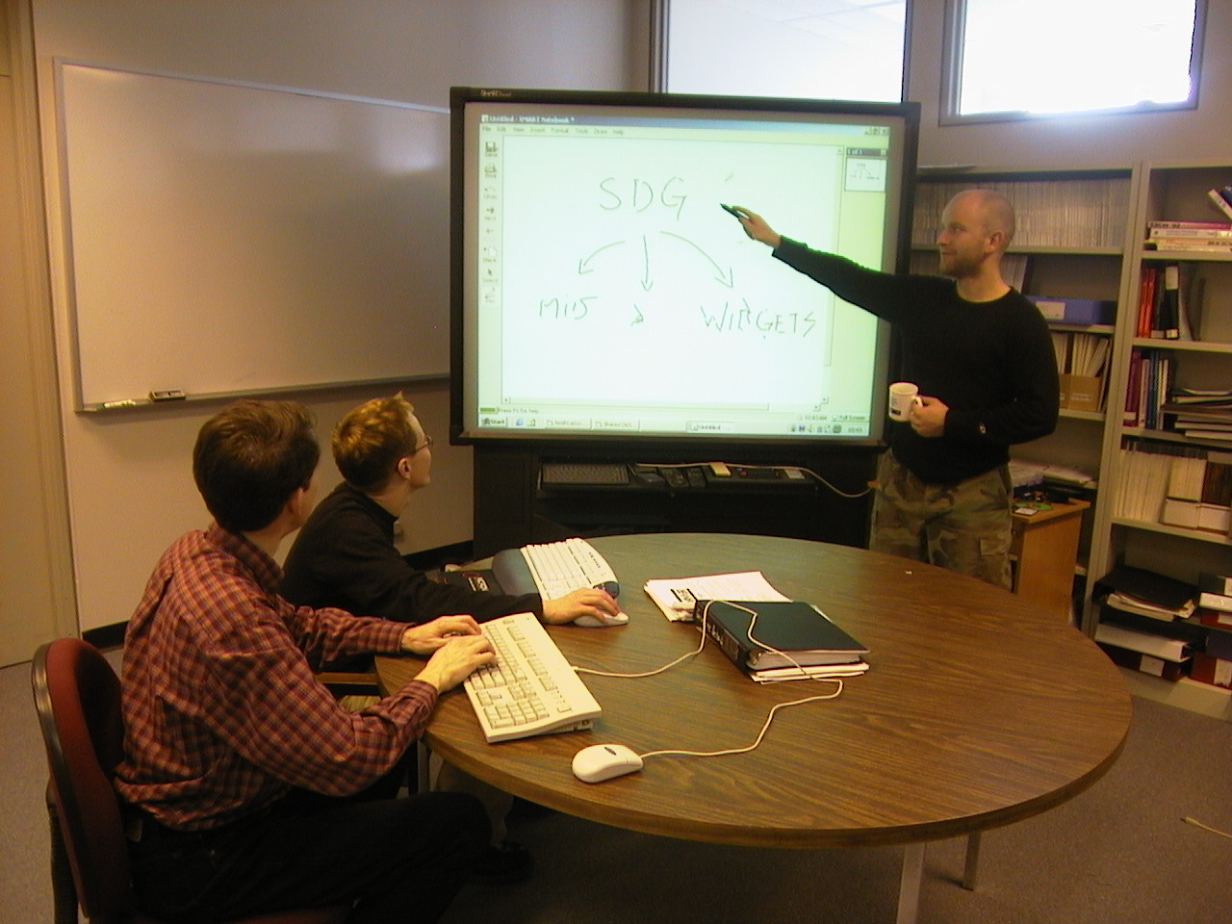
SDG Configurations
co-located
shared display
multiple input devices

Slide 4
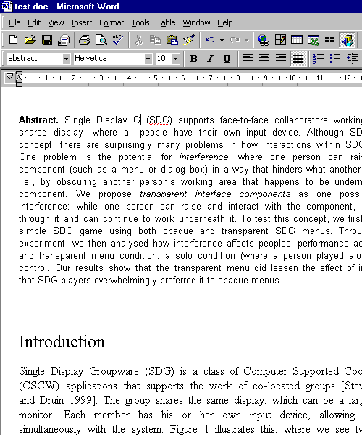


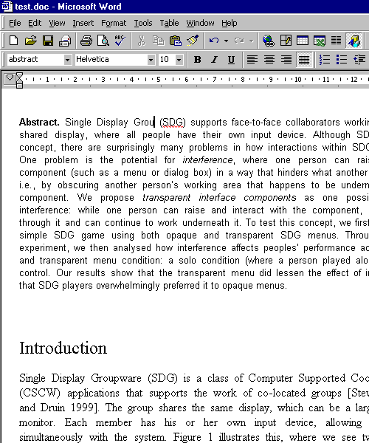


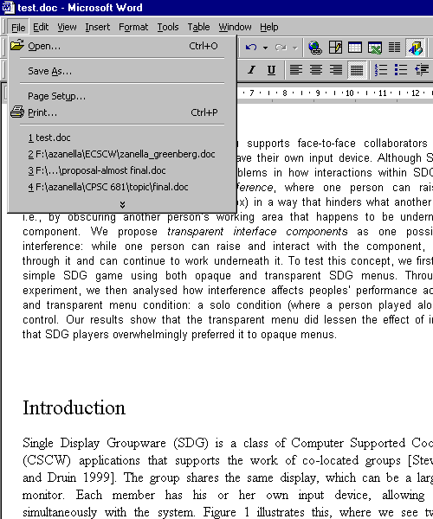
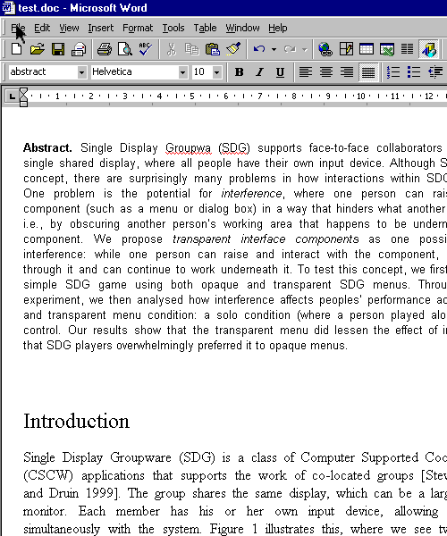

Interference
Notes:
In this hypothetically situation 2 users are editing a text together
While one user is typing a second user decides to save the work and reaches for the menu.
When user2 selects the File menu, user1 is impeded to continue his work, since his view is obstructed

Slide 5
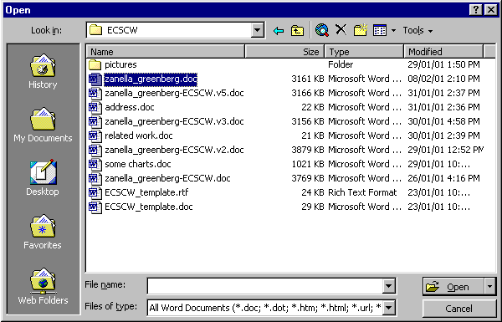
Interference
Notes:
In this hypothetically situation 2 users are editing a text together
While one user is typing a second user decides to save the work and reaches for the menu.
When user2 selects the File menu, user1 is impeded to continue his work, since his view is obstructed

Slide 6
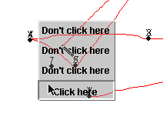
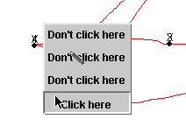
Minimizing Interference
Translucent widgets: popup menus
Translucent
Opaque
Notes:
The approach we propose to minimize interference is the use of TRANSLUCENT widgets.
As opposed to opaque widgets, translucent widgets allow users to see whatever is underneath an interface component and though continue their work
In this study we tested popup menus

Slide 7
Research Question
Can people in Single Display Groupware effectively use translucent interface components in high interference situations?

Slide 8
User Study
SDG “connect the dots” game
  Player
  Interferer
  Solo
  Opaque
  Translucent
Notes:
We implemented an SDG connect the dots game, where 2 users played.
The player was the user connecting the dots (identified by a cursor with a pen shape)
The interferer was requested to try to slow the player down, simply by popping up menus on the top of the players cursor, to create and interference
The users played the game in 3 situations: solo (only the player, no interference), opaque menus (2 users, interference), translucent (2 players, interference)

Slide 9
User Study
 | solo | translucent | opaque
 | Time1 | Time2, #overlapping2 | Time3, #overlapping3
 | Time22, | Time23, #overlapping23 | Time24, #overlapping24
1
sets
…
…
…
…
8
Users’ satisfaction
Notes:
Each one of the 30 pairs we tested played 24 games, divided into 8 sets of 3 games in each condition – we did not consider the 1st set in our analysis because these were considered training games.
For each different condition we measure the time for the completion of each game and the number of times an interference occurred
We also measured user’s preferences.

Slide 10
Results - Users’ Satisfaction
How do the translucent menus affect your task compared to opaque menus ?
Player
Easier | Same | Harder
28 | 2 | 0
Notes:
We asked the users how did they like the translucent menus when compared to opaque ones for the specific task they were doing.
Most of the players thought it was easier to connect the dots with the translucent menus

Slide 11
Results - Users’ Satisfaction
How do the translucent menus affect your task compared to opaque menus ?
Interferer
Easier | Same | Harder
0 | 5 | 25
Notes:
We asked the users how did they like the translucent menus when compared to opaque ones for the specific task they were doing.
Most of the players thought it was easier to connect the dots with the translucent menus

Slide 12
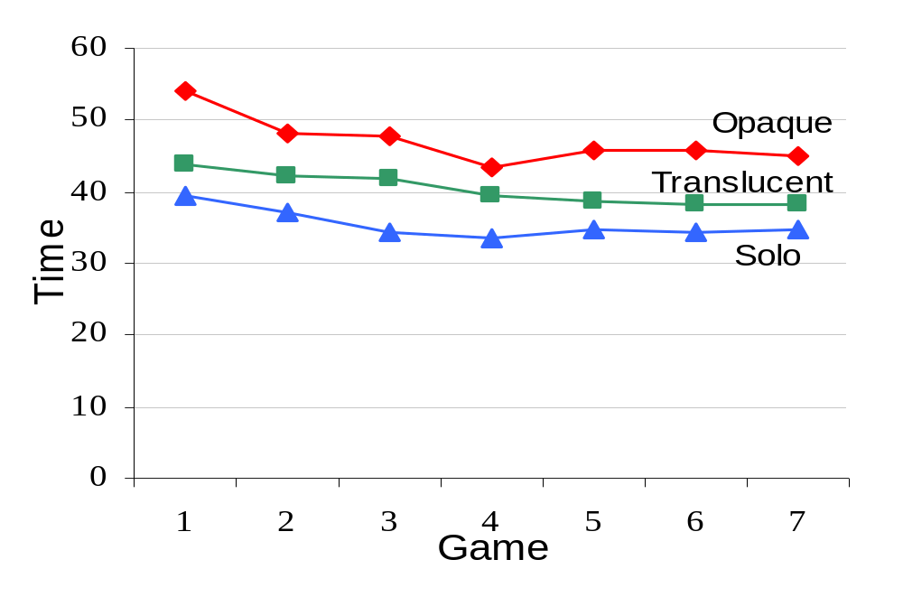
Results – Average Times
  Solo < Translucent < Opaque
Notes:
As for the average times
you can see that every single game with opaque menus was slower to complete than with translucent
when comparing to the solo condition, translucent were slower
The difference among times in each condition are statistically significant
But… one may think that more interferences occurred on the opaque condition than in the translucent condition…
So , we also investigated that

Slide 13
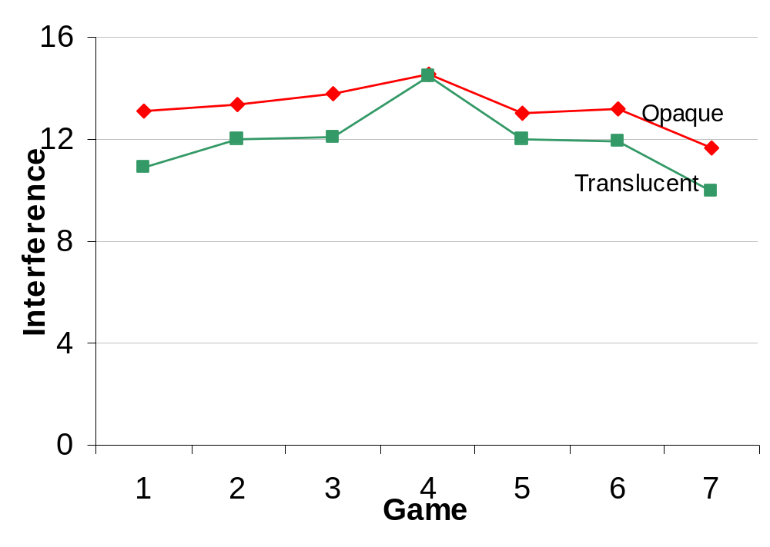
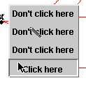
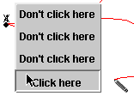
Results - Overlapping
Overlapping
No overlapping
Notes:
This graph shows the average number of interference per game in the opaque and translucent condition
We counted how many times the menu was popped up by the interferer on the top of the players cursor
And…. Although the averages seem different, there is no statistical difference between the 2 condition,
what this means that the number of interference was the same in both conditions
and that the differences we see in the time for completing the games are purely based on the menu type.

Slide 14
Conclusion
Translucent interface components can be used in Single Display Groupware to help minimize interference among users.
  People like them
  People perform faster
Full paper in ECSCW
  http://www.cpsc.ucalgary.ca/grouplab/papers/
Notes:
Transparency could be used in other interface components – for example menus, dialog boxes and toolboxes
and different SDG applications – meeting tools and collaborative games
Users liked the translucent widgets – some users said they would like to have translucent interface components even in single-user applications
We do realize that our user study presented a somewhat simplistic SDG situation – a competitive game, with just 2 users, with thin lines and few numbers on the background, that would not obscure the menu and so on – but we do believe that the results shown here can be generalized to a certain extent.

