Slide 1
A Single Display Groupware Widget Set
Ana Zanella
Saul Greenberg
University of Calgary

Slide 2
Single Display Groupware
- definition -
Single Display Groupware (SDG) is a class of CSCW applications that supports multiple simultaneous users interacting co-located on a single shared display, usually using multiple input devices (MID)
[Stewart]

Slide 3
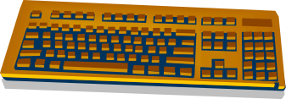

SDG vs. Groupware

Slide 4
Types of SDG Applications
Children’s Application
    games, educational tools
Meeting Tools
    brainstorming, discussing and modifying data
SDG Editors
    text, drawing
Multiple Input Device Systems
    two handed input

Slide 5
Issues in SDG Design
Identifying users’ devices and user’s work
Managing simultaneous input by several users and devices
Providing widgets that recognize and respond to actions of multiple users
Designing interface components to avoid user’s interference
Providing awareness of other users’ work
Dealing with public and personal information
Redesigning conventional applications

Slide 6
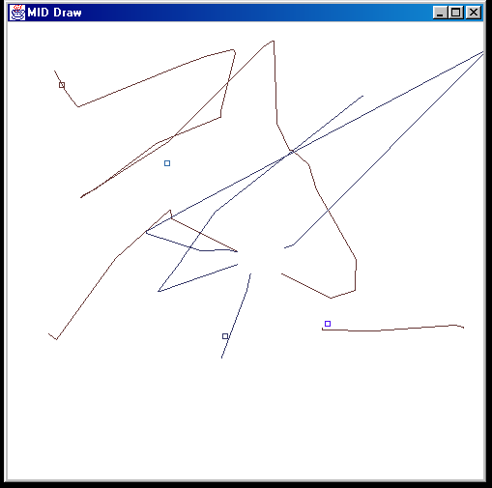
MidDraw
MID [Bederson]

Slide 7
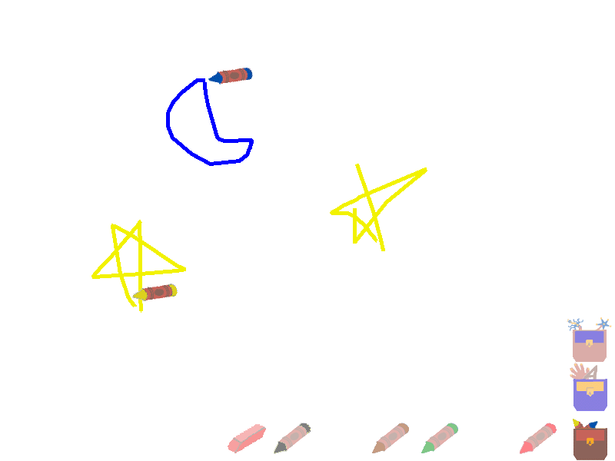
KidPad
MID [Bederson]

Slide 8
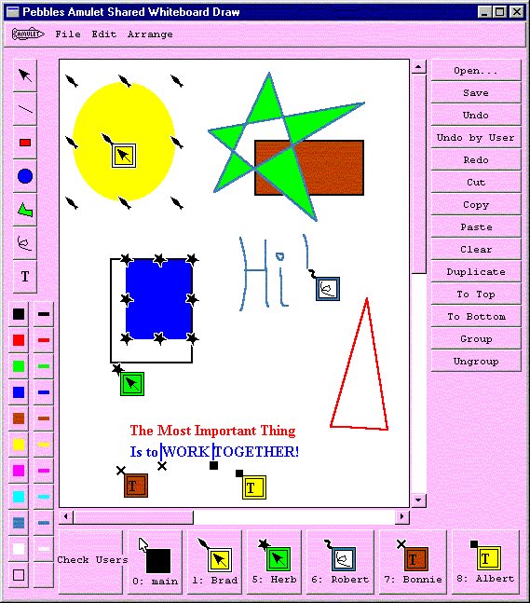
Pebbles Draw
Pebbles [Myers]

Slide 9
Research Project
Build or use an existing architecture that supports multiple input devices
Build device-aware widget set that can be used rapidly prototype SDG applications
Evaluate various widgets by studying how people use these widgets, and how they affect the collaboration process

