Slide 1

The Notification Collage
Michael Rounding,
Saul Greenberg;
University of Calgary
Michael Rounding, Saul Greenberg
CSCW 2000; Dec, 2000; Philadelphia

Slide 2

Outline
Social Interaction
Research Focus
Casual Interaction & Awareness
The Notification Collage
Demonstration
Michael Rounding, Saul Greenberg
CSCW 2000; Dec, 2000; Philadelphia
Notes:
Here’s a brief outline of what I’ll talk about
First talk about different scales of social interaction
Then will focus down and explain where this research is targeted
After talking a bit about casual interaction and awareness, I’ll present the Notification Collage and some of its features and uses.
Finish up with a quick demonstration that will let you see the system in motion.

Slide 3
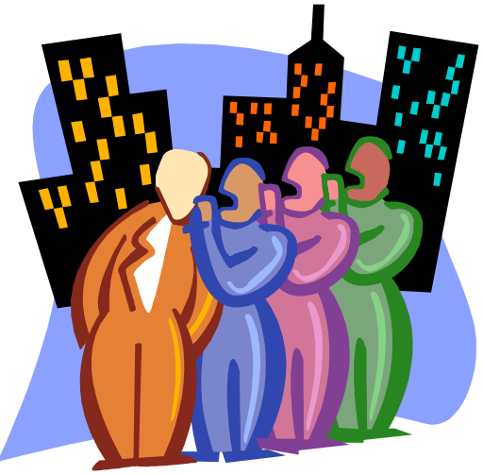


Social Interaction
The World
strangers
Organizations
associates
Teams
intimate collaborators
Michael Rounding, Saul Greenberg
CSCW 2000; Dec, 2000; Philadelphia
Notes:
The world of social interaction exists on lots of different levels.
On a global scale of social interaction, we don’t really know the people we interact with; you say ‘hi’ to people you don’t know at all without a second thought and usually they respond with a casual greeting in turn.
At an organizational level, lots of different people have lots of different goals, but they are generally commonly focused to the betterment of the organization as a whole. Associates for me could be people I know in different research groups in our department at the University of Calgary.
At the teams level, you are dealing with a set of intimate collaborators. For me, these people are other researchers and Supervisors tied to GroupLab at the University of Calgary.

Slide 4
Research Focus
Intimate collaborators
  collective goal(s)
  membership / relationship
Real need for close coordination and collaboration
Teams
intimate collaborators
Michael Rounding, Saul Greenberg
CSCW 2000; Dec, 2000; Philadelphia
Notes:
Okay, it’s this idea of teams that is most central to the research we’re doing.
In the teams situation, you have a set of intimate collaborators who have a collective set of goals to work towards. Each person in the team has something to offer towards the fulfillment of that goal.
Each member of the team should have the sense that they are a member of said team; they have social relationships between team-members that can sometimes dictate how work gets done.
The important note here is that there is a real need in this teams environment for close coordination and collaboration between the team members. The social relationships help to facilitate this by providing a medium to communicate and get work done.

Slide 5



Research Focus
Intimate collaborators
  collective goal(s)
  membership / relationship
  sometimes distance-separated, sometimes co-located
Intimate collaborators
  collective goal(s)
  membership / relationship
Real need for close coordination and collaboration
Teams
intimate collaborators
Real need for close coordination and collaboration
Michael Rounding, Saul Greenberg
CSCW 2000; Dec, 2000; Philadelphia
Notes:
These days, team members may occupy the same space or actually work in a more distributed setting.
While this may be true, it’s still important to have coordination and collaboration to get things done, and we’re looking into ways to support this social setting.

Slide 6
Research Focus
Goal
Support smooth transition from awareness to casual encounters to conversation and work between intimate collaborators
Teams
intimate collaborators
Michael Rounding, Saul Greenberg
CSCW 2000; Dec, 2000; Philadelphia
Notes:
We have several goals with this research.
We want to support casual interaction and make it more natural for distributed group members to step into collaboration and coordination.
The inclusion of real world collaborations and opportunities can make it easier and more natural to coordinate efforts and work. The closer we can mirror how people work in real life, the better the communication support will be.

Slide 7
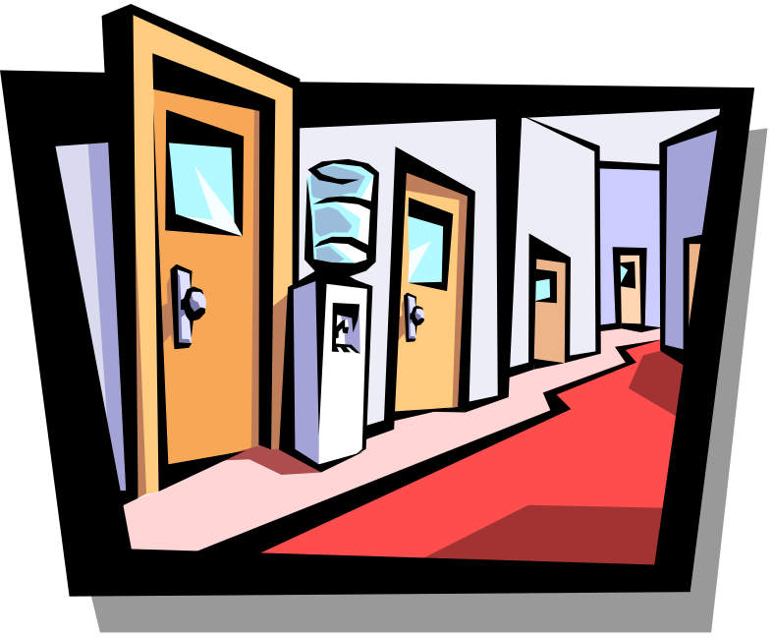
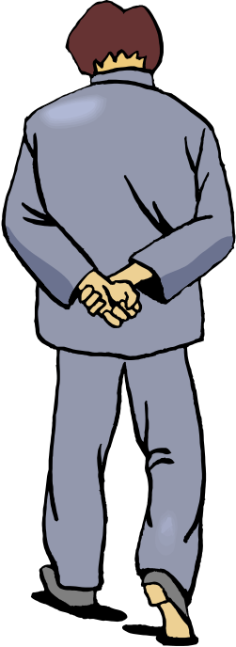
Casual Interaction & Awareness
Questions
  who is around?
  are they available now?
  can they be interrupted?
  how can I initiate contact?
Michael Rounding, Saul Greenberg
CSCW 2000; Dec, 2000; Philadelphia
Notes:
This brings up the point of Casual interaction.
90% of communication in a workplace is done through casual interaction: You meet up with someone in the hallway, a conversation ensues and an opportunity for coordination and or collaboration is presented.
In an every day office setting, initiating contact is done by answering a few simple questions. Who is around? Are they available? Can I interrupt what they’re doing? How do I make my presence available to them to initiate a conversation? In a workplace, these simple questions of awareness are answered automatically, we don’t even have to think about it!!
This gets immediately more difficult, however, if the team is comprised of both co-located and distributed group members.

Slide 8
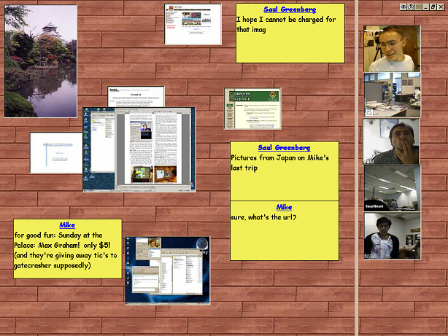
The Notification Collage
community posts media elements to a collage
people can keep a personal view of “what is going on”
people can respond to posted media
can be a casual meeting place for casual interaction
Michael Rounding, Saul Greenberg
CSCW 2000; Dec, 2000; Philadelphia
Notes:
With all of this in mind, we present the notification collage. Here’s the basic way it works:
A community with access to the NC posts media elements for everyone to see to a collage of media elements.
People can keep their own personal view of “what’s going on,” it is not necessarily “WYSIWIS” although the same information is available to everyone in the community. Media elements can be moved around or hidden by each user.
Members of the community can respond to media as posted by other members.
The end result is that the NC can become a casual meeting place where people will engage in casual interaction.

Slide 9
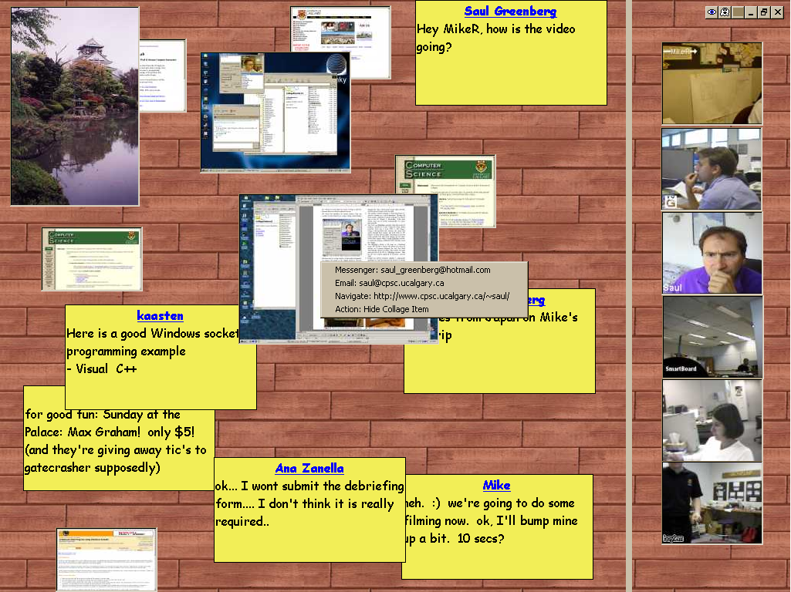
The Notification Collage
Michael Rounding, Saul Greenberg
CSCW 2000; Dec, 2000; Philadelphia
Notes:
Okie, so here we gots some media elements that can be posted by members of the community.
This follows on the metaphor of a real-world bulletin board.
Two sides: new elements always appear on the left of the bar, elements deemed important by a user can be placed on the right side of the bar, so they won’t be covered.
Lots of different media elements
Video links (with a very slow video rate) – most community members had cameras attached to their workstations and felt that the video post was one of the most essential things to post. Video made it possible to be much more expressive over the NC. It’s also a much more explicit depiction of “who’s around.”
Sticky notes – which people used in a variety of ways from announcements to general queries to full out chatting.
There are pictures and virtual slide shows,
Desktop snapshots
Web page thumbnails
Not pictured here, a ticker tape element that cascades across the bottom.
Each element has “action items” attached to it to provide different ways of making contact or customizing the display.
We found that while this was originally designed to be a one-instance application running on a public display, many people wanted to run it for themselves on their machines. The application takes up a lot of screen space, so this problem needed to be solved. This was done in a couple of ways. First, you can hit the little ghost button…

Slide 10
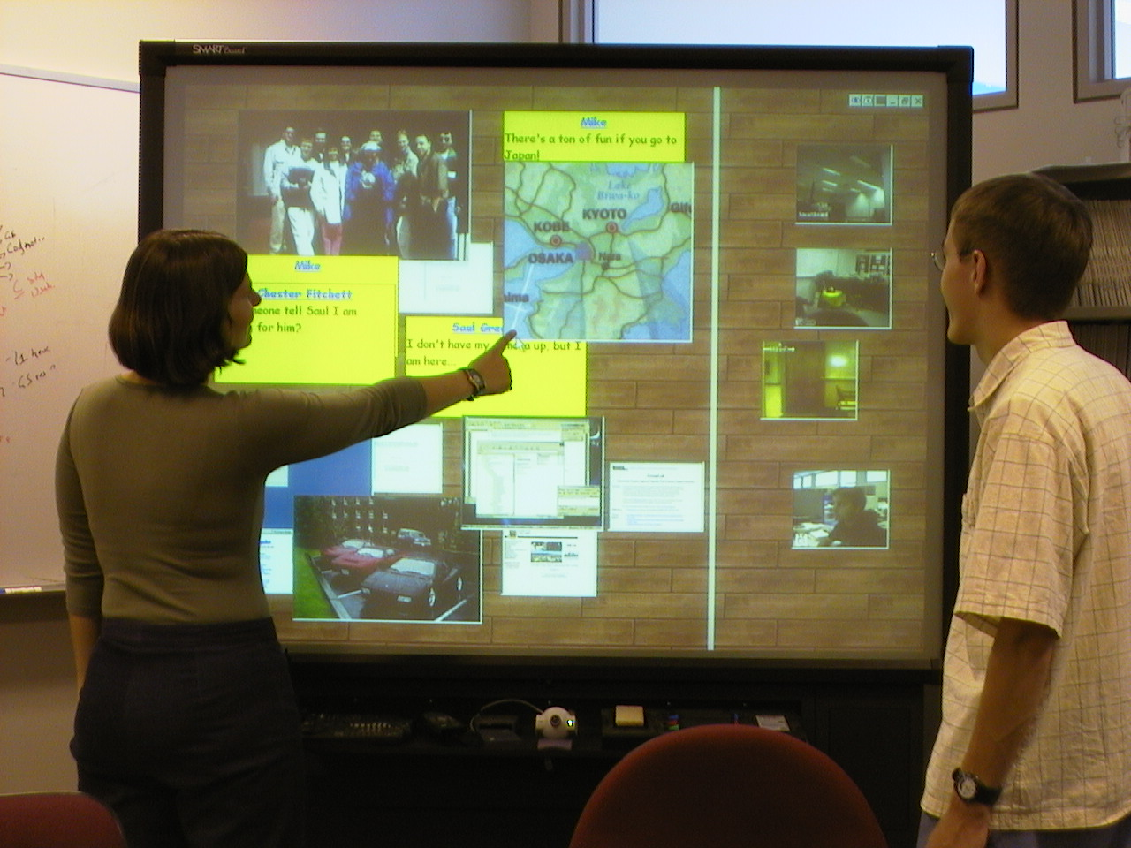
The Public Artifact
Michael Rounding, Saul Greenberg
CSCW 2000; Dec, 2000; Philadelphia
Notes:
The initial thrust of the NC development was centered on public displays, and creating a public artifact. This is the large display in our lab.
The idea of making a public artifact is that “information held by the computer can be seen, heard, and acted upon in an easy and natural way by the people inhabiting the area around the computer.”
SmartBoard has its own camera as well, and distributed community members would frequently contact people in view of the SmartBoard through the NC.

Slide 11
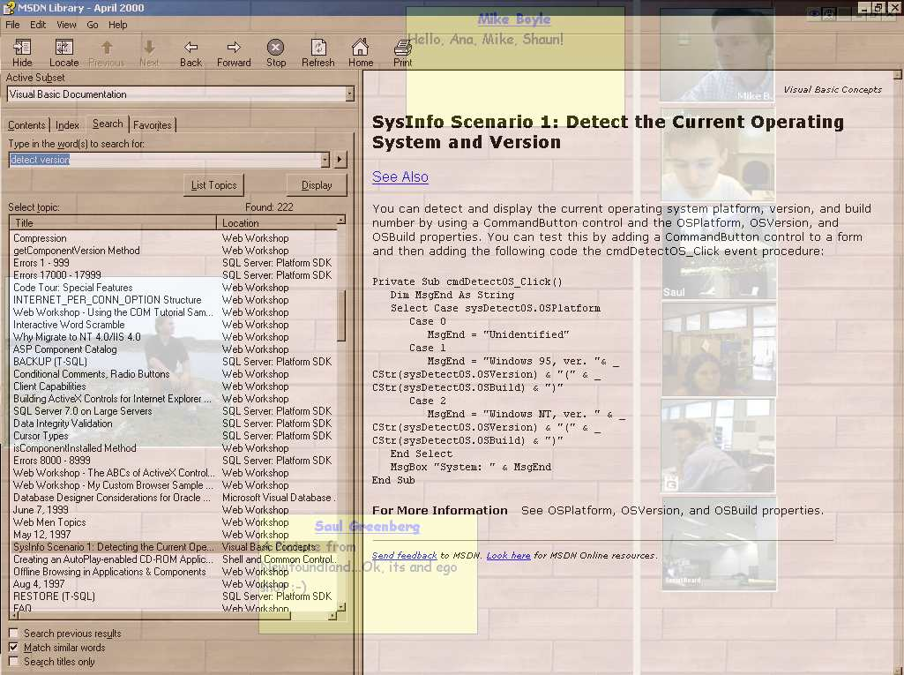
The Notification Collage
Michael Rounding, Saul Greenberg
CSCW 2000; Dec, 2000; Philadelphia
Notes:
And the window turns transparent! The idea here is that you can work on whatever you were working on underneath a transparent version of the NC, which lets you keep a view of “what’s going on” in the community while still keeping your workspace available.

Slide 12
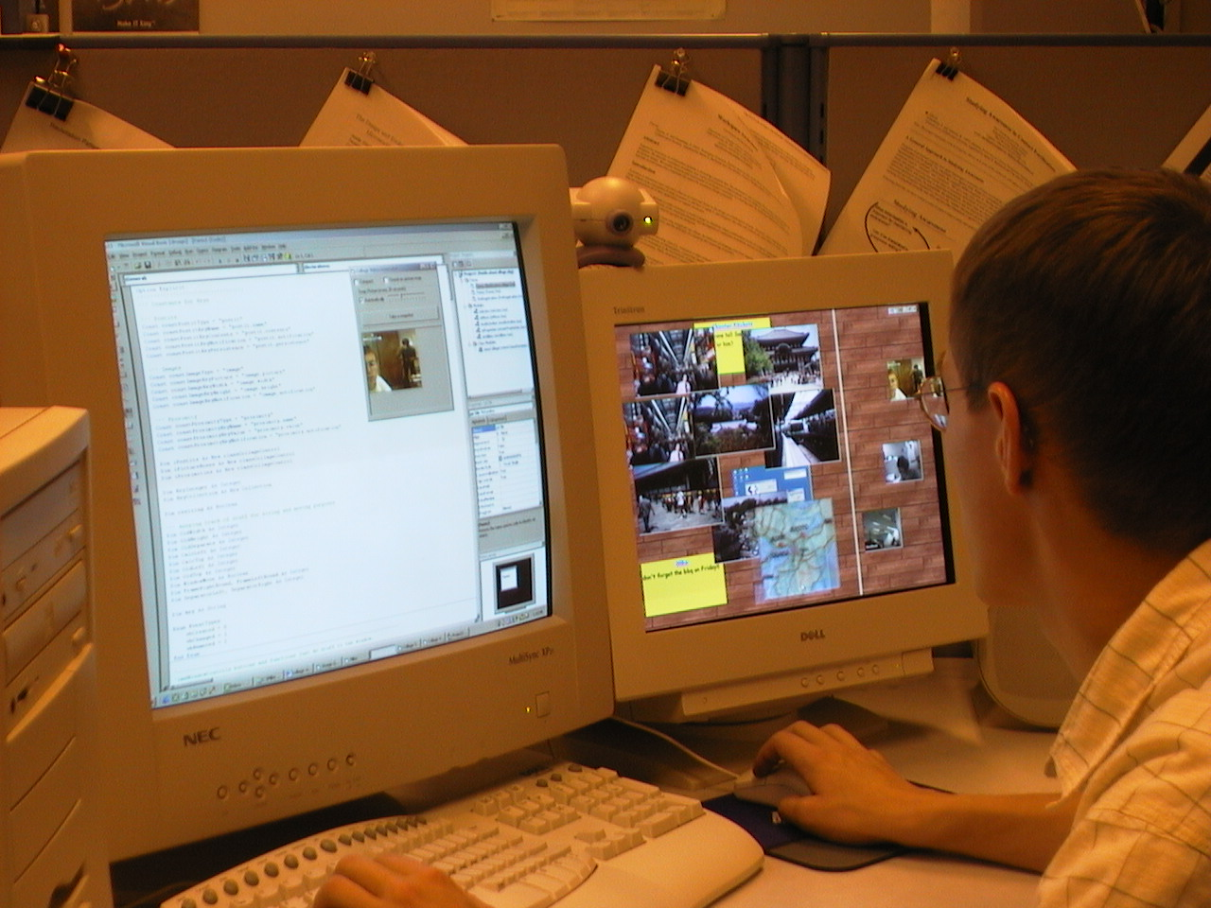
The Secondary Display
Michael Rounding, Saul Greenberg
CSCW 2000; Dec, 2000; Philadelphia
Notes:
Also, people frequently ran the NC in a secondary display, which are usually used to track peripheral information anyways.
We found people running it in a secondary display translucently, as well. I do that a lot, with the main reason being that I can read code documentation in the secondary display while working in the primary display.

Slide 13

Demonstration
Michael Rounding, Saul Greenberg
CSCW 2000; Dec, 2000; Philadelphia

Slide 14
Directions
How can public displays and such be used to support casual interaction and awareness?
Michael Rounding, Saul Greenberg
CSCW 2000; Dec, 2000; Philadelphia

