Slide 1
Integrating Back, Bookmarks and History
Alternative History Mechanisms for Web Browsers
Note: Presentation also included a live demo of his system
Shaun Kaasten
Saul Greenberg
University of Calgary
Canada

Slide 2
Motivation
People revisit web pages with surprising frequency!
  60% navigations are revisits
Tauscher, Greenberg ‘97

Slide 3
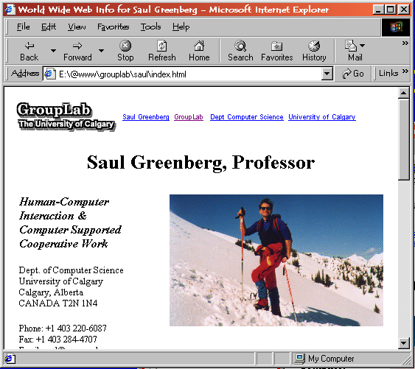
How is Revisitation Supported?
Back button

Slide 4
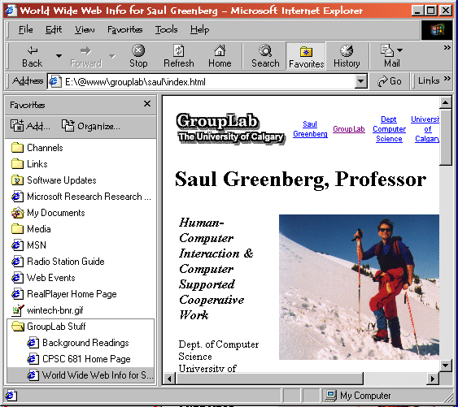
How is Revisitation Supported?
Back button
Bookmarks /
Favorites

Slide 5
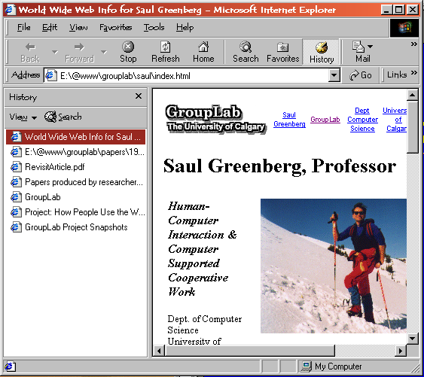
How is Revisitation Supported?
Back button
Bookmarks /
Favorites
History lists

Slide 6
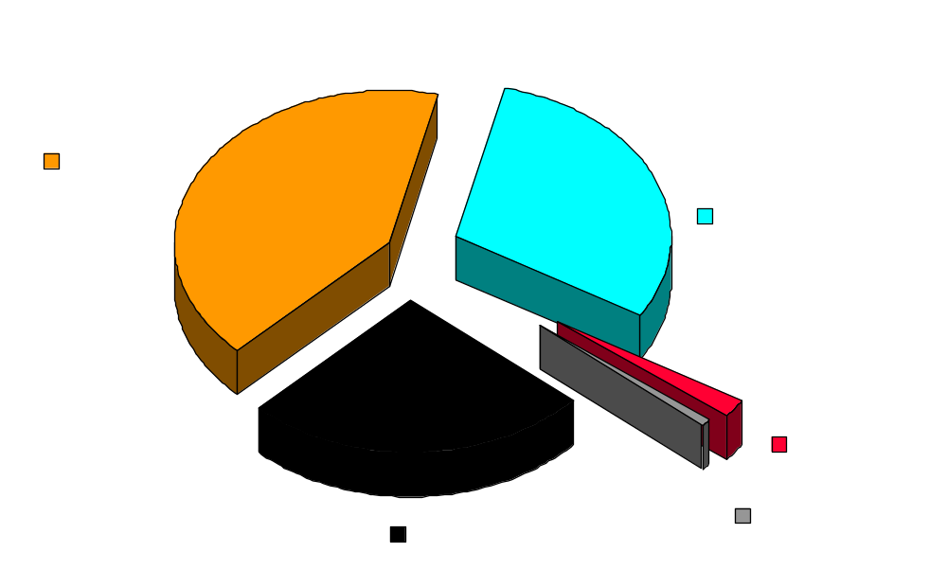
How Users Revisit
Tauscher, Greenberg ‘97

Slide 7
Integration – a Single System
Goal: Get me back to that web page!
Approach: Use best aspects of each

Slide 8
User Studies
Field Test
Regular back vs. our recency back
Page representation
  titles vs. URL vs. thumbnails

