Slide 1
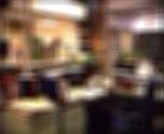
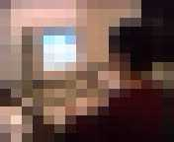


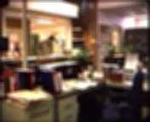
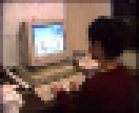
The Effects of Filtered Video on Awareness and Privacy
Michael Boyle, Christopher Edwards, Saul Greenberg
University of Calgary

Slide 2
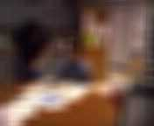

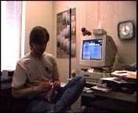
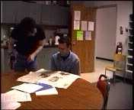

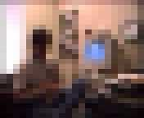
Question
Using distortion filters, can we find a level where privacy and awareness are adequately balanced?
Notes:
In our study, we looked at using two simple distortion filters---the blur filter and the pixelize filter---applied across a wide range of levels. We were particularly interested in finding the threshold levels where awareness cues could be perceived in the video and the threshold levels where privacy was compromised. Our goal was to find a range of levels at which privacy and awareness could be adequately balanced.

Slide 3

Video Is Here
Casual Contact for Intimate Collaborators
Notes:
Our study was motivated by the fact that video is more and more becoming a part of our work and social environments. We know from the previous work done by many researchers of video-mediated communication that always-on video links hold promise for supporting casual contact among intimate collaborators. It is important to point out here that we are strictly looking at the use of video among people who share an a priori relationship with each other and have an existing need to engage in frequent and lightweight informal interactions across distances. These informal interactions have been shown in previous research to be the backbone of collaboration. Video is believed to be a useful medium for supporting casual contact because provides collaborators with a sense of one another’s presence and supports lightweight mechanisms for accruing and maintaining informal awareness of one’s colleagues.
These suppositions have been confirmed, at least in part, by the work done in video media spaces.

Slide 4
Where Did Privacy Go?
N.B.: Click the videos (black rectangles) to begin playback.
Intrusive Technology
Fears of “Big Brother”
Notes:
But, these initial usage experiences revealed an important problem: privacy. Even in the relaxed and friendly research environments into which these video media spaces were deployed, some users felt the ubiquitous video technology to be disruptive or intrusive while others had fears of “Big Brother” style abuses of video. Although there are many issues at work here---quite possibly only a handful yet understood---it is supposed that one reason for people’s apprehension is the fact that the full-fidelity video and audio provided in a video media space provides a lot of information: more than may be required to provide informal awareness needed to facilitate casual interactions.

Slide 5
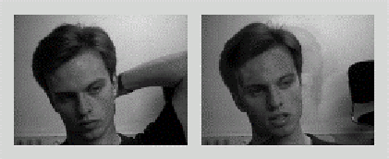
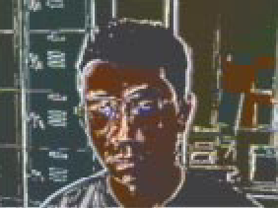
Distortion Filters Might Help
Obscure detail to preserve privacy…
Coutaz, Crowley, and Bérard, 1997
…But, still support awareness-gathering
Zhao and Stasko, 1998
Notes:
In light of this, several researchers have speculated that distortion filtration---algorithmically modifying the real-time video so as to obscure some aspects of it---might be a suitable technique for striking a balance between providing awareness and preserving privacy. Moreover, by providing people with just the appropriate amount of awareness of others, they can make good judgements about the availability of their coworkers and thereby respect one another’s solitude.
In fact, Zhao and Stasko showed that is possible to filter video so some aspects of the scene remain visible, while others are masked and that this in turn can be used to control the amount of awareness information that can be extracted from the filtered video stream. Their study looked at several distortion filters to see what kinds of awareness-related information could and could not be discerned by observers.
Our own study draws heavily on their previous work. But, whereas Zhao and Stasko looked at awareness, we turned our attention to both awareness and privacy and the tension that exists between them. Also, while Zhao and Stasko looked at a number of filters---some very sophisticated---these levels were operated at a single level: our study looks at the effect of two rather simplistic filters operated across a range of levels.

Slide 6

Balance Awareness and Privacy
N.B.: Click the videos (black rectangles) to begin playback and then click to animate slide.
Less Balance?
No Balance?
Balance?
No Awareness
No Awareness
No Awareness
Awareness
Awareness
Awareness
Privacy
Privacy
Privacy
No Privacy
No Privacy
No Privacy
Notes:
When we take a look at a video scene that has been distortion filtered, we can see that there are some levels to which it could be applied where it is difficult to tell much of anything that might be going on in the scene. We surmise that these levels could protect the privacy of video media space users who filter the video they send out at that level. But, we suppose that these extremely low-fidelity images will be of little use to coworkers looking for awareness cues to assess availability. By a similar token, at extremely high levels of image fidelity, we suppose that while awareness gathering is adequately supported, privacy will not be preserved at all.
We are most interested in the levels in between the extremes. We are keen to find a lower bound on image fidelity at which sufficient awareness cues may be discerned to decide availability and facilitate casual interactions. Also, we are keen to find an upper bound on image fidelity at which privacy is protected enough to warrant leaving an always-on video link engaged under most ordinary circumstances.
We suppose that if this range is quite wide, that is there is lots of room to trade off privacy and awareness and tailor this trade-off to an individual’s preference, then such a filter is amenable to striking a balance between awareness and privacy.
If the range is quite small, however, we suppose that it will be more difficult for users to find filtration levels to meet their privacy and awareness demands. Such a filter then would be not as amenable to balancing privacy and awareness.
And, if there is no overlap, that is there is no level at which privacy is preserved and yet sufficient awareness cues may be discerned, then we suppose that such a filter is *not* amenable to striking a balance between awareness and privacy in a video media space.

Slide 7
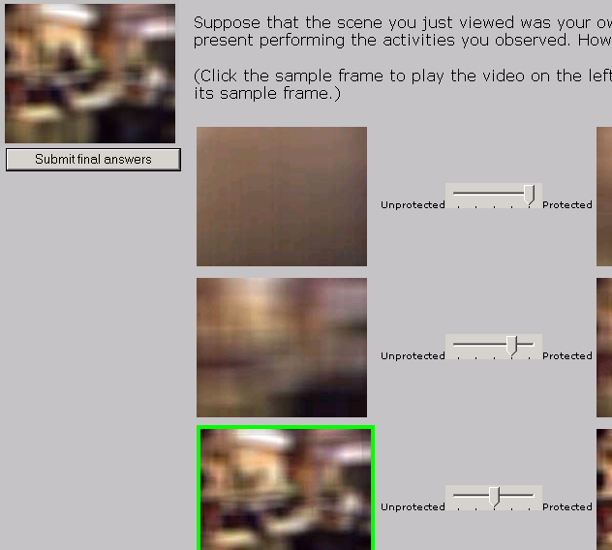
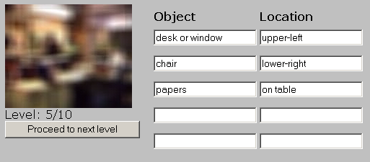
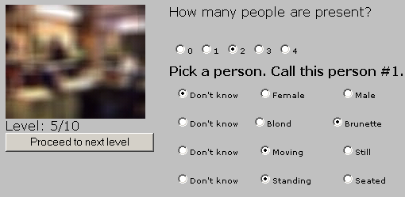
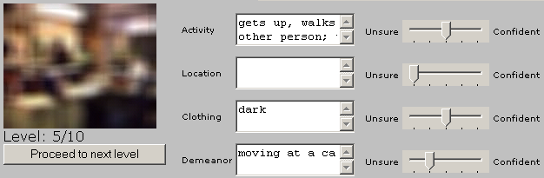
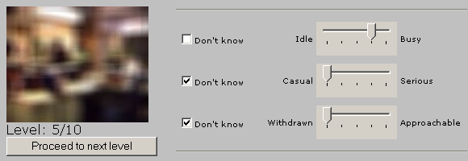
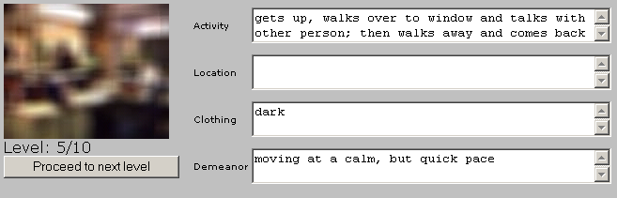
Awareness and Privacy Metrics
N.B.: Click to animate slide.
People
Objects
Activities
Availability
Confidence
Privacy
Notes:
To establish this useful range of filtration levels, we had participants view a video scene distorted using one of the two filters tested, starting at the lowest level of image fidelity. Through the course of testing, the level of image fidelity was increased to the point where the video was unfiltered. At each level, we asked participants questions about what they could discern from the video. We asked questions relating to the people that the could see in the scene, including the number of actors, their gender and simple physical characteristics, and their posture, that is, if they were moving or still, standing or seated.
We asked participants to describe in their own words the objects that they could see.
We also asked to discern what activities the actors in the scene were engaged in.
We then asked participants to use this information to infer aspects of the actors availability, including busyness, seriousness, and approachability.
Our testing protocol asked participants to state their first guesses in response to each of these questions as early as possible in the testing process. Thus, for every question, we asked the participants to rate how confident they were in the accuracy or correctness of their responses. At subsequent levels, participants were given the opportunity to amend or correct their responses if they deemed it necessary, and adjust the level of confidence they felt in the accuracy of their responses.
After all of the levels for a filter had been tested, we then showed the participants snapshots of each levels tested. We asked them to imagine that they were one of the actors they had just watched, and rate each level’s ability to preserve their privacy.

Slide 8











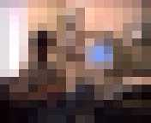
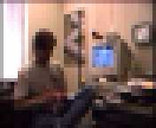
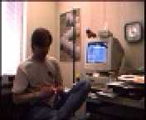
Blur and Pixelize Filter Levels
Notes:
As mentioned earlier, the two distortion filters we used in our study were blur and pixelize. Each was applied at ten different levels, with level 1 being the most obscured and level 10 being an unfiltered image. I should point out here that we do not suppose that there is a correspondence between the blur filter levels tested and the pixelize levels tested, that is, we do not claim that blur level 5 should be equivalent to pixelize level 5 in any way.

Slide 9
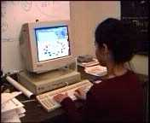
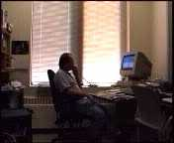
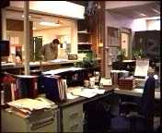
Video Scenes Used
Notes:
Five different video sequences were used in testing. The scenes varied from half a minute to a minute in half in length, and depicted typically office and work locales, including a coffee room, private offices, and a public main office. Each had from 1 to 4 actors present: not all actors were present throughout the course of the entire video. The activities depicted ranged from social to work encounters, and showed both solitary and group efforts.
Our aim with this selection of scenes was to pick environments and activities, as well as angles and lighting conditions representative of the kinds that may be encountered in a video media space. Unfortunately, these scene do not test extreme cases where privacy must at all costs be preserved. This fact, that while our testing protocol asks about privacy the test videos do not test extremely sensitive cases, proves to be a caveat to our study results.

Slide 10
Results: Blur Filter
N.B.: Click the videos (black rectangles) to begin playback and click to animate slide.
Levels 1-2
Levels 3-4
Levels 5-6
Levels 7-10
No Awareness
Presence
Basic Awareness
Total Comprehension
Balance
Awareness
Privacy
Total Privacy
Some Privacy
No Privacy

Slide 11
Results: Pixelize Filter
N.B.: Click the mouse cursor over the videos (black rectangles) to begin playback and click to animate slide.
Levels 1-4
Levels 5-6
Level 7
Levels 8-10
No Awareness
Presence
Basic Awareness
Total Comprehension
Balance
Awareness
Privacy
Total Privacy
Some Privacy
No Privacy

Slide 12
Application of Results
Use blur filter to levels 3, 5, and 10
Level in effect is reciprocal, mutually-decided
Implicit, reactive control

Slide 13


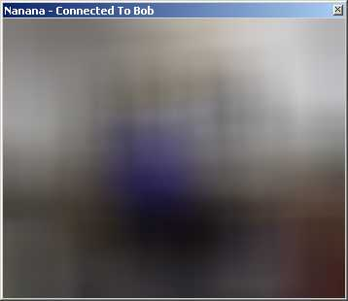
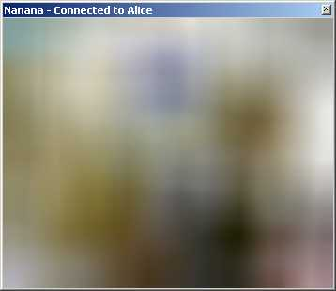
Alice Working Alone
Bob Working Alone
Not Interested
Not Interested
Low Fidelity (Level 3)
Favour Privacy over Awareness

Slide 14
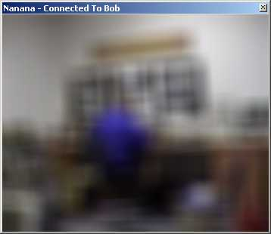
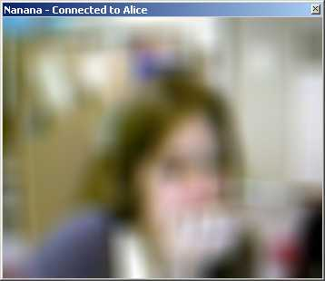
Alice Looking At Bob
Bob Still Working Alone
Interested
Not Interested
Medium Fidelity (Level 5)
Balance Privacy and Awareness

Slide 15
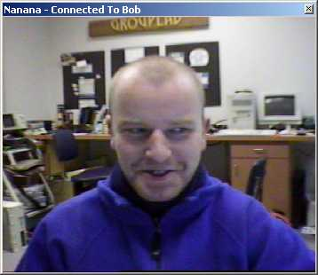
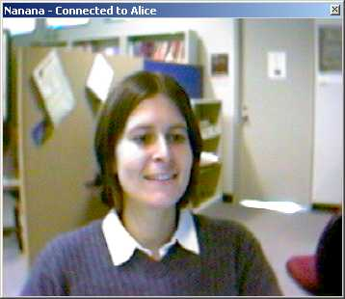
Alice Looking at Bob
Bob Looking at Alice
Interested
Interested
High Fidelity (No Distortion)
No Privacy

Slide 16


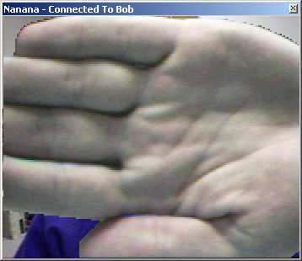
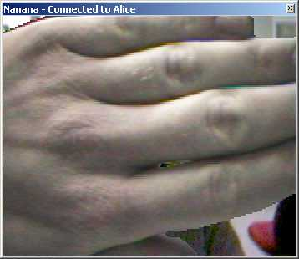
Alice Looking At Bob
Bob Blocking Alice
Blocked
Blocking
Totally Preserve Privacy

Slide 17
Summary
Always-on video is good for awareness
But threatens privacy, solitude
Distortion filtration may balance tension
  Blur filter: range of levels around level 5
Large caveats

