Slide 1
Supporting Collaborative Interpretation in Distributed Groupware
Donald Cox | Saul Greenberg
IBM Canada Laboratory | University of Calgary
Presented at ACM CSCW 2000.
Note: the talk included a demonstration of the system, which is not
shown here

Slide 2
Agenda
Collaborative Interpretation
Supporting Emergence
Supporting Distributed CI

Slide 3
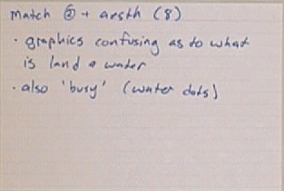
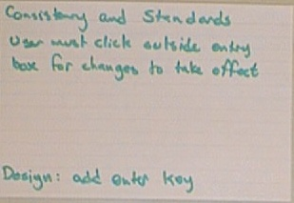
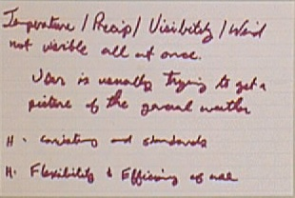

Slide 4
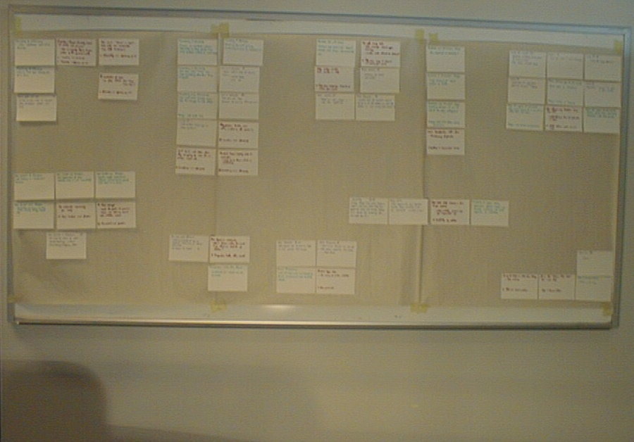

Slide 5
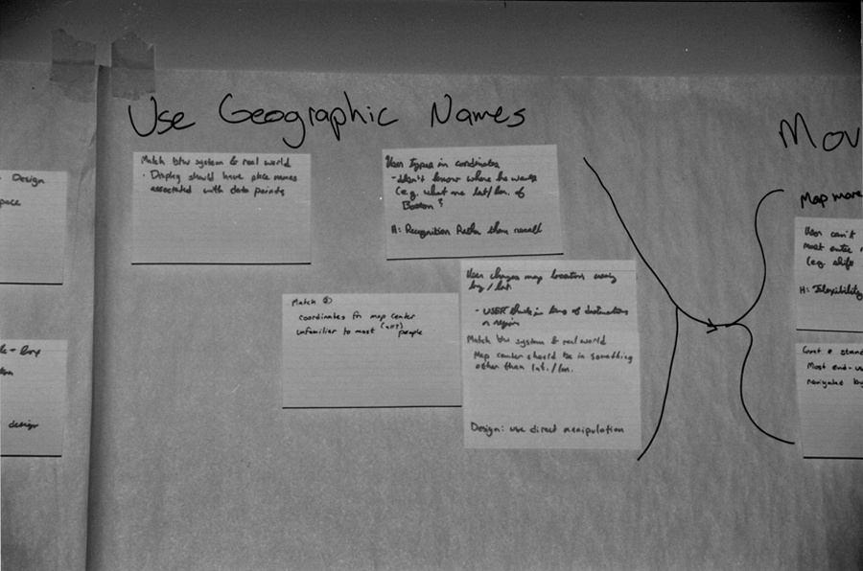

Slide 6
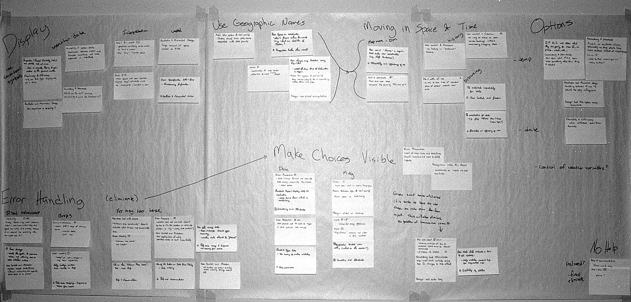
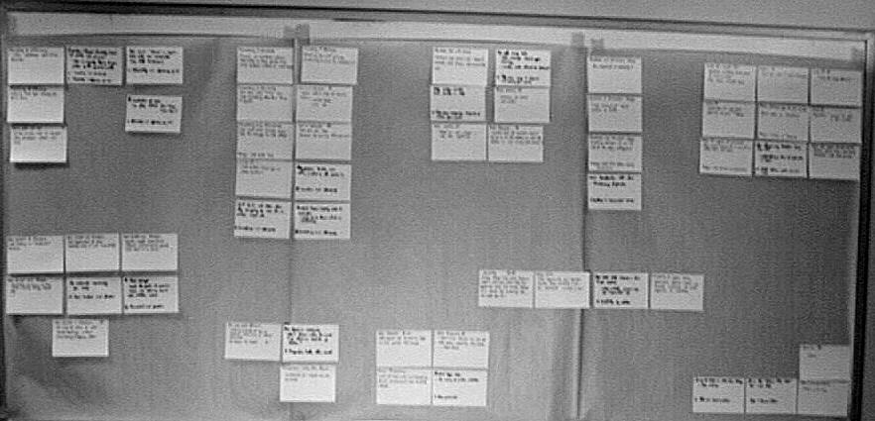
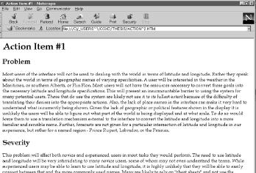
Collaborative Interpretation
A process where a group interprets and transforms a diverse set of information fragments into a smaller, coherent set of meaningful descriptions.

Slide 7
Steps in CI
Preparation
Familiarization
Interpretation (emergence)
Recording the interpretation

Slide 8
Preparation

Slide 9
Familiarization

Slide 10
Interpretation

Slide 11

Reporting

Slide 12
Moving to Distributed Groupware

Slide 13
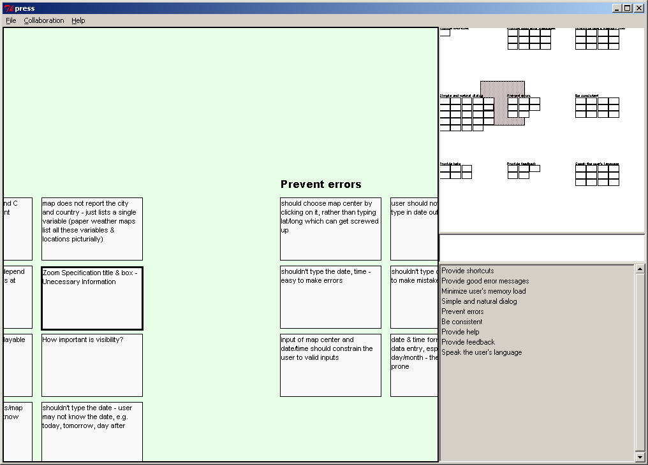
Preparation/Familiarization

Slide 14
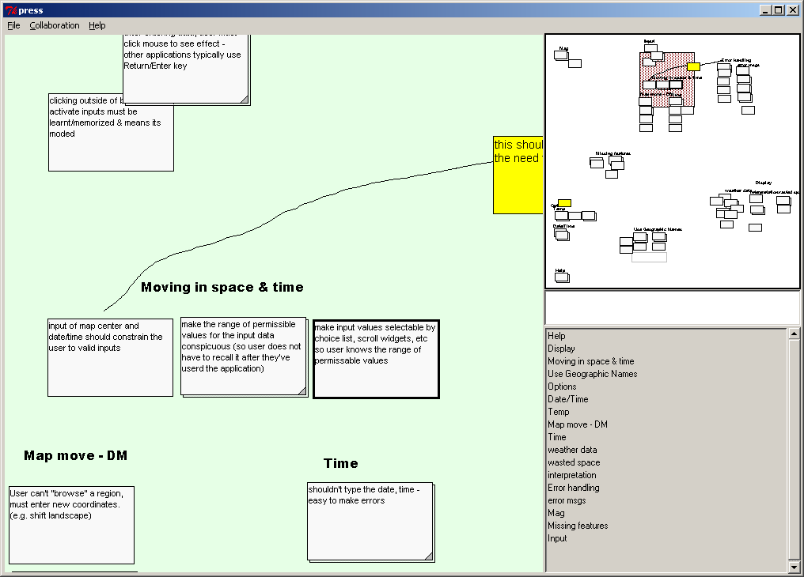
Interpretation

Slide 15
Reporting

Slide 16
Emergence
Ideas do not arise well formed. At first there are expressions of fragments of thoughts. Once there is some rough material to work with, interpretations gradually begin to emerge as they are discussed.
  -- Moran, Chiu, & van Melle, UIST ‘97

Slide 17
Supporting Emergence
Spatial and visual workspace
Use spatial proximity
Free creation & movement
Free-form annotation

Slide 18
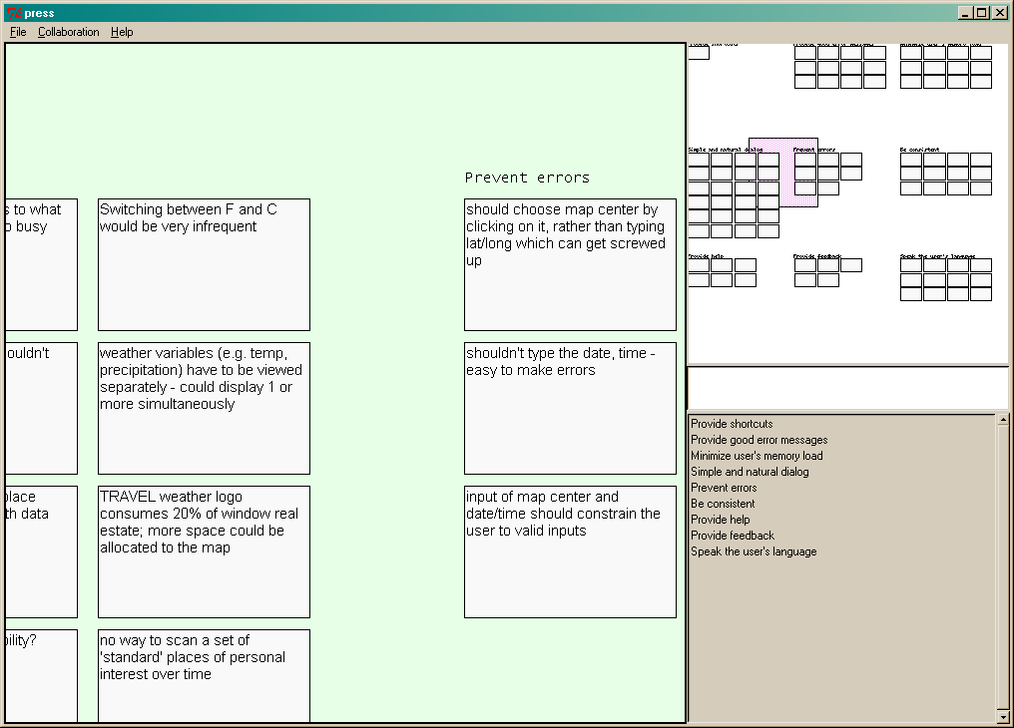
Spatial Visual Workspace
Overview
Main View
Info Area

Slide 19
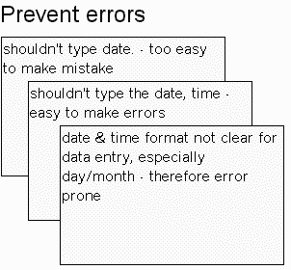
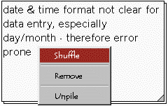
Spatial Proximity

Slide 20
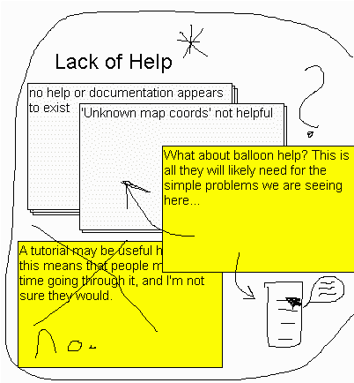
Free-form Annotation

Slide 21
Free Creation & Movement

Slide 22
Supporting Distributed CI
Collaborative Interpretation is a “classic” CSCW activity.

Slide 23
Design Principles
Emergence
  Spatial visual workspace
  Use spatial proximity
  Free-form annotation
  Free creation and movement
Distributed CI
  Provide a common visually similar space.
  Provide timely feedback and feed-through.
  Support gesture and diectic references.
  Support workspace awareness.

Slide 24
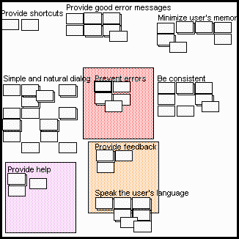
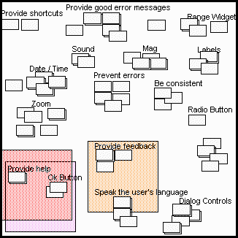
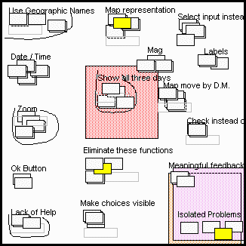
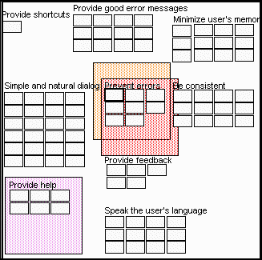
Summary

Slide 25
The End
The next sequence shows extra slides not shown at the presentation…

Slide 26
Are You Familiar with Collaborative Interpretation?
Have you ever written down bits of information on Post-It Notes or Index cards?
Then spread the cards out over a work surface?
Then worked with others to organize the cards so they made sense?
If so, you’ve probably engaged in collaborative interpretation

Slide 27
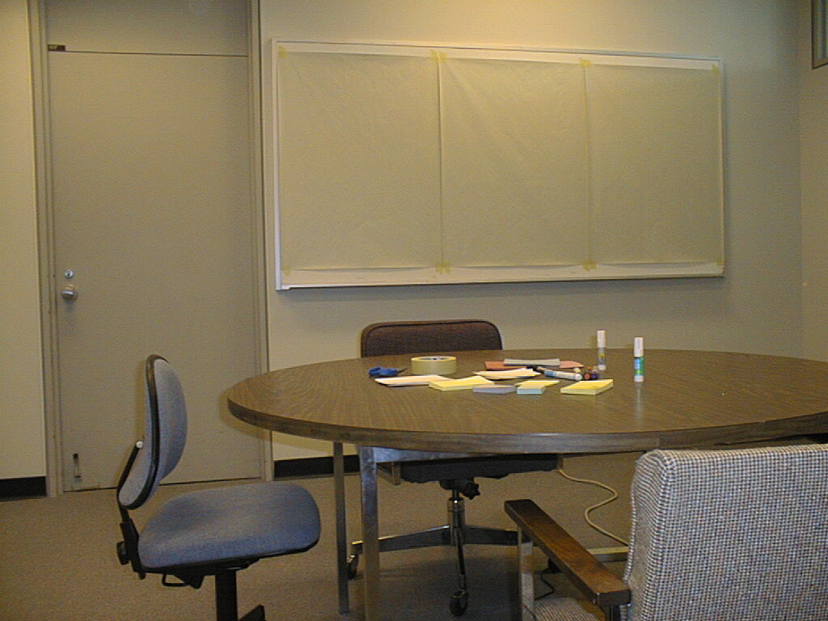

Slide 28
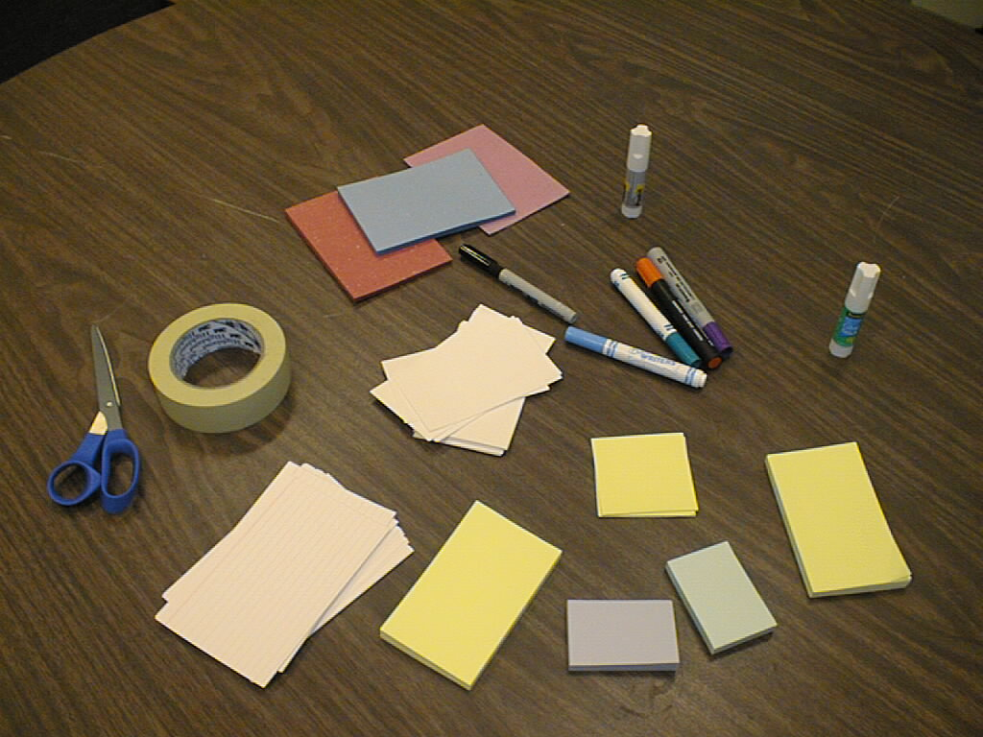

Slide 29
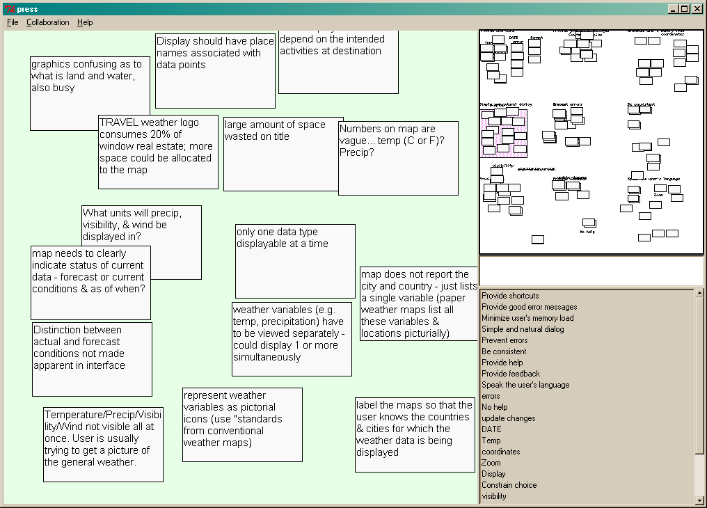
Initial Interpretation

Slide 30
Emergence (demo)
Spatial Visual workspace
  Theoretically unbounded
  Undifferentiated, conventional space
Free form annotation
  Free hand annotation
Free creation and movement
  Notes
  Text annotations
  TA list
  Drop to overview
  Navigation techniques

Slide 31
Collaboration
Sense-making requires multiple participants
Groups may be hetero- or homogeneous
Differences require effective and efficient communication
Collaborators often are not co-located

Slide 32
Interpretation
Starts with fragments – ill-conditioned data
Meaning created through process, one of many possible
Meaning of data changes through and through-out process - emergence

Slide 33
Scenario Walkthrough (demo)
Preparation
Familiarization & duplicate identification
Initial organization
Re-organization
Finalizing the interpretation

Slide 34
Related Work
Supporting Emergence
  Monty
  Marshall et al
  Moran et al
  …
Supporting Distributed Groupware
  Randy Smith (Overview)
  Carl Gutwin (Workspace awareness)
  …

Slide 35
Results Synthesis
Group = heuristic evaluators
Fragments = notes on observed issues
Descriptions = problem reports

Slide 36
Results Synthesis (demo)
Cards/Problem descriptions as the information fragments
Show only summary on card
Creation of new cards not permitted
Separate tool for capturing descriptions from which raw data is imported

Slide 37
Single User Evaluations
The goal was to find bugs in a simple environment.
Users performed interpretation task.
Users made progress in time allowed.
Defects were fixed, and enhancements made

Slide 38
Multi-user Evaluations
The goal was to see if the system deserved the name “groupware”.
Three 2-user and one 3-user session.
Users performed interpretation task.
We saw differences in behaviour from face-to-face.

Slide 39
Conclusions
CI is a widespread and important phenomenon
Distributed CI is as well
Principles we identified led to creation of a usable system

Slide 40
Closing Thoughts
Collaborative Interpretation is a widespread, important phenomenon.
We have design principles that can guide us in constructing systems supporting CI.
PReSS is usable for Results Synthesis.
There are many avenues for further research.

