Slide 1
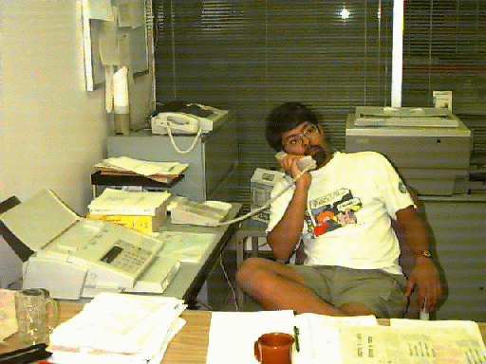

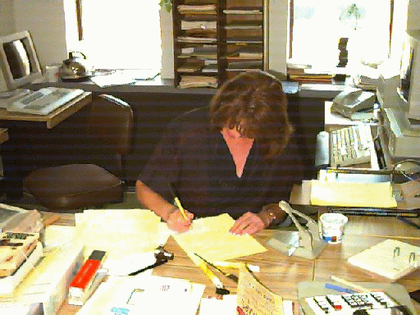
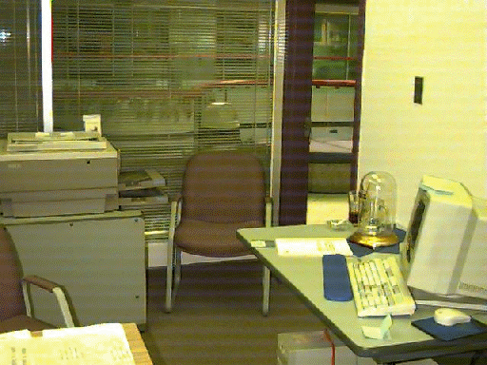
Mediating Awareness and Communication Through Digital but Physical Surrogates
Hideaki Kuzuoka
University of Tsukuba
Saul Greenberg
University of Calgary

Slide 2
The Message
Digital but physical surrogates can:
  support transition from awareness to casual interaction
  mitigate privacy and distraction concerns

Slide 3
Outline
Motivation and background
Digital but physical surrogates
Privacy and distraction

Slide 4

Research Focus
Social interaction in small teams
  intimate collaborators
  have a real need for close
  coordination and collaboration
Teams

Slide 5
A Persistent Problem
Real time distributed groupware can only work after people make contact with each other
?

Slide 6
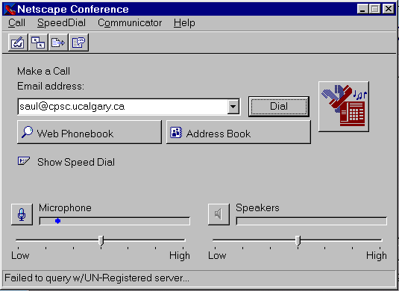
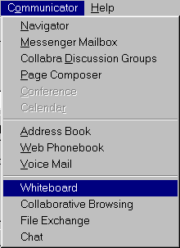
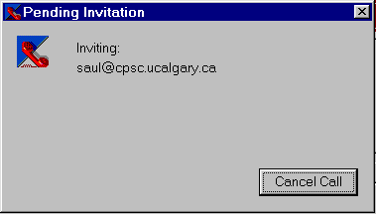
can I reach the person through software?
can I reach the person through software?
is the person there?
start a communication channel
start 1 or more groupware applications
load information...
can I reach the person through software?
is the person there?
Time

Slide 7
Casual Interaction
Success of real time distributed groupware requires
  awareness of each other
  ease of establishing casual communication

Slide 8
Awareness & Casual Interaction
  Who is around?
  Are they available now?
  Can they be interrupted?
  How can I initiate contact?
Bellcore

Slide 9
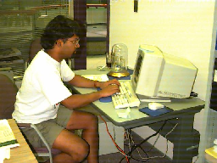
Media Spaces

Slide 10
Glances
Saul’s office
Glance at:
o Saul
o Judy
o Fred
o Marylin
Glance at:
o Saul
o Judy
o Fred
o Marylin

Slide 11
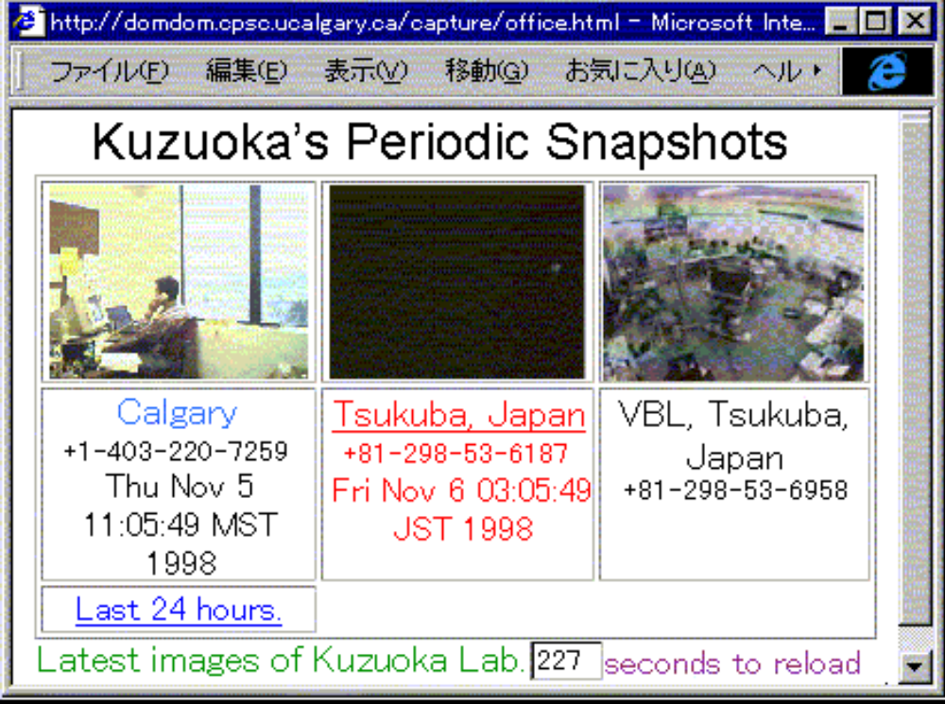
Periodic Snapshots

Slide 12
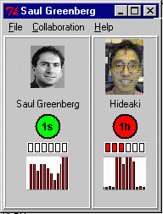
Iconic Indicators
idle time
motion

Slide 13
Design Issues
Provide appropriate awareness information
Support transition from awareness to conversation
Minimize distraction
Balance awareness with privacy

Slide 14




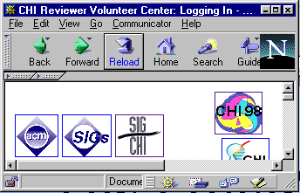
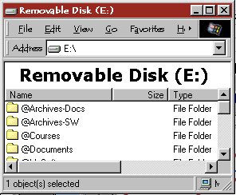
My computer is a busy place!

Slide 15


…and I don't always use it!

Slide 16
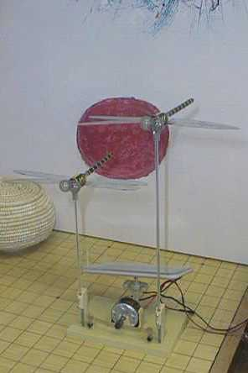
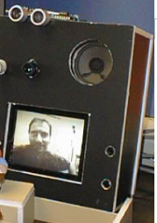
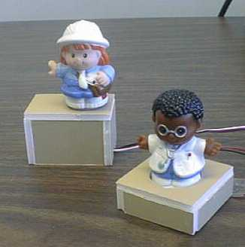
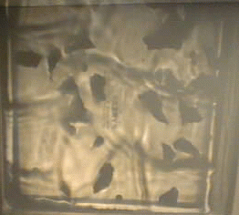
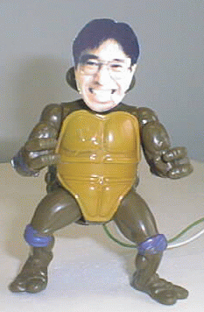
Digital but Physical Surrogates

Slide 17
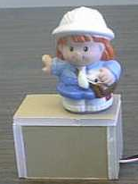
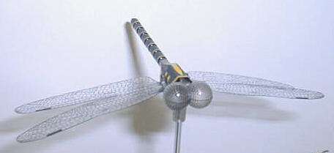
Presenting Awareness Information
Foreground vs
background
Active Models
Light patterns

Slide 18
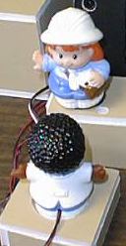
Indicating Interest in Others
Explicit acts
  call
  persistent
  interest
Holding
Orientation

Slide 19
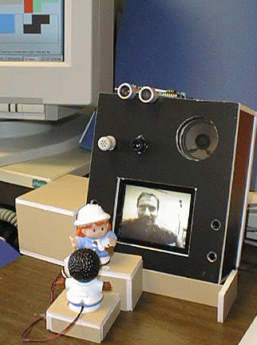
Controlling a Media Space
Active Hydra surrogate
  reactive environment
  dynamically adjust
  audio/video

Slide 20
Mitigating Distraction
  background (ambient) display
  spatial location

Slide 21
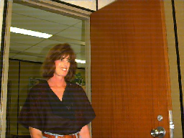
Mitigating Privacy
  information abstracted and restricted
human activity
surrogate activity
transformation

Slide 22
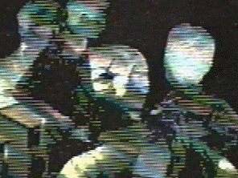

Mitigating Privacy
  information abstracted and restricted
  capture only selected information
    explicit acts (control)
    low fidelity instrumentation

Slide 23
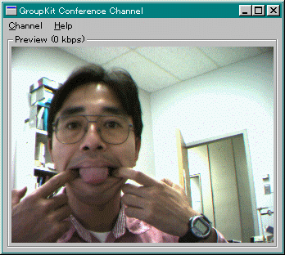
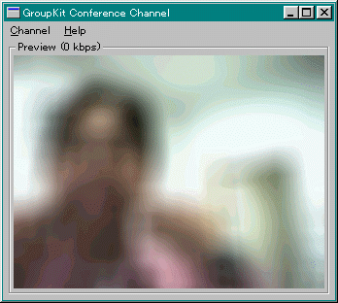
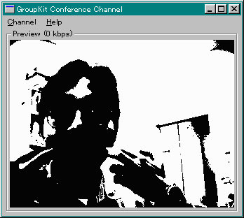
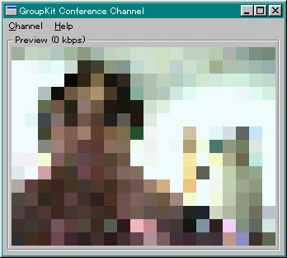
Mitigating Privacy Concerns
  information abstracted and restricted
  capture only selected information
  hide 'rich' information
    adjust 'QoS'
    natural use of space as
    control (proximity)

Slide 24


Next Steps
Different form factors
Uncle touch (Fujitsu)
Surrogates as art

Slide 25
Next Steps
Scalability
Teams

Slide 26
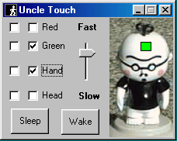
Next Steps
Architecture
  model-view-controller
  phidgets

Slide 27
Next Steps
Evaluation
  awareness
  interactions
  distraction
  privacy
  acceptance

Slide 28
Summary
Digital but physical surrogates:
  support transition from awareness to casual interaction
  mitigate privacy and distraction concerns

Slide 29
For more information
Full paper (in submission)
  www.cpsc.ucalgary.ca/grouplab/papers

Slide 30
UNUSED AFTER HERE
The following slides were to help answer questions, if needd

Slide 31


Social Interaction
The World
strangers
Organizations
associates
Teams
intimate collaborators

Slide 32
Studying Awareness
Information
Evaluation
Capture
Presentation

Slide 33
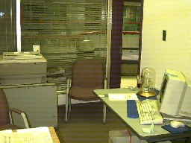
Information
Information
What information is important?
How is it obtained?
How is it used?
When is it used?
Theories of awareness?
Evaluation
Capture
Presentation

Slide 34
Information
Information
What information is important?
How is it obtained?
How is it used?
When is it used?
Theories of awareness?
Evaluation
Capture
Presentation

Slide 35
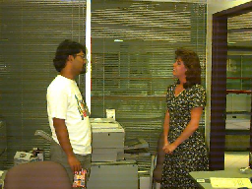
Information
Information
What information is important?
How is it obtained?
How is it used?
When is it used?
Theories of awareness?
Evaluation
Capture
Presentation

Slide 36
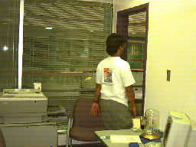
Information
Information
What information is important?
How is it obtained?
How is it used?
When is it used?
Theories of awareness?
Evaluation
Capture
Presentation

Slide 37
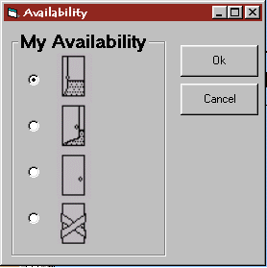
Capture
Information
Information:
gathering
abstraction and storage
transmission
system nuances
control
Evaluation
Capture
Presentation

Slide 38
Capture
Information
Information:
gathering
abstraction and storage
transmission
system nuances
control
Evaluation
Capture
Presentation

Slide 39
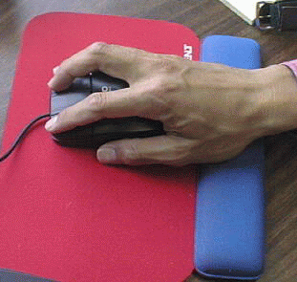
Capture
Information
Information:
gathering
abstraction and storage
transmission
system nuances
control
Evaluation
Capture
Presentation

Slide 40
Capture
Information
Information:
gathering
abstraction and storage
transmission
system nuances
control
Evaluation
Capture
Presentation

Slide 41
Presentation
Information
can we display it?
can it be interpreted?
is it used?
awareness vs distraction?
awareness vs privacy?
Evaluation
Capture
Presentation
Bellcore, Xerox Parc, U Toronto...

Slide 42
Presentation
Information
can we display it?
can it be interpreted?
is it used?
awareness vs distraction?
awareness vs privacy?
Evaluation
Capture
Presentation
EuroParc, Nynex, Kuzuoka

Slide 43
Presentation
Information
can we display it?
can it be interpreted?
is it used?
awareness vs distraction?
awareness vs privacy?
Evaluation
Capture
Presentation
idle time
U Calgary, Xerox Parc...
motion

Slide 44
Mitigating privacy concerns
  information abstracted and restricted
  capture only selected information
  hide 'rich' information
  reciprocity

Slide 45
Summary
Problem:
  real time distributed groupware cannot work if people cannot contact with each other
?

Slide 46
Summary
Success of real time distributed groupware tied to contact facilitation
  awareness of each other
  ease of establishing casual communication
?

Slide 47
Summary
Need to understand
  information people require to judge availability
  how it can be captured and presented
  trade-offs: availability, privacy and distraction
  evaluation

