Slide 1
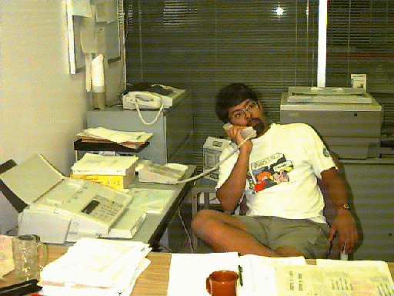

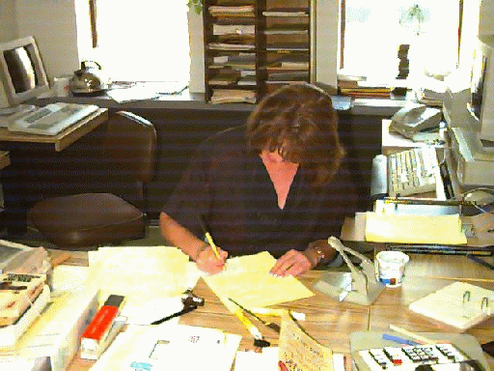
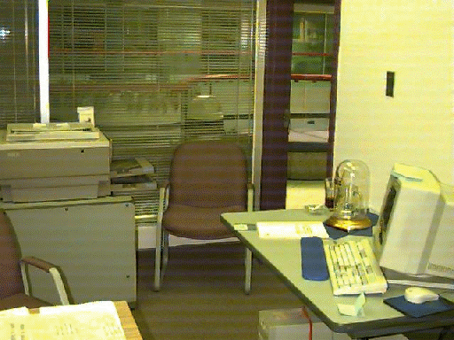
Note: Videos shown during the presentation are not included in this slide deck
The Ebb and Flow of
Collaboration in Groupware
Saul Greenberg
University of Calgary
Canada

Slide 2
Research Focus
Intimate collaborators
  real need for close coordination and collaboration

Slide 3

Research Focus
Intimate collaborators
  real need for close coordination and collaboration
Groupware for
  geographically separated
  real time

Slide 4
Groupware must support the natural ebb and flow of social interaction before it can become a natural setting for learning, work, and play.

Slide 5
Tight ⇔ Loose Coupling
People move between tightly and loosely coupled activities
  group and individual aspects to work
With Carl Gutwin, U Saskatechwan

Slide 6
Tight ⇔ Loose Coupling
Who?
What?
Where?
When?
How?
Peripheral vision
Glances
Seeing the big picture
Verbal shadowing
Workspace Awareness
  up-to-the-moment knowledge about others’ interaction with a shared workspace

Slide 7
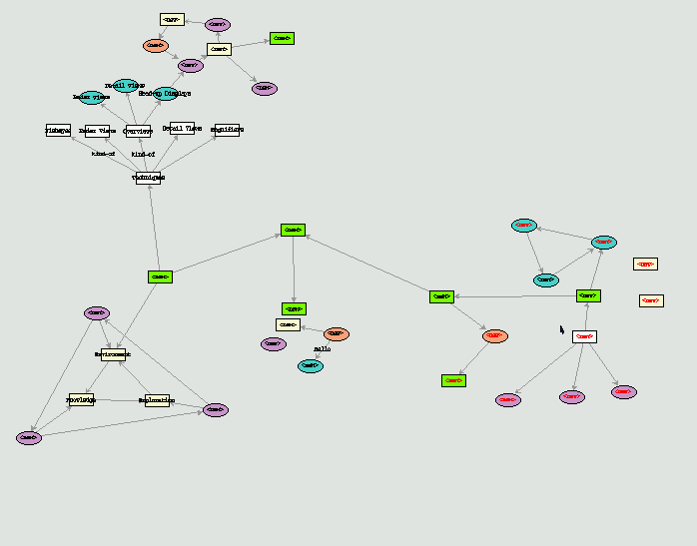
Tight ⇔ Loose Coupling
Saul
Carl

Slide 8
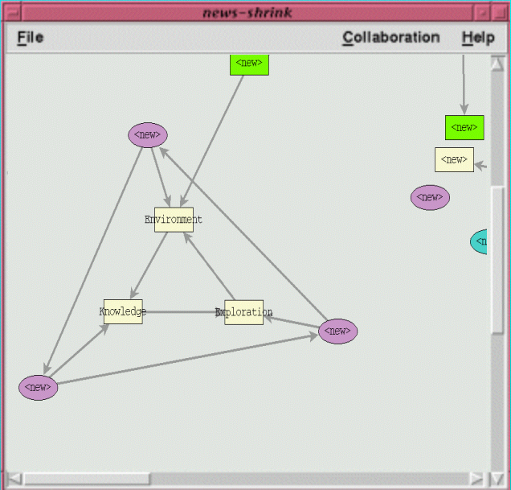
Tight ⇔ Loose Coupling

Slide 9
Tight ⇔ Loose Coupling
Saul
Carl

Slide 10
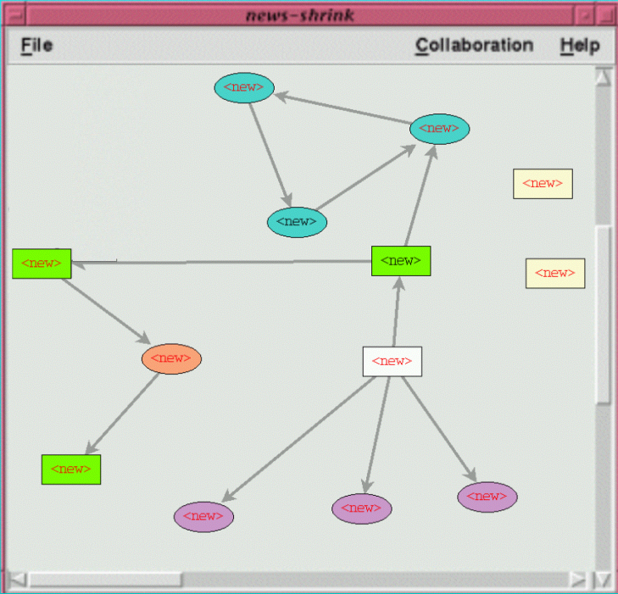
Tight ⇔ Loose Coupling
Awareness lost
  no visible frame of reference  gestures invisible
  verbal shadowing out of context  no big picture

Slide 11
Video
workspace awareness
the problem in groupware

Slide 12
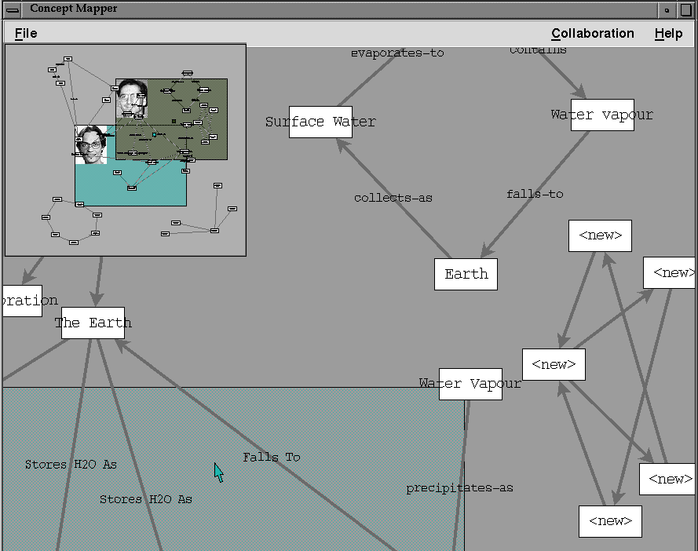
Radar Overviews
Provides
identity
location
actions
gestures

Slide 13
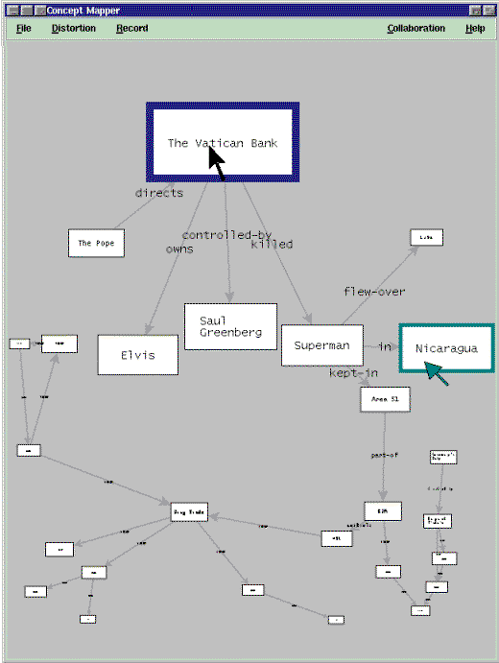
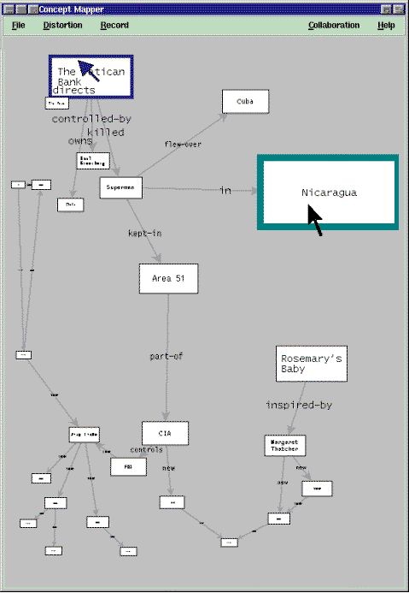
Fisheye Views

Slide 14
Video
Radar overview

Slide 15
Tight ⇔ Loose Coupling
Theory
  framework of workspace awareness
Application
  visualization systems created to provide workspace awareness
Evaluation
  critical awareness information is present
  supported ebb and flow between tight and loose coupling
but
  each visualization technique has particular problems

Slide 16
Seams in Groupware
single user ⇔ multi-user

Slide 17
Seams in Groupware
single user ⇔ multi-user
asynchronous ⇔ synchronous

Slide 18
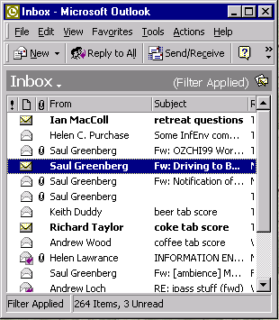
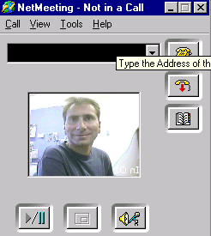
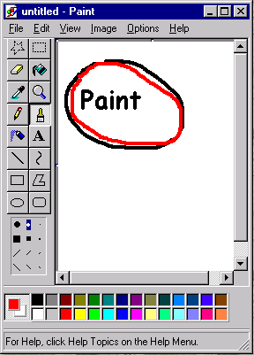
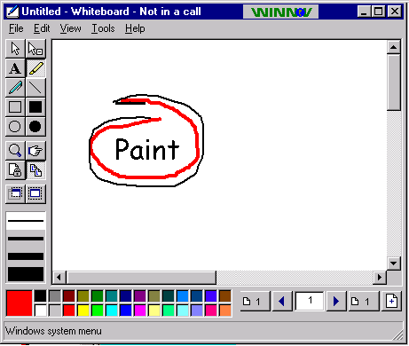
Seams in Groupware

Slide 19
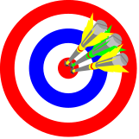


Collaborative Environments
Physical team rooms
  naturally supports seamless interactions
  a place for
    individual and group work
    face to face meetings
    leaving reminders, work artifacts
    casual meetings and activities
Research ideas
rooms metaphor
meeting room tool?
multiple input devices
With Mark Roseman, Teamwave Ltd

Slide 20
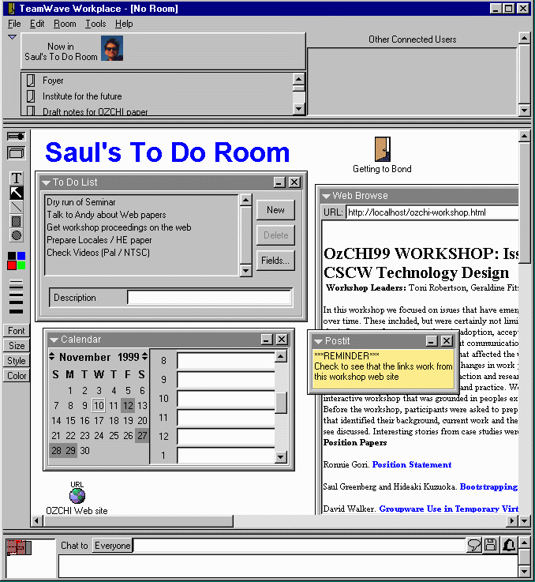
Teamwave
Workplace
A room for
individual
work

Slide 21
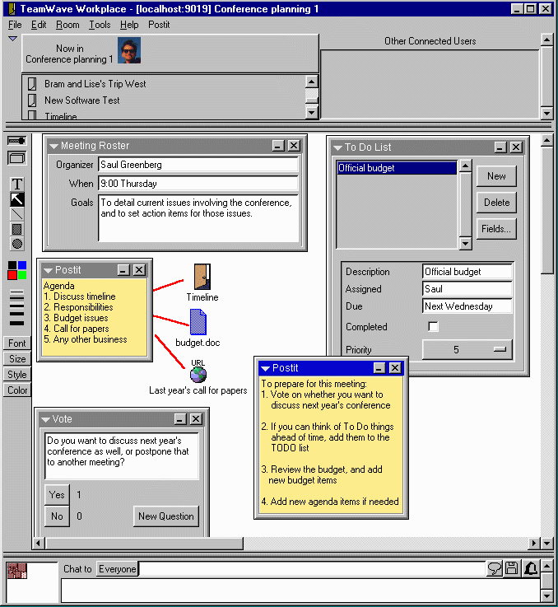
Teamwave
Workplace
Asynchronous
meeting preparation

Slide 22
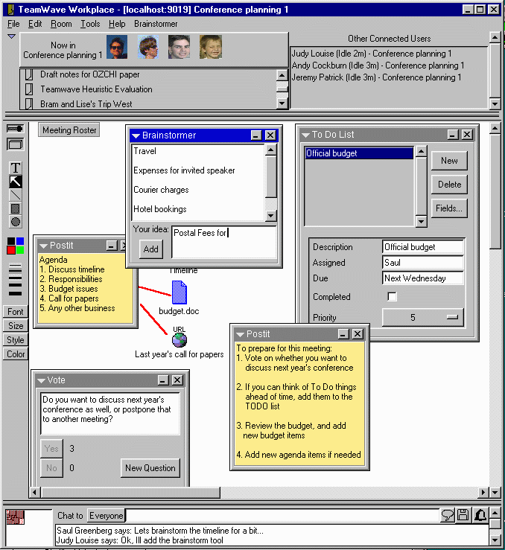
Teamwave
Workplace
Synchronous
meeting

Slide 23
Collaborative Environments
TeamRooms (now Teamwave Workplace)
  No distinction between single and multi-user work
    strictly a social phenomenon
  Asynchronous
    items can be left in a room for others
      work artifacts
      coordination and management artifacts
  Synchronous
    team members in the same room are
    automatically working together

Slide 24
Awareness ⇔ Making contact
Casual interaction
  rapid, opportunistic & lightweight meetings

Slide 25
Awareness ⇔ Making contact
Awareness
  The glue behind
  casual interaction
Awareness questions
  who is around?
  are they available now?
  can they be interrupted?
  how can I initiate contact?
Bellcore

Slide 26
Video
Hallways

Slide 27
A Persistent Problem
Real time distributed groupware can only work after people make contact with each other
?
especially across times zones and non-trivial distance separation…

Slide 28
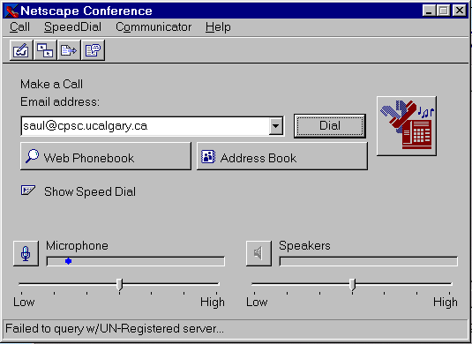
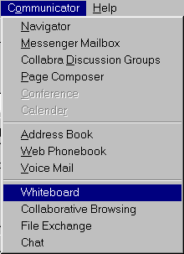
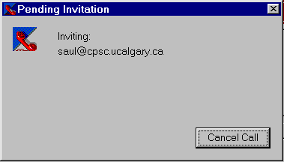
can I reach the person through software?
can I reach the person through software?
is the person there?
start a communication channel
start 1 or more groupware applications
load information...
can I reach the person through software?
is the person there?
Time

Slide 29
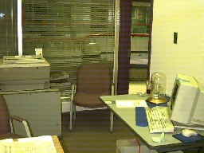
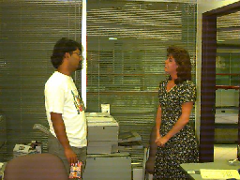
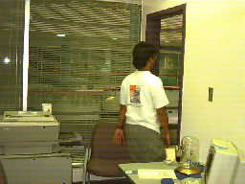
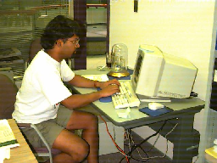
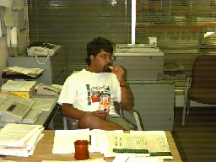
How do People Judge Availability?
  Inter-personal relationships, needs, context
  Awareness of state of the other person
availability
Idle
Absent
At work
Transitions
Conversation

Slide 30
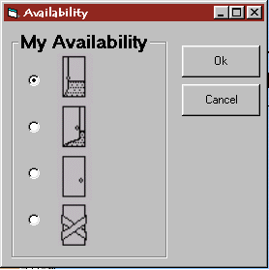
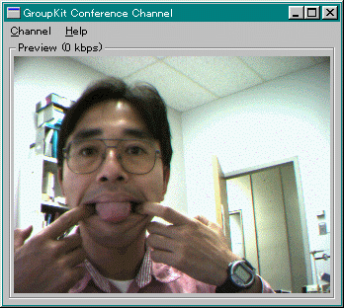
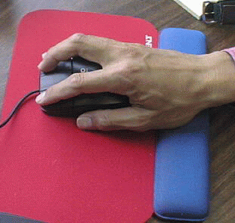

How Can We Capture Availability?
Explicit acts
Always-on video
Computer activity
Instrumented
office

Slide 31
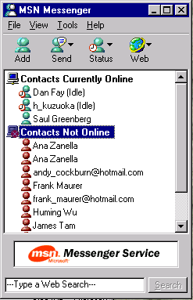
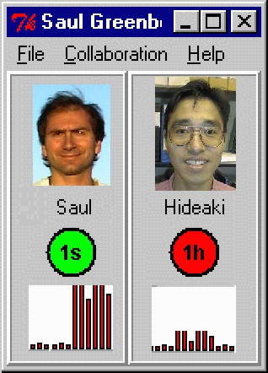
How Can We Display Availability?

Slide 32
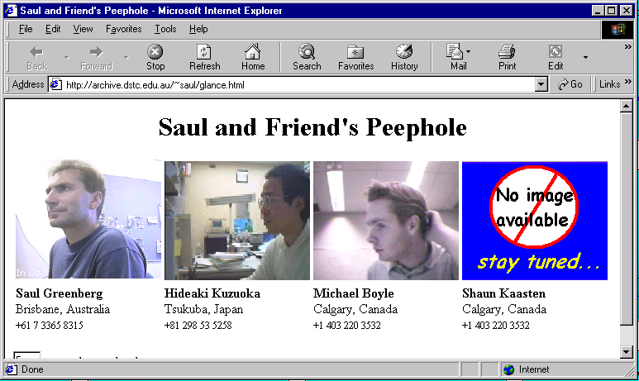
How Can We Display Availability?
With Hideaki Kuzuoka, U. Tsukuba & Michael Boyle, U. Calgary

Slide 33




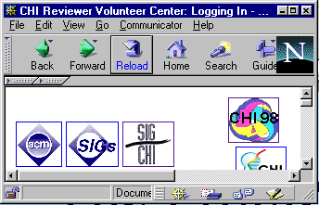
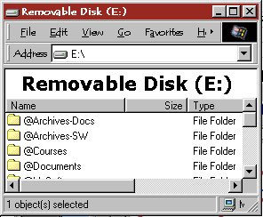
My computer is a busy place!

Slide 34


…and I don't always use it!

Slide 35
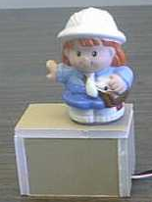
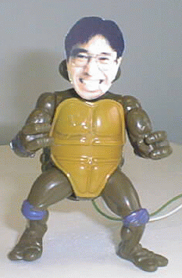
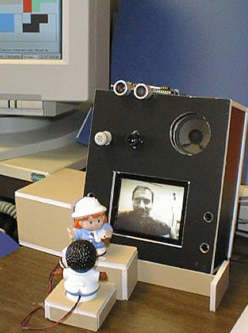
Digital but Physical Surrogates
Presenting
awareness
Indicating interest
in others
As a reactive
media space

Slide 36
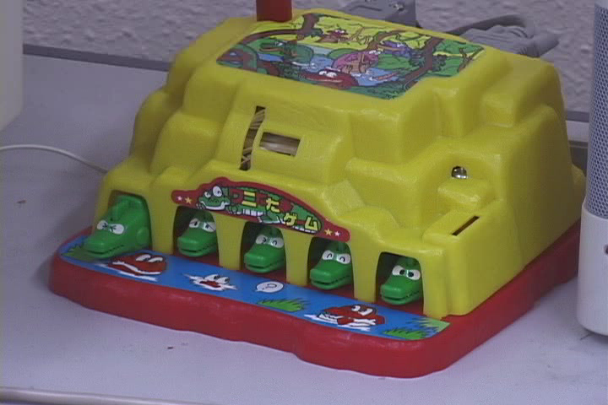
Multiple collaborators
With Hideaki Kuzuoka, Tsukuba

Slide 37
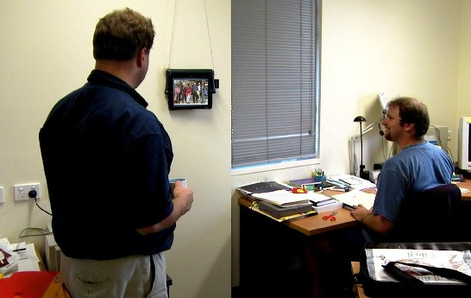
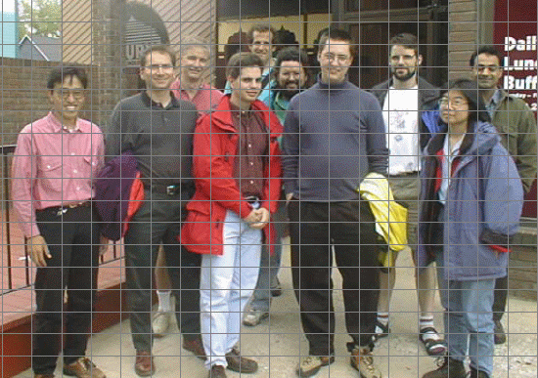
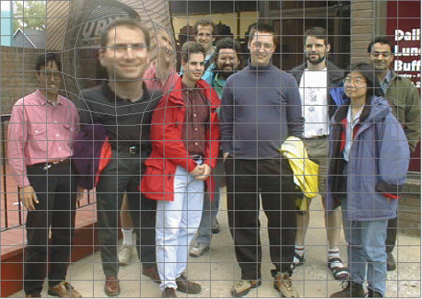
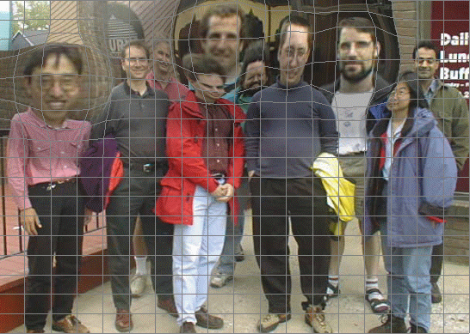
Multiple Collaborators
With Sheelagh Carpendale, U. Calgary

Slide 38
Casual Interaction
Requires
  knowledge of what comprises awareness information
  ways of capturing information electronically
  effective presentation of this information while safeguarding privacy and distraction
  ability to act on the information
?

Slide 39
Summary
Groupware must support the natural ebb and flow of social interaction before it can become a natural setting for learning, work, and play.

Slide 40
Summary
tightly coupled ⇔ loosely coupled
Workspace Awareness

Slide 41
Summary
tightly coupled ⇔ loosely coupled
single user ⇔ multi-user
asynchronous ⇔ synchronous
Collaborative Environments

Slide 42
Summary
tightly coupled ⇔ loosely coupled
single user ⇔ multi-user
asynchronous ⇔ synchronous
awareness of others ⇔ making contact
Casual Interaction

Slide 43
Further Information
Grouplab:
  www.cpsc.ucalgary.ca/grouplab
Publications
  www.cpsc.ucalgary.ca/grouplab/papers
Teamwave
  www.teamwave.com

Slide 44
Ebb and Flow
tightly coupled ⇔ loosely coupled

Slide 45
Ebb and Flow
tightly coupled ⇔ loosely coupled
Workspace Awareness

Slide 46
Ebb and Flow
tightly coupled ⇔ loosely coupled
single user ⇔ multi-user
asynchronous ⇔ synchronous

Slide 47
Ebb and Flow
tightly coupled ⇔ loosely coupled
single user ⇔ multi-user
asynchronous ⇔ synchronous
Collaborative Environments

Slide 48
Ebb and Flow
tightly coupled ⇔ loosely coupled
single user ⇔ multi-user
asynchronous ⇔ synchronous
awareness of others ⇔ making contact

Slide 49
Ebb and Flow
tightly coupled ⇔ loosely coupled
single user ⇔ multi-user
asynchronous ⇔ synchronous
awareness of others ⇔ making contact
Casual Interaction

Slide 50
Capture Issues
Technological intrusions
  video cameras, sensors
Inaccuracies
  activity < > availability
Privacy concerns
  misuse of collected information

Slide 51
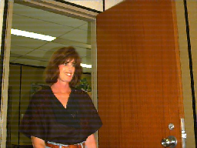
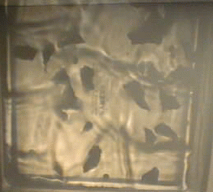
Mitigating Privacy
  information abstracted and restricted
human activity
surrogate activity
transformation

Slide 52
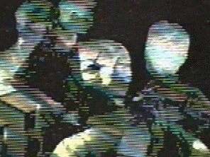
Mitigating Privacy
  information abstracted and restricted
  capture only selected information
    low fidelity instrumentation

Slide 53
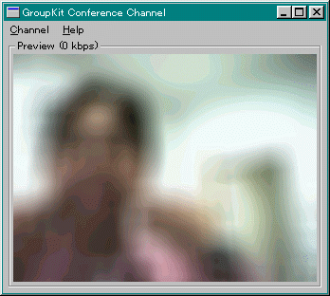
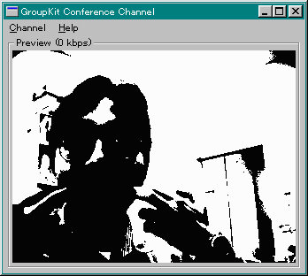
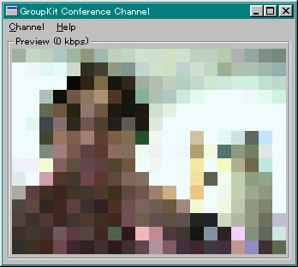
Mitigating Privacy Concerns
  information abstracted and restricted
  capture only selected information
  hide 'rich' information
    adjust 'QoS'
    natural use of space as
    control (proximity)

Slide 54
Mitigating privacy concerns
  information abstracted and restricted
  capture only selected information
  hide 'rich' information
  reciprocity

Slide 55
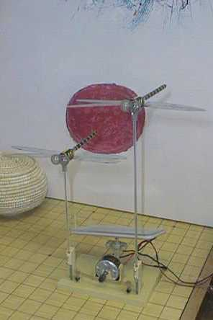
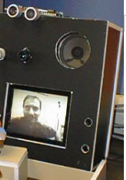
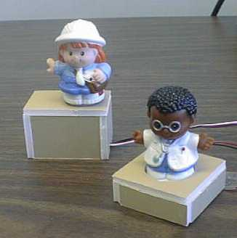
Digital but Physical
Surrogates
With Hideaki Kuzuoka, Tsukuba

