Slide 1
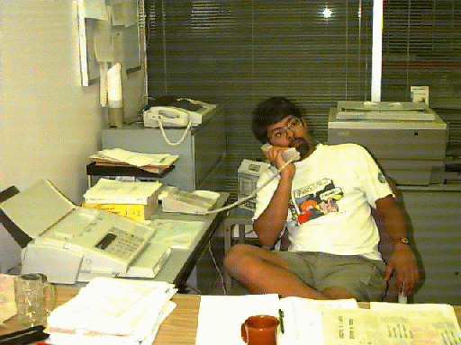


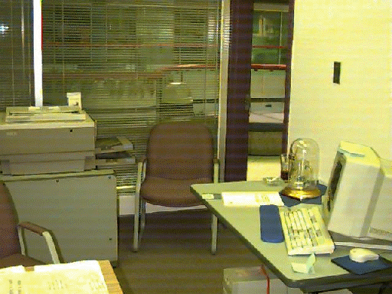
Judging People's Availability from Video Snapshots
Brad Johnson
Saul Greenberg

Slide 2
The Message & Question
Success of real time distributed groupware tied to contact facilitation
  awareness of each other
  ease of establishing casual communication
Research Question:
  what information do people use to judge availability of others?

Slide 3
The Problem
Real time distributed groupware can only work after people make contact with each other
?

Slide 4
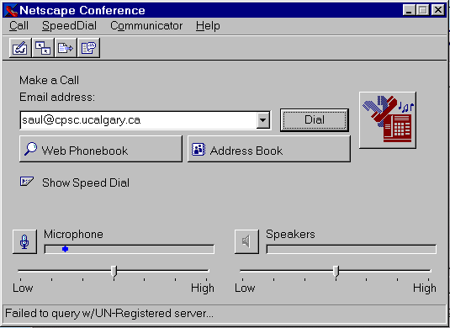
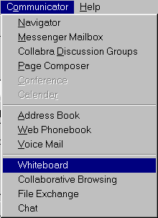
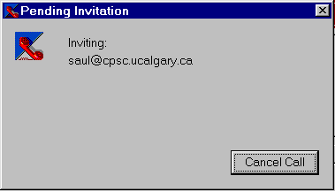
how do I get in touch with them?
is the person there?
start a communication channel
start 1 or more groupware applications
load information...
Time

Slide 5
Casual Awareness & Interaction
Awareness questions
  who is around?
  are they available now?
  can they be interrupted?
  how can I initiate contact?

Slide 6
Media Spaces, Glances
Saul’s office
Brad’s office

Slide 7
Video Walls

Slide 8
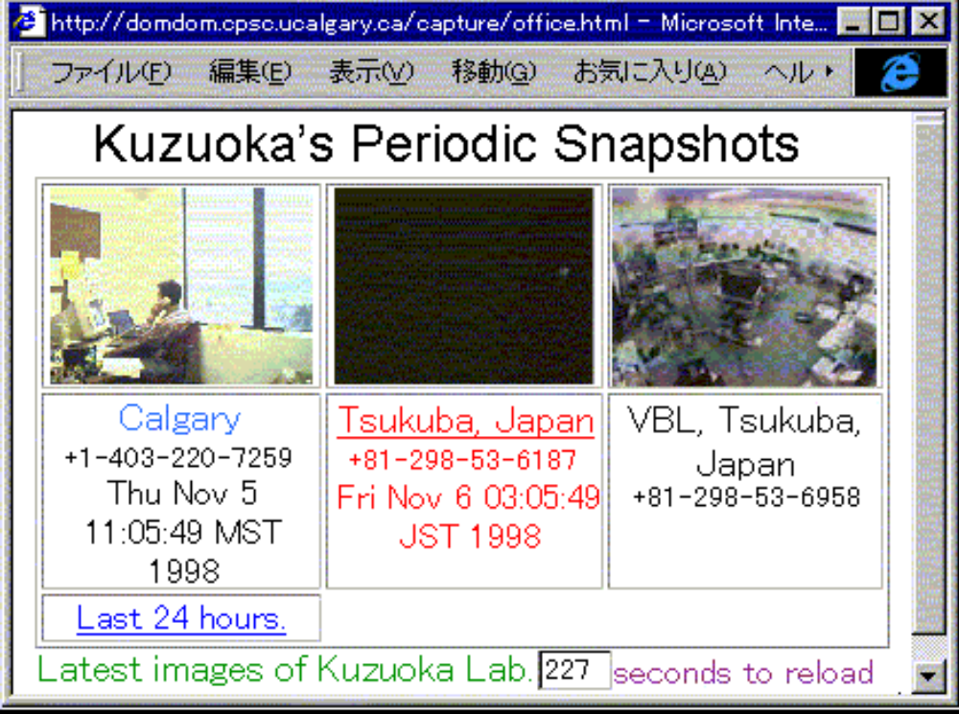
Periodic Snapshots

Slide 9
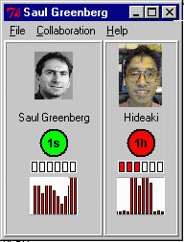
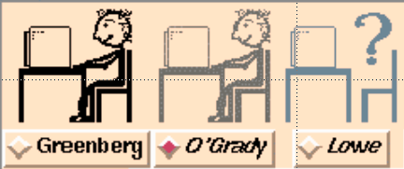
Iconic Indicators
idle time
motion

Slide 10
Active Badges
Active badges

Slide 11
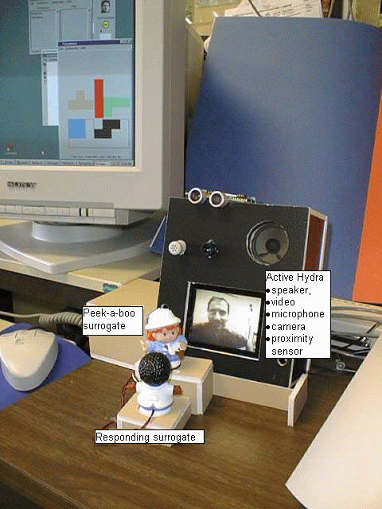
Digital but Physical Surrogates

Slide 12
Studying awareness
Information
what information is important?
how is it obtained?
how is it used?
when is it used?
theories of awareness?
Does it work?
Translation to groupware setting
Presentation in groupware

Slide 13
Information in Video Snapshots
Study
  Given different video snapshots, subjects had to
    decide availability
    rank order snapshots by availability

Slide 14
Information in Video Snapshots
Materials:
  images of four actors
  ten different “availability” poses
  six different image sizes/resolutions

Slide 15
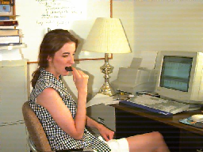

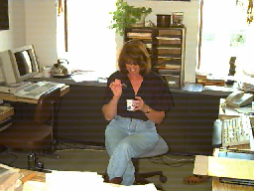
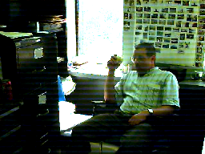
The Four Actors

Slide 16
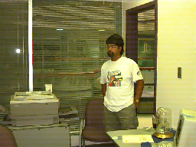
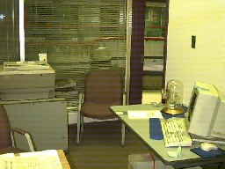
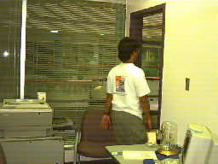
The Availability Poses
Empty Room
Transitions

Slide 17

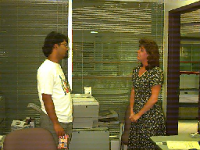
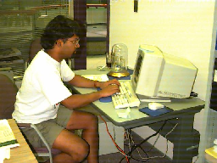
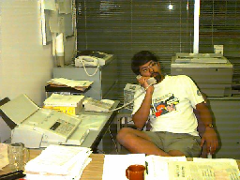
The Availability Poses
Working at Desk
In Conversation

Slide 18

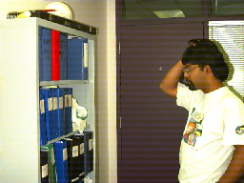
The Availability Poses
apparently 'idle'

Slide 19


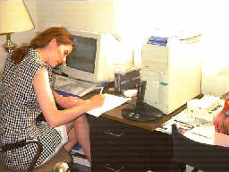

Image size / resolution
16
32
64
128
256
512

Slide 20


Slide 21
Method
  You are an administrative assistant
  You must periodically speak with your employers
  You have a video system that allows you to see snapshots of your employers office
  Based on your evaluation of these snapshots, you will either interrupt them and ask your questions or wait for a later opportunity

Slide 22
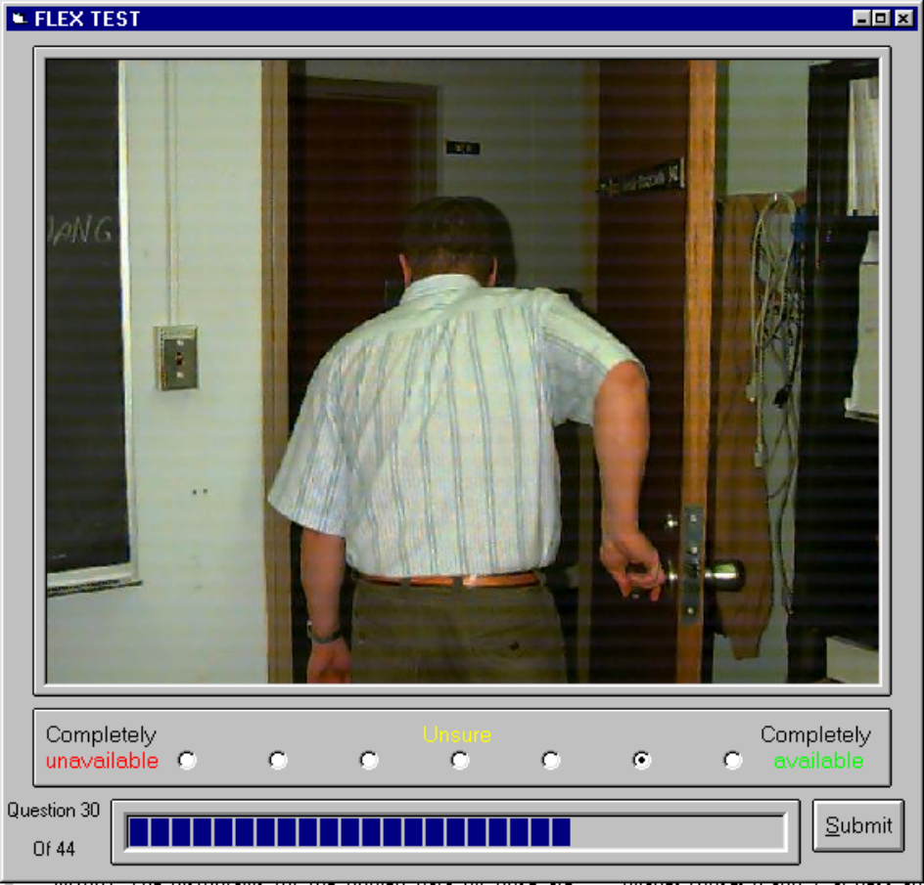
Method
Rank availability (choice)
Rank availability (forced sort)

Slide 23
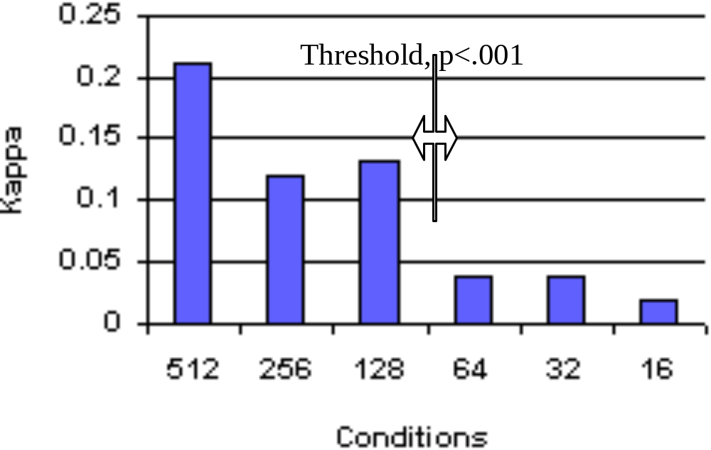
Results 1: Image size
  People found it difficult to determine availability below 128x128 pixels
64
128

Slide 24
Results 2: Poses
Measure:
  each pose had a position in each subject's sorted pile
Qualitative analysis:
  plot data for each pose's position as frequency histogram
  examine trends

Slide 25

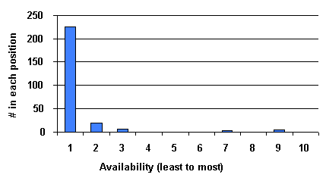
Least available: Empty Room

Slide 26
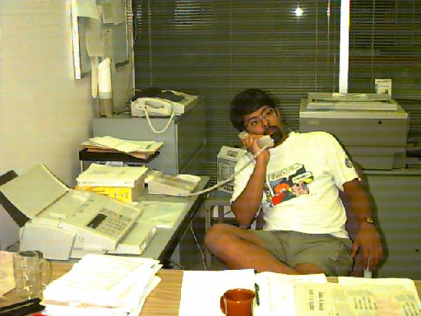
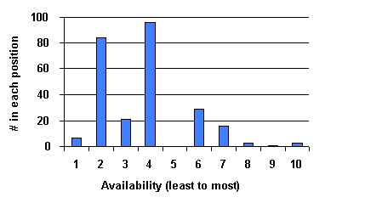

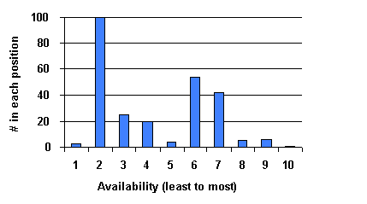
Low availability: Conversations

Slide 27
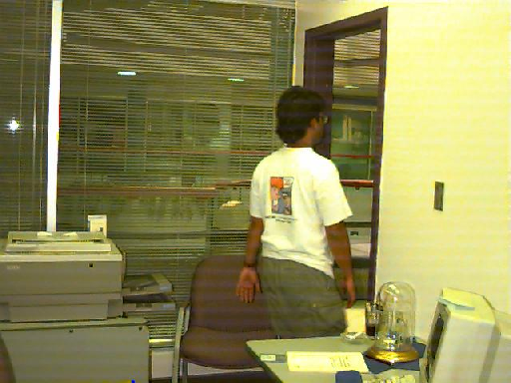
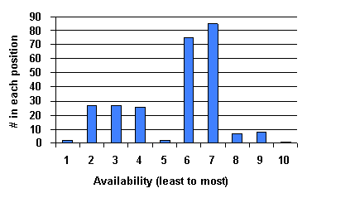
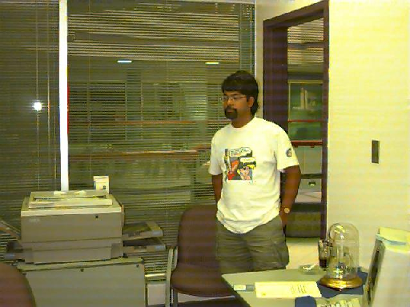
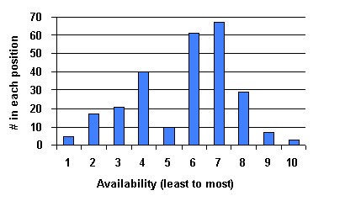
Modest Availability: Transitions

Slide 28

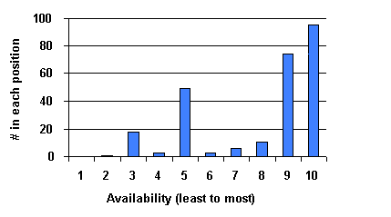
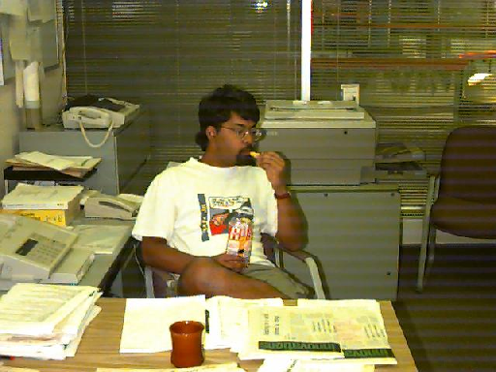
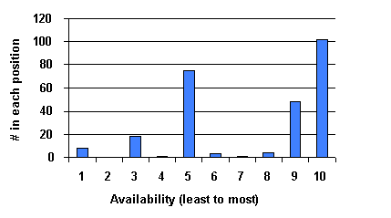
High Availability: 'Idle'

Slide 29

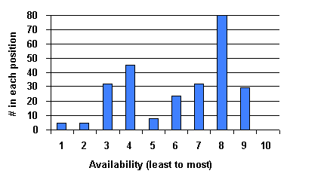
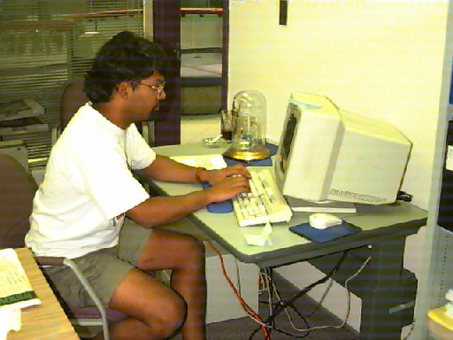
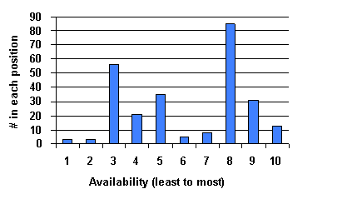
Split decision: Working

Slide 30
General Conclusion
People do interpret stereotypic situations as indicating varying degrees of availability.
Computers can
  detect and show these situations, or
  infer availability from these situations
But it is somewhat dangerous!

Slide 31
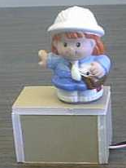
Specific applications
Video snapshots
  minimum size: low resolution mitigates privacy
  can be triggered by 'events' as well as time
Instrumented offices
  capture particular activities via sensors
  display abstracted notion of availability

Slide 32
Summary
Groupware success tied to contact facilitation
  awareness of each other
  ease of establishing casual communication
Research Question:
  what information do people use to judge availability of others?
Idle
Empty office
At work
Transitions
Conversation

