Slide 1

Integrating Back, Bookmarks and History
Alternative History Mechanisms for Web Browsers
History Workshop Dec 3, 1999
Shaun Kaasten
Saul Greenberg
University of Calgary
Canada

Slide 2
Outline
Current History Mechanisms
  Back, Bookmarks, History List
Integrating these mechanisms
Demo: Current Prototype
Future Work / Summary

Slide 3
Motivation
People revisit web pages with surprising frequency!
  60% navigations are revisits

Slide 4
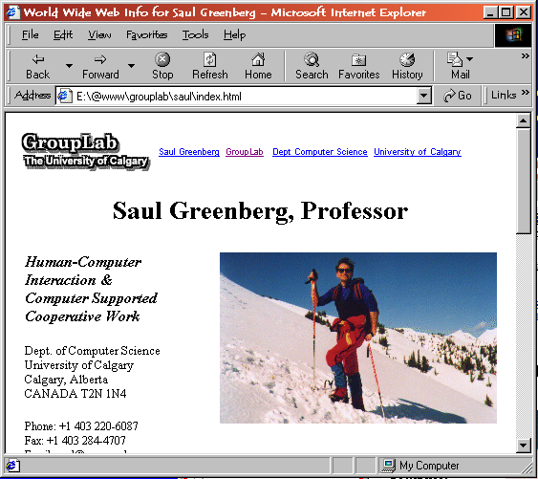
How is Revisitation Supported?
Back button

Slide 5
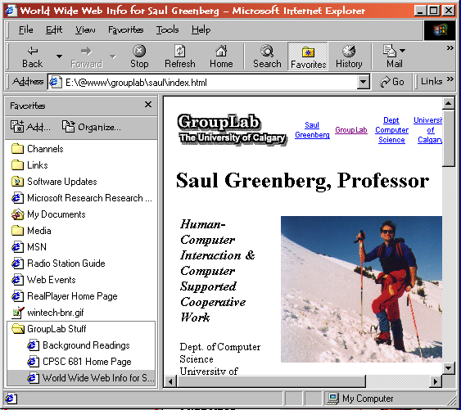
How is Revisitation Supported?
Back button
Bookmarks /
Favorites

Slide 6
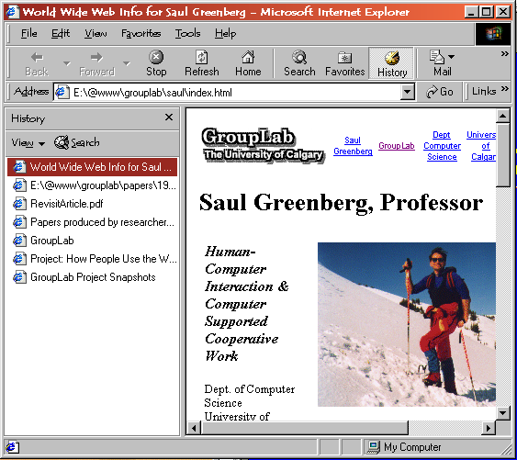
How is Revisitation Supported?
Back button
Bookmarks /
Favorites
History lists

Slide 7
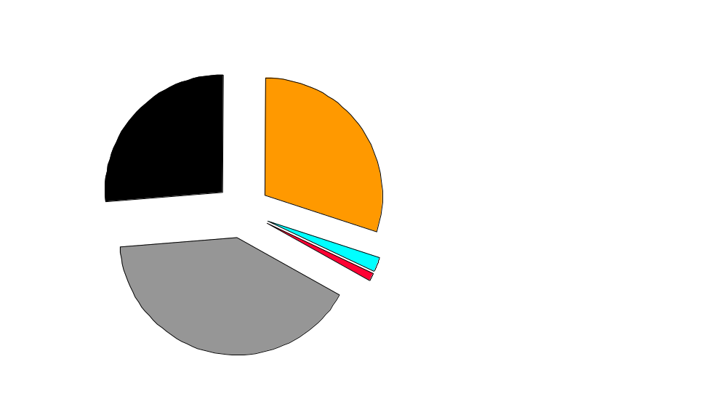
How Users Revisit
Tauscher, Greenberg

Slide 8

The Back Button
Requires little physical / cognitive effort
Works on current session only
Stack model –items disappear!
    Tauscher & Greenberg
    Catledge & Pitkow

Slide 9
Bookmark Difficulties
User must know to bookmark a page
Require constant maintenance

Slide 10
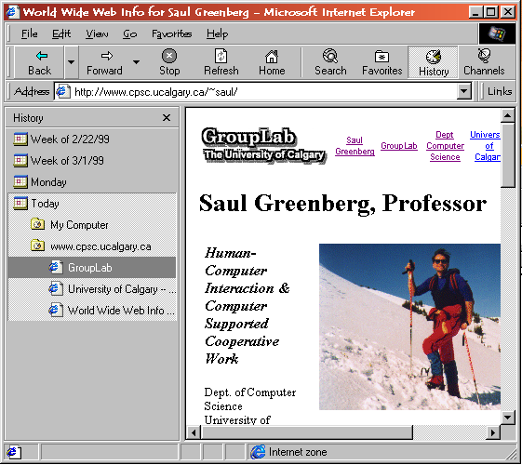
History Difficulties
Awkward organization

Slide 11
Integration – a Single System
Goal: Get me back to that web page!
Approach: Use best aspects of each

Slide 12
What pages do I need?
40%
new
Recent items!
60%
60%
revisits
But…
I still need those old pages
50
43%
10
39%
6
29%
2

Slide 13
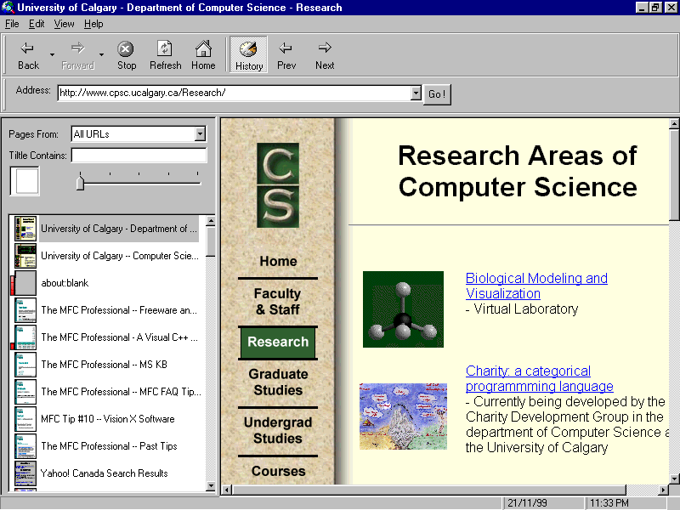
Recency Ordered History List
Most recent pages at top
Pages migrate to bottom of list

Slide 14
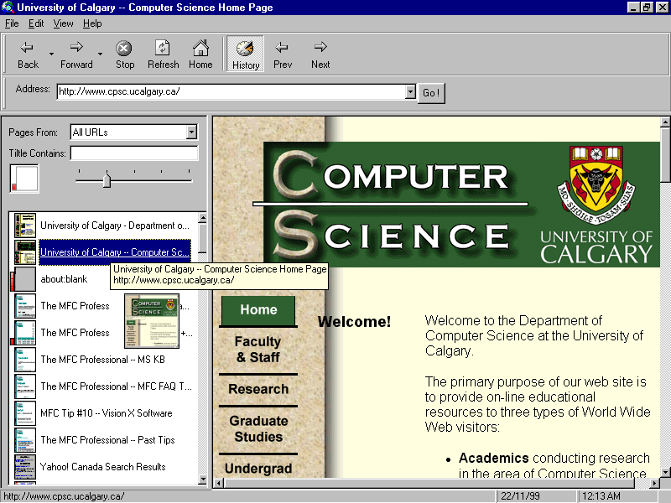
Titles are Confusing
Thumbnail images-
often recognizable

Slide 15
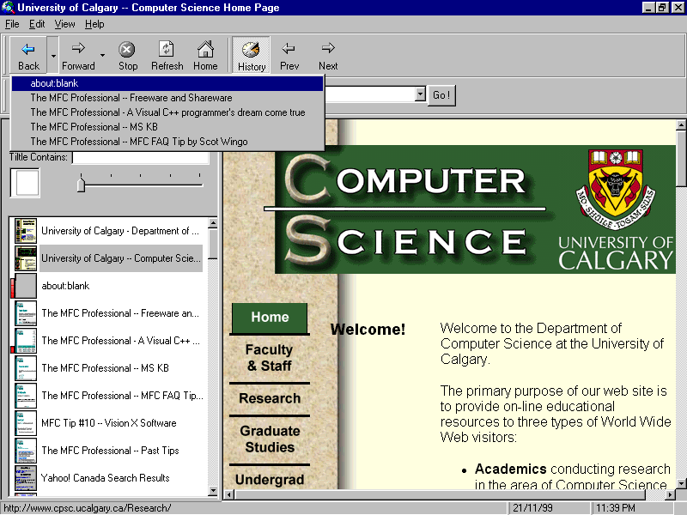
Back Button Integration
Points up and down through list

Slide 16
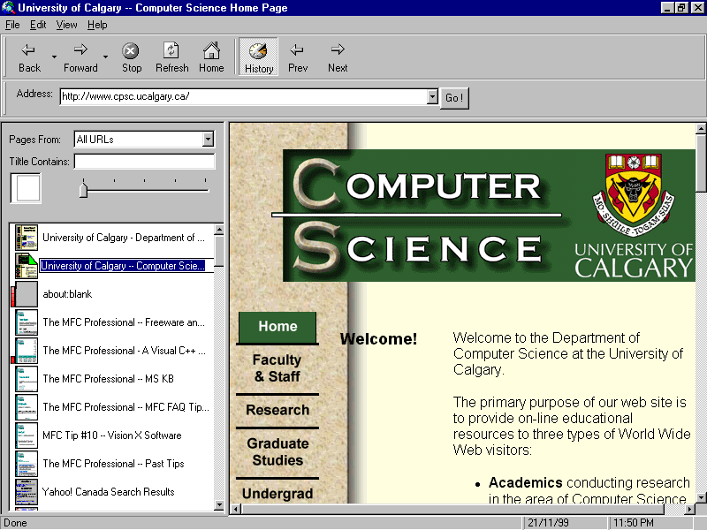
Bookmarks (Dogears)
Bookmarks ordered by recency
Old bookmarks migrate to bottom

Slide 17
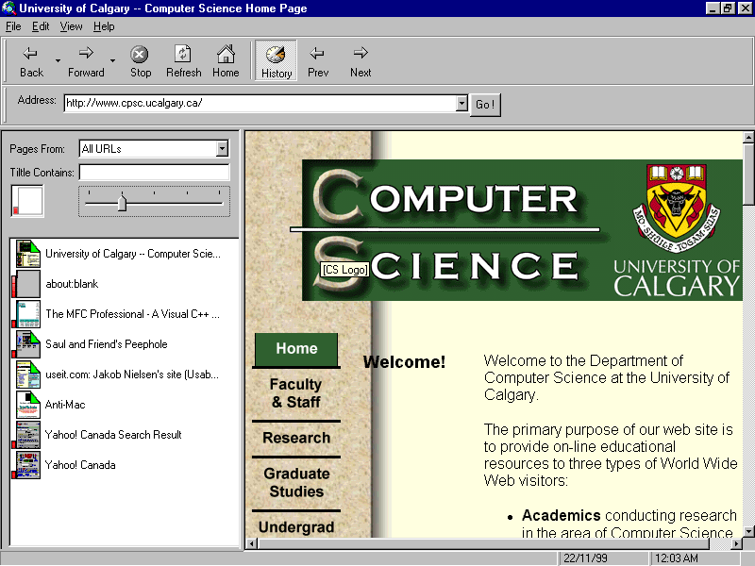
Implicit Bookmarks
Frequently accessed pages
Remain sorted by recency

Slide 18
Future Work
Organization Schemes – folders
User Study – No clear answers yet

Slide 19
Summary
Uniform model for revisitation
Back not limited to current session
Bookmarks react to usage
History information put to use

