Slide 1

Bootstrapping Intimate Collaborators
How did I and my intimate collaborators bootstrap our groupware and social interactions to enable remote interactions?

Slide 2
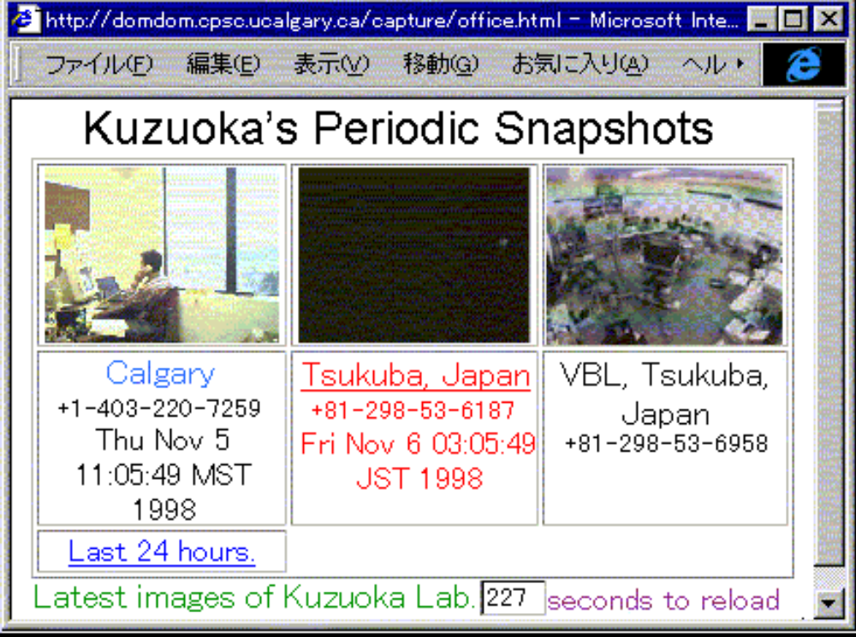
Periodic Snapshots v0.1
  Takes snapshots of people
  every 10 seconds
    but used specialized
    hardware & software
  Usage
    others could see Kuzuoka
    on web
    not passed on to others
by Hideaki Kuzuoka

Slide 3
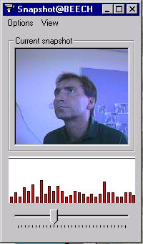
Snapshot Tool
  Snapshot Tool
    standard Windows
    any cameras
    posted image + activity value to web site
  Usage
    passed around by email / web
    installation complexity an issue
    gradually deployed…
The Web
by Boyle & Greenberg

Slide 4
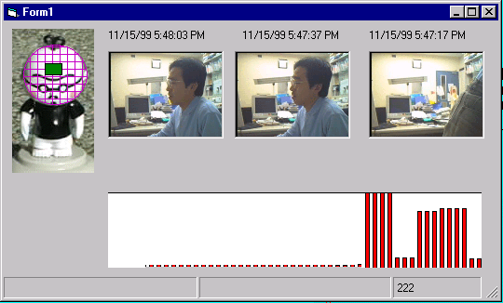
Periodic Snapshots v0.2
  Specialized snapshot display software
  Usage
    used heavily by one person
    did not spread
      hard to configure
      not reliable
The Web

Slide 5
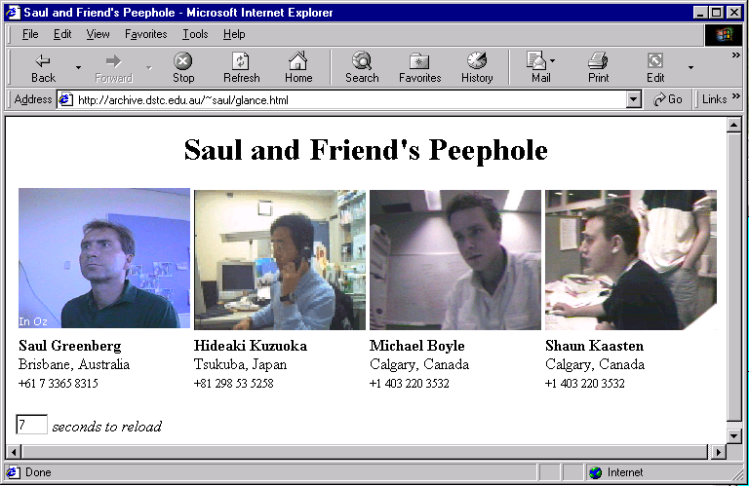




Periodic Snapshots v0.3
  Web Viewer
    standard web page
    several images
    animated gifs
  Usage
    one person created ‘community’ page
    others linked to it
    communicated
    through images

Slide 6
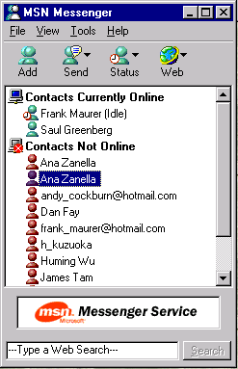
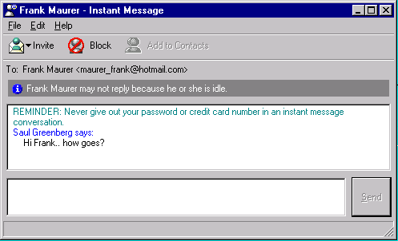
MSN Messenger
  Usage
    side by side with Peepholes
    spread to non-video people
    easy to install
    easy to invite people to use it
    robust to use

Slide 7
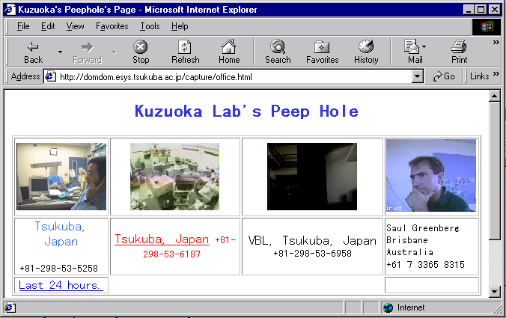
Periodic Snapshots v0.4
  Web Viewer
    template page
    created
  Usage
    template passed
    around
    others edited it to
    display their friends

Slide 8
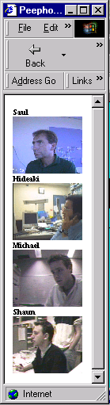
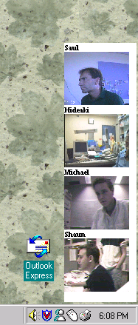
Periodic Snapshots v0.5
  WebViewer
    modified to make it more compact
  Usage
    compact view spread
    more likely to stay on desktop
    active desktop integration passed around

Slide 9
Lessons?
Effortless:
  easy for one person to tell others about the system
  simple retrieval, installation and configuration
  trivial connectivity e.g., informal URL exchange
Customizable
  people can form and easily modify their own sub-communities
Unpredictable
  people will adapt groupware in unseen ways
Awareness for making contact critical
  crucial for people to be aware of other’s availability
  but visual footprint must be small

Slide 10
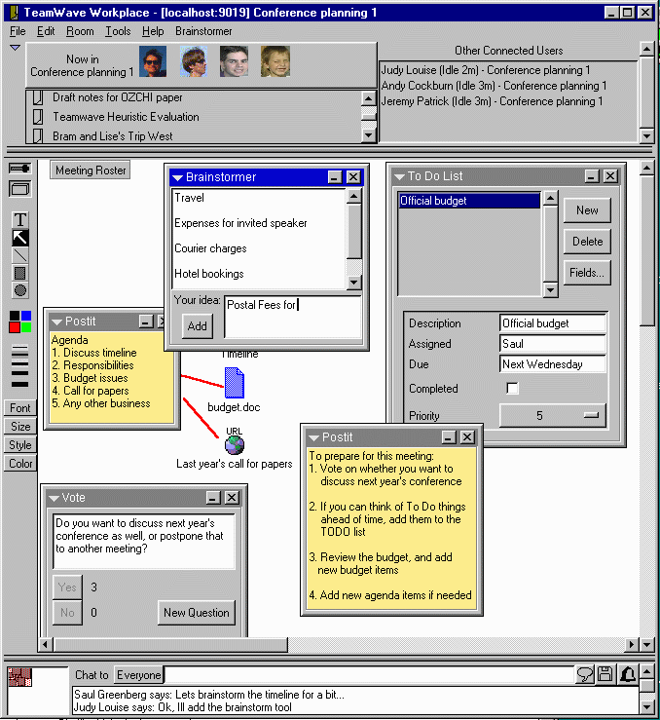
  Teamwave Workplace
    group decision to use it
    installed it on machines
    primed it with
    collaborative material
    started using it
  Where it failed
    too heavy-weight
    needed to be logged on
      who is around
      any changes?
    use petered out

Slide 11
Message
Effortless
Customizable notion of community
Awareness for making contact critical
Unpredictable uses

Slide 12
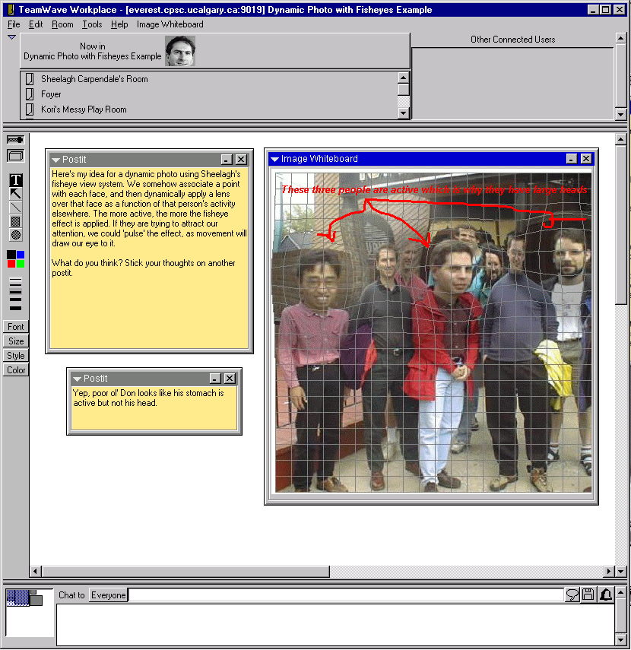
Dyn. Photo room

Slide 13
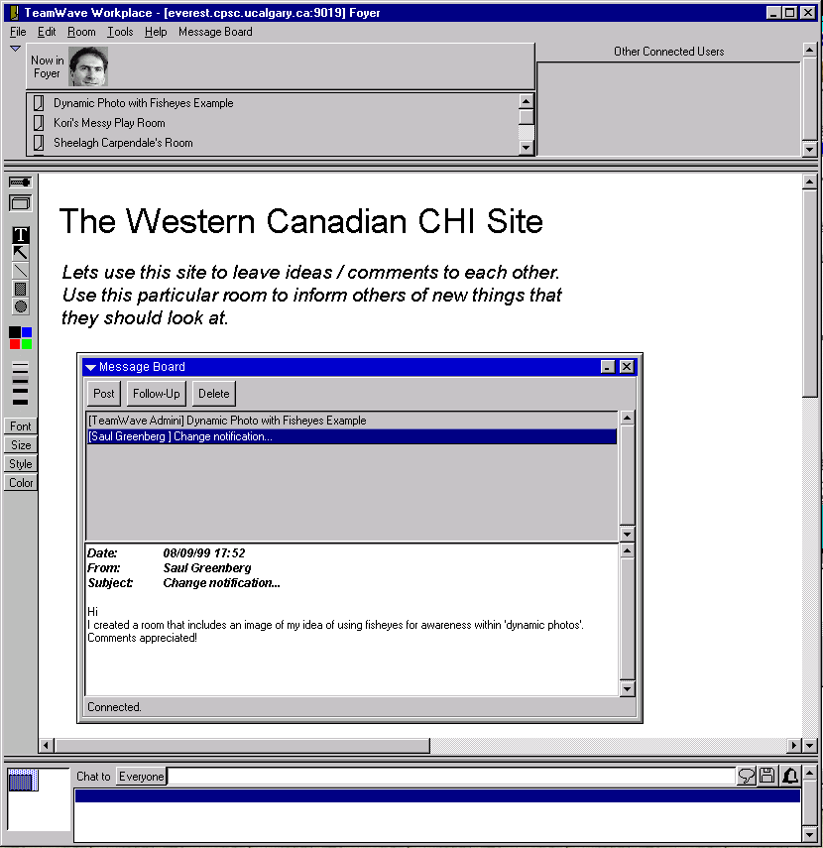
Teamwave Workplace
    group decision to set it up
    primed it with
    collaborative material
    started using it

Slide 14
Foyer

Slide 15
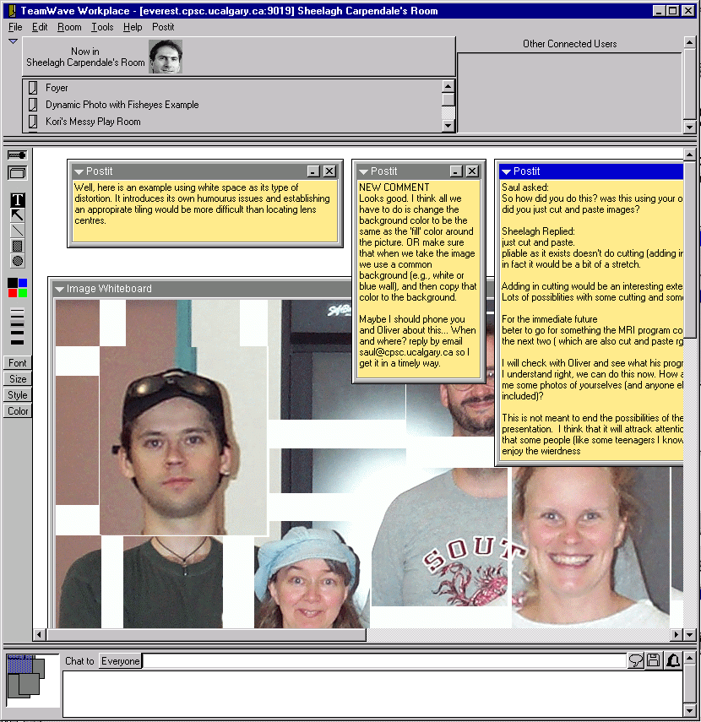
Teamwave
Workplace
Sheelagh’s room

Slide 16
Issues of Use in CSCW Technology Design

Slide 17
Emergent use
normative

Slide 18
Emergent use
Organizational support
normative
structured

Slide 19
Theory
explain
prescribe
Emergent use
Organizational support
normative
structured

Slide 20
Theory
explain
prescribe
evaluate
evaluate
Emergent use
Organizational support
normative
structured

Slide 21
Theory
explain
prescribe
CSCW
CSCL
evaluate
evaluate
Emergent use
Organizational support
normative
structured

